Slide 1
Database Management Systems
Chapter 1
Introduction

Slide 2
Objectives
What is a database?
What do database applications look like?
How are databases used to build applications?
What are the major components of a database management system?
What are the advantages of using a database management system?
What are the main database management systems?
How have database management systems changed over time?
What potential problems exist with a DBMS approach?
What is an application?
What databases are used with this book?
What are the first steps to start a project?

Slide 3
Sample Applications
Web site downloads
  Sally’s Pet Store
  Rolling Thunder Bicycles
  CornerMed
  All Powder Board and Ski Shop (Workbooks)
Database systems
  Microsoft Access includes tables, data, forms, reports
  Microsoft SQL Server includes tables, data
  Oracle includes tables, data

Slide 4
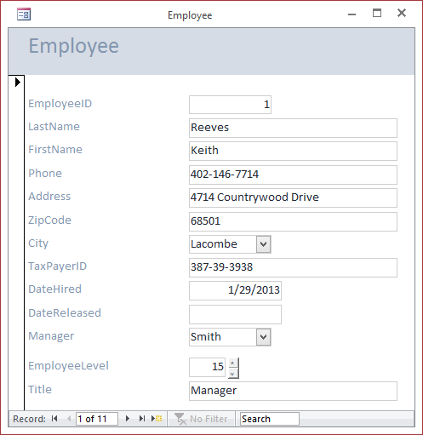
Sally’s Pet Store Employee Form
Users see a form with controls to help them enter and edit data.
The data items are stored in the database but the form could be located on a single computer, a Web site, or even a mobile application.

Slide 5
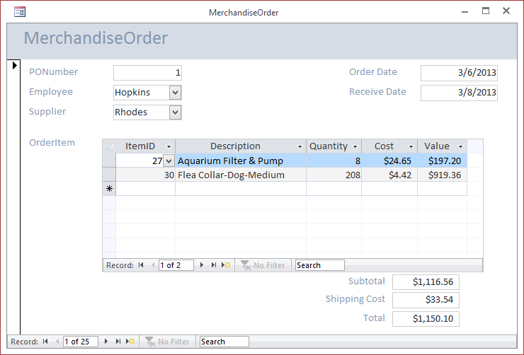
Sample Purchase Order
The order form is more complex and handles data entry for the order itself as well as the individual items being purchased in the detail/repeating section.

Slide 6
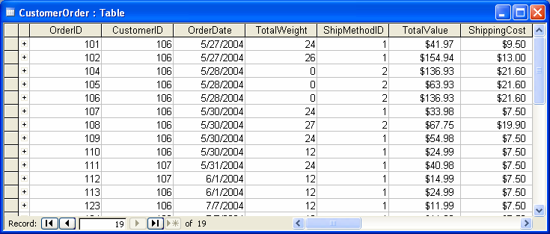


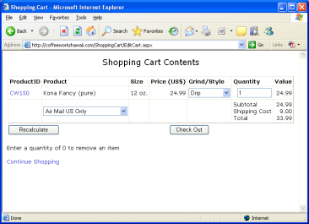
Application Development with a DBMS
SQL Queries
Data
Database Tables
Forms, Reports,
Programs
Database Server
Application Server
Users
Developers and
Administrators
Application Forms
Notes:
Application development with a DBMS. Developers and administrators define the database in the form of tables. They then create forms and reports on the application server. Users run the application and enter data or make choices.

Slide 7
Goal: Build a Business Application
Tools:
Database Design
SQL (queries)
Programming
Design
Program
SQL
Best:
Spend your time
on design and SQL.
Program
Design
SQL
Worst:
Compensate for poor design
and limited SQL with programming.
Notes:
Creating business applications. A DBMS can save you hundreds of hours of work in building applications. However, you must design your database correctly and use SQL to do the heavy work.

Slide 8
DBMS: Database Management System
Database
  A collection of data stored in a standardized format, designed to be shared by multiple users.
Database Management System
  Software that defines a database, stores the data, supports a query language, produces reports, and creates data entry screens.

Slide 9
Application Development
tasks
Feasibility
Identify scope, costs, and schedule
Analysis
Gather information from users
Design
Define tables, relationships, forms, reports
Development
Create forms, reports, and help; test
Implementation
Transfer data, install, train, review
time
Notes:
Systems development. Particularly for large projects, it is useful to divide application development into separate steps. They can be used to track the progress of the development team and highlight the steps remaining. For some projects, it is possible to overlap or even iterate the tasks, but steps should not be skipped.

Slide 10
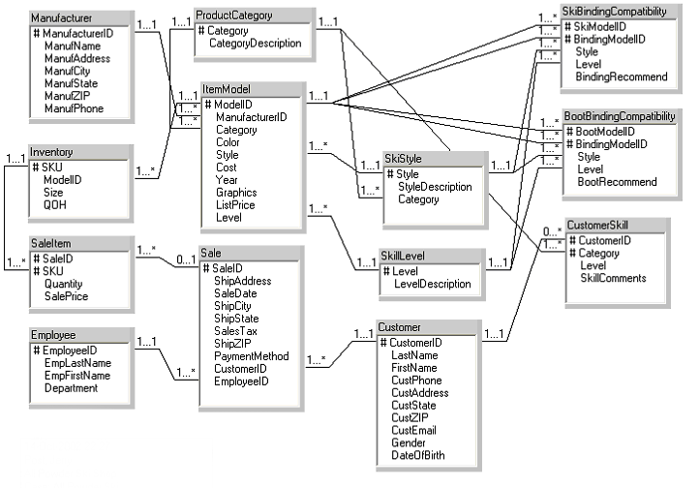
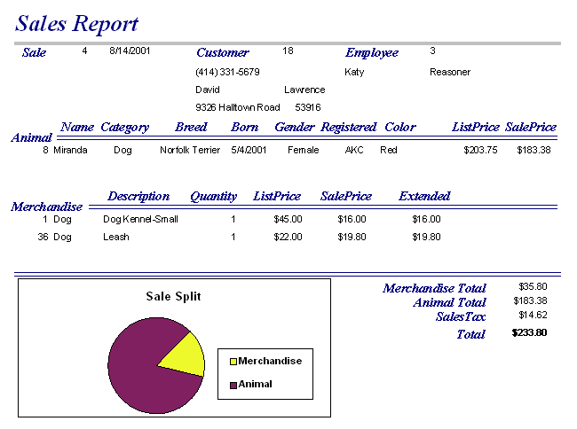

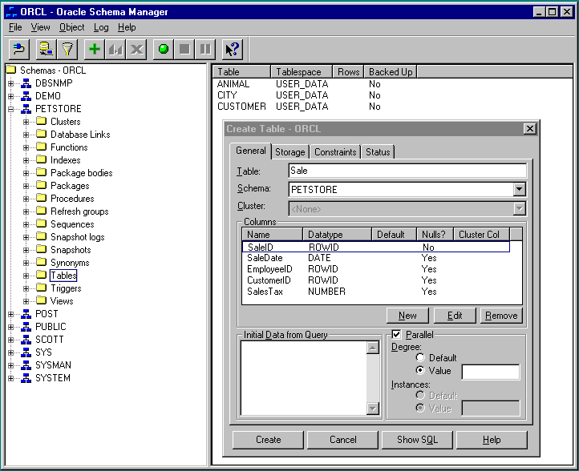
DBMS Application Design
1. Identify business rules.
2. Define tables and relationships.
3. Create input forms and reports.
4. Combine as applications for users.
Notes:
Steps in database design. The business rules and data are used to define database tables. Forms are used to enter new data. The database system retrieves data to answer queries and produce reports. Users see only the application in terms of forms and reports.

Slide 11
DBMS Features/Components
Database engine
  Storage
  Retrieval
  Update
Query Processor
Data dictionary
Utilities
Security
Report writer
Forms generator (input screens)
Application generator
Communications
3GL Interface

Slide 12
DBMS Engine, Security, Utilities
Data
Tables
Product
ItemID Description
887 Dog food
946 Cat food
Order
OrderID ODate
9874 3-3-97
9888 3-9-97
Customer
CustomerID Name
1195 Jones
2355 Rojas
Database
Engine
Product
ItemID Integer, Unique
Description Text, 100 char
Customer
CustomerID Integer, Unique
Name Text, 50 char
Data
Dictionary
Security
User Identification
Access Rights
Concurrency and
Lock Manager
Utilities
Backup and
Recovery
Administration
Notes:
Database engine. The engine is responsible for defining, storing, and retrieving the data. The security subsystem of the engine identifies users and controls access to data.

Slide 13
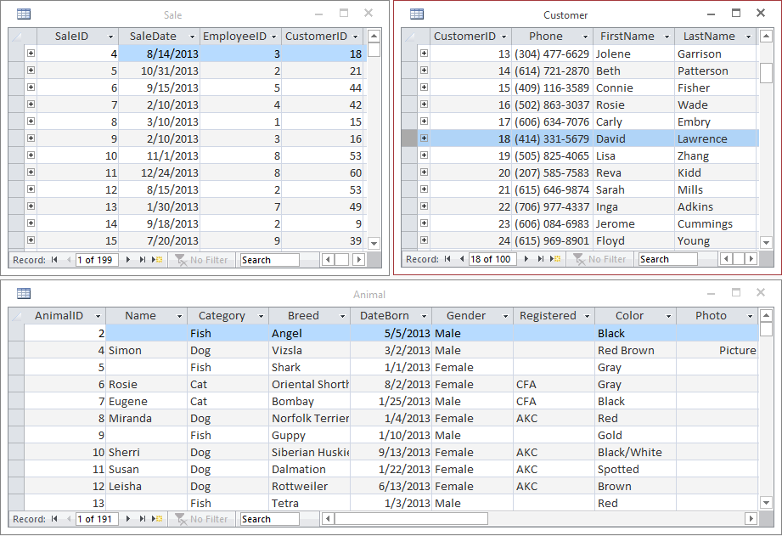
Database Tables (Access)
Notes:
Database tables in Access. Tables hold data about one business entity. For example, each row in the Animal table holds data about a specific animal.

Slide 14
Database Tables (Oracle)

Slide 15
DBMS Query Processor
All Data
Database Engine
Data Dictionary
Animal
Query Processor
AnimalID
Name
Category
Breed
Category | CountOfAnimalID
Dog | 100
Cat | 47
Bird | 15
Fish | 14
Reptile | 6
Mammal | 6
Spider | 3
Field | Category | AnimalID
Table | Animal | Animal
Totals | Group By | Count
Sort |  | Descending
Criteria
Or
Notes:
Database query processor. The data dictionary determines which tables and columns should be used. When the query is run, the query processor communicates with the database engine to retrieve the requested data.

Slide 16
DBMS Report Writer
All Data
Database Engine
Data Dictionary
Query Processor
Report Writer
Report
Format
and Query
Notes:
Database report writer. The design template sets the content and layout of the report. The report writer uses the query processor to obtain the desired data. Then it formats and prints the report.

Slide 17
Report Writer (Oracle 10g)
Notes:
Oracle Reports report writer. The Data Model is used to create a query and select the data to be displayed. Then Reports creates the basic report layout. You can modify the layout and add features to improve the design or highlight certain sections.

Slide 18
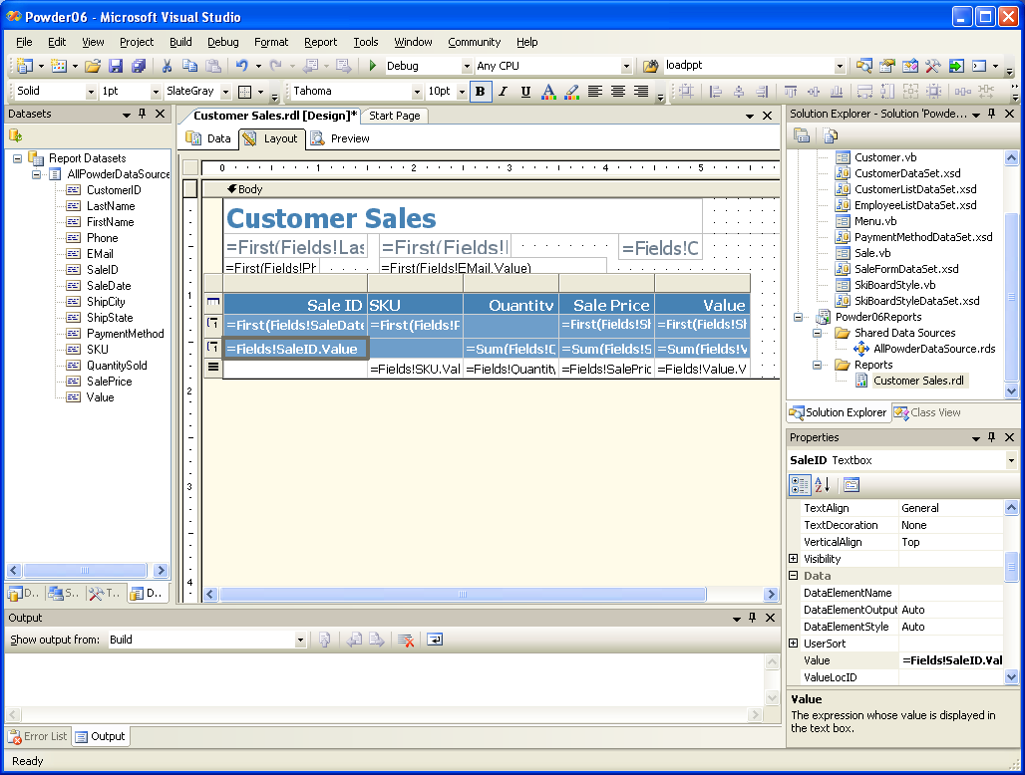
Report Writer (SQL Server 2008, Visual Studio 2008)

Slide 19
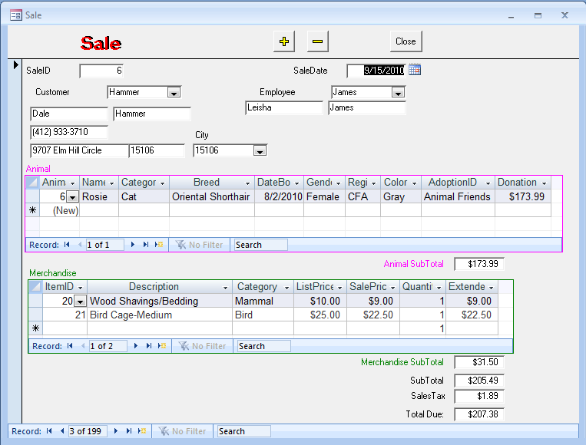
DBMS Input Forms
All Data
Database Engine
Data Dictionary
Query Processor
Form Builder
Input
Form
Design
Notes:
Database form. A form is used to collect data. It is designed to match the tasks of the user, making it easy to enter data and look up information. The query processor is used to obtain related data and fill in look-up data in combo boxes.

Slide 20
DBMS Components
All Data
Communication
Network
Database Engine
Data Dictionary
Security
3GL
Connector
Query Processor
Form
Builder
Report
Writer
Program
Application
Generator

Slide 21
Advantages of Database Approach
Minimal data redundancy.
Data consistency.
Integration of data.
Sharing of data.
Enforcement of standards.
Ease of application development.
Uniform security, privacy and integrity.
Data independence.
Notes:
Advantages of a DBMS. The DBMS provides a solution to basic data storage and retrieval problems. By using a DBMS to handle data storage problems, programmers can concentrate on building applications—saving time and money in developing new systems and simplifying maintenance of existing applications.

Slide 22
Database Management Approach
Data is most important
  Data defined first
  Standard format
Access through DBMS
  Queries, Reports, Forms
  Application Programs
  3GL Interface
Data independence
  Change data definition without changing code
  Alter code without changing data
  Move/split data without changing code
All Data
DBMS
Program1
Queries
Reports
Program2
Notes:
DBMS focus on data. First, define the data. Then all queries, reports, and programs access the data through the DBMS. The DBMS always handles common problems such as concurrency and security.

Slide 23
Modifying Data with DBMS
Add cell number to employee table
  Open table definition
  Add data element
  If desired, modify reports
    Use report writer
    No programming
Existing reports, queries, code will all run as before with no changes.
Field Name Data Type Description
EmployeeID Number Autonumber..
TaxpayerID Text Federal ID
LastName Text
FirstName Text
. . .
Phone Text
. . .
CellPhone Text Cellular . . .
Notes:
Adding cellular phone numbers to the Employee table. Adding a new element to a table does not affect the existing queries, reports, forms or programs.

Slide 24



Web Databases
Database
Developers
Web Server
Users
data
Web forms
and reports
Reports
Notes:
Web databases. Developers build forms and reports that are stored on a central server. Users access the data and display reports using a standard Web browser.

Slide 25
Drawbacks of old File methods
Uncontrolled Duplication
  Wastes space
  Hard to update all files
Inconsistent data
Inflexibility
  Hard to change data
  Hard to change programs
Limited data sharing
Poor enforcement of standards
Poor programmer productivity
Excessive program maintenance

Slide 26
File Method Problems
Files defined in program
  Cannot read file without definition
  Hard to find definition
  Every time you alter file, you must rewrite code
  Change in a program/file will crash other code
  Cannot tell which programs use each file
Multiuser problems
  Concurrency
  Security
    Access
    Backup & Restore
  Efficiency
    Indexes
    Programmer talent
      System
      Application

Slide 27
Old File Method/3GL
Programs
Files
Payroll
Data Definition
File 1
…
File 2
…
Pay History
Benefits
Benefits
Data Definition
File A
File 2
File C
…
Employee
Employee
Choices

Slide 28
Example of File Method v DBMS
COBOL
Employee File
File Division
01 Employees
02 ID
02 Name
02 Address
01 Department
02 ID
02 . . .
112 Davy Jones 999 Elm
Street . . . 113 Peter Smith
101 Oak St . . .
Add to file (e.g.Cell phone)
  Write code to copy employee file and add empty cell phone slot.
  Find all programs that use employee file.
    Modify file definitions.
    Modify reports (as needed)
    Recompile, fix new bugs.
Easier: Keep two employee files?
02 Cell Phone
More programs
File Division
01 Employees
...

Slide 29
Examples of Commercial Systems
Vendor | Product
Oracle | Oracle MySQL
Microsoft | SQL Server Access
IBM | DB2 Informix
Open source | PostgreSQL
Notes:
Commercial DBMS vendors. These are the leading DBMS products that you are likely to encounter. Many older systems exist, and dozens of smaller vendors provide complete systems and other tools.

Slide 30
Hierarchical Database
Customers
Customer
Order
Items Ordered
Orders
To retrieve data, you must start at the top (customer). When you retrieve a customer, you retrieve all nested data.
Items
Item Description Quantity
998 Dog Food 12
764 Cat Food 11
Notes:
Hierarchical database. To retrieve data, the DBMS starts at the top (customer). When it retrieves a customer, it retrieves all nested data (order, then items ordered).

Slide 31
Network Database
Entry point
Customer
Order
Items
Ordered
Items
Entry point
Notes:
Network database. All data sets must be connected with indexes as indicated by the arrows. Likewise, all entry points (starting point for a query) must be defined and created before the question can be answered.

Slide 32
Relational Database
Customer(CustomerID, Name, …
Order(OrderID, CustomerID, OrderDate, …
ItemsOrdered(OrderID, ItemID, Quantity, …
Items(ItemID, Description, Price, …
Notes:
Relational database. Data is stored in separate sets of data. The tables are not physically connected; instead, data is linked between columns. For example, when retrieving an order, the database can match and retrieve the corresponding customer data based on CustomerID.

Slide 33
Object-Oriented DBMS
Order
Customer
OrderID
CustomerID
…
CustomerID
Name
…
Government
Customer
Commercial
Customer
ContactName
ContactPhone
Discount, …
NewOrder
DeleteOrder
…
Add Customer
Drop Customer
Change Address
ContactName
ContactPhone
…
NewContact
NewContact
OrderItem
Item
OrderID
ItemID
…
ItemID
Description
…
OrderItem
DropOrderItem
…
New Item
Sell Item
Buy Item …
Notes:
Object-oriented database. Objects have properties—just as relational entities have attributes— that hold data to describe the object. Objects have methods that are functions the objects can perform. Objects can be derived from other objects.

Slide 34
Base Data Types
Numbers
  Integers
  Reals
Text
  Length
  International
Date/Time
Images
  Bitmap
  Vector
Sound
  Samples
  MIDI
Video
Input
Process
Output
Numbers,
Text, and
Dates
20
000001100
12 + 8 = 20
000001000
----------------
000010100
0010000000000000000
0100000000000001001
0110000011000011011
Images
0111111111111001111
1111111111111011111
1111111111100011111
pitch,
Sound
volume
8 9 20 7 8 19 5 6 15
time
000001000 000001001 000010100 .....
00101010111
Video
00101010111
00101010111
11010101010
11010101010
11010101010
01010101010
01010101010
01010101010
11110100011
11110100011
11110100011
00101011011
00101011011
00101011011
00101010111
00101010111
11010101010
11010101010
01010101010
01010101010
11110100011
11110100011
00101011011
00101011011

Slide 35
Objects
Class name
Customer
CustomerID
Address
Phone
Object Definition--encapsulation.
  Object Name
  Properties
  Methods
Often need to ignore inheritance.
  Combine into one table.
  Use multiple tables and link by primary key.
    More efficient.
    Need to add rows to many tables.
Properties
Methods
AddCustomer
DropCustomer
Inheritance
Commercial
Government
Contact
VolumeDiscount
Contact
BalanceDue
ComputeDiscount
BillLateFees
AddCustomer
Polymorphism

Slide 36
Objects in a Relational Database
Separate inherited classes.
Link by primary key.
Adding a new customer requires new rows in each table.
Definitely need cascade delete.
Customer
CustomerID
Address
Phone
CommercialCustomer
GovernmentCustomer
CustomerID
Contact
VolumeDiscount
CustomerID
Contact
BalanceDue

Slide 37
OO Difficulties: Methods
IBM Server
Unix Server
Database Object
Personal Computer
Database Object
How can a method run on different computers?
Different processors use different code.
Possibility: Java
Customer
Method:
Add New Customer
Application
Customer
Name
Address
Phone
Program code

Slide 38
SQL 99: OO Features
Abstract data type
  User defined data types.
  Equality and ordering functions.
  Encapsulation: Public, Private, Protected.
  Inheritance.
Sub-tables that inherit all columns from another table.
Persistent Stored Modules (Programming Language).
  Create methods.
  SQL and extensions.
  External language.
User defined operators.
Triggers for events.
External language support
  Call-Level Interface (CLI)
    Direct access to DBMS
  Embedded SQL
    SQL commands in an external language.

Slide 39
Abstract Data Types
GeoPoint
Latitude
Longitude
Altitude
Procedure: DrawRegion
{
Find region components.
SQL: Select …
For each component {
Fetch MapLine
Set line attributes
MapLine.Draw
}
}
GeoLine
NumberOfPoints
ListOfGeoPoints
Notes:
Abstract data types or objects. A geographic information system needs to store and share complex data types. For example, regions are defined by geographic line segments. Each segment is a collection of points, which are defined by latitude, longitude, and altitude. Using a database makes it easier to find and share data.

Slide 40
SQL 99 Sub-Tables
CREATE SET TABLE Customer
(
CustomerID INTEGER,
Address VARCHAR,
Phone CHAR(15)
)
Customer
CustomerID
Address
Phone
CREATE SET TABLE CommercialCustomer
(
Contact VARCHAR,
VolumeDiscount NUMERIC(5,2)
)
UNDER Customer;
Inherits columns
from Customer.
CommercialCustomer
Contact
VolumeDiscount
Notes:
SQL subtables. A subtable inherits the columns from the selected supertable. Queries to the CommercialCustomer table will also retrieve data for the CustomerID, Address, and Phone columns inherited from the Customer table.

Slide 41
SQL 99: Programming
Database
External Programs
Data Types
Tables, …
Embedded SQL
Call-Level Interface
Persistent Stored Modules
SQL
Extended SQL code
External language code
CURSOR …
SELECT …
FETCH …

Slide 42
OODBMS Vendors
InterSystems Caché
Progress Software ObjectStore
Objectivity
McObject Perst
Versant
JADE
Notes:
OODBMS vendors and products. Each tool has different features and goals. Contact the vendors for details or search the Web for user comments.

Slide 43
Key-Value Pairs: Cassandra
Example: Web-based, Social networks
  Hundreds of millions of users
  Complex and large data: photos, files, blogs/large text
Focus on keys and complex data, and timestamp/versions
  UserID + e-mail, name, Web URL
  Photo Name+ timestamp, image file
  Definitely not relational, and does not attempt to enforce relationships
  Terminology is confusing compared to relational; so details not in this chapter
Focus on ability to split data across thousands of servers
  Massively parallel
  All machines can operate independently

Slide 44
Why don’t all developers use a DBMS?
Most new projects (in last 5 years) do use a DBMS
Need specialized personnel
  Programmers
  Designers/Analysts
  Database administrators
Need to define data for organization
Cost
  PC: $400 - $2000
  Large: $100,000 +

Slide 45
How do you sell a DBMS approach?
Applications change a lot, but same data.
Need for ad hoc questions and queries.
Need to reduce development times.
Need shared data.
Improve quality of data.
Enable users to do more development.

Slide 46
Building the Right System: Feasibility
Costs
  Up-front/one-time
    Software ($ millions !)
    Hardware
    Communications
    Data conversion
    Studies and Design
    Training
  On-going costs
    Personnel
    Software upgrades
    Supplies
    Support
    Software & Hardware maintenance
Benefits
  Cost Savings
    Software maintenance
    Fewer errors
    Less data maintenance
    Less user training
  Increased Value
    Better access to data
    Better decisions
    Better communication
    More timely reports
    Faster reaction to change
    New products & services
  Strategic Advantages
    Lock out competitors
Easy to estimate
Hard to value
Notes:
Common costs and benefits from introducing a database management system. Note that benefits can be hard to measure, especially for tactical and strategic decisions. But it is still important to list potential benefits. Even if you cannot assign a specific value, managers need to see the complete list.

Slide 47
Economic Feasibility: NPV
=NPV(B14,$D$7:$D$11)+$D$6
=NPV(rate, range) + starting

Slide 48
Exercise: Build a First Database
Employee(EmployeeID, LastName, FirstName, Address, DateHired)
332 Ant Adam 354 Elm 5/5/1964
442 Bono Sonny 765 Pine 8/8/1972
553 Cass Mama 886 Oak 2/2/1985
673 Donovan Michael 421 Willow 3/3/1971
773 Moon Keith 554 Cherry 4/4/1972
847 Morrison Jim 676 Sandalwood 5/5/1968
Client(ClientID, LastName, FirstName, Balance, EmployeeID)
1101 Jones Joe 113.42 442
2203 Smith Mary 993.55 673
2256 Brown Laura 225.44 332
4456 Dieter Jackie 664.90 442
5543 Wodkoski John 984.00 847
6673 Sanchez Paula 194.87 773
7353 Chen Charles 487.34 332
7775 Hagen Fritz 595.55 673
8890 Hauer Marianne 627.39 773
9662 Nguyen Suzie 433.88 553
9983 Martin Mark 983.31 847

Slide 49
Exercise: Report
Ant, Adam 5/5/1964
Brown, Laura 225.24
Chen, Charles 487.34
712.58
Bono, Sonny 8/8/1972
Dieter, Jackie 664.90
Jones, Joe 114.32
779.22

