Slide 1
Database Management Systems
Chapter 2
Database Design

Slide 2
Objectives
What is database design and why is it important?
Why are models important in designing systems?
How do you begin a database project?
How do you know what data to put in the database?
What is a class diagram (or entity-relationship diagram)?
Is there an easier way to get started with database design?
How are some common business associations handled in class diagrams?
Are more complex diagrams different?
What are the different data types?
What are events, and how are they described in a database design?
How are teams organized on large projects?
How does UML split a big project into packages?
What is an application?
What process is followed when starting a project?

Slide 3

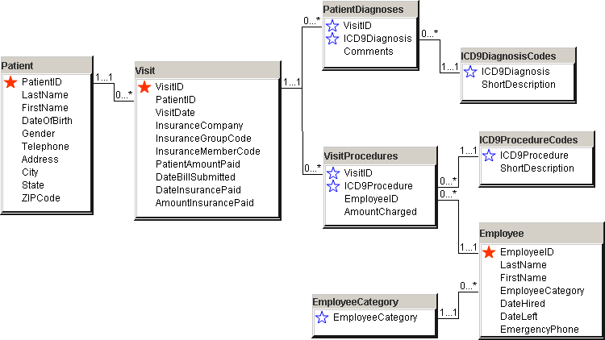
Database System Design
Patient(PatientID, LastName, FirstName, DateOfBirth, ...)
Visit(VisitID, PatientID, VisitDate, InsuranceCompany, ...)
PatientDiagnoses(VisitID, ICD9Diagnosis, Comments)
VisitProcedures(VisitID, ICD9Procedure, EmployeeID, AmountCharged)
ICD9DiagnosisCodes(ICD9Diagnosis, ShortDescription)
ICD9ProcedureCodes(ICD9Procedure, ShortDescription)
Employee(EmployeeID, LastName, FirstName, EmployeeCategory, ...)
EmployeeCategory(EmployeeCategory)
User views
of data.
Conceptual
data model.
Implementation
(relational)
data model.
Physical
data
storage.
Class diagram that shows business entities, relationships, and rules.
List of nicely-behaved tables. Use data normalization to derive the list.
Indexes and storage methods to improve performance.
Notes:
Design models. The conceptual model records and describes the user views of the system. The implementation model describes the way the data will be stored. The final physical database may utilize storage techniques like indexing to improve performance.

Slide 4
The Need for Design
Goal: To produce an information system that adds value for the user
  Reduce costs
  Increase sales/revenue
  Provide competitive advantage
Objective: To understand the system
  To improve it
  To communicate with users and IT staff
Methodology: Build models of the system

Slide 5
Designing Systems
Designs are a model of existing & proposed systems
  They provide a picture or representation of reality
  They are a simplification
  Someone should be able to read your design (model) and describe the features of the actual system.
You build models by talking with the users
  Identify processes
  Identify objects
  Determine current problems and future needs
  Collect user documents (views)
Break complex systems into pieces and levels

Slide 6
Design Stages
Initiation
  Scope
  Feasibility
  Cost & Time estimates
Requirements Analysis
  User Views & Needs
    Forms
    Reports
  Processes & Events
  Objects & Attributes
Conceptual Design
  Models
    Data flow diagram
    Entity Relationships
    Objects
  User feedback
Physical Design
  Table definitions
  Application development
    Queries
    Forms
    Reports
    Application integration
  Data storage
  Security
  Procedures
Implementation
  Training
  Purchases
  Data conversion
  Installation
Evaluation & Review

Slide 7
Initial Steps of Design
1. Identify the exact goals of the system.
2. Talk with the users to identify the basic forms and reports.
3. Identify the data items to be stored.
4. Design the classes (tables) and relationships.
5. Identify any business constraints.
6. Verify the design matches the business rules.
Notes:
Initial steps in database design. A database design represents the business rules of the organization. You must carefully interview the users to make sure you correctly identify all of the business rules. The process is usually iterative, as you design classes you have to return to the users to obtain more details.

Slide 8
Entities/Classes
Customer
Name
CustomerID
LastName
FirstName
Phone
Address
City
State
ZIP Code
Properties
Add Customer
Delete Customer
Methods
(optional for database)
Notes:
Class. A class has a name, properties, and methods. The properties describe the class and represent data to be collected. The methods are actions the class can perform, and are seldom used in a database design.

Slide 9
Tables and Relationships
Customer
Sales
CustomerID
LastName
FirstName
Phone
Address
City
State
ZIP Code
1
SaleID
SaleDate
CustomerID
*
Notes:
Relationships. The Sales tables needs CustomerID to reveal which customer participated in the sale. Putting the rest of the customer data into the Sales table would waste space and cause other problems. The relationship link to the Customer table enables the database system to find all of the related data based on just the CustomerID value.

Slide 10
Business Rules
Tables and their relationships represent business rules.
Different businesses can have different assumptions and different rules which result in different database designs.
Many of these rules show up in the form of one-to-many or many-to-many associations.
Can a Customer place one Order or many orders?
Does an Order come from one Customer or many Customers?
In most businesses, a Customer can place many Orders and each Order comes from exactly one Customer.

Slide 11
Definitions
Relational database: A collection of tables.
Table: A collection of columns (attributes) describing an entity. Individual objects are stored as rows of data in the table.
Property (attribute): a characteristic or descriptor of a class or entity.
Every table has a primary key.
  The smallest set of columns that uniquely identifies any row
  Primary keys can span more than one column (concatenated keys)
  We often create a primary key to insure uniqueness (e.g., CustomerID, Product#, . . .) called a surrogate key.
Primary key
Properties
Class: Employee
Rows/Objects
Employee
EmployeeID TaxpayerID LastName FirstName HomePhone Address
12512 888-22-5552 Cartom Abdul (603) 323-9893 252 South Street
15293 222-55-3737 Venetiaan Roland (804) 888-6667 937 Paramaribo Lane
22343 293-87-4343 Johnson John (703) 222-9384 234 Main Street
29387 837-36-2933 Stenheim Susan (410) 330-9837 8934 W. Maple
Notes:
Basic database definitions. Codd has more formal terms and mathematical definitions, but these are easier to understand. One row in the data table represents a single object, a specific employee in this situation. Each column (attribute) contains one piece of data about that employee

Slide 12
Unified Modeling Language (UML)
A relatively new method to design systems.
Contains several types of diagrams:
Contains several types of diagrams:
The class diagram is the most important for database design.

Slide 13
Definitions
Entity: Something in the real world that we wish to describe or track.
Class: Description of an entity, that includes its attributes (properties) and behavior (methods).
Object: One instance of a class with specific data.
Property: A characteristic or descriptor of a class or entity.
Method: A function that is performed by the class.
Association: A relationship between two or more classes.
Pet Store Examples
Entity: Customer, Merchandise, Sales
Class: Customer, Merchandise, Sale
Object: Joe Jones, Premium Cat Food, Sale #32
Property: LastName, Description, SaleDate
Method: AddCustomer, UpdateInventory, ComputeTotal
Association: Each Sale can have only one Customer.
Notes:
Basic definitions. These terms describe the main concepts needed to create a class diagram. The first step is to identify the business entities and their properties. Methods are less important than properties in a database context, but you should identify important functions or calculations.

Slide 14
Associations
General
  One-to-one (1:1)
  One-to-many (1:M)
  Many-to-many (M:N)
Relationships represent business rules
  Sometimes common-sense
  Sometimes unique to an organization
Users often know current relationships, rarely future
Objects related to objects
  An employee can work in only one department
  Many departments can work on many different products
Objects related to properties
  An employee can have only one name
  Many employees can have the same last name
Breed
1
*
Animal
Supplier
1
*
Purch.
Order
Cust.
1
*
Sale
Emp
*
*
Tasks
sent to
places 
performs 
Notes:
Associations. Three types of relationships (one-to-one, one-to-many, and many-to-many) occur among entities. They can be drawn in different ways, but they represent business or organizational rules. Avoid vague definitions where almost any relationship could be classified as many-to-many. They make the database design more complex.

Slide 15
Class Diagram
Class/Entity (box)
Association/Relationship
  Lines
  Minimum
    0: optional
    1: required
  Maximum
    Arrows
    1, M
.
Customer
1 … 1
0 … *
Order
0 … *
1 … *
Item
.
Notes:
Class diagram or entity-relationship diagram. Each customer can place zero or many orders. Each sale must come from at least one and no more than one customer. The zero (0) represents an optional item, so a customer might not have placed any orders yet.

Slide 16
Sample Association Rules (Multiplicity)
An order must have exactly 1 customer,
  1 … 1 Minimum of 1
  1 … 1 Maximum of 1
And at least one item.
  1 … * Minimum of 1
  1 … * Maximum many
An item can show up on no orders or many orders.
  0 … * Optional (0)
  0 … * Maximum many
Customer
1 … 1
0 … *
Sale
0 … *
1 … *
Item

Slide 17
Creating a Class Diagram
1. Identify the primary classes and data elements.
2. Create the easy classes.
3. Create generated keys if necessary.
4. Add tables to split many-to-many relationships.
5. Check primary keys.
6. Verify relationships
CustomerID OrderID
Each customer can place many orders (so key OrderID)
Each order comes from one customer (do not key CustomerID)
*OrderID
CustomerID
Notes:
Steps to create a class diagram. Primary keys often cause problems. Look for many-to-many relationships and split them into new tables.
Identifying primary keys. Write down the potential key columns. Ask if each of the first entity (customer) can have one or many of the second entity (order). If the answer is many, key the second item. Reverse the process to see if one of the second items can be associated with one or many of the first items.

Slide 18
Sample Database for Sales
Sale ID |  |  |  |  | Date
Customer First Name Last Name Address City, State ZIPCode
ItemID | Description | List Price | Quantity | QOH | Value
 |  |  |  |  | Total
Notes:
Sample sales form. First look for possible keys, keeping in mind that repeating sections (one-to-many relationships) will eventually need composite keys.

Slide 19
Quick Start
Initial Business Objects:
Customers
Items
Sales
Each seems to be a base object that can stand alone.
Each can be given a generated key by the database.

Slide 20
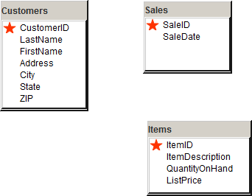
Initial Tables

Slide 21
Relationship for Customers and Sales
CustomerID SaleID
Write down both primary keys.
Answer two questions (left to right and right to left):
Can a Customer place one Sale or many? Many => key SaleID
Can a Sale come from one Customer or many? One => no key for CID
CustomerID *SaleID
So need a table where SaleID is the only key: Sales
Add CustomerID to that table but do NOT make it a key.

Slide 22
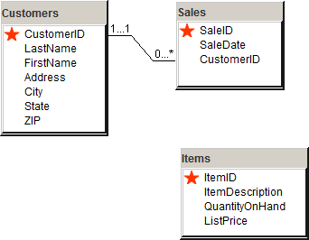
Sales and Customers
Each Sale has one Customer
Each Customer can place many Sales

Slide 23
Sales and Items Relationship
SaleID ItemID
Each Sale can have many Items (key ItemID).
Each Item can be sold many times (key SaleID).
Need a table with both SaleID and ItemID as keys:
*SaleID
*ItemID
Table does not exist, so create it: SaleItems

Slide 24
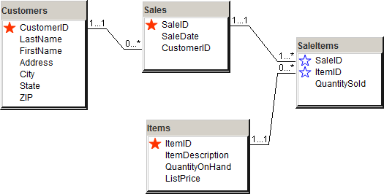
New SalesItem Table

Slide 25
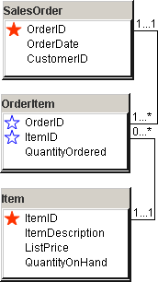
Using Generated Keys
Notes:
Using generated keys. OrderID is generated in the SalesOrder table. It is used in the OrderItem table as part of the primary key, but it cannot be generated twice. DBDesign highlights where keys are generated to remind you that the column must be the only key in the generating table and it cannot be generated in the second table (OrderItem).

Slide 26
N-ary Associations
Associations can connect more than two classes.
Associations can become classes.
  Events
  Many-to-many
  Need to keep data
Example has two many-to-many relationships.
  We know which components go into each product.
  We know which employees worked on a product.
We need to expand the relationships to show which employees installed which components into each product.
  Each assembly entry lists one employee, one component, and one product.
  By appearing on many assembly rows, the many-to-many relationships can still exist.
Employee
*
*
Component
*
*
Product
Notes:
Many-to-many relationships cause problems for databases. In this example, many employees can install many components on many products, but we do not know which components the employee actually installed.

Slide 27
N-ary Association Example
Employee
Name
...
1
*
1
Assembly
*
*
1
Component
CompID
Type
Name
Product
ProductID
Type
Name
Assembly
EmployeeID
CompID
ProductID
Multiplicity is defined as the number of items that could appear if the other N-1 objects
are fixed. Almost always “many.”
Notes:
Many-to-many associations are converted to a set of one-to-many relationships with an n-ary association, which includes a new class. In this example each row in the Assembly class holds data for one employee, one component, and one product. Notice that the Assembly class (box) is connected to the Assembly association (diamond) by a dashed line.

Slide 28
Association Details: Aggregation
Sale
Item
*
contains
*
SaleDate
Employee
Description
Cost
Aggregation: the Sale consists of a set of Items being sold.
Notes:
Association aggregation. A Sale contains a list of items being purchased. A small diamond is placed on the association to remind us of this special relationship.

Slide 29
Association Details: Composition
Bicycle
Wheels
Bicycle
Size
Model Type
…
1
built from
2
Rims
Spokes
…
Size
Model Type
…
1
1
Wheels
1
Crank
ItemID
Weight
Crank
Two ways to display composition.
1
Stem
Stem
ItemID
Weight
Size
Composition: aggregation where the components become the new object.
Notes:
Association composition. A bicycle is built from several individual components. These components no longer exist separately; they become the bicycle.
Association composition. It is easier to see the composition by embedding the component items within the main class.

Slide 30
Association Details: Generalization
Animal
DateBorn
Name
Gender
Color
ListPrice
{disjoint}
Mammal
Fish
Spider
LitterSize
TailLength
Claws
FreshWater
ScaleCondition
Venomous
Habitat
Notes:
Association generalization. The generic Animal class holds data that applies to all animals. The derived subclasses contain data that is specific to each species.

Slide 31
Inheritance
Class name
Accounts
Class Definition--encapsulation
  Class Name
  Properties
  Methods
Inheritance Relationships
  Generic classes
  Focus on differences
  Polymorphism
  Most existing DBMS do not handle inheritance
AccountID
CustomerID
DateOpened
CurrentBalance
Properties
Methods
OpenAccount
CloseAccount
Inheritance
Savings Accounts
Checking Accounts
InterestRate
MinimumBalance
Overdrafts
PayInterest
BillOverdraftFees
CloseAccount
Polymorphism
Notes:
Class inheritance. Object classes begin with a base class (e.g., Accounts). Other classes are derived from the base class. They inherit the properties and methods, and add new features. In a bank, all accounts need to track basic customer data. Only checking accounts need to track overdraft fees.

Slide 32
Multiple Parents
Vehicle
Motorized
Human
Powered
On-Road
Off-Road
or
Car
Bicycle
Notes:
Multiple parent classes. Classes can inherit properties from several parent classes. The key is to draw the structure so that users can understand it and make sure that it matches the business rules.

Slide 33
Association Details: Reflexive Relationship
manages
worker
*
Employee
0…1
manager
A reflexive relationship is an association from one class back to itself.
In this example, an employee can also be a manager of other employees.
Notes:
Reflexive relationship. A manager is an employee who manages other workers. Notice how the labels explain the purpose of the relationship.

Slide 34
Defining Packages for High-Level Views
Adopt
Animals
Supplier
Employee
Customer
Purchase
Merchandise
Sell
Merchandise

Slide 35
PetStore Overview Class Diagram
*
Animal
*
1
Adoption
Group
1
1
*
*
1
Supplier
Employee
Sale
Customer
1
1
*
Merchandise
Purchase
*
*
*
Merchandise
*
*
Notes:
Initial class diagram for the PetStore. Animal purchases and sales are tracked separately from merchandise because the store needs to monitor different data for the two entities.

Slide 36
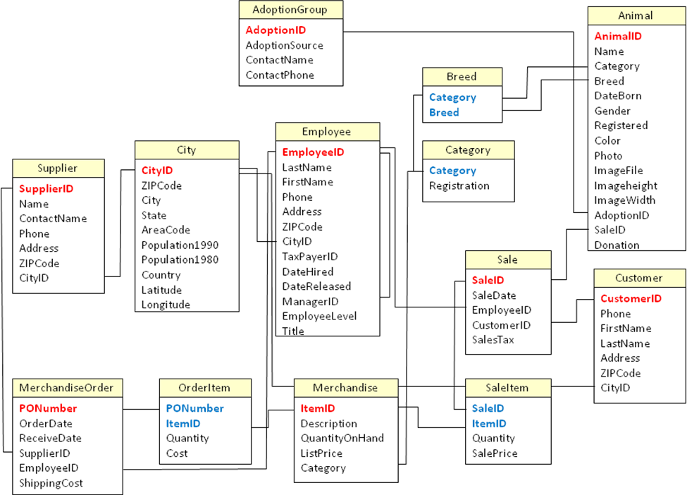
Pet Store Class Diagram: Access
Notes:
Detailed class diagram for the pet store. Notice the tables added to solve many-to-many problems: OrderItem, AnimalOrderItem, SaleItem, and SaleAnimal. The City table was added to reduce data entry. The Breed and Category tables were added to ensure data consistency. Users select the category and breed from these tables, instead of entering text or abbreviations that might be different every time.

Slide 37
Data Types (Domain)
Common data types
  Text
    Fixed length 1 to 64 K bytes
    Variable length 1 to 2 G bytes
  Memo/Note
  Numeric
    Byte 1 byte 0 to 255
    Boolean 2 bytes True or False
    Integer 2 bytes -32,768 to 32,767 (no decimal points)
    Long 4 bytes -2,147,483,648 to 2,147,483,647 (no decimal points)
    Floating 4 bytes 1.401298E-45 to 3.402823E38
    Double 8 bytes 4.94065645841247E-324 to 1.79769313486232E308
    Currency 8 bytes -922,377,203,685,477.5808 to 922,377,203,685,477.5807
  Date/Time 8 bytes Jan 1, 100 to Dec 31, 9999
  Objects/Raw binary
    Any type of data supported by the machine
    Pictures, sound, video . . .

Slide 38
Data Types
Generic | Access | SQL Server | Oracle
Text fixed variable Unicode memo XML | NA Short Text Short Text Long Text NA | char varchar nchar, nvarchar nvarchar(max) Xml | CHAR VARCHAR2 NVARCHAR2 LONG XMLType
Number Byte (8 bits) Integer (16 bits) Long (32 bits) (64 bits) Fixed precision Float Double Currency Yes/No | Byte Integer Long NA Decimal Float Double Currency Yes/No | tinyint smallint int bigint decimal(p,s) real float money bit | INTEGER INTEGER INTEGER NUMBER(38,0) NUMBER(p,s) NUMBER, FLOAT NUMBER NUMBER(38,4) INTEGER
Date/Time Interval | Date/Time NA | datetime smalldatetime interval year … | DATE INTERVAL YEAR …
Image | OLE Object | varbinary(max) | LONG RAW, BLOB
AutoNumber | AutoNumber | Identity rowguidcol | SEQUENCES ROWID
Notes:
Data types (domains). Common data types and their variations in three database systems. The text types in SQL Server and Oracle beginning with an “N” hold Unicode character sets, particularly useful for non-Latin based languages.

Slide 39
Data Type Sizes
Data Types | Size
 | Access | SQL Server | Oracle
Text (characters) fixed variable memo XML | 255 64 K | 8 K, 4 K 8 K, 4 K 2 G, 1 G 2G | 2 K 4 K 2 G
Numeric Byte (8 bits) Integer (16 bits) Long (32 bits) (64 bits) Fixed precision Float Double Currency Yes/No | 255 +/- 32767 +/- 2 B NA p: 1-28 +/- 1 E 38 +/- 1 E 308 +/- 900.0000 trillion 0/1 | 255 +/- 32767 +/- 2B 18 digits +/- 1 E 38, p: 1 to 38 +/- 1 E 38 +/- 1 E 308 +/- 900.0000 trillion (8 bytes) 0/1 | 38 digits 38 digits 38 digits p: 38 digits s: -84 to 127; p: 1 to 38 38 digits 38 digits 38 digits
Date/Time | 1/1/100 – 12/31/9999 (1 sec) | 1/1/1753 – 12/31/9999 (3 ms) 1/1/1900 – 6/6/2079 (1 min) 8 bytes | 1/1/-4712, 1/31/9999 (sec)
Image | OLE Object | 2 GB | 2 GB, 4 GB
AutoNumber | Long (2 B) | 2 B or 18 digits with bigint | Column: 38 digit maximum
Notes:
Data sizes. Make sure that you choose a data type that can hold the largest value you will encounter. Choosing a size too large can waste space and cause slow calculations, but if in doubt, choose a larger size.

Slide 40
Computed Attributes
Denote computed values with a preceding slash (/).
Employee
Name
DateOfBirth
/Age
Phone
…
{Age = Today - DateOfBirth}
Notes:
Derived values. The Age attribute does not have to be stored, since it can be computed from the date of birth. Hence, it should be noted on the class diagram. Computed attribute names are preceded with a slash.

Slide 41
Event Examples
Business Event
  Item is sold.
  Decrease Inventory count.
Data Event
  Inventory drops below preset level.
  Order more inventory.
User Event
  User clicks on icon.
  Send purchase order to supplier.
Trigger
ON (QuantityOnHand < 100)
THEN Notify Purchasing Manager
Notes:
Sample trigger. List the condition and the action.

Slide 42
Event Triggers
Business Process: Ship Product
  Trigger: Inventory Change
  Executes function/trigger in Inventory object.
Object: Inventory
  Property: Current Inventory.
  Function: Update Inventory.
  Trigger: On Update, call Analyze function.
Process: Analyze Inventory
  Function: Determine need to reorder.
  Trigger: Generate new order.
Order
…
ShipOrder
…
Inventory
…
Subtract
Analyze
…
Inventory
…
Subtract
Analyze
…
1. Subtract(Prod,
Qty sold)
low
1.1 Analyze
(Product)
1.1.1
Reorder
(Product,
quantity)
Purchase
…
Reorder
…
Notes:
Collaboration diagram shows inventory system events. An Order shipment triggers a reduction of inventory quantity on hand which triggers an reorder-point analysis routine. If necessary, the analysis routine triggers a new purchase order for the specified item.

Slide 43
Design Importance: Large Projects
Design is harder on large projects.
  Communication with multiple users.
  Communication between IT workers.
  Need to divide project into pieces for teams.
  Finding data/components.
  Staff turnover--retraining.
Need to monitor design process.
  Scheduling.
  Evaluation.
Build systems that can be modified later.
  Documentation.
  Communication/underlying assumptions and model.
Notes:
Development issues on large projects. Large projects require more communication, adherence to standards, and project monitoring.

Slide 44
Large Projects
Project Teams
  Divide the work
  Fit pieces together
  Evaluate progress
Standards
  Design
  Templates
  Actions
  Events
  Objects
    Naming convention
    Properties
Project planning software
  Schedules
  Gantt charts
CASE tools
Groupware tools
  Track changes
  Document work
  Track revisions

Slide 45
CASE Tools
Computer-Aided Software Engineering
  Diagrams (linked)
  Data Dictionary
  Teamwork
  Prototyping
    Forms
    Reports
    Sample data
  Code generation
  Reverse Engineering
Examples
  Rational Rose
  Sterling
    COOL: Dat
    COOL: Jex (UML)
  Oracle
  IBM
Notes:
CASE tool features. CASE tools help create and maintain diagrams. They also support teamwork and document control. Some can generate code from the designs or perform reverse engineering.

Slide 46
Rolling Thunder: Top-Level
Sales
Bicycle
Assembly
Employee
Location
Purchasing
Notes:
Rolling Thunder Bicycles—top-level view. The packages are loosely based on the activities of the firm. The goal is for each package to describe a self-contained collection of objects that interacts with the other packages.

Slide 47
Rolling Thunder: Sales
Customer
1…1
Bicycle::Bicycle
CustomerID
Phone
FirstName
LastName
Address
ZipCode
CityID
BalanceDue
1…1
BicycleID
…
CustomerID
StoreID
…
0…*
0…*
Retail Store
Customer
Transaction
StoreID
StoreName
Phone
ContactFirstName
ContactLastName
Address
ZipCode
CityID
0…1
CustomerID
TransactionDate
EmployeeID
Amount
Description
Reference
0…*
Notes:
Rolling Thunder Bicycles—Sales package. Some associations with other packages are not shown here. (See the other packages.)

Slide 48
Rolling Thunder: Bicycle
ModelType
Bicycle
1…1
BicycleTubeUsed
1…1
ModelType
Description
SerialNumber
CustomerID
ModelType
PaintID
FrameSize
OrderDate
StartDate
ShipDate
ShipEmployee
FrameAssembler
Painter
Construction
WaterBottleBrazeOn
CustomName
LetterStyleID
StoreID
EmployeeID
TopTube
ChainStay
…
1…*
SerialNumber
TubeID
Quantity
0…*
1…1
Paint
0…*
1…1
PaintID
ColorName
ColorStyle
ColorList
DateIntroduced
DateDiscontinued
BikeParts
0…*
SerialNumber
ComponentID
SubstituteID
Location
Quantity
DateInstalled
EmployeeID
0…*
LetterStyle
1…1
LetterStyleID
Description
Notes:
Rolling Thunder Bicycles—Bicycle package. Note the composition associations into the Bicycle class from the BikeTubes and BikeParts classes. To save space, only some of the Bicycle properties are displayed.

Slide 49
Rolling Thunder: Assembly
Component
Bicycle::BikeParts
1…1
ComponentID
ManufacturerID
ProductNumber
Road
Category
Length
Height
Width
Description
ListPrice
EstimatedCost
QuantityOnHand
1…1
GroupComponents
SerialNumber
ComponentID
...
0…*
GroupID
ComponentID
0…*
0…*
0…*
Groupo
GroupID
GroupName
BikeType
1…1
Bicycle::
BicycleTubeUsed
TubeMaterial
1…1
TubeID
Material
Description
Diameter
…
ComponentName
1…1
ComponentName
AssemblyOrder
Description
SerialNumber
TubeID
Quantity
0…*
Notes:
Rolling Thunder Bicycles—Assembly package. Several events occur during assembly, but they cannot be shown on this diagram. As the bicycle is assembled, additional data is entered into the Bicycle table within the Bicycle package.

Slide 50
Rolling Thunder: Purchasing
PurchaseOrder
1…1
Manufacturer
PurchaseID
EmployeeID
ManufacturerID
TotalList
ShippingCost
Discount
OrderDate
ReceiveDate
AmountDue
1…1
ManufacturerID
ManufacturerName
ContactName
Phone
Address
ZipCode
CityID
BalanceDue
1…1
1…1
0…*
ManufacturerTrans
ManufacturerID
TransactionDate
Reference
EmployeeID
Amount
Description
0…*
PurchaseItem
Assembly::
Component
PurchaseID
ComponentID
PricePaid
Quantity
QuantityReceived
1…*
1…1
0…*
ComponentID
ManufacturerID
ProductNumber
0…*
Notes:
Rolling Thunder Bicycles—Purchasing package. Note the use of the Transaction class to store all related financial data for the manufacturers in one location.

Slide 51
Rolling Thunder: Location
Sales::
Customer
Employee::
Employee
City
1…1
CustomerID
…
CityID
1…1
EmployeeID
…
CityID
CityID
ZipCode
City
State
AreaCode
Population1990
Population1980
Country
Latitude
Longitude
0…*
1…1
1…1
1…1
Sales::
RetailStore
Purchasing::
Manufacturer
StoreID
…
CityID
ManufacturerID
…
CityID
0…*
0…*
StateTaxRate
0…1
State
TaxRate
Notes:
Rolling Thunder Bicycles—Location package. By centralizing the data related to cities, you speed clerical tasks and improve the quality of the data. You can also store additional information about the location that might be useful to managers.

Slide 52
Rolling Thunder: Employee
Employee
Bicycle::
Bicycle
1…1
0…*
worker
EmployeeID
TaxpayerID
LastName
FirstName
HomePhone
Address
ZipCode
CityID
DateHired
DateReleased
CurrentManager
SalaryGrade
Salary
Title
WorkArea
1…1
1…1
Purchasing::
PurchaseOrder
SerialNumber
…
EmployeeID
ShipEmployee
FrameAssembler
Painter
0…*
PurchaseID
…
EmployeeID
0…*
0…*
manages
0…*
0…*
Bicycle::
BikeParts
0…1
manager
SerialNumber
ComponentID
…
EmployeeID
0…*
Notes:
Rolling Thunder Bicycles—Employee package. Note the reflexive association to indicate managers.

Slide 53
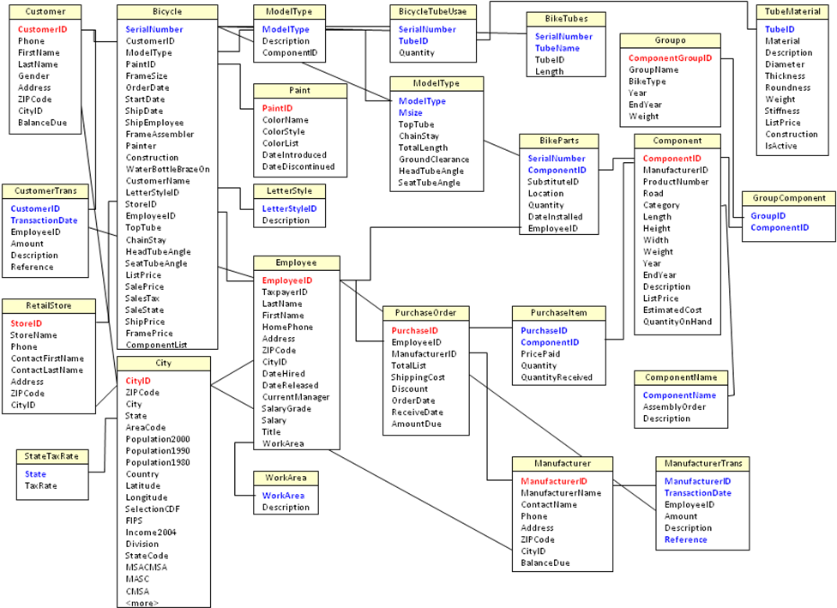
Rolling Thunder: Combined
Notes:
Rolling Thunder detailed class diagram. The detail class diagram is a nice reference tool for understanding the organization, but for many organizations this diagram will be too large to display at this level of detail.

Slide 54
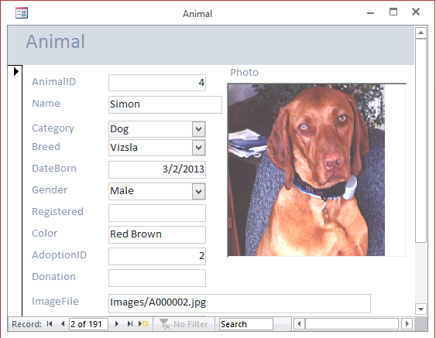
Application Design
Simple form based on one table (Animal).
But also need lookup tables for Category and Breed.
Notes:
Basic Animal form. Initially this form seems to require one table (Animal). But to minimize data-entry errors, it really needs a table to hold data for Category and Breed, which can be entered via a selection box.

Slide 55
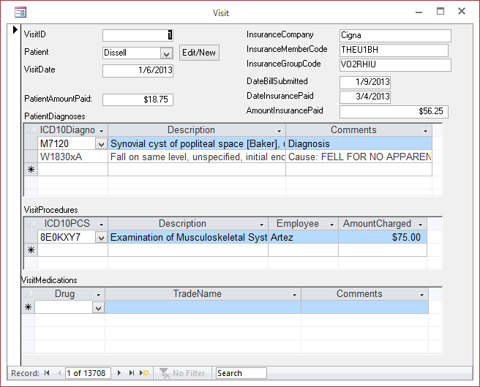
Corner Med: Patient Visit Form
Notes:
Patient Visit form. This form has two repeating sections: One for diagnoses and one for treatment. Many more details can be added but it is possible to start with these key data elements.

Slide 56
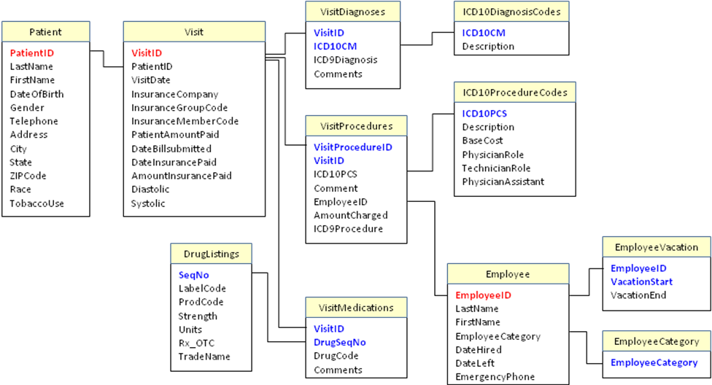
Corner Med: Basic Tables
Notes:
Corner Med basic tables. Ultimately, all of these tables will contain more data columns.

Slide 57
Appendix: DB Design System
http://JerryPost.com/dbdesign
Students and instructors need only an Internet connection and a Java-enabled Web browser.
Instructor can sign up free by sending email to: jpost@JerryPost.com
Instructors set up the class and select assignments.
Students create accounts and work on the assignments.
The system provides immediate feedback in the form of comments and questions for each proposed table.
Notes:
Typical order form. Each order can be placed by one customer but can contain multiple items ordered as shown by the repeating section.

Slide 58
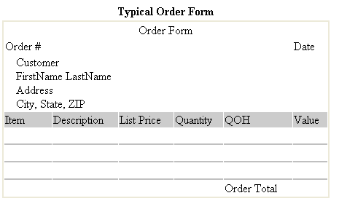
Appendix: Typical Customer Order

Slide 59
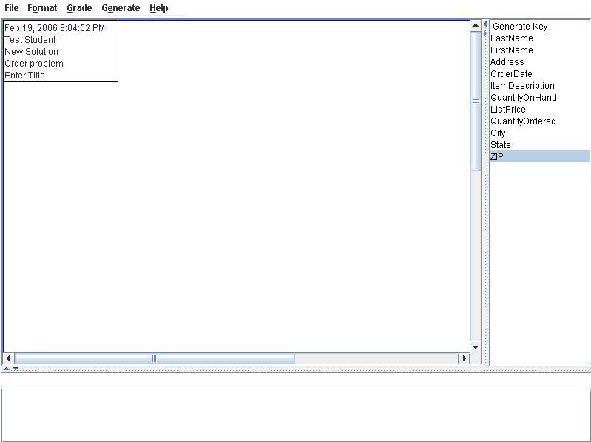
Appendix: DB Design Screen
Menu
Column list
Title box
Drag to move
Double-click to set title
Drawing area
Right-click to add tables
Scroll bars to display more of the drawing area
Drag borders
to resize
Status line
Feedback window (Double-click errors for details.)
Notes:
DB Design screen. Once you log in, use the menu option File/Open to choose the Order Problem. The Help menu has an option to View the Problem. The right-hand window contains a list of the available columns that will be placed into tables. Selecting the Grade menu option generates comments in the feedback window.

Slide 60
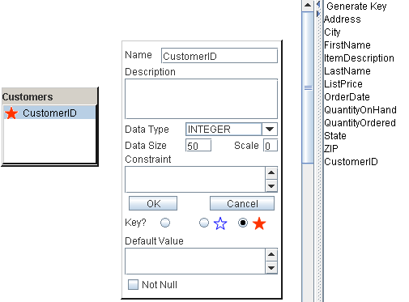
Appendix: Adding a Table and a Key
Right click in the main drawing window and select the option to Add table.
Right click the gray bar at the top of the table, select the Rename table option and enter “Customer”
Drag the Generate Key item onto the new Customer table.
Right click on the new column name, select the Rename option and enter “CustomerID”
3
4
1
2
Notes:
Adding a table and key. (1) Right click and select Add table. (2) Enter a new name (Customer) in the title box. (3) Drag the Generate Key item onto the table. (4) Enter a new name (CustomerID) in the edit box and click the OK button.

Slide 61
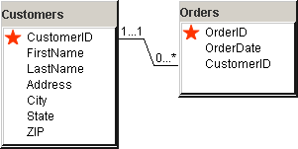
Appendix: Two Tables
The Customer table has a generated key of CustomerID
Each column in the table represents data collected for each customer.
Each column depends completely on the primary key.
Each Order is identified by a unique OrderID generated by the database system.
The CustomerID column is used because the customer number can be used to look up the corresponding data in the Customer table.
Notes:
Two tables. Each table represents a single entity, and all columns are data collected for that entity. The Orders table contains the CustomerID, which provides a method to obtain the matching data in the Customer table. Build the Customer table first, followed by the Orders table and the relationship line will probably be added automatically for you.

Slide 62
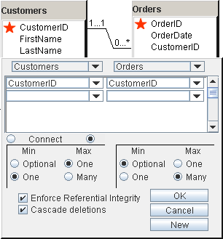
Appendix: Relationships—Linking Tables
Drag the CustomerID column from the Customer table and drop it on the CustomerID column in the Orders table.
For the Min value in Customer, select One instead of Optional.
Click the OK button to accept the relationship definition.
Notes:
Relationships. Drag the CustomerID column from the Customer table and drop it onto the CustomerID column in the Orders table. Then set the minimum and maximum values for each side of the relationship. An order must have exactly one customer, and a customer can place from zero to many orders.

Slide 63
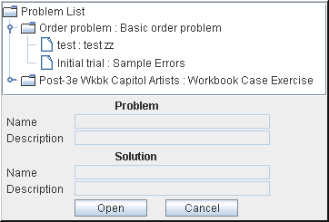
Appendix: Saving and Opening Solutions
Solutions
Click handle to expand
Resize
Notes:
Opening solutions. You can save multiple versions or solutions for any problem. To open a saved solution, you have to expand the list by clicking the handle icon in front of the problem name.

Slide 64
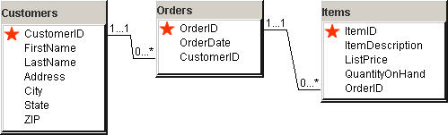
Appendix: Creating Problems
Notes:
Creating errors. To demonstrate a potential problem, add the OrderID column to the Items table and then link it to the Orders table.

Slide 65
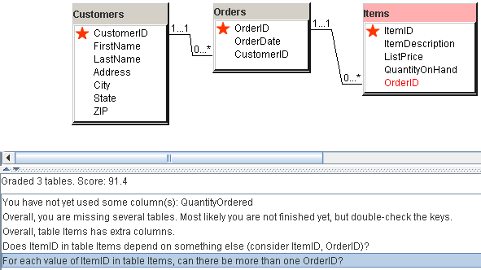
Appendix: Detecting Problems (Grading)
Notes:
Grading the exercise. Click a comment to highlight the table and column causing problems. In this case, each ItemID can appear in many Orders, but OrderID is not part of the key. Double-click an error message to see more information about the error.

Slide 66
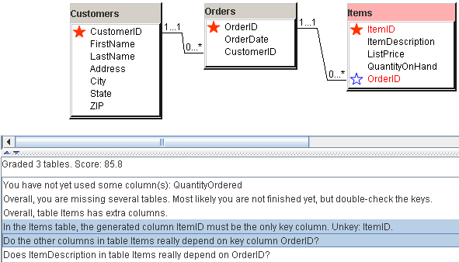
Appendix: Testing a Change
Attempted fix
  Make the relationship many-to-many
  Make OrderID a key
But, the score went down!!!
Notes:
Trying to fix the problems. You could try making OrderID part of the key, but notice that the score decreased, so the fix actually made the situation worse. The problems with the OrderID and the relationship have not been solved. You can use Ctrl+Click to highlight several errors at the same time.

Slide 67
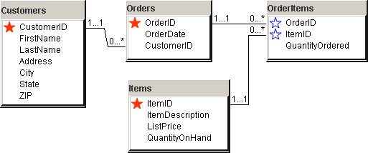
Appendix: A Solution
The intermediate table OrderItem converts the many-to-many relationship into two one-to-many relationships.
Both OrderID and ItemID are keys, indicating that each order can have many items, and each item can be sold on many orders.
Notes:
A solution. Add the intermediate table OrderItems and include keys from both tables (OrderID and ItemID). Use one-to-many relationships to link it to both tables. Notice the difference in the key indicators. The solid red star shows where a key value is generated.

Slide 68
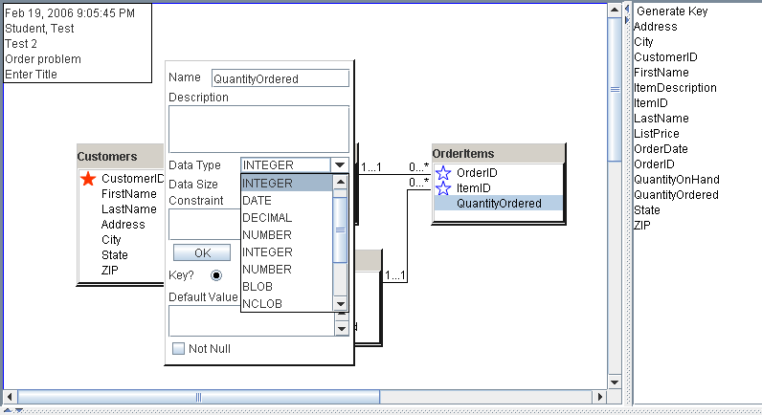
Appendix: Data Types
Right click the column names and set the data type.
Notes:
Data types. Double-click a column name to open the edit window. Set the data type. The default is Text, so you do not have to change common columns like the customer name. You can also add a description and a default value setting. The Constraint setting has to match the format of the target DBMS.

Slide 69
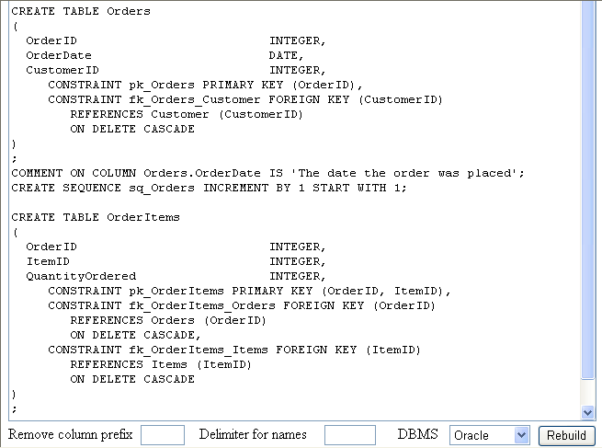
Appendix: Generating Tables
Notes:
Generate Tables. Choose the Generate/Generate Tables menu option to create a set of SQL commands that can be run on your DBMS to build the tables created in the diagram. You can choose the target DBMS before running the command or select it on the generated page. Use Ctrl+A to select the entire text in the window, then open a text editor or a SQL editor and paste the commands with Ctrl+V.

