Slide 1
Database Management Systems
Chapter 3
Data Normalization

Slide 2
Objectives
Why is database design important?
What is a table and how do you choose keys?
What are the fundamental rules of database normalization?
How do you begin analyzing a form to create normalized tables?
How do you create a design in first normal form?
What is second normal form?
What is third normal form?
What problems exist beyond third normal form?
How do business rules change the database design?
What problems arise when converting a class diagram to normalized tables?
What tables are needed for the Sally’s Pet Store?
How do you combine tables from multiple forms and many developers?
How do you record the details for all of the columns and tables?

Slide 3
Why Normalization?
Need standardized data definition
Advantages of DBMS require careful design
Define data correctly and the rest is much easier
It especially makes it easier to expand database later
Method applies to most models and most DBMS
Similar to Entity-Relationship
Similar to Objects (without inheritance and methods)
Goal: Define tables carefully
Save space
Minimize redundancy
Protect data

Slide 4
Definitions
Relational database: A collection of tables.
Table: A collection of columns (attributes) describing an entity. Individual objects are stored as rows of data in the table.
Property (attribute): a characteristic or descriptor of a class or entity.
Every table has a primary key.
The smallest set of columns that uniquely identifies any row
Primary keys can span more than one column (concatenated keys)
We often create a primary key to insure uniqueness (e.g., CustomerID, Product#, . . .) called a surrogate key.
Primary key
Properties
Class: Employee
Rows/Objects
Employee
EmployeeID TaxpayerID LastName FirstName HomePhone Address
12512 888-22-5552 Cartom Abdul (603) 323-9893 252 South Street
15293 222-55-3737 Venetiaan Roland (804) 888-6667 937 Paramaribo Lane
22343 293-87-4343 Johnson John (703) 222-9384 234 Main Street
29387 837-36-2933 Stenheim Susan (410) 330-9837 8934 W. Maple

Slide 5
Keys
Primary key
Every table (object) must have a primary key
Uniquely identifies a row (one-to-one)
Concatenated (or composite) key
Multiple columns needed for primary key
Identify repeating relationships (1 : M or M : N)
Key columns are underlined
First step
Collect user documents
Identify possible keys: unique or repeating relationships

Slide 6
Notation
Table name
Table columns
Customer(CustomerID, Phone, Name, Address, City, State, ZipCode)
Primary key is underlined
CustomerID Phone LastName FirstName Address City State Zipcode
1 502-666-7777 Johnson Martha 125 Main Street Alvaton KY 42122
2 502-888-6464 Smith Jack 873 Elm Street Bowling Green KY 42101
3 502-777-7575 Washington Elroy 95 Easy Street Smith’s Grove KY 42171
4 502-333-9494 Adams Samuel 746 Brown Drive Alvaton KY 42122
5 502-474-4746 Rabitz Victor 645 White Avenue Bowling Green KY 42102
6 616-373-4746 Steinmetz Susan 15 Speedway Drive Portland TN 37148
7 615-888-4474 Lasater Les 67 S. Ray Drive Portland TN 37148
8 615-452-1162 Jones Charlie 867 Lakeside Drive Castalian Springs TN 37031
9 502-222-4351 Chavez Juan 673 Industry Blvd. Caneyville KY 42721
10 502-444-2512 Rojo Maria 88 Main Street Cave City KY 42127

Slide 7
Identifying Key Columns
Orders
Each order has
only one customer.
So Customer is not
part of the key.
OrderID Date Customer
8367 5-5-10 6794
8368 5-6-10 9263
OrderItems
OrderID Item Quantity
8367 229 2
8367 253 4
8367 876 1
8368 555 4
8368 229 1
Each order has
many items.
Each item can appear
on many orders.
So OrderID and Item
are both part of the key.
Notes:
Composite keys. OrderItems uses a composite key (OrderID + Item) because there is a many-to-many relationship. Each order can contain many items (shown by the solid arrows). Each item can show up on many different orders (dotted arrows).

Slide 8
Surrogate Keys
Real world keys sometimes cause problems in a database.
Example: Customer
Avoid phone numbers: people may not notify you when numbers change.
Avoid SSN (privacy and most businesses are not authorized to ask for verification, so you could end up with duplicate values)
Often best to let the DBMS generate unique values
Access: AutoNumber
SQL Server: Identity
Oracle: Sequences (but require additional programming)
Drawback: Numbers are not related to any business data, so the application needs to hide them and provide other look up mechanisms.
Distributed database: GUID

Slide 9
Common Order System
Customer
Salesperson
1
1
*
Order
*
1
*
OrderItem
*
1
Item
Customer(CustomerID, Name, Address, City, Phone)
Salesperson(EmployeeID, Name, Commission, DateHired)
Order(OrderID, OrderDate, CustomerID, EmployeeID)
OrderItem(OrderID, ItemID, Quantity)
Item(ItemID, Description, ListPrice)
Notes:
A small class diagram for a basic order system. The numbers indicate relationships. For instance, each customer can place many orders, but a given order can come from only one customer.
Table notation. Column details are easier to see in a simple listing of the tables. This list is also useful when the tables are entered into the database.

Slide 10
Database Normalization Rules
1. Each cell in a table contains atomic (single-valued) data.
2. Each non-key column depends on all of the primary key columns (not just some of the columns).
3. Each non-key column depends on nothing outside of the key columns.
Notes:
The three main rules for data normalization. Essentially, each table has to accurately represent the business definitions. Each table represents a single entity and the keys accurately identify the entity and represent the one-to-many relationships among the attributes.

Slide 11
Atomic Values for Phone Numbers
CustomerID | LastName | FirstName | Phone | Business | CellPhone
15023 | Jones | Mary | 222-3034 | 222-4094 | 223-0984
63478 | Sanchez | Miguel | 030-9693 | 403-4094
94552 | O’Reilly | Madelline | 849-4948 | 292-3332 | 139-3831
45791 | Stein | Marta | 294-4421
49004 | Brise | Mer | 764-5103
Notes:
Atomic values for phone numbers. Is phone number atomic (single-valued) or repeating? You might add a column for each possible type of phone number. But how many customers have each type of phone and what if more types are needed in the future?

Slide 12
Repeating Values for Phone Numbers
CustomerID | LastName | FirstName | Phone
15023 | Jones | Mary | 222-3034 222-4094 223-0984
63478 | Sanchez | Miguel | 030-9693 403-4094
94552 | O’Reilly | Madeline | 849-4948 292-3332 139-3831 339-4040
45791 | Stein | Marta | 294-4421
49004 | Brise | Mer | 764-5103
Notes:
Repeating values for phone numbers. Each customer can have from one to many phone numbers. This table would be a bad design because it would cause problems with retrieving or editing an individual phone number.

Slide 13
Repeating Values for Phone Numbers
CustomerID | LastName | FirstName
15023 | Jones | Mary
63478 | Sanchez | Miguel
94552 | O’Reilly | Madeline
45791 | Stein | Marta
49004 | Brise | Mer
CustomerID | PhoneType | Phone
15023 | Land | 222-3034
15023 | Skype | 222-4094
15023 | Cell | 223-0984
63478 | Land | 030-9693
63478 | Skype | 403-4094
94552 | Land | 849-4948
94552 | Skype | 292-3332
94552 | Cell | 139-3831
94552 | Business | 339-4040
45791 | Land | 294-4421
49004 | Land | 764-5103
Notes:
Repeating values for phone numbers. Split the phone numbers into a separate table. Include the key (CustomerID) to link back to the original Customer table.

Slide 14
Simple Form
Customer ID Company Name City Contact LastName, FirstName Phone
Notes:
A portion of a form for a firm that sells products to other companies. The dependencies among the attributes have to be identified based on common business practices.

Slide 15
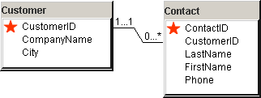
Initial Design
Customer(CustomerID, CompanyName, City)
Contact(ContactID, CustomerID, LastName, FirstName)
Notes:
The two main tables for the customer case. The key columns in the Contact table reveal that there can be many ContactIDs at each customer, but each contact works for only one customer. Where does the phone number belong?
The final design with the Customer and Contact tables. The most reasonable assumption is to decide that users will want to call contacts directly, so Phone depends on ContactID instead of CustomerID.

Slide 16
Client Billing Example
Client Billing
Client(ClientID, Name, Address, BusinessType)
Partner(PartnerID, Name, Speciality, Office, Phone)
PartnerAssignment(PartnerID, ClientID, DateAcquired)
Billing(ClientID, PartnerID, Date/Time, Item, Description, Hours, AmountBilled)
Each partner can be assigned many clients.
Each client can be assigned to many partners.

Slide 17
Client Billing--Different Rules
Client(ClientID, Name, Address, BusinessType)
Partner(PartnerID, Name, Speciality, Office, Phone)
PartnerAssignment(PartnerID, ClientID, DateAcquired)
Billing(ClientID, PartnerID, Date/Time, Item, Description, Hours, AmountBilled)
combine
Each client is assigned to only one partner.
Cannot key PartnerID.
Combine Client and PartnerAssignment tables, since
they have the same key.

Slide 18
Client Billing--New Assumptions
Billing
ClientID PartnerID Date/Time Item Description Hours AmountBilled
115 963 8-4-04 10:03 967 Stress analysis 2 $500
295 967 8-5-04 11:15 754 New Design 3 $750
115 963 8-8-04 09:30 967 Stress analysis 2.5 $650
More realistic assumptions for a large firm.
Each Partner may work with many clients.
Each client may work with many partners.
Each partner and client may work together many times.
The identifying feature is the date/time of the service.
What happens if you do not include Date/Time as a key?

Slide 19
Sample Database for Sales
Sale ID |  |  |  |  | Date
Customer First Name Last Name Address City, State ZIPCode
ItemID | Description | List Price | Quantity | QOH | Value
 |  |  |  |  | Total
Notes:
Sample sales form. First look for possible keys, keeping in mind that repeating sections (one-to-many relationships) will eventually need composite keys.

Slide 20
Initial Objects
Initial Object | Key | Sample Properties
Customer | Assign CustomerID | Name Address Phone
Item | Assign ItemID | Description List Price Quantity On Hand
Sale | Assign SaleID | Sale Date
SaleItems | SaleID + ItemID | Quantity
Notes:
Initial objects for the sale form. Note that the transaction has two parts, Sale and SaleItems because many items can be sold at many different times.

Slide 21
Initial Form Evaluation
SaleForm(SaleID, SaleDate, CustomerID, FirstName, LastName,
Address, City, State, ZIPCode,
(ItemID, Description, ListPrice, Quantity, QuantityOnHand) )
Sale ID |  |  |  |  | Date
Customer First Name Last Name Address City, State ZIPCode
ItemID | Description | List Price | Quantity | QOH | Value
 |  |  |  |  | Total
Identify potential keys.
Identify repeating groups.
Notes:
Initial form evaluation. Once you have collected basic user forms, you can convert them into a more compact notation. The notation makes the normalization steps easier by highlighting potential issues.

Slide 22
Problems with Repeating Sections
SaleForm(SaleID, SaleDate, CustomerID, FirstName, LastName, Address, City, State, ZIPCode,
(ItemID, Description, ListPrice, Quantity, QuantityOnHand) )
Repeating section
Duplication
Not atomic
SaleID | Date | CID | FirstName | LastName | Address | City | State | ZIP | ItemID | Description | ListPrice | Quantity | QOH
11851 | 7/15 | 15023 | Mary | Jones | 111 Elm | Chicago | IL | 60601 | 15 27 32 | Air Tank Regulator Mask 1557 | 192.00 251.00 65.00 | 2 1 1 | 15 5 6
11852 | 7/15 | 63478 | Miguel | Sanchez | 222 Oro | Madrid |  |  | 15 33 | Air Tank Mask 2020 | 192.00 91.00 | 4 1 | 15 3
11853 | 7/16 | 15023 | Mary | Jones | 111 Elm | Chicago | IL | 60601 | 41 75 | Snorkel 71 Wet suit-S | 44.00 215.00 | 2 1 | 15 3
11854 | 7/17 | 94552 | Madeline | O’Reilly | 333 Tam | Dublin |  |  | 75 32 57 | Wet suit-S Mask 1557 Snorkel 95 | 215.00 65.00 83.00 | 2 1 1 | 3 6 17
Notes:
Problems with repeating data. Storing repeating data with the main form results in either non-atomic cells or substantial duplication of data.

Slide 23
First Normal Form
SaleForm(SaleID, SaleDate, CustomerID, FirstName, LastName, Address, City, State, ZIPCode,
(ItemID, Description, ListPrice, Quantity, QuantityOnHand) )
SaleForm2(SaleID, SaleDate, CustomerID, FirstName, LastName, Address, City, State, ZIPCode)
SaleLine(SaleID, ItemID, Description, ListPrice, Quantity, QuantityOnHand)
Notes:
First normal form. All repeating (non-atomic) groups must be split into new tables. Be sure that the new table includes a copy of the key from the original table. The table holding the repeating group must have a composite key so that the data can be recombined in queries.

Slide 24
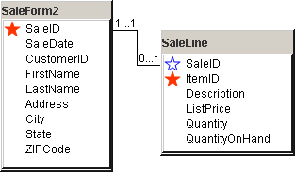
Current Design
SaleLine table is clearly wrong because it contains both generated and non-generated key columns.
Notes:
Current design. Splitting the repeating items into the SaleLine table helps but it does not solve all of the problems.

Slide 25
Multiple Repeating: Independent Groups
FormA(Key1, Simple Columns, (Group1, A, B, C), (Group2, X, Y) )
MainTable(Key1, Simple Columns)
Group1(Key1, Group1, A, B, C)
Group2(Key1, Group2, X, Y)
Notes:
Independent groups. In this example, two groups are repeating independently of each other. They are split separately into new tables. Remember to include the original key (Key1) in every new table.

Slide 26
Nested Repeating Sections
Table (Key1, . . . (Key2, . . . (Key3, . . .) ) )
Table1(Key1, . . .)
TableA (Key1,Key2 . . .(Key3, . . .) )
Table2 (Key1, Key2 . . .)
Table3 (Key1, Key2, Key3, . . .)
Nested: Table (Key1, aaa. . . (Key2, bbb. . . (Key3, ccc. . .) ) )
First Normal Form (1NF)
Table1(Key1, aaa . . .)
Table2(Key1, Key2, bbb . .)
Table3(Key1, Key2, Key3, ccc. . .)
Notes:
Nested repeating groups. Groups are nested when they repeat within another group (key3 inside key2 inside key1). Split them in steps: Pull all of group2 from group1, then pull group3 from group2. Note that every table will contain the original key (key1). With three levels, the final table (Table3) must contain three columns in the key.

Slide 27
First Normal Form Problems (Data)
SaleLine(SaleID, ItemID, Description, ListPrice, Quantity, QuantityOnHand)
Duplication for columns that depend only on ItemID
SaleID | ItemID | Description | ListPrice | Quantity | QOH
11851 | 15 | Air Tank | 192.00 | 2 | 15
11851 | 27 | Regulator | 251.00 | 1 | 5
11851 | 32 | Mask 1557 | 65.00 | 1 | 6
11852 | 15 | Air Tank | 192.00 | 4 | 15
11852 | 33 | Mask 2020 | 91.00 | 1 | 3
11853 | 41 | Snorkel 71 | 44.00 | 2 | 15
11853 | 75 | West suit-S | 215.00 | 1 | 3
11854 | 75 | Wet suit-S | 215.00 | 2 | 3
11854 | 32 | Mask 1557 | 65.00 | 1 | 6
11854 | 57 | Snorkel 95 | 83.00 | 1 | 17
Notes:
Problems with first normal form. This design is in 1NF but it still contains duplicated data. Every time an item is sold, the clerk has to reenter its description, list price, and quantity on hand. Also, if an item has not yet been sold, what is its ListPrice? The problems arise because these columns depend only on the ItemID, not on the SaleID.

Slide 28
Second Normal Form Definition
Depends on both SaleID and ItemID
SaleLine(SaleID, ItemID, Description, ListPrice, Quantity, QuantityOnHand)
Depend only on ItemID
Each non-key column must depend on the entire key.
Only applies to concatenated keys
Some columns only depend on part of the key
Split those into a new table.
Dependence (definition)
If given a value for the key you always know the value of the property in question, then that property is said to depend on the key.
If you change part of a key and the questionable property does not change, then the table is not in 2NF.
Notes:
Second normal form definition. Each nonkey column must depend on the entire key. It is only an issue with composite keys. The solution is to split off the parts that only depend on part of the key.

Slide 29
Second Normal Form Example
SaleLine(SaleID, ItemID, Description, ListPrice, Quantity, QuantityOnHand)
SaleItems(SaleID, ItemID, Quantity)
Item(ItemID, Description, ListPrice, QuantityOnHand)
Notes:
Creating second normal form. Split the original table so that the items that depend on only part of the key are moved to a separate table. Note that both tables must contain the ItemID key.

Slide 30
Second Normal Form Example (Data)
SaleItems(SaleID, ItemID, Quantity)
SaleID | ItemID | Quantity
11851 | 15 | 2
11851 | 27 | 1
11851 | 32 | 1
11852 | 15 | 4
11852 | 33 | 1
11853 | 41 | 2
11853 | 75 | 1
11854 | 75 | 2
11854 | 32 | 1
11854 | 57 | 1
Item(ItemID, Description, ListPrice, QuantityOnHand)
ItemID | Description | ListPrice | QOH
15 | Air Tank | 192.00 | 15
27 | Regulator | 251.00 | 5
32 | Mask 1557 | 65.00 | 6
33 | Mask 2020 | 91.00 | 3
41 | Snorkel 71 | 44.00 | 15
57 | Snorkel 95 | 83.00 | 17
75 | Wet suit-S | 215.00 | 3
77 | Wet suit-M | 215.00 | 7
Notes:
Second normal form data. Product items are now stored only one time. Other tables (SaleItems) can refer to an item just by its key (ItemID), which provides a link back to the Item table.

Slide 31
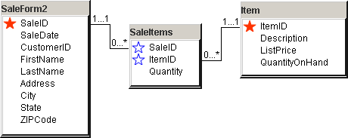
Second Normal Form in DB Design
Notes:
Second normal form in DB Design. ItemID is generated in a table that only refers to items. This value is used along with SaleID in a table that shows which items were purchased on each sale.

Slide 32
Second Normal Form Problems (Data)
SaleForm2(SaleID, SaleDate, CustomerID, FirstName, LastName, Address, City, State, ZIPCode)
SaleID | Date | CustomerID | FirstName | LastName | Address | City | State | ZIP
11851 | 7/15 | 15023 | Mary | Jones | 111 Elm | Chicago | IL | 60601
11852 | 7/15 | 63478 | Miguel | Sanchez | 222 Oro | Madrid
11853 | 7/16 | 15023 | Mary | Jones | 111 Elm | Chicago | IL | 60601
11854 | 7/17 | 94552 | Madeline | O’Reilly | 333 Tam | Dublin
Duplication
Notes:
Problems with second normal form. The hidden dependency in the customer data leads to duplicating the customer address each time a customer rents videos from the store. Similarly, if old transaction rows are deleted, the firm might lose all of the data for some customers.

Slide 33
Third Normal Form Definition
Depend on SaleID
SaleForm2(SaleID, SaleDate, CustomerID, FirstName, LastName, Address, City, State, ZIPCode)
Depend on CustomerID
Notes:
Third normal form definition. This table is not in 3NF since some of the columns depend on CustomerID, which is not part of the key.

Slide 34
Third Normal Form Example
SaleForm2(SaleID, SaleDate, CustomerID, FirstName, LastName, Address, City, State, ZIPCode)
Sale(SaleID, SaleDate, CustomerID)
SaleID | Date | CustomerID
11851 | 7/15 | 15023
11852 | 7/15 | 63478
11853 | 7/16 | 15023
11854 | 7/17 | 94552
Customer(CustomerID, FirstName, LastName, Address, City, State, ZIPCode)
CustomerID | FirstName | LastName | Address | City | State | ZIP
15023 | Mary | Jones | 111 Elm | Chicago | IL | 60601
63478 | Miguel | Sanchez | 222 Oro | Madrid
94552 | Madeline | O’Reilly | 333 Tam | Dublin
Notes:
Third normal form. Putting customer data into a separate table eliminates the hidden dependency and resolves the problems with duplicate data. Note that CustomerID remains in both tables, but it is still not a key in the Sale table because only one customer participates in a given sale.

Slide 35
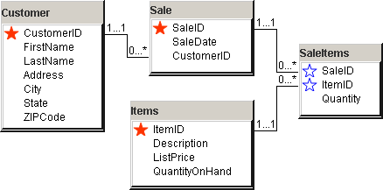
Third Normal Form Tables
Notes:
Third normal form tables. Each cell is atomic, with no no repeating groups within a table, and each nonkey column depends on the whole key and nothing but the key.

Slide 36
Third Normal Form Tables
Customer(CustomerID, FirstName, LastName, Address, City, State, ZIPCode)
Sale(SaleID, SaleDate, CustomerID)
SaleItems(SaleID, ItemID, Quantity)
Item(ItemID, Description, ListPrice, QuantityOnHand)
Notes:
Third normal form table list. The list is an easy way to fit dozens of tables on a page but does not show the relationships.

Slide 37
3NF Rules/Procedure
Split out repeating sections
Be sure to include a key from the parent section in the new piece so the two parts can be recombined.
Verify that the keys are correct
Is each row uniquely identified by the primary key?
Are one-to-many and many-to-many relationships correct?
Check “many” for keyed columns and “one” for non-key columns.
Make sure that each non-key column depends on the whole key and nothing but the key.
No hidden dependencies.

Slide 38
Checking Your Work (Quality Control)
Look for one-to-many relationships.
Many side should be keyed (underlined).
e.g., VideosRented(TransID, VideoID, . . .).
Check each column and ask if it should be 1 : 1 or 1: M.
If add a key, renormalize.
Verify no repeating sections (1NF)
Check 3NF
Check each column and ask:
Does it depend on the whole key and nothing but the key?
Verify that the tables can be reconnected (joined) to form the original tables (draw lines).
Each table represents one object.
Enter sample data--look for replication.

Slide 39
Boyce-Codd Normal Form (BCNF)
c
Employee-Specialty(EID, Specialty, Manager)
b
a
d
Business rules.
Each employee may have many specialties.
Each specialty has many managers.
Employee has only one manager for each specialty.
Each manager has only one specialty.
Employee(EID, Manager)
Manager(Manager, Specialty)
Notes:
Boyce-Codd normal form. There is a hidden dependency (d) between manager and specialty. If we delete rows from the original table, we risk losing data about our managers. The solution is to add a table to make the dependency explicit.

Slide 40
Fourth Normal Form (Keys)
EmployeeTasks(EID, Specialty, ToolID)
Business rules.
Each employee has many specialties.
Each employee has many tools.
Tools and specialties are unrelated.
EmployeeSpecialty(EID, Specialty)
EmployeeTools(EID, ToolID)
Notes:
Fourth normal form. The original table is 3NF because there are no nonkey columns. The keys are legitimate, but there is a hidden (multivalued) dependency because Specialty and ToolID are unrelated. The solution is to create two tables—one to show each of the two dependencies.

Slide 41
Domain-Key Normal Form (DKNF)
EmployeeTask(EmployeeID, TaskID, Tool)
Each employee performs many tasks with many tools.
Each Tool can be used for many tasks, or
Each task has a standard list of tools (but some employees may use others)
Need to add:
RequiredTools(TaskID, ToolID)
But, it is really BCNF: TaskID → ToolID is hidden.
But, this dependency might not have been explicitly stated.
Notes:
DKNF example. With the stated rule, the tables are in BCNF but might not be in DKNF. The initial table combines information about tasks and tools. Maybe there is an additional undefined dependency between task and tool, where employees commonly use the same tools for each task.

Slide 42
No Hidden Dependencies
The simple normalization rules:
Remove repeating sections
Each non-key column must depend on the whole key and nothing but the key.
There must be no hidden dependencies.
Solution: Split the table.
Make sure you can rejoin the two pieces to recreate the original data relationships.
For some hidden dependencies within keys, double-check the business assumption to be sure that it is realistic. Sometimes you are better off with a more flexible assumption.

Slide 43
Data Rules and Integrity
Simple business rules
Limits on data ranges
Price > 0
Salary < 100,000
DateHired > 1/12/2005
Choosing from a set
Gender = M, F, Unknown
Jurisdiction=City, County, State, Federal
Referential Integrity
Foreign key values in one table must exist in the master table.
Sale(SaleID, SaleDate, CID,…)
CID must exist in the customer table.
Sale
SaleID SaleDate CID …
1173 Jan-04 321
1174 Jan-05 938
1185 Jan-08 337
1190 Jan-09 321
1192 Jan-09 776
No data for this
customer yet!
Customer
CID Name Phone …
321 Jones 9983-
337 Sanchez 7738-
938 Carson 8738-
Notes:
Data integrity. Integrity can be maintained by simple rules. Relational databases rely on referential integrity constraints to ensure that customer data exists before the customer number can be entered in the Rental table.

Slide 44
SQL Foreign Key (Oracle, SQL Server)
CREATE TABLE Order
( OID NUMBER(9) NOT NULL,
Odate DATE,
CID NUMBER(9),
CONSTRAINT pk_Order PRIMARY KEY (OID),
CONSTRAINT fk_OrderCustomer
FOREIGN KEY (CID)
REFERENCES Customer (CID)
ON DELETE CASCADE
)
Notes:
SQL referential integrity definition. In the Sale table, declaring a column as a foreign key tells the DBMS to check each value in this table to find a matching value in the referenced (e.g., Customer) table.

Slide 45
Effect of Business Rules
Key business rules:
A player can play on only one team.
There is one referee per match.
Notes:
Database design for a soccer league. The design and normalized tables depend on the business rules. Some of the rules are shown on the form.

Slide 46
Business Rules 1
There is one referee per match.
A player can play on only one team.
Match(MatchID, DatePlayed, Location, RefID)
Score(MatchID, TeamID, Score)
Referee(RefID, Phone, Address)
Team(TeamID, Name, Sponsor)
Player(PlayerID, Name, Phone, DoB, TeamID)
PlayerStats(MatchID, PlayerID, Points, Penalties)
RefID and TeamID are not keys in the Match
and Team tables, because of the one-to-one rules.
Notes:
Restrictive rules. With only one referee per match, the referee key is added to the Match table. Similarly, the TeamID column is placed in the Player table.

Slide 47
Business Rules 2
There can be several referees per match.
A player can play on only several teams (substitute),
but only on one team per match.
Match(MatchID, DatePlayed, Location, RefID)
Score(MatchID, TeamID, Score)
Referee(RefID, Phone, Address)
Team(TeamID, Name, Sponsor)
Player(PlayerID, Name, Phone, DoB, TeamID)
PlayerStats(MatchID, PlayerID, Points, Penalties)
To handle the many-to-many relationship, we need to make
RefID and TeamID keys. But if you leave them in the same
tables, the tables are not in 3NF. DatePlayed does not depend
on RefID. Player Name does not depend on TeamID.
Notes:
Relaxing the rules to allow many-to-many relationships. You might try to make the RefID and TeamID columns part of the primary key, but the resulting tables are not in 3NF. Location does not depend on RefID, and Player Name does not depend on TeamID.

Slide 48
Business Rules 2: Normalized
There can be several referees per match.
A player can play on only several teams (substitute),
but only on one team per match.
Match(MatchID, DatePlayed, Location)
RefereeMatch(MatchID, RefID)
Score(MatchID, TeamID, Score)
Referee(RefID, Phone, Address)
Team(TeamID, Name, Sponsor)
Player(PlayerID, Name, Phone, DoB)
PlayerStats(MatchID, PlayerID, TeamID, Points, Penalties)
Notes:
Relaxing the rules and normalizing the tables. The RefereeMatch table enables the department to have more than one referee per match. Moving the TeamID to the PlayerStats table indicates that someone can play for more than one team—but for only one team during a given match.

Slide 49
Converting a Class Diagram to Normalized Tables
Manager
*
1
1
*
Purchase
Order
*
1
Supplier
Employee
*
*
Item
Raw
Materials
Assembled
Components
Office
Supplies
subtypes
Notes:
Converting a class diagram to normalized tables. Note the four types of relationships: (1) one-to-many, (2) many-to-many, (3) subtype, and (4) recursive.

Slide 50
One-to-Many Relationships
1
*
*
1
Supplier
Purchase
Order
Employee
Supplier(SID, Name, Address, City, State, Zip, Phone)
Employee(EID, Name, Salary, Address, …)
PurchaseOrder(POID, Date, SID, EID)
The many side becomes a key (underlined).
Each PO has one supplier and employee.
(Do not key SID or EID)
Each supplier can receive many POs. (Key PO)
Each employee can place many POs. (Key PO)
Notes:
Converting one-to-many relationships. Add the primary key from the one-side into the many-side table. In the example SID and EID are added to the PurchaseOrder table. Note that they are not primary keys in the PurchaseOrder table.

Slide 51
One-to-Many Sample Data
Supplier
Purchase Order
POID | Date | SID | EID
22234 | 9-9-2004 | 5676 | 221
22235 | 9-10-2004 | 5676 | 554
22236 | 9-10-2004 | 7831 | 221
22237 | 9-11-2004 | 8872 | 335
Employee
Notes:
Sample data for one-to-many relationships. The Supplier and PurchaseOrder tables are linked through the SID column. Similarly, the Employee table is linked through the data in the EID column. Both the SID and EID columns are foreign keys in the PurchaseOrder table, but they are not primary keys in that table.

Slide 52
Many-to-Many Relationships
Purchase
Order
PurchaseOrder(POID, Date, SID, EID)
Purchase
Order
1
*
1
*
*
POItem(POID, ItemID, Quantity, PricePaid)
POItem
*
*
*
1
1
Item
Item(ItemID, Description, ListPrice)
Item
Each POID can have many Items (key/underline ItemID).
Each ItemID can be on many POIDs (key POID).
Need the new intermediate table (POItem) because:
You cannot put ItemID into PurchaseOrder because Date, SID, and EID
do not depend on the ItemID.
You cannot put POID into Item because Description and ListPrice
do not depend on POID.
Notes:
Converting a many-to-many relationship. Many-to-many relationships use a new, intermediate table to link the two tables. The new POItem table contains the primary keys from both the PurchaseOrder and Item tables.

Slide 53
Many-to-Many Sample Data
Purchase Order
POID | Date | SID | EID
22234 | 9/9 | 5676 | 221
22235 | 9/10 | 5676 | 554
22236 | 9/10 | 7831 | 221
22237 | 9/11 | 8872 | 335
POItem
POID | ItemID | Quantity | Price
22234 | 444098 | 3 | 2.00
22234 | 444185 | 1 | 25.00
22235 | 444185 | 4 | 24.00
22236 | 555828 | 10 | 150.00
22236 | 555982 | 1 | 5800.00
Item
ItemID | Description | ListPrice
444098 | Staples | 2.00
444185 | Paper | 28.00
555828 | Wire | 158.00
555982 | Sheet steel | 5928.00
888371 | Brake assembly | 152.00
Notes:
Sample data for the many-to-many relationship. Note that the intermediate POItem table links the other two tables. Verify that the three tables are in 3NF, where each nonkey column depends on the whole key and nothing but the key.

Slide 54
N-ary Associations
Employee
Name
...
1
*
Assembly
1
*
*
1
Component
CompID
Type
Name
Product
ProductID
Type
Name
Assembly
EmployeeID
CompID
ProductID
Notes:
N-ary association. The Assembly association is also a class. It can be modeled as a set of binary (one-to-many) associations. The primary key from each of the main classes is included in the new Assembly class.

Slide 55
Generalization or Subtypes
Item
Raw
Materials
Assembled
Components
Office
Supplies
Item(ItemID, Description, ListPrice)
RawMaterials(ItemID, Weight, StrengthRating)
AssembledComponents(ItemID, Width, Height, Depth)
OfficeSupplies(ItemID, BulkQuantity, Discount)
Add new tables for each subtype.
Use the same key as the generic type (ItemID)--one-to-one relationship.
Add the attributes specific to each subtype.
Notes:
Converting subtypes. Every item purchased has basic attributes, which are recorded in the Item table. Each item can be placed in one of three categories, which have different attributes. To convert these relationships to 3NF, create new tables for each subtype. Use the same key in the new tables and in the generic table. Add attributes specific to each of the subtypes.

Slide 56
Subtypes Sample Data
Item
ItemID | Description | ListPrice
444098 | Staples | 2.00
444185 | Paper | 28.00
555828 | Wire | 158.00
555982 | Sheet steel | 5928.00
888371 | Brake assembly | 152.00
RawMaterials
ItemID | Weight | StrengthRating
555828 | 57 | 2000
555982 | 2578 | 8321
AssembledComponents
ItemID | Width | Height | Depth
888371 | 1 | 3 | 1.5
OfficeSupplies
ItemID | BulkQuantity | Discount
444098 | 20 | 10%
444185 | 10 | 15%
Notes:
Sample data for the subtype relationships. Notice how each Item has an entry in the Item table and a row in one of the three subtype tables.

Slide 57
Composition
Bicycle
Bicycle
Size
Model Type
…
SerialNumber
ModelType
WheelID
CrankID
StemID
…
Components
Wheels
ComponentID
Category
Description
Weight
Cost
Crank
Stem
Notes:
Normalizing a composition association. First decide how to handle the subclasses. In this case they are combined into one Components table. Second, handle the composition by storing the ComponentID and the SerialNumber as keys in a new junction table.

Slide 58
Recursive Relationships
Manager
*
1
Employee
Employee(EID, Name, Salary, Address, Manager)
Employee
Add a manager column that contains Employee IDs.
An employee can have only one manager. (Manager is not a key.)
A manager can supervise many employees. (EID is a key.)
Notes:
Converting recursive relationships. An employee can have only one manager, so add a Manager column to the Employee table which contains the EID to point to the manager. In the example, Smith reports to Manager 335 (Sanchez).

Slide 59
Normalization Examples
Possible topics
Auto repair
Auto sales
Department store
Hair stylist
HRM department
Law firm
Manufacturing
National Park Service
Personal stock portfolio
Pet shop
Restaurant
Social club
Sports team

Slide 60
Multiple Views & View Integration
Collect multiple views
Documents
Reports
Input forms
Create normalized tables from each view
Combine the views into one complete model.
Keep meta-data in a data dictionary
Type of data
Size
Volume
Usage
Example
Federal Emergency Management Agency (FEMA). Disaster planning and relief.
Make business assumptions as necessary, but try to keep them simple.

Slide 61
The Pet Store: Sales Form
Sales(SaleID, Date, CustomerID, Name, Address, City, State, Zip, EmployeeID, Name, (AnimalID, Name, Category, Breed, DateOfBirth, Gender, Registration, Color, Donation, AdoptionGroup), (ItemID, Description, Category, ListPrice, SalePrice, Quantity))
Notes:
Pet Store sample sales form. Separate sections for selling animals and merchandise reflect a business rule to treat them differently.

Slide 62
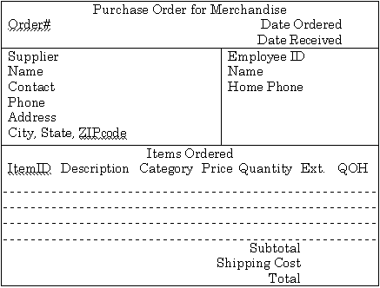
The Pet Store: Purchase Merchandise
MerchandiseOrder(PONumber, OrderDate, ReceiveDate, SupplierID, Name, Contact, Phone, Address, City, State, Zip, EmployeeID, Name, HomePhone, (ItemID, Description, Category, Price, Quantity, QuantityOnHand), ShippingCost)
Notes:
Pet Store sample purchase order for merchandise. Note the similarities and differences between the two types of orders. Keep in mind that additional data will have to be collected later.

Slide 63
Pet Store Normalization
Sale(SaleID, Date, CustomerID, EmployeeID)
SaleItem(SaleID, ItemID, SalePrice, Quantity)
Customer(CustomerID, Name, Address, City, State, Zip)
Employee(EmployeeID, Name)
Animal(AnimalID, Name, Category, Breed, DateOfBirth,
Gender, Registration, Color, ListPrice, SaleID, Donation, AdoptionID)
Merchandise(ItemID, Description, Category, ListPrice)
MerchandiseOrder(PONumber, OrderDate, ReceiveDate, SID, EmpID, ShipCost)
MerchandiseOrderItem(PONumber, ItemID, Quantity, Cost)
Supplier(SupplierID, Name, Contact, Phone, Address, City, State, Zip)
Employee(EmployeeID, Name, Phone)
Merchandise(ItemID, Description, Category, QuantityOnHand)
Notes:
Pet Store normalized tables for the basic sales form. You should do the normalization first and see if your results match these tables.

Slide 64
Pet Store View Integration
Sale(SaleID, Date, CustomerID, EmployeeID)
SaleItem(SaleID, ItemID, SalePrice, Quantity)
Customer(CustomerID, Name, Address, City, State, Zip)
Employee(EmployeeID, Name, Phone, DateHired)
Animal(AnimalID, Name, Category, Breed, DateOfBirth,
Gender, Registration, Color, SaleID, AdoptionID, Donation)
Merchandise(ItemID, Description, Category, ListPrice, Cost, QuantityOnHand)
MerchandiseOrder(PONumber, OrderDate, ReceiveDate, SID, EmpID, ShipCost)
MerchandiseOrderItem(PONumber, ItemID, Quantity, Cost)
Supplier(SupplierID, Name, Contact, Phone, Address, City, State, Zip)
Employee(EmployeeID, Name, Phone)
Merchandise(ItemID, Description, Category, QuantityOnHand)
Notes:
Pet Store view integration. Data columns from similar tables can be combined into one table. For example, we need only one Employee table. Look for tables that have the same keys. The goal is to have one set of normalized tables that can hold the data for all the forms and reports.

Slide 65
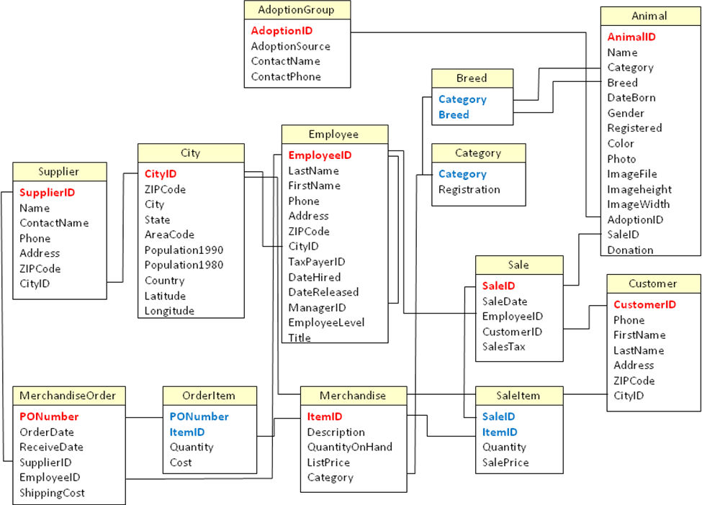
Pet Store Class Diagram
Notes:
Pet Store class diagram. The tables become entities in the diagram. The relationships verify that the tables are interconnected through the data. Some new data has been added for the employees. Also, cities have been defined in a single table to simplify data entry. Likewise, the new Breed and Category tables ensure consistency of data.

Slide 66
Rolling Thunder Integration Example
Bicycle Assembly form. The main EmployeeID control
is not stored directly, but the value is entered in the
assembly column when the employee clicks the column.
Notes:
Bicycle Assembly form. The main EmployeeID control is not stored directly, but the value is entered in the FrameAssembler column of the Bicycle table when the employee clicks the Frame box.

Slide 67
Initial Tables for Bicycle Assembly
BicycleAssembly(
SerialNumber, Model, Construction, FrameSize, TopTube, ChainStay, HeadTube, SeatTube,
PaintID, PaintColor, ColorStyle, ColorList, CustomName, LetterStyle, EmpFrame, EmpPaint,
BuildDate, ShipDate,
(Tube, TubeType, TubeMaterial, TubeDescription),
(CompCategory, ComponentID, SubstID, ProdNumber, EmpInstall, DateInstall, Quantity, QOH) )
Bicycle(SerialNumber, Model, Construction, FrameSize, TopTube, ChainStay, HeadTube, SeatTube,
PaintID, ColorStyle, CustomName, LetterStyle, EmpFrame, EmpPaint, BuildDate, ShipDate)
Paint(PaintID, ColorList)
BikeTubes(SerialNumber, TubeID, Quantity)
TubeMaterial(TubeID, Type, Material, Description)
BikeParts(SerialNumber, ComponentID, SubstID, Quantity, DateInstalled, EmpInstalled)
Component(ComponentID, ProdNumber, Category, QOH)
Notes:
Notation for the BicycleAssembly form. There are two repeating groups, but they are independent. The 4NF tables from this form are displayed, but you should try to derive the tables yourself.

Slide 68
Rolling Thunder: Purchase Order
Notes:
Purchase Order form. Only the items ordered is a repeating group. The Look for Products section is a convenience for users and does not store data. The Date Shipment Received box is initially blank and is filled in when the product arrives at the loading dock.

Slide 69
RT Purchase Order: Initial Tables
PurchaseOrder(PurchaseID, PODate, EmployeeID, FirstName, LastName, ManufacturerID,
MfgName, Address, Phone, CityID, CurrentBalance, ShipReceiveDate,
(ComponentID, Category, ManufacturerID, ProductNumber, Description, PricePaid, Quantity,
ReceiveQuantity, ExtendedValue, QOH, ExtendedReceived), ShippingCost, Discount)
PurchaseOrder(PurchaseID, PODate, EmployeeID, ManufacturerID,
ShipReceiveDate, ShippingCost, Discount)
Employee(EmployeeID, FirstName, LastName)
Manufacturer(ManufacturerID, Name, Address, Phone, Address, CityID, CurrentBalance)
City(CityID, Name, ZipCode)
PurchaseItem(PurchaseID, ComponentID, Quantity, PricePaid, ReceivedQuantity)
Component(ComponentID, Category, ManufacturerID, ProductNumber, Description, QOH)
Notes:
Tables from the Purchase Order form. Note that the computed columns (extension is price * quantity) are not stored in the tables.

Slide 70
Rolling Thunder: Transactions
Notes:
Manufacturer Transaction form. The balance due is stored in the database, but only one time. The Initial Balance and Balance Due boxes are computed by the form to display the effect of transactions added by the user.

Slide 71
RT Transactions: Initial Tables
ManufacturerTransactions(ManufacturerID, Name, Phone, Contact, BalanceDue,
(TransDate, Employee, Amount, Description) )
Manufacturer(ManufacturerID, Name, Phone, Contact, BalanceDue)
ManufacturerTransaction(ManufacturerID, TransactionDate, EmployeeID,
Amount, Description)
Notes:
Tables for Manufacturer Transaction form. This normalization is straightforward. Note that the TransactionDate column also holds the time, so it is possible to have more than one transaction with a given manufacturer on the same day.

Slide 72
Rolling Thunder: Components
Notes:
Component form. Note that components have an internal ID number that is assigned by Rolling Thunder employees. Products usually also have a Product number that is assigned by the manufacturer. It is difficult to rely on this number, since it might be duplicated across suppliers and the formats vary widely.

Slide 73
RT Components: Initial Tables
ComponentForm(ComponentID, Product, BikeType, Category, Length, Height,
Width, Weight, ListPrice,Description, QOH, ManufacturerID, Name,
Phone, Contact, Address, ZipCode, CityID, City, State, AreaCode)
Component(ComponentID, ProductNumber, BikeType, Category, Length, Height,
Width,Weight, ListPrice, Description, QOH, ManufacturerID)
Manufacturer(ManufacturerID, Name, Phone, Contact, Address, ZipCode, CityID)
City(CityID, City, State, ZipCode, AreaCode)
Notes:
Tables derived from the Component form. The ZipCode in the Manufacturer table is specific to that company (probably a nine-digit code). The ZipCode in the City table is a base (five-digit) code that can be used for a reference point, but there are often many codes per city.

Slide 74
RT: Integrating Tables
Duplicate Manufacturer tables:
PO Mfr(ManufacturerID, Name, Address, Phone, CityID, CurrentBalance)
Mfg Mfr(ManufacturerID, Name, Phone, Contact, BalanceDue)
Comp Mfr(ManufacturerID, Name, Phone, Contact, Address, ZipCode, CityID)
Note that each form can lead to duplicate tables.
Look for tables with the same keys, but do not expect
them to be named exactly alike.
Find all of the data and combine it into one table.
Manufacturer(ManufacturerID, Name, Contact, Address, Phone,
Address, CityID, |ZipCode, CurrentBalance)
Notes:
Multiple versions of the Manufacturer table. Tables with the same key should be combined and reduced to one table. Moving Contact and ZipCode to the first table means the other two tables can be deleted. Do not be misled by the two names (CurrentBalance and BalanceDue) for the same column.

Slide 75
RT Example: Integrated Tables
Bicycle(SerialNumber, Model, Construction, FrameSize, TopTube, ChainStay, HeadTube,
SeatTube, PaintID, ColorStyle, CustomName, LetterStyle, EmpFrame,
EmpPaint, BuildDate, ShipDate)
Paint(PaintID, ColorList)
BikeTubes(SerialNumber, TubeID, Quantity)
TubeMaterial(TubeID, Type, Material, Description)
BikeParts(SerialNumber, ComponentID, SubstID, Quantity, DateInstalled, EmpInstalled)
Component(ComponentID, ProductNumber, BikeType, Category, Length, Height, Width,
Weight, ListPrice, Description, QOH, ManufacturerID)
PurchaseOrder(PurchaseID, PODate, EmployeeID, ManufacturerID,
ShipReceiveDate, ShippingCost, Discount)
PurchaseItem(PurchaseID, ComponentID, Quantity, PricePaid, ReceivedQuantity)
Employee(EmployeeID, FirstName, LastName)
Manufacturer(ManufacturerID, Name, Contact, Address, Phone,
CityID, ZipCode, CurrentBalance)
ManufacturerTransaction(ManufacturerID, TransactionDate, EmployeeID, Amount,
Description, Reference)
City(CityID, City, State, ZipCode, AreaCode)
Notes:
Integrated tables. Duplicate tables have been combined, and normalization (4NF) has been verified. Also draw a class diagram to be sure the tables link together. Note the addition of the Reference column as an audit trail to hold the corresponding PurchaseID. Observe that some tables (e.g., Employee) will need additional data.

Slide 76
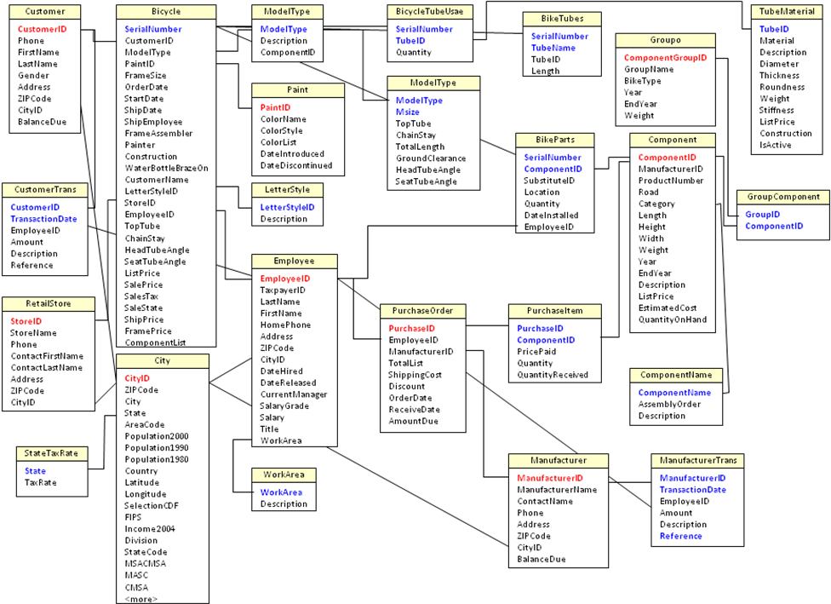
Rolling Thunder Tables

Slide 77
View Integration (FEMA Example 1)
Team Roster
Team# Date Formed Leader
Home Base Name Fax Phone
Response time (days) Address, C,S,Z Home phone
Total Salary
Team Members/Crew
ID Name Home phone Specialty DoB SSN Salary
This first form is kept for each team that can be called on to help in emergencies.
Notes:
Practice forms for in-class examples.

Slide 78
View Integration (FEMA Example 2)
Disaster Name HQ Location On-Site Problem Report
Local Agency Commander
Political Contact
Date Reported Assigned Problem# Severity
Problem Description
Reported By: Specialty Specialty Rating
Verified By: Specialty Specialty Rating
SubProblem Details
Total Est. Cost
Sub Prob# Category Description Action Est. Cost
Major problems are reported to HQ to be prioritized and scheduled for correction.

Slide 79
View Integration (FEMA Example 3)
Location Damage Analysis Date Evaluated
LocationID, Address Team Leader Title Repair Priority
Latitude, Longitude Cellular Phone Damage Description
Item Loss Total
Estimated Damage Total
Room Damage Descrip. Damage%
Room Damage Descrip. Damage%
Item Value $Loss
Item Value $Loss
On-site teams examine buildings and file a report on damage at that location.

Slide 80
View Integration (FEMA Example 3a)
Location Analysis(LocationID, MapLatitude, MapLongitude, Date, Address, Damage, PriorityRepair, Leader, LeaderPhone, LeaderTitle, (Room, Description, PercentDamage, (Item, Value, Loss)))

Slide 81
View Integration (FEMA Example 4)
Task Completion Report Date
Disaster Name Disaster Rating HQ Phone
Problem# Supervisor Date
Total Expenses
Problem# Supervisor Date
Total Expenses
SubProblem Team# Team Specialty CompletionStatus Comment Expenses
SubProblem Team# Team Specialty CompletionStatus Comment Expenses
Teams file task completion reports. If a task is not completed, the percentage accomplished is reported as the completion status.

Slide 82
View Integration (FEMA Example 4a)
TasksCompleted(Date, DisasterName, DisasterRating, HQPhone, (Problem#, Supervisor, (SubProblem, Team#, CompletionStatus, Comments, Expenses))

Slide 83
DBMS Table Definition
Enter Tables
Columns
Keys
Data Types
Text
Memo
Number
Byte
Integer, Long
Single, Double
Date/Time
Currency
AutoNumber (Long)
Yes/No
OLE Object
Descriptions
Column Properties
Format
Input Mask
Caption
Default
Validation Rule
Validation Text
Required & Zero Length
Indexed
Relationships
One-to-One
One-to-Many
Referential Integrity
Cascade Update/Delete
Define before entering data

Slide 84
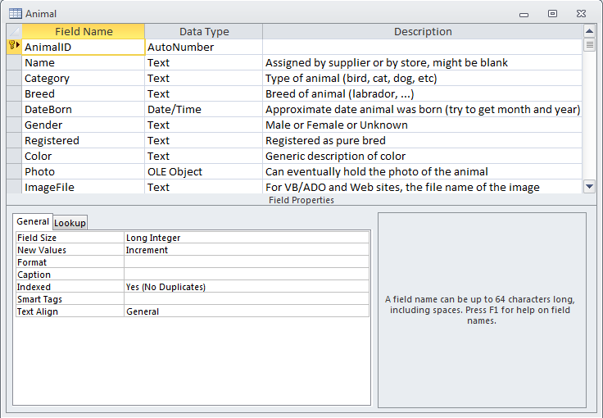
Table Definition in Access
Key
Numeric Subtypes or text length
Notes:
Table definition in Microsoft Access. Note the primary key indicator. Also note that text size limits and numeric subtypes are defined in the list at the bottom of the form

Slide 85
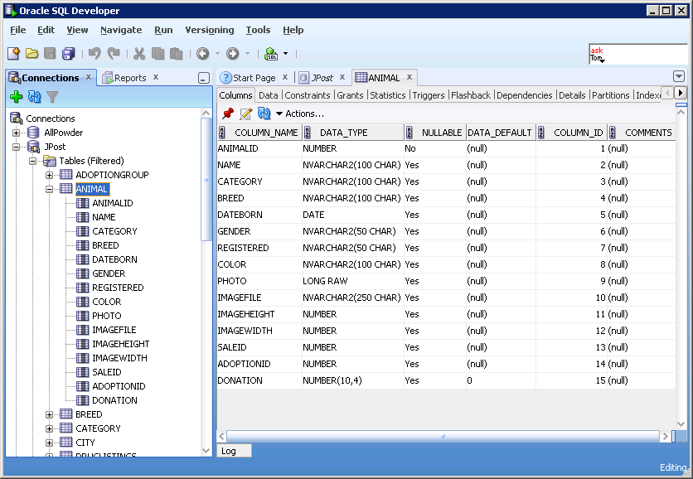
Graphical Table Definition in Oracle
SQL Developer
Notes:
Oracle Schema Manager for creating tables. Primary keys and foreign keys are set in the Constraints tab. For primary key columns, be sure to also check that the values cannot be null.

Slide 86
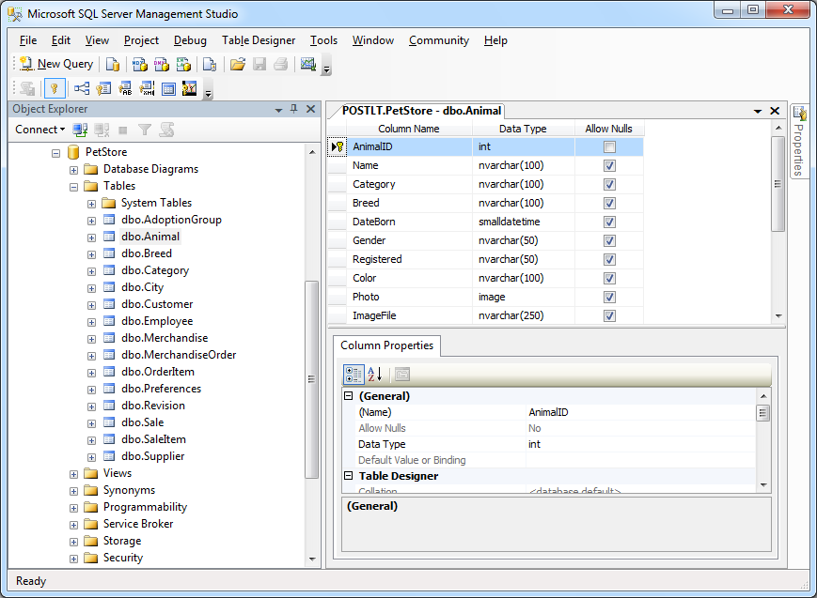
Graphical Table Definition in SQL Server
Notes:
Microsoft SQL Server form for creating tables. You can right-click and choose a menu item to create relationships.

Slide 87
SQL Table Definition
CREATE TABLE Animal
(
AnimalID INTEGER,
Name NVARCHAR2(50),
Category NVARCHAR2(50),
Breed NVARCHAR2(50),
DateBorn DATE,
Gender NVARCHAR2(50) CHECK (Gender='Male' Or
Gender='Female' Or Gender='Unknown' Or Gender Is Null),
Registered NVARCHAR2(50),
Color NVARCHAR2(50),
Photo LONG RAW,
ImageFile NVARCHAR2(250),
ImageHeight INTEGER,
ImageWidth INTEGER,
AdoptionID INTEGER,
Donation NUMBER(10,2),
CONSTRAINT pk_Animal PRIMARY KEY (AnimalID),
CONSTRAINT fk_BreedAnimal FOREIGN KEY (Category,Breed)
REFERENCES Breed(Category,Breed)
ON DELETE CASCADE,
CONSTRAINT fk_CategoryAnimal FOREIGN KEY (Category)
REFERENCES Category(Category)
ON DELETE CASCADE
);
Notes:
Oracle SQL Statements to create the Animal table. The statements for SQL Server are similar—just change the data types.

Slide 88
Oracle Databases
For Oracle and SQL Server, it is best to create a text file that contains all of the SQL statements to create the table.
It is usually easier to modify the text table definition.
The text file can be used to recreate the tables for backup or transfer to another system.
To make major modifications to the tables, you usually create a new table, then copy the data from the old table, then delete the old table and rename the new one. It is much easier to create the new table using the text file definition.
Be sure to specify Primary Key and Foreign Key constraints.
Be sure to create tables in the correct order—any table that appears in a Foreign Key constraint must first be created. For example, create Customer before creating Order.
In Oracle, to substantially improve performance, issue the following command once all tables have been created:
Analyze table Animal compute statistics;

Slide 89
Data Volume
Estimate the total size of the database.
Current.
Future growth.
Guide for hardware and software purchases.
For each table.
Use data types to estimate the number of bytes used for each row.
Multiply by the estimated number of rows.
Add the value for each table to get the total size.
For concatenated keys (and similar tables).
OrderItems(O#, Item#, Qty)
Hard to “know” the total number of items ordered.
Start with the total number of orders.
Multiply by the average number of items on a typical order.
Need to know time frame or how long to keep data.
Do we store all customer data forever?
Do we keep all orders in the active database, or do we migrate older ones?

Slide 90
Data Volume Example
Customer(C#, Name, Address, City, State, Zip)
Row: 4 + 15 + 25 + 20 + 2 + 10 = 76
Order(O#, C#, Odate)
Row: 4 + 4 + 8 = 16
OrderItem(O#, P#, Quantity, SalePrice)
Row: 4 + 4 + 4 + 8 = 20
Business rules
Three year retention.
1000 customers.
Average 10 orders per customer per year.
Average 5 items per order.
Customer | 76*1000 | 76,000
Order | 16*30,000 | 480,000
OrderItem | 20*150,000 | 3,000,000
Total |  | 3,556,000
Notes:
Estimating data volume. First estimate the size of each row, and then estimate the number of rows in the table. If there is a concatenated key, you will usually multiply an average value times the number of rows in a prior table, as in the calculation for OrderItem.

Slide 91
Appendix: Formal Definitions: Terms
Formal | Definition | Informal
Relation | A set of attributes with data that changes over time. Often denoted R. | Table
Attribute | Characteristic with a real-world domain. Subsets of attributes are multiple columns, often denoted X or Y. | Column
Tuple | The data values returned for specific attribute sets are often denoted as t[X] | Row of data
Schema | Collection of tables and constraints/relationships
Functional dependency | X → Y | Business rule dependency

Slide 92
Appendix: Functional Dependency
Derives from a real-world relationship/constraint.
Denoted X → Y for sets of attributes X and Y
Holds when any rows of data that have identical values for X attributes also have identical values for their Y attributes:
If t1[X] = t2[X], then t1[Y] = t2[Y]
X is also known as a determinant if X is non-trivial (not a subset of Y).

Slide 93
Appendix: Keys
Keys are attributes that are ultimately used to identify rows of data.
A key K (sometimes called candidate key) is a set of attributes
With FD K → U where U is all other attributes in the relation
If K’ is a subset of K, then there is no FD K’ → U
A set of key attributes functionally determines all other attributes in the relation, and it is the smallest set of attributes that will do so (there is no smaller subset of K that determines the columns.)

Slide 94
Appendix: First Normal Form
A relation is in first normal form (1NF) if and only if all attributes are atomic.
Atomic attributes are single valued, and cannot be composite, multi-valued or nested relations.
Example:
Customer(CID, Name: First + Last, Phones, Address)
CID | Name: First + Last | Phones | Address
111 | Joe Jones | 111-2223 111-3393 112-4582 | 123 Main

Slide 95
Appendix: Second Normal Form
A relation is in second normal form (2NF) if it is in 1NF and each non-key attribute is fully functionally dependent on the primary key.
K → Ai for each non-key attribute Ai
That is, there is no subset K’ such that K’ → Ai
Example:
OrderProduct(OrderID, ProductID, Quantity, Description)
OrderID | ProductID | Quantity | Description
32 | 15 | 1 | Blue Hose
32 | 16 | 2 | Pliers
33 | 15 | 1 | Blue Hose

Slide 96
Appendix: Transitive Dependency
Given functional dependencies: X → Y and Y → Z, the transitive dependency X → Z must also hold.
Example:
There is an FD between OrderID and CustomerID. Given the OrderID key attribute, you always know the CustomerID.
There is an FD between CustomerID and the other customer data, because CustomerID is the primary key. Given the CustomerID, you always know the corresponding attributes for Name, Phone, and so on.
Consequently, given the OrderID (X), you always know the corresponding customer data by transitivity.

Slide 97
Appendix: Third Normal Form
A relation is in third normal form if and only if it is in 2NF and no non-key attributes are transitively dependent on the primary key.
That is, K → Ai for each attribute, (2NF) and
There is no subset of attributes X such that K → X → Ai
Example:
Order(OrderID, OrderDate, CustomerID, Name, Phone)
OrderID | OrderDate | CustomerID | Name | Phone
32 | May-05 | 1 | Jones | 222-3333
33 | May-05 | 2 | Hong | 444-8888
34 | May-05 | 1 | Jones | 222-3333

Slide 98
Appendix: Boyce-Codd Normal Form
A relation is in Boyce-Codd Normal Form (BCNF) if and only if it is in 3NF and every determinant is a candidate key (or K is a superkey).
That is, K → Ai for every attribute, and there is no subset X (key or nonkey) such that X → Ai where X is different from K.
Example: Employees can have many specialties, and many employees can be within a specialty. Employees can have many managers, but a manager can have only one specialty: Mgr → Specialty
EmpSpecMgr(EID, Specialty, ManagerID)
EID | Speciality | ManagerID
32 | Drill | 1
33 | Weld | 2
34 | Drill | 1
FD ManagerID → Specialty is not currently a key.

Slide 99
Appendix: Multi-Valued Dependency
A multi-valued dependency (MVD) exists when there are at least three attributes in a relation (A, B, and C; and they could be sets), and one attribute (A) determines the other two (B and C) but the other two are independent of each other.
That is, A →B and A → C but B and C have no FDs
Example:
Employees have many specialties and many tools, but tools and specialties are not directly related.

Slide 100
Appendix: Fourth Normal Form
A relation is in fourth normal form 4NF if and only if it is in BCNF and there are no multi-valued dependencies.
That is, all attributes of R are also functionally dependent on A.
If A → → B, then all attributes of R are also functionally dependent on A: A → Ai for each attribute.
Example:
EmpSpecTools(EID, Specialty, ToolID)
EmpSpec(EID, Specialty)
EmpTools(EID, ToolID)

