Slide 1
Database Management Systems
Chapter 4
Queries

Slide 2
Objectives
Why do you need a query language?
What are the main tasks of a query language?
What business questions can be answered with the basic SQL SELECT command?
What is the basic structure of a query?
What tables and columns are used in the Pet Store?
How do you write queries for a specific DBMS?
How do you create a basic query?
What types of computations can be performed in SQL?
How do you compute subtotals?
How do you use multiple tables in a query?
How do you query XML data with XQuery?
How do you search long text with regular expressions?

Slide 3
Why do we Need Queries
Natural languages (English) are too vague
With complex questions, it can be hard to verify that the question was interpreted correctly, and that the answer we received is truly correct.
Consider the question: Who are our best customers?
We need a query system with more structure
We need a standardized system so users and developers can learn one method that works on any (most) systems.
Query By Example (QBE)
SQL

Slide 4
Four Questions to Create a Query
What output do you want to see?
What do you already know (or what constraints are given)?
What tables are involved?
How are the tables joined together?
What output do you want to see? | SELECT columns
What tables are involved? | FROM table
How are the tables joined? | INNER JOIN table
What do you already know (or what constraints are given)? | WHERE conditions
Notes:
Four questions to create a query. Every query is built by asking these four questions.

Slide 5
Example: Column Filter
SELECT EmployeeID, LastName, Phone
FROM Employee;
EmployeeID LastName Phone
1 Reeves 402-146-7714
2 Gibson 919-245-0526
3 Reasoner 413-414-8275
4 Hopkins 412-524-9814
5 James 407-026-6653
6 Eaton 906-446-7957
7 Farris 615-891-5545
8 Carpenter 215-545-8897
9 O'Connor 203-170-0146
10 Shields 304-607-9081
11 Smith 860-333-9872

Slide 6
Example: Row Filter
SELECT EmployeeID, LastName, Phone, EmployeeLevel
FROM Employee
WHERE EmployeeLevel=3;
EmployeeID LastName Phone EmployeeLevel
4 Hopkins 412-524-9814 3
5 James 407-026-6653 3
7 Farris 615-891-5545 3
And conditions tighten the filter and reduce the number of rows that meet all conditions.
Or conditions broaden the filter because rows can match any of the multiple conditions.

Slide 7
Joining Tables
Sales
Customer
SaleID
SaleDate
CustomerID
CustomerID
LastName
FirstName
Phone
SaleID | SaleDate | CustomerID
1 | 5/1 | 1
2 | 5/1 | 2
3 | 5/2 | 4
4 | 5/2 | 1
CustomerID | LastName | FirstName | Phone
1 | Jones | Mary | 111-2222
2 | Smith | Marta | 222-3333
3 | Jackson | Miguel | 444-2222
4 | Smith | Mark | 555-5662
SaleID | SaleDate | CustomerID | CustomerID | LastName | FirstName | Phone
1 | 5/1 | 1 | 1 | Jones | Mary | 111-2222
2 | 5/1 | 2 | 2 | Smith | Marta | 222-3333
3 | 5/2 | 4 | 4 | Smith | Mark | 555-5662
4 | 5/2 | 1 | 1 | Jones | Mary | 111-2222
Notes:
Joining tables. A join causes a lookup to match rows across the tables.

Slide 8
Cross Join (Bad)
Sales
Customer
SaleID
SaleDate
CustomerID
CustomerID
LastName
FirstName
Phone
SaleID | SaleDate | CustomerID
1 | 5/1 | 1
2 | 5/1 | 2
3 | 5/2 | 4
4 | 5/2 | 1
CustomerID | LastName | FirstName | Phone
1 | Jones | Mary | 111-2222
2 | Smith | Marta | 222-3333
3 | Jackson | Miguel | 444-2222
4 | Smith | Mark | 555-5662
SaleID | SaleDate | CustomerID | CustomerID | LastName | FirstName | Phone
1 | 5/1 | 1 | 1 | Jones | Mary | 111-2222
1 | 5/1 | 1 | 2 | Smith | Marta | 222-3333
1 | 5/1 | 1 | 3 | Jackson | Miguel | 444-2222
1 | 5/1 | 1 | 4 | Smith | Mark | 555-5662
2 | 5/1 | 2 | 1 | Jones | Mary | 111-2222
2 | 5/1 | 2 | 2 | Smith | Marta | 222-3333
2 | 5/1 | 2 | 3 | Jackson | Miguel | 444-2222
2 | 5/1 | 2 | 4 | Smith | Mark | 555-5662
8 more rows
Notes:
Cross join. With no join condition, the DBMS performs a cross join and matches every row in the first table to every row in the second table, often leading to millions of rows in the result. Be sure to specify a join condition and stay away from cross joins.

Slide 9
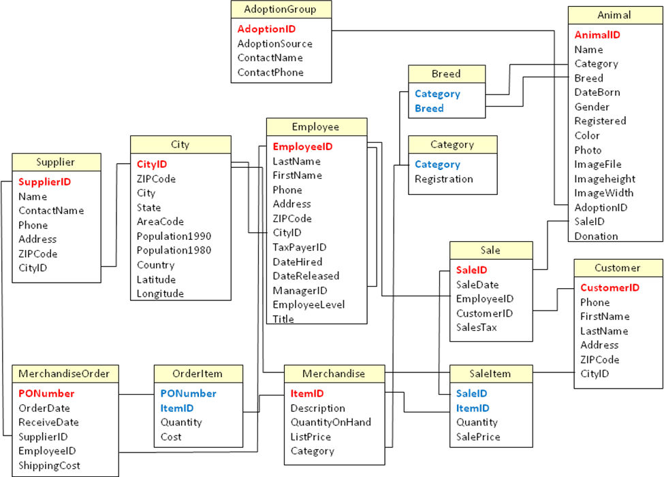
Tables
Notes:
Tables for the Pet Store database. Notice that animals and merchandise are similar, but they are treated separately.

Slide 10
Organization
Single table
Constraints
Computations
Groups/Subtotals
Multiple Tables

Slide 11
Sample Questions
Which animals were born after August 1? List the animals by category and breed. List the categories of animals that are in the Animal list. Which dogs have a donation value greater than $250? Which cats have black in their color? List cats excluding those that are registered or have red in their color. List all dogs who are male and registered or who were born before 01-June-2013 and have white in their color. What is the extended value (price * quantity) for sale items on sale 24? What is the average donation value for animals? | What is the total value of order number 22? How many animals were adopted in each category? How many animals were adopted in each category with total adoptions of more than 10? How many animals born after June 1 were adopted in each category with total adoptions more than 10? List the CustomerID of everyone who bought or adopted something between April 1, 2013 and May 31, 2013. List the names of everyone who bought or adopted something between April 1, 2013 and May 31, 2013. List the name and phone number of anyone who adopted a registered white cat between two given dates.
Notes:
Sample questions for the Pet Store. Most of these are easier since they involve only one table. They represent typical questions that a manager or customer might ask.

Slide 12
Query By Example & SQL
Query04_Fig08
Animal
AnimalID
Name
Category
Breed
DateBorn
Gender
Which animals were born after August 1?
Field | AnimalID | Name | Category | DateBorn
Table | Animal | Animal | Animal | Animal
Sort
Criteria |  |  |  | >’01-Aug-2013’
Or
Note that Access uses # instead of quotes.
#01-Aug-2013#
SELECT AnimalID, Name, Category, Breed
FROM Animal
WHERE DateBorn > ’01-Aug-2013’;
Notes:
Sample query shown in QBE and SQL. Since there is only one table, only three questions need to be answered: What tables? What conditions? What do you want to see?

Slide 13
Basic SQL SELECT
SELECT columns What do you want to see?
FROM tables What tables are involved?
JOIN conditions How are the tables joined?
WHERE criteria What are the constraints?
Notes:
The basic SQL SELECT command matches the four questions you need to create a query. The uppercase letters are used in this text to highlight the SQL keywords. They can also be typed in lowercase.

Slide 14
ORDER BY
SELECT columns
FROM tables
JOIN join columns
WHERE conditions
ORDER BY columns (ASC DESC)
Animal
SELECT Name, Category, Breed
FROM Animal
ORDER BY Category, Breed;
Name Category Breed
Cathy Bird African Grey
Bird Canary
Debbie Bird Cockatiel
Bird Cockatiel
Terry Bird Lovebird
Bird Other
Charles Bird Parakeet
Curtis Bird Parakeet
Ruby Bird Parakeet
Sandy Bird Parrot
Hoyt Bird Parrot
Bird Parrot
AnimalID
Name
Category
Breed
DateBorn
Gender
Field | Name | Category | Breed
Table | Animal | Animal | Animal
Sort |  | Ascending | Ascending
Criteria
Or
Notes:
The ORDER BY clause sorts the output rows. The default is to sort in ascending order, adding the keyword DESC after a column name results in a descending sort. When columns like Category contain duplicate data, use a second column (e.g., Breed) to sort the rows within each category.

Slide 15
DISTINCT
SELECT Category
FROM Animal;
SELECT DISTINCT Category
FROM Animal;
Category
Fish
Dog
Fish
Cat
Cat
Dog
Fish
Dog
Dog
Dog
Fish
Cat
Dog
. . .
Category
Bird
Cat
Dog
Fish
Mammal
Reptile
Spider
Notes:
The DISTINCT keyword eliminates duplicate rows of the output. Without it the animal category is listed for every animal in the database.

Slide 16
Constraints: And
Query04_Fig12
Animal
AnimalID
Name
Category
Breed
DateBorn
Gender
Which dogs have a donation amount greater than $250?.
Field | AnimalID | Name | Category | Donation
Table | Animal | Animal | Animal | Animal
Sort
Criteria |  |  | Dog | >250
Or
SELECT AnimalID, Category, DateBorn
FROM Animal
WHERE Category=N’Dog’ AND Donation>250;
Note the use of N’…’ for Unicode (National) text.
Notes:
Boolean algebra. An example of two conditions connected by AND. QBE uses an AND connector for all conditions listed on the same row.

Slide 17
Pattern Matching
Query04_Fig13
Animal
AnimalID
Name
Category
Breed
DateBorn
Gender
Which cats have black in their color?
Field | AnimalID | Name | Category | Color
Table | Animal | Animal | Animal | Animal
Sort
Criteria |  |  | ‘Cat’ | LIKE ‘%Black%’
Or
SELECT AnimalID, Name, Category, Color
FROM Animal
WHERE Category=N’Cat’ AND Color LIKE N‘%Black%’;
Notes:
Pattern matching. The percent sign matches any characters, so if the word Black appears anywhere in the Color column the LIKE condition is true.

Slide 18
Boolean Algebra
a = 3
b = -1
c = 2
And: Both must be true.
Or: Either one is true.
Not: Reverse the value.
(a > 4) And (b < 0)
F
T
F
(a > 4) Or (b < 0)
F
T
T
NOT (b < 0)
T
F
Notes:
A truth table shows the difference between AND and OR. Both clauses must be true when connected by AND. Only one clause needs to be true when clauses are connected by OR.
Boolean algebra examples. Evaluate each clause separately. Then evaluate the connector. The NOT operator reverses the truth value.

Slide 19
Boolean Algebra
The result is affected by the order
of the operations.
Parentheses indicate that an
operation should be performed first.
With no parentheses, operations are
performed left-to-right.
a = 3
b = -1
c = 2
( (a > 4) AND (b < 0) ) OR (c > 1)
F
T
T
F
T
T
(a > 4) AND ( (b < 0) OR (c > 1) )
Always use parentheses,
so other people can read
and understand your query.
F
T
T
F
T
F
Notes:
Boolean algebra mixing AND and OR operators. The result changes depending on which operator is applied first. You must set the order of evaluation with parentheses. Innermost clauses are evaluated first.

Slide 20
DeMorgan’s Law Example
Query04_Fig17
Animal
AnimalID
Name
Category
Breed
DateBorn
Gender
Customer: "I want to look at a cat, but I don’t want any cats that are registered or that have red in their color."
Field | AnimalID | Category | Registered | Color
Table | Animal | Animal | Animal | Animal
Sort
Criteria |  | ‘Cat’ | Is Null | Not Like ‘%Red%’
Or
SELECT AnimalID, Category, Registered, Color
FROM Animal
WHERE (Category=N‘Cat’) AND
NOT ((Registered is NOT NULL)
OR (Color LIKE N‘%Red%’));
Notes:
Sample problem with negation. Customer knows what he or she does not want. SQL can use NOT, but you should use DeMorgan’s law to negate the Registered and Color statements.

Slide 21
DeMorgan’s Law
Negation of clauses
Not (A And B) becomes Not A Or Not B
Not (A Or B) becomes Not A And Not B
Registered=ASCF
Color=Black
NOT ((Registered is NOT NULL) OR (Color LIKE ‘%Red%’))
T
or
F
not
T
F
(Registered is NULL) AND NOT (Color LIKE ‘%Red%’)
F
not
F
and
T
F
Notes:
DeMorgan’s law. Compound statements are negated by reversing each item and swapping the connector (AND for OR). Use truth tables to evaluate the examples.

Slide 22
Conditions: And, Or
Query04_Fig19
Animal
AnimalID
Name
Category
Breed
DateBorn
Gender
List all dogs who are male and registered or who were born before 6/1/2013 and have white in their color.
Field | AnimalID | Category | Gender | Registered | DateBorn | Color
Table | Animal | Animal | Animal | Animal | Animal | Animal
Sort
Criteria |  | ‘Dog’ | ‘Male’ | Is Not Null
Or |  | ‘Dog’ |  |  | < ’01-Jun-2013’ | Like ‘%White%’
SELECT AnimalID, Category, Gender, Registered, DateBorn, Color
FROM Animal
WHERE (( Category=N‘Dog’) AND
( ( (Gender=N‘Male’) AND (Registered Is Not Null) ) OR
( (DateBorn<’01-Jun-2013’) AND (Color Like N‘%White%’) ) ) );
Notes:
Boolean criteria—mixing AND and OR. Notice the use of parentheses in SQL to ensure the clauses are interpreted in the right order. Also note that QBE required duplicating the condition for “Dog” in both rows.

Slide 23
Useful Where Conditions
Comparisons | Examples
Operators | <, =, >, <>, >= BETWEEN, LIKE, IN
Numbers | AccountBalance > 200
Text Simple Pattern match one Pattern match any | Name > N‘Jones’ License LIKE N‘A_ _82_’ Name LIKE N‘J%’
Dates | SaleDate BETWEEN ’15-Aug-2013’ AND ’31-Aug-2013’
Missing Data | City IS NULL
Negation | Name IS NOT NULL
Sets | Category IN (N‘Cat’, N‘Dog’, N‘Hamster’)
Notes:
Common comparisons used in the WHERE clause. The BETWEEN clause is useful for dates but can be used for any type of data.

Slide 24
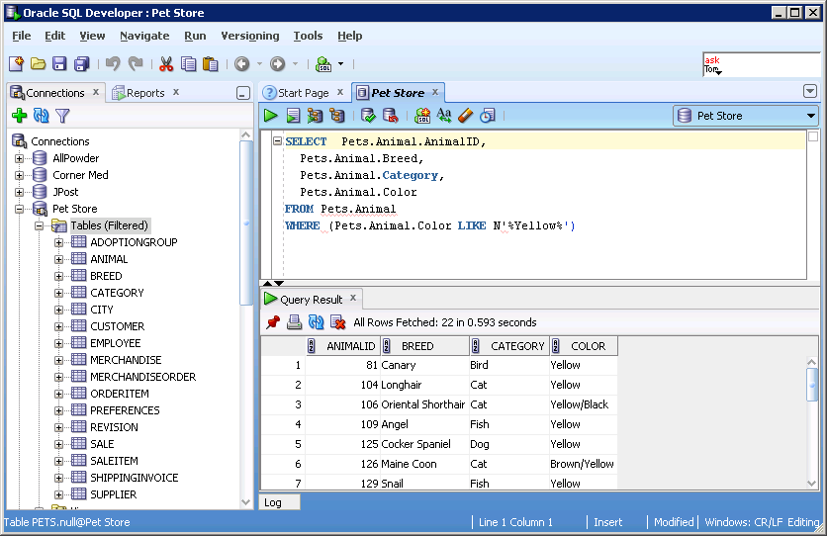
Oracle Views: SQL Developer

Slide 25
Oracle Views and SQL
CREATE VIEW Pets.Example AS
SELECT Pets.Animal.AnimalID,
Pets.Animal.Breed,
Pets.Animal.Category,
Pets.Animal.Color
FROM Pets.Animal
WHERE (Pets.Animal.Color LIKE N‘%Yellow%’)
The CREATE VIEW command saves it with the specified name.

Slide 26
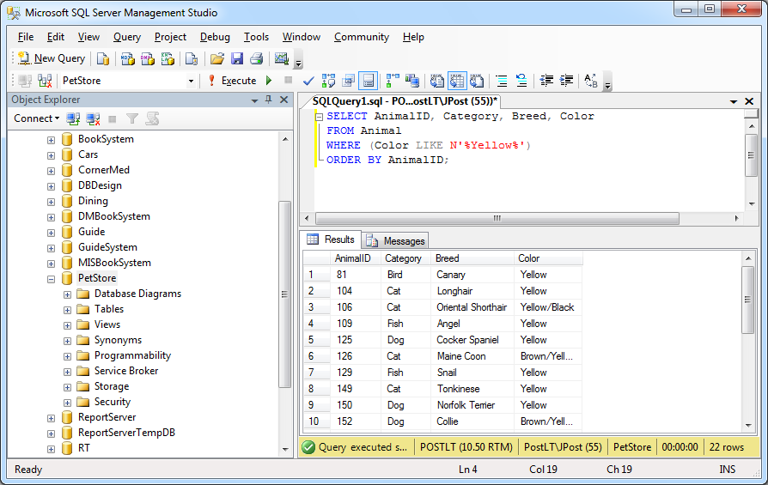
SQL Server: Management Studio

Slide 27
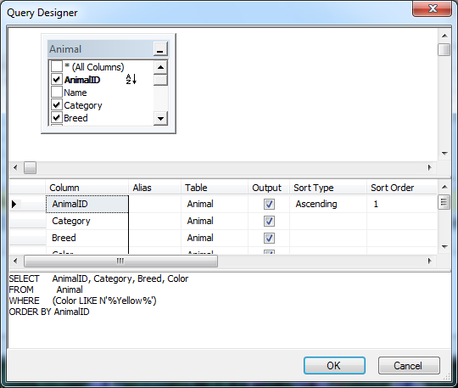
SQL Server Query Designer

Slide 28
Simple Computations
Query04_Fig22
SaleItem(SaleID, ItemID, SalePrice, Quantity)
Select SaleID, ItemID, SalePrice, Quantity, SalePrice*Quantity As Extended
From SaleItem;
SaleID ItemID Price Quantity Extended
24 25 2.70 3 8.10
24 26 5.40 2 10.80
24 27 31.50 1 31.50
Basic computations (+ - * /) can be performed on numeric data.
The new display column should be given a meaningful name.
Notes:
Computations. Basic computations (+ - * /) can be performed on numeric data in a query. The new display column should be given a meaningful name.

Slide 29
Computations: Aggregation--Avg
Query04_Fig23
What is the average donation for all animals?
Animal
Sum
Avg
Min
Max
Count
StDev or StdDev
Var
AnimalID
Name
Category
Donation
Field | SalePrice
Table | SaleAnimal
Total | Avg
Sort
Criteria
Or
SELECT Avg(Donation) AS AvgOfDonation
FROM Animal;
Notes:
Aggregation functions. Sample query in QBE and SQL to answer: What is the average sale price for all animals? Note that with Microsoft Access you have to click the summation button on the toolbar (Σ) to display the Total line on the QBE grid.

Slide 30
Computations (Math Operators)
Query04_Fig24
OrderItem
PONumber
ItemID
Quantity
Cost
SELECT Sum(Quantity*Cost) AS OrderTotal
FROM OrderItem
WHERE (PONumber=22);
Field | PONumber | OrderTotal: Quantity*Cost
Table | OrderItem | OrderItem
Total
Sort
Criteria | =22
Or
OrderTotal
1798.28
What is the total value of the order for PONumber 22?
Use any common math operators on numeric data.
Operate on data in one row at a time.
Notes:
Computations. Row-by-row computations (Quantity*Cost) can be performed within an aggregation function (Sum), but only the final total will be displayed in the result.

Slide 31
SQL Differences
Task | Access | SQL Server | Oracle
Strings Concatenation Length Upper case Lower case Partial string | FName & “ “ & LName Len(LName) UCase(LName) LCase(LName) MID(LName,2,3) | FName + ‘ ‘ + LName Length(LName) Upper(LName) Lower(LName) Substring(LName,2,3) | FName || ‘ ‘ || LName LENGTH(LName) UPPER(LName) LOWER(LName) SUBSTR(LName,2,3)
Dates Today Month Day Year Date arithmetic | Date( ), Time( ), Now( ) Month(myDate) Day(myDate) Year(myDate) DateAdd DateDiff | GetDate() DateName(month, myDate) DatePart(day, myDate) DatePart(year, myDate) DateAdd DateDiff | SYSDATE TRUNC(myDate, ‘mm’) TRUNC (myDate, ‘dd’) TRUNC (myDate, ‘yyyy’) ADD_MONTHS MONTHS_BETWEEN LAST_DAY
Formatting | Format(item, format) | Str(item, length, decimal) Cast, Convert | TO_CHAR(item, format) TO_DATE(item, format)
Numbers Math functions Exponentiation Aggregation Statistics | Cos, Sin, Tan, Sqrt 2 ^ 3 Min, Max, Sum, Count, Avg StDev, Var | Cos, Sin, Tan, Sqrt Power(2, 3) Min, Max, Sum, Count, Avg, StDev, Var, LinReqSlope, Correlation | COS, SIN, TAN, SQRT POWER(2,3) MIN, MAX, SUM, COUNT, AVG, STDDEV, VARIANCE, REGR, CORR
Notes:
Differences in SQL functions. This table shows some of the differences that are commonly encountered when working with these database systems. Queries are often used to perform basic computations, but the syntax for handling these computations depends on the specific DBMS.

Slide 32
Subtotals (Where)
Query04_Fig24a
Animal
AnimalID
Name
Category
Breed
DateBorn
Gender
SELECT Count(AnimalID) AS CountOfAnimalID
FROM Animal
WHERE (Category = N‘Cat’);
Field | AnimalID | Category
Table | Animal | Animal
Total | Count | Where
Sort
Criteria |  | ‘Cat’
Or
How many cats are in the Animal list?

Slide 33
Groups and Subtotals
Query04_Fig26
Animal
AnimalID
Name
Category
Breed
DateBorn
Gender
Category CountOfAnimalID
Dog 100
Cat 47
Bird 15
Fish 14
Reptile 6
Mammal 6
Spider 3
Field | Category | AnimalID
Table | Animal | Animal
Total | Group By | Count
Sort |  | Descending
Criteria
Or
SELECT Category, Count(AnimalID) AS CountOfAnimalID
FROM Animal
GROUP BY Category
ORDER BY Count(AnimalID) DESC;
Count the number of animals in each category.
You could type in each WHERE clause, but that is slow.
And you would have to know all of the Category values.
Notes:
GROUP BY computes subtotals and counts for each type of animal. This approach is much more efficient than trying to create a WHERE clause for each type of animal. To convert business questions to SQL, watch for phrases such as by or for each which usually signify the use of the GROUP BY clause.

Slide 34
Conditions on Totals (Having)
Query04_Fig27
Animal
AnimalID
Name
Category
Breed
DateBorn
Gender
Category CountOfAnimalID
Dog 100
Cat 47
Bird 15
Fish 14
Field | Category | AnimalID
Table | Animal | Animal
Total | Group By | Count
Sort |  | Descending
Criteria |  | >10
Or
Count number of Animals in each Category, but only list them if more than 10.
SELECT Category, Count(AnimalID) AS CountOfAnimalID
FROM Animal
GROUP BY Category
HAVING Count(AnimalID) > 10
ORDER BY Count(AnimalID) DESC;
Notes:
Limiting the output with a HAVING clause. The GROUP BY clause with the Count function provides a count of the number of animals in each category. The HAVING clause restricts the output to only those categories having more than 10 animals.

Slide 35
Where (Detail) v Having (Group)
Query04_Fig28
Animal
AnimalID
Name
Category
Breed
DateBorn
Gender
Category CountOfAnimalID
Dog 30
Cat 18
Field | Category | AnimalID | DateBorn
Table | Animal | Animal | Animal
Total | Group By | Count | Where
Sort |  | Descending
Criteria |  | >10 | >’01-Jun-2013’
Or
Count Animals born after 6/1/2013 in each Category, but only list Category if more than 10.
SELECT Category, Count(AnimalID) AS CountOfAnimalID
FROM Animal
WHERE DateBorn > ’01-Jun-2013’
GROUP BY Category
HAVING Count(AnimalID) > 10
ORDER BY Count(AnimalID) DESC;
Notes:
WHERE versus HAVING. Count the animals born after June 1, 2007, in each category, but list the category only if it has more than 10 of these animals. The WHERE clause first determines whether each row will be used in the computation. The GROUP BY clause produces the total count for each category. The HAVING clause restricts the output to only those categories with more than 10 animals.

Slide 36
Multiple Tables (Intro & Distinct)
Query04_Fig29
Sale
CustomerID
6
8
14
19
22
24
28
36
37
38
39
42
50
57
58
63
74
80
90
SaleID
SaleDate
EmployeeID
CustomerID
SalesTax
List the CustomerID of everyone who bought something between 01-Apr-2013 and 31-May-2013.
Field | CustomerID | SaleDate
Table | Sale | Sale
Sort | Ascending
Criteria |  | Between ’01-Apr-2013’ And ’31-May-2013’
Or
SELECT DISTINCT CustomerID
FROM Sale
WHERE (SaleDate Between ’01-Apr-2013’
And ’31-May-2013’)
ORDER BY CustomerID;
Notes:
List the CustomerID of everyone who bought something between April 1, 2007 and May 31, 2007. Most people would prefer to see the name and address of the customer—those attributes are in the Customer table.

Slide 37
Joining Tables
Query04_Fig30
Sale
Customer
CustomerID LastName
22 Adkins
57 Carter
38 Franklin
42 Froedge
63 Grimes
74 Hinton
36 Holland
6 Hopkins
50 Lee
58 McCain
…
SaleID
SaleDate
EmployeeID
CustomerID
CustomerID
Phone
FirstName
LastName
Field | CustomerID | LastName | SaleDate
Table | Sale | Customer | Sale
Sort |  | Ascending
Criteria |  |  | Between ’01-Apr-2013’ And ’31-May-2013’
Or
SELECT DISTINCT Sale.CustomerID, Customer.LastName
FROM Customer
INNER JOIN Sale ON Customer.CustomerID = Sale.CustomerID
WHERE (SaleDate Between ’01-Apr-2013’ And ’31-May-2013’)
ORDER BY Customer.LastName;
List LastNames of Customers who bought between 4/1/2013 and 5/31/2013.
Notes:
Joining tables causes the rows to be matched based on the columns in the JOIN statement. You can then use data from either table. The business question is, List the last name of customers who bought something between April 1, 2007, and May 31, 2007.

Slide 38
SQL JOIN
FROM table1
INNER JOIN table2
ON table1.column = table2.column
SQL 92/Current syntax
FROM table1, table2
WHERE table1.column = table2.column
SQL 89 syntax (Oracle)
FROM table1, table2
JOIN table1.column = table2.column
Informal syntax
Notes:
SQL 92 and SQL 89 syntax to join tables. The informal syntax cannot be used with a DBMS, but it is easier to read when you need to combine many tables.
Joining multiple tables. With SQL 92 syntax, first join two tables within parentheses and then add a table and its JOIN condition. When you want to focus on the tables being joined, use the easier notation—just remember that it must be converted to SQL 92 syntax for the computer to understand it.

Slide 39
Syntax for Three Tables
SQL ‘92 syntax to join three tables
FROM Table1
INNER JOIN Table2
ON Table2.ColA = Table3.ColA
INNER JOIN Table3
ON Table1.ColB = Table2.ColB
Easier notation, but not correct syntax
FROM Table1, Table2, Table3
JOIN Table1.ColB = Table2.ColB
Table2.ColA = Table3.ColA

Slide 40
Multiple Tables (Many)
Query04_Fig32
Animal
Sale
Customer
AnimalID
Name
Category
SaleID
SaleID
SaleDate
EmployeeID
CustomerID
CustomerID
Phone
FirstName
LastName
Field | LastName | Phone | Category | Registered | Color | SaleDate
Table | Customer | Customer | Animal | Animal | Animal | Sale
Sort | Ascending
Criteria |  |  | ‘Cat’ | Is Not Null | Like ‘%White%’ | Between ’01-Jun-2013’ And ’31-Dec-2013’
Or
SELECT Customer.LastName, Customer.Phone
FROM Customer
INNER JOIN Sale ON Customer.CustomerID=Sale.CustomerID
INNER JOIN Animal ON Sale.SaleID=Animal.SaleID
WHERE ((Animal.Category=N‘Cat’) AND (Animal.Registered Is Not Null)
AND (Color Like N‘%White%’) AND (SaleDate Between ’01-Jun-2013’ And ’31-Dec-2013’));
List the Last Name and Phone of anyone who adopted a registered White cat between 6/1/2013 and 12/31/2013.
Notes:
Joining multiple tables. QBE makes joining multiple tables relatively easy—just connect the tables with a line. With SQL, just start with two tables and expand outward; for example, start with (Animal INNER JOIN SaleAnimal ON Animal.AnimalID = SaleAnimal.AnimalID), and then add a third table (Sale) with its JOIN.

Slide 41
Oracle
SELECT lastname, phone
FROM customer inner join sale ON customer.customerid = sale.customerid
INNER JOIN saleanimal ONsale.saleid = saleanimal.saleid
INNER JOIN animal ONsaleanimal.animalid = animal.animalid
WHERE (category = N'Cat') and (Registered is not null)
AND (color like N'%White%')
AND (saledate between '01-Jun-2013' and '31-Dec-2013')
;

Slide 42
Building a Query
List the Last Name and Phone of anyone who bought a registered White cat between 6/1/10 and 12/31/10.
Identify the tables involved.
Look at the columns you want to see.
LastName, Phone: Customer
Look at the columns used in the constraints.
Registered, Color, Category: Animal
Sale Date: Sale
Find connector tables.
To connect Animal to Sale: SaleAnimal
Select the desired columns and test the query.
Enter the constraints.
Set Order By columns.
Add Group By columns.
Add summary computations to the SELECT statement.

Slide 43
Joining Tables (Hints)
Build Relationships First
Drag and drop
From one side to many side
Avoid multiple ties between tables
SQL
FROM Table1
INNER JOIN Table2
ON Table1.ColA = Table2.ColB
Join columns are often keys, but they can be any columns--as long as the domains (types of data) match.
Multiple Tables
FROM (Table1
INNER JOIN Table2
ON T1.ColA = T2.ColB )
INNER JOIN Table3
ON T3.ColC = T3.ColD
Shorter Notation
FROM T1, T2, T3
JOIN T1.ColA = T2.ColB
T1.ColC = T3.ColD
Shorter Notation is not correct syntax, but it is easier to write.

Slide 44
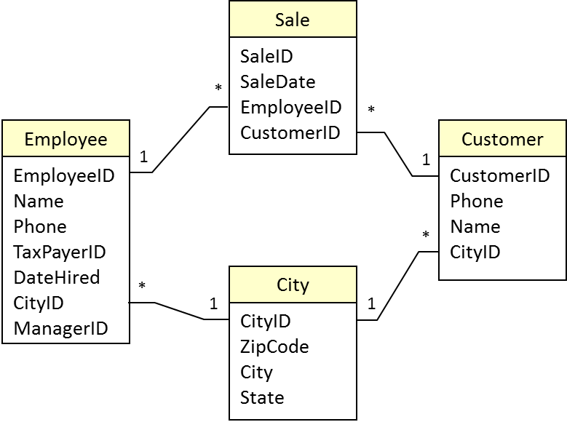
Tables with Multiple Joins
Potential problem with three or more tables.
Access uses predefined relationships to automatically determine JOINs.
JOINS might loop.
Most queries will not work with loops.
A query with these four tables with four JOINS would only return rows where the Employee had the same CityID as the Customer. If you only need the Customer city, just delete the JOIN between Employee and City. If you want both cities, add the City table again as a fifth table.
Notes:
A query with these four tables with four JOINS would return only rows where the Employee had the same CityID as the Supplier. If you need only the supplier city, just delete the JOIN between Employee and CityID. If you want both cities, add a second copy of the City table as a fifth table.

Slide 45
Table Alias
Query04_Fig35
City
Customer
Sale
Employee
City_1
CityID
ZipCode
City
State
CustomerID
Phone
Name
CityID
SaleID
SaleDate
EmployeeID
CustomerID
EmployeeID
LastName
ZipCode
CityID
CityID
ZipCode
City
State
SELECT Customer.CustomerID, Customer.CityID, City.City, Sale.EmployeeID, Employee.LastName, Employee.CityID, City_1.City
FROM (City INNER JOIN (Customer INNER JOIN (Employee INNER JOIN Sale ON Employee.EmployeeID = Sale.EmployeeID) ON Customer.CustomerID = Sale.CustomerID) ON City.CityID = Customer.CityID) INNER JOIN City AS City_1 ON Employee.CityID = City_1.CityID;
CID Customer.CityID City.City EID LastName Employee.CityID City_1.City
15 11013 Galveston 1 Reeves 11060 Lackland AFB
53 11559 Beaver Dam 2 Gibson 9146 Roanoke Rapids
38 11701 Laramie 3 Reasoner 8313 Springfield
66 7935 Danville 8 Carpenter 10592 Philadelphia
5 9175 Fargo 3 Reasoner 8313 Springfield
Notes:
Table alias. The City table is used twice. The second time, it is given the alias City2 and treated as a separate table. Hence, different cities can be retrieved for Supplier and for Employee.

Slide 46
Saved Query: Create View
Save a query
Faster: only enter once
Faster: only analyze once
Any SELECT statement
Can use the View within other SQL queries.
CREATE VIEW Kittens AS
SELECT *
FROM Animal
WHERE (Category = N‘Cat’) AND (Today - DateBorn < 180);
SELECT Avg(ListPrice)
FROM Kittens
WHERE (Color LIKE N‘%Black%’);
Notes:
Views. Views are saved queries that can be run at any time. They improve performance because they have to be entered only once, and the DBMS has to analyze them only once.
Queries based on views. Views can be used within other queries.

Slide 47
Updateable Views
Query04_Fig38
SaleItem(SaleID, ItemID, Quantity)
Merchandise(ItemID, Description)
SaleLine(SaleID, ItemID, Description, Quantity)
To be updateable, a view must focus on one primary table. (OrderItem)
Goal is to change data in only one table. (OrderItem)
Data can be displayed from other tables. (Item)
Never include or attempt to change primary keys from more than one table. (Item.ItemID)
Notes:
Updatable view. The OrderLine view is designed to change data in only one table (OrderItem). The Description from the Item table is used for display to help the user verify that the ItemID was entered correctly.

Slide 48
Non Updateable View
Query04_Fig37
SaleItem(SaleID, ItemID, Quantity)
Merchandise(ItemID, Description)
121 57 3
121 82 2
122 57 1
57 Cat food
58 Dog food
59 Bird food
SaleLine(SaleID, Item.ItemID, Description, Quantity)
121 57 Cat food 3
121 82 Bird feeder 2
122 57 Cat food 1
32
If you attempt to change the Item.ItemID in the OrderLineView:
You will simply change the primary key value in the Item table.
It will not add a new row to the OrderItem table.
Notes:
Nonupdatable view. Do not mix primary keys from different tables. If this view works at all, it will not do what you want. If you try to change the ItemID from 57 to 32, you will only change the ItemID of cat food. You will not be able to enter new data into the OrderItem table.

Slide 49
Simple XML Example
<shipment>
<ShipID>1573</ShipID>
<ShipDate>15-May-2013</ShipDate>
<Items>
<Item>
<ItemID>15</ItemID>
<Description>Leash</Description>
<Quantity>20</Quantity>
<Price>8.95</Price>
</Item>
<Item>
<ItemID>32</ItemID>
<Description>Collar</Description>
<Quantity>25</Quantity>
<Price>14.50</Price>
</Item>
</Items>
</shipment>

Slide 50
XML Schema
<xsd:schema xmlns:xsd=“http://www.w3.org/2001/XMLSchema” >
<xsd:element name=“shipment”>
<xsd:complexType>
<xsd:element name=“ShipID” minOccurs=“0” type=“xsd:int” />
<xsd:element name=“ShipDate” minOccurs=“0” type=“xsd:date” />
<xsd:sequence>
<xsd:element ref=“Items” minOccurs=“0” maxOccurs=“unbounded” />
</xsd:sequence>
</xsd:complexType
</xsd:element>
<xsd:element name=“Items”>
<xsd:complexType>
<xsd:sequence>
<xsd:element name=“ItemID” minOccurs=“0” type=“xsd:int” />
<xsd:element name=“Description” minOccurs=“0” />
<xsd:element name=“Quantity” minOccurs=“0” type=“xsd:int” />
<xsd:element name=“Price” minOccurs=“0” type=“xsd:double” />
</xsd:sequence>
</xsd:complexType>
</xsd:element>
</xsd:schema>

Slide 51
SQL Server Example
CREATE TABLE ShippingInvoice (
ShippingID int IDENTITY(1,1) NOT NULL,
InvoiceDate date NULL,
OrderID int NULL,
Contents xml NULL,
CONSTRAINT pk_ShippingInvoice PRIMARY KEY (ShippingID)
)
GO
INSERT INTO ShippingInvoice (InvoiceDate, OrderID, Contents)
VALUES (’19-May-2013’, 12, ‘
<shipment>
<ShipID>1573</ShipID>
<ShipDate>15-May-2013</ShipDate>
<Items>
<Item><ItemID>15</ItemID><Description>Leash</Description>
<Quantity>20</Quantity><Price>8.95</Price></Item>
<Item><ItemID>32</ItemID><Description>Collar</Description>
<Quantity>25</Quantity><Price>14.50</Price></Item>
</Items>
</shipment>
‘);

Slide 52
Oracle Example
CREATE TABLE ShippingInvoice (
ShippingID number NOT NULL,
InvoiceDate date,
OrderID number,
xContents XMLType,
CONSTRAINT pk_ShippingInvoice PRIMARY KEY (ShippingID)
);
INSERT INTO ShippingInvoice (ShippingID, InvoiceDate, OrderID, xContents)
VALUES (1, '19-May-2013', 12, '
<shipment>
<ShipID>1573</ShipID>
<ShipDate>15-May-2013</ShipDate>
<Items>
<Item><ItemID>15</ItemID><Description>Leash</Description>
<Quantity>20</Quantity><Price>8.95</Price></Item>
<Item><ItemID>32</ItemID><Description>Collar</Description>
<Quantity>25</Quantity><Price>14.50</Price></Item>
</Items>
</shipment>
');

Slide 53
XQuery Example
SELECT Contents.query('shipment/Items') As ItemList
FROM ShippingInvoice
WHERE ShippingID=1;
<Items>
<Item>
<ItemID>15</ItemID>
<Description>Leash</Description>
<Quantity>20</Quantity>
<Price>8.95</Price>
</Item>
<Item>
<ItemID>32</ItemID>
<Description>Collar</Description>
<Quantity>25</Quantity>
<Price>14.50</Price>
</Item>
</Items>
Extract a portion of the XML document: The Items list.

Slide 54
XQuery in Oracle
select extract(xContents, '
/shipment/Items
') As ListResult
from ShippingInvoice
where ShippingID=1;

Slide 55
XQuery Example with Comparison
SELECT Contents.query('
/shipment/Items/Item[ItemID=15]
') As ItemList
FROM ShippingInvoice
WHERE ShippingID=1;
<Item>
<ItemID>15</ItemID>
<Description>Leash</Description>
<Quantity>20</Quantity>
<Price>8.95</Price>
</Item>
Find a node based on the value of an element. ItemID=15
(Could use multiple conditions.)

Slide 56
XQuery Return One Element
SELECT Contents.query('
/shipment/Items/Item[ItemID=15]/Quantity
') As ItemList
FROM ShippingInvoice
WHERE ShippingID=1;
<Quantity>20</Quantity>
Return a single element from within a (found) node.

Slide 57
XQuery FLWOR
SELECT Contents.query('
for $item in /shipment/Items/Item
where $item/ItemID=15
return data($item/Quantity)
') As ItemList
FROM ShippingInvoice
WHERE ShippingID=1;
20
FLWOR example:
for
let (not in SQL Server)
where
order by
return
It also supports if/then/else

Slide 58
Regular Expressions (RegEx)
Basic LIKE commands are limiting.
MySQL and Oracle (and others) have built-in functions to use RegEx for complex pattern matching.
SQL Server (2005 and above) can create a C# common-language runtime (CLR) function to implement regular expressions.
Oracle Functions:
Regexp_Count, Regexp_Instr, Regexp_Like, Regexp_Replace.
Regexp_Like is used in the WHERE clause similar to an extended LIKE clause:
SELECT …
FROM …
WHERE Regexp_Like(testcolumn, ‘regexp pattern’);

Slide 59
SQL Server Setup
Start Visual Studio.
Open a New Project: Visual C#, Database, SQL Server: Visual C# SQL CLR Database Project.
Choose the Pet Store database.
Right-click the project name, Add, User Defined Function: RegexMatch.cs.
If using VS 2010, right-click project name, Properties. Change .NET version from 4.0 down to 3.5 (not the client).
Modify or replace the function code (in the next figure).
Build then Build, Deploy.
In SQL Server Management Studio, open the database and enable CLR functions.
EXEC sp_configure 'show advanced options' , '1';
reconfigure;
EXEC sp_configure 'clr enabled' , '1' ;
reconfigure;
EXEC sp_configure 'show advanced options' , '0';
reconfigure;

Slide 60
C# RegexMatch Function
using System;
using System.Data;
using System.Data.SqlClient;
using System.Data.SqlTypes;
using System.Text.RegularExpressions;
using Microsoft.SqlServer.Server;
public partial class UserDefinedFunctions
{
public static readonly RegexOptions Options =
RegexOptions.IgnorePatternWhitespace |
RegexOptions.Singleline;
[Microsoft.SqlServer.Server.SqlFunction]
public static SqlBoolean RegexMatch(
SqlChars input, SqlString pattern)
{
Regex regex = new Regex( pattern.Value, Options );
return regex.IsMatch( new string( input.Value ) );
}
};

Slide 61
RegEx Simple Patterns
SELECT *
FROM Merchandise
WHERE dbo.RegexMatch(Description, N'Small') <> 0;
1 Dog Kennel-Small 11 45.00 Dog
5 Cat Bed-Small 36 25.00 Cat
32 Collar-Dog-Small 47 12.00 Dog
A simple string searches for that pattern (case-sensitive) anywhere in the Description text.

Slide 62
Groups of Characters
[a-z] Match one lower-case letter.
[AEIOU] Match one of the vowels.
[123] Match one of the numbers.
[^0-9] Match a character not a digit.
^ is “not”
SELECT *
FROM Customer
WHERE dbo.RegexMatch(LastName, N'H[ai]ll') <> 0;
78 (505) 646-2748 Elaine Hall …
Matches a customer last name of Hill or Hall.

Slide 63
RegEx Special Symbols
. (dot) | Match any single character.
\n | Match newline character.
\t | Match the tab character.
\d | Match a digit [0-9].
\D | Match a non-digit [^0-9].
\w | Match an alphanumeric character.
\W | Match a non-alphanumeric character.
\s | Match a whitespace character.
\S | Match a non-whitespace character.
\ | Escape special characters, such as \.
^ | Match the beginning of the input.
$ | Match the end of the input.

Slide 64
RegEx Repetition
* Match zero or infinite of the pattern before the asterisk.
? Match zero or one of the pattern before.
+ Match one or more of the pattern before.
SELECT *
FROM Merchandise
WHERE dbo.RegexMatch(Description, N'n*e')<>0;
>>>> Match any description that contains the letter “e”.
(Because the * means the n is optional.
SELECT *
FROM Merchandise
WHERE dbo.RegexMatch(Description, N'n+e')<>0;
>>>> Match any description that contains the letter “n” followed by any characters and then the letter “e”.
(Because the + means the n is required.

Slide 65
RegEx Exact Repetition
{#} such as {3} Exact number of repetitions.
SELECT dbo.RegexMatch(N'123-45-6789', N'^\d{3}-\d{2}-\d{4}$' )
Pattern to test a U.S. Social Security Number. The string must begin with 3 digits, then a hyphen, then 2 digits, another hyphen, and end with exactly 4 digits. From MSDN article.

Slide 66
RegEx Groups of Characters
Parentheses create a group pattern:
(ab)+ matches ab or abab, but not acb.
(aa|bb)+ matches aa, or bbcc, but not abab.
Anything in parentheses is like an “AND” condition where the entire pattern must exist.
The vertical bar (|) is an “OR” condition where either pattern or both are tested to exist.
All of these patterns can be combined into long, complex patterns.
It can be difficult to read or debug patterns created by other people.
When you create patterns, document them!

Slide 67
SQL Syntax: ALTER TABLE
ALTER TABLE table
ADD COLUMN column datatype (size)
DROP COLUMN column
CREATE TABLE
See also:
DROP TABLE

Slide 68
SQL Syntax: COMMIT
COMMIT WORK
See also:
ROLLBACK

Slide 69
SQL Syntax: CREATE INDEX
CREATE [UNIQUE] INDEX index
ON table (column1, column2, … )
WITH {PRIMARY | DISALLOW NULL | IGNORE NULL}
See also:
CREATE TABLE

Slide 70
SQL Syntax: CREATE TABLE
CREATE TABLE table
(
column1 datatype (size) [NOT NULL] [index1] ,
column2 datatype (size) [NOT NULL] [index2],
… ,
CONSTRAINT pkname PRIMARY KEY (column, …),
CONSTRAINT fkname FOREIGN KEY (column)
REFERENCES existing_table (key_column)
ON DELETE CASCASDE
)
ALTER TABLE
See also:
DROP TABLE

Slide 71
SQL Syntax: CREATE VIEW
CREATE VIEW viewname AS
SELECT …
See also:
SELECT

Slide 72
SQL Syntax: DELETE
DELETE
FROM table
WHERE condition
See also:
DROP

Slide 73
SQL Syntax: DROP
DROP INDEX index ON table
DROP TABLE
DROP VIEW
See also:
DELETE

Slide 74
SQL Syntax: INSERT
INSERT INTO table (column1, column2, …)
VALUES (value1, value2, … )
INSERT INTO newtable (column1, column2, …)
SELECT …
See also:
SELECT

Slide 75
SQL Syntax: GRANT
GRANT privilege privileges
ON object ALL, ALTER, DELETE, INDEX,
TO user | PUBLIC INSERT, SELECT, UPDATE
See also:
REVOKE

Slide 76
SQL Syntax: REVOKE
REVOKE privilege privileges
ON object ALL, ALTER, DELETE, INDEX,
FROM user | PUBLIC INSERT, SELECT, UPDATE
See also:
GRANT

Slide 77
SQL Syntax: ROLLBACK
SAVEPOINT savepoint {optional}
ROLLBACK WORK
TO savepoint
See also:
COMMIT

Slide 78
SQL Syntax: SELECT
SELECT DISTINCT table.column {AS alias} , . . .
FROM table/query
INNER JOIN table/query ON T1.ColA = T2.ColB
WHERE (condition)
GROUP BY column
HAVING (group condition)
ORDER BY table.column
{ UNION, INTERSECT, EXCEPT … }

Slide 79
SQL Syntax: SELECT INTO
SELECT column1, column2, …
INTO newtable
FROM tables
WHERE condition
See also:
SELECT

Slide 80
SQL Syntax: UPDATE
UPDATE TABLE table
SET column1 = value1, column2 = value2, …
WHERE condition
See also:
DELETE

