Slide 1
Database Management Systems
Chapter 6
Forms and Reports

Slide 2
Objectives
How do users interact with the database?
What is the difference between a good form and a bad form?
What common structures are used in forms?
What are the main steps used to create forms?
Can form usability be improved?
What are the basic roles of reports?

Slide 3
Usability
Never give users direct access to tables!
Consider SaleItem: SaleID, ItemID, SalePrice, Quantity
  Users will not understand the table.
  They will not enter data correctly.
  They will be frustrated.
Even for simple tables such as Customer, use a form.
Create Forms to enter data.
Create Reports (and interactive forms) to examine data.
Forms must be intuitive and easy to use.
  Need to match the forms to what the users understand and the way they work.
  Follow current interface practices and standards (which evolve).

Slide 4
Uses of Forms
Collect Data
Display Query Results
Display Analysis and Computations
Switchboard for other Forms and Reports
Direct Manipulation of Objects
  Graphics
  Drag and Drop and touch
Notes:
Basic uses of database forms. It is important to understand the use of a form, since forms designed for data collection will be different from those designed to analyze data.

Slide 5
Human Factors Design
User Control
  Match user tasks.
  Application responds to user control & events.
  User customization
Consistency
  Layout, Design & colors
  Actions
Clarity
  Organization
  Purpose
  Terminology
Aesthetics
  Art to enhance, graphics
  Sound
Feedback
  Methods
    Visual
    Text
    Audio
  Uses
    Acceptance of input
    Changes to data
    Completion of tasks
    Events / Activation
Forgiveness
  Anticipation and correction of errors
  Confirmation on delete and updates
  Backup and recovery
Notes:
Basic human factors design elements. All designs should be evaluated in terms of these basic features.

Slide 6
Interface / Accessibility
Multiple Input Methods
  Keyboard
  Mouse
  Voice
Multiple Output
  Visual
  Sound
  Color
Some Suggestions:
  Beware of Red/Green.
  Avoid requiring rapid user responses.
  Avoid rapid flashing on the screen.
  Give users customization options.
    Volume
    Color
    Typefaces & Fonts

Slide 7
Standard Form Controls
Label
Last Name
Text box
City
Drop down list or ComboBox
Option or Radio button
Individual
Corporate
Animal Interests
Bird
Check box
x
Cat
Save
Button
x
Dog
Reptile
Notes:
Common form controls. All DBMSs have these basic controls. Labels and text boxes are used the most. Round option buttons are used for mutually exclusive items.

Slide 8
Windows Interface Standards
The Windows Interface: An Application Design Guide (Microsoft)
Navigation and Choices
  Mouse, Icons
  Keyboard, Short-cuts
  Menus
Selections from a list
  Single
  Contiguous Multiple
  Disjoint Multiple
Focus
  Outline box
  Cursor
Manipulation
  Activation
  Drag and Drop
Feedback
  Progress indicators and status gauges
  Flashing
  Tool tips
  Status bar
  3-D controls
  Message boxes

Slide 9
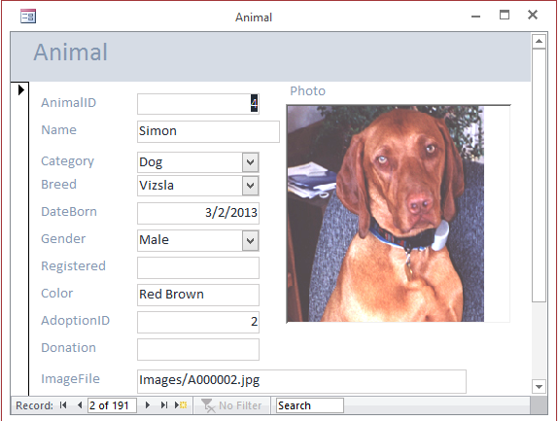
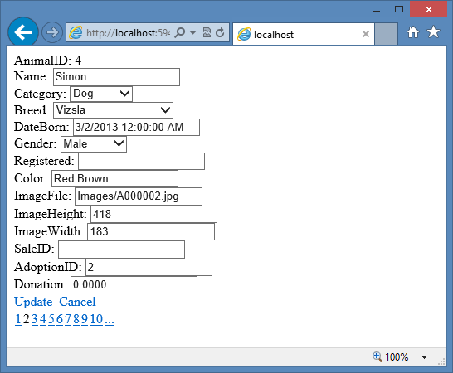
Common Form Structure
Title
Data-bound controls
Record selection

Slide 10
Foreign Keys and Drop Down Lists
Customer Table
CID | Last | First | Phone
113 | Brown | Sue | 2223
115 | Jones | Mary | 0394
116 | Sanchez | David | 3958
Query: display list
Sales Form
Sale ID
298
113 Brown, Sue
115 Jones, Mary
116 Sanchez, David
Sale Date
6/1/…
Customer
Jones, Mary
Selected value
Sales Table
SaleID | SaleDate | CID
298 | 6/1/… | 115
Notes:
Drop down list for foreign key link. The values displayed in the list come from the Customer table. When the user selects one customer, the matching ID value is stored in the Sales table that underlies the Sales form.

Slide 11
User Interface—International
Language and characters
Currency
Time zones
Time and date formats
Calendar—starting day
Number formats
Country names and maps
National ID numbers—privacy
Notes:
Common internationalization issues. Applications that will be used by people in different nations need to adapt to national conventions as much as possible.

Slide 12
International Attributes
Language
Character sets and punctuation marks
Sorting
Data formats
  Date
  Time
  Metric v English
  Currency symbol and format
  Separators (decimal, . . .)
  Phone numbers
    Separators
    International code prefix
  Postal codes
  National ID Numbers

Slide 13
International: Multiple Languages
English
LastNameLabel Last Name
CityLabel City
IndividualLabel Individual
CorporateLabel Corporate
BirdLabel Bird
CatLabel Cat
…
LastNameLabel
CityLabel
IndividualLabel
CorporateLabel
AnimalInterestsLabel
Español
BirdLabel
LastNameLabel Nombre de Familia
CityLabel Ciudad
IndividualLabel Individuo
CorporateLabel Corporativo
BirdLabel Pájaro
CatLabel Gato
…
x
CatLabel
Save Button
x
DogLabel
ReptileLabel
Resource file for each language

Slide 14
Style Sheets and Templates
Template: Page Layout
Style sheet: Fonts+Colors
Menu … … …
Help
MenuText
Black, 10 point, …
Help icon
Help.jpg
TitleText
Black, 12 point, bold
LabelText
Blue, 9 point, …
Title
Labels
Controls…
Find Edit Delete
?
Animal
AnimalID
Name
…

Slide 15
Form types
Form Type | Common Uses
Tabular Multiple rows of data. | Lookup lists or tables with a limited number of columns when it is useful to see several rows of data at a time.
Single row One row of data at a time. | The most common type. Provides complete control over page layout and space for many columns and links.
Subforms Combine row and details. | One-to-many relationships. Repeating section shows data related to main form. The items section of a sales form is a typical example.
Startup Customized with buttons. | A designed form that is used as the main menu to open the other forms and reports.
Notes:
Form layout. Once you understand the single row and tabular (repeating) forms, you can create more complex forms by creating subforms. The startup form is similar to a menu that links the forms and reports together.

Slide 16
Form Layout
Types of Forms
  Tabular
  Single Row
  Sub-forms (one-to-many)
  Switchboard
Controls
Form Properties
Form Events
Form
Order
Items
11 Dog 5
7 Dog 1
13 Cat 2

Slide 17
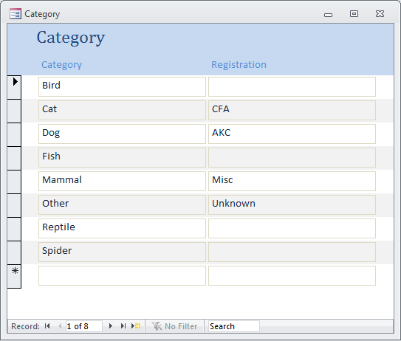
Tabular Form
Works best for single table.
Designer can control data entry sequence.
Probably include buttons for sorting.
Notes:
Sample tabular form. You define the controls for one row, and the DMBS displays data for all of the rows in the query. Scroll bars enable the user to see more rows (or columns of data).

Slide 18
Single Row (Columnar) Form
Data for only one row.
Designer can set optimal layout.
Similar in appearance to paper forms.
Can use color, graphics, and command buttons to make the form easier to use.
Note the importance of the navigation buttons.
Probably want a Find command.
Useful to include subforms.
Notes:
A simple single-row form. This form displays data for one row at a time. You have substantial control over layout through color, graphics, and command buttons. The navigation buttons on the bottom enable the user to display different rows.

Slide 19
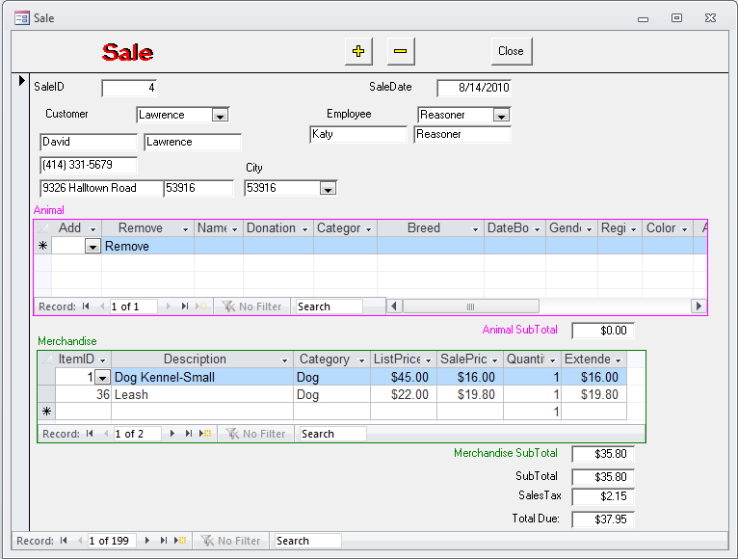
Sub-Forms
Typically a one-to-many relationship.
Subform contents are linked to the main form through a common column (not displayed on the subform.)
Can have multiple subforms (Independent or Nested).
Notes:
Subform example. The main form is based on the Sale table, which has a one-to-many relationship with the SaleAnimal table used on the subform. The subform contents are linked via the SaleID. The two subforms in this example are independent.

Slide 20
Startup Form
Blank Form
Graphics/Picture/Background
Identify User
Choose Task.
Notes:
Sample switchboard form. The buttons match the user’s tasks.

Slide 21
Menu Design
Main Menu
Customer Information
1. Setup Choices
2. Data Input
3. Print Reports
4. DOS Utilities
5. Backups
Daily Sales Reports
Friday Sales Meeting
Monthly Customer Letters
Quit
Hard to understand
Organized by user tasks.
Notes:
Designing menus for users. Which menu is easier for a secretary to understand? When designing applications, you should organize the application to match the processes users perform.

Slide 22
Forms: One Table
Each form should focus on a single event.
Each form should add new data to only one table.
  Straightforward for form as single-row or even multiple rows.
  For main/subform
    The main form is tied to one main table.
    The subform is tied to a second, linked table.
Queries
  Often you want to display data on a form from multiple tables.
  Such as Sales, which needs to include Customer data.
  To work, the form needs to include all columns from the main Sale table
  In most systems, you can use a query to add in some columns from the Customer table—but never include its key column: Customer.CustomerID

Slide 23
Form Query Example
Clerk enters a CustomerID.
  Stored in the Order table.
Query joins Sale and Customer.
  Automatically matches the CustomerID.
  Matching name is displayed on the form.
  Do not include the join column (CustomerID) from the look up table (Customer).
Customer Order
SaleID
1234
Date
7/25/01
CustomerID
17
Carly
Embry

Slide 24
Updateable Query
Customer Order
SaleID
1234
Date
7/25/..
CustomerID
17
Carly
Embry
Data
entry
Data
display
Sale
Customer
SaleID CustomerID Sdate
1232 23 7/24/..
1233 74 7/24/..
1234 17 7/25/..
CustomerID First Last
15 Connie Fisher
16 Rosie Wade
17 Carly Embry
Query
Join
Notes:
Basing the Order form on a query. The query contains all the columns from the Sale table and some columns from the Customer table. The query must never include the CustomerID column from the Customer table, which is the column used to join the two tables.

Slide 25
Updateable Query
SELECT Sale.SaleID, Sale.SaleDate, Sale.CustomerID,
Customer.LastName, Customer.FirstName, Customer.Phone
FROM Sale
INNER JOIN Customer
ON Sale.CustomerID=Customer.CustomerID
The Sale form is designed primarily for the Sale table.
The query includes all columns from the base table (Sale).
It can include some columns from the Customer table.
But do not include key columns for other tables (Customer.CustomerID)
Notes:
Updateable query for Sales form. New rows will be entered into the Sale table, but some systems will also support updates to the three columns from the Customer table. Note that you should never include the Customer.CustomerID column in the SELECT statement.

Slide 26
Linked Forms
Sale Form
Customer
CustomerID
15
Edit
CustomerID
Last Name
First Name
Phone
15
Connie
Fisher
(409) 116-3589
If you cannot or do not want to use subforms,
You can created linked forms.
It is a common approach on the Web.
The goal is to keep simple screens that work with a single topic.
Notes:
Linked forms. The Edit button opens the Customer form and loads the data that matches the current value of CustomerID on the Sale Form.

Slide 27
Form Properties
Category | Properties
Data | Base table / query Filters Sort
Integrity | Edits Additions, deletions Locks
Format | Caption Scroll bars Record selectors Navigation buttons Size and centering Background/pictures Colors Tab order
Other | Pop-up menus Menu bar Help
Notes:
Basic properties for forms. At a minimum, set the data source and basic format properties. Additional properties ensure consistency, protect data, and make the form easier to use.

Slide 28
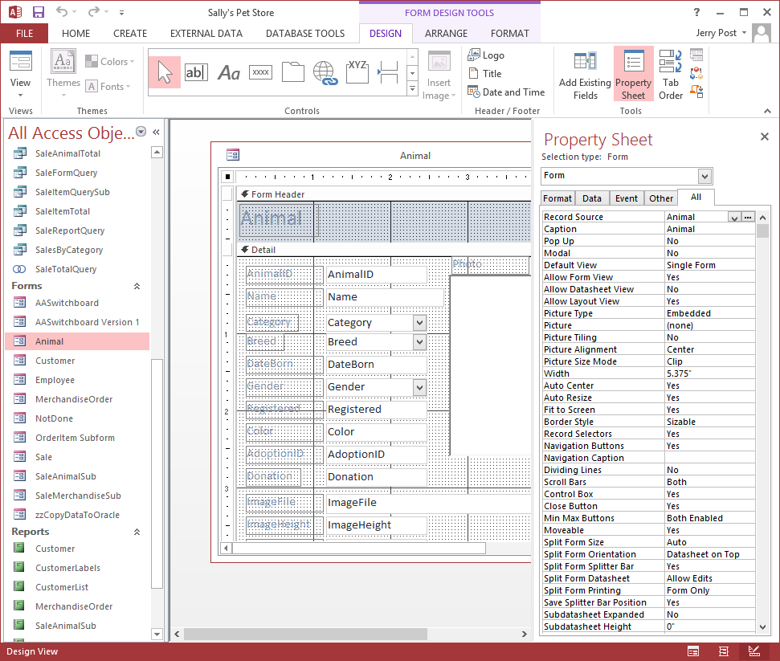
Form Properties: Access

Slide 29
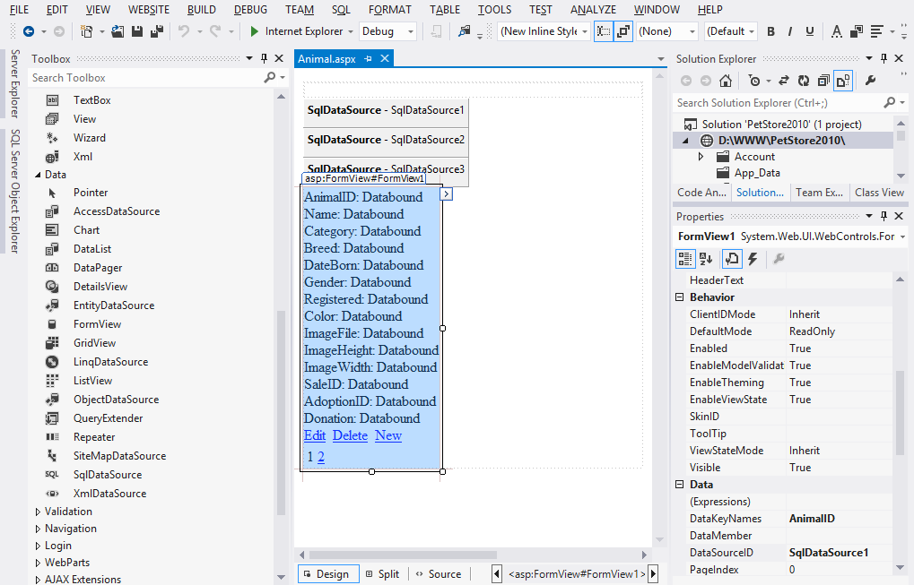
Form Properties: Visual Studio

Slide 30
Controls on Forms (Basic)
Drop down list or combo box
List box
Label
Text box
Last Name
Clothing
Shoes
Electronics
Country
Payment Method
Options
Credit Card
Check
Cash
x
Gift wrap
Gift card
Monogram
Sales
x
Check box
Command button
Option button

Slide 31
Visual Studio Controls
The list is long.
And you can buy or write additional controls.

Slide 32

Pictures
Background pictures
  Unbound, unchanging.
  Stored with the form.
  Keep edit screen readable.
  Sizing (zoom, scale, clip).
Pictures stored as data
  Bound to a data column.
  Define column as object.
  Tie to scanner or graphics package through OLE.
  Beware of data size
    Resolution
    Number of colors
  User machine capabilities.
Employee
Name: Che Zhang
ID: 3354
Phone: 222-111-1524
. . .
Photo:
Notes:
Image bound to a data column. Employee photo is scanned and stored in the database column.

Slide 33
Handling Photos for Web Apps
It is usually best to store images as files on the server.
Pages are delivered with HTML controls and HTML knows how to integrate image files.
If you store the actual image in a database table, you need to write a program page to convert HTML requests into database queries to retrieve the image and stream the bytes to the browser.
Storing images in a database quickly eats up table space. The free versions of commercial DBMS software allow limited storage space.
It is easier to transfer images as files than to export them and import them through the database.

Slide 34
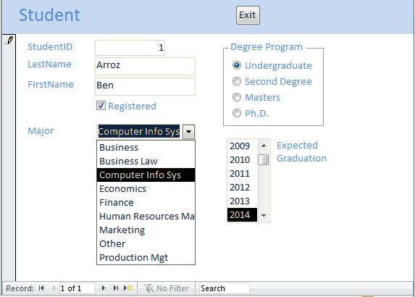
Basic Controls
Text box
Command button
Label
Option group
Single select
Check box
List box
Combo box

Slide 35
Combo & List Boxes
User selects from a list
Combo box can enter new data, or restrict to list.
Two basic uses:
  Insert a value into a table
    Choose from a list of preset options, e.g. gender.
    Select from a different table, e.g., choose a customer.
  Find the data record in this form that matches the choice.
  Be careful! Many systems do not distinguish between the two uses (enter data and search).
Example when you want to use data entry:
  On a sales form, use a combo box for customer.
  It takes a value from the Customer table and inserts the ID into the Sale table.
Example when you want to use a search:
  On a Customer edit form, you might use a combo to search the Customer table.
  Be sure the combo is not bound to the table!
  Probably need to write code for search.

Slide 36
Combo Box
ControlSource sets the column to receive the choice (in the Sale table)
RowSource generates the list of data to display.
  Uses standard SQL.
  Note 4 columns displayed.
  First column is the one to store in the data table.
Properties
Name CustomerID
ControlSource CustomerID
Format
DecimalPlaces Auto
InputMask
RowSource/Type Table/Query
RowSource SELECT . . .
ColumnCount 4
ColumnHeads No
ColumnWidths . . .
BoundColumn 1
SELECT Customer.CustomerID, Customer.LastName, Customer.FirstName, Customer.Phone FROM Customer ORDER BY Customer.LastName;

Slide 37
Combo Box Sources
Microsoft Access supports three methods:
  Fixed list.
  Query from a table.
  Defined function.
With some systems (e.g., Visual Basic), you write code to generate each list entry.
You might use a fixed list for simple lists like “male”, “female”, “unknown”.
It is better to query from a table, even for simple lists.
  Use a one column table.
  Easier to add to a table than to change a combo box.
Useful feature of list combo box.
  The Row Source property is a text string.
  This string can be generated by code.
  List entries can be changed in response to user actions.
Programmed function.
  For straightforward cases, it is easier to use a fixed list and just change the text.
  More complex cases, you can write a subroutine that generates the list choices following a specific format.

Slide 38
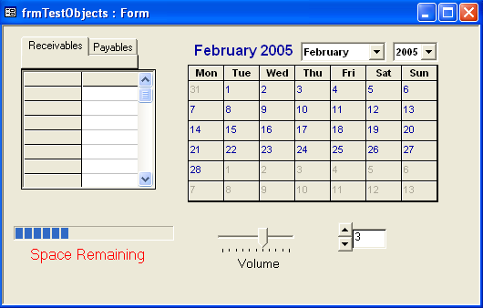
Controls on Forms (Complex)
Calendar
Common
  Tab
  Grid
  Calendar
  Gauge
  Slider
  Spin Box
Additional
  Purchase
  Create your own (C++)
Tab
Grid
Gauge
Slider
Spin box
Note: Calendar control was removed in Office 2010!
Date picker is semi-automatic with date text boxes.
Notes:
Additional controls. Thousands of controls are available to improve the user interface or perform specialized tasks. Common controls include tabs, grid, calendar, gauges, sliders, and the spin box. You can also create custom controls.

Slide 39
Charts
Build a query that generates the data to be graphed.
  Numeric data
    Individual series
    Aggregate data
  Labels
  Columns to link to form.
  Summary chart--unlinked.
Insert chart.
  Set chart type.
  Set up data and labels.
  Set chart properties.
  Verify size.
Sale 1
Animal
Merchandise
Sale 2
Merchandise
Animal
Sale 3
Merchandise
Animal
Total Sales
Merchandise
Animals
Notes:
Charts on forms or reports. The top charts show the split in sales for each individual sale and will change with each row of data. The bottom graph shows the sales split for all sales and is not bound to an individual row.

Slide 40
Multiple Forms
Sale
Customer
FirstName: Mary
LastName: Jones
Address: 123 Oaxaca Ave.
City: Los Angeles
ZipCode: 90086
Gender: Female
Age: 20
AccountBalance: $150
Customer
FirstName: Mary
LastName: Jones
Address: 123 Oaxaca Ave.
Edit
Animals Purchased
Merchandise

Slide 41
Multiple Forms
Animal
Using data on other forms
  The forms object collection
  Forms![FormName]![Control]
Subtotals and subforms
  The form property
  Forms![MainForm]![SubForm].Form![Control]
Multi-page v Separate forms
  Same recordset
  Screen size
  Side-by-side
AnimalID
Sale
=AnimalID from Animal form
ItemsSold
- - - - - - -
- - - - - - -
Subtotal=Sum(Price*Quantity)
=Forms!Sale!ItemsSold.Form!Subtotal
Subtotal
Tax
=Subtotal*[TaxRate]
OrderTotal
=Subtotal+Tax
Notes:
Copying data from a different form. The default AnimalID is copied into the Sale form from the Animal table. Likewise, the subtotal is first computed on the subform and then copied to the main form.

Slide 42
Integrity
Avoid relying on forms
  Set integrity conditions in table definitions
  Be sure to set referential integrity (relationships)
Use forms to make it easy to enter quality data
  Combo/list boxes
  Menus
  Pop-up forms
  Ties to related forms
  Data transfer across forms
  Computations
  Error checking & trapping
Controls
  Security rights
  Data formats
    Data entry
    Round-off
  Selectivity
    Visible
    Enabled & Locked
    Example: no production change after item is sold.
User assistance
  Tool tips
  Status bar
  Menu
  Help--context sensitive

Slide 43




Direct Manipulation of Objects
Group/
Adoptions
Current Choices
Customer
Bird
Cat
Tabby
Dog
Fish
Mammal
Reptile
Spider
Lab
A graphical approach.
Minimize data entry.
Drag and drop objects (blue arrows).
Notes:
Direct manipulation of graphical objects at the Pet Store. Instead of entering an AnimalID into a box, you drag the picture of the animal to the customer to indicate a sale. Double-clicking on an item brings up more detail or related graphics screens.

Slide 44
Creating a Graphical Approach
Get the hardware.
  Images: Scanners
  Sound: Microphone and Sound card
  Video: Camera and capture card
  Lots of disk space.
  High speed processors.
Add an object column to your table definition.
Design the screens.
  Be creative.
  Get user input.
  Make the user’s job easier.
  Avoid using graphics just for show.
  Double-click
  Drag-and-drop
Programming!

Slide 45
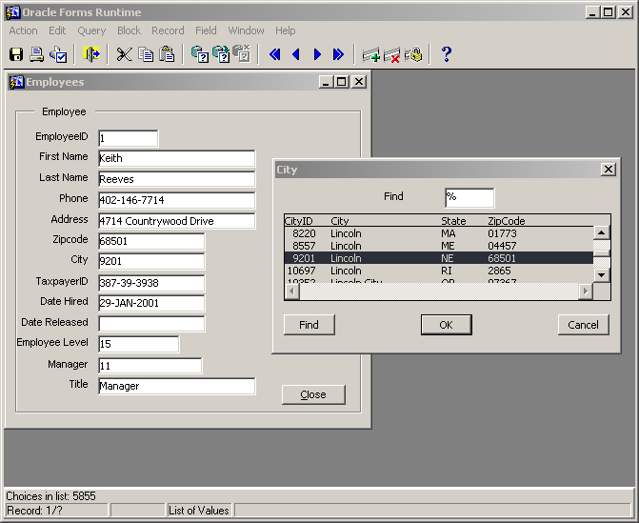
Oracle Forms
Use List of Values (LOV) instead of select boxes.
These are the older 10g versions of Oracle (Designer). See the Workbook 11g for newer Web-based versions.

Slide 46
Oracle Forms Designer

Slide 47
Oracle Forms: Sales
Oracle provides minimal support for updateable queries, so several items are grayed out to indicate they cannot be changed here.

Slide 48
Oracle Forms: Sales Design
Two new data blocks are used for the repeating sections.

Slide 49
Oracle Forms Design Hints
(SELECT Sale.columns, Customer.Columns, Employee.Columns
FROM Sale, Customer, Employee
WHERE (Sale.CustomerID = Customer.CustomerID)
AND (Sale.EmployeeID = Employee.EmployeeID))
Displaying non-updateable data from other tables is tricky. In Master/Sale set:
  DML Data Target Type = Table
  DML Data Target Name = Sale
  For SaleID, set PrimaryKey = Yes
Add the other tables
  Query Data Source Type = Table
  Query Data Source Name (parentheses are critical!)

Slide 50
Oracle Forms Hints
Add non-updateable columns by hand. Use aliases in the query to ensure all column names are unique. Then set properties:
General – Name: cLastName
Functional – Enabled No (optional but clearer to the user)
Database – Database Item Yes
Database – Column Name cLastName
Database – Query Only Yes
Database – Insert Allowed No
Database – Update Allowed No

Slide 51
Design Problems of Many-to-Many
Customers
1
CustomerID
LastName
FirstName
Phone
Address
City
State
ZIPCode
SaleCustomers
SaleID
CustomerID
*
*
Sales
SaleItems
Items
1
1
*
1
SaleID
SaleDate
SaleID
ItemID
Quantity
SalePrice
*
ItemID
Description
ListPrice
SaleEmployees
SaleID
EmployeeID
*
*
Employees
1
EmployeeID
LastName
FirstName
Phone
Address
City
State
ZIPCode
More flexible?
Each sale can have many customers.
Each sale can involve many employees.
Notes:
Database design variation. If there can be many customers and many employees per sale, the database design needs two new tables: SaleCustomers and SaleEmployees.

Slide 52
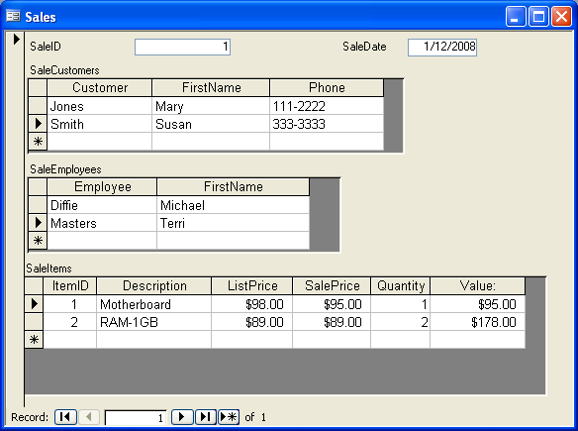
Design Options: Multiple Sections
Notes:
Database design variation. To handle many customers and many employees, two new subforms need to be added to the sales form. This form is more complex and more difficult to use than the standard sales form, so it should be avoided unless the users truly do need to record many customers and many employees.

Slide 53
Report Design
Report usage/user needs.
Report layout choices.
  Tabular
  Columns/Subgroups
  Charts/graphs
Paper sizes.
Printer constraints.
How often is it generated?
Events that trigger report?
How large is the report?
Number of copies?
Colors?
Security controls
  Distribution list
  Unique numbering
  Concealed/non-printed data
  Secured printers
  Transmission limits
  Print queue controls
Output concerns
  Typefaces
    Readability
    Size
    User disabilities
  OCR needs
Notes:
Fundamentals of report design. Determine content and layout with users. Estimate size and printing times. Identify security controls. Check typefaces and sizing for user readability.

Slide 54
Terminology
Facing pages (portrait)
Page Layout
  Landscape v. portrait
  Margins
  Gutter (binding space)
Typefaces
  Serif (Times New Roman)
  Sans-serif (Arial)
  Ornamental
  Fixed width
Font size
  common: 10 - 12 point
  72 points approx. 1 inch
  pica (1/6 inch) (12 points)
gutter
margins
Landscape
Alignment marks for color separations.
Notes:
Basic publishing terminology. Understanding the basic design terms helps you design better reports and communicate with publishers and typesetters.

Slide 55
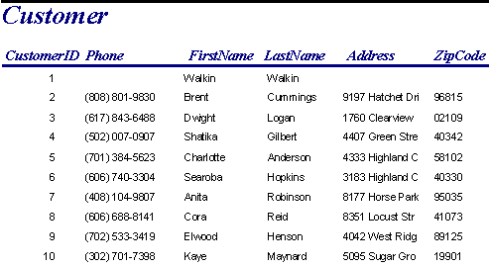
Report Types: Tabular
Notes:
Tabular report layout. Tabular reports have few options but are good for detailed data listings. They are used for itemized listings of data.

Slide 56
Report Types: Labels
Dwight Parrish 9904 Plum Springs Road Worcester, MA 01613 | Dwight Logan 1760 Clearview Street Boston, MA 02109 | David Sims 6623 Glenview Drive Boston, MA 02116
Hershel Keen 8124 Industrial Drive Nashua, NH 03060 | Reva Kidd 5594 Halltown Road Bangor, ME 04401 | Dan Kennedy 3108 Troon Court Burlington, VT 05401
Sharon Sexton 2551 Elementary Drive Barre, VT 05641 | Kelly Moore 6116 Clearview Street Middlebury, VT 05753 | Cassy Tuck 7977 Fairways Drive Clinton, NJ 07015
Notes:
Label report layout. This three-up report is commonly used to print on label paper. It can be used for small sets of data that need to be printed across a page.

Slide 57
Report Types
Column.
Column with groups.
Notes:
Group or subtotal report. Note that several orders are being printed. Each order is a group and has a detailed repeating section of items being ordered. The report can compute subtotals for each order and a total for the entire report.

Slide 58
Report Layout
Report Header
Page Header
Group Header1
  Group Header2
    . . .
    Detail
    . . .
  Group Footer2
Group Footer1
Page Footer
Report Footer
Notes:
Report layout for groups. Note the basic report elements (report header, etc.). Also notice that the page layout is set by the position and properties of the data controls. In the sample report for Merchandise Orders, only one group is defined (on the Order number).

Slide 59
Report Layout/Common Use
Report Header
  Title pages that are printed one time for entire report.
Page Header
  Title lines or page notes that are printed at the top of every page.
Group Header
  Data for a group (e.g., Order) and headings for the detail section.
Detail
  Innermost data.
Group Footer
  Subtotals for the group.
Page Footer
  Printed at the bottom of every page--page totals or page numbers and notes.
Report Footer
  Printed one time at the end of the report. Summary notes, overall totals and graphs for entire data set.
Notes:
Common uses for report layout elements. Most elements are available in pairs, but you are free to delete any components you do not need.

Slide 60
Report Computations
Query
  Same row computations.
  Extended=Price*Quantity
Report
  Group subtotals.
  Page and report totals.
  Mixed, e.g., commission = rate * total
  Scope depends on location
    Group footer: subtotal
    Page footer: page total
    Report footer: report total

Slide 61
Report Graphs
Graphs
  Separate query.
  Detail
    Locate in detail or group footer section.
    Avoid aggregation and groups in query.
    Include column that links to detail query in report.
  Subtotals and totals
    Typically located in report footer or header.
    Compare group totals
    Relies on Group By and aggregation.
    Be sure query groups match report groups.

Slide 62
Oracle Report Writer: Preview
Notes:
Group report created and previewed with the report writer in Oracle. Shading is used to show the group headers and a highlight color draws attention to the detail heading.

Slide 63
Oracle Report Writer: Design
Notes:
Group report created and previewed with the report writer in Oracle. Shading is used to show the group headers and a highlight color draws attention to the detail heading.

Slide 64
Oracle Reports: Data View
The data view can be used to create reports with complex data structures. It is primarily used for master/detail reports.
In this example, each supplier can be sent many purchase orders, which each contain many items being ordered. The report can produce group breaks on all three sections.

Slide 65
Report Layout/Groups
Customer(C#, Name, …)
Order(O#, C#, Odate, …)
OrderItem(O#, Item#, Qty, …)
Report of Orders
Rpt footer: graph orders by customer
Group1: Customer
H1: Customer name, address, …
F1: Customer total orders:
Group2: Order
H2: Order#, Odate, Salesperson.
F2: Order total: Sum(Extended)
Often use groups/breaks for one-to-many relationships.
Use a query to join all necessary tables.
  Can include all columns.
  Use query to create computed columns (e.g., Extended:Price*Quantity).
  Avoid creating aggregates or subtotals in the query.
Each one-to-many relationship becomes a new subgroup.
Detail: Item#, Qty, Extended
Notes:
Nested groups. For example, each customer can place many orders, and each order has many detail lines. Two groups are used: (1) to show the total orders for each customer and (2) to show the total value of each order.

Slide 66
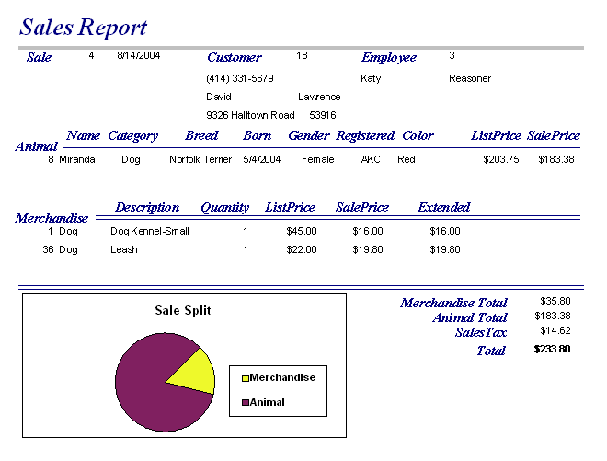
Report Graph for Group
Notes:
Sample graph on the sales report. It illustrates the portion of the sale spent on animals versus merchandise. Note that the graph appears on the same level as the Sale table—not on the detail level and not on the report footer.

Slide 67
Appendix: Oracle PL/SQL: Data Types
Primary Data Types
  NUMBER(precision, scale)
    precision: Number of digits
    scale: Round-off point
    NUMBER(7,4): 123.4567
  INTEGER
    Default: NUMBER(4)
  BOOLEAN
    Yes/No
  NCHAR
    Fixed length string
  NVARCHAR2
    Unicode Variable length string
  LONG, LONG RAW
    Binary data
  DATE

Slide 68
Appendix: Oracle PL/SQL Structure
CREATE OR REPLACE PACKAGE myPackage AS
PROCEDURE myProcedure(oldProjectID IN NUMBER);
END myPackage;
CREATE OR REPLACE PACKAGE BODY myPackage AS
DECLARE
myGlobalVar NUMBER;
PROCEDURE myProcedure(oldProjectID IN NUMBER) IS
DELCARE
myLocalVar NUMBER;
BEGIN
myLocalVar := oldProjectID;
IF
END IF
COMMIT;
END myProcedure;
End myPackage;

Slide 69
Appendix: PL/SQL Operators

Slide 70
Appendix: PL/SQL IF-THEN-ELSE-ELSEIF
DECLARE
X NUMBER(10,2);
BEGIN
-- retrieve the balance
IF (BALANCE > 0) THEN
X = BALANCE*1.10;
ELSE
X = 0.0;
END IF;
END;
Use ELSEIF for case statements.
IF (ACCOUNT = ‘P’) THEN
-- do personal accounts
ELSEIF (ACCOUNT = ‘C’) THEN
-- do corporate accounts
ELSEIF (ACCOUNT = ‘S’) THEN
-- do small business
ELSE
-- handle error
END IF;
Watch the semicolons!

Slide 71
Appendix: PL/SQL Loops
(Start statement)
LOOP
…
EXIT;
EXIT WHEN (condition);
…
END LOOP;
WHILE (condition) LOOP
…
END LOOP;
FOR (variable) IN low...high LOOP
…
END LOOP;

Slide 72
Appendix: Procedures or Subroutines
PROCEDURE DropOldAccounts (CutDate DATE) IS
-- local variables are defined here
BEGIN
-- First copy the data to a backup table
INSERT INTO OldAccounts
SELECT * FROM Account WHERE AccountID NOT IN
(SELECT AccountID FROM Order WHERE
Odate > CutDate);
-- Copy additional tables…
-- Delete from Account automatically cascades to others
DELETE FROM Account WHERE AccountID NOT IN
(SELECT AccountID FROM Order WHERE
Odate > CutDate);
END DropOldAccounts;

Slide 73
Appendix: SQL Cursors
DECLARE
CURSOR c1 IS
SELECT Name, Salary, DateHired FROM Employee;
varTotal Employee.Salary%TYPE;
BEGIN
varTotal = 0;
OPEN c1;
FOR recEmp in c1 LOOP
varTotal := varTotal + recEmp.Salary;
END LOOP;
CLOSE c1;
-- Now do something with the varTotal
END;

Slide 74
Appendix: Error Handling
PROCEDURE myProc ( ) IS
DECLARE
-- declare all local variables
BEGIN
-- SQL statements here
EXCEPTION
WHEN OTHERS THEN -- you can specify a particular error
-- but OTHERS captures all errors
-- PL/SQL code to execute if an error arises
END myProc;

