Slide 1
Database Management Systems
Chapter 8
Applications

Slide 2
Objectives
What features need to be included in finished applications?
How do you create a consistent application design?
How are forms and reports integrated and organized?
How can users gain easy access to standard operations across the application?
How do you create custom help files?
What does your application do when something goes wrong?
How do you know your application works correctly?
How will your application be installed?

Slide 3
Application Features
Application organization
Menu
Toolbar
Help
Transactions
Improving forms
Customized reports
Distributing Applications
Customer
Report
File Edit Help
File Edit Help
File Edit Help
File Edit Help
Sales
Report
Startup/Menu

Slide 4
Application Design
Customer Form
Order Form
Bad design:
  Enter data twice.
Poor design:
  Memorize data (ID) on one form to enter on second.
Better design:
  Automatically transfer data across forms.
Order
Customer: 1592
Jane Doe
Customer
CID: 1592
First: Jane
Last: Doe
Address: 123 Oak
Edit
Notes:
Application structure. Forms are connected so users can click a button or link to get more detail, open other forms, or display reports.

Slide 5
Page Design Template
Initial Form
Template
Consistent Form
Menu
Main Print Help
Customer
ID
Title
Customer
1523
First
Label
Input
ID
1523
Mary
First
Mary
Last
Jones
Last
Jones
Phone
123-4444
Phone
123-4444
Notes:
Template. The template defines the structure of the form and the attributes of the various elements. It can also include common features such as menus and navigation buttons.

Slide 6
Consistency and Usability
Sales Order
Receipts
Customer
Customer
Jones, Mary
209-111-2222 Jones
218-232-3938 Smith
306-335-3048 Jackson
415-209-0398 Sanchez
Search: J%
Jackson Joe 218-232-3938
Jamison Lisa 601-193-4841
Johnson Sam 502-203-8383
Jones Mary 209-111-2222
Inconsistency:
The left form looks up customers by phone number.
The right form looks up customers by name within a pop-up box.
Users will be confused and annoyed.
Notes:
Consistent usability. Both forms require the selection of a customer since you cannot expect people to memorize ID numbers. It would be annoying to select customer by phone number in a drop down list on the Sales form but by a pop-up list organized by name on the Receipts form.

Slide 7

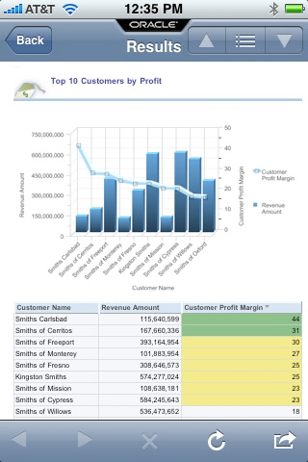
Mobile Devices
Images from Apple.com
Screen shot is an Oracle App.

Slide 8
Screen Size Issues
Mobile screens are smaller
  Physically: height and width
  Number of pixels
Tradeoff
  Smaller text and images
  Scrolling or smaller pieces on multiple pages
Device | Size (Diagonal in.) | Pixels
Desktop | 24 | 1920 x 1200
Laptop | 15 | 1440 x 800 to 1920 x 1080
Apple iPad | 11 | 2048 x 1536
Google Nexus 10 | 10 | 2560 x 1600
Apple iPhone 5 | 4 | 1136 x 640
Samsung S4 | 5 | 1920 x 1080

Slide 9
Multiple Monitors/Sizes
Develop two (or more!) versions of the forms and reports.
  Mobile screen size.
  Mobile screen navigation differences.
  Mobile bandwidth limitations.
Hopefully less than twice the development time.
  Purpose, data, calculations, and functions are reusable.
  Probably need a separate developer to code the screens.
  Probably need more people to handle maintenance and upgrades.

Slide 10
Application Importance
User interface
  Make users’ jobs easier.
  Tie input forms and reports.
  Automate basic tasks
  Tie to external data collection devices.
  Help system.
Ensure data integrity
  Validate data.
  Perform computations.
  Verify totals.
  Control user access.
  Maintain related transactions.
  Backup and recovery.
Decision Support
  Monitoring of events.
  Analysis, Graphs, Reports.
  Statistical analysis and optimization.
  Forecasts and simulation.
  Linking to other software.
Expert Systems & Intelligence
  Logic and forward chaining.
  Analysis and decisions in code.
  Databases of cases, situations and solutions.

Slide 11
Application Organization
Organized by user needs.
  Identify user.
  Outline tasks.
  Organize forms and reports.
Direct users to tasks.
Potential drawbacks
  Too many layers makes it difficult for users to find anything.
  Poor organization confuses users and requires additional support and training.
Build forms and reports.
Start with a core concept.
  Identify most important features. Get them correct.
  Add features, forms and reports. Issue application updates--number and date!
Use menu stubs for incomplete and future work.
  Make them invisible to the user with the Visible property.
  Be sure they are disabled.

Slide 12
Application Structure
Forms and Reports
Visual Basic
Internet
Oracle Forms
Front end
Middle Tier
(Optional)
Business logic
Rules
If x > 10,000 Then
Else
End If
Database
Oracle
SQL Server
DB2
Access
Back end
Notes:
Application structure. It is common to use different tools for the back-end database and front-end forms. The use of the middle tier to handle business rules depends on the size of the application and the management details of the firm.

Slide 13
User Orientation
Database application is a model of the organization.
  Applications based on user jobs.
  Flexibility and user control.
Application organization
  User tasks.
  User control over sequence.
Forms
  Minimize user entry.
  Anticipation.
Reports
  Easy access from forms.
  User selection of scope and conditions or filters.
Notes:
Uses of startup forms. As the initial form for an application, the main startup form can be used to control tasks that apply to the complete session.

Slide 14
Sally’s Pet Store: Poor Organization
Order
Merchandise
Item
Receive
Merchandise
Item
Sell
Merchandise
Item
What is wrong?
Get
Customer
Data
Focus needs to be at higher level (Order, Receipt, Sale); not Item.A
You cannot go from Order to Receipt.
You cannot go from Receipt to Sale.
You need to get customer data before recording the sale.
Notes:
Poor organization of the Pet Store application. The links are at the wrong level (item instead of order). Managers rarely need to track individual items from order to receipt to sale.

Slide 15
Sally’s Pet Store: Better Organization
Supplier
Customer
Orders
Receipt
special
orders
Sale
Inventory
Items
More links--usually as buttons.
Separate sales from orders, except for special orders.
Notes:
Improved organization for the Pet Store. The lines represent links from one form to a second form. The links are usually created through buttons placed on the form.

Slide 16
Collaboration Diagram for Sales
Sales Clerk
Sales
Merchandise
Animal Health
Animals
Genealogy
Customers
Receipts
Notes:
Collaboration diagram for sales clerk section. Diagramming the forms and reports used by an actor (employee) makes it easier to identify the overall structure and menu for this role.

Slide 17
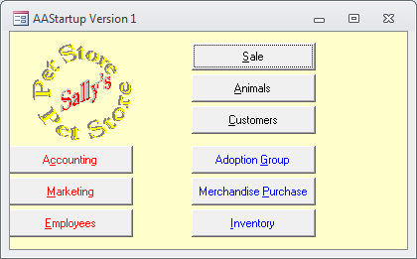
Initial Menu / Startup
Starting point for users.
  Identify the user.
    From network if possible.
    Separate log in if needed.
  Customized for users.
    Hide restricted options.
    Different forms as needed.
Avoid cluttered screens.
  Use graphics and color to enhance the presentation.
  Limit the number of options.
Notes:
Sample startup form. The buttons match the user’s tasks.

Slide 18
Startup Form Uses
Acts as a directory for the application.
Identifies users.
Contains startup and shutdown code.
  Can preload forms in background.
    Make them invisible.
    Speed up later usage.
  Can initiate transaction and security logs.
  Can establish network connections.
Contains copyright and usage notes.

Slide 19
Menus
Why a custom menu?
  Place it on a toolbar.
  Limit user actions.
  Simplify user interface.
  Add custom actions.
  Menus can be activated by keystrokes.
    Accessibility
    Touch-typists and heads-down data entry.
  Sometimes need different menus for each form.
File
Help
Contents
Search
About Rolling Thunder
File Help
Edit
Add Customer
Delete Customer Ctrl+D
Modify Customer Data

Slide 20
Creating Menus
View | Toolbars | Customize
Drag and Drop
  Multilevel menu.
    Sublevels/hierarchy.
    Each level is a separate menu with its own name.
  Menu choices
    Each entry has a name.
    Access key: & (e.g., &File).
    Status Bar Text
  Actions
    Submenu.
    Run any code.

Slide 21
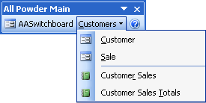
Sample Menu
Notes:
Sample menu. Note the hierarchical structure. Also, the underlined letter represents the access key, which can be activated from the keyboard. You can add shortcut keys (e.g., Ctrl+D), to activate a choice without going through the menu.

Slide 22
Toolbars
Why toolbars?
  Single click for complex actions.
  Commands available across the application / shortcuts.
  Position and customization by user.
Toolbar components
  Button
    Text
    Icon/graphic (bitmap)
  Tool Tip
  Status Bar description
  Action
Print
Identify report
Ask for single or multiple pages.
Preview or print.
Startup
Weekly Sales Analysis
Build graphs
Print reports
Export data to spreadsheet
Notes:
Sample toolbar. Toolbars can contain buttons and menus. Buttons generally display icons. When the pointer moves over them, a tooltip is displayed that briefly describes the button. When the button is clicked, an action is performed or a menu is displayed.

Slide 23
Creating Toolbars
View | Toolbars | New
Customizing
  Add new button.
    Select from DBMS list.
    Bring up query/form/report.
    Run code.
  Change icon.
    Modify existing icon.
    Replace icon.
    Create your own icon and paste it on the button.
    Place text label on button.
Tool tips are vital.
Status bar for description.

Slide 24
Icons
16 by 16 pixels
16 colors
  Bright and shaded
  Dither to mix colors
Outline in black

Slide 25
Activating Toolbars and Menus
Install a menu
  Form: Attach a bar using the form properties.
  Code
    On Activate
    On Deactivate
Modify from code
  Add or remove options
  Enable/Disable (dim)
Set myBar = CommandBars(”Custom1")
If user = ”Clerk" Then
myBar.Visible = True
Else
CommandBars(”Database").Reset
myBar.Enabled = False
End If
With myBar
.Controls.Add Type:=msoControlButton, Id:=3
.Controls(1).Enabled = False
.Controls.Add Type:=msoControlButton, Id:=3
End With
myBar.Visible = True

Slide 26
Accessibility
Need to make applications accessible to as many as possible.
  Required for programs sold to the U.S. Federal government.
  Good to add for all programs.
Common approaches
  Support multiple input methods (keyboard as well as mouse).
  Do not put text into graphics and add the Alt tag with text to describe images.
  Enable users to resize the screen (e.g., zoom). Do not override font choices.
  Select user-chosen colors such as System.Text instead of “Black.” Many people are red-green color blind.
All buttons, menu, and toolbar items need Alt-letter definitions.
  Most systems use ampersand (&), such as &Help displayed as Help, and triggered with Alt-H.

Slide 27
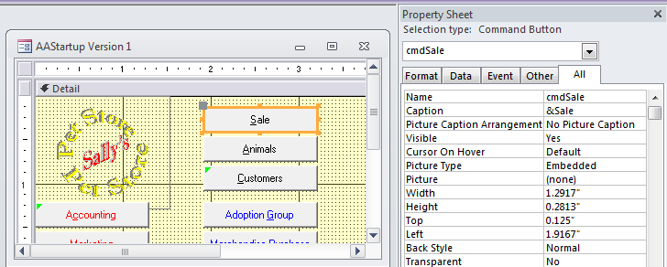
Microsoft Access: Accessibility
Ampersand (&) Adds underline and Alt-letter trigger

Slide 28
Accessibility: Federal and Web
Federal and State government require accessibility: Section 508
  http://www.section508.gov
  http://www.ada508.com
Web-based forms
  http://www.w3.org/WAI/
Watch the laws.
  Currently the Americans with Disabilities Act applies to physical stores.
  Many states have similar laws but different elements.
  Some discussion is taking place to require section 508 requirements for commercial Web sites.
Legal issues can be challenging and expensive
  Many nuisance lawsuits regarding physical ADA
  A Federal law regarding Web sites could be problematic for small businesses unless it tightly limits lawsuits (unlikely).

Slide 29
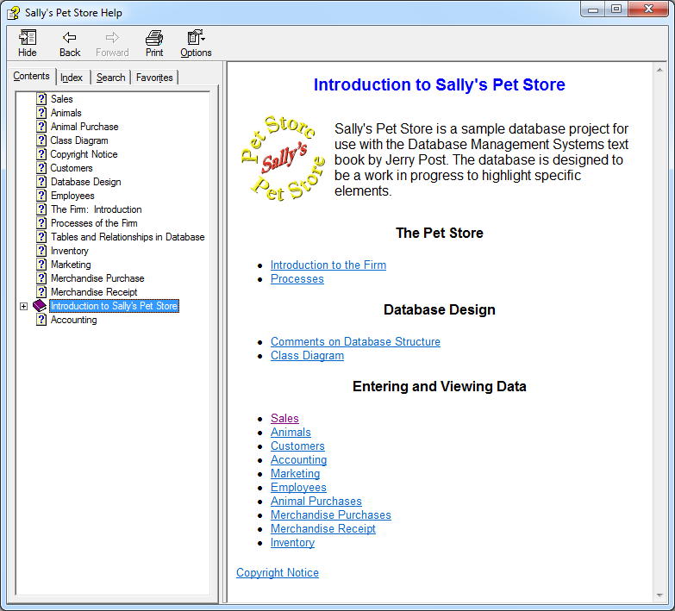
Help
Context sensitive:
  Pressing F1 key provides information on topic with current focus
Hypertext links to related topics
Sequential topics
  Descriptions
  Examples
Definitions / Glossary
Contents / overview
Index / keywords
Full-text search
Notes:
Sample help screen. The Windows help system handles all of the display and searches. You just have to write the HTML topic pages and specify keywords.

Slide 30
Help Structure
Help files are processed by the Windows help system.
  You need a Help Compiler
  Free: HTML Help Workshop from Microsoft
  Pay: Several commercial products (see developer magazine ads)
Basic steps
  Create each topic as a separate HTML page with links and graphics.
  Be sure to have a start page.
  Create a new project in HTML Help Workshop

Slide 31
Writing the Help File
Get a good HTML editor. You can use Wordpad if you want, but do not use Word.
Create an HTML style sheet
Create HTML topic pages
Write a single topic on a page.
  Add links <a href=“”>
  Add graphics <img src=“”>
  Headings can be used for Table of Contents
Topics
  Keep a list of pages for reference.
  No spaces in file names.
HTML Help Workshop
  Add all the HTML files.
  Define a Main window
  Set project options
    Title, Start page
    Files: Auto generate contents, index keywords from HTML files
  Add keywords to HTML files (try the wizard, but best to copy and edit <OBJECT> info from example.
  Map topic/file names to numbers in Topics.h
  Add Topics.h to project

Slide 32
Sample Help Page-A
<object type="application/x-oleobject" classid="clsid:1e2a7bd0-dab9-11d0-b93a-00c04fc99f9e">
<PARAM name="Keyword" value="Contents">
<PARAM name="Keyword" value="Introduction">
<PARAM name="Keyword" value="Sally's Pet Store">
<PARAM name="Keyword" value="Management">
</object>
<html>
<head>
<titlePet Store Introduction</title>
<link rel="stylesheet" type="text/css" href="PetHelpStyle.css“ />
</head>
<body>
Notes:
Partial sample Help page. Create each topic as a separate Web page using HTML. The anchor <a> tag links to other pages. The <img> tag loads images. Use style sheets to set fonts and design. Use a table or a style to control layout. Place keywords for the page in the <object> tag.

Slide 33
Sample Page - B
<h1>Introduction to Sally's Pet Store</H1>
<table><tr>
<td><img src='PetStoreLogo2.gif' border='0'></td>
<td>Sally's Pet Store is a sample database project
for use with the Database Management Systems text book
by Jerry Post. The database is designed to be a work
in progress to highlight specific elements.</td>
</tr></table>
<h2>The Pet Store</h2>
<ul>
<li><a href='FirmIntroduction.html'>Introduction to the Firm</a></lI>
<li><a href='FirmProcesses.html'>Processes</a></lI>
</ul>
</body>
</html>

Slide 34
HTML Help
Get the Microsoft HTML Help Workshop (search: htmlhelp.exe)
http://msdn.microsoft.com/library/default.asp?url=/library/en-us/htmlhelp/html/hwMicrosoftHTMLHelpDownloads.asp
Create each of the following
  Help project files
    Use separate directory
  HTML topic files
    Standard HTML with some additions for keywords
  Topic Header and Text File
  Graphics and multimedia
    Avoid monster sizes
  Contents files
    Can auto-generate from heading tags (<H1>, <H2>, …)
  Index files
    Use Help workshop to set keywords within each topic

Slide 35
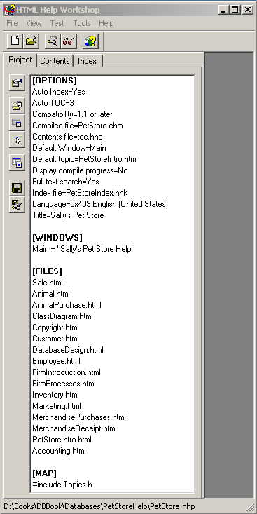
HTML Help Workshop
PROPERTIES
Project name, keywords, table of contents.
FILES
Load each HTML file.
MAP
Each topic name must be given a number.

Slide 36
HTML Project Hints
Project Options
  Project Title
  Default file (first page)
Can create new files with File - New
  Be sure to Add/Remove Topic files to project list
  Edit – Compiler Information to add keywords to HTML file
Concentrate on creating useful help content
On large projects, hire/train someone to manage help
  Add useful features
  Keep content up to date
  Manage/organize all the files

Slide 37
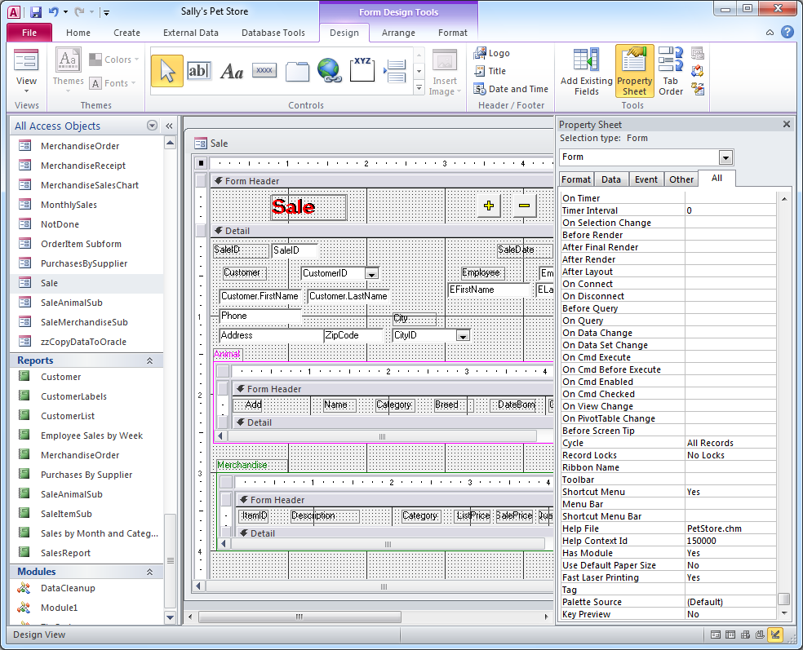
Context-Sensitive Help
Set the help file name in the form properties.
Set the topic number (Context Id) for each form or control.
Notes:
Setting context-sensitive help. In every form, enter the name of the Help file in the Help File property. Then enter the topic number for that form in the Help Context ID property. Every control or subform can also have a different Help topic—just enter the corresponding topic number.

Slide 38
Context Sensitive HTML Help
Create a header file to link the topic names to numbers
#define PetStoreIntro 100
#define Accounting 10000
#define Animal 20000
#define AnimalPurchase 30000
#define ClassDiagram 40000
#define Copyright 50000
#define Customer 60000
#define DatabaseDesign 70000
#define Employee 80000
#define FirmIntroduction 90000
#define FirmProcesses 100000
#define Inventory 110000
#define Marketing 120000
#define MerchandisePurchases 130000
#define MerchandiseReceipt 140000
#define Sale 150000
Notes:
Map file. Applications refer to topics by number, but the help system uses the filename. The map file (Topics.h) is a simple text file that assigns a number to each page.

Slide 39
Windows HTML Help 3
Introduced with Visual Studio 2010
Modified/simplified version of Help 2 used for Visual Studio 2003 and 2005 as well as Office 2007/2010.
File suffix: MSHC
It is a ZIP archive.
Files are strict HTML: XHTML
All metadata is stored within the individual file using meta tags.
No compiler is needed. Create a ZIP file and put all of the help files and images in that file. Create a basic manifest file.
The MSHC files are not yet supported on Windows, but maybe in the near future?

Slide 40
Sample Help 3 Heading Tags
<?xml version="1.0" encoding="utf-8"?>
<html xmlns="http://www.w3.org/1999/xhtml">
<head>
<title>My Page Title</title>
<meta name="Microsoft.Help.TopicLocale" content="en-us" />
<meta name="Microsoft.Help.TopicVersion" content="100" />
<meta name="Microsoft.Help.Id" content="fadf1f04-77dd-43fb-81f6-72e5ae0bfc3d" />
<meta name=“SelfBranded content=“true” />
<meta name=“Microsoft.Help.Locale” content=“en-us” />
<meta name=“Microsoft.Help.Package” content=“My_Help_Package_Pets_en-us_1” />
<meta name=“Microsoft.Help.F1” content=“PetStore” />
<meta name=“Microsoft.TocParent” content=“-1” />
<meta name=“Microsoft.Help.Category” content=“Petstore::Introduction” />
<meta name=“Microsoft.Help.ContentType” content=“Concepts” />
<meta name=“Microsoft.Help.Keywords” content=“Introduction” />
<meta name=“Microsoft.Help.Keywords” content=“Pet Store” />
<meta name=“Description” content=“Basic description goes here…” />
<meta name=“Microsoft.Help.tocOrder” content=“1” />
</head>

Slide 41
Sample HTML Help 3 Body
<body class=“primary-mtps-offline-document”>
<div class=“topic”>
<div class=“majorTitle”>This is the Page Title</div>
<p>Sally’s Pet Store …. </p>
<p><a href=“ms-xhelp:///?Id= fadf1f04-77dd-43fb-81f6-433e3ae08ac22”>My Link</a>
</div>
</body>
</html>

Slide 42
Sample Manifest
<html xmlns="http://www.w3.org/1999/xhtml">
<head>
<title>An optional title.</title>
</head>
<body class="vendor-book">
<div class="details">
<span class="vendor">Pet Store</span>
<span class="locale">en-us</span>
<span class=”product”>Pet Store Sales </span>
<span class="name">Pet Store</span>
</div>
<div class="package-list">
<div class="package">
<span class="name">package1</span>
<a class="current-link"
href="packages\package1.mshc">package1.mshc</a>
</div>
<div class="package">
<span class="name">package2</span>
<a class="current-link"
href="packages\package2.mshc">package2.mshc</a>
</div>
</div>
</body>
</html>

Slide 43
Catching Errors
Oracle | SQL Server | C# | Access
BEGIN {code} EXCEPTION WHEN OTHERS THEN {code} END | BEGIN TRY {code} END TRY BEGIN CATCH {code} END CATCH | try { {code} } catch (exception e) { {code} } | ON ERROR GOTO errX {code} exitX: Exit Sub errX: {code} End Sub
SQL 2003 Standard | DECLARE EXIT HANDLER FOR SQLEXCEPTION Sql_procedure_name {code}
Notes:
Common error-handling structure. Most systems use a try/catch structure but use different syntax to define the sections. The SQL 2003 standard supports various conditions (SQLEXCEPTION) and can EXIT the existing code or return to it (CONTINUE) after processing the handler code.

Slide 44
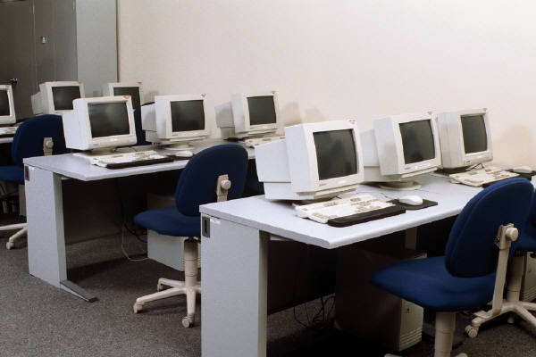

Application Testing
Stress
Company X
Forms
Sales
Customers
Inventory
Integrated Application
Receipt
Item Qty Price
2 10.50
178 1 27.85
251 4 21.17
Modules
If (Sales > 50)
bonus=10000
Else
bonus=5000
End If
Usability
Security
Notes:
Application testing. Testing usually begins at the detailed level of forms and modules. When the application is built, the integrated features are tested. You also test for usability and performance under stress. Security testing should occur at every level.

Slide 45
Testing: SQL Injection Attacks
Username
Password
Bad: Build SQL string by appending text:
strSQL = “SELECT * FROM USER WHERE Username=‘“ & user & “’ AND Password=“’ & password & “ ‘ “;
Attacker enters user value: ‘ OR (1=1) -- results in SQL:
SELECT * FROM USER WHERE Username = ‘’ OR (1=1) -- ignore rest
Which will match any user, and probably return the first entry which is likely to be the administrator! Or even add commands to delete things.
Better to use parameters …WHERE Username = @Username…
But usually need to check incoming data and drop certain characters, including quotes and comment characters.

Slide 46
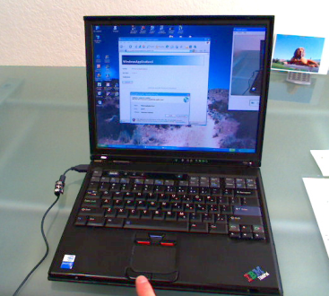
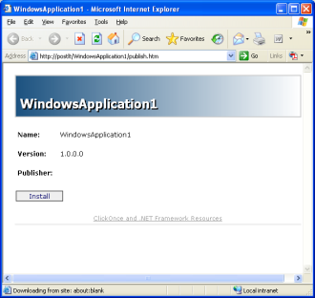
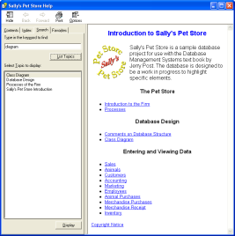
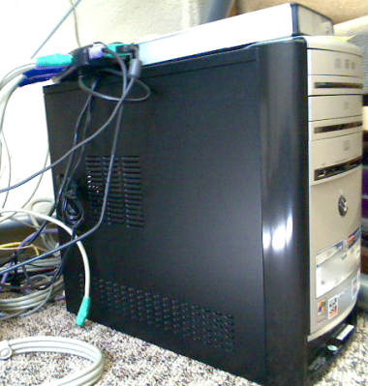
Deployment
Compiling and Packaging
Installation
Customers
Inventory
Forms
Receipt
Item Qty Price
2 10.50
178 1 27.85
251 4 21.17
Reports
Tables and Modules
Help
Data
Server and Database Configuration
Notes:
Deployment. The forms, reports, and help files are compiled and packaged into an installation file that is run on client computers. The DBMS is installed on a server and the tables and modules are installed and configured. Initial data is loaded and network connections are established.

Slide 47
Improving Forms
Combo Boxes
  Restricting with WHERE.
  NotInList to add data.
Make it easy for user
  Click for autoentry.
  Advanced lookup.
  Print options.
Decision Support
  Statistical analysis
  Optimization
  Simulation
Adding Expert System features
  Automatically compute values.
  Guide user by asking questions and suggesting answers.
  Intelligence/logic in code.

Slide 48
Opening Forms for Related Data
Customer
CustomerID
Name
Address
Open a second form based on value in current form.
Print a report for current entry on a form.
11
Lee Gentry
5744 High Street
Payments
Customer Payments
CustomerID
11
Print
Date Amount
2-15-98 $97.00
3-15-98 $97.00
Sub Payments_Click()
Dim stDocName As String
Dim stLinkCriteria As String
stDocName = "CustomerPayment"
stLinkCriteria = "[CustomerID]=" & Me![CustomerID]
DoCmd.OpenForm stDocName, , , stLinkCriteria
End Sub
Customer Bill
Name
Address
Balance Due
Payments
2-15-98 $97
3-15-98 $97

Slide 49
Combo Boxes / Hierarchical Data
Department Evaluation
Division
Department
Many business situations use hierarchical relationships
  Divisions: Departments
  Category: Product
Data entry on a form
  User select higher level from first combo box.
  For lower level, select from list that is restricted to those in the higher level.
Add a WHERE clause to the lower level combo box SQL.
Force the new clause to requery when entry changes.
cboDivision
Finance
Investments
Budgeting
Cost Analysis
cboDepartment.RowSource
SELECT Department
FROM DepartmentList
WHERE DepartmentList.Division =
[cboDivision];
cboDivision: AfterUpdate
cboDepartment.Requery

Slide 50
Combo Boxes / NotInList
Two ways to add to list.
  Separate button
  NotInList event
To user NotInList is easy.
Be careful when adding
  Give user chance to cancel.
  Don’t make user enter data twice.
  Add data to all necessary tables.
Set LimitToList = True.
Basic structure
  See if user wants to cancel.
  Open table, AddNew row.
  Copy new value.
  Open form at that value and get additional data.
Potential problems
  Method might not be obvious to user.
  Difficult to enter data with matching key, e.g., phone number shared by two customers.
Might need button as well.

Slide 51
NotInList Code
Set cnn = CurrentProgram.Connection
Set rst = CreateObject(“ADODB.Recordset”)
StrSQL = “SELECT CustomerID, … FROM Customer ORDER BY CustomerID”
rst.Open “Customer”, cnn, adOpenDynamic, adLockOptimistic
Set ctl = Me!Customer
If (MsgBox("Do you wish to add a new Customer?", vbYesNo, _
"Customer is not in list yet.") = vbYes) Then
rst.AddNew
rst("Name") = NewData
strMatch = "[CustomerID] = " & rst("CustomerID")
rst.Update
rst.Close
Response = acDataErrContinue
Me![CustomerID].Requery
DoCmd.OpenForm “Customer”, acNormal, ,strMatch
Else
Response = acDataErrContinue
ctl.Undo
End If

Slide 52
Click Events for Automatic Entry
Bicycle Assembly
User selects from list.
Code sets default values.
Rolling Thunder Assembly
  Clicking on PartID signals that it was installed.
  Speeds up data entry.
  Minimizes errors.
EmployeeID
BicycleParts
ComponentID EmployeeID
Rolling Thunder Assembly
Sub EmployeeID_Click()
[EmployeeID] = Forms![BicycleAssembly]![EmployeeID]
[DateInstalled] = Now
End Sub
Sub ComponentID_DblClick()
DoCmd.OpenForm "Component", , , _
"ComponentID=" & Me![ComponentID], acReadOnly
End Sub

Slide 53
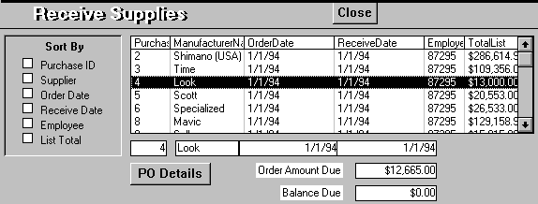
Advanced Lookup Lists
DoCmd.GoToControl "PurchaseID"
DoCmd.FindRecord [OrderList] ‘Displaydata
If (DoUpdate = True) Then ‘Parameter
If (IsNull([ReceiveDate])) Then
[ReceiveDate] = Now ‘DblClick-set date
SetQuantityReceived (Now)
Else ‘If date set, DblClick means remove
[ReceiveDate] = Null
SetQuantityReceived (Null)
End If
End If
Forms![ReceiveSupplies].Refresh
Forms![ReceiveSupplies]![OrderList].Requery
List of items
Rolling Thunder Supplies
  Click shows details.
  DblClick sets receive date.
  Button opens matching form to change details.
  Sort buttons rebuild list query ORDER BY clause.

Slide 54
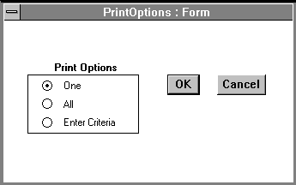
Print Options
Message
Single Item
Entire Set
Page layout, . . .
Selection Criteria
Message set by calling subroutine
' Global PrintWhereClause As String
' Global PrintOptionResponse As Integer
' It is called as follows:
' PrintWhereClause = "CustomerID = " & [CustomerID]
' DoCmd OpenForm "PrintOptions" "1Print the _____ report for " & CustomerName
' The leading value is the default selection: 1=one record, 2=all records, 3=criteria
' Select Case PrintOptionResponse
' Case 1
' DoCmd OpenReport "myReport", acViewPreview, , "Customer ID = " & [CustomerID]
' Case 2
' DoCmd OpenReport "myReport", acViewPreview
' Case 3
' DoCmd OpenReport "myReport", acViewPreview, , PrintWhereClause
' Case Else
' Do nothing
' End Select
' Be sure to have an ON ERROR section to catch bad where clauses set by users in option 3
Criteria invisible until user picks 3

Slide 55
Custom Reports
Limitations to report writers
  Limited computations
  Control over layout
  Format codes: SGML & HTML
  Conditional (data driven) changes
    Color-codes based on data (show negative as red).
    Data thresholds (over 100,000 different formula).
Hints for custom code
  Be careful with proportional typefaces and graphics.
  Best to write to a standard file format like RTF or EPS and print with a word processor.

Slide 56
Report Layout
Report header
Page header
Group1 header
Group2 header
Detail
Group2 footer
Group1 footer
Page footer
Report footer
Report Footer
Customer Purchases
Customer: Jones
Order 4748
Item # Value
11987 $ 198.75
14847 $7462.83
Total $7661.58
Order 5092
Item# Value
73632 $ 52.35
Total $ 52.35
Customer Total $7713.93
Page 32

Slide 57
Report Coding Structure
Report Header
Loop
  Test for top of page
  Test for top of group 1
    Test for top of group 2 . ..
  Perform calculations and subtotals
  Print detail
  Increment line/position counters
  Test for page break
  Set all prior group values
  Read next row of data
  Test for end of groups
    Last to first
    Print group footers
Report Footer

Slide 58
Report Coding
Define base query first.
Write separate lookups if:
  queries are not available.
  performance problems.
Pages
  Counter for page numbers.
  Line counter or position measure, and page size.
Groups
  Accumulator for sum, avg.
  Counter for average.
  Prior value to test break.

Slide 59
Report Code
Dim cnn As ADODB.Connection, rst As ADODB.Recordset
Dim lngPriorKey1 As Long, bolTopGroup1 As Boolean
Dim dblSum1 As Double, dblSubTotal1 As Double
Set cnn = CurrentProject.Connection
Set rst = CreateObject(“ADODB.Recordset”)
rst.Open “SELECT …”, cnn
bolTopGroup1 = True
dblSum1 = 0#
dblSubTotal1 = 0#
Do Until rst.EOF
If (bolTopGroup1) Then
‘ Print group header
bolTopGropu = False
End If
‘ Print detail line
dblSubTotal1 = dblSubTotal1 + rst(“Value1”)
dblSum1 = dblSum1 + rst(“Value1”)
lngPriorKey1 = rst(“Key1”)
rst.MoveNext
If (rst.Eof) Or (lngPriorKey1 <> rst(“Key1”) Then
‘ Print group footer
dblSubTotal1 = 0#
bolTopGroup1 = True
End If
Loop
rst.Close

Slide 60
Multiple Group Reports

Slide 61
Paging Complications
Whenever anything is displayed
  Update page position
  Test for page break
Try to keep group on page.
  Not possible if too long.
  Pre-test group before printing.
  If forced to break across a page, might reprint group headers.
All print sections as subroutines.
  One call to estimate size.
  Second call to actually print.
  Bookmarks keep position.
Print to word processor.
  User can modify/customize.
  Need file formats / RTF.

Slide 62
Report Paging
Note: To use bookmark you
must set Option Compare Binary!

Slide 63
Distributing an Access Application
Make the application standalone.
  Runs completely from your forms.
  Never need to use the Access database menu (Tables, Queries, Forms, Reports).
  Automatically starts when the database is opened.
    Tools | Database Utilities | Startup.
    AutoExec macro.
Application format.
  Standard mdb file.
  Encrypted mde file.
Run-time package (Developer’s Edition).
Security (Chapter 10).
Installation package (Developer’s Edition).

Slide 64
Distributing VB, Oracle, and Web Apps.
Visual Basic
  Compile the application.
  Use wizard to build a setup program.
  Distribute files (and database).
Oracle
  In-house, build the database centrally or use Oracle distributed database features.
  Applications all run on the server.
  Assign security inside Oracle.
The Web
  Install the database on a server.
  Copy the Web pages to a directory.
  Set security.

