Slide 1
Database Management Systems
Chapter 9
Data Warehouses and Data Mining

Slide 2
Objectives
What is the difference between transaction processing and analysis?
How do indexes improve performance for retrievals and joins?
Is there another way to make query processing more efficient?
How is OLAP different from queries?
How are OLAP databases designed?
What tools are used to examine OLAP data?
What tools exist to search for patterns and correlations in the data?

Slide 3
Sequential Storage and Indexes
We picture tables as simple rows and columns, but they cannot be stored this way.
  It takes too many operations to find an item.
  Insertions require reading and rewriting the entire table.
ID | LastName | FirstName | DateHired
1 | Reeves | Keith | 1/29/20xx
2 | Gibson | Bill | 3/31/20xx
3 | Reasoner | Katy | 2/17/20xx
4 | Hopkins | Alan | 2/8/20xx
5 | James | Leisha | 1/6/20xx
6 | Eaton | Anissa | 8/23/20xx
7 | Farris | Dustin | 3/28/20xx
8 | Carpenter | Carlos | 12/29/20xx
9 | O'Connor | Jessica | 7/23/20xx
10 | Shields | Howard | 7/13/20xx
Notes:
Find an item in a sequential table. Even if you know the primary key value, the system has to start at the first row and continue until it finds the desired match. On average, with N total rows, it takes N/2 row retrievals to find a particular item.

Slide 4
Binary Search
Given a sorted list of names.
How do you find Jones.
Sequential search
  Jones = 10 lookups
  Average = 15/2 = 7.5 lookups
  Min = 1, Max = 14
Binary search
  Find midpoint (14 / 2) = 7
  Jones > Goetz
  Jones < Kalida
  Jones > Inez
  Jones = Jones (4 lookups)
Max = log₂ (N)
  N = 1000 Max = 10
  N = 1,000,000 Max = 20
Adams
Brown
Cadiz
Dorfmann
Eaton
Farris
1 Goetz
Hanson
3 Inez
4 Jones
2 Kalida
Lomax
Miranda
Norman
14 entries
Notes:
Binary search. To find the entry for Jones, divide the list in half. Jones falls below that value (Goetz), so divide the second part in half again. Jones falls above Kalida. Continue dividing the remaining sections in half until you find the matching row.

Slide 5
Operations on Sequential Tables
Row Prob. # Reads
A 1/N 1
B 1/N 2
C 1/N 3
D 1/N 4
E 1/N 5
… 1/N i
Read entire table
  Easy and fast
Sequential retrieval
  Easy and fast for one order.
Random Read/Sequential
  Very weak
  Probability of any row = 1/N
  Sequential retrieval
  1,000,000 rows means 500,000 retrievals per lookup!
Delete
  Easy
Insert/Modify
  Very weak

Slide 6
Insert into Sequential Table
ID LastName FirstName DateHired
8 Carpenter Carlos 12/29/..
6 Eaton Anissa 8/23/..
7 Farris Dustin 3/28/..
2 Gibson Bill 3/31/..
4 Hopkins Alan 2/8/..
5 James Leisha 1/6/..
9 O'Connor Jessica 7/23/..
3 Reasoner Katy 2/17/..
1 Reeves Keith 1/29/..
10 Shields Howard 7/13/..
Insert Inez:
  Find insert location.
  Copy top to new file.
  At insert location, add row.
  Copy rest of file.
ID LastName FirstName DateHired
8 Carpenter Carlos 12/29/..
6 Eaton Anissa 8/23/..
7 Farris Dustin 3/28/..
2 Gibson Bill 3/31/..
11 Inez Maria 1/15/..
5 James Leisha 1/6/..
9 O'Connor Jessica 7/23/..
3 Reasoner Katy 2/17/..
1 Reeves Keith 1/29/..
10 Shields Howard 7/13/..

Slide 7
Pointers
When data is stored on drive (or RAM).
  Operating System allocates space with a function call.
  Provides location/address.
    Physical address
    Virtual address (VSAM)
      Imaginary drive values mapped to physical locations.
    Relative address
      Distance from start of file.
      Other reference point.
Address
Data
      Volume
      Track
      Cylinder/Sector
      Byte Offset
      Drive Head
Key value
Address /
pointer

Slide 8
Pointers and Indexes
Address
Data
LastName Index
A11
1 Reeves Keith 1/29/..
LastName Pointer
Carpenter A67
Eaton A58
Farris A63
Gibson A22
Hopkins A42
James A47
O'Connor A78
Reasoner A32
Reeves A11
Shields A83
A22
2 Gibson Bill 3/31/..
ID Index
A32
3 Reasoner Katy 2/17/..
ID Pointer
1 A11
2 A22
3 A32
4 A42
5 A47
6 A58
7 A63
8 A67
9 A78
10 A83
A42
4 Hopkins Alan 2/8/..
A47
5 James Leisha 1/6/..
A58
6 Eaton Anissa 8/23/..
A63
7 Farris Dustin 3/28/..
A67
8 Carpenter Carlos 12/29/..
A78
9 O’Connor Jessica 7/23/..
A83
10 Shields Howard 7/13/..
Notes:
Pointers and indexes. Each piece of data is stored in a location with a specific address. An index consists of the column value to be searched along with the pointer to the rest of the row. Multiple indexes can be assigned to a table and quickly searched.

Slide 9
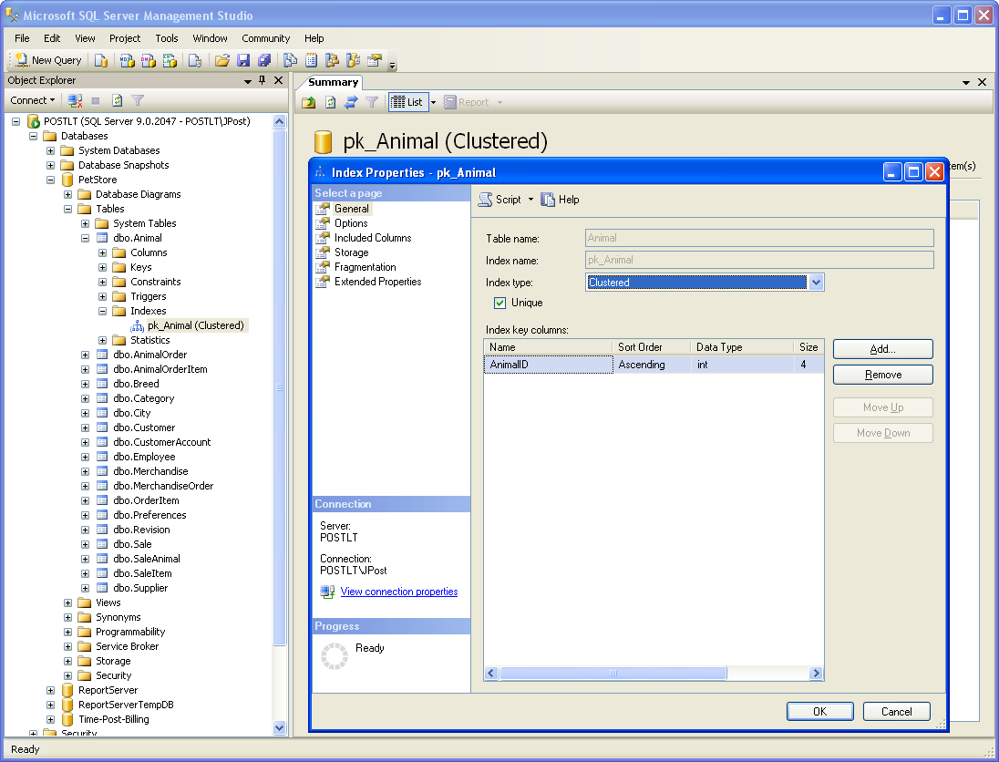
Creating Indexes: SQL Server Primary Key
Notes:
Index for primary key. SQL Server automatically generates and maintains indexes for primary key columns. Higher-end systems, such as SQL Server, provide several options to optimize the storage and use of indexes. These options can be used to improve the performance of your queries and applications.

Slide 10
SQL CREATE INDEX
CREATE INDEX ix_Animal_Category_Breed
ON Animal (Category, Breed)
Notes:
SQL CREATE INDEX command. The basic syntax is straightforward. Give the index a unique name, then specify the table and columns to be used. Most systems support additional options to control the details such as storage and type of index.

Slide 11
Indexed Sequential Storage
Address
Common uses
  Large tables.
  Need many sequential lists.
  Some random search--with one or two key columns.
  Mostly replaced by B+-Tree.
A11
A22
A32
A42
A47
A58
A63
A67
A78
A83
ID LastName FirstName DateHired
1 Reeves Keith 1/29/98
2 Gibson Bill 3/31/98
3 Reasoner Katy 2/17/98
4 Hopkins Alan 2/8/98
5 James Leisha 1/6/98
6 Eaton Anissa 8/23/98
7 Farris Dustin 3/28/98
8 Carpenter Carlos 12/29/98
9 O'Connor Jessica 7/23/98
10 Shields Howard 7/13/98
ID Pointer
1 A11
2 A22
3 A32
4 A42
5 A47
6 A58
7 A63
8 A67
9 A78
10 A83
LastName Pointer
Carpenter A67
Eaton A58
Farris A63
Gibson A22
Hopkins A42
James A47
O'Connor A78
Reasoner A32
Reeves A11
Shields A83
Indexed for ID and LastName

Slide 12
Linked List
Separate each element/key.
Pointers to next element.
Pointers to data.
Starting point.
A67
8 Carpenter Carlos 12/29/98
A22
2 Gibson Bill 3/31/98
A58
6 Eaton Anissa 8/23/98
A63
7 Farris Dustin 3/28/98
B87
Carpenter
B29
A67
B38
Gibson
00
A22
B29
Eaton
B71
A58
B71
Farris
B38
A63

Slide 13
B-Tree (Detail in Chapter 12)
Store key values
Utilize binary search (or better).
Trees
  Nodes
  Root
  Leaf (node with no children)
  Levels / depth
  Degree (maximum number of children per node)
<
Key
Data
>=
Hanson
Dorfmann
Kalida
Brown
Farriis
Inez
Miranda
Adams
Cadiz
Eaton
Goetz
Inez
Jones
Lomax
Norman
A
B
C
D
E
F
G
H
I
J
K
L
M
N

Slide 14
Index Options: Bitmaps and Statistics
Bitmap index
  A compressed index designed for non-primary key columns. Bit-wise operations can be used to quickly match WHERE criteria.
Analyze statistics
  By collecting statistics about the actual data within the index, the DBMS can optimize the search path. For example, if it knows that only a few rows match one of your search conditions in a table, it can apply that condition first, reducing the amount of work needed to join tables.

Slide 15
Problems with Indexes
Each index must be updated when rows are inserted, deleted or modified.
Changing one row of data in a table with many indexes can result in considerable time and resources to update all of the indexes.
Steps to improve performance
  Index primary keys
  Index common join columns (usually primary keys)
  Index columns that are searched regularly
  Use a performance analyzer

Slide 16
Data Warehouse
Predefined
reports
Interactive
data analysis
Operations
data
Daily data
transfer
OLTP Database
3NF tables
Data warehouse
Star configuration
Flat files
Notes:
Data warehouse. Data from the OLTP system and other sources is cleaned and transferred into a data warehouse on a regular basis. The data warehouse is optimized for interactive data analysis.

Slide 17
Data Warehouse Goals
Existing databases optimized for Online Transaction Processing (OLTP)
Online Analytical Processing (OLAP) requires fast retrievals, and only bulk writes.
Different goals require different storage, so build separate dta warehouse to use for queries.
Extraction, Transformation, Loading (ETL)
Data analysis
  Ad hoc queries
  Statistical analysis
  Data mining (specialized automated tools)

Slide 18
Extraction, Transformation, and Loading (ETL)
Customers
Convert Client to Customer
Apply standard product numbers
Convert currencies
Fix region codes
Data warehouse:
All data must be consistent.
Transaction data from diverse systems.
Notes:
Extraction, transformation, and transportation (ETT). Transaction data usually has to be modified to make it completely consistent. This process must be automated so it can run unattended on a regular schedule.

Slide 19
OLTP v. OLAP

Slide 20
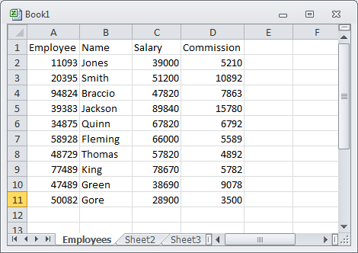
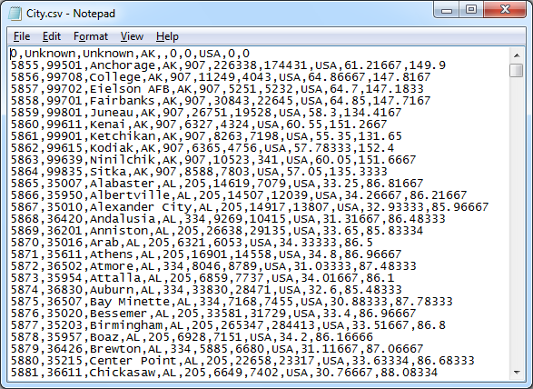
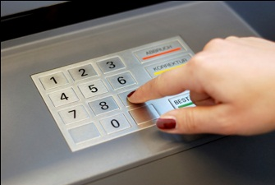
ETL Data Sources
SQL Database
Spreadsheet
Data Warehouse
CSV File
Proprietary Files

Slide 21
Problems with Timing
Export
Bulk loader
Spreadsheet
CSV File
Data Warehouse
Need to set a timer to automate the data export.
Timer runs in operating system, so you need an OS program to control the tool (Excel).
The bulk loader must run after the CSV file has been created.
If anything goes wrong, it will be difficult to fix automatically and a person probably needs to be called.

Slide 22
ETL Tools
Get data into SQL to use its power to compare and transform data.
Dynamic Distributed Link Connection
  For SQL data sources, creates remote linked table that can be used in SQL statements.
  INSERT INTO warehouse table … SELECT * FROM remote…
  Sometimes for CSV.
Bulk Load
  Mostly for CSV sources.
  Often issues with date formats.
Local Source
  Sometimes need to push data from the source into a CSV file.
  Particularly from proprietary formats.
  Can be harder to automate.

Slide 23
Multidimensional Cube
Spider
Category
Fish
Dog
Cat
Bird
CA
1420
1258
1184
1098
1578
MI
437
579
683
873
745
Customer Location
NY
1011
1257
985
874
1256
TX
880
750
935
684
993
Jan
Feb
Mar
Apr
May
Time
Sale Month
Notes:
Multidimensional cube. The fact element is sales. The dimensions are location, time, and category. Managers are interested in various combinations of the dimensions, and can use a cube browser to look at various subtotals.

Slide 24
Sales Date: Time Hierarchy
Year
Levels
Roll-up
To get higher-level totals
Quarter
Month
Drill-down
To get lower-level details
Week
Day
Notes:
Drill down and Roll up. In a given dimension, drill down provides more detail. Roll up aggregates the values from subcategories.

Slide 25
OLAP Computation Issues
Quantity | Price | Quantity*Price
3 | 5.00 | 15.00
2 | 4.00 | 8.00
5 | 9.00 | 45.00 or 23.00
Compute Quantity*Price in base query, then add to get $23.00
If you use Calculated Measure in the Cube, it will add first and multiply second to get $45.00, which is wrong.
Notes:
Order of computations. Multiplications should be performed in a query that is used for the fact table to get the correct total of $23.00. Computing it in the cube calculation causes sums to be computed first and then multiplied to give the incorrect value of $45.00.

Slide 26
Snowflake Design
City
CityID
ZipCode
City
State
Merchandise
Sale
ItemID
Description
QuantityOnHand
ListPrice
Category
SaleID
SaleDate
EmployeeID
CustomerID
SalesTax
Customer
CustomerID
Phone
FirstName
LastName
Address
ZipCode
CityID
OLAPItems
SaleID
ItemID
Quantity
SalePrice
Amount
Dimension tables can join to other dimension tables.
Notes:
Snowflake design. It is less strict than the star design in that dimension tables can be joined to other dimension tables before being connected to the fact table.

Slide 27
Star Design
Dimension Tables
Products
Sales Date
Fact Table
Sales
Quantity
Amount=SalePrice*Quantity
Customer
Location
Notes:
Star OLAP design. The fact table holds the numeric data managers want to examine. The dimension tables hold the characteristics. In a star design, all dimension tables connect directly to the fact table.

Slide 28
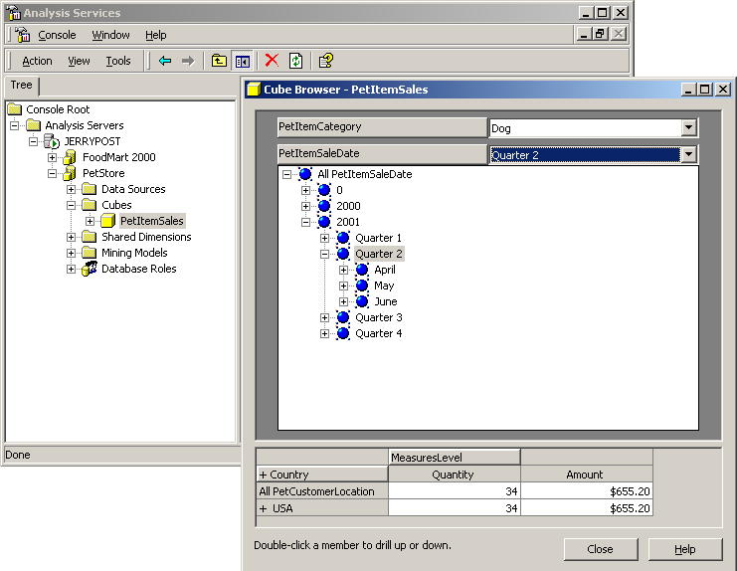
OLAP Data Browsing

Slide 29
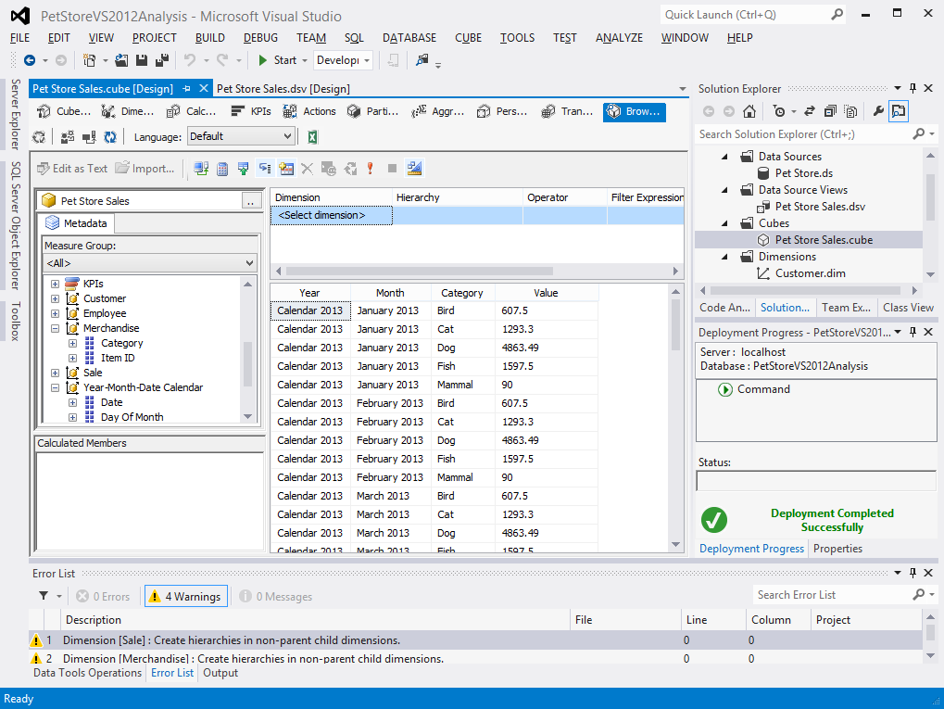
OLAB Cube Browser: SQL Server
Notes:
An OLAP cube browser. The time (SaleDate) dimension is shown in the table of data along with the merchandise Category. Users can change the display simply by dragging the dimensions on or off the grid. They can also add filter fields such as the State dimension. The year-month-date hierarchy enables users to drill down or roll up data. But Visual Studio 2013 – 2012 does not support separate column headings. All dimensions are rows—but this approach does make it easier to display multiple measures.

Slide 30
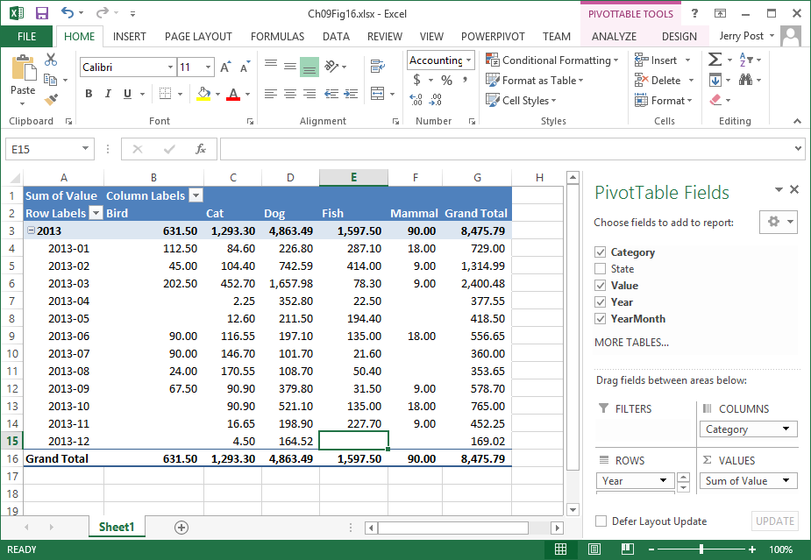
Microsoft PivotTable
Notes:
The Microsoft PivotTable is more flexible in supporting columns and rows of data. Simply drag items to the appropriate section (in the key window). If the cube has already been created in Visual Studio 2013 – 2013 you can click the Excel icon in the cube browser to open to Excel.
Using Access as the DBMS, create a query:
SELECT Year([SaleDate]) AS [Year], Format([SaleDate],"yyyy-mm") AS YearMonth, City.State, Merchandise.Category, [Quantity]*[SalePrice] AS [Value]
FROM City INNER JOIN (Customer INNER JOIN (Merchandise INNER JOIN (Sale INNER JOIN SaleItem ON Sale.SaleID = SaleItem.SaleID) ON Merchandise.ItemID = SaleItem.ItemID) ON Customer.CustomerID = Sale.CustomerID) ON City.CityID = Customer.CityID;

Slide 31
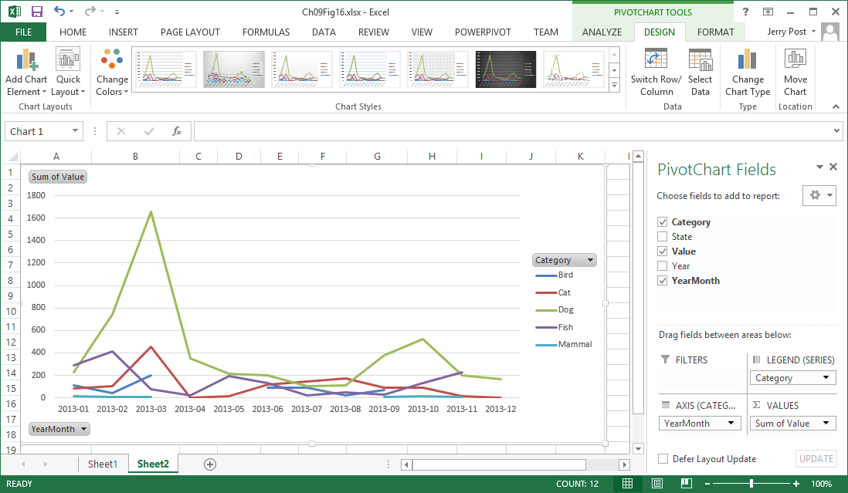
Microsoft PivotChart
Notes:
Microsoft PivotChart. Pivot tools make it easy for managers to examine cube data from any perspective, to select subsets of the data, to perform calculations, and to create charts.

Slide 32
SELECT with two GROUP BY Columns
Category | Month | Amount
Bird Bird ⋮ Cat Cat ⋮ | 1 2 ⋮ 1 2 ⋮ | 135.00 45.00 ⋮ 396.00 113.85 ⋮
SELECT Category, Month([SaleDate]) AS [Month],
Sum([SalePrice]*[Quantity]) AS Amount
FROM Merchandise
INNER JOIN (Sale INNER JOIN SaleItem
ON Sale.SaleID = SaleItem.SaleID)
ON Merchandise.ItemID = SaleItem.ItemID
GROUP BY Merchandise.Category, Month([SaleDate]);
Notes:
SELECT query with two GROUP BY columns. You get subtotals for each animal category for each month. You do not see totals across an entire category (Birds for all months), and you do not get the overall total.

Slide 33
SQL ROLLUP
SELECT Category, Month(SaleDate) As SaleMonth,
Sum(SalePrice*Quantity) As Amount
FROM Sale INNER JOIN SaleItem
ON Sale.SaleID=SaleItem.SaleID
INNER JOIN Merchandise ON
SaleItem.ItemID=Merchandise.ItemID
GROUP BY Category, Month(SaleDate) WITH ROLLUP;
Category | Month | Amount
Bird Bird ⋮ Bird Cat Cat ⋮ Cat ⋮ (null) | 1 2 ⋮ (null) 1 2 ⋮ (null) ⋮ (null) | 135.00 45.00 ⋮ 607.50 396.00 113.85 ⋮ 1293.30 ⋮ 8451.79
Notes:
ROLLUP option. Adding the ROLLUP option to the GROUP BY statement generates the super-aggregate totals. In this case, the query provides totals for each Category element and the overall total. Notice that the corresponding Month is a null value.

Slide 34
Missing Values Cause Problems
If there are missing values in the groups, it can be difficult to identify the super-aggregate rows.
Category Month Amount
Bird 1 135.00
Bird 2 45.00
…
Bird (null) 32.00
Bird (null) 607.50
Cat 1 396.00
Cat 2 113.85
…
Cat (null) 1293.30
…
(null) (null) 8451.79
Missing date
Super-aggregate

Slide 35
GROUPING Function
SELECT Category, Month…, Sum …,
GROUPING (Category) AS Gc,
GROUPING (Month) AS Gm
FROM …
GROUP BY ROLLUP (Category, Month...)
Category Month Amount Gc Gm
Bird 1 135.00 0 0
Bird 2 45.00 0 0
…
Bird (null) 607.50 1 0
Cat 1 396.00 0 0
Cat 2 113.85 0 0
…
Cat (null) 1293.30 1 0
…
(null) (null) 8451.79 1 1
Notes:
GROUPING function. The GROUPING function returns a value of one when the row
displayed is a super-aggregate for the selected column parameter.
SQL Server:
SELECT Category, Month(SaleDate) As SaleMonth,
Sum(SalePrice*Quantity) As Amount,
GROUPING (Category) AS Gc,
GROUPING (Month(SaleDate)) AS Gm
FROM Sale INNER JOIN SaleItem
ON Sale.SaleID=SaleItem.SaleID
INNER JOIN Merchandise ON
SaleItem.ItemID=Merchandise.ItemID
GROUP BY Category, Month(SaleDate) WITH ROLLUP;

Slide 36
CUBE Option
SELECT Category, Month, Sum, GROUPING (Category) AS Gc,
GROUPING (Month) AS Gm
FROM …
GROUP BY CUBE (Category, Month...)
Category Month Amount Gc Gm
Bird 1 135.00 0 0
Bird 2 45.00 0 0
…
Bird (null) 607.50 1 0
Cat 1 45.00 0 0
Cat 2 113.85 0 0
…
Cat (null) 1293.30 1 0
(null) 1 1358.82 0 1
(null) 2 1508.94 0 1
(null) 3 2362.68 0 1
…
(null) (null) 8451.79 1 1
Notes:
CUBE option. The CUBE option computes super-aggregate values for all columns in the GROUP BY statement. The rows near the bottom with the Gm indicator value of 1 are the totals by month for all categories of products.
SQL Server:
SELECT Category, Month(SaleDate) As SaleMonth,
Sum(SalePrice*Quantity) As Amount,
GROUPING (Category) AS Gc,
GROUPING (Month(SaleDate)) AS Gm
FROM Sale INNER JOIN SaleItem
ON Sale.SaleID=SaleItem.SaleID
INNER JOIN Merchandise ON
SaleItem.ItemID=Merchandise.ItemID
GROUP BY Category, Month(SaleDate) WITH CUBE;

Slide 37
GROUPING SETS: Hiding Details
SELECT Category, Month, Sum
FROM …
GROUP BY GROUPING SETS
( ROLLUP (Category),
ROLLUP (Month),
( )
)
Category Month Amount
Bird (null) 607.50
Cat (null) 1293.30
…
(null) 1 729.00
(null) 2 1358.82
(null) 3 2362.68
…
(null) (null) 8451.79
Notes:
GROUPING SETS to hide detail. The GROUPING function can be used to hide the details so users can focus on the super-aggregate totals.
SQL Server 2008:
SELECT Category, Month(SaleDate) As SaleMonth,
Sum(SalePrice*Quantity) As Amount,
GROUPING (Category) AS Gc,
GROUPING (Month(SaleDate)) AS Gm
FROM Sale INNER JOIN SaleItem
ON Sale.SaleID=SaleItem.SaleID
INNER JOIN Merchandise ON
SaleItem.ItemID=Merchandise.ItemID
GROUP BY GROUPING SETS(Category, Month(SaleDate));

Slide 38
SQL OLAP Analytical Functions
VAR_POP variance
VAR_SAMP
STDDEV_POP standard deviation
STDEV_SAMP
COVAR_POP covariance
COVAR_SAMP
CORR correlation
REGR_R2 regression r-square
REGR_SLOPE regression data (many)
REGR_INTERCEPT

Slide 39
SQL RANK Functions
SELECT Employee, SalesValue
RANK() OVER (ORDER BY SalesValue DESC) AS rank
DENSE_RANK() OVER (ORDER BY SalesValue DESC) AS dense
FROM Sales
ORDER BY SalesValue DESC, Employee;
Employee SalesValue rank dense
Jones 18,000 1 1
Smith 16,000 2 2
Black 16,000 2 2
White 14,000 4 3
DENSE_RANK does not skip numbers
Notes:
RANK functions. The sort order for the rank function is specified separately. Ties are given the same rank. RANK skips values that would have been assigned to tie values. DENSE_RANK does not skip values.
SQL SERVER
Query:
CREATE VIEW EmployeeSales AS
SELECT Sale.EmployeeID, Employee.LastName,
Sum(SalePrice*Quantity) As SalesValue
FROM Employee
INNER JOIN Sale
ON Sale.EmployeeID=Employee.EmployeeID
INNER JOIN SaleItem
ON Sale.SaleID=SaleItem.SaleID
GROUP BY Sale.EmployeeID, Employee.LastName
;
Go
SELECT LastName, SalesValue,
ROW_NUMBER() OVER (ORDER BY SalesValue DESC) As Row,
RANK() OVER (ORDER BY SalesValue DESC) AS rank,
DENSE_RANK() OVER (ORDER BY SalesValue DESC) AS dense
FROM EmployeeSales
ORDER BY SalesValue DESC, LastName;
Or
SELECT Employee.EmployeeID, Employee.LastName, Sum(SalePrice*Quantity) As SalesValue,
RANK() OVER (ORDER BY Sum(SalePrice*Quantity) DESC) As Rank,
DENSE_RANK() OVER (ORDER BY Sum(SalePrice*Quantity) DESC) As Dense_Rank
FROM SaleItem
INNER JOIN Sale ON Sale.SaleID = SaleItem.SaleID
INNER JOIN Employee ON Sale.EmployeeID=Employee.EmployeeID
GROUP BY Employee.EmployeeID, Employee.LastName

Slide 40
Intermediate Query
qryOLAPSQL99
CREATE VIEW qryOLAPSQL99 AS
SELECT Category,
Year(SaleDate)*100+Month(SaleDate) As SaleMonth,
Sum(SalePrice*Quantity) As MonthAmount
FROM Sale
INNER JOIN SaleItem
ON Sale.SaleID=SaleItem.SaleID
INNER JOIN Merchandise
ON SaleItem.ItemID=Merchandise.ItemID
GROUP BY Category, Year(SaleDate)*100+Month(SaleDate)
;

Slide 41
SQL OLAP Windows
SELECT Category, SaleMonth, MonthAmount,
AVG(MonthAmount)
OVER (PARTITION BY Category
ORDER BY SaleMonth ASC ROWS 2 PRECEDING)
AS MA
FROM qryOLAPSQL99
ORDER BY SaleMonth ASC;
Category | SaleMonth | MonthAmount | MA
Bird Bird Bird Bird ⋮ | 2013-01 2013-02 2013-03 2013-06 | 135 45 202.5 67.5 | 135 90 127.5 105
Cat Cat Cat Cat ⋮ | 2013-01 2013-02 2013-03 2013-04 | 396 113.85 443.7 2.25 | 396 254.925 317.85 186.6
Notes:
SQL-99 OLAP PARTITION versus GROUP BY. The window PARTITION statement enables you to display aggregate data (average) along with the detail rows. The GROUP BY statement only provides the summarized data. Also note the use of the PRECEDING statement in the partition to calculate across previous rows of data. This version is based on the Oracle syntax.
SQL SERVER
SELECT Category, SaleMonth, MonthAmount,
AVG(MonthAmount)
OVER (PARTITION BY Category) AS Avg
FROM dbo.qryOLAPSQL99
ORDER BY SaleMonth ASC;

Slide 42
SQL Server Partition Syntax
CREATE VIEW qryMonthlyMerchandise AS
SELECT Category,
Year(SaleDate)*100+Month(SaleDate) As SaleMonth,
sum(SalePrice*Quantity) As MonthAmount
FROM Sale INNER JOIN SaleItem ON Sale.SaleID=SaleItem.SaleID
INNER JOIN Merchandise ON Merchandise.ItemID=SaleItem.ItemID
GROUP BY Category, Year(SaleDate)*100+Month(SaleDate)
;
SELECT Category, SaleMonth, MonthAmount, AVG(MonthAmount)
OVER (PARTITION BY Category
ORDER BY SaleMonth ASC ROWS 2 PRECEDING)
AS MA
FROM qryMonthlyMerchandise
ORDER BY Category, SaleMonth;

Slide 43
Ranges: OVER
SELECT SaleDate, Value
SUM(Value) OVER (ORDER BY SaleDate) AS running_sum,
SUM(Value) OVER (ORDER BY SaleDate RANGE
BETWEEN UNBOUNDED PRECEDING
AND CURRENT ROW) AS running_sum2,
SUM (Value) OVER (ORDER BY SaleDate RANGE
BETWEEN CURRENT ROW
AND UNBOUNDED FOLLOWING) AS remaining_sum;
FROM …
ORDER BY …
Sum1 computes total from beginning through current row.
Sum2 does the same thing, but more explicitly lists the rows.
Sum3 computes total from current row through end of query.
Notes:
OVER and RANGE functions. The first SUM function computes the total from the beginning to through the current row. The second SUM function does the same thing more explicitly. The third SUM function totals the values from the current row through the remaining rows in the query.

Slide 44
OVER Function
-- Create a view to get the simple monthly merchandise totals
CREATE VIEW qryMonthlyTotal AS
SELECT SaleMonth, Sum(MonthAmount) As Value
FROM qryMonthlyMerchandise
GROUP BY SaleMonth;
SELECT SaleMonth, Value,
SUM(Value) OVER (ORDER BY SaleMonth) AS running_sum,
SUM(Value) OVER (ORDER BY SaleMonth RANGE
BETWEEN UNBOUNDED PRECEDING
AND CURRENT ROW) AS running_sum2,
SUM (Value) OVER (ORDER BY SaleMonth RANGE
BETWEEN CURRENT ROW
AND UNBOUNDED FOLLOWING) AS remaining_sum
FROM qryMonthlyTotal
ORDER BY SaleMonth;

Slide 45
OVER Function Results
Month | Value | Sum1 | Sum2 | Remain
2013-01 2013-02 2013-03 2013-04 2013-05 2013-06 2013-07 2013-08 2013-09 2013-10 2013-11 2013-12 | 1358.82 1508.94 2362.68 377.55 418.50 522.45 168.30 162.70 288.90 666.00 452.25 164.70 | 1358.82 2867.76 5230.44 5607.99 6026.49 6548.94 6717.24 6879.94 7168.84 7834.84 8287.09 8451.79 | 1358.82 2867.76 5230.44 5607.99 6026.49 6548.94 6717.24 6879.94 7168.84 7834.84 8287.09 8451.79 | 8451.79 7092.97 5584.03 3221.35 2843.80 2425.30 1902.85 1734.55 1571.85 1282.95 616.95 164.70

Slide 46
LAG and LEAD Functions
LAG or LEAD: (Column, # rows, default)
SELECT SaleMonth, Value,
LAG(Value, 1, 0) OVER (ORDER BY SaleMonth) AS Prior_Month,
LEAD(Value,1,0) OVER (ORDER BY SaleMonth) AS Next_Month
FROM qryMonthlyTotal
ORDER BY SaleMonth
Prior is 0 from default value
SaleMonth | MonthAmount | Prior_Month | Next_Month
2013-01 2013-02 2013-03 ⋮ 2013-12 | 1358.82 1508.94 2362.68 ⋮ 164.70 | 0 1358.82 1508.94 ⋮ 452.25 | 1508.94 2362.68 377.55 ⋮ 0
Not part of standard yet? But are in SQL Server and Oracle.
Notes:
LAG and LEAD functions. As inline functions, they easily return a value from a prior or following line. You can specify how many lines to go backward or forward.

Slide 47
Data Mining
Goal: To discover unknown relationships in the data that can be used to make better decisions.
Transactions and operations
Reports
Specific ad hoc questions
Queries
Aggregate, compare, drill down
OLAP
Databases
Unknown relationships
Data Mining
Notes:
Data mining. With a goal of identifying unknown relationships. Data mining is a bottom-up approach. Highly specialized tools scan the data searching for information that might be useful.

Slide 48
Exploratory Analysis
Data Mining usually works autonomously.
  Supervised/directed
  Unsupervised
  Often called a bottom-up approach that scans the data to find relationships
Some statistical routines, but they are not sufficient
  Statistics relies on averages
  Sometimes the important data lies in more detailed pairs

Slide 49
Common Techniques
Classification/Prediction/Regression
Association Rules/Market Basket Analysis
Clustering
  Data points
  Hierarchies
Neural Networks
Deviation Detection
Sequential Analysis
  Time series events
  Websites
Textual Analysis
Spatial/Geographic Analysis
Notes:
Data mining techniques. Classification and market basket analysis are popular technologies in business. New technologies and new methods of estimating relationships are still being developed.

Slide 50
Classification Examples
Examples
  Which borrowers/loans are most likely to be successful?
  Which customers are most likely to want a new item?
  Which companies are likely to file bankruptcy?
  Which workers are likely to quit in the next six months?
  Which startup companies are likely to succeed?
  Which tax returns are fraudulent?
Notes:
Classification examples. Many common business problems can benefit from classification analysis. Each problem has an outcome and the goal is to classify elements into the outcome choices based on a set of attributes.

Slide 51
Classification Process
Clearly identify the outcome/dependent variable.
Identify potential variables that might affect the outcome.
  Supervised (modeler chooses)
  Unsupervised (system scans all/most)
Use sample data to test and validate the model.
System creates weights that link independent variables to outcome.
Income | Married | Credit History | Job Stability | Success
50000 | Yes | Good | Good | Yes
25000 | Yes | Bad | Bad | No
75000 | No | Good | Good | No
Notes:
Bank loan classification. The indicator attributes affect the outcome in some fashion. The data mining software estimates the strength of each attribute on a set of test data. The resulting model can be applied to future data to predict the potential success or failure of new loans.

Slide 52
Classification Techniques
Regression
Bayesian Networks
Decision Trees (hierarchical)
Neural Networks
Genetic Algorithms
Complications
  Some methods require categorical data
  Data size is still a problem

Slide 53
Data For Classification
Columns/Attributes
Sales | Year_Month | Employee | SaleState
59510 | 201301 | 15 | CA
35202 | 201301 | 16 | OR
63039 | 201302 | 15 | CA
29281 | 201301 | 15 | OR
48402 | 201302 | 16 | CA
57812 | 201303 | 15 | CA
Each row is one instance.
SELECT Sum(Price*Quantity) As Sales,
Year(SaleDate)*100+Month(SaleDate) As Year_Month,
EmployeeID, SaleState
FROM …

Slide 54
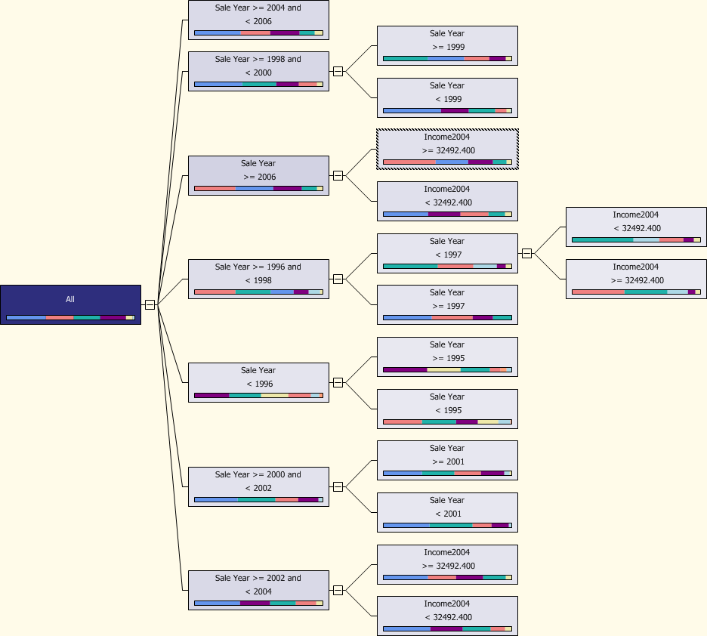
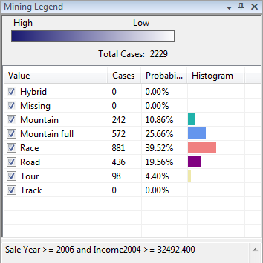
Classification Example: Decision Tree for Model Type
Attributes tested: Gender, SaleYear, Income, and city Population

Slide 55
Association/Market Basket
Examples
  What items are customers likely to buy together?
  What Web pages are closely related?
  Others?
Classic (early) example:
  Analysis of convenience store data showed customers often buy diapers and beer together.
  Importance: Consider putting the two together to increase cross-selling.

Slide 56
Association Details (two items)
Rule evaluation (A implies B)
  Support for the rule is measured by the percentage of all transactions containing both items: P(A ∩ B)
  Confidence of the rule is measured by the transactions with A that also contain B: P(B | A)
  Lift is the potential gain attributed to the rule—the effect compared to other baskets without the effect. If it is greater than 1, the effect is positive:
    P(A ∩ B) / ( P(A) P(B) )
    P(B|A)/P(B)
Example: Diapers implies Beer
  Support: P(D ∩ B) = .6 P(D) = .7 P(B) = .5
  Confidence: P(B|D) = .857 = P(D ∩ B)/P(D) = .6/.7
  Lift: P(B|D) / P(B) = 1.714 = .857 / .5
Notes:
Evaluating a market basket association. Support is the percentage of both items being purchased in one transaction. Confidence is the probability of purchasing beer (B) given that diapers (D) are purchased. Lift is the contribution of the effect to sales and should be greater than 1.

Slide 57
Association Challenges
If an item is rarely purchased, any other item bought with it seems important. So combine items into categories.
Item | Freq.
1 “ nails | 2%
2” nails | 1%
3” nails | 1%
4” nails | 2%
Lumber | 50%
Item | Freq.
Hardware | 15%
Dim. Lumber | 20%
Plywood | 15%
Finish lumber | 15%
Some relationships are obvious.
  Burger and fries.
Some relationships are meaningless.
  Hardware store found that toilet rings sell well only when a new store first opens. But what does it mean?
Notes:
Balanced frequencies. Items that are rarely purchased will lead to false rules. The solution is to define the items so that they balance. In this case, combine nails into a hardware category and split lumber into smaller categories.

Slide 58
Data for Association
Transaction
Basket
SaleID | ItemID | Description | Category
4 | 36 | Leash | Dog
4 | 1 | Dog Kennel-Small | Dog
6 | 20 | Wood Shavings/Bedding | Mammal
6 | 21 | Bird Cage-Medium | Bird
7 | 40 | Litter Box-Covered | Cat
7 | 19 | Cat Litter-10 pound | Cat
7 | 5 | Cat Bed-Small | Cat
8 | 16 | Dog Food-Can-Premium | Dog
8 | 36 | Leash | Dog
8 | 11 | Dog Food-Dry-50 pound | Dog
36, 1
20, 21
40, 19, 5
16, 36, 11
SELECT SaleItem.SaleID, SaleItem.ItemID, Merchandise.Description, Merchandise.Category
FROM Merchandise
INNER JOIN SaleItem
ON Merchandise.ItemID = SaleItem.ItemID
ORDER BY SaleItem.SaleID;
Need to write cursor code that builds a comma-separated string for each SaleID.
Specify SaleID as the transaction identifier.

Slide 59
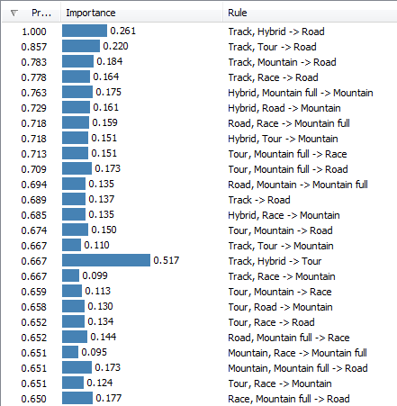
Example: Model Types by Customer

Slide 60
Cluster Analysis
Examples
  Are there groups of customers? (If so, we can cross-sell.)
  Do the locations for our stores have elements in common? (So we can search for similar clusters for new locations.)
  Do our employees (by department?) have common characteristics? (So we can hire similar, or dissimilar, people.)
Problem: Many dimensions and large datasets
Large intercluster distance
Small intracluster distance
Notes:
Cluster analysis. The goal is to find data points that are grouped close to each other and farther from other groups. Larger datasets with multiple dimensions are difficult and time-consuming to evaluate.

Slide 61
Data for Cluster Analysis
Attributes are columns
Sales | Age
55032 | 35
38394 | 15
84940 | 27
47482 | 16
22502 | 23
48490 | 46
39309 | 56
Each row represents one combination/point

Slide 62
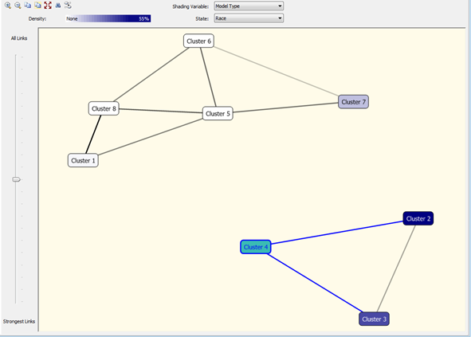
Cluster Example: Bicycle
Mountain and Hybrid
Road, Race, Track
Attributes: model type, construction type (a proxy for material used), order year, sale price, bike size, and time to build.

Slide 63
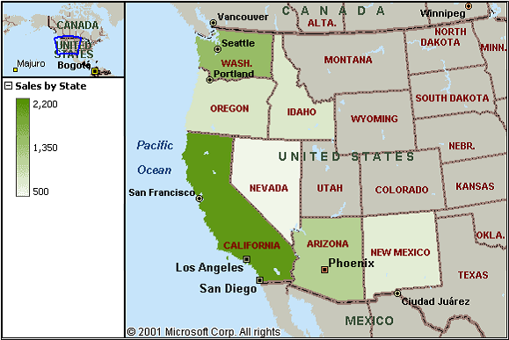
Geographic/Location
Examples
  Customer location and sales comparisons
  Factory sites and cost
  Environmental effects
Challenge: Map data, multiple overlays
Notes:
Geographic analysis. This basic map shows sales by state. As shown by the key, darker colors represent larger sales. Additional data, such as income, could be shown as overlays or compared in charts.

Slide 64
Data for Geographic Analysis
Attributes are columns.
At least one column must contain geographic location.
State | Sales
CA | 50381
WA | 42145
OR | 36208
ID | 28891
AZ | 46784
UT | 38987
NV | 32889
Each row represents one location.
Location can be many things.
State
Country
Region (custom defined)
Latitude, Longitude
Address
City
County
ZIP Code
Census Tract
Standard Metropolitan Statistical Area

Slide 65
Bicycle Sales by State for 2009

