Slide 1
Database Management Systems
Chapter 10
Database Administration

Slide 2
Objectives
What administrative tasks need to be performed with a database application?
How do you ensure data is consistent across multiple databases?
What are the basic tasks of a database administrator?
How does a DBMS support multiple databases?
How does a DBA find out what is stored in each database?
What DBA tasks need to be performed as an application is developed?
How do you back up data that is constantly changing?
How should computers be configured for DMBS software and database files?
What security techniques are used to protect databases?
How do you prevent eavesdroppers or hackers from reading data?
What security conditions would be needed at Sally’s Pet Store?

Slide 3





Data Administration
Data and information are valuable assets.
There are many databases and applications in an organization.
Someone has to be responsible for organizing, controlling, and sharing data.
Data Administrator (DA)
Notes:
Data administration. With many projects and developers, a data administrator coordinates the projects so data can be integrated across applications.

Slide 4
Data Administrator (DA)
Provide centralized control over the data.
  Data definition.
    Format
    Naming convention
  Data integration.
  Selection of DBMS.
Act as data and database advocate.
  Application ideas.
  Decision support.
  Strategic uses.
Coordinate data integrity, security, privacy, and control.
Notes:
Data administrator roles. The DA is responsible for maintaining the quality of the data and for integrating data across the organization. The DA also advocates the use of databases and is often in charge of security.

Slide 5
Database Administrator (DBA)
Install and upgrade DBMS.
Create user accounts and monitor security.
In charge of backup and recovery of the database.
Monitor and tune the database performance.
Coordinate with DBMS vendor and plan for changes.
Maintain DBMS-specific information for developers.
Notes:
Database administrator roles. The DBA tasks are fairly technical and require daily monitoring and changes to the DBMS.

Slide 6
Database Structure
Database
The schema is a namespace often assigned to users so that table names do not have to be unique across the entire database.
The catalog is a container with the goal of making it easier to find schema, but is probably not supported by any DBMS yet.
Users and Permissions
Catalog: (very rare)
Schema
Table
Columns
Data types
Constraints
Views
Triggers
Routines and Modules
…
Notes:
Database structure. The schema serves as a container for other elements to minimize potential naming conflicts.

Slide 7
Use of Schemas
Database: MyBusiness
Schema: HR
Tables:
Employee
Payroll
Vacation
…
Schema: Recreation
Tables:
Employee
Teams
…
Table with same name, but no conflict:
MyBusiness.HR.Employee
MyBusiness.Recreation.Employee

Slide 8
Metadata
Data about data
  Example: a system table that contains a list of user tables.
SQL standard uses the information_schema views that retrieve data from the definition_schema
Information_Schema Examples
(61 total views)
Schemata
Tables
Domains
Views
Table_Privileges
Referential_Constraints
Check_Constraints
Triggers
Trigger_Table_Usage
Parameters
Routines
SELECT Table_Name, Table_Type
FROM Information_Schema.Tables
WHERE table_name LIKE ‘Emp%’
Notes:
Information Schema. A few of the 61 views in the standard are listed on the left. The sample query shows how DBAs can query the metadata views to quickly find a specific item.

Slide 9
MetaData Examples
SELECT MSysObjects.Name, MSysObjects.Type
FROM MSysObjects
WHERE MSysObjects.Name Like "EMP*";
Access
SELECT *
FROM sys.tables
WHERE name Like N'Emp%';
SQL Server
SELECT *
FROM ALL_TABLES
WHERE TABLE_NAME Like ‘Emp%’;
Oracle
SELECT *
FROM INFORMATION_SCHEMA.TABLES
WHERE TABLE_NAME LIKE N'Emp%';
SQL Standard

Slide 10
Database Administration
Planning
  Determine hardware and software needs.
Design
  Estimate space requirements, estimate performance.
Implementation
  Install software, create databases, transfer data.
Operation
  Monitor performance, backup and recovery.
Growth and Change
  Monitor and forecast storage needs.
Security
  Create user accounts, monitor changes.

Slide 11
Database Planning
Estimation
  Data storage requirements
  Time to develop
  Cost to develop
  Operations costs

Slide 12
Managing Database Design
Teamwork
  Data standards
  Data repository
  Reusable objects
  CASE tools
  Networks / communication
Subdividing projects
  Delivering in stages
    User needs / priorities
    Version upgrades
  Normalization by user views
    Distribute individual sections
    Combine sections
  Assign forms and reports
Notes:
Managing database design. Database design requires teamwork and standards to ensure that individual components can be integrated into a complete application. CASE tools and networks improve communication through a centralized repository of design data.

Slide 13
Database Implementation
Standards for application programming.
  User interface.
  Programming standards.
    Layout and techniques.
    Variable & object definition.
  Test procedures.
Data access and ownership.
Loading databases.
Backup and recovery plans.
User and operator training.
Notes:
Implementation management. The user interface must be carefully chosen. Programming standards and test procedures help ensure compatibility of the components and provide quality control. Business managers should be assigned ownership of the data, so they can make final determinations of security conditions and quality. Backup and recovery plans have to be created and tested. Training programs have to be created for operators and users.

Slide 14
Database Operation and Maintenance
Monitoring usage
  Size and growth
  Performance / delays
  Security logs
  User problems
Backup and recovery
User support
  Help desk
  Training classes

Slide 15
Database Growth and Change
Detect need for change
  Size and speed
  Structures / design
    Requests for additional data.
    Difficulties with queries.
  Usage patterns
  Forecasts
Delays in implementing changes
  Time to recognize needs.
  Time to get agreement and approval.
  Time to install new hardware.
  Time to create / modify software.

Slide 16
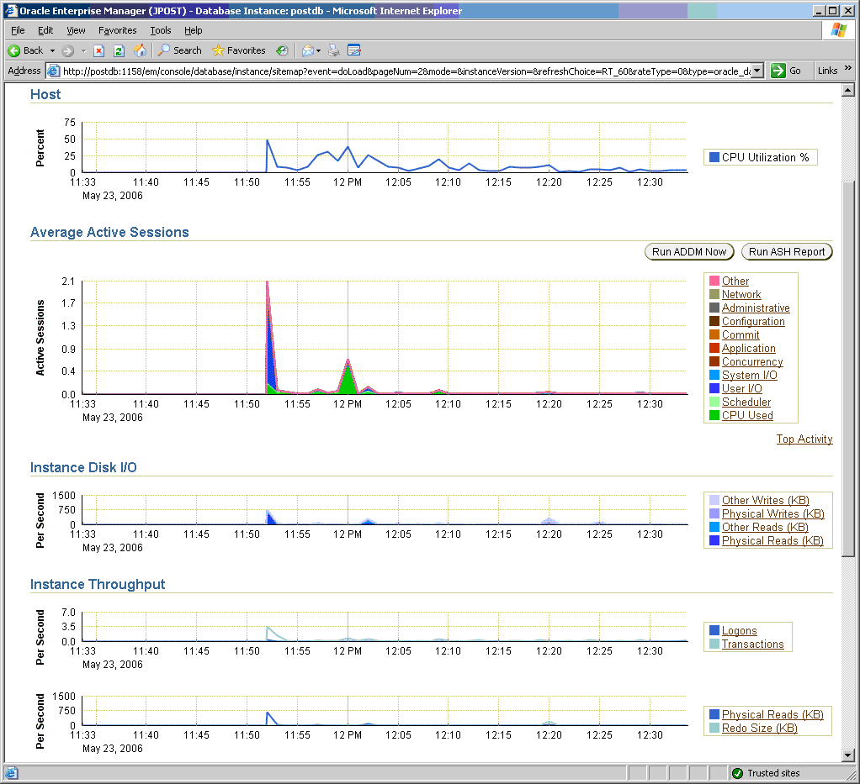
Database Monitoring
Notes:
Oracle’s basic performance monitoring statistics. The load on this server is minimal, but the DBA can watch these charts on a regular basis to spot problems and identify trends.

Slide 17
Backup and Recovery
Changes
OrdID Odate Amount ...
192 2/2/13 252.35 …
193 2/2/13 998.34 …
OrdID Odate Amount ...
192 2/2/13 252.35 …
193 2/2/13 998.34 …
194 2/2/13 77.23 ...
Journal/Log
Snapshot
Ins 194 2/2/13 77.23…
Upd 194 Amount=77.28
Ins 195 2/2/13 101.52…
OrdID Odate Amount ...
192 2/2/13 252.35 …
193 2/2/13 998.34 …
194 2/2/13 77.28 …
195 2/2/13 101.52 …
Notes:
Backup of a changing database. Backup takes a snapshot at one point in time. New changes are stored in the journal or log. Recovery loads snapshot and adds or deletes changes in the journal.

Slide 18
Backups
Backups are crucial!
Offsite storage!
Scheduled backup.
  Regular intervals.
  Record time.
  Track backups.
Journals / logs
Checkpoint
Rollback / Roll forward
Modern:
Simultaneous writes for duplicates

Slide 19
RAID Drives
Drive 1
Drive 2
Drive 3
Drive 4
Drive 5
Row 1
Row 1
Row 2
Row 2
Notes:
RAID drives. Pieces of data, such as a row, are written on two different drives. Other rows are spread across drives so that multiple disk reads and writes can occur at the same time to dramatically improve performance.

Slide 20
Virtual Machine
VMs with own operating systems
DBMS
Base Operating System with Hypervisor
Computer/ Processor/ Memory
Set up a new, clean VM and install the DBMS software.
VMs are easy to backup and restore.
Plus security access to that VM can be controlled.

Slide 21
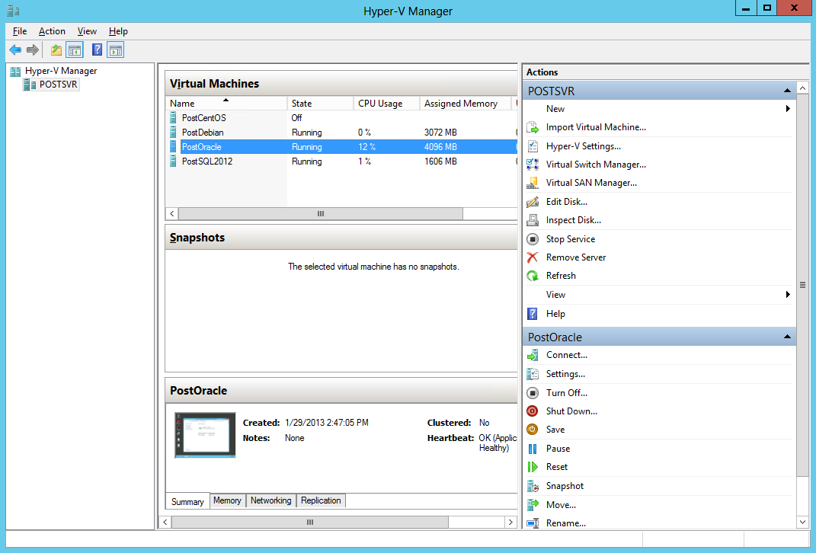
Hyper-V Management

Slide 22

Physical Configuration
DBMS VM
Backup
DBMS
Network attached storage (RAID drives)
Server
The DBMS software runs on a VM on the server.
The database files are on RAID drives on a network-attached storage box with its own backup.
Log files are stored on separate drives.

Slide 23
Database Security and Privacy
Physical security
  Protecting hardware
  Protecting software and data.
Logical security
  Unauthorized disclosure
    Confidentiality
  Unauthorized modification
    Integrity
  Unauthorized withholding
    Access
Behavioral Security
  Users make mistakes
    Give out passwords
    Insert “found” USB drives…
  Training helps but not perfect
Security Threats
  Employees / Insiders
    Disgruntled employees
    “Terminated” employees
    Dial-up / home access
  Programmers
    Time bombs
    Trap doors
  Visitors
  Consultants
  Business partnerships
    Strategic sharing
    EDI
  Hackers--Internet

Slide 24



Data Privacy
Who owns data?
Customer rights.
International complications.
Do not release data to others.
Do not read data unnecessarily.
Report all infractions and problems.
Privacy tradeoffs
Marketing needs
Government requests
Employee management
Notes:
Privacy. Many reasons exist to collect and analyze data. People might find some reasons invasive. Although few privacy laws exist, businesses and database administrators should consider the implications and trade-offs of using this data

Slide 25
Physical Security
Hardware
  Preventing problems
    Fire prevention
    Site considerations
    Building design
  Hardware backup facilities
    Continuous backup (mirror sites)
    Hot sites
    Shell sites
    “Sister” agreements
  Telecommunication systems
  Personal computers
Data and software
  Backups
  Off-site backups
  Personal computers
    Policies and procedures
    Network backup
Disaster planning
  Write it down
  Train all new employees
  Test it once a year
  Telecommunications
Allowable time between disaster and business survival limits.
Notes:
Physical security controls. Backup data is the most important step. Having a place to move to is a second step. Disaster plans and prevention help prevent problems and make recovery faster.

Slide 26
Physical Security Provisions
Backup data.
Backup hardware.
Disaster planning and testing.
Prevention.
  Location.
  Fire monitoring and control.
  Control physical access.
Continuous backups/duplicate facilities
  Multiple data centers with shared load
  Cloud-based operations

Slide 27
Managerial Controls
“Insiders”
  Hiring
  Termination
  Monitoring
  Job segmentation
  Physical access limitations
    Locks
    Guards and video monitoring
    Badges and tracking
Consultants and Business alliances
  Limited data access
  Limited physical access
  Paired with employees

Slide 28
Logical Security
Unauthorized disclosure.
Unauthorized modification.
Unauthorized withholding.
Disclosure example
  Letting a competitor see the strategic marketing plans.
Modification example
  Letting employees change their salary numbers.
Withholding example
  Preventing a finance officer from retrieving data needed to get a bank loan.
Notes:
Logical security problems. Each situation can cause problems for the company, including financial loss, lost time, lost sales, or destruction of the company.

Slide 29
User Identification
User identification
Accounts
  Individual
  Groups
Passwords
  Do not use “real” words.
  Do not use personal (or pet) names.
  Include non-alphabetic characters.
  Use at least 8 characters.
  Change it often.
  Too many passwords!
Alternative identification
  Finger / hand print readers
  Voice
  Retina (blood vessel) scans
  DNA typing
  Iris
Hardware passwords
  The one-minute password.
  Card matched to computer.
  Best method for open networks / Internet.
Notes:
Password suggestions. Pick passwords that are not in a dictionary and are hard to guess. The catch is, Can you remember a convoluted password?

Slide 30
Basic Security Ideas
Limit access to hardware
  Physical locks.
  Video monitoring.
  Fire and environment monitors.
  Employee logs / cards.
  Dial-back modems
Monitor usage
  Hardware logs.
  Access from network nodes.
  Software and data usage.
Background checks
  Employees
  Consultants

Slide 31
Access Controls
Operating system
  Access to directories
    Read
    View / File scan
    Write
    Create
    Delete
  Access to files
    Read
    Write
    Edit
    Delete
  DBMS usually needs most of these
  Assign by user or group.
DBMS access controls
  Read Data
  Update Data
  Insert Data
  Delete Data
  Open / Run
  Read Design
  Modify Design
  Administer
Owners and administrator
Need separate user identification / login to DBMS.
Notes:
DBMS privileges. These privileges apply to the entire table or query. The first three (read, update, and insert) are commonly used. The design privileges are usually granted only to developers.

Slide 32
SQL Security Commands
GRANT privileges
REVOKE privileges
Privileges include
  SELECT
  DELETE
  INSERT
  UPDATE
Objects include
  Table
  Table columns (SQL 92+)
  Query
Users include
  Name/Group
  PUBLIC
GRANT INSERT
ON Bicycle
TO OrderClerks
REVOKE DELETE
ON Customer
FROM Assemblers
Notes:
SQL security commands. Most systems also provide a visual tool to assign and revoke access rights.

Slide 33
WITH GRANT OPTION
GRANT SELECT
ON Bicycle
TO MarketingChair
WITH GRANT OPTION
Enables the recipient to also grant the specified privilege to other users. It passes on part of your authority.

Slide 34

Roles
ItemID | Description | Price | QOH
111 | Dog Food | 0.95 | 53
222 | Cat Food | 1.23 | 82
333 | Bird Food | 3.75 | 18
Items: SELECT
Customers: SELECT, UPDATE
Sales: SELECT, UPDATE, INSERT
CustomerID | LastName | FirstName | Phone
1111 | Wilson | Peta | 2222
1112 | Pollock | Jackson | 3333
1113 | Locke | Jennifer | 4444
SalesID | SaleDate | CustomerID
111 | 03-May- | 1112
112 | 04-May- | 1112
113 | 05-May- | 1113
Role: SalesClerk
Assign permissions to the role.
New hire:
Add role to person
Notes:
Database roles. Create a role and assign permissions to the role. When an employee is added or released, you simply assign or remove the desired roles to instantly provide the appropriate permissions.

Slide 35
Using Queries for Control
Permissions apply to entire table or query.
Use query to grant access to part of a table.
Example
  Employee table
  Give all employees read access to name and phone (phonebook).
  Give managers read access to salary.
SQL
  Grant
  Revoke
Employee(ID, Name, Phone, Salary)
Query: Phonebook
SELECT Name, Phone
FROM Employee
Security
Grant Read access to Phonebook
for group of Employees.
Grant Read access to Employee
for group of Managers.
Revoke all access to Employee
for everyone else (except Admin).
Notes:
Security using queries. You wish to let all employees look up worker phone numbers. But employees should not be able to see salaries. Define a query that contains only the data needed, and then give employees access to the query—not to the original table.

Slide 36
Separation of Duties
Supplier
Purchasing manager can add new suppliers, but cannot add new orders.
SupplierID Name …
673 Acme Supply
772 Basic Tools
983 Common X
Resource | Purchasing Manager | Purchasing Clerk
Supplier table | Select, Insert, Modify, Delete | Select
PurchaseOrder table PurchaseItem table | Select | Select, Insert, Modify, Delete
Referential
integrity
PurchaseOrder
Clerk must use SupplierID from the Supplier table, and cannot add a new supplier.
OrderID SupplierID
8882 772
8893 673
8895 009
Notes:
Separation of duties. The clerk cannot create a fake supplier. Referential integrity forces the clerk to enter a SupplierID from the Supplier table, and the clerk cannot add a new row to the Supplier table.

Slide 37
Securing an Access Database
Realistically, if you need a secure database, avoid Access and use SQL Server, Oracle, DB2, PostgreSQL, or maybe MySQL.
Basic Access Steps:
Set up a secure workgroup
  Create a new Admin user.
  Enable security by setting a password
  Remove the original Admin user.
Run the Security Wizard in the database to be secured.
Assign user and group access privileges in the new database.
  Encrypt the new database.
Save it as an MDE (ACCDE) file.

Slide 38

Encryption
Plain text
message
Protection for open transmissions
  Networks
  The Internet
  Weak operating systems
Single key (AES)
Dual key
  Protection
  Authentication
Trap doors / escrow keys
U.S. export limits
  64 bit key limit
  Breakable by brute force
    Typical hardware:2 weeks
    Special hardware: minutes
AES
Key: 9837362
Encrypted
text
Single key: e.g., AES
Encrypted
text
AES
Key: 9837362
Plain text
message
Notes:
Single-key encryption. The same key is used to encrypt and decrypt the message. Distributing and controlling access to keys becomes a major problem when several users are involved.

Slide 39
Dual Key Encryption
Message
Message
Transmission
Alice
Encrypt+A
Encrypt+A
Private Key
13
Use
Alice’s
Private key
Bob
Public Keys
Alice 29
Bob 17
Use
Alice’s
Public key
Private Key
37
Notes:
Dual-key encryption. Bob sends a message to Alice. Alice publishes here public key, which Bob uses to encrypt the message. Only Alice can read the message, because she is the only one who has access to her matching private key.

Slide 40
Dual Key Encryption + Authentication
Message
Transmission
Message
Encrypt+T+M
Alice
Encrypt+M
Encrypt+T
Private Key
13
Bob
Use
Alice’s
Private key
Public Keys
Alice 29
Bob 17
Private Key
37
Use
Bob’s
Private key
Use
Bob’s
Public key
Use
Alice’s
Public key
* Using Bob’s private key ensures it came from him.
* Using Alice’s public key means only she can read it.
Notes:
Dual-key encryption. Bob sends a message to Alice. Alice publishes here public key, which Bob uses to encrypt the message. Only Alice can read the message, because she is the only one who has access to her matching private key.

Slide 41
Sally’s Pet Store: Security
Management
Sally/CEO
Sales Staff
Store manager
Sales people
Business Alliances
Accountant
Attorney
Suppliers
Customers
Products
Sales
Purchases
Receive products
Animals
Sales/Adoptions
Animal Healthcare
Employees
Hiring/Release
Hours
Pay checks
Accounts
Payments
Receipts
Management Reports
Operations
Users
Notes:
Initial list of user groups for Sally’s Pet Store.
Primary operations at Sally’s Pet Store. All of these transactions will have forms or reports built into the database.

Slide 42
Sally’s Pet Store: Purchases
Purchase | Purchase Query |  |  |  | PurchaseItem Query
 | Merch. Order | Supplier | Employee | City | Order Item | Merch.
Sally/CEO | SIUD | SIUD | SIUD | SIUD | SIUD | SIUD
Store Mgr. | SIUD | S* | SIUD | SIUD | I | SIUD
Salespeople | S | S* | S: ID, Name | S | S | S
Accountant | S | S* | S: ID, Name | S | S | S
Attorney | - | - | - | - | - | -
Suppliers | S | S* | - | S | S | S
Customers | - | - | - | - | - | -
S: Select, I: Insert, U: Update, D: Delete
Notes:
Permissions for purchases. Notice that only the owner can add new suppliers, and only top-level managers can create new orders.

