Slide 1
Database Management Systems
Chapter 13
Non-Relational Databases

Slide 2
Objectives
Why would anyone need a non-relational database?
What are the main features of non-relational databases?
How are databases designed and queried using Cassandra?
How does cloud computing benefit key-value pair databases?

Slide 3
Relational v Key-Value Pairs
CID | LastName | FirstName | Email
101 | Brown | Bobby | BBrown@gmail.com
102 | Jones | Jackie | JJackie@live.com
103 | Piste | Paula | SkiFast@yahoo.com
Relational table: Primary key (with index).
Atomic cell data, JOINs to other tables.
Fixed columns, all columns searchable.
Key | Value
91e83b31… | LN=Brown, FN=Bobby, E=BBrown@gmail.com
4f763ab4… | LN=Jones, FN=Jackie, E=JJackie@live.com
a754d4a… | LN=Piste, FN=Paula, E=SkiFast@yahoo.com
Key-value pairs. Row key is unique and defines storage partition.
Row key is the default way to retrieve a row.
Searching by other columns requires a secondary index.
Data value can be almost anything.
Columns are treated as more key-value pairs and are flexible by row.

Slide 4
Key-Value Pairs
Row identifier/hash
Column Key-value pairs
Primary Key
10938374
LastName=‘Jones’, FirstName=‘John’, …
38739415
LastName=‘Crow’, FirstName=‘Candy’, …
29274367
LastName=‘Brown’, FirstName=‘Barb’, …

Slide 5
Column Collections
Row identifier/hash
Column Key-value pairs
Primary Key
10938374
LastName=‘Jones’, FirstName=‘John’, …
E-mail={‘Home’ : ‘John@Jones.com’,
‘Work’ : ‘JJones@gmail.com’}
The E-mail column is a map collection.
It can contain multiple key-value pairs that are defined and controlled by the application. The E-mail column retrieves the entire map collection, which then must be processed by the application.

Slide 6
Cassandra: Set, List, Map
set
{‘John@Jones.com’, ‘JJones@gmail.com’}
list
[‘John@Jones.com’, ‘JJones@gmail.com’]
map
{‘Home’ : ‘John@Jones.com’, ‘Work’ : ‘JJones@gmail.com’}
Set: unordered collection, cannot contain duplicates
List: ordered collection [1, 2, …] can contain duplicates
Map: key-value pairs
Similar to creating an XML column in a relational DBMS. Avoid using unless necessary because the application code has to handle all of the data differences, which makes it harder to write, read, and debug the code.

Slide 7
Cassandra Data Storage (Overview)
servers
Gossip/status
Key range
000-200
201-400
301-600
601-800
801-1000
Replication = 3
Data: key=325
Servers are configured as (virtual) nodes.
They communicate with each other via gossip for status (every second).
A data partitioner assigns data to an initial server based on key value.
The replication parameter specifies the number of copies.

Slide 8
Cassandra Peer-to-Peer
Data Center
Data Center
Cluster/Rack
Cluster/Rack
Individual servers
Individual servers
Detailed control exists for partitioning and replication including the ability to consider if another node is in the same rack (fast network sharing) or in a different data center (slower connection but different geographical location).
These details are not covered in this text.

Slide 9
Tunable Consistency (Cassandra)
Level | Nodes | Description
ANY (lowest) | 1 | Write will still succeed if a hinted handoff has been written.
ONE, TWO, THREE | 1, 2, or 3 | Write must be logged and committed to the specified number of replica nodes.
QUORUM | Replication/2 + 1 | Write logged and committed to at least half the replication nodes.
LOCAL_QUORUM | Same data center | Same as quorum within the local data center.
EACH QUORUM | All data centers | Same as quorum within all data centers.
ALL (highest) | All replicas | Write must be logged and committed to all replicas.

Slide 10
Storage Affects Queries
Hierarchical
Network
Key-Value Pairs
Index/links
Keys
Index
Customers
Orders
Customers
ID
Customers
Orders
Orders
Order Items
Order Items
Order Items
ID
Orders + Customer
Orders
Order Items
Order Items
Hierarchical stored and located data by starting at the top level and working down.
Network allowed more flexibility by separating the tables and linking them through indexes that had to be built to support queries.
Key-Value combines elements of both by using indexes on keys to locate individual rows. Any other searches require additional indexes.

Slide 11
Key-Value Pair DB Design
Identify the basic data to be stored.
Do a base data normalization to identify potential tables.
Identify all the ways an application will need to query the data.
Identify the primary key-value pairs (base tables).
If needed, duplicate data to improve performance.
Create additional indexes to support queries not covered by primary keys.
Test performance, combine data and reduce indexes if needed.
Database design for key-value pairs has no fixed solution method.
The objective is to maximize performance for a fixed number of queries.
Primary keys are fast, storing duplicated data in one location is fast.
Creating additional indexes adds support for more queries, but too many queries can slow down the data updates and inserts.

Slide 12
Installation Summary
Virtual Machine Server—open source: Debian
http://www.debian.org/releases/stable/installmanual
Sun/Oracle version of Java: at least JRE and JNA
Java –version (default is open source Java)
Download and install from Oracle, then set as default
http://www.oracle.com/technetwork/java/javase/downloads/index.html
Download and install Cassandra from DataStax (Community edition)
Several configuration steps for production are not needed for the sample and testing. And only one node is needed.
Download and install the PetStoreWeb files.
Unzip and copy them to a folder
In terminal mode, run the cql command to install:
cqlsh –f PetStoreWeb.txt
http://www.datastax.com/docs
Apache Cassandra 1.2 Documentation—or current release

Slide 13
Pet Store Web Site Usage
Customer logs in:
Username
Password
Searches for products by category
Selects a product
CustomerID
ItemID
Comments
Add

Slide 14
Initial Application Queries
Find CustomerID given the Username
List Merchandise given a Category
Display Merchandise data given an ItemID
List all comments and customer screen name for a specified ItemID
Insert a new comment given ItemID and CustomerID
These queries will affect the database design.
Lookups by ID are handled as primary keys.
Other lookups will require additional indexes.

Slide 15
Pet Store Web Example Design
Customer
Merchandise
ItemComments
*CustomerID
FirstName
LastName
ScreenName
Username
Password
Email
*ItemID
Description
QuantityOnHand
ListPrice
Category
*ItemID
*CustomerID
CommentDate
ScreenName
Title
Comment
Rating
Customer and Merchandise are base tables and the ID key columns are uuids.
ItemComments are new and each customer can comment once on a given item (but can change the comments later).
Notice the duplication of ScreenName in the ItemComments table.

Slide 16
CREATE TABLE
CREATE TABLE Customer(
CustomerID uuid,
FirstName varchar,
LastName varchar,
ScreenName varchar,
Username varchar,
Password varchar,
Email set<text>,
PRIMARY KEY (CustomerID)
);
CREATE TABLE Merchandise (
ItemID uuid,
Description varchar,
QOH int,
ListPrice decimal,
Category varchar,
PRIMARY KEY(ItemID)
);
CREATE TABLE ItemComments(
ItemID uuid,
CustomerID uuid,
CommentDate timestamp,
ScreenName varchar,
Title varchar,
Comment varchar,
Rating int,
PRIMARY KEY (ItemID, CustomerID)
);
Supports multiple e-mail addresses
Specify both key columns

Slide 17
Primary Cassandra Data Types
Data Type | Description | Data Type | Description
ascii | US ASCII text string | inet | IP address as string
bigint | 64-bit signed integer | int | 32-bit integer
Blob | Binary object/picture | text or varchar | UTF-8 string
boolean | true/false | timestamp | Date+ time, 8 bytes
counter | 64-bit integer, but… | uuid | Type 1 or 4 uuid
decimal | variable precision decimal | varint | Arbitrary-precision int
double | 64-bit floating point | Java classes | Optional classes in Java
float | 32-bit floating point

Slide 18
Compound Primary Keys
PRIMARY KEY (ItemID, CustomerID, optional columns)
Only the first column is used to partition the data—which controls where the rows are stored and how the data is retrieved.
The remaining columns are clustering columns and the data within a row is stored and retrieved in sorted order based on the values of those keys.
>>> Data queries retrieve a row by specifying ONLY the value for the first key column, and all other rows (CustomerIDs) are returned with one query.

Slide 19
Composite Primary Key
PRIMARY KEY ( (ItemID, CustomerID), optional columns)
All columns in the inner parentheses are used to partition the data—which controls where the rows are stored and how the data is retrieved.
The remaining columns are clustering columns and the data within a row is stored and retrieved in sorted order based on the values of those keys.
>>> Data queries retrieve a row by specifying values for ALL of the key columns.

Slide 20
Pet Store Comment Keys
compound: PRIMARY KEY (ItemID, CustomerID)
composite: PRIMARY KEY ( (ItemID, CustomerID) )
The compound key requires specifying a value for ItemID and returns all comments made by any customer.
The composite key requires specifying values for BOTH ItemID and CustomerID and returns one row (or none).
The composite key will NOT work in this example because the application does not know which customers (ID values) have made comments on a specific Item. And there is no easy way to get that list—except by trying every possible CustomerID which would be horribly slow.

Slide 21
Sample Comment Data/Key Structure
Compound key: ItemID, CustomerID
ItemID | CustomerID | Data
588e633f… | 7f81c5d6… 804a2cdb… | Not big enough… Easy to assemble…
7ee762a1… | 04201f56… 3e137d55… 538adbba… | Smells bad… Yummy… Too big…
Specify ItemID=588e633f…
Get all matching data
Composite key: ItemID + CustomerID
Specify ItemID=588e633f…
AND CID=804a2cdb…
Get one row
ItemID | CustomerID | Data
588e633f… | 7f81c5d6… | Not big enough…
588e633f… | 804a2cdb… | Easy to assemble…
7ee762a1… | 04201f56… | Smells bad…
7ee762a1… | 3e137d55… | Yummy…
7ee762a1… | 538adbba… | Too big…

Slide 22
Two Initial CQL SELECT Queries
SELECT Count(*) FROM Customer;
count ---------- 99
SELECT * FROM Customer WHERE CustomerID=71c1da88-88af-4217-aa41-332ea3d33ae9;
customerid email firstname lastname … -----------------+-------------------------------------------------------------------+----------------+-------------------+ 71c1da88… | {BCummings@gmail.com, bignotes@gmail.com} | Brent | Cummings |
The basic CQL syntax is similar to SQL but much more limited. Count is the only aggregate function supported. The SELECT clause lists columns to retrieve and the WHERE clause can be used to specify primary key entries.

Slide 23
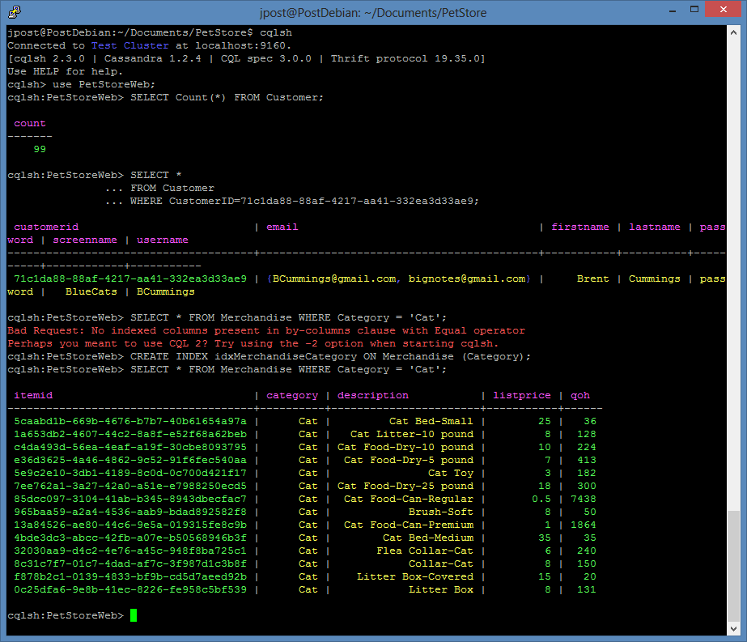
Screen Print of cqlsh Commands
SELECT Count(*)
FROM Customer
SELECT * FROM Customer
WHERE CustomerID
=71c1da88-88af-4217-
aa41-332ea3d33ae9;
SELECT * FROM Merchandise
WHERE Category = 'Cat';
CREATE INDEX idxMerchandiseCategory ON Merchandise (Category);

Slide 24
Experiments with SELECT
SELECT * FROM Customer WHERE CustomerID= 71c1da88-88af-4217-aa41-332ea3d33ae9 OR CustomerID= 378feb73-34cd-451f-90a9-a739a94c30f4; >>> Error: Expected EOF at OR…
SELECT * FROM Customer WHERE CustomerID IN (71c1da88-88af-4217-aa41-332ea3d33ae9, 378feb73-34cd-451f-90a9-a739a94c30f4); >>> Retrieves two rows.
SELECT * FROM Customer WHERE CustomerID > 71c1da88-88af-4217-aa41-332ea3d33ae9; >>> Error: Must use EQ or IN
SELECT CustomerID, LastName FROM Customer WHERE token(customerid) > token(00000000-0000-0000-0000-000000000000); >>> Retrieves random rows where the hash value is greater than the hash of 0…
Initially, a table can be searched only by individual values of the primary key. Conjunctions (Or, And) and inequalities (<, >) are not allowed. The IN (…) condition is used to find multiple values in one command. The token ( ) function does support inequality values but the comparison is made based on the hashed value of the key which is probably random.

Slide 25
Indexes
SELECT * FROM Merchandise WHERE Category = ‘Cat’; >>> Error: No indexed columns present…
CREATE INDEX idxMerchandiseCategory ON Merchandise (Category);
SELECT Category, Description, ListPrice FROM Merchandise WHERE Category = ’Cat’;
category description listprice ---------+-----------------------+---------- Cat | Cat Bed-Small | 25 Cat | Cat Litter-10 pound | 8 Cat | Cat Food-Dry-10 pound | 10 Cat | Cat Food-Dry-5-pound | 7 Cat | Cat Toy | 3 Cat | Cat Food-Dry-25 pound | 18 Cat | Cat Food-Can-Regular | 0.5 Cat | Brush-Soft | 8 Cat | Cat Food-Can-Premium | 1 Cat | Cat Bed-Medium | 35 Cat | Flea Collar-Cat | 6 Cat | Collar-Cat | 8 Cat | Litter Box-Covered | 15 Cat | Litter Box | 8

Slide 26
Filters
SELECT Category, Description, ListPrice FROM Merchandise WHERE Category = ‘Cat’ AND ListPrice > 10 LIMIT 10 ALLOW FILTERING;
category description listprice ---------+-----------------------+---------- Cat | Cat Bed-Small | 25 Cat | Cat Food-Dry-25 pound | 18 Cat | Cat Bed-Medium | 35 Cat | Litter Box-Covered | 15
Conditions on other (non-indexed) columns can be added as long as the ALLOW FILTERING phrase is added at the end.
The LIMIT n command can be used in any SELECT query—and defaults to 10,000 rows if not specified.

Slide 27
Indexes for Pet Store Web
CREATE INDEX idxCustomerUsername ON Customer(Username);
CREATE INDEX idxMerchandiseCategory ON Merchandise(Category);
Best practice: Define the index before loading table data.
Warning note/Current version of Cassandra (1.2)
Creating the index on text columns after the data has been bulk loaded does not always work (never?).
The index is created but SELECT commands retrieve no matching values.
You can try nodetool repair, but not sure that helps.
Probably have to unload the data and reload it:
truncate customer;
COPY petstoreweb.customer(customerid, firstname, lastname, screenname, username, password, email) FROM 'Customers.csv';

Slide 28
SELECT QUERY for Compound Key
SELECT CommentDate, ScreenName, Title, Comment, Rating FROM ItemComments WHERE ItemID=7ee762a1-3a27-42a0-a51e-e7988250ecd5 LIMIT 10;
commentdate screenname title comment rating ------------+------------+----------+-------------------------+------- 2014-11-14… | Gazer33 | Smells… | The smell is horrible… | 4 2014-11-01… | Caged19 | Yummy… | My human/slave feeds… | 5 2014-15-21… | Cathouse | Too big… | OK I only have one cat… | 3 2014-03-07… | RedStar | Not… | Not sure it matters… | 3
PRIMARY KEY (ItemID, CustomerID)
The query is easy because the compound key requires only the value for the first column. The query then returns all matching rows (up to the limit).
This result is exactly what is needed for the application, which is why the compound key was chosen in the database design.

Slide 29
Query Secondary Columns (Compound)
SELECT ItemID, CommentDate FROM ItemComments WHERE CustomerID=9f9f66c2-a949-4f60-b21b-1ec95158583c ALLOW FILTERING;
itemid commentdate -------------------------------------+------------- 563907d0-16bf-4b17-b516-3f42b7c787b7 | 2013-02-10… 7cbc9858-3cf6-41e7-aba3-db09cc27ebbb | 2013-02-03…
The second (and later) columns in a compound key effectively already have an index and can be retrieved directly with a WHERE statement as long as the ALLOW FILTERING command is used.
Note that no JOIN command can be used to retrieve the Item data.
That would require the application to issue a second query using one ItemID at a time.

Slide 30
Pet Store Web Summary
Tables:
Customer(CustomerID,…)
Merchandise(ItemID, …)
ItemComments(ItemID, CustomerID, …)
Indexes:
Customer.Username
Merchandise.Category
The application stores and retrieves data quickly using primary keys and two indexes.
No JOINs were used and lookups are minimized.
But the database design had to carefully match the query needs of the application.

Slide 31
Cloud Computing: Options
Your own data centers, your own DBMS
High fixed costs
Personnel and expertise to manage
Manage your own DBMS (Cassandra) on public VMs.
Amazon EC2
Rackspace
Many others
Public cloud non-relational DBMS
Amazon: SimpleDB
Google: App Engine Datastore (bigtable)
Many others
Cloud computing has lower fixed costs and is easier to expand.
But monthly costs can be higher—for the same capacity.
But firms rarely know how much capacity they need ahead of time.

Slide 32
Cassandra on Amazon EC2
Amazon EC2
Web server
data
VM
HTML Page
VM
VM
VM
VM
Cassandra nodes
VM
Developer
User
DataStax has a copy and instructions specifically for installing Cassandra on Amazon EC2.
Nodes can be added in minutes to expand capacity with almost no fixed costs.

