Slide 1
All Powder Board and Ski
Oracle 11g Workbook
Chapter 1: Introduction
Jerry Post
Copyright © 2010

Slide 2
Inventory
Inventory Snowboards Manufacturer Mfg ID Size Description Graphics List Price QOH Freestyle Pipe Standard Extreme Skis Manufacturer Mfg ID Size Description Graphics List Price QOH Slalom Cross country-skate Cross country-trad. Telemark Jumping Freestyle Downhill/race

Slide 3
Boots and Bindings
Boot-Binding Compatibility
Manuf. Mfg. ID Board/Ski Binding/Style Color Price Cost
Size QOH 34
35
36
…

Slide 4
Sales
Sales Customer Sale Date First Name Last Name Salesperson Phone E-Mail Department Address Shipping Address City, State ZIP City, State ZIP Male/Female Ski/Board Age/Date of Birth Style Skill Level Item Description New/Used Size Quantity Price Subtotal
Item Total Tax Total Due Method of Payment

Slide 5
Rentals
Rentals Customer Rental Date First Name Last Name Expected Return Phone E-Mail Address Shipping Address City, State ZIP City, State ZIP Male/Female Ski/Board Age/Date of Birth Style Skill Level Item Description Size Fee Return Date Condition Charges
Item Total Tax Total Due Added Charges Method of Payment Signature

Slide 6
Action
Action
Find information about skis and snowboards on the Internet.
If necessary, install and upgrade the DBMS.

Slide 7
Project Structure
Project Title: Sales System for Boards and Skis Customer: All Powder Board and Ski Shop Primary Contact: Katy Goals: Project Description: Primary Forms: Primary Reports: Lead Developer: Estimated Development Time: Estimated Development Cost: Date Prepared:

Slide 8
Project Plan
Define the project and obtain approval. Analyze the user needs and identify all forms and reports. System Design Determine the tables and relationships needed. Create the tables and load basic data. Create queries needed for forms and reports. Build forms and reports. Create transaction elements. Define security and access controls. Additional Features Create data warehouse to analyze data as needed. Handle distributed database elements as needed. System Implementation Convert and load data. Train users. Load testing. System review

Slide 9
Action
Action
Fill in the project milestone dates based on your school calendar.

Slide 10
Feasibility
Assumptions
Annual discount rate | 0.03
Project life/years | 5
Costs |  | Present Value | Subtotal
One-time
DBMS Software
Hardware
Development
Data entry
Training

Slide 11
Feasibility-2
Ongoing
Personnel
Upgrades/annual
Supplies
Support
Maintenance
Benefits
Cost Savings
Better inventory control
Fewer clerks
Strategic
Increased sales
Other?
Net Present Value

Slide 12
Action
Action
Create the feasibility plan for the project.

Slide 13
DBMS Update
Oracle academic initiative
https://academy.oracle.com
Oracle technology network
http://www.oracle.com/technology
Oracle documentation—requires OTN
http://www.oracle.com/technology/documentation

Slide 14
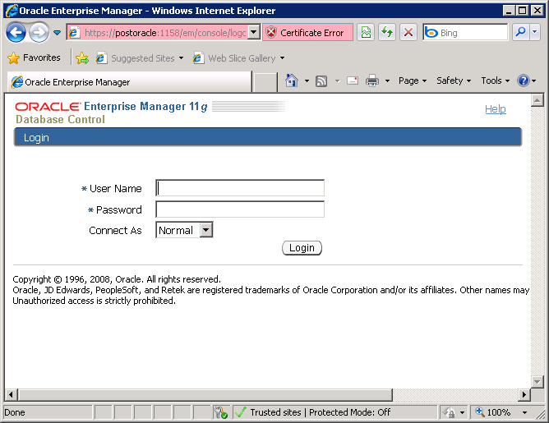
Log on
Enterprise Manager (Admin rights)
http://servername:1158/em

Slide 15
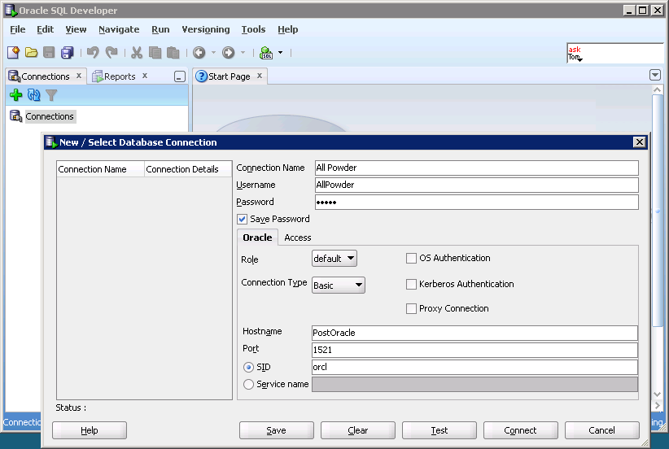
SQL Developer Log On
Runs on client computer.
Connect to Oracle server, SQL Server, Access, …
Name you will recognize
Add connection
Username
Password
Server name
Typical port
Typical SID

Slide 16
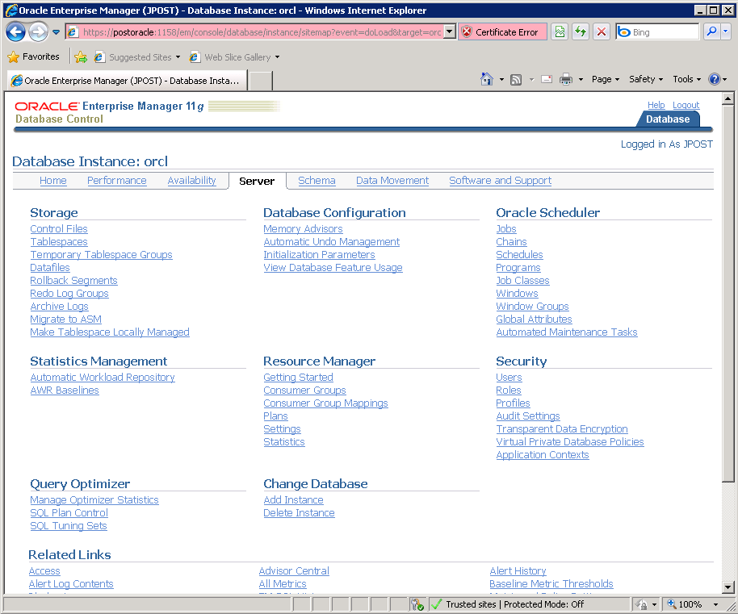
Enterprise Manager
Can be used to create users and tables.
Need administrator permissions.

Slide 17
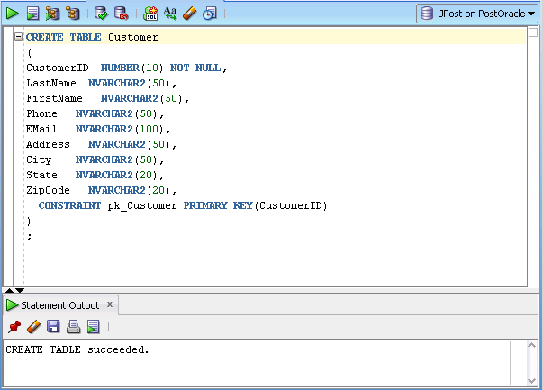
Create a Table with SQL
Type command.
Highlight/select.
Click Run

Slide 18
Create Table
CREATE TABLE Customer
(
CustomerID NUMBER(10) NOT NULL,
LastName NVARCHAR2(50),
FirstName NVARCHAR2(50),
Phone NVARCHAR2(50),
Address NVARCHAR2(100),
City NVARCHAR2(50),
State NVARCHAR2(20),
ZipCode NVARCHAR2(20),
CONSTRAINT pk_Customer PRIMARY KEY (CustomerID)
)
;

Slide 19
Action
Action
Start SQL Developer.
Connect to the database.
Enter the CREATE TABLE commands.
You can use the designer but need the Advanced options to set NVARCHAR2.
Click the Run button.
Type DESCRIBE Customer to ensure that the table was created correctly.

Slide 20
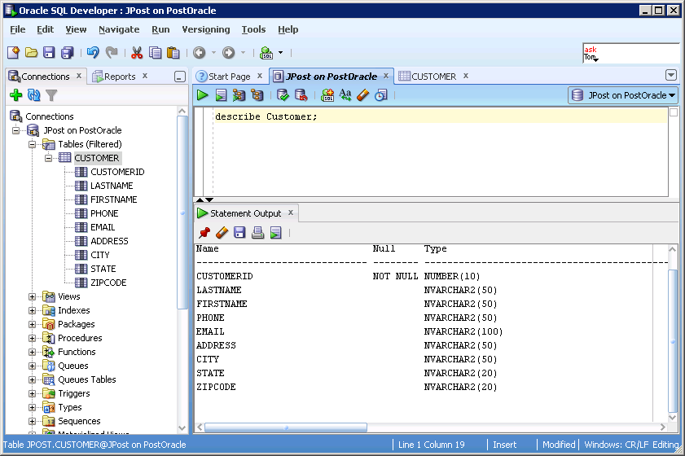
Describe a Table

Slide 21
Action
Action
Insert three lines of data into the table using SQL Worksheet.
Copy the resulting INSERT commands and save them in your lab notebook

Slide 22
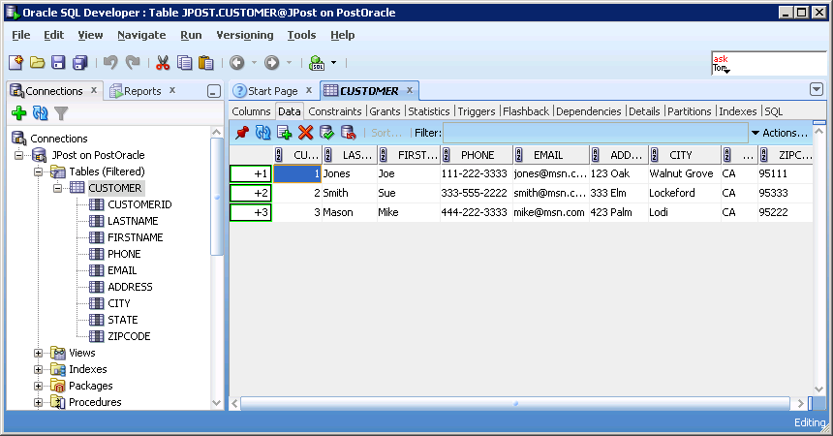
Insert Data Into a Table: Worksheet
2. Insert row, enter data
3. Commit changes
1. Right-click: Open

Slide 23
Insert Data into a Table: SQL
INSERT INTO CUSTOMER(CUSTOMERID, LASTNAME, FIRSTNAME, PHONE, EMAIL, ADDRESS, CITY, STATE, ZIPCODE)
VALUES (1, 'Jones', 'Joe', '111-222-3333', 'jones@msn.com', '123 Oak', 'Walnut Grove', 'CA', '95111');
INSERT INTO CUSTOMER(CUSTOMERID, LASTNAME, FIRSTNAME, PHONE, EMAIL, ADDRESS, CITY, STATE, ZIPCODE)
VALUES (2, 'Smith', 'Sue', '333-555-2222', 'smith@msn.com', '333 Elm', 'Lockeford', 'CA', '95333')
INSERT INTO CUSTOMER(CUSTOMERID, LASTNAME, FIRSTNAME, PHONE, EMAIL, ADDRESS, CITY, STATE, ZIPCODE)
VALUES (3, 'Mason', 'Mike', '444-222-3333', 'mike@msn.com', '423 Palm', 'Lodi', 'CA', '95222')
commit;

Slide 24
Action
Action
If necessary, download and install JDeveloper.
Run it the first time and browse to find the Java.exe file in the JDK.

Slide 25
Action
Action
In JDeveloper, select Application/New.
Name it AllPowder01.
Select Template: Fusion Web Application (ADF).
Add the ADF Faces components.

Slide 26
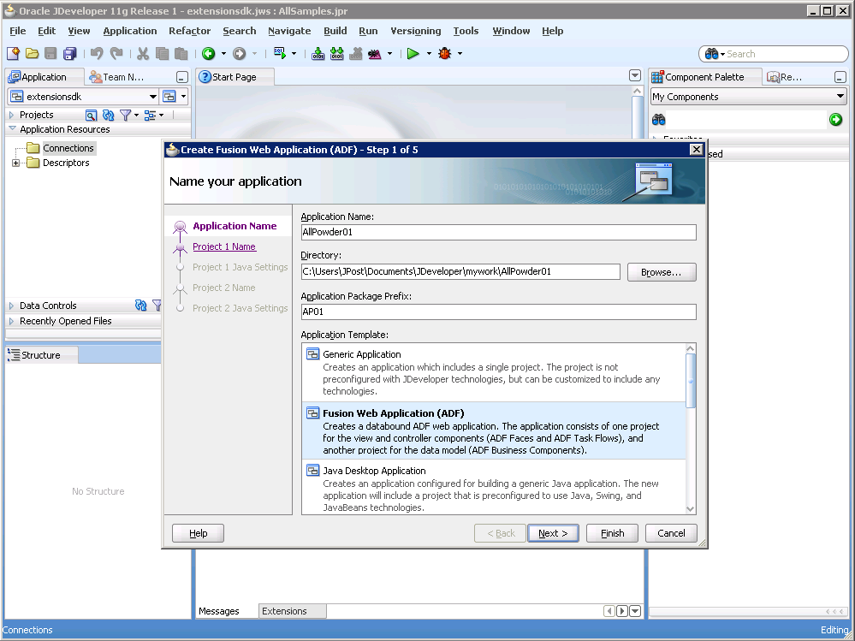
JDeveloper: New Application

Slide 27
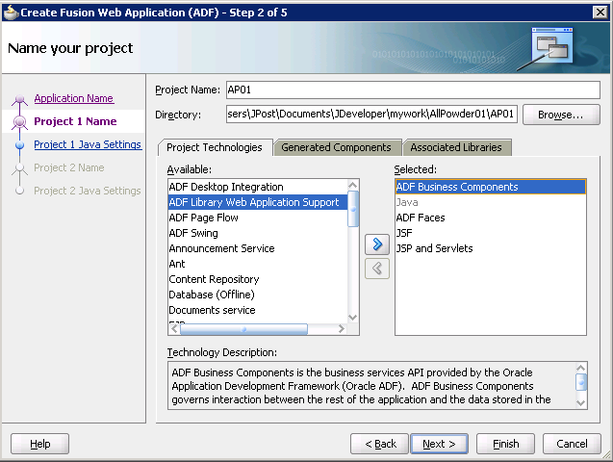
Technologies: ADF Faces

Slide 28
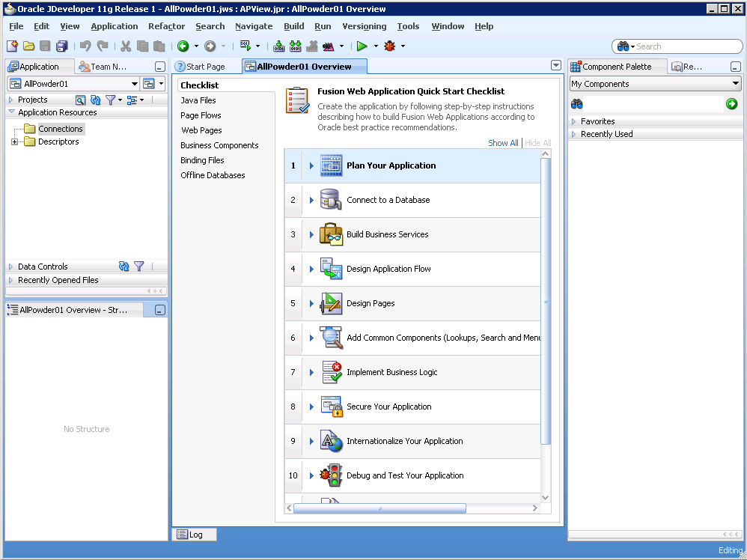
Fusion Project List

Slide 29
Action: Connect to Database
Action
Open Step 2: Connect to a database.
Create a Database connection (button).
Enter the database name and password.
Verify the server name and SID.
Click the Test Connection button.

Slide 30
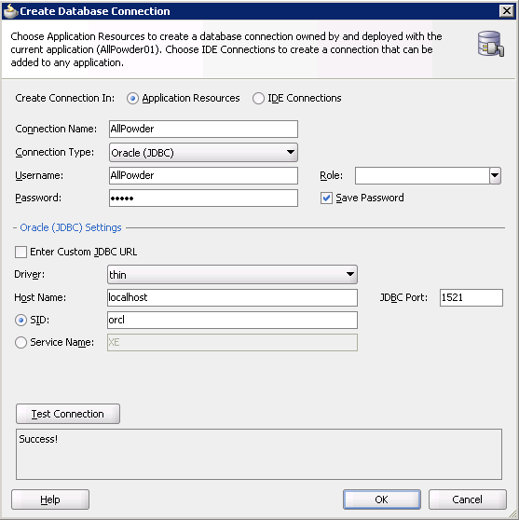
Database Connection

Slide 31
Action: Step 3
Action
Open Step 3: Build Business Services.
Open substeps.
Step 3.1: Add Entity
Choose the Model object.
At Entity Objects: Click Query button.
Select the Customer table.
Add it to the selected Updatable Views.
Skip the Read-only View objects.
Stick with default choices.

Slide 32
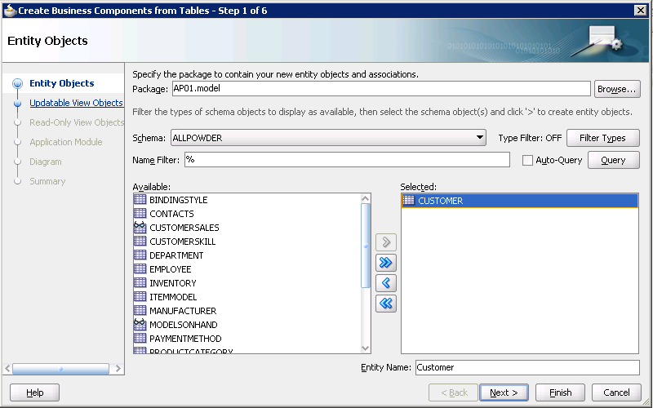
Select Tables

Slide 33
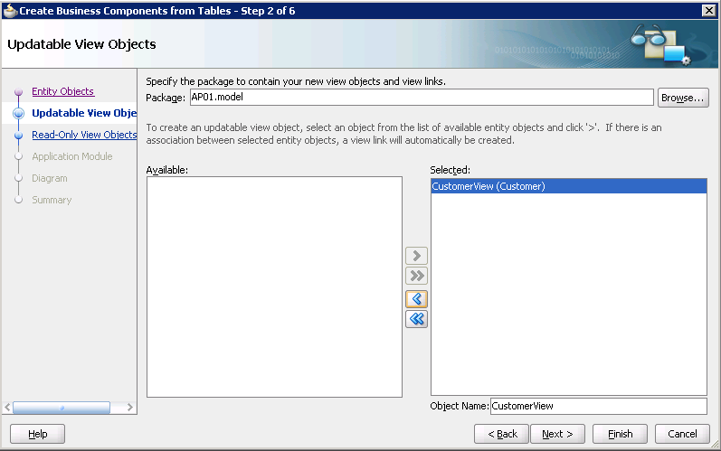
Updatable Views

Slide 34
Action: Step 5
Action
Return to the Checklist.
Open Step 5 and the substeps.
Open Step 5.2: Create Pages.
Create a JSF Page.
Project: ViewController.
Name: Customer.jspx
Quick Start Layout: One Column Header.
Use the defaults to finish.

Slide 35
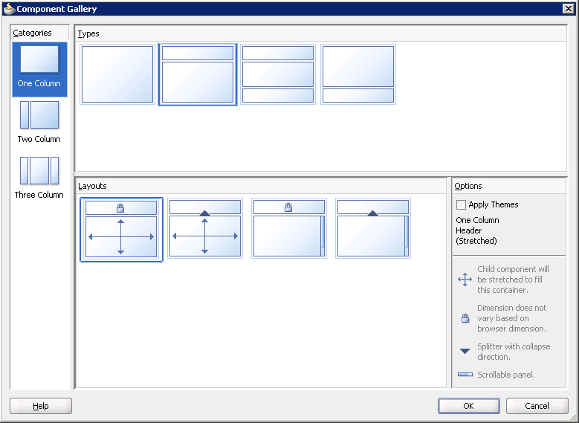
Layouts

Slide 36
Action: Add Components
Action
At the top of the page, type Customer.
Select/highlight it and choose the Heading 1 style from the dropdown list.
Expand Data Controls navigator (on the left-side).
Drag CustomerView1 onto the lower page section.
Choose Form/ADF Form.
Check boxes for Navigation and Submit buttons.

Slide 37
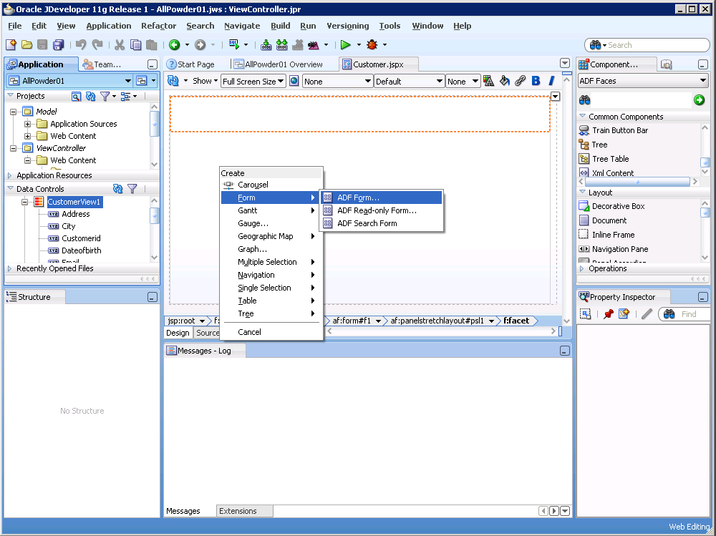
Data Controls/Form

Slide 38
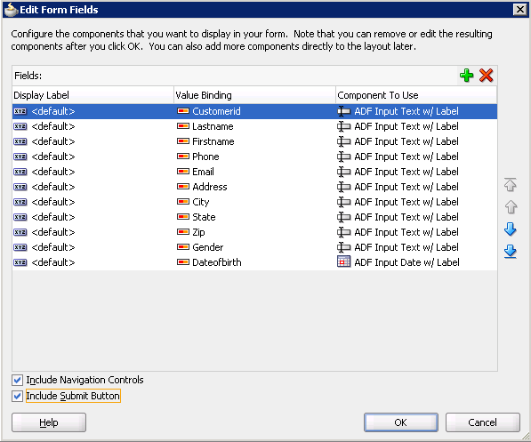
Selection Options

Slide 39
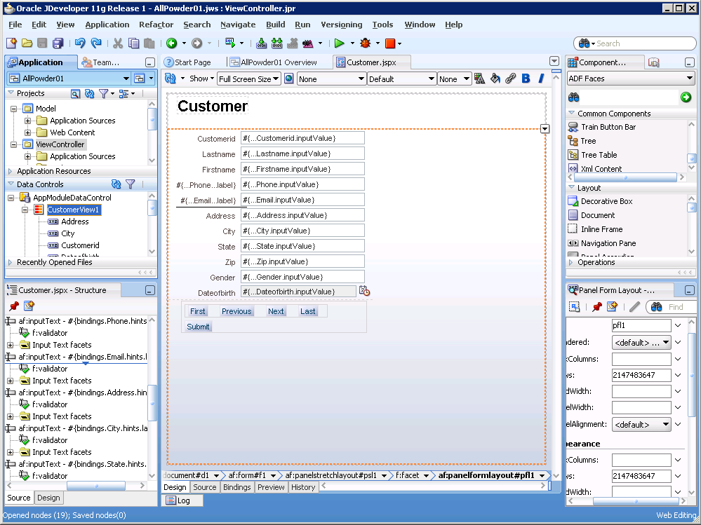
Page Design

Slide 40
Action: Run
Action
Right-click the form, choose Run.
Wait for the server to start.
If on a server, best to add the server to the list of Trusted Sites in Options/Security.
Probably want to resize the E-mail input box in Properties: Appearance: Columns.
Use bindings.Lastname… instead of bindings.Email…

Slide 41
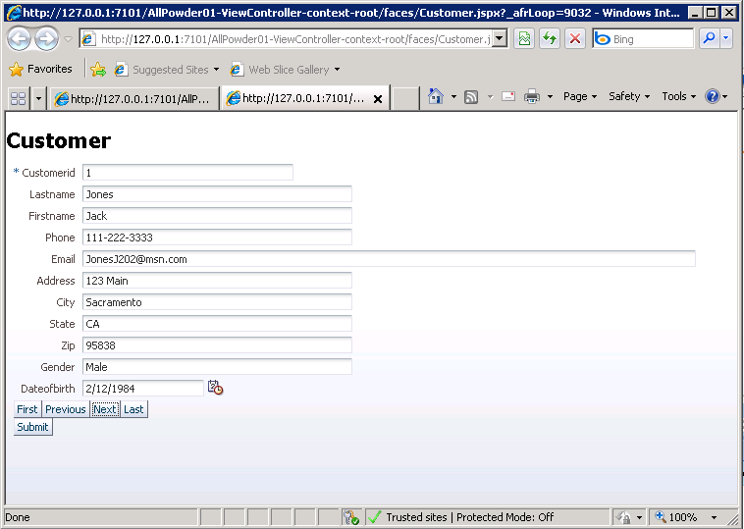
The Customer Form

Slide 42
Action: Email
Action
Fix the E-mail length.
Stop the browser (red square button).
Select the Email text box.
Properties: bottom right.
Expand Appearance
Set Columns to: #{bindings.Lastname.hints.displayWidth}
(Lastname instead of Email to set the width to the same as the Lastname box.)

