Slide 1
All Powder Board and Ski
Oracle 11g Workbook
Chapter 2: Database Design
Jerry Post
Copyright © 2010

Slide 2
DBDesign: An Expert System
http://JerryPost.com/DBdesign
Benefits
  Makes it easy to create database diagrams
  Saves data in central location, so changes can be made from almost any computer
  Provides immediate detailed feedback on the design
Requirements
  Instructors must ask for a free account
  Instructors and students need a Java-enabled Web browser

Slide 3
Oracle Data Types (Domains)
 | Name | Data | Bytes
Text (characters) fixed variable national/Unicode memo | CHAR or NCHAR VARCHAR2 NVARCHAR2 LONG | 2000 bytes 4000 bytes 4000 bytes 2 gigabytes | Fixed Variable Variable Variable
Numeric Byte (8 bits) Integer (16 bits) Long (32 bits) (64 bits) Fixed precision Float Double Currency Yes/No | NUMBER(38) NUMBER(38) NUMBER(38) NUMBER(38) NUMBER(p,s) NUMBER NUMBER NUMBER(p,4) NA | 38 digits 38 digits 38 digits 38 digits p: 1...38, s: -84...127 38 digits 38 digits 38 digits | 2-21 2-21 2-21 2-21 2-21 2-21 2-21 2-21
Date/Time Interval | DATE, TIMESTAMP INTERVAL YEAR/MONTH | 1/1/-4712 to 12/31/9999 (sec) | 7/11/13
Image | LONG RAW or BLOB | 2 gigabytes, 4 gigabytes | Variable
OTN.Oracle.com, SQL Reference book, search for Oracle Built-in Datatypes

Slide 4
Initial Business Objects
Sale
Customer
SaleID
SaleDate
CustomerID
EmployeeID
CustomerID
LastName
FirstName
Phone
Address
City
State
ZIP
Rental
Employee
RentID
RentDate
CustomerID
ExpectedReturn
EmployeeID
TaxpayerID
LastName
FirstName
Address
City
State
ZIP

Slide 5
Associations or Relationships
Sale
Customer
SaleID
SaleDate
CustomerID
EmployeeID
1…1
CustomerID
LastName
FirstName
Phone
Address
City
State
ZIP
0…*
Rental
Employee
RentID
RentDate
CustomerID
ExpectedReturn
EmployeeID
TaxpayerID
LastName
FirstName
Address
City
State
ZIP

Slide 6
Action
Action
Browser: http://JerryPost.com/dbdesign
Login with your database book account.

Slide 7
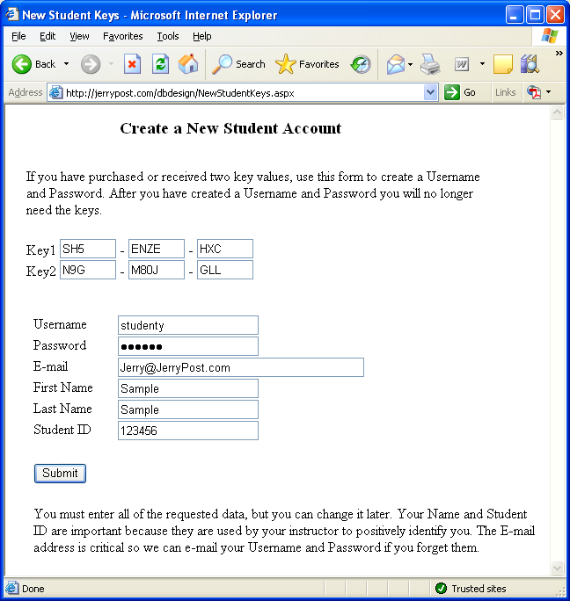
Getting Started
Enter the key numbers you received
Create a username and password.
Enter your correct name, e-mail address and StudentID

Slide 8
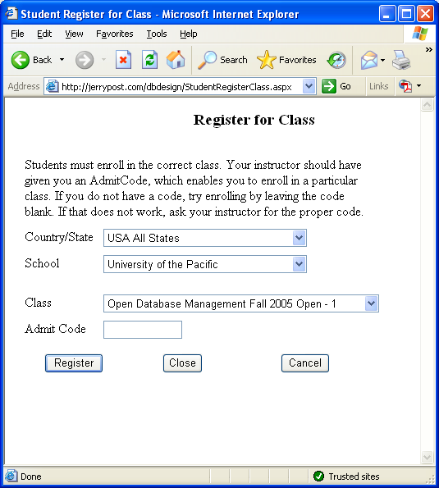
Class Registration
Choose a country or state to reduce the search list
Select your school
Select your class
Enter the admit code provided by your instructor

Slide 9
Action
Action
File/Open, choose All Powder case
Right click/Add Table
Right click header/Rename table
Drag columns from right onto table
Right click name/set data type

Slide 10
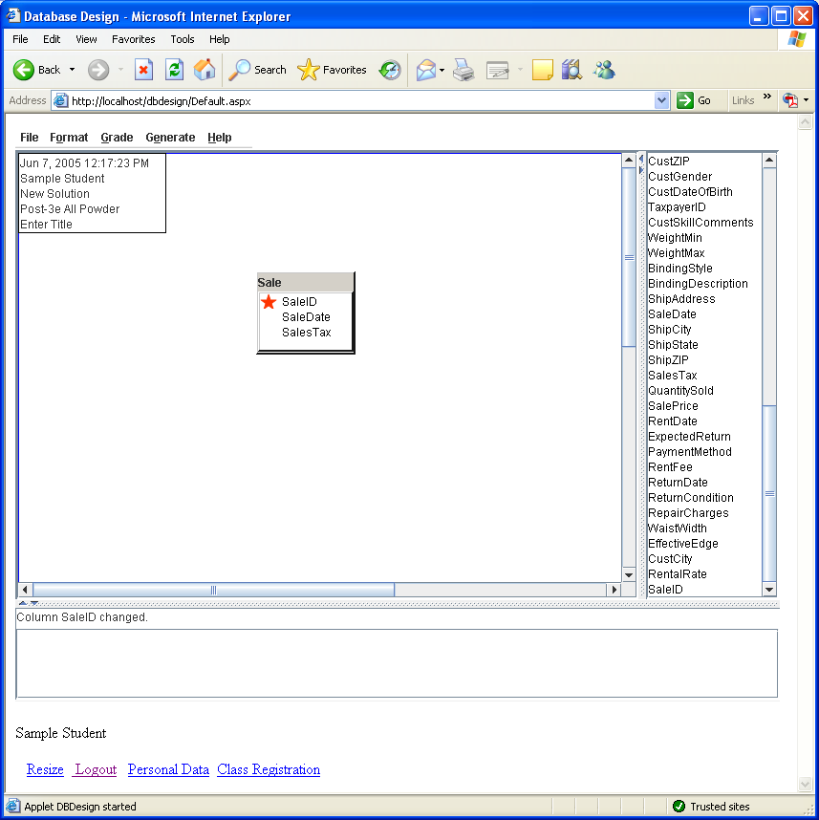
DBDesign: Example
Menu
Class
(entity)
Status line
Available columns
Corrections

Slide 11
Action
Action
Add Customer and Sale tables
Add GenerateKey to Customer table
Rename it to CustomerID
Drag new CustomerID from right side into Sale table
Drag CustomerID from Customer and drop it on CustomerID in Sale table
Fill out relationship box

Slide 12
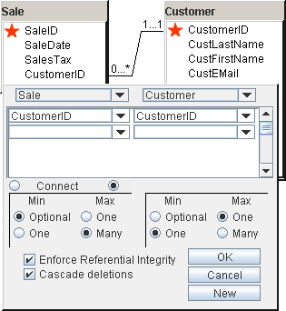
Relationships
Drag-and-drop column
Select min and max for both sides of the relationship

Slide 13
Action
Action
Choose Grade/Grade and Mark
Double click messages in window
Fix errors by removing columns and adding new tables

Slide 14
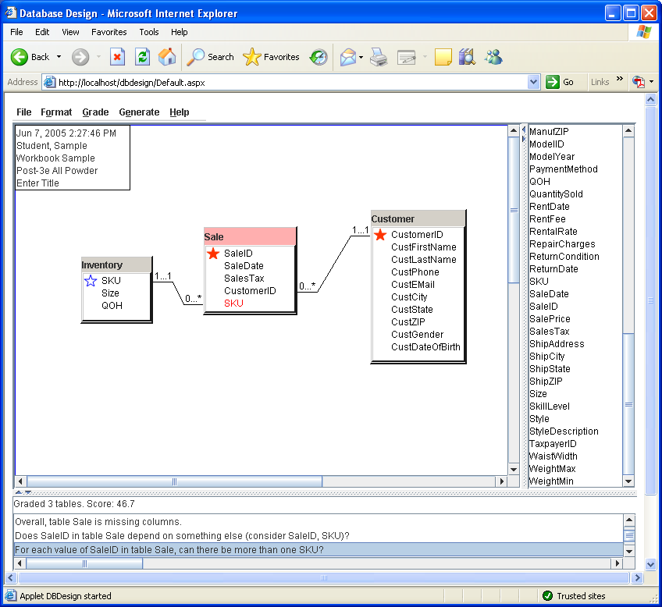
Design Errors
Add SKU to the Sale table
Connect the Inventory table to the Sale table
Click the diagnostic message
Possible errors are highlighted
Double-click message for details

Slide 15
Split Many-to-Many Relationship
Many-to-Many
Inventory
Sale
SKU
Size
QOH
1…1
1…1
SaleID
SaleDate
CustomerID
EmployeeID
SaleItem
1…*
SaleID
SKU
QuantitySold
SalePrice
0…*

Slide 16

Ski Shop Inventory
Item: 196 cm
Item: 181 cm
Ski shops carry multiple lengths of each ski or board model.
Model information refers to the overall type of board or ski.
Inventory information refers to an individual ski or board—defined by its length.
Model:
Rossignol Axium
Photo: www.rossignol.com

Slide 17
Action
Action
Create the SaleItem table
Create the ItemModel table
Include the proper columns
Set the keys
Set the data types
Grade/Grade and Mark

Slide 18
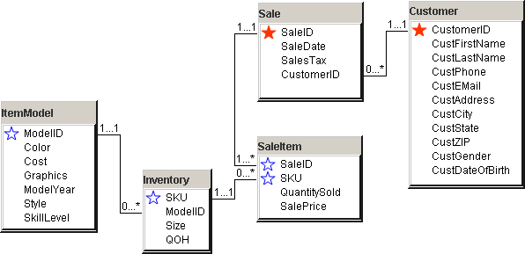
Models and Items

Slide 19
Customer Skill Level
CustomerID, LastName, … Style, SkillLevel
CustomerID, LastName, … Style, SkillLevel
Business rule: Each customer can have one skill in many styles.
Business rule: Each style can apply to more than one customer.
Need a table with both attributes as keys.
CustomerID, LastName, … Style, SkillLevel
But you cannot include LastName, FirstName and so on, because then you would have to re-enter that data for each customer skill.

Slide 20
Customer Style Skills
Customer
Style
CustomerID
LastName
FirstName
Phone
Address
City
State
ZIP
Style
StyleDescription
CustomerSkill
CustomerID
Style
SkillLevel
SkillLevel
SkillLevel
SkillDescription

