Slide 1
All Powder Board and Ski
Oracle 11g Workbook
Chapter 3: Database Tables
Jerry Post
Copyright © 2010

Slide 2
DBDesign: An Expert System
http://JerryPost/dbdesign
Benefits
Makes it easy to create database diagrams
Saves data in central location, so changes can be made from almost any computer
Provides immediate detailed feedback on the design
Requirements
Instructors must ask for a free account
Instructors and students need a Java-enabled Web browser

Slide 3
Identifying Key Columns
If you are uncertain about which columns to key.
Write them down and evaluate the business rules.
OrderID CustomerID
For a given order, can there ever be more than one customer?
If yes, then key CustomerID.
In most businesses, only one customer per order, so do not key it.
For a given customer, can there ever be more than one order?
If yes, then key OrderID, otherwise, do not key it.
All businesses hope to get more than one order from a customer,
so OrderID must be key. Underline it. Since OrderID is the only key,
these columns belong in the Order table.
CustomerOrder(OrderID CustomerID, … )

Slide 4
Sequences: Introduction
Sometimes it is best to let the DBMS generate a guaranteed unique key value
The table must contain a single column primary key that is assigned a numeric data type, such as NUMBER(38)
Later, you will create a SEQUENCE to generate the numbers
Later, you will create a trigger to automatically obtain and use the generated key value

Slide 5
Customer Skill Level
Consider what happens if you (incorrectly) try to place Style and SkillLevel in the Customer table:
CustomerID, LastName, … Style, SkillLevel
CustomerID, LastName, … Style, SkillLevel
Business rule: Each customer can have one skill in many styles.
Business rule: Each style can apply to more than one customer.
Need a table with both attributes as keys.
CustomerID, LastName, … Style, SkillLevel
But you cannot include LastName, FirstName and so on, because then you would have to re-enter that data for each customer skill.

Slide 6
Customer Style Skills
Customer
Style
CustomerID
LastName
FirstName
Phone
Address
City
State
ZIP
Style
StyleDescription
CustomerSkill
CustomerID
Style
SkillLevel
SkillLevel
SkillLevel
SkillDescription

Slide 7
Action
Action
Start SQL Developer and type in the CREATE TABLE Customer command.
Enter column names and data types.
Assign the primary key.
Make sure the command runs with no errors.

Slide 8
Create Tables with SQL
Table name
CREATE TABLE Customer
(
CustomerID INTEGER,
LastName NVARCHAR2(25),
FirstName NVARCHAR2(25),
Phone NVARCHAR2(25),
Email NVARCHAR2(120),
Address NVARCHAR2(50),
City NVARCHAR2(50),
State NVARCHAR2(25),
ZIP NVARCHAR2(15),
Gender NVARCHAR2(15),
DateOfBirth DATE,
CONSTRAINT pk_Customer PRIMARY KEY (CustomerID),
CONSTRAINT ck_CustGender
CHECK (Upper(Gender) IN ('FEMALE', 'MALE', 'UNIDENTIFIED'))
);
Data type
Data size
Primary key

Slide 9
Action
Action
Write the CREATE TABLE commands to build the ItemModel table.
Be sure to include the CHECK constraint.
Test the constraint with sample data, using a INSERT INTO statements.

Slide 10
Table in SQL: ItemModel
CREATE TABLE ItemModel
(
ModelID NVARCHAR2(50),
Color NVARCHAR2(50),
Cost NUMBER(50,0)
CONSTRAINT ck_ItemModel_Cost CHECK (Cost>0),
Graphics NVARCHAR2(50),
ModelYear INTEGER,
Style NVARCHAR2(50),
SkillLevel NVARCHAR2(50),
CONSTRAINT pk_ItemModel PRIMARY KEY (ModelID)
)
;
Create unique name
Specify constraint type
Write condition

Slide 11
Relationships: Department and Employee
Department
1…1
Employee
Department
Description
EmployeeID
TaxpayerID
LastName
FirstName
Address
Phone
City
State
ZIP
Department
Reference Table
1…*
Foreign Key

Slide 12
Action
Action
Write the CREATE TABLE statement for Department.
Be sure the Department column is keyed.
Write the CREATE TABLE statement for Employee.
Set EmployeeID as a primary key constraint.
Create a new foreign key constraint.
Name it fk_EmployeeDept.
Specify the Department table as a reference.
Add the Cascade On Delete option.
Run the two CREATE statements and fix any errors.
Insert a Department row, then an Employee row.

Slide 13
Relationships in SQL
CREATE TABLE Department
(
Department NVARCHAR2(50),
Description NVARCHAR2(150),
CONSTRAINT pk_Department PRIMARY KEY (Department)
);
CREATE TABLE Employee
(
EmployeeID INTEGER,
TaxpayerID NVARCHAR2(50),
LastName NVARCHAR2(25),
FirstName NVARCHAR2(25),
Address NVARCHAR2(50),
Phone NVARCHAR2(25),
City NVARCHAR2(50),
State NVARCHAR2(15),
ZIP NVARCHAR2(15),
Department NVARCHAR2(50)
DEFAULT ‘Sales’,
CONSTRAINT pk_Employee PRIMARY KEY (EmployeeID),
CONSTRAINT fk_DepartmentEmployee FOREIGN KEY (Department)
REFERENCES Department(Department)
ON DELETE CASCADE
);

Slide 14
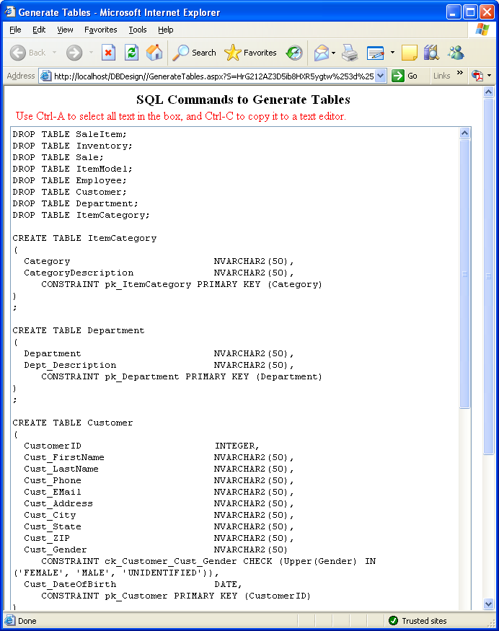
Create Tables with Database Design
Drop existing tables

Slide 15
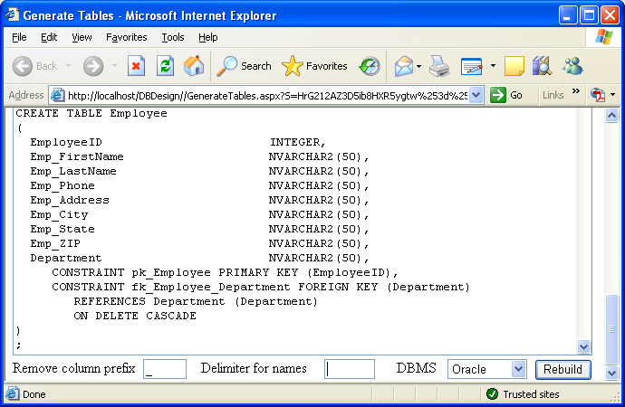
Database Design Options
Specify a prefix delimiter
Add quotation marks for names
Change the DBMS

Slide 16
Action
Action
Choose the Generate/Set DBMS option on the main menu.
Choose Oracle and click Save.
Choose Generate/Generate Tables.
Copy the SQL commands and paste them into WordPad.
Save the file as AllPowder.sql.
Start SQL Developer and run the file with
Start <location>\AllPowder.sql.

Slide 17
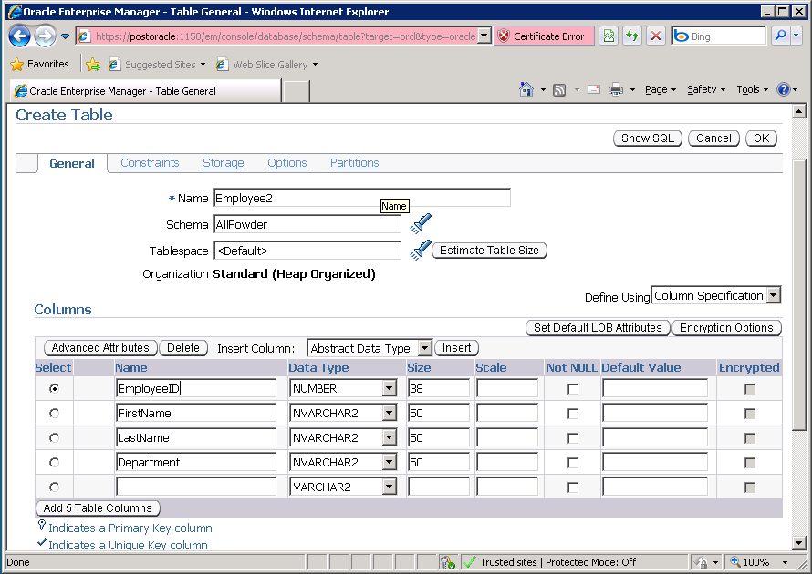
Create Tables: Enterprise Manager
Constraints
Table name
Columns

Slide 18
Action
Action
Start the Enterprise Manager.
Click the Administration tab, then the Tables link under the Schema section.
Enter the columns for the Employee table, but name it Employee2.
Create the primary key constraint.
Create the foreign key constraint.
Look at the SQL and create the table.
Delete the table.

Slide 19
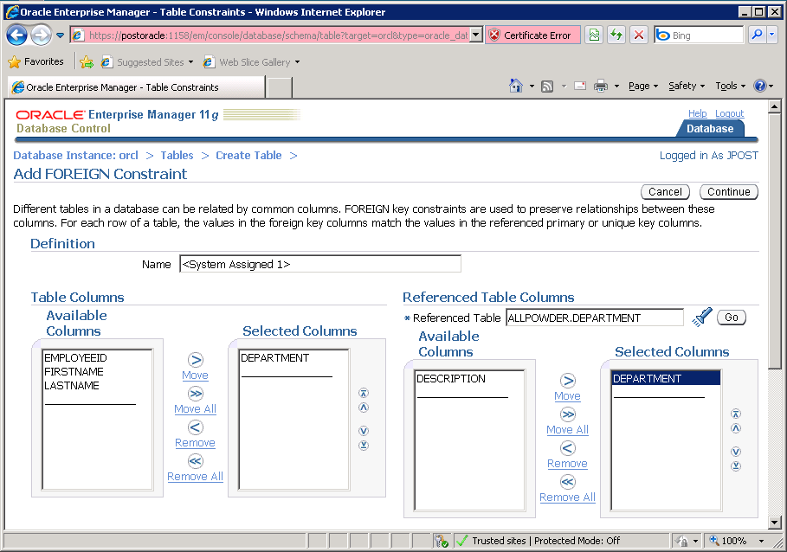
Tables with Enterprise Manager
Select reference table
Choose reference column
Choose column

Slide 20
Estimating Database Size
CustomerID NUMBER(12) 8
LastName NVARCHAR(50) 30
FirstName NVARCHAR(50) 20
Phone NVARCHAR(50) 24
Email NVARCHAR(150) 100
Address NVARCHAR(50) 50
State NVARCHAR(50) 4
ZIP NVARCHAR(15) 20
Gender NVARCHAR(15) 20
DateOfBirth Date 7
Average bytes per customer 283
Customers per week (winter) *200
Weeks (winter) *25
Bytes added per year 1,415,000

Slide 21
Action
Action
Create a spreadsheet
Enter table names as rows
Add columns for: Bytes, Rows, Totals
Calculate the bytes per table row
Estimate the number of rows
Compute the table and overall totals

Slide 22
Data Assumptions
200 customers per week for 25 weeks
2 skills per customer
2 rentals per customer per year
3 items per rental
20 percent of customers buy items
4 items per sale
100 manufacturers
20 models per manufacturer
5 items (sizes) per model

Slide 23
Database Table Sizes

