Slide 1
All Powder Board and Ski
Oracle 11g Workbook
Chapter 4: Queries
Jerry Post
Copyright © 2010

Slide 2
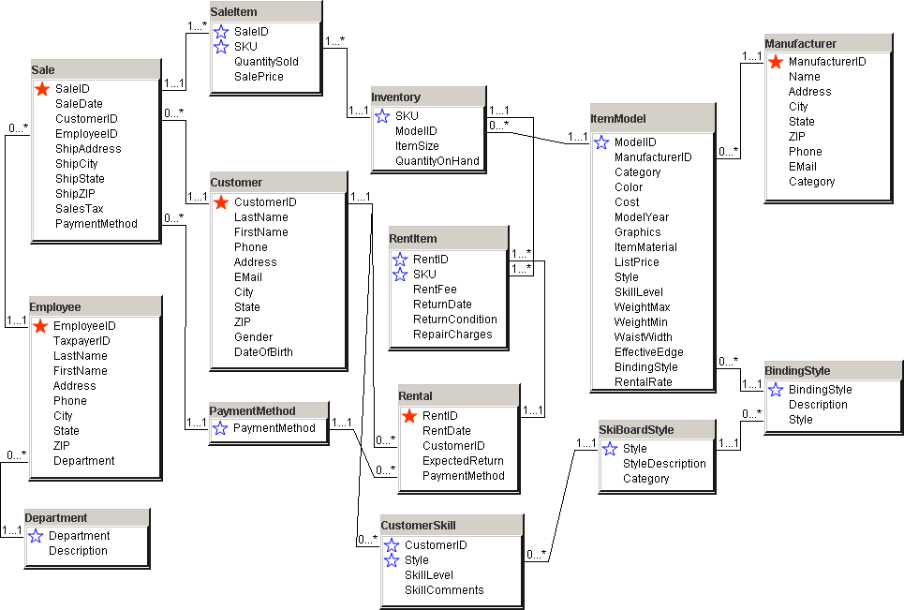
Primary Tables

Slide 3
Action
Action
Download the initial All Powder database.
Start SQL Developer.
Drop or rename conflicting tables:
Start <path>\0DropAllPowderTables.sql.
Edit the csv_dir path in the 1Build… file.
Start <path>\1BuildOracleAllPowder.sql.
Wait a few minutes for the data to load.
Note: The data files should be in a folder on the server or same machine running the Oracle DBMS software. Otherwise, you might be able to use a shared network path name such as \\myPC\OracleFiles\1BuildOracleAllPowder.sql but security can be a pain to set correctly.

Slide 4
File/Get External Data/Import
Start D:\Oracle\1BuildOracleAllPowder.sql
create or replace directory succeeded.
CREATE TABLE succeeded.
CREATE TABLE succeeded.
CREATE TABLE succeeded.
…
Analyze table Sale succeeded.
Analyze table SaleItem succeeded.
commited
SELECT table_name FROM user_tables
WHERE table_name Not Like 'BIN%'
ORDER BY table_name;
CUSTOMER
CUSTOMERSKILL
DEPARTMENT
EMPLOYEE
INVENTORY
ITEMCATEGORY
ITEMMODEL
MANUFACTURER
PAYMENTMETHOD
PRODUCTCATEGORY
RENTAL
RENTITEM
SALE
SALEITEM
SKIBOARDSTYLE
SKILLLEVEL

Slide 5
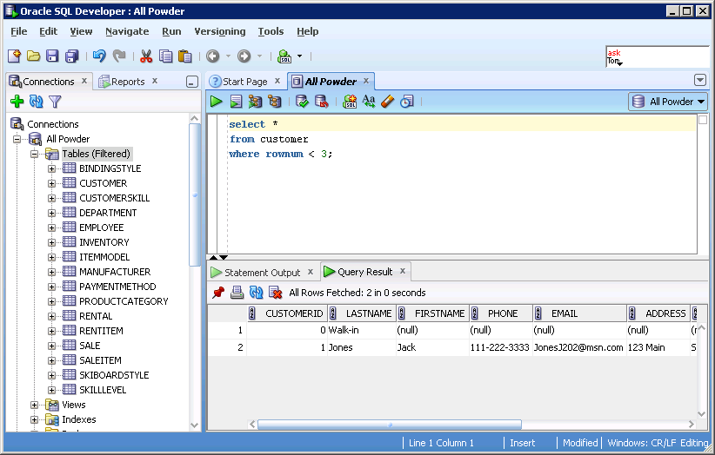
Starting a Query: SQL Developer
Execute query
Prior commands/History
SQL statement
Results

Slide 6
Action
Action
Run the query:
SELECT Category, ListPrice, WeightMax, Color, Graphics
FROM ItemModel
WHERE Category=’Board’
AND ListPrice<300
AND WeightMax>150;

Slide 7
Sample Query
Question | Display snowboards with a list price under $300 and max weight over 150 pounds.
SQL | SELECT Category, ListPrice, WeightMax, Color, Graphics FROM ItemModel WHERE Category=‘Board’ AND ListPrice < 300 AND WeightMax > 150;
Results | CATEGORY LISTPRICE WEIGHTMAX COLOR GRAPHICS Board 292 188 Orange Fade Board 263 181 Magenta Geometric Board 262 179 Purple Space Board 290 194 Blue Abstract Board 294 158 Red Sunrise Board 270 191 Yellow Landscape …

Slide 8
Action
Action
Format the ListPrice column using the TO_CHAR function
SELECT Category,
to_char(ListPrice,'$9999.00') As List_Price, …

Slide 9
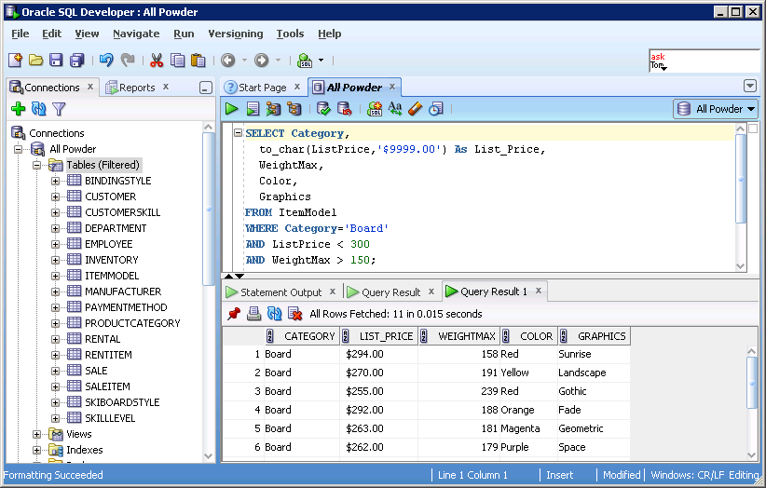
Formatting Columns
Format currency

Slide 10
More Complex Query
Question | Jumping skis, made from composite materials.
SQL | SELECT Category, Color, ItemMaterial, Style, ListPrice FROM itemModel WHERE Category='Ski' AND ItemMaterial='Composite' AND Style='Jump‘;
CATEGORY COLOR ITEMMATERIAL STYLE LISTPRICE Ski Red Composite Jump $223.00 Ski Orange Composite Jump $386.00 Ski Blue Composite Jump $229.00 Ski Black Composite Jump $410.00 Ski Turquoise Composite Jump $99.00 Ski White Composite Jump $142.00 (20 rows total)

Slide 11
Action
Action
Clear any existing SQL and results.
Enter the keywords SELECT, FROM, WHERE.
SELECT Category, Color, ItemMaterial, Style, ListPrice.
Enter ItemModel as the table on the FROM line.
Enter conditions: Category=’Ski’ And Style=’Jump’ And ItemMaterial=’Composite’.
Run the query to ensure it works.
Add the conditions for Color=’Yellow’ and ListPrice<300.
Test the query.

Slide 12
Action (continued)
Add the conditions for Color=’Red’ and ListPrice<400.
Add the correct parentheses.
Run the query and test it.

Slide 13
Color Options
Question | Jumping skis, made from composite materials. And Yellow and ListPrice < 300
SQL | SELECT Category, Color, ItemMaterial, Style, ListPrice FROM itemModel WHERE Category='Ski' AND ItemMaterial='Composite' AND Style='Jump' AND Color='Yellow' AND ListPrice<300 ;
CATEGORY COLOR ITEMMATERIAL STYLE LISTPRICE Ski Yellow Composite Jump $70.00

Slide 14
Multiple Conditions
Question | Jumping skis, made from composite materials. (Yellow And ListPrice < 300) OR (Red and ListPrice < 400)
SQL | SELECT Category, Color, ItemMaterial, Style, ListPrice FROM ItemModel WHERE Category='Ski' AND ItemMaterial='Composite' AND Style='Jump' AND ( (Color='Yellow' AND ListPrice<300) OR (Color='Red' AND ListPrice<400) ) ;
CATEGORY COLOR ITEMMATERIAL STYLE LISTPRICE Ski Red Composite Jump $223.00 Ski Red Composite Jump $294.00 Ski Red Composite Jump $137.00 Ski Yellow Composite Jump $70.00

Slide 15
JOIN Query: Sales
Question | List customers (ID) with sales in May who paid with Cash.
SQL | SELECT SaleID, SaleDate, CustomerID, PaymentMethod FROM Sale WHERE SaleDate Between '01-May-2010' AND '31-May-2010' AND PaymentMethod='Cash' ;
SALEID SALEDATE CUSTOMERID PAYMENTMETHOD 1304 07-MAY-10 1309 Cash 1356 02-MAY-10 314 Cash 1376 10-MAY-10 69 Cash 1495 13-MAY-10 645 Cash

Slide 16
Action
Action
Start with a blank query.
Add SELECT, FROM, WHERE.
Set SaleID, SaleDate, CustomerID, and PaymentMethod.
Use only the Sale table.
Set the SaleDate between 01-May-2010 AND 31-May-2010.
Set PaymentMethod to Cash.
Run the query to test it.

Slide 17
JOIN Tables: Sale + Customer
Question | List customers (ID) with sales in May who paid with Cash.
SQL | SELECT SaleID, SaleDate, Sale.CustomerID, LastName, FirstName, PmtMethod FROM Sale INNER JOIN Customer ON Sale.CustomerID = Customer.CustomerID WHERE SaleDate Between '01-May-2010' AND '31-May-2010' AND PaymentMethod='Cash' ;
SALEID SALEDATE CUSTOMERID LASTNAME FIRSTNAME PAYMENTMETHOD 1304 07-MAY-10 1309 Pratt Adrian Cash 1356 02-MAY-10 314 Rich Manuel Cash 1376 10-MAY-10 69 Forbes Horace Cash 1495 13-MAY-10 645 Alexander Marvin Cash

Slide 18
Action
Action
Add the INNER JOIN line after FROM.
Add the Customer table.
Add the join condition: ON Sale.CustomerID = Customer.CustomerID.
Change to Sale.CustomerID on the SELECT statement.
Add Customer LastName and FirstName to the SELECT statement.
Run the query to test it.

Slide 19
Building a more complex query
Which customers bought Atomic skis in January or February?
What do you want to see? | Customer names, SaleDate
What do you know? | Manufacturer name, SaleDate range, Category is Ski
What tables are involved? How are they joined? | Customer … Sale … ItemModel, Manufacturer
SELECT LastName, FirstName, SaleDate
FROM Customer, …, Sale, …, ItemModel, Manufacturer
JOIN …
WHERE Manufacturer.Name=‘Atomic”’
AND Sale.SaleDate BETWEEN ‘01-Jan-2010’ AND ‘28-Feb-2010’
AND ItemModel.Category = ‘Ski’

Slide 20
Join: Many Tables
Question | Which customers bought Atomic skis in January or February?
SQL | COLUMN LastName Format A10 SELECT LastName, FirstName, ItemModel.Category, Name, SaleDate FROM Manufacturer INNER JOIN ItemModel ON Manufacturer.ManufacturerID = ItemModel.ManufacturerID INNER JOIN Inventory ON ItemModel.ModelID = Inventory.ModelID INNER JOIN SaleItem ON Inventory.SKU = SaleItem.SKU INNER JOIN Sale ON SaleItem.SaleID = Sale.SaleID INNER JOIN Customer ON Sale.CustomerID = Customer.CustomerID WHERE ItemModel.Category = 'Ski' AND Name='Atomic' AND SaleDate BETWEEN '01-Jan-2010' AND '28-Feb-2010’ ;
LASTNAME FIRSTNAME CATEGORY NAME SALEDATE Patterson Gene Ski Atomic 15-FEB-10 Mahoney Francis Ski Atomic 23-JAN-10

Slide 21
Older JOIN Method
Question | List customers (ID) with sales in May paid with Cash. (Older syntax.)
SQL | SELECT SaleID, SaleDate, Sale.CustomerID, LastName, FirstName, PaymentMethod FROM Sale, Customer WHERE Sale.CustomerID = Customer.CustomerID AND SaleDate BETWEEN '01-May-2010' AND '31-May-2010' AND PaymentMethod='Cash' ;
SALEID SALEDATE CUSTOMERID LASTNAME FIRSTNAME PAYMENTMETHOD 1304 07-MAY-10 1309 Pratt Adrian Cash 1356 02-MAY-10 314 Rich Manuel Cash 1376 10-MAY-10 69 Forbes Horace Cash 1495 13-MAY-10 645 Alexander Marvin Cash

Slide 22
Calculations
Question | Compute the profit (Price - Cost) for items with price greater than $575.
SQL | SELECT Category, ItemMaterial, ListPrice, ListPrice-Cost As Profit FROM ItemModel WHERE (ListPrice > 575) ORDER BY Category, ListPrice DESC;
CATEGORY ITEMMATERIAL LISTPRICE PROFIT ------------ --------------- --------- --------- Board Wood $649.00 $227.15 Board Wood $647.00 $226.45 Board Wood $646.00 $226.10 Board Wood $644.00 $225.40 Board Fiberglass $642.00 $224.70 …

Slide 23
Action
Action
Create a new query using only the ItemModel table.
In the SELECT row, add a new pseudo column to compute ListPrice-Cost As Profit.
Add the ORDER BY line to sort by Category and List Price descending.
Use the WHERE clause to limit the number of rows returned.
Run the query.

Slide 24
Common Functions
Lower To lower case
Length Length/number of characters
Substr Get substring
Trim Remove leading and trailing spaces
Upper To upper case
SYSDATE Current date
ADD_MONTHS Add days, months, years to a date
MONTHS_BETWEEN Subtract two dates
TO_CHAR Highly detailed formatting
TO_DATE Format dates
SYSDATE Current date and time
Abs Absolute value
Cos Cosine, all common trig functions
Floor Integer, drop decimal values
Round Round-off

Slide 25
Format Dates: TO_CHAR
Question | Convert sale date into the year and month.
SQL | SELECT SaleID, SaleDate, TO_CHAR(SaleDate, 'yyyy-mm') AS SaleMonth FROM Sale WHERE rownum < 15 ;
SALEID SALEDATE SALEMON 1002 17-MAR-10 2010-03 1003 25-JUN-10 2010-06 1004 30-JUN-10 2010-06 1005 26-APR-10 2010-04 1006 31-JAN-10 2010-01 1007 19-FEB-10 2010-02 1008 12-APR-10 2010-04 1009 09-MAR-10 2010-03 1010 07-MAR-10 2010-03 1011 04-FEB-10 2010-02 1012 05-JAN-10 2010-01

Slide 26
Add Days and ADD_MONTHS
Question | Compare date calculations by day and month arithmetic.
SQL | SELECT SaleID, SaleDate, SaleDate+30 As LateDate, ADD_MONTHS(SaleDate,1) As LateMonth FROM Sale WHERE rownum < 15 ;
SALEID SALEDATE LATEDATE LATEMONTH 1002 17-MAR-10 16-APR-10 17-APR-10 1003 25-JUN-10 25-JUL-10 25-JUL-10 1004 30-JUN-10 30-JUL-10 31-JUL-10 1005 26-APR-10 26-MAY-10 26-MAY-10 1006 31-JAN-10 02-MAR-10 28-FEB-10 1007 19-FEB-10 21-MAR-10 19-MAR-10 1008 12-APR-10 12-MAY-10 12-MAY-10 1009 09-MAR-10 08-APR-10 09-APR-10 1010 07-MAR-10 06-APR-10 07-APR-10 1011 04-FEB-10 06-MAR-10 04-MAR-10

Slide 27
Action
Action
Create a new query.
Use only the Sale table.
SELECT SaleID and SaleDate.
Add 30 days to the SaleDate to get LateDate.
Use ADD_MONTHS to add one month to the SaleDate to get SaleMonth.
Run the query.

Slide 28
Query: Sum
Question | Compute the sales tax total for California.
SQL | SELECT Sum(SalesTax) AS SumOfSalesTax FROM Sale WHERE ShipState='CA' ;
SUMOFSALESTAX 5332.11

Slide 29
Action
Action
Create a new query.
Add the Sale table.
SELECT ShipState and SalesTax
WHERE ShipState = ‘CA’.
Run the query.
Verify the correct states are displayed.
Remove ShipState from SELECT.
SELECT Sum(SalesTax) AS SumOfSalesTax.
Run the query.

Slide 30
GROUP BY: Sum For Each State
Question | Compute the sales tax total for each state.
SQL | COLUMN ShipState Format A10 SELECT ShipState, Sum(SalesTax) AS SumOfSalesTax FROM Sale GROUP BY ShipState ;
SHIPSTATE SUMOFSALESTAX AK 0 AL 784.77 AR 313.25 AZ 510.93 CA 5332.11 CO 347.48 CT 254.38 (other states not shown)

Slide 31
Action
Action
Create a new query.
Use the Sale table.
Select columns: ShipState and Sum(SalesTax) AS SumOfSalesTax.
Add a row at the bottom: GROUP BY ShipState.
Run the query.

Slide 32
Total Sales Value in Colorado
Question | Compute the total value of all sales to Colorado.
SQL | SELECT Sum(QuantitySold*SalePrice) As SaleTotal FROM Sale INNER JOIN SaleItem ON Sale.SaleID = SaleItem.SaleID WHERE Sale.ShipState='CO' ;
SALETOTAL 4964

Slide 33
CREATE VIEW—Save a Query
CREATE VIEW ColoradoSales AS
SELECT Sum(QuantitySold*SalePrice) AS SaleTotal
FROM Sale INNER JOIN SaleItem ON Sale.SaleID = SaleItem.SaleID
WHERE ShipState=’CO’

