Slide 1
All Powder Board and Ski
Oracle 11g Workbook
Chapter 5: Advanced Queries
Jerry Post
Copyright © 2010

Slide 2
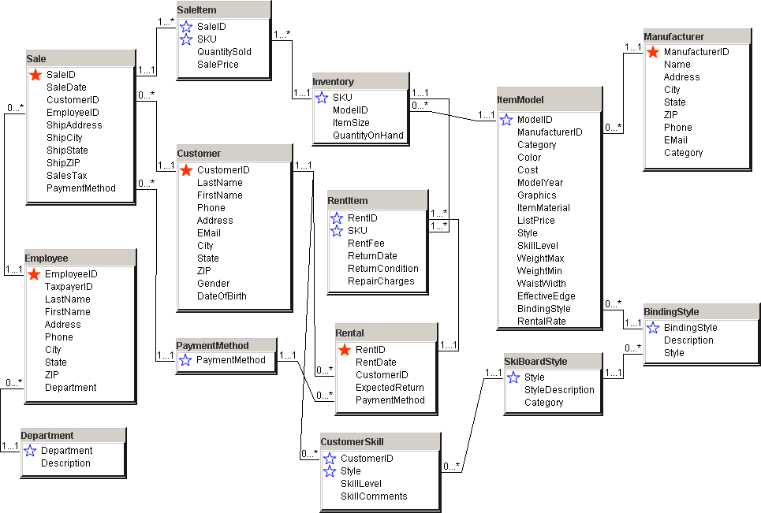
Primary Tables

Slide 3
Find Best Customers: 1

Slide 4
Action
Action
Create a new query.
Tables: Customer, Sale, SaleItem.
Columns: CustomerID, LastName, FirstName, Sum(QuantitySold*SalePrice) AS SalesValue
Group By the other columns.
Run the query.
Save as a view CustomerSales.
Create new query.
Table: CustomerSales query.
SELECT Avg(SalesValue) …
Run the query.

Slide 5
Average Customer Sales
Question | Compute average total purchases for customers.
SQL | SELECT Avg(SalesValue) As AvgOfSalesValue FROM CustomerSales;
AVGOFSALESVALUE 942.114155

Slide 6
Action
Action
Create a new query.
Table: CustomerSales query.
Columns: LastName, FirstName, SalesValue.
Criteria for SalesValue
>(SELECT Avg(SalesValue) FROM CustomerSales).

Slide 7
Best Customers

Slide 8
INNER JOIN: Sales and Rentals

Slide 9
Action
Action
Create a new query.
Tables: Rental and Sale.
Columns: RentDate, SaleDate, and CustomerID from both tables.
Join the tables on CustomerID.
Run the query.
Add a join between the tables on RentDate=SaleDate.
Run the query.

Slide 10
Sales and Rentals on Same Day

Slide 11
Action
Action
Create a new query.
FROM (Customer INNER JOIN Sale
ON Customer.CustomerID=Sale.CustomerID)
LEFT JOIN Rental ON Sale.CustomerID = Rental.CustomerID.
Columns: LastName, FirstName, and CustomerID from Sale and Rental.
Run the query.

Slide 12
Rental Without a Purchase
Question | List all customers who rented and did or did not make a purchase.
SQL | COLUMN LastName Format A15 COLUMN FirstName Format A15 SELECT LastName, FirstName, Sale.CustomerID, Rental.CustomerID FROM (Customer INNER JOIN Sale ON Customer.CustomerID=Sale.CustomerID) LEFT JOIN Rental ON Sale.CustomerID=Rental.CustomerID ORDER BY LastName, FirstName ;
LASTNAME FIRSTNAME CUSTOMERID CUSTOMERID Abel Marshall 1406 1406 Abel Marshall 1406 1406 Abel Melinda 1467 1467 Abrams Marc 603 (null) Adkins April 413 413 Adkins Manuel 1499 1499 Aldrich Jewell 142 142 Aldrich Jewell 142 142 …

Slide 13
Action
Action
Create a new query.
Tables: Customer and Sale.
Columns: LastName, FirstName, and CustomerID.
WHERE CustomerID Not In (SELECT CustomerID FROM Rental).
Run the query.

Slide 14
Purchase but Never Rented

Slide 15
Model Quantity On Hand

Slide 16
Action
Action
Create a new query.
Table: Inventory.
Columns: ModelID and Sum(QuantityOnHand).
Sort by the Sum descending.
Run the query.
Save it as ModelsOnHand.
Create a new table: SalesCategory.
Columns: CategoryID, CategoryName, LowLimit, HighLimit.
Enter data from Figure 5.10 (next).

Slide 17
Categories
Question | Data for the new SalesCategory table.
SQL | INSERT INTO SalesCategory VALUES (1, 'Hot', 0, 6); INSERT INTO SalesCategory VALUES (2, 'Good', 6, 10); INSERT INTO SalesCategory VALUES (3, 'OK', 10, 20); INSERT INTO SalesCategory VALUES (4, 'Weak', 20, 40); INSERT INTO SalesCategory VALUES (5, 'Slow', 40, 1000); SELECT * FROM SalesCategory;
CATEGORYID CATEGORYNAME LOWLIMIT HIGHLIMIT 1 Hot 0 6 2 Good 6 10 3 OK 10 20 4 Weak 20 40 5 Slow 40 1000

Slide 18
CREATE TABLE
CREATE TABLE SalesCategory
(
CategoryID INTEGER,
CategoryName NVARCHAR2(15),
LowLimit INTEGER,
HighLimit INTEGER,
CONSTRAINT pk_SalesCategory PRIMARY KEY(CategoryID)
) ;

Slide 19
Action
Action
Create a new query.
Columns: ModelID, SumOfQuantityOnHand, CategoryID, and CategoryName.
Tables: ModelsOnHand and SalesCategory.
Add the inequality join.
Run the query.

Slide 20
Inequality Join

Slide 21
Sales Categories

Slide 22
Action
Action
Create a new query.
Columns: CustomerID, LastName, FirstName, and SaleDate.
Tables: Customer and Sale.
Set January sale date in WHERE.
Copy the entire statement.
Add the word Union.
Paste the SELECT statement and change the date condition and name to March.
Run the query.

Slide 23
UNION Query

Slide 24
Action: Recursive Query
Action
Look at the Employee table—the ManagerID column.
Create the recursive query to show the reporting relationships.
Check the results against the data.

Slide 25
Recursive Query Data
EmployeeID | LastName | FirstName | ManagerID
0 | Staff |  | 8
1 | Killy | Jean-Claude
2 | Miyahira | Hideharu | 4
3 | Street | Picabo | 6
4 | Heiden | Beth | 1
5 | Cavagnoud | Regine | 4
6 | Daehlie | Bjorn | 1
7 | Moe | Tommy | 15
8 | Tomba | Alberto | 18
9 | Jasey-Jay | Anderson | 15
10 | Carr | Chris | 4
11 | Fawcett | Mark | 6
12 | Mckenna | Lesley | 18
13 | Weinbrecht | Donna | 3
14 | Adam | Arno | 3
15 | Brassard | Jean-Luc | 1
16 | Boit | Philip | 6
17 | Bourgeat | Pierrick | 15
18 | Gravier | Richard | 1

Slide 26
Recursive Query
SELECT lpad( '*', level, '*') || LastName
FROM EMPLOYEE
Start with ManagerID Is null
Connect by prior EmployeeID=ManagerID;
*Killy
**Heiden
***Miyahira
***Cavagnoud
***Carr
**Daehlie
***Street
****Weinbrecht
****Adam
***Boit
**Brassard
***Moe
***Jasey-Jay
***Bourgeat
**Gravier
***Tomba
****Staff
***Mckenna
****Fawcett

Slide 27
Action
Action
Create a new query
Enter the CREATE TABLE command
Run the query

Slide 28
CREATE TABLE Query
CREATE TABLE Contacts
(
ContactID INTEGER,
ManufacturerID INTEGER,
LastName NVARCHAR2(25),
FirstName NVARCHAR2(25),
Phone NVARCHAR2 (15),
Email NVARCHAR2 (120),
CONSTRAINT pk_Contacts PRIMARY KEY (ContactID),
CONSTRAINT fk_ContactsManufacturer FOREIGN KEY (ManufacturerID)
REFERENCES Manufacturer(ManufacturerID)
)
;

Slide 29
Create a Temporary Table
CREATE TABLE MyTemp
(
ID INTEGER,
LName NVARCHAR2(25),
FName NVARCHAR2(25),
CONSTRAINT pk_MyTemp PRIMARY KEY (ID)
);

Slide 30
Action
Action
Create a new query
Type the INSERT command: INSERT INTO Customer (CustomerID, LastName, FirstName, City, Gender) VALUES (4000, 'Jones', 'Jack', 'Nowhere', 'Male');
Run the query

Slide 31
INSERT INTO (One Row)
INSERT INTO Customer (CstomerID, LastName, FirstName, City, Gender)
VALUES (4000, 'Jones', 'Jack', 'Nowhere', 'Male');
Lab 7 shows how to create sequences so CustomerID is generated automatically.

Slide 32
INSERT INTO (Copy Rows)
INSERT INTO MyTemp (ID, LName, FName)
SELECT CustomerID, LastName, FirstName
FROM Customer
WHERE City='Sacramento'
;

Slide 33
Action
Action
Create a new query.
Columns: Category, ModelYear, and Round(Cost*1.04,2).
Table: ItemModel.
Criteria: Category=’Board’ And ModelYear=2010.
Run the query.
Change the first two lines to:
UPDATE ItemModel
SET Cost = Round(Cost*1.04,2).
Run the query.

Slide 34
UPDATE Board Cost
Question | Increase the cost of snow boards by four percent for 2010.
SQL | SELECT Category, ModelYear, Round(Cost*1.04,2) FROM ItemModel WHERE Category='Board' AND ModelYear=2010 ; -- run the top query first, then edit it to make the actual changes UPDATE ItemModel SET Cost = Round(Cost*1.04,2) WHERE Category='Board' AND ModelYear=2010 ;
88 rows updated.

Slide 35
Action
Action
Create a new query: SELECT * FROM MyTemp WHERE ID > 100;
Test the query.
Change the SELECT row to DELETE.
Run the query.
Run a commit; command.

Slide 36
DELETE Rows
Question | Delete sample row from the MyTemp table.
SQL | -- SELECT * DELETE FROM MyTemp WHERE ID > 100; Commit;
ID LNAME FNAME 1184 Cherry Louis 1 row deleted. commit; Commited

Slide 37
DROP TABLE
DROP TABLE MyTemp;

Slide 38
Action
Action
Create a new query.
Columns: Category, Sum(RentFee).
Tables: Rental, RentItem, Inventory, and ItemModel.
GROUP BY Category.
Test the query.

Slide 39
Query Parameters

Slide 40
Action
Action
Create a new query.
Copy or paste the code to create the package and procedure.
Run the package creation code.
Enter the five commands to execute the parameter query.
Run the query.
Change the dates to Oct-Dec.
Run the query.

Slide 41
Query Parameters: Package
CREATE PACKAGE pckCategoryFees AS
TYPE typeCategoryFees IS RECORD
( Category NVARCHAR2(15),
SumOfRentFees NUMBER(8,2)
);
TYPE typeCursorFees IS REF CURSOR RETURN typeCategoryFees;
PROCEDURE GetCategoryFees
( dateStart IN DATE,
dateEnd IN DATE,
cvFees IN OUT typeCursorFees
);
END;
/

Slide 42
Package Body
CREATE PACKAGE BODY pckCategoryFees AS
PROCEDURE GetCategoryFees
( dateStart IN DATE,
dateEnd IN DATE,
cvFees IN OUT typeCursorFees
) IS
BEGIN
OPEN cvFees FOR
SELECT Category, Sum(RentFee) AS SumOfRentFee
FROM Rental INNER JOIN RentItem INNER JOIN Inventory
INNER JOIN ItemModel
ON Inventory.ModelID=ItemModel.ModelID
ON RentItem.SKU=Inventory.SKU
ON Rental.RentID=RentItem.RentID
WHERE RentDate Between dateStart And dateEnd
GROUP BY Category;
END;
END;

Slide 43
Query Parameters
Question | Use the parameterized procedure to display rental totals for specified dates.
SQL | SET AUTOPRINT ON VARIABLE cv REFCURSOR EXECUTE pckCategoryFees.GetCategoryFees('01-Jan-2010', '31-Mar-2010', :cv);
CATEGORY SUMOFRENTFEE Board $18,660.00 Boots $14,370.00 Electronic $1,350.00 Poles $790.00 Rack $420.00 Ski $37,900.00

