Slide 1
All Powder Board and Ski
Oracle 11g Workbook
Chapter 6: Forms and Reports
Jerry Post
Copyright © 2010

Slide 2
Model-View-Controller
View
Model
Page
Controller
Database

Slide 3
Form Types
Ski Board Style
Customer
Style | Style Description | Category
Last Name
First Name
Phone
Address
City
Grid
Sale
Main
Customer
Salesperson
ItemID | Description | Price | Quantity | Value
Main and
Subform

Slide 4
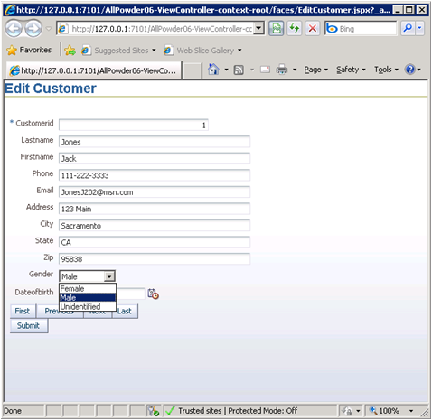
Customer Main Form
Text box with Label
Gender Combo Box/LOV
Record navigation

Slide 5
Action
Action
Start JDeveloper with the default role.
Use menu: Application/New.
Name: AllPowder06, Package prefix: AP06.
Pick Fusion Web (ADF) template.
Create default project Model with ADF objects.
Create default project ViewController with ADF Faces.
Finish with defaults.

Slide 6
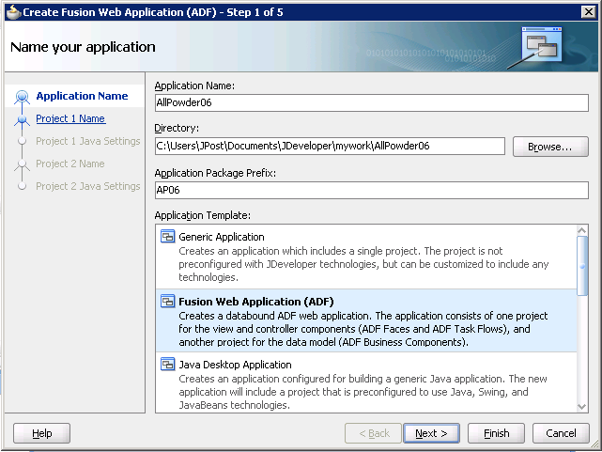
JDeveloper: Application/New

Slide 7
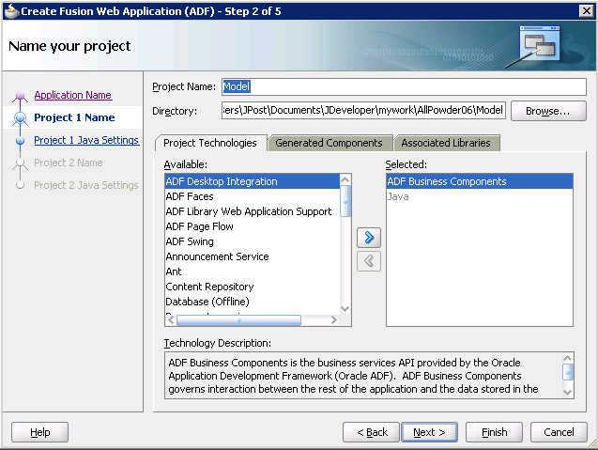
Model Project

Slide 8
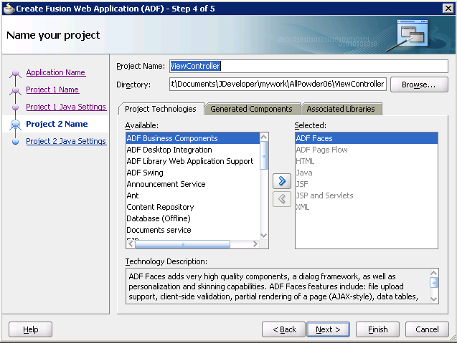
ViewController Project

Slide 9
Action: Database
Action
Use Checklist Step 2, or
Right-click Connections, New Connection/Database.
Name it (AllPowder).
Enter standard login information (Username/Password).
Set the server and SID if needed.
Test Connection!

Slide 10
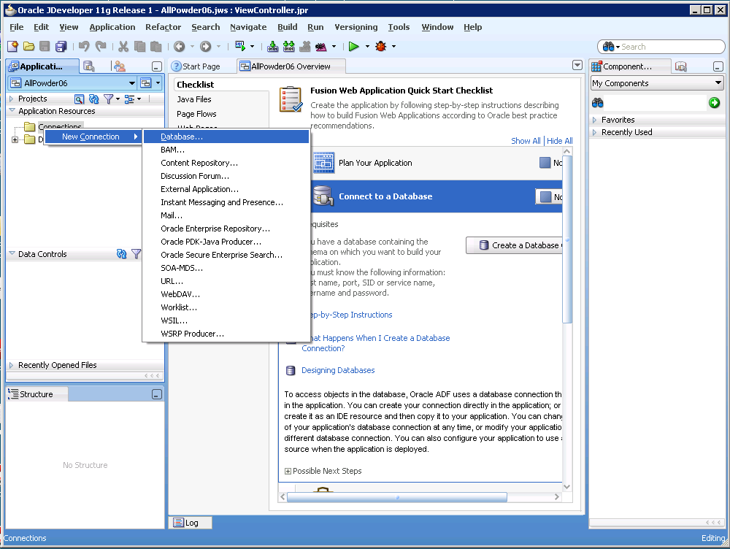
Database Connection
Application Navigator
Component Navigator
Edit Windows
Property Navigator

Slide 11
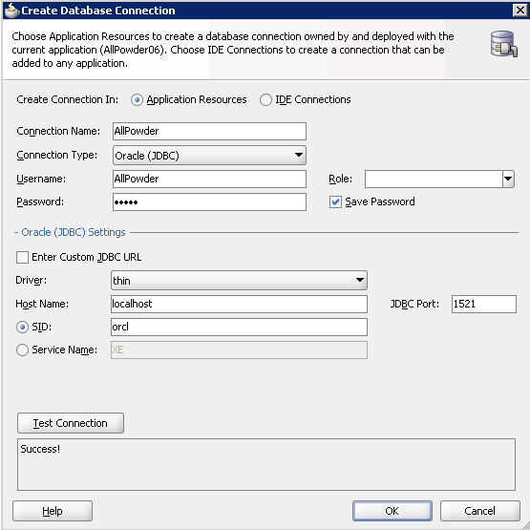
Database Connection (Oracle)

Slide 12
Action: Customer Component
Action
Use Checklist Step 3.1 or,
Expand Projects, right-click Model, New.
Pick Business Tier/ADF Business Components.
Click Query button.
Select Customer table to the right side.
Updatable View: Select Customer table.
Finish with defaults.

Slide 13
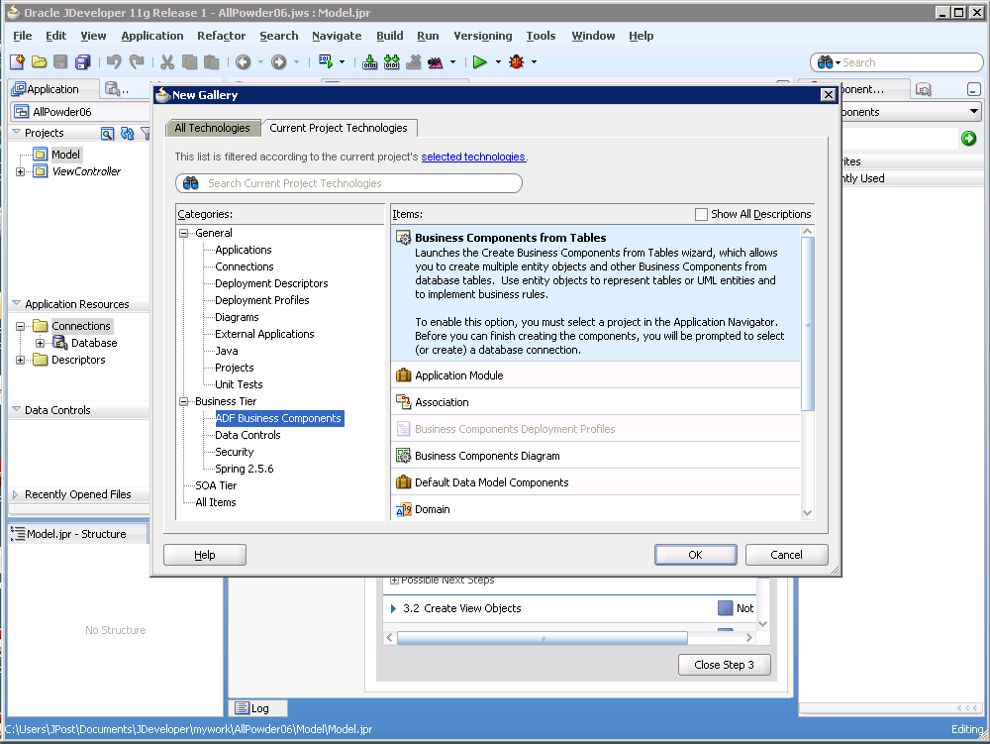
Model Components

Slide 14
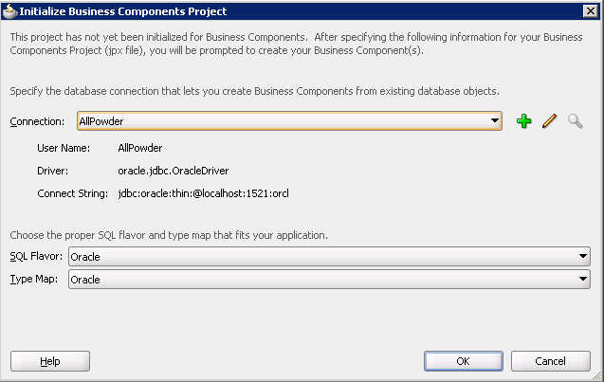
Initialize Project Connection

Slide 15
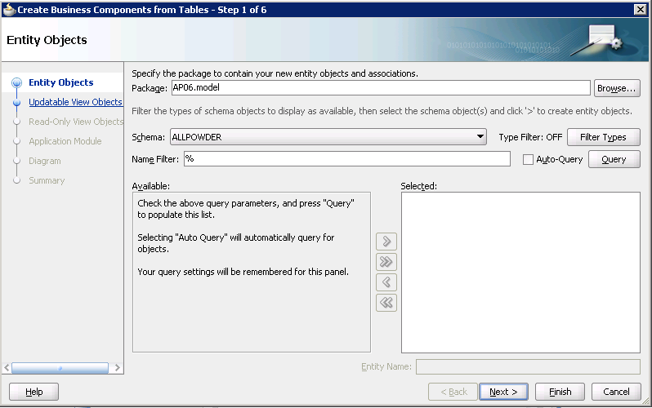
Entity Objects

Slide 16
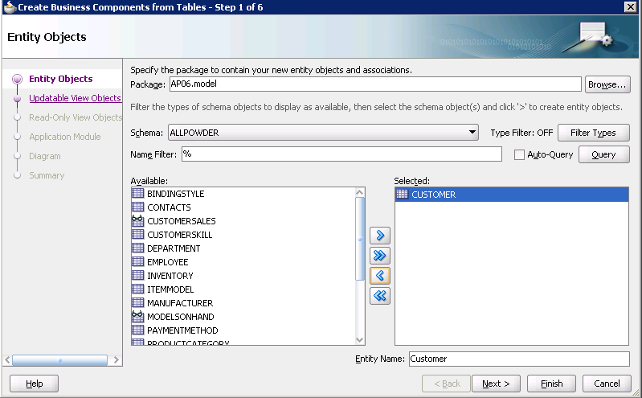
Table Objects
Choose table. Click arrow to select.

Slide 17
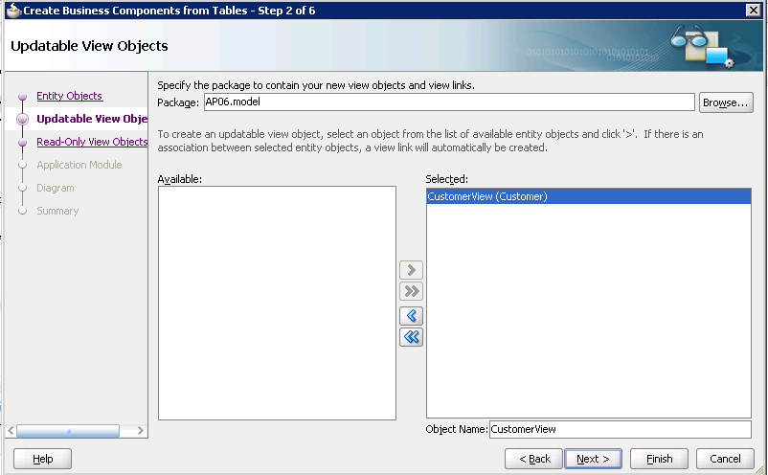
Updatable Views

Slide 18
Action: Gender LOV Object
Action
Right-click Projects/Model/AP06.model.
Create a New View Object.
Name: GenderLOVView.
Select Rows populated at design time (Static List).
Add Attributes with the New button.
Name: Gender, Key Attribute (check box).
Static List: Click the Plus sign.
Add three rows: Female, Male, Unidentified.
Set check box for Application Module.
Finish with defaults.
Select List UI Hints tab.
Keep default type: Choice List.
Move Gender column to Selected side.

Slide 19
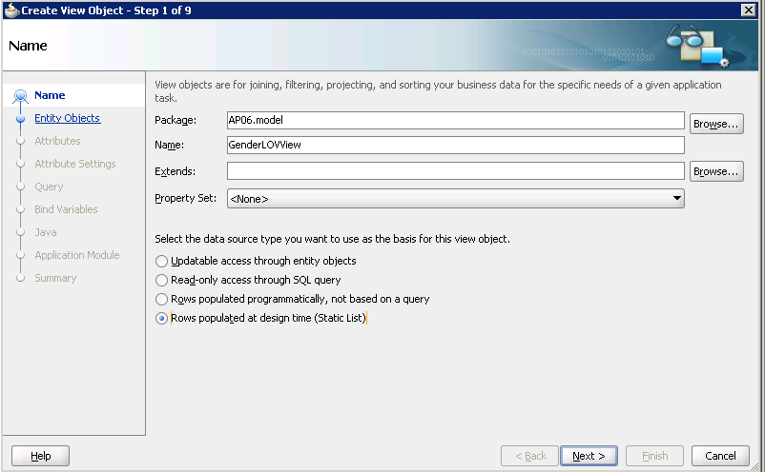
LOV: New View Object
Projects/Model/Ap06.model: New View Object

Slide 20
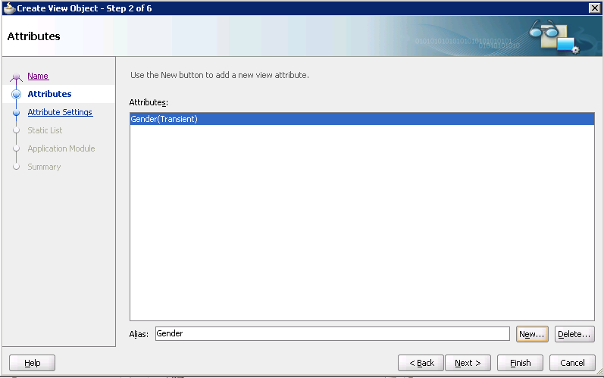
LOV Attributes

Slide 21
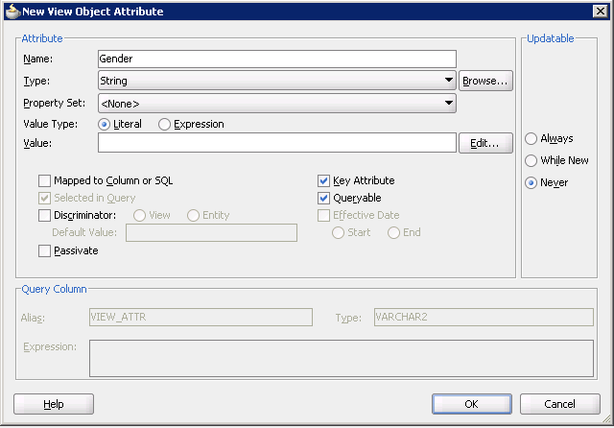
Gender Attribute

Slide 22
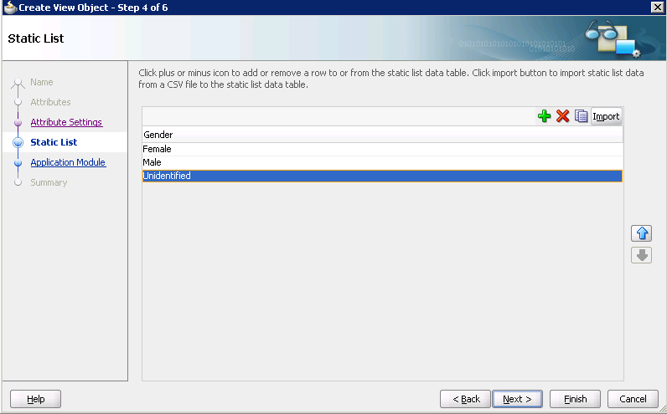
Gender List

Slide 23
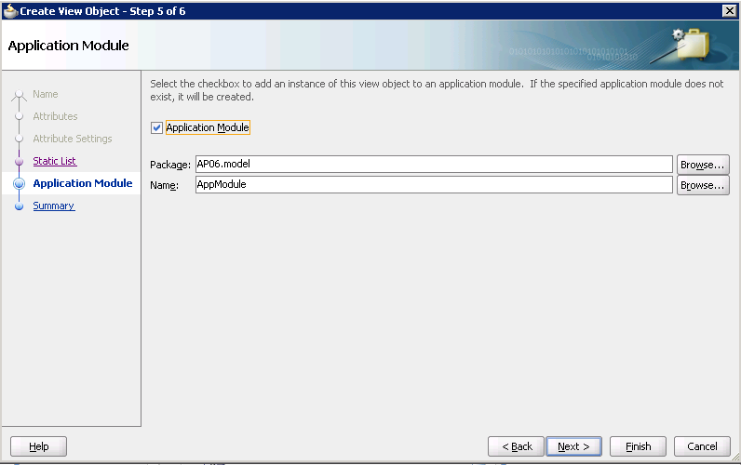
Application Module

Slide 24
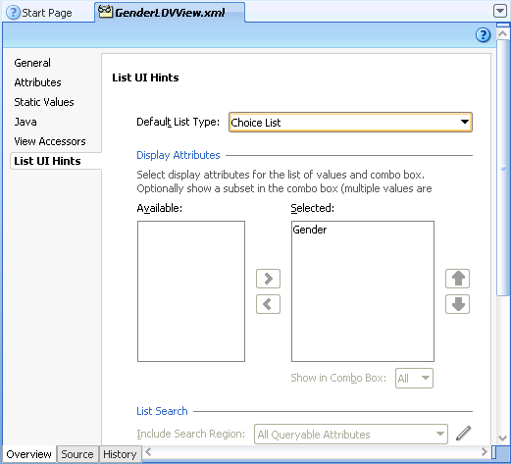
List UI Hints

Slide 25
Action: Gender LOV Object
Action
Open Customer table object in model.
View Accessors tab, click plus sign.
Move GenderLOVView to right side.
Attributes tab, select Gender column.
Double-click to edit Gender attribute.
Select Validation tab click New.
Set Rule Type to List.
Set List Type: View Accessor Attribute.
Choose GenderLOVView1/Gender.
Failure Handling tab, enter message (Female, Male, Unidentified).

Slide 26
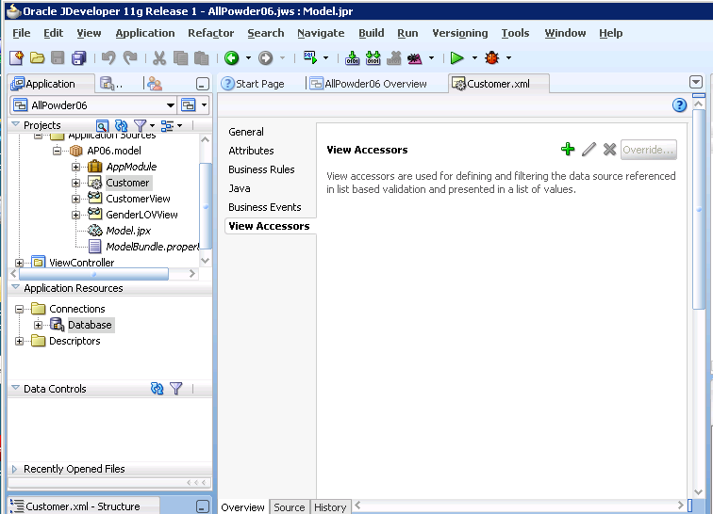
Customer View Accessors

Slide 27
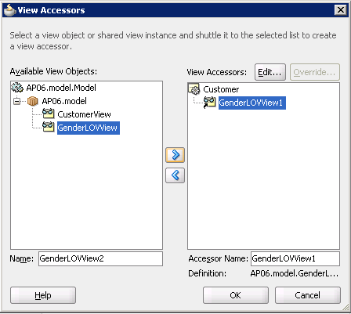
View Accessors: Gender

Slide 28
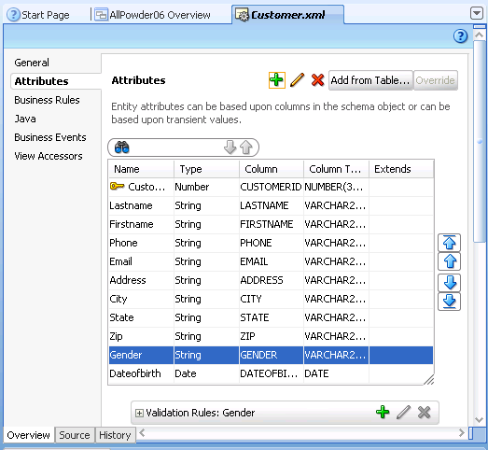
Gender Attribute

Slide 29
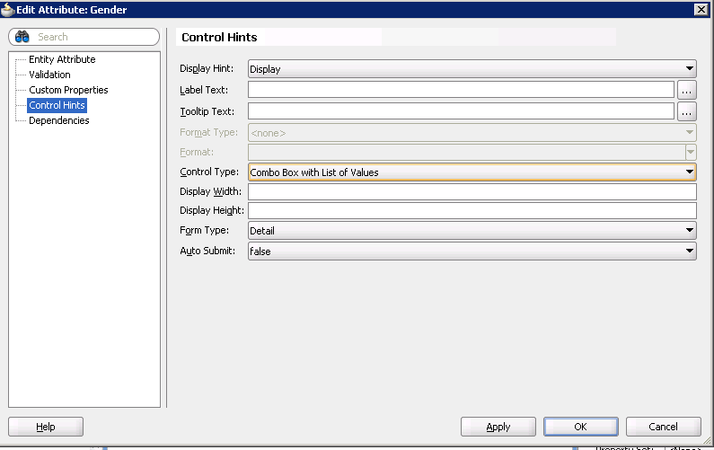
Gender Control

Slide 30
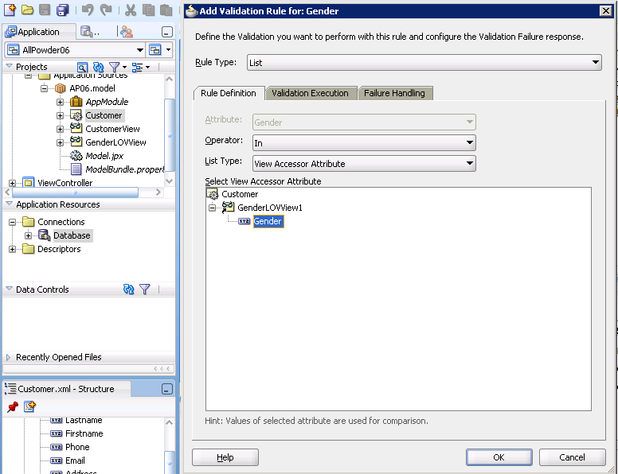
Gender Validation

Slide 31
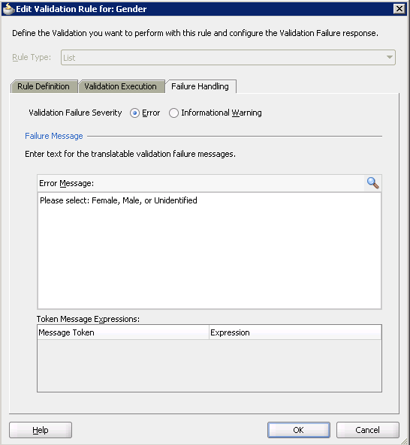
Validation Message

Slide 32
Action: LOV to Customer View
Action
Open Customer View in model.
Select Gender column.
Scroll to bottom.
List of Values: Gender, click Plus sign.
List Data Source: GenderLOVView1.
List Attribute: Gender.
Ignore warning messages.

Slide 33
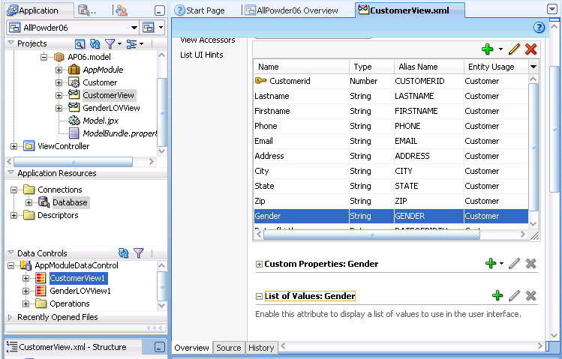
Apply LOV to Gender Column

Slide 34
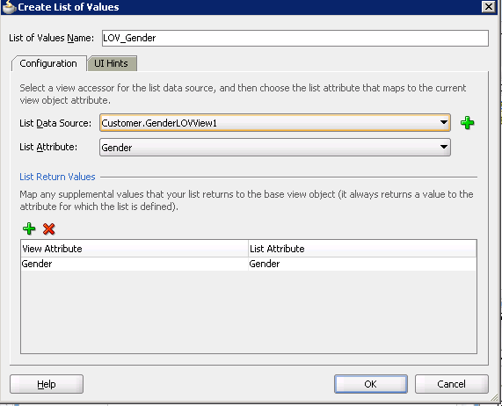
Pick GenderLOV and Column
Optional—change control type
Ignore any warning messages.

Slide 35
Action: Create Page
Action
Checklist Step 5.2 or
ViewController project, right-click Web Content, New JSF Page.
File Name: EditCustomer.jspx.
Choose Quick Start Layout (One Column Header).
Type title: Edit Customer.
Set it as Heading 1.
In Component navigator, pick CSS from dropdown instead of ADF Faces.
Drag JDeveloper.css onto the form and rename as Powder.css.
In Application navigator, refresh Data Controls section.
Drag CustomerView1 object to form page (bottom).
Check two boxes: Navigation and Submit buttons.
Verify Gender column is set to ADF Select One Choice.

Slide 36
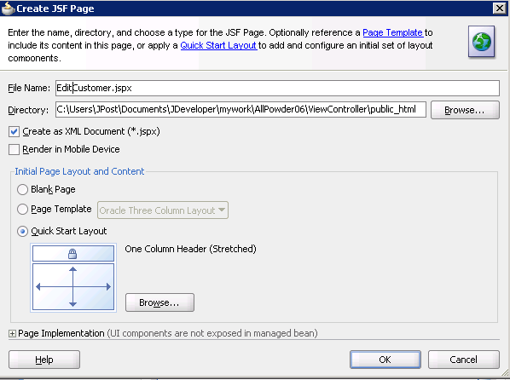
ViewController: New JSF Page

Slide 37
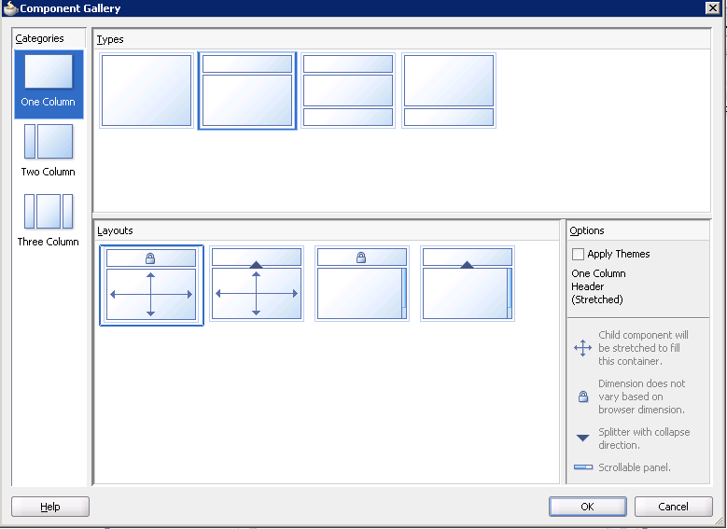
Layout Gallery

Slide 38
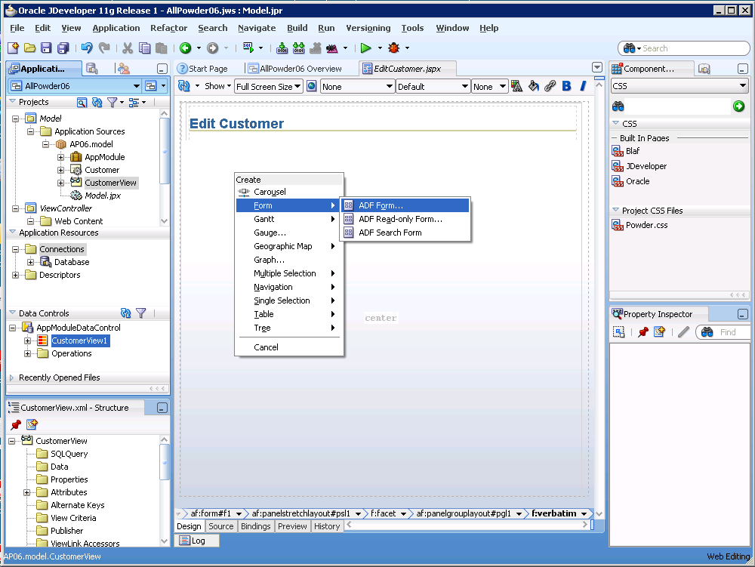
Add Edit Control to Form

Slide 39
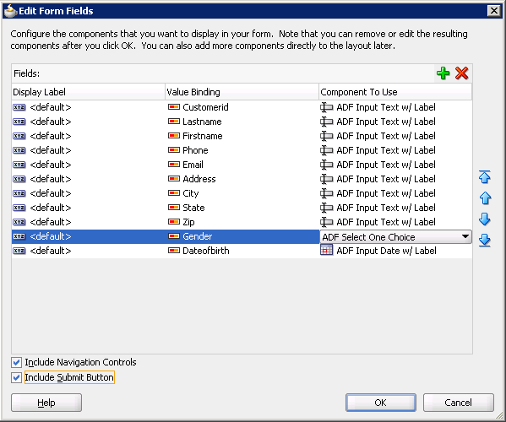
Select Controls with LOV
Check to enable edit

Slide 40
Action: Create Page
Action
Save everything (button).
Right-click the form and choose Run.
Wait.
Use red square stop button to stop the form.
Select the Email box.
Expand Properties/Appearance.
Change Columns from bindings.Email… to bindings.Lastname…
Select Gender combo box.
Change columns to bindings.Lastname…
Run form.
Test gender combo box.
Test date picker.
Stop form and close all design pages.

Slide 41
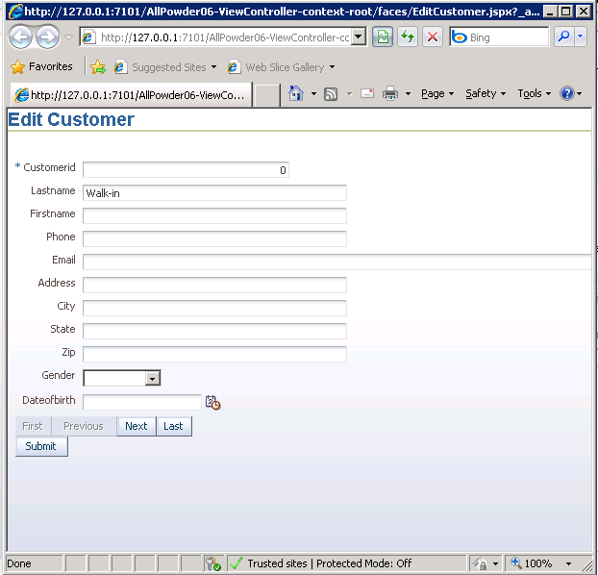
First Run
Too wide!

Slide 42
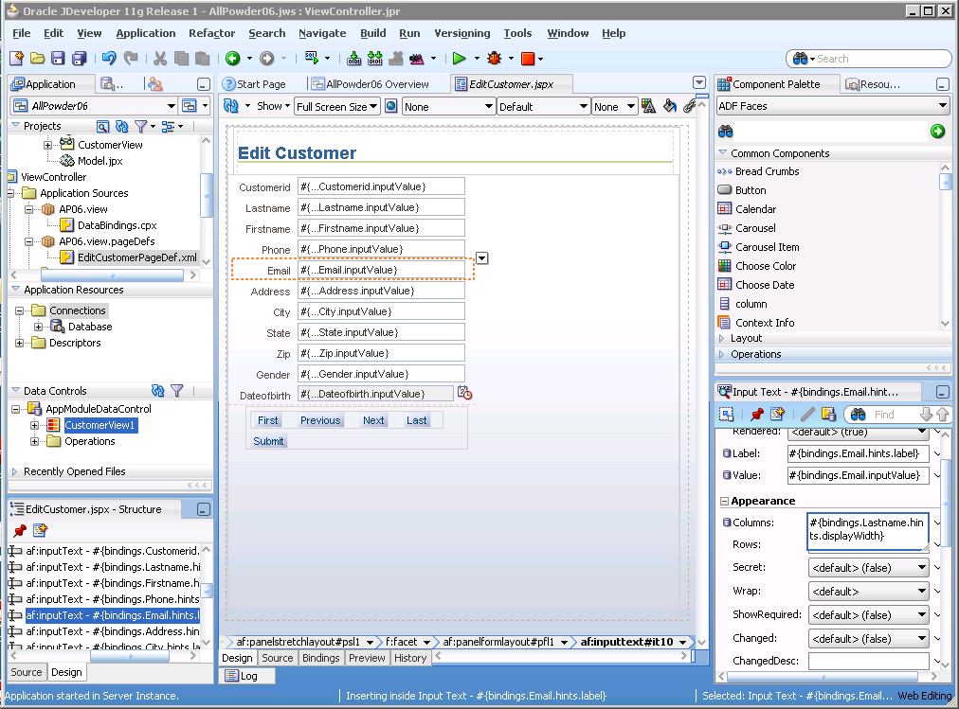
Edit E-mail Width

Slide 43
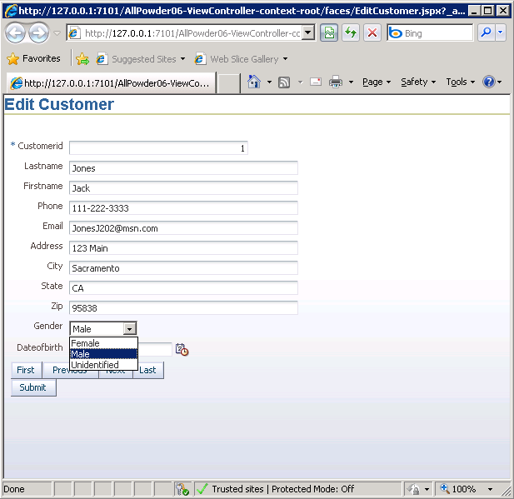
Run with LOV Combo

Slide 44
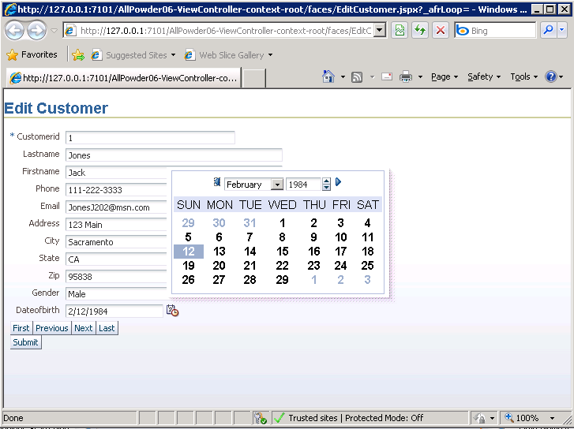
Run with Date Picker
Date picker -- automatic

Slide 45
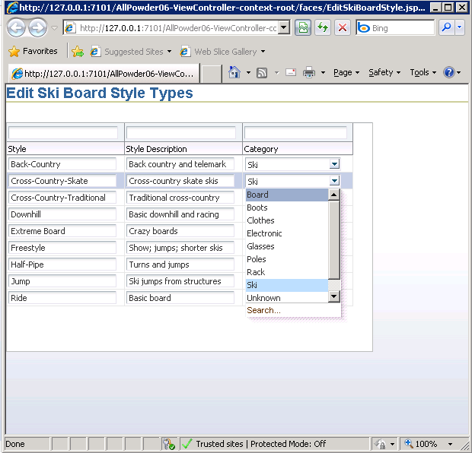
Grid/Table Form: Ski Board Style

Slide 46
Action: Start Grid Page
Action
Application Navigator: Model/New.
Business Components: Business Components from Tables.
Click Query button, select SkiBoardStyle table to right.
Updatable View, select SkiBoardStyle table.
Read-only, none, default.
Finish with defaults.

Slide 47
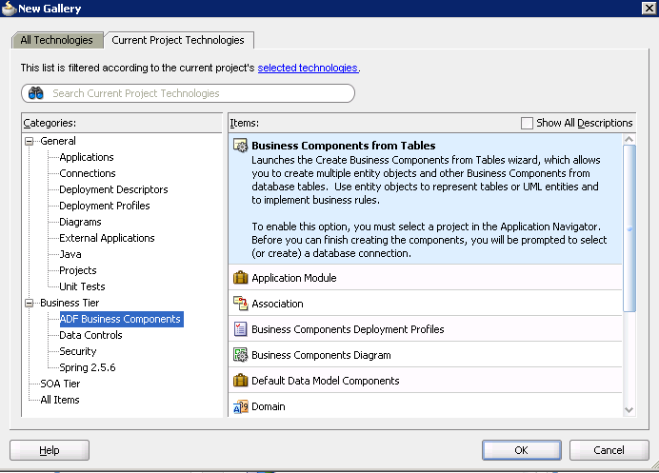
New Business Component

Slide 48
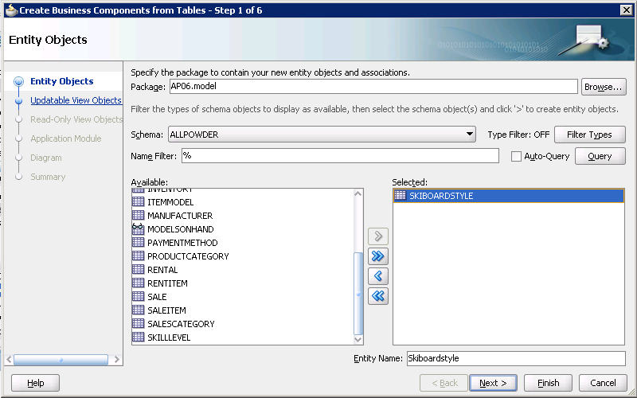
SkiBoardStyle Table

Slide 49
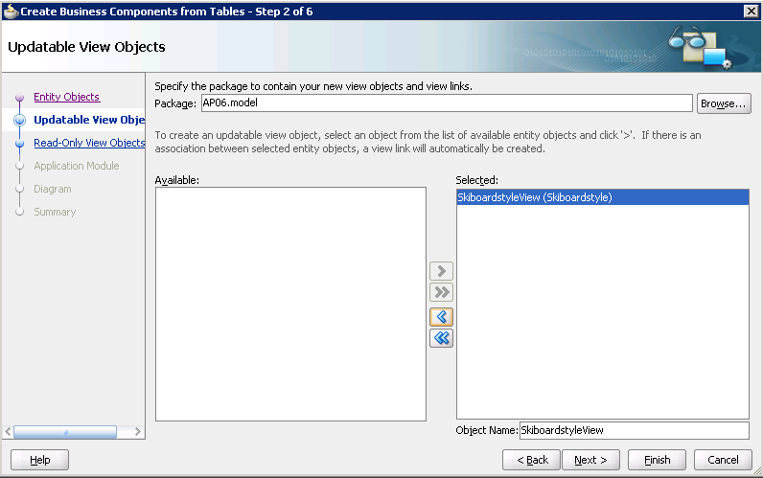
Updatable

Slide 50
Action: Model Data for LOV
Action
Projects/Model/Ap06.model: New View Object.
Name: ProductCategoryLOVView.
Read-only access through SQL query.
Write SQL.
Accept most defaults, but set Category as Key Attribute.
Set Checkbox for Application Module.
Use defaults to finish.
List UI Hints tab: Keep default: Choice List
Move Category column to Selected box.

Slide 51
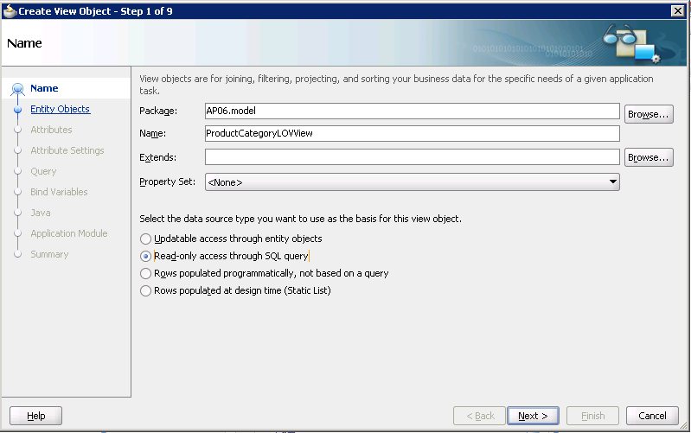
Product Category LOV Object

Slide 52
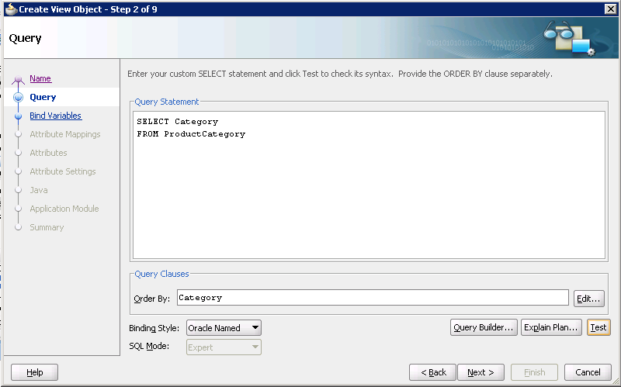
LOV Query Lookup
SELECT Category FROM ProductCategory
ORDER BY Category

Slide 53
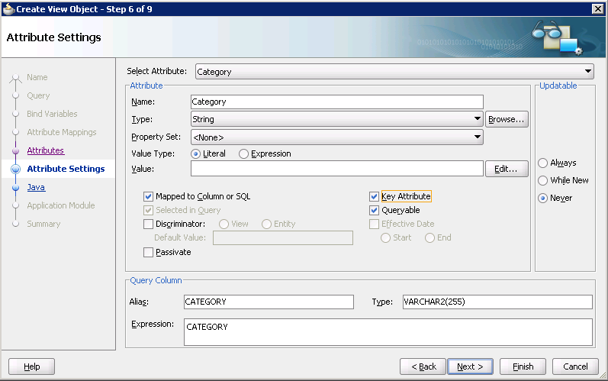
Key Attribute

Slide 54
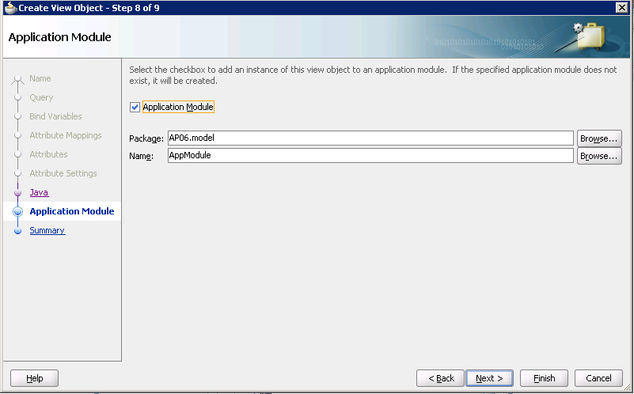
Application Module

Slide 55
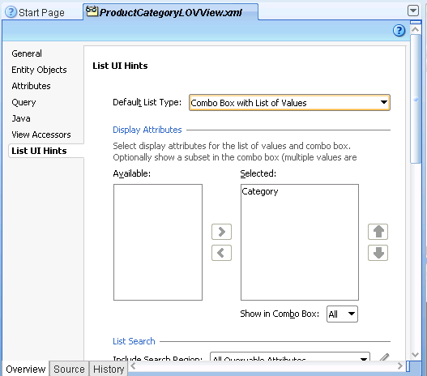
List UI Hints: Column

Slide 56
Action: Add LOV to SkiBoardStyle Table
Action
Model/SkiBoardStyle table: Edit/double click.
View Accessors tab, click plus sign to add.
Move ProductCategoryLOVView to right panel.
Attributes tab, select Category.
Validation rule, click plus sign to add.
Rule Type: List.
List Type: View Accessor Attribute
Choose ProductCategorLyOVView1 and Category.
Failure Handling message: Please select category from list.

Slide 57
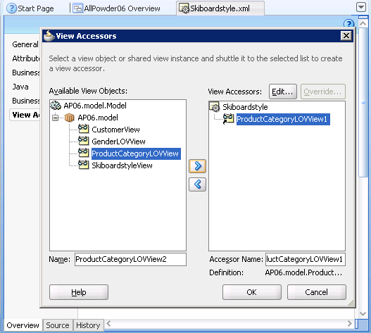
SkiBoardStyle: Accessors

Slide 58
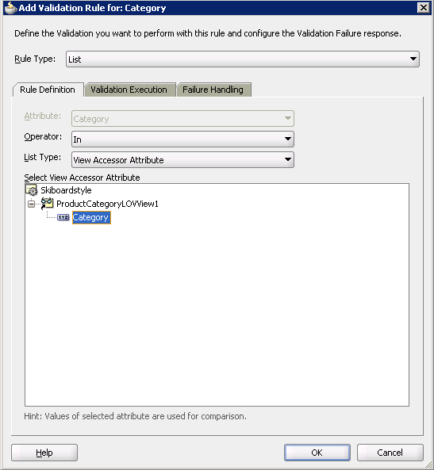
SkiBoardStyle: Category Validation

Slide 59
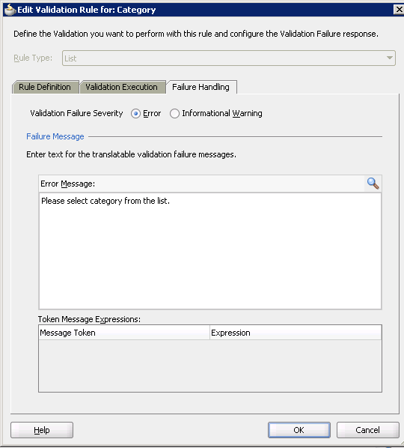
Validation Message

Slide 60
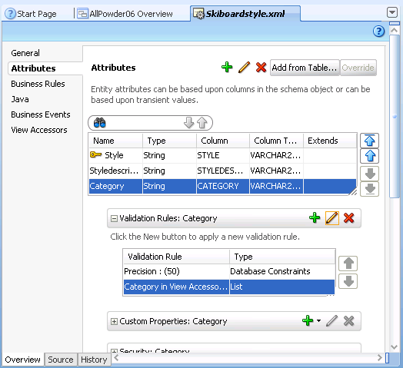
SkiBoardStyle Table Summary

Slide 61
Action: Ski Board Style View
Action
Model/SkiBoardStyle View: Edit/double click.
Attributes tab, select Category column.
List of Values: Category, click plus sign to add.
List Data Source: Skiboardstyle.ProductCategoryLOVView1.
List Attribute: Category.
Ignore error messages.

Slide 62
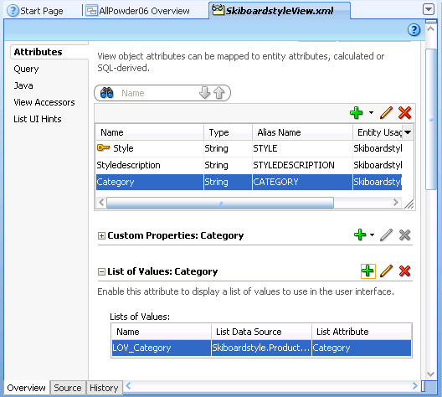
SkiBoardStyle View Edit
Click plus to assign LOV

Slide 63
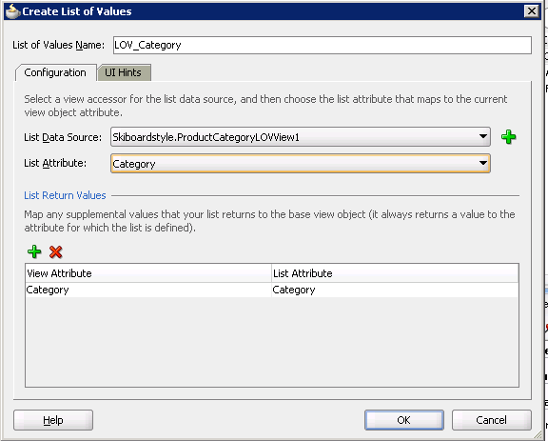
Assign LOV to SkiBoardStyle

Slide 64
Action: New Grid Page
Action
Application Navigator, ViewController project, right-click Web Content/New.
Web Tier, JSF, pick JSF Page.
File Name: EditSkiBoardStyle.jspx.
Quick Start Layout: One Column Header (Stretched).
Type title at the top: Edit Ski Board Style Types.
Set it as Heading 1 and drag the powder.css file to the page.
Refresh the Data Controls section.
Drag Skiboardstyleview1 onto the main part of the form.
Choose Table/ADF table from the pop-up menu.
Check options for Row Selection, Filtering, and Sorting.
Save everything.

Slide 65
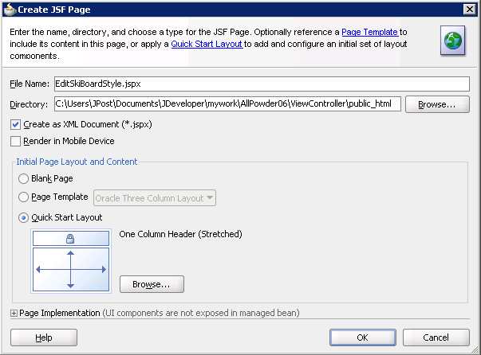
Create New Web Page

Slide 66
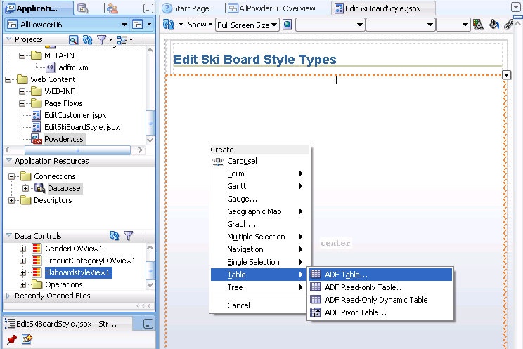
Add SkiBoardStyleView as Table

Slide 67

Table Options

Slide 68

Page Design View

Slide 69
Action: Run the Grid Form
Action
Right-click the form and run it. Wait.
Notice the column widths.
Stop the browser.
Adjust the column widths by dragging the borders in the design.
Fix the title/label for Style Description.
Model: Edit Skiboardstyle View.
Attributes tab: Edit Styledescription
Set Label Text: Style Description.
Save everything and run the form.
Test the LOV for Category.
Test the sorting by clicking the column headings.
Test the filter. Enter Board in the box above the Category heading and press <Enter>.

Slide 70

Initial Run

Slide 71

Change Label
Model: SkiBoardStyleView / Edit
Styledescription column/Edit

Slide 72

Run Grid with LOV Search

Slide 73
Main/Subform by Sale
Overview:
Create data view for Sale + Customer.
Create data view for SaleItem + Inventory.
Create link to join the two views.
Build the initial form to test it.
Add LOVs to the main form.
Clean up the form display.
Add Sale Total calculation.

Slide 74
Action: Tables and Associations
Action
Add the table objects to the project: Sale, SaleItem, Inventory.
Do NOT create views for them. You can add all tables for use later.
If it was not created automatically, create a new Association: Sale + Customer.
Choose Customer/CustomerID as the source (left) and Sale/CustomerID as the destination (right).
Click the Add button to create the link.
Accept defaults except check the box to add to the Application Module.

Slide 75

Build Entity Objects—All Tables

Slide 76

Do Not Build View Objects

Slide 77

Customer Sale Association

Slide 78

Sale + Customer View Object

Slide 79
Action
Action
Right-click AP06.model and choose New View Object.
Name: SaleCustomerView.
Defaults: Updatable access through entity objects.
Select Sale and Customer tables, Sale will be updatable, Customer will not.
Verify the link between Sale and Customer.
Select all columns from the Sale table and LastName, FirstName, Phone, Email from Customer.
Add Order By Sale.SaleID.
Build a second view for SaleItem and Inventory using all columns from SaleItem and ItemSize and ModelID from Inventory.

Slide 80

Select Sale and Customer

Slide 81

Select Attributes

Slide 82

Sale+Customer Query

Slide 83
Action
Action
In the SaleItemInventory View, at Attribute summary, click the Add button to create a new transient attribute.
Name: LineTotal
Type: BigDecimal
Value Type: Expression
Value: Quantitysold*Saleprice
Click the Edit button.
Select Quantitysold and Saleprice to trigger recalculations.

Slide 84

SaleItem+Inventory View

Slide 85

Choose Tables

Slide 86

Choose Attributes

Slide 87

Add Computed Value: P*Q

Slide 88

Edit New Value

Slide 89

Query

Slide 90
Action
Action
Right-click AP06.model, New View Link.
Name: SaleToSaleItemViewLink
Source: SaleCustomerView.Saleid
Destination: SaleItemInventoryView.Saleid
Click the Add button.
Accept the defaults except set the Application Module

Slide 91

New View Link Object

Slide 92

Link Tables and IDs

Slide 93

Default Accessor

Slide 94
Action: Create NewPage
Action
ViewController, Web Content, New page.
Web Tier/JSF/JSF Page.
Name: Sale.jspx, single-column template.
Add title, set as Heading 1, drag Powder.css onto page.
Refresh the Data Controls.
Find SaleCustomerView2 and expand it.
Verify that SaleItemInventoryView2 is beneath it.
Drag SaleCustomerView2 onto the form: Form/ADF Form.
Select Navigation and Submit buttons.
Drag nested SaleItemInventoryView2 onto the bottom of the form: Table/ADF Table.
Check the Row Selection and Sorting boxes (not filtering).
Run the form to test it.

Slide 95

New Page

Slide 96

Main/Master: Sale
Take SaleCustomerView2
Hosting SaleItemInventoryView2

Slide 97

Detail Section: Table
Use nested SaleItemInventoryView2

Slide 98

Detail Options

Slide 99

Initial Sale Form Design

Slide 100

Initial Run: Check Detail SaleID

Slide 101
Action: Submit=Commit
Action
Close the browser running the Sale form.
In Data Controls, under the SaleCustomerView2 entry, expand the Operations node.
Drag the Commit function and drop it onto the Submit button.
Check the boxes to keep the original values for the name (Submit) and disabled (empty).

Slide 102

Add Commit to Submit Button
Check to keep old
Drag

Slide 103
Action: Create LOVs
Action
Create a New View Object.
Name: CustomerLOVView.
Read-only access through SQL Query.
Query includes CustomerID and a LastName+FirstName+Phone display column.
List UI Hints: Combo Box with List of Values.
Edit SaleCustomerView.
Add new LOV as a view accessor.
Link to Customerid in the Sale table.
Create a PaymentMethodLOV using the default Choice List.

Slide 104

Customer Lookup: LOV

Slide 105

Customer LOV Query
SELECT CustomerID, Lastname || ', ' || Firstname || ' ' || Phone AS Fullname
FROM Customer
ORDER BY Fullname

Slide 106

CustomerID Key Attribute

Slide 107

List UI Hints: Customer

Slide 108

SaleCustomerView Accessors

Slide 109

CustomerID Attribute

Slide 110

PaymentMethod LOV

Slide 111

PaymentMethod Query
SELECT PaymentMethod FROM PaymentMethod
ORDER BY PaymentMethod

Slide 112

PaymentMethod UI

Slide 113

SaleCustomerView: Accessors

Slide 114

PaymentMethod: LOV

Slide 115
Action: Add LOVs to Page
Action
Open the Sale.jspx page in design mode.
Refresh the Data Controls.
Expand the SaleCustomerView2 node.
Delete the CustomerID text control.
Drag Customerid (not Customerid1) and drop it between two text controls.
Choose List of Values/ADF LOV Choice List.
Repeat the steps for PaymentMethod.

Slide 116

Add LOV to Sale Form
Choose LOV
Delete old
Drag

Slide 117

Initial Sale Form Run

Slide 118
Action: Clean up the Subform
Action
Clean up the subform.
Set Table width to 500.
Delete SaleID column (in subform).
Reduce all column widths to 70.
Delete the SKU1 column (at end).
Go back to SaleItemInventoryView and set formats for SalePrice and LineTotal.

Slide 119
Clean Up Subform
Set Table width to 500.
Delete SaleID column (in subform).
Reduce all column widths to 70.
Delete the SKU1 column (at end).
Go back to SaleItemInventoryView and set formats for SalePrice and LineTotal.

Slide 120

Format SalePrice and LineTotal

Slide 121
Action: New Sale Button
Action
In Data Controls expand the SaleCustomerView1 node.
Scroll down and expand the Operations node.
Drag the CreateInsert function and drop it next to the Submit button on the main form.
Select the Button option.
Edit the Source page to add a horizontal layout.

Slide 122
New Sale Button with Layout
<af:panelGroupLayout layout="horizontal" id="pgl4">
<af:commandButton text="Submit" id="cb4"
actionListener="#{bindings.Commit.execute}"/>
<af:commandButton actionListener="#{bindings.CreateInsert.execute}"
text="New Sale"
disabled="#{!bindings.CreateInsert.enabled}"
id="cb6"/>
</af:panelGroupLayout>

Slide 123
Action: Compute Subtotal
Action
Open the underlying SaleCustomerView.
In the Attributes tab click the plus sign.
Name: SaleTotal
Type: BigDecimal
Expression value:
SaleItemInventoryView.sum(“LineTotal”)
Control Hints: Currency
Dependencies: Saleid
Sale.jspx, drag-and-drop SaleTotal as Text/ADF Output Formatted w/Label

Slide 124

Subtotal: SaleCustomerView
Accessor name from Association: SaleItemInventoryView

Slide 125

Current Form

Slide 126
Action: Create Report
Action
Create a View object CustomerSalesReportMainView that retrieves basic Customer data.
Create a View object SalesTotalsReportView that computes the total value for each Sale.
Create a Link View object to join the two new views.
Add a subtotal column to the Sales Main view.
Create a new JSF page that uses the Master/Detail tools to add two tables.
Clean up the report.
Run it and save it.

Slide 127

View Object: Customer Sales

Slide 128

Customer Query

Slide 129
Query Text
SELECT
CUSTOMER.CUSTOMERID CUSTOMERID,
CUSTOMER.LASTNAME LASTNAME,
CUSTOMER.FIRSTNAME FIRSTNAME,
CUSTOMER.EMAIL EMAIL,
CUSTOMER.STATE STATE,
CUSTOMER.GENDER GENDER
FROM
CUSTOMER
ORDER BY CUSTOMER.LASTNAME, CUSTOMER.FIRSTNAME

Slide 130

Detail View: Sale Total

Slide 131
Query Text
SELECT
SALE.SALEID SALEID,
SALE.SALEDATE SALEDATE,
SALE.CUSTOMERID CUSTOMERID,
SUM(SALEITEM.QUANTITYSOLD*SALEITEM.SALEPRICE) SaleTotal,
COUNT(SALE.SALEID) SaleCount
FROM
SALE INNER JOIN SALEITEM
ON SALE.SALEID=SALEITEM.SALEID
GROUP BY SALE.SALEID, SALE.SALEDATE, SALE.CUSTOMERID
ORDER BY SALE.SALEDATE

Slide 132

Report Link View

Slide 133

Create Master-Detail Control

Slide 134

Initial Report

Slide 135

Improved Report

