Slide 1
All Powder Board and Ski
Oracle 11g Workbook
Chapter 7: Integrity and Transactions
Jerry Post
Copyright © 2010

Slide 2
Program Code in Oracle
public String cb6_action() {
BindingContainer bindings =
getBindings();
OperationBinding operationBinding=
bindings.getOperationBinding(
"callSalesTaxFunction");
…
return null;
}
SaleID
Sale Date
Name
Page backing and Modules
Java
Web Page: HTML
Tables
Data
<script type=“text/javascript”>
function validate_form()
{
if (document.form1.name.value == ″ ″ )
{
alert(″ Please enter a name. ″);
return false;
}
return true;
}
</script>
CREATE OR REPLACE Function ComputeSalesTax
(Amount REAL) return REAL
AS
BEGIN
RETURN Round(0.07*Amount,2);
END ComputeSalesTax;
/
Functions, Procedures, Triggers
PL/SQL
Javascript mixed in HTML

Slide 3
PL/SQL Functions
CREATE OR REPLACE FUNCTION function_name (
sName NVARCHAR2, nValue NUMBER)
returns NUMBER
AS
v_Var1 NUMBER := 0;
BEGIN
SELECT Balance INTO v_Var1, …
WHILE <condition> LOOP
…
END LOOP;
IF <condition> THEN
…
ELSE
…
END IF;
RETURN v_Var1;
EXCEPTION WHEN others THEN …
END;
Variable assignment
Common structures
Error trapping

Slide 4
PL/SQL Triggers
CREATE OR REPLACE TRIGGER myTriggerName
BEFORE INSERT ON TABLE
FOR EACH ROW
BEGIN
code…
END;
/
Event and table

Slide 5
ADF Faces and Java
DBModule.xml
SalesPageDef.xml
Powder.css
XML
Configuration
XML
Bindings
Stylesheet
DBModuleImpl.java
Java
Code
Java
Control references
HTML
Form
Controls
Javascript
Sales.java
Sales form
To User
XML
<af: controls>
PL/SQL Functions
Sales.jspx

Slide 6
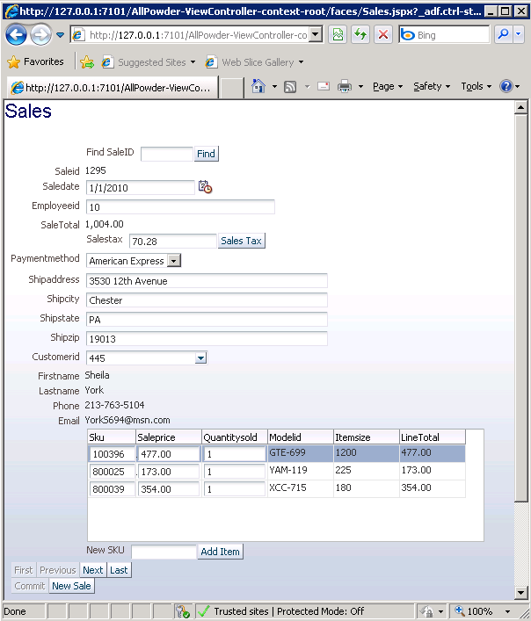
Improved Sale Form

Slide 7
Action
Action
Create the new sequence definition for the Sale table.
Create a trigger for the Sale table that generates a new sequence value and uses it for the SaleID.
Test the process by inserting a row into the Sale table without using a SaleID.

Slide 8
A Sequence for the Sale Table
--DROP SEQUENCE sq_Sale;
CREATE SEQUENCE sq_Sale
INCREMENT BY 1
START WITH 10000
NOMAXVALUE
NOCYCLE
CACHE 10;
Start at a high number to avoid collisions with existing data

Slide 9
Trigger to Generate Key
Automatically generate and use a new key value for SaleID whenever a row is added to the Sale table
CREATE OR REPLACE TRIGGER GenKeyForSale
BEFORE INSERT ON Sale
FOR EACH ROW
BEGIN
SELECT sq_Sale.NEXTVAL INTO :NEW.SaleID FROM dual;
END;
/
Generate next value
Use it as the new SaleID

Slide 10
Optional Test for real Keys
CREATE OR REPLACE TRIGGER GenKeyForSale
BEFORE INSERT ON Sale
FOR EACH ROW
BEGIN
IF :NEW.SaleID Is Null OR :New.SaleID < 0 THEN
SELECT sq_Sale.NEXTVAL INTO :NEW.SaleID FROM dual;
END IF
END;
/
If you want to allow people/code to insert their own ID values and skip the generated number, you can add an IF/END statement.
However, you need some way to avoid collisions so that numbers entered directly do not fall into the range of generated values.

Slide 11
Test the Key Generator
Question | Insert a new Sale row and check the sequence value.
SQL | INSERT INTO Sale (CustomerID, EmployeeID) VALUES (582, 5); SELECT sq_Sale.CURRVAL FROM dual; SELECT SaleID, CustomerID FROM Sale WHERE SaleID=10000;
CURRVAL 10000 SQL> SELECT SaleID, CustomerID FROM Sale WHERE SaleID=10000; SALEID CUSTOMERID 10000 582

Slide 12
Action: New Project
Action
Define sequences and INSERT triggers for tables: Sale, Customer, Manufacturer, Employee, and Rental.
Create a new application: AllPowder with package prefix: AP.
Define the database connection.
Create entities for all tables, do not create view objects.
Assign the default Application Module.
Select the Business Components diagram.

Slide 13
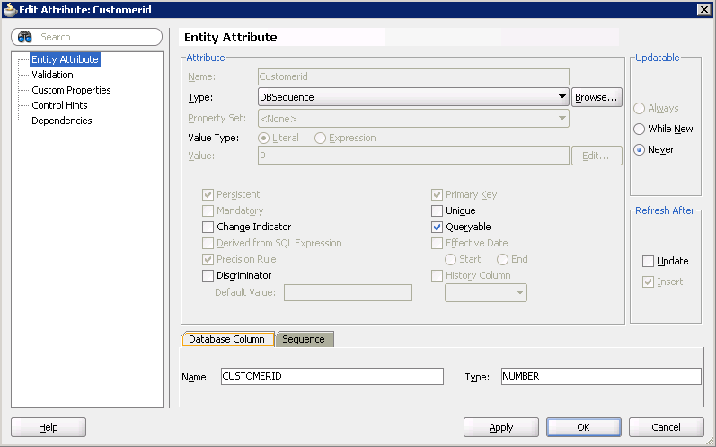
Assign DBSequence in Table

Slide 14
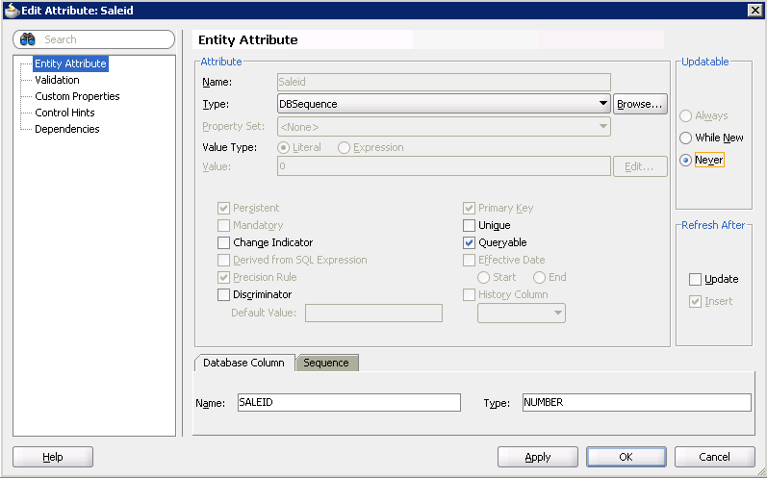
Edit Sale: SaleID=DBSequence

Slide 15
Action: Customer Form
Action
Edit the Customer table object.
Click the Attributes tab.
Edit the CustomerID.
Change its type to: DBSequence.
Set Update to Never.
Re-create the CustomerView.
Re-create the Gender LOV and assign it to the CustomerView.
Re-create the Edit Customer form.
Drag the Commit operation and drop it onto the Submit button.
Add a CreateInsert button to the form.

Slide 16
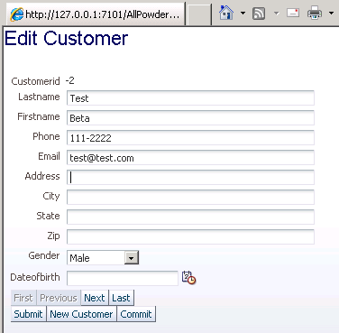
Sequence Generated

Slide 17
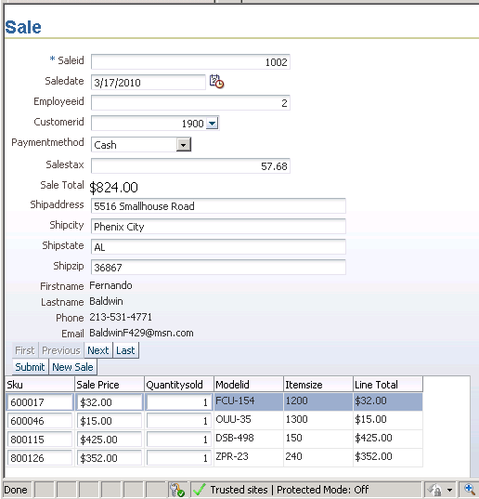
Compute Sales Tax
Sales Tax

Slide 18
Action
Action
Use SQL to create the ComputeSalesTax function within a new Taxes package.
Test the function with an SQL statement.

Slide 19
Create Oracle Package and Function
Question | Create function to compute sales taxes.
SQL | CREATE OR REPLACE PACKAGE Taxes AS Function ComputeSalesTax(Amount REAL) return REAL; END Taxes; / CREATE PACKAGE BODY Taxes AS FUNCTION ComputeSalesTax(Amount REAL) return REAL IS taxRate REAL := 0.07; BEGIN RETURN (Round(taxRate*Amount,2)); END ComputeSalesTax; END Taxes; /
PACKAGE TAXES compiled PACKAGE BODY TAXES compiled

Slide 20
Alternate Function
CREATE OR REPLACE Function ComputeSalesTax
(Amount REAL) return REAL
AS
BEGIN
RETURN Round(0.07*Amount,2);
END ComputeSalesTax;
/

Slide 21
Test the Function in SQL
Question | Test the function by computing the tax on 500.
SQL | SELECT Taxes.ComputeSalesTax(500) FROM dual;
TAXES.COMPUTESALESTAX(500) 35

Slide 22
Action: Create a Module
Action
Create a new Application Module that extends the existing AppModule.
Check box to Generate Application Class.
Open DBModuleImpl.java and add helper code from Oracle.
Add function: callSalesTaxFunction
Open DBModule.xml, Overview tab, Java tab, Client Interface.
Move new function to Selected side.

Slide 23
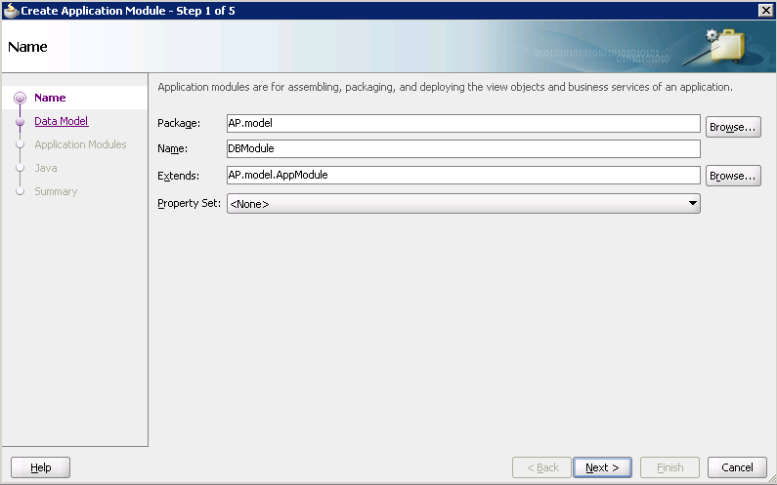
Create New Application Module

Slide 24
Helper Code from Oracle
// Helper method from Oracle Fusion Documentation Chapter 37.5
// Some constants
protected static int NUMBER = Types.NUMERIC;
protected static int DATE = Types.DATE;
protected static int VARCHAR2 = Types.VARCHAR;
protected Object callStoredFunction(int sqlReturnType, String stmt,
Object[] bindVars) {
CallableStatement st = null;
try {
// 1. Create a JDBC CallabledStatement
st = getDBTransaction().createCallableStatement(
"begin ? := "+stmt+";end;",0);
// 2. Register the first bind variable for the return value
st.registerOutParameter(1, sqlReturnType);
if (bindVars != null) {
// 3. Loop over values for the bind variables passed in, if any
for (int z = 0; z < bindVars.length; z++) {
// 4. Set the value of user-supplied bind vars in the stmt
st.setObject(z + 2, bindVars[z]);
}
}

Slide 25
Helper Code continued
// 5. Set the value of user-supplied bind vars in the stmt
st.executeUpdate();
// 6. Return the value of the first bind variable
return st.getObject(1);
}
catch (SQLException e) {
throw new JboException(e);
}
finally {
if (st != null) {
try {
// 7. Close the statement
st.close();
}
catch (SQLException e) {}
}
}
}

Slide 26
Helper Code Location
DBModuleImpl.java
public class DBModuleImpl extends ApplicationModuleImpl implements DBModule {
/**
* This is the default constructor (do not remove).
*/
public DBModuleImpl() {
}
>>>> Paste helper code here
>>>> Write callSalesTaxFunction here
}

Slide 27
Java Code to Call Sales Tax
public String callSalesTaxFunction(Number value) {
String result=(String)callStoredFunction(
VARCHAR2, " Taxes.ComputeSalesTax(?)",
new Object[]{value});
return result;
}

Slide 28
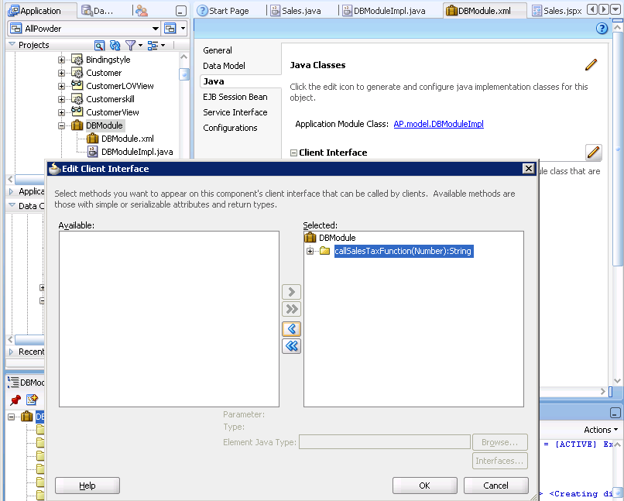
Create Client Interface

Slide 29
Action: Define Objects for Sales
Action
Create Sale + Customer View.
Create CustomerLOVView as a Combo Box/LOV.
Assign it to the SaleCustomerView.
Create PaymentMethodLOVView
Assign it to the SaleCustomerView.
Create SaleItem + Inventory View.
Add LineTotal=Saleprice*Quantitysold attribute.
Create new View Link SaleToSaleItemViewLink to join the SaleCustomerView to the SaleItemInventoryView.
In SaleCustomerView, create SaleTotal=SaleItemInventoryView.sum(“LineTotal”)
Set formats for money items to Number: #,000.00 not to Currency.

Slide 30
Action: Create Basic Sale Form
Action
Create a new Sale.jspx page.
Expand the Page Implementation section.
Check: Automatically Expose UI Components in a New Managed Bean.
For the Main form, drag SaleCustomerView as Form/ADF Form.
For the subform, drag SaleItemInventoryVIew as Table/ADF Table.
Clean up the form and subform.
Drag the Commit operation onto the Submit button.
Do not add any buttons yet.

Slide 31
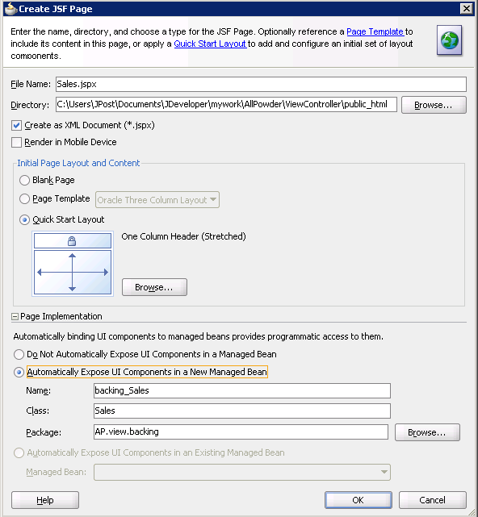
Create Sales Page: Backing

Slide 32
Action: Add Tax Button + Code
Action
Drag a button onto the page from the ADF control list.
Double-click the button to generate the code entry in the java file.
Add code to handle the event that calls the Sales Tax Function.
Open the file SalesPageDef.xml and select the Overview tab.
Click the Add (plus) button in the Bindings window and select methodAction.
Select the DBModule in the top window
Choose callSalesTaxFunction in the Operation selection list.
Run the form and test the tax button.

Slide 33
JSPX Page Layout Structure
<af:form ... >
<af:panelStretchLayout ... >
<f:facet name="top"> ... title ... </f:facet>
<f:facet name="center">
<af:panelFormLayout ... >
... inputText controls for main form ...
<af:facet name="footer">
<af:panelGroupLayout layout="vertical" ...>
<af:panelGroupLayout layout="horizontal" ...>
... command buttons ...
</af:panelGroupLayout>
</af:panelGroupLayout>
</af:facet>
<af:table ...>
... subform columns
</af:table>
</af:panelFormLayout>
</facet>
</af:panelStretchLayout>
</af:form>

Slide 34
Sales Tax Button Code
public String cb8_action() {
BindingContainer bindings = getBindings();
OperationBinding operationBinding=
bindings.getOperationBinding("callSalesTaxFunction");
// set parameter
Map paramsMap = operationBinding.getParamsMap();
RichInputText salesTotalTextBox = getIt13();
DecimalFormatSymbols sym = new DecimalFormatSymbols();
sym.setDecimalSeparator('.');
sym.setGroupingSeparator(',');
DecimalFormat form = new DecimalFormat("");
Change to match the ID of your SaleTotal Text Box

Slide 35
Sales Tax Button Code (end)
Number v;
try {
v = form.parse(salesTotalTextBox.getValue().toString());
} catch (Exception e) {
return null; // no value
}
paramsMap.put("value", v);
Object result = operationBinding.execute();
// System.out.println("### Result Sales.java= " + result);
RichInputText salesTaxTextBox = getIt3();
salesTaxTextBox.setValue(result.toString());
return null;
}
Change to match the ID of your Sales Tax Text Box

Slide 36
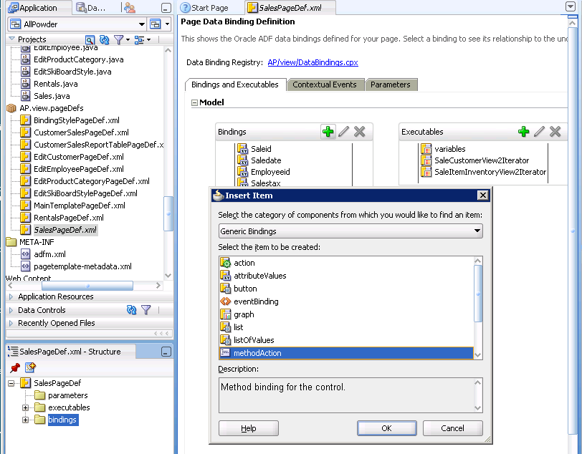
PageDef methodAction

Slide 37
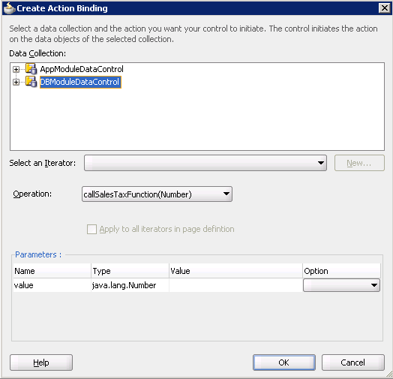
methodAction Function

Slide 38
methodAction XML
<methodAction id="callSalesTaxFunction" RequiresUpdateModel="true"
Action="invokeMethod" MethodName="callSalesTaxFunction“
IsViewObjectMethod="false“
DataControl="DBModuleDataControl"
InstanceName="DBModuleDataControl.dataProvider"
ReturnName="DBModuleDataControl.methodResults.callSalesTaxFunction_DBModuleDataControl_dataProvider_callSalesTaxFunction_result">
<NamedData NDName="value" NDValue=““
NDType="java.lang.Number"/>
</methodAction>
Reference required in the SalePageDef.xml file.

Slide 39
Action: Sale Buttons
Action
Create PL/SQL for inserting a new Sale.
Create PL/SQL for inserting a new SaleItem.
Add Java functions in DBModuleImpl.java to call the PL/SQL code.
Add the Client Interface.
Add a button to the main page for New Sale.
Write the code for the New Sale button.
Add the methodAction for insertNewSale in the SalePageDef.xml file.
Add a text box and a button for a New Sale Item.
Write the code for the New Sale Item.
Add methodAction for insertNewSaleItem in SalePageDef.xml file.
Add a text box and button for SaleID search.
Write the code for the SaleIDSearch.

Slide 40
PL/SQL for New Sale
CREATE OR REPLACE FUNCTION InsertNewSale return NUMBER
AS
BEGIN
INSERT INTO Sale(SaleDate)
VALUES (SysDate);
Commit;
RETURN sq_Sale.CURRVAL;
END InsertNewSale;
/
--To test:
set serveroutput on;
declare
result number;
begin
result := InsertNewSale();
dbms_output.put_line('result: ' || result);
end;

Slide 41
PL/SQL for New SaleItem
CREATE OR REPLACE FUNCTION InsertNewSaleItem(inSaleID NUMBER,
inSKU NVARCHAR2)
return NUMBER
AS
v_ListPrice NUMBER(10,4);
BEGIN
SELECT ItemModel.ListPrice INTO v_ListPrice
FROM INVENTORY
INNER JOIN ITEMMODEL
ON INVENTORY.MODELID=ITEMMODEL.MODELID
WHERE INVENTORY.SKU=inSKU;
INSERT INTO SaleItem(SaleID, SKU, QuantitySold, SalePrice)
VALUES (inSaleID, inSKU, 1, v_ListPrice);
Commit;
return 1;
EXCEPTION WHEN others THEN
RETURN 0;
END;
/

Slide 42
Java Code in DBModuleImpl
public Number InsertNewSale() {
Number result = (Number)callStoredFunction(
NUMBER, " InsertNewSale()",
null);
return result;
}
public Number InsertNewSaleItem(Number SaleID, String SKU) {
Number result=(Number)callStoredFunction(
NUMBER, " InsertNewSaleItem(?,?)",
new Object[]{SaleID, SKU});
return result;
}

Slide 43
Import Statements: DBModule
import AP.model.common.DBModule;
import java.sql.CallableStatement;
import java.sql.SQLException;
import java.sql.Types;
import oracle.jbo.JboException;
import oracle.jbo.server.ApplicationModuleImpl;

Slide 44
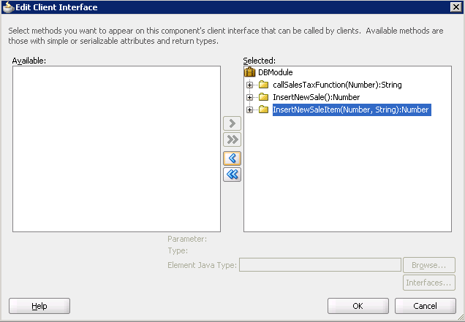
DBModule Client Interface

Slide 45
Sales Helper Function
public BindingContainer getBindings() {
return BindingContext.getCurrent().getCurrentBindingsEntry();
}

Slide 46
Java Page Code for New Sale
public String cb9_action() {
// Add event code here... New Sale
BindingContainer bindings = getBindings();
OperationBinding operationBinding= bindings.getOperationBinding("InsertNewSale");
Object result = operationBinding.execute();
//System.out.println("### Result new SalesID= " + result);
// Requery the page to load the newly inserted row
DCBindingContainer dcBindings =
(DCBindingContainer)BindingContext.getCurrent().getCurrentBindingsEntry();
DCIteratorBinding iterBind =
(DCIteratorBinding)dcBindings.get("SaleCustomerView2Iterator");
iterBind.executeQuery();
//Find the new row
iterBind.setCurrentRowWithKeyValue(result.toString());
return null;
}
Call the insert Sale function.
Reload the data for the page.
Set the new row as current.

Slide 47
Java Code for New Sale Item
public String cb6_action() {
// Add event code here...Insert new SaleItem
BindingContainer bindings = getBindings();
OperationBinding operationBinding=
bindings.getOperationBinding("InsertNewSaleItem");
// set parameters
RichInputText SIDTextBox = getIt1();
RichInputText SKUTextBox = getIt20();
Map paramsMap = operationBinding.getParamsMap();
Define the insert Sale Item function.
Get SaleID and new SKU.
Edit the two get statements to match your text boxes.

Slide 48
New Sale Item Code (more)
NumberFormat fmt = NumberFormat.getInstance();
Number v;
try {
v = fmt.parse(SIDTextBox.getValue().toString());
} catch (Exception e) {
return null; // no value
}
paramsMap.put("SaleID", v);
paramsMap.put("SKU", SKUTextBox.getValue().toString());
Object result = operationBinding.execute();
// Requery the subform to load the newly inserted row
DCBindingContainer dcBindings =
(DCBindingContainer)BindingContext.getCurrent().getCurrentBindingsEntry();
DCIteratorBinding iterBind =
(DCIteratorBinding)dcBindings.get("SaleItemInventoryView2Iterator");
iterBind.executeQuery();
return null;
}
Convert the SaleID from string to number.
Call the insert Sale Item function.
Refresh the subform with the new data.

Slide 49
Code for SaleID Search
public String cb5_action() {
// call find row on iterator
RichInputText findSIDTextBox = getIt17();
try {
DCBindingContainer dcBindings =
(DCBindingContainer)BindingContext.getCurrent().getCurrentBindingsEntry();
DCIteratorBinding iterBind =
(DCIteratorBinding)dcBindings.get("SaleCustomerView2Iterator");
String sSID = findSIDTextBox.getValue().toString();
iterBind.setCurrentRowWithKeyValue(sSID);
} catch (Exception e) {
findSIDTextBox.setValue("Invalid");
}
return null;
}

Slide 50
Main Import Statements: Sales
import java.text.DecimalFormat;
import java.text.DecimalFormatSymbols;
import java.text.NumberFormat;
import java.text.ParseException;
import javax.faces.component.UISelectItems;
import java.util.Map;
import javax.faces.convert.Converter;
import javax.faces.convert.NumberConverter;
import oracle.adf.view.rich.context.AdfFacesContext;
import oracle.adf.model.BindingContext;
import oracle.adf.model.binding.DCBindingContainer;
import oracle.adf.model.binding.DCIteratorBinding;
import oracle.binding.BindingContainer;
import oracle.binding.OperationBinding;

Slide 51
Add To SalePageDef.xml
<methodAction id="InsertNewSale" RequiresUpdateModel="true"
Action="invokeMethod" MethodName="InsertNewSale"
IsViewObjectMethod="false" DataControl="DBModuleDataControl"
InstanceName="DBModuleDataControl.dataProvider"
ReturnName="DBModuleDataControl.methodResults.InsertNewSale_DBModuleDataControl_dataProvider_InsertNewSale_result"/>
<methodAction id="InsertNewSaleItem" RequiresUpdateModel="true"
Action="invokeMethod" MethodName="InsertNewSaleItem"
IsViewObjectMethod="false" DataControl="DBModuleDataControl"
InstanceName="DBModuleDataControl.dataProvider"
ReturnName="DBModuleDataControl.methodResults.InsertNewSaleItem_DBModuleDataControl_dataProvider_InsertNewSaleItem_result">
<NamedData NDName="SaleID" NDValue="1" NDType="java.lang.Number"/>
<NamedData NDName="SKU" NDValue="'1'" NDType="java.lang.String"/>
</methodAction>

Slide 52
Inventory Database Triggers
Sale(SaleID, CustomerID, EmployeeID, SaleDate, …)
SaleItem(SaleID, SKU, QuantitySold, SalePrice)
Inventory(SKU, QuantityOnHand, …)
If a new item is sold, subtract QuantitySold from QuantityOnHand
Complications: changes to the data
A SaleItem is revoked, the SaleItem row deleted
The QuantitySold is changed
The SKU is changed
Sample values:
SaleID=3000 SKU=500000 or 500010
CustomerID=582 EmployeeID=5

Slide 53
Action
Action
Insert a new row into the Sale table with a SaleID of 3000, CustomerID of 582, and EmployeeID of 5.
Create the AFTER INSERT trigger for the SaleItem table.
Insert a new row into the SaleItem table (3000, 500000, 1, 100).
Check the value of QuantityOnHand in the Inventory table for SKU=500000 and ensure it was decreased from 10 to 9.

Slide 54
Database Event Triggers
DELETE
BEFORE INSERT AFTER
UPDATE
CREATE OR REPLACE TRIGGER NewSaleQOH
AFTER INSERT ON SaleItem
FOR EACH ROW
BEGIN
UPDATE INVENTORY
SET QuantityOnHand = QuantityOnHand - :NEW.QuantitySold
WHERE SKU = :NEW.SKU;
END;
New/inserted value

Slide 55
Setup Example
INSERT INTO Sale (SaleID, CustomerID, EmployeeID)
VALUES (3000, 582, 5);
SELECT SKU, QuantityOnHand
FROM Inventory
WHERE SKU=500000;
INSERT INTO SaleItem (SaleID, SKU, QuantitySold, SalePrice)
VALUES (3000, 500000, 1, 100);
Check the QuantityOnHand before and after the INSERT

Slide 56
Action
Action
Delete the SaleItem row (SaleID=3000 And SKU=500000).
Check the quantity on hand.
Add the AFTER DELETE trigger.
Insert the SaleItem row again.
Check the quantity on hand.
Delete the SaleItem row.
Check the quantity on hand.

Slide 57
Potential Problem: Delete Row
DELETE FROM SaleItem
WHERE SaleID=3000 And SKU=500000;
Check the QuantityOnHand before and after the DELETE
The value does not change!
CREATE OR REPLACE TRIGGER DelSaleQOH
AFTER DELETE ON SaleItem
FOR EACH ROW
BEGIN
UPDATE INVENTORY
SET QuantityOnHand = QuantityOnHand + :OLD.QuantitySold
WHERE SKU = :OLD.SKU;
END;
Restore the deleted quantity

Slide 58
Problems
What if the clerk entered the wrong value and should have entered 1 instead of 2 units?
Test it, and the code subtracts 1 from the QOH, leaving 7.
You need to add the original 2 units back.
QuantityOnHand = QuantityOnHand – QuantitySold + OldQuantity

Slide 59
Action
Action
Add the ON UPDATE trigger.
Check the quantity on hand.
Issue an update to change the QuantitySold in the SaleItem table.
Check the quantity on hand.

Slide 60
Problem: Change the Quantity
Test it
UPDATE SaleITem
SET QuantitySold = 2
WHERE SaleID=3000 And SKU=500000;
CREATE or REPLACE TRIGGER ChangeSaleQOH
AFTER UPDATE ON SaleItem
FOR EACH ROW
BEGIN
UPDATE Inventory
SET QuantityOnHand = QuantityOnHand
+ :OLD.QuantitySold - :NEW.QuantitySold
WHERE SKU = :OLD.SKU;
END;
Add back the old quantity (1) and subtract the new value (2)
Test it again

Slide 61
Problem: Change the SKU
SELECT SKU, QuantityOnHand
FROM Inventory
WHERE SKU=500000 Or SKU=500010;
Test it by changing both QuantitySold and SKU
UPDATE SaleITem
SET QuantitySold = 3, SKU = 500010
WHERE SaleID=3000 And SKU=500000;
SELECT SKU, QuantityOnHand
FROM Inventory
WHERE SKU=500000 Or SKU=500010;

Slide 62
Action
Action
Create the full ON UPDATE trigger.
Check the quantity on hand.
Change the QuantitySold and SKU (to 500010) in the SaleItem row.
Check the quantity on hand for SKU 500000 and 500010.

Slide 63
Trigger to Handle SKU Changes
CREATE or REPLACE TRIGGER ChangeSaleQOH
AFTER UPDATE ON SaleItem
FOR EACH ROW
BEGIN
IF (:OLD.SKU = :NEW.SKU) THEN
UPDATE Inventory
SET QuantityOnHand = QuantityOnHand
+ :OLD.QuantitySold - :NEW.QuantitySold
WHERE SKU = :OLD.SKU;
ELSE
UPDATE Inventory
SET QuantityOnHand = QuantityOnHand + :OLD.QuantitySold
WHERE SKU = :OLD.SKU;
UPDATE Inventory
SET QuantityOnHand = QuantityOnHand - :NEW.QuantitySold
WHERE SKU = :NEW.SKU;
END IF;
END;
Test it again

Slide 64
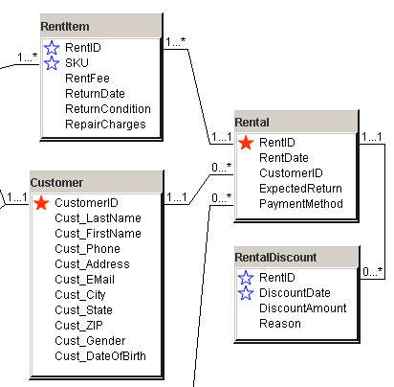
Transactions for Discounts

Slide 65
Action
Action
Create the RentalDiscount table.

Slide 66
CREATE TABLE
CREATE TABLE RentalDiscount
(
RentID INTEGER,
DiscountDate DATE,
DiscountAmount NUMBER(10,4),
Reason NVARCHAR2(255),
CONSTRAINT pk_RentalDiscount PRIMARY KEY(RentID, DiscountDate),
CONSTRAINT fk_RentalDiscount_Rent FOREIGN KEY(RentID)
REFERENCES Rental (RentID)
ON DELETE CASCADE
);

Slide 67
Transaction Code
CREATE OR REPLACE FUNCTION GiveCustomerRentalDiscount
(oldRentID NUMBER, oldSKU NVARCHAR2, DiscountAmount NUMBER,
Reason NVARCHAR2) RETURN NUMBER
AS
OldRepairCharge NUMBER(10,4);
BEGIN
SELECT RepairCharges INTO OldRepairCharge FROM RentItem
WHERE RentItem.RentID=oldRentID AND RentItem.SKU=oldSKU;
OldRepairCharge := OldRepairCharge-DiscountAmount;
IF (OldRepairCharge < 0) THEN
OldRepairCharge := 0;
END IF;
UPDATE RentItem SET RepairCharges=OldRepairCharge
WHERE RentItem.RentID=oldRentID AND RentItem.SKU=oldSKU;
INSERT INTO RentalDiscount(RentID, DiscountDate, DiscountAmount, Reason)
VALUES (oldRentID, SYSDATE, DiscountAmount, Reason);
Commit;
Return OldRepairCharge;
UPDATE +
INSERT

Slide 68
Transaction Code (more)
If something goes wrong, cancel the first update
EXCEPTION
WHEN others THEN
ROLLBACK;
Return -1;
END GiveCustomerRentalDiscount;
/

Slide 69
Script to Test the Function
set ServerOutput on
declare result NUMBER;
begin
result := GiveCustomerRentalDiscount (
4020, '200285', 15, 'Testing');
dbms_output.put_line('result: ' || result);
end;
Result is 3 which is 18 – 15 (charge – discount).

Slide 70
Action
Action
Create a new query.
Tables: Sale and SaleItem.
Create column TO_CHAR(SaleDate, ‘ww’) AS SaleWeek.
Create column QuantitySold*SalePrice AS Value.
Sum the Value column by week.

Slide 71
Query for Cursor: Weekly Sales
CREATE VIEW WeeklySales AS
SELECT TO_CHAR(SaleDate, 'ww') AS SalesWeek,
Sum(SalePrice*QuantitySold) AS Value
FROM Sale INNER JOIN SaleItem ON Sale.SaleID=SaleItem.SaleID
WHERE SaleDate Is Not Null
GROUP BY TO_CHAR(SaleDate, 'ww');

Slide 72
Action
Action
Create the SalesAnalysis package with the AvgPercentWeeklyChange function.
Use SQL to call the function: SELECT SalesAnalysis.AvgPercentWeeklyChange FROM dual.

Slide 73
Set up Package to Compute Average
CREATE OR REPLACE PACKAGE SalesAnalysis AS
FUNCTION AvgPercentWeeklyChange return REAL;
END SalesAnalysis;
/
CREATE or REPLACE PACKAGE BODY SalesAnalysis AS
FUNCTION AvgPercentWeeklyChange return REAL IS
CURSOR c1 IS
SELECT SalesWeek, Value FROM WeeklySales;
Avg1 REAL;
N Integer;
PriorValue WeeklySales.Value%TYPE;
Define the SELECT statement for the cursor to trace through
Create variable to hold the value from the previous row with the same data type as the column in the table

Slide 74
Code to Compute Average Change
BEGIN
Avg1 := 0;
N := 0;
PriorValue := -1;
FOR recSales in c1 LOOP
IF PriorValue > 0 THEN
Avg1 := Avg1 + (recSales.Value - PriorValue)/PriorValue;
N := N + 1;
END IF;
PriorValue := recSales.Value;
END LOOP;
RETURN (Avg1/N);
END AvgPercentWeeklyChange;
END SalesAnalysis;
/
Skip the first week because there is no prior value
Compute the percent change and keep a running total
Save the current row value and move to the next row

Slide 75
Action
Action
Open the EditCustomer.jspx page in JDeveloper and run it.
Open a Database query window connected to AllPowder.
Run a SELECT query to verify the data matches the ID on the form.
Run an UPDATE query to change the ZIP Code.
Change the ZIP Code value on the Edit Customer form and click the Submit or Commit button.
Note the error message.

Slide 76
SQL to Change ZIP Code
SELECT CustomerID, LastName, ZIP
FROM Customer
WHERE CustomerID=1110;
UPDATE Customer
SET ZIP=’32777’
WHERE CustomerID=1110;
Commit;

Slide 77
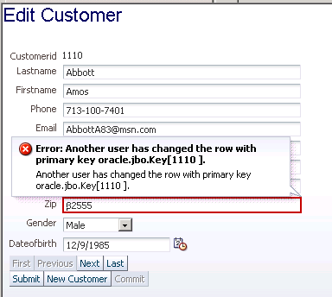
EditCustomer Form Error

