Slide 1
All Powder Board and Ski
Oracle 11g Workbook
Chapter 8: Applications
Jerry Post
Copyright © 2010

Slide 2
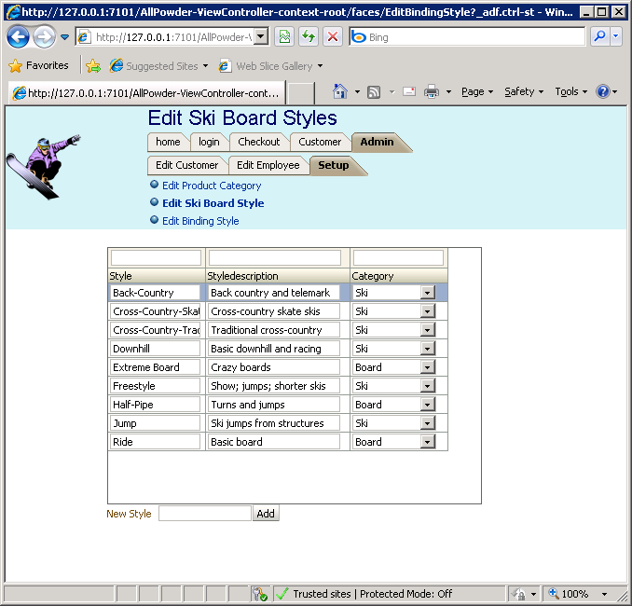
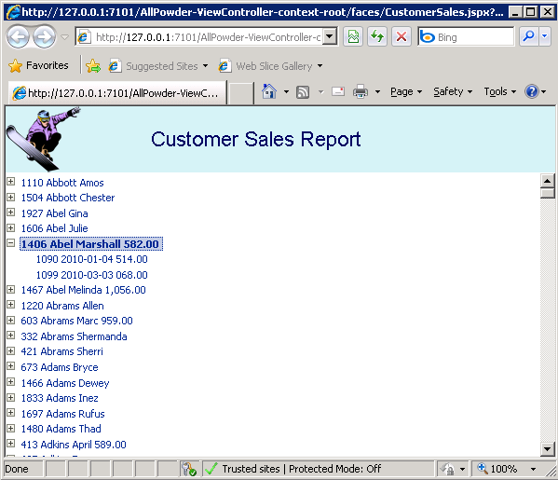
Applications: Integration
Help files
Login form
Custom menu
Integrated forms and reports

Slide 3
Skins
Goal: Create a central display scheme that applies to all pages.
Create a CSS file.
- ViewController right-click: New, Web Tier/HTML: CSS
- Define styles: PageTitle, TitleBackground, MenuBackground, MessageText, MessageBackground
Define the new skin by creating an XML file.
Edit the trinidad-config.xml file to tell it to use the new skin.

Slide 4
Action: Create a Skin/Stylesheet
Action
Create a new Style Sheet: Powder.css.
ViewController right-click: New, Web Tier/HTML: CSS.
Create styles for: PageTitle, TitleBackground, MenuBackground, MessageText, MessageBackground.
Define the new skin by creating an XML file:
WEB-INF, right-click, New, General, XML: XML Document Name: trinidad-skins.xml
Edit the trinidad-config.xml file to tell it to use the new skin <skin-family>.
Main menu: Tools/Preferences/CSS Editor: CSS Level 3.

Slide 5
Skins: Powder.css
.PageTitle {
color : #000060;
font-family: Arial, Helvetica, sans-serif;
font-size: 200%;
}
.TitleBackground {
background: #D0F0F0;
}
.MenuBackground {
background: #F0FFFF ;
}
.MessageText {
color: red;
font-family: Arial, Helvetica, sans-serif;
}
.MessageBackground {
background: white;
}
.MainBackground {
background: white;
}

Slide 6
Skin: Definition in XML
WEB-INF, right-click, New, General, XML: XML Document
Name: trinidad-skins.xml
<?xml version="1.0" encoding="windows-1252" ?>
<skins xmlns="http://myfaces.apache.org/trinidad/skin">
<skin>
<id>APSkin.desktop</id>
<family>APSkin</family>
<extends>blafplus-rich.desktop</extends>
<style-sheet-name>css/Powder.css</style-sheet-name>
</skin>
</skins>

Slide 7
Skin Choice: trinidad-config.xml
<?xml version="1.0" encoding="windows-1252"?>
<trinidad-config xmlns="http://myfaces.apache.org/trinidad/config">
<skin-family>APSkin</skin-family>
</trinidad-config>

Slide 8
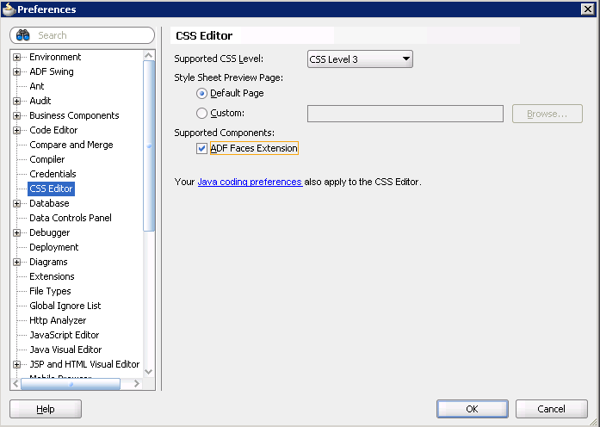
Skins: Set CSS Level 3
Main menu: Tools/Preferences

Slide 9
Template: Structure
Title
Five facets:
TitleArea
ButtonArea
MenuArea:
MainArea
MessageArea
Logo
Buttons
Menu
Main Content
Messages

Slide 10
Action: Create a Template
Action
Create a new template.
Right-click ViewController, New, Web Tier, JSF: JSF Page Template.
Name: MainTemplate.
Check option for Create Associated ADFm Page Definition.
Uncheck option for Quick Start Layout.
Define five facets: TitleArea, ButtonArea, MenuArea, MainArea, and MessageArea.
Drag a Panel Stretch Layout control onto the blank MainTemplate.jspx.
Place a Panel Group Layout into the top element and set its Appearance/Layout to horizontal.
Place an Image Control in the left of this group and locate an icon file.
Add a new Panel Group Layout just to the right of the image and set its layout to vertical.

Slide 11
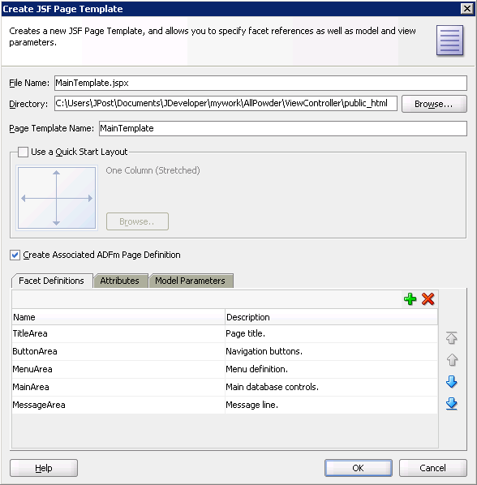
Template Definition

Slide 12
Action: Template Facets
Action
Drop a Facet ref into the new vertical layout and assign it: TitleArea.
Drop a second Facet ref below that one and assign it to: ButtonArea.
Drop a third Facet ref in the start area for the MenuArea.
Drop a fourth Facet ref in the center for the MainArea.
Drop a fifth Facet ref on the bottom for the MessageArea.
Delete the “end” facet on the right side of the page.
Assign styles. Main Panel Stretch Layout: MainBackground.
Top main horizontal Panel Group Layout: TitleBackground.

Slide 13
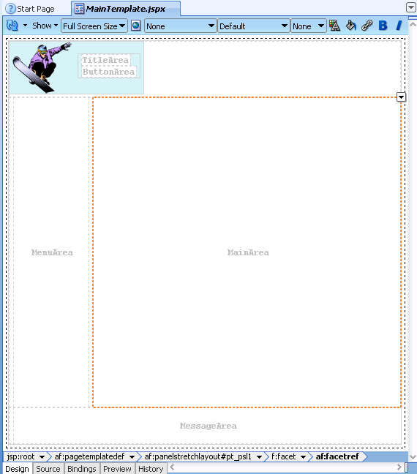
MainTemplate.jspx

Slide 14
Details of Top Source
<f:facet name="top">
<af:panelGroupLayout id="pt_pgl1" layout="horizontal" >
<af:image source="/APLogo1.png"
shortDesc="All Powder Board and Ski Shop" id="pt_i1"/>
<af:panelGroupLayout id="pt_pgl2" layout="vertical">
<af:facetRef facetName="TitleArea"/>
<af:facetRef facetName="ButtonArea"/>
</af:panelGroupLayout>
</af:panelGroupLayout>
</f:facet>

Slide 15
Action: Edit Employee Page
Action
Create a new EditEmployee.jspx page using the MainTemplate.
Drag an Output Text control into the TitleArea.
Value: Edit Employee, Style: PageTitle.
Drag an Output Text control into the MessageArea.
Value: “”, Style: MessageText
Run the page to test it.
Edit the Powder.css TitleBackground to add: min-width: 100%;
Create the Employee data entity and an LOV for Manager.
Add buttons for Commit.
Write PL/SQL and Module code to add an Insert Employee button.

Slide 16
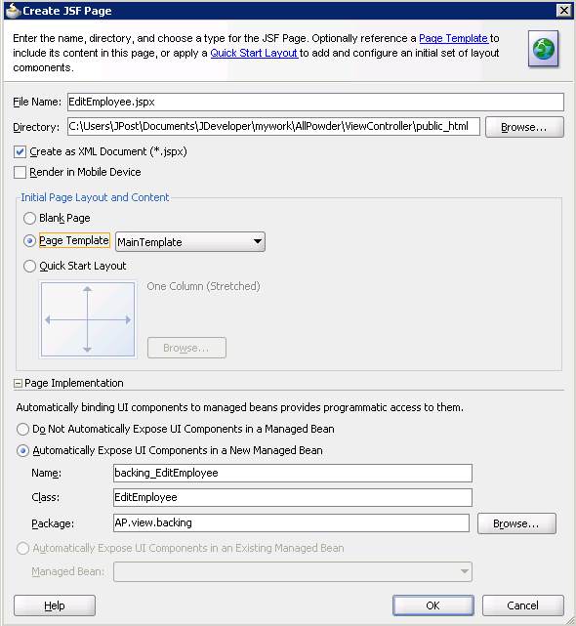
Template and Skin Test

Slide 17
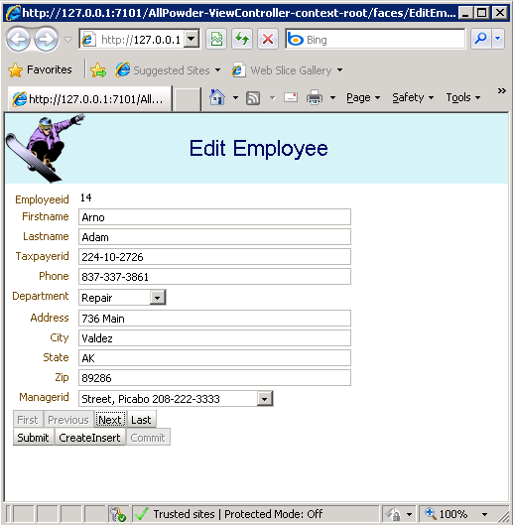
Employee Page with Template
To make the top row extend across the top, Edit the style sheet, add:
min-width: 100.0%;

Slide 18
Action: Retrofit Template Page
Action (optional)
1. Find the existing panelStretchLayout
2. Replace it with the starting <af:pageTemplate stuff
3. Move the existing outputText into the TitleArea facet
4. Delete the old facets.
5. Go to the end, delete the closing </af:panelStretchLayout>
6. Enter a new closing tag for the template--should be automatic.
7. Add the facet for MessageArea
8. In design, drag an outputText into the MessageArea and set style.
9. Delete the psl1 entry and two functions in the Java backing page.
How to assign a template to an existing page (e.g., Edit Customer).
You have to edit the Source so be careful.
Basically, replace the Panel Stretch Layout with the new Template and place any controls into the new facets.

Slide 19
Action: New Tree Report (option)
Action
Create a new JSPX page.
Rebuild the CustomerSales and SalesDetail views if necessary.
Rebuild the View Link to join them if necessary.
In the Data Module, drag the CustomerSalesReportMain onto the center section of the page.
Select the Customer data to be displayed.
Click the Green Plus sign and add the Detail section to the list.
Add the SaleID, SaleDate, and SaleTotal to the nested display.
Run the report.

Slide 20
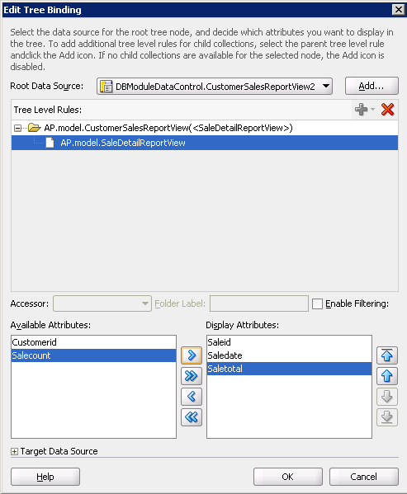
Hierarchy Report with Tree

Slide 21
Report with Tree

Slide 22
Action: Create Home Page
Action
Create a new JSPX page: home.jspx based on the MainTemplate and including the backing bean.
Add a title and place simple text on the page: Welcome to the shop.
On the main menu: Run / Choose Active Run Configuration / Manage Run Configurations…
For the Default Run Target, click Browse, search for the home.jspx page (up a level in the folder then public_html).

Slide 23
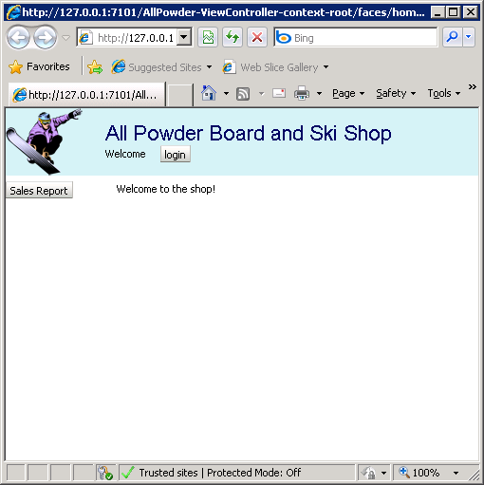
Initial Home Page
Logo
Title
Login
Future menu
More content later

Slide 24
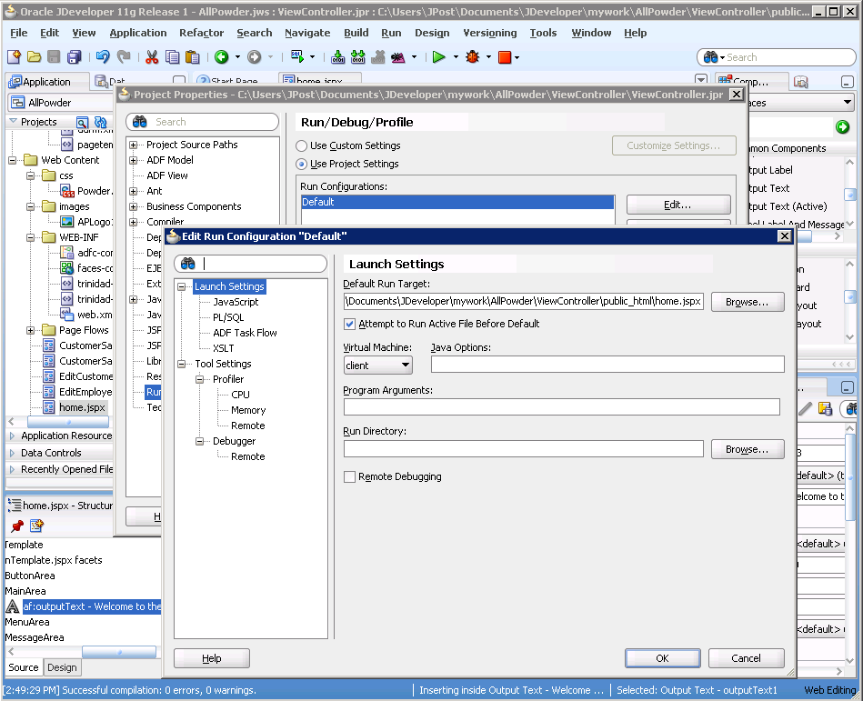
Run Configuration: home.jspx

Slide 25
Action: First Task Flow
Action
Open adfc-config.xml, click the Diagram tab.
Drag the home.jspx file onto the diagram.
From component palette drag a View onto the diagram, name it: login.
In the component palette, click the Control Flow Case object.
In the main diagram, click the home object followed by login object.
Name the flow: toLogin.
Repeat the process to create a connection from login to home: toHome.
Save everything, close JDeveloper and restart it.

Slide 26
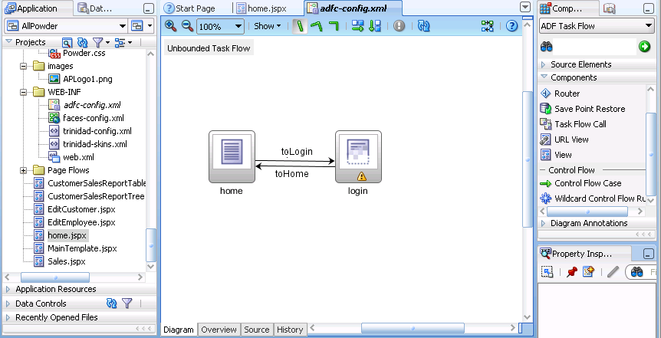
Task Flow in adfc-config.xml

Slide 27
Action: Create login Page
Action
Double-click the login icon to create a new login.jspx page.
Add the title and Message box.
Add a Panel Form Layout to the main section.
Add input text boxes for Last Name and Phone.
Set Behavior/Required to true for both and Secret for the Phone box.
Add a command button named login.
Save everything even though the login button is not finished.

Slide 28
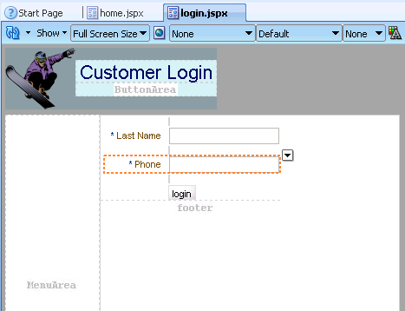
Page login.jspx

Slide 29
Action: Edit home.jspx for login
Action
Add a horizontal group layout to the Button Area of home.jspx.
Add an Output Text box and use Expression Builder to set its value to:
Welcome Welcome #{backingBeanScope.backing_login.it1.value}
Add a spacer and a login button after the output box.
Set the login Button Action to: toLogin using the selection choices.
Save everything, run the home.jspx page and test the login button.

Slide 30
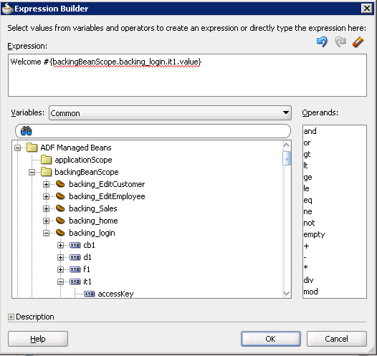
home.jspx Text: Welcome …
Welcome #{backingBeanScope.backing_login.it1.value}

Slide 31
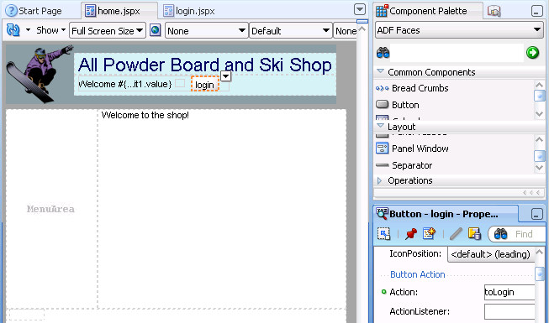
Page: home.jspx

Slide 32
Action: Create Login Code
Action
Write PL/SQL code to search Person table for Lastname and Phone.
Add a new Application Module: LoginModule.
Write module code to connect to the database TestLogin function.
Write the login.java code to call to the TestLogin function.

Slide 33
Login PL/SQL Code
CREATE OR REPLACE FUNCTION TestCustomerLogin(
sLastname NVARCHAR2, sPhone NVARCHAR2)
RETURN NUMBER
AS
nID integer;
BEGIN
nID := -1;
SELECT CustomerID INTO nID
FROM CUSTOMER
WHERE Lastname=sLastName AND Phone=sPhone;
return nID;
EXCEPTION WHEN others THEN
return -1;
END TestCustomerLogin;

Slide 34
LoginModuleImpl.java code
Include helper code here …
int loginAttempts = 0;
Number nCustomerID=-1;
public Number TestCustomerLogin(String lastname, String phone) {
loginAttempts++;
Number result =
(Number)callStoredFunction(NUMBER, " TestCustomerLogin(?,?)",
new Object[] { lastname, phone });
nCustomerID=result;
if (result.longValue() > 0) {
loginAttempts = 0;
} else {
if (loginAttempts < 3) {
result = 0;
}
}
return result;
}
public Number getCustomerID() {
return nCustomerID;
}

Slide 35
Login.java Button Code
Public String cb1_action() {
// Add event code here... Login button
String result = "toHome";
// compare in database
BindingContainer bindings = BindingContext.getCurrent().getCurrentBindingsEntry();
OperationBinding operationBinding
= bindings.getOperationBinding("TestCustomerLogin");
String sLastname = getIt1().getValue().toString();
String sPhone = getIt2().getValue().toString();
Map paramsMap = operationBinding.getParamsMap();
paramsMap.put("lastname", sLastname);
paramsMap.put("phone", sPhone);
Object oID = operationBinding.execute();
long nID = Long.parseLong(oID.toString());

Slide 36
Login Button Code continued
String sMessage = "";
AdfFacesContext afContext = AdfFacesContext.getCurrentInstance();
afContext.getPageFlowScope().put("CustomerID", nID);
if (nID <= 0) {
result = null;
if (nID < 0) { // have exceeded allowed number of attempts
sMessage = "Please stop guessing.";
} else {
sMessage = "Incorrect login. Please try again.";
}
FacesContext messageContext = FacesContext.getCurrentInstance();
messageContext.addMessage(null, new FacesMessage(sMessage));
// or just use the output text at the bottom which is faster
}
else {
it2.setValue(null);
}
return result;
}

Slide 37
Customer Login
Use:
Peck
213-249-4611

Slide 38
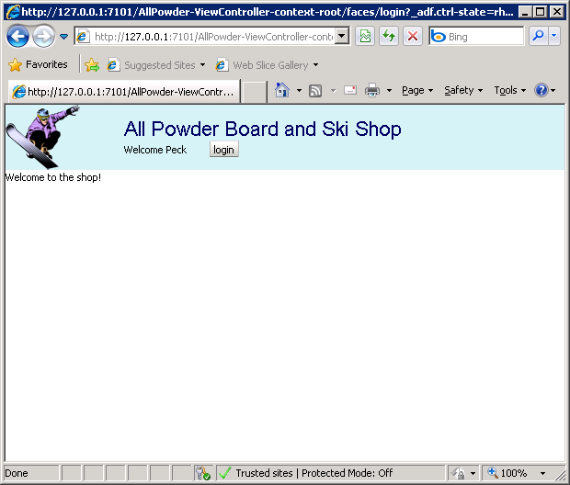
Home Page After Login

Slide 39
Action: A New Customer Report
Action
Create a new Customer report where the Customer query uses a bind variable to retrieve data for a single CustomerID.
Define the bind variable customeridVar.
Define the subform query and build the View Link.
Create the new OneCustomerSalesReport page.
Drag the OneSalesTotalsReportView2 object to create a Master-Detail: ADF Master form, Detail table.

Slide 40
View with Parameter: Query
SELECT
CUSTOMER.CUSTOMERID CUSTOMERID,
CUSTOMER.LASTNAME LASTNAME,
CUSTOMER.FIRSTNAME FIRSTNAME,
CUSTOMER.EMAIL EMAIL,
CUSTOMER.STATE STATE,
CUSTOMER.GENDER GENDER
FROM
CUSTOMER
WHERE CUSTOMER.CUSTOMERID=:customeridVar
ORDER BY CUSTOMER.LASTNAME, CUSTOMER.FIRSTNAME

Slide 41
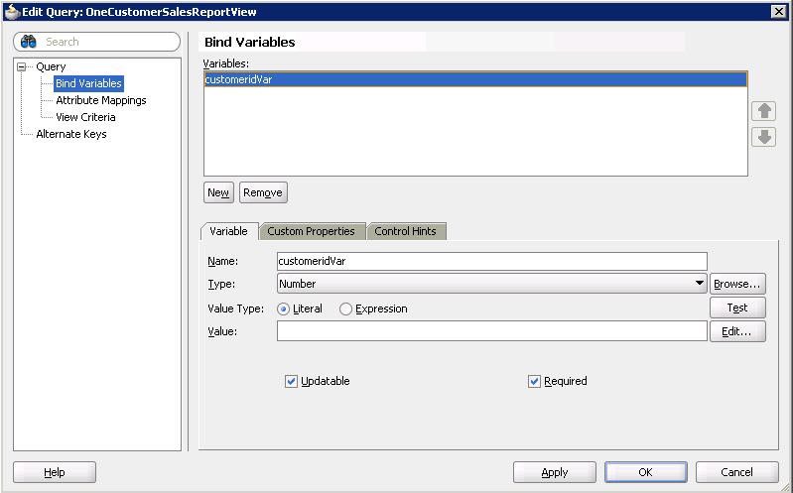
View with Bind Variable/Param

Slide 42
Details Query for Subform
SELECT
SALE.SALEID SALEID,
SALE.SALEDATE SALEDATE,
SALE.CUSTOMERID CUSTOMERID,
SUM(SALEITEM.QUANTITYSOLD*SALEITEM.SALEPRICE) SaleTotal,
COUNT(SALE.SALEID) SaleCount
FROM
SALE INNER JOIN SALEITEM
ON SALE.SALEID=SALEITEM.SALEID
GROUP BY SALE.SALEID, SALE.SALEDATE, SALE.CUSTOMERID
ORDER BY SALE.SALEDATE

Slide 43
Action: Bind Variables on Page
Action
OneCustomerSalesReport page, click the Bindings tab.
In Bindings window click the green plus sign, choose “action.”
Select the main AppModuleDataControl
Select Iterator: OneCustomerSalesReportView2Iterator.
Select Operation: ExecuteWithParams.
For parameter: customeridVar, oracle.jbo.domain.Number
Value: #{pageFlowScope.CustomerID}
In Executables window click the green plus sign, choose “invokeAction”
id: invokeExecuteWithParams
binds: ExecuteWithParams
In the Executables window select the new invokeExecuteWithParams entry and click the edit pencil icon.
Select the Common tab and set Refresh to “ifNeeded” and
RefreshCondition: #{adfFacesContext.postback == false}

Slide 44
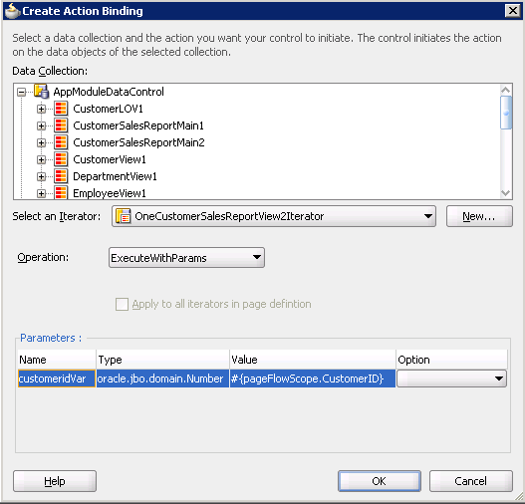
One Customer Report Page

Slide 45
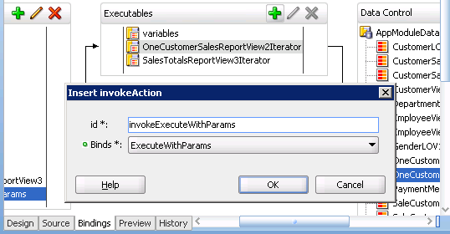
Executables Bindings

Slide 46
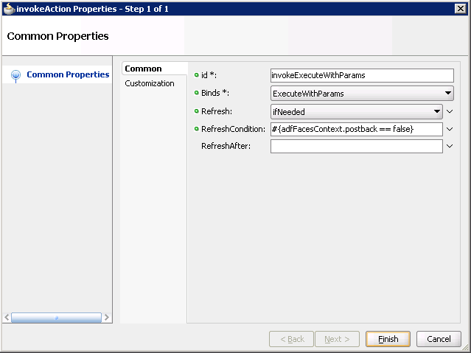
Invoke Action Refresh

Slide 47
Login Code Connection
…
String sMessage = "";
// Save the returned ID in the pageFlow scope
AdfFacesContext afContext = AdfFacesContext.getCurrentInstance();
afContext.getPageFlowScope().put("CustomerID", nID);
If (nID <= 0) …

Slide 48
Action: Build Task Flow
Action
Open adfc-config.xml diagram.
Drag OneCustomerSaleReport onto the diagram.
Add a Control Task Flow from home to the new report, name it: toSalesReport.
Add a return control flow named: back.
In home.jspx, add a Panel Group Layout set to vertical and place a command button in it.
Set the button label to: Sales Report and select its action as: toSalesReport.
Add a button to the Sales Report, label it Back and set its Action to back.
Test the login and open the Sales report for Peck.

Slide 49
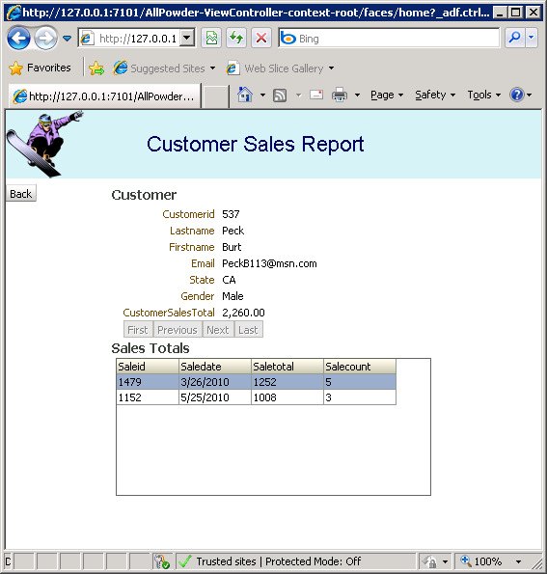
One Customer Report
Home page
Login button
Login page
Peck/213-249-4611
Login button
Home page
Sales Report button

Slide 50
Action: Add Sale Detail Report
Action
Add a column to the OneCustomerSalesReport detail that includes a command button.
Write code function in OneCustomerSalesReport2.java.
Create a new Sales view (DisplaySaleReportView) with a bind variable for saleidVar.
Create the subreport query (DisplaySaleItemsView) and the view link (DisplaySalereportToItemsViewLink).
Create a new page for DisplaySale.jspx using the Master-Detail form/table for the DisplaySaleItemsView2 object.
Add the page bindings setting saleidVar to #{pageFlowScope.SaleID}.
Add the DisplaySale page to the adfc-config diagram.
Add a Control Flow Case from OneCustomerSalesReport to DisplaySale using: showSale.
Add a reverse control flow with the keyword: back.
Add a button to the DisplaySale.jspx page and assign the back Action.
Save everything and test the reports.

Slide 51
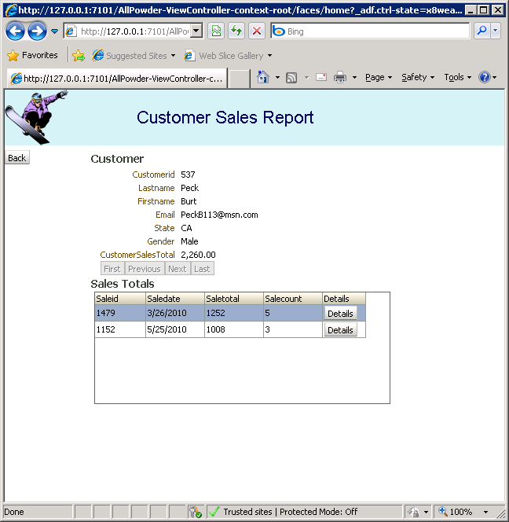
Add Details Column

Slide 52
OneCustomerSalesReport
OneCustomerSalesReport.jspx, add to table:
<af:column headerText="Details“
sortable="false" id="c6" width="60">
<af:commandButton id="cbT0" text="Details“
action="#{backingBeanScope.backing_OneCustomerSalesReport.showSale}" />
</af:column>
OneCustomerSalesReport.java, add code (next screen)
Public String showSale() {
…
return “showSale”;
}

Slide 53
showSale() function for Sales
public String showSale() {
RichTable tbl = getT1();
List<oracle.jbo.Key> kList = (List<oracle.jbo.Key>)tbl.getRowKey();
// Could be multiple keys, but we know there is only one key with a single value
oracle.jbo.Key key1 = kList.get(0);
Object oList[] = key1.getAttributeValues();
long nID=-1;
try {
nID = Long.parseLong(oList[0].toString());
} catch (Exception ex) {
nID=-1;
}
AdfFacesContext afContext = AdfFacesContext.getCurrentInstance();
afContext.getPageFlowScope().put("SaleID", nID);
return "showSale";
}

Slide 54
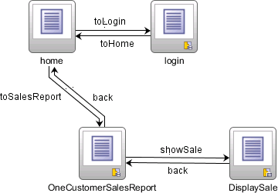
Task Flows: adfc-config.xml

Slide 55
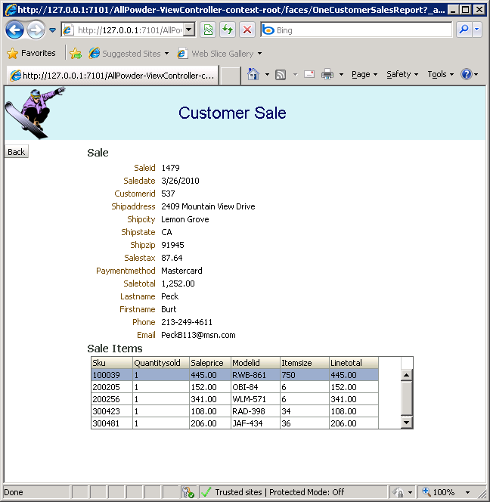
Sales Report

Slide 56
Action: Create More Forms
Action
If you have time create more forms.
Create the Rentals form following the details for the Sales form.
Create edit forms (tabular) for ProductCategory, SkiBoardStyle, and Binding Style.
Add the forms to the adfc-config.xml diagram. If you lack time, just add View objects.
Do not add flow connectors.

Slide 57
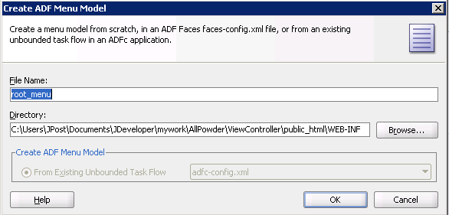
Creating Menus
Right-click main diagram in adfc-config.xml.
Choose: Create ADF Menu Model and accept defaults.

Slide 58
root_menu.xml Structure
Home Login Checkout Customer Admin Help
Sales
Rentals
Edit Customer
Edit Employee
Setup
Categories
Ski Board Style
Binding Style
<menu …
<itemNode … “home”
<itemNode… “login”
<groupNode … “Checkout”
<itemNode … “Sales”
<itemNode… “Rentals”
</groupNode>
…
<groupNode … “Admin”
<itemNode … “Edit Customer”
<itemNode … “EditEmployee”
<groupNode … “Setup”
<itemNode … “Categories”
…
</groupNode>
</groupNode>
</menu>

Slide 59
Action: Create root_menu.xml
Action
Right-click the main diagram and choose: Create ADF Menu Model.
Sketch a potential menu layout.
Edit the root_menu.xml file to add groupNodes.
Change the label values.
Create three main groups: Checkout, Customer, and Admin.
Create a nested group (Setup) inside the Admin group.

Slide 60
root_menu.xml
<?xml version="1.0" encoding="windows-1252" ?>
<menu xmlns="http://myfaces.apache.org/trinidad/menu">
<itemNode id="itemNode_home" label="home" action="adfMenu_home"
focusViewId="/home"/>
<itemNode id="itemNode_login" label="login" action="adfMenu_login"
focusViewId="/login"/>
<groupNode id="groupNode_Checkout" label="Checkout" idref="itemNode_Sales">
<itemNode id="itemNode_Sales" label="Sales" action="adfMenu_Sales"
focusViewId="/Sales"/>
<itemNode id="itemNode_Rental" label="Rental" action="adfMenu_Rental"
focusViewId="/Rental"/>
</groupNode>
<groupNode id="groupNode_Customer" label="Customer" idref="itemNode_OneCustomerSalesReport">
<itemNode id="itemNode_OneCustomerSalesReport"
label="One Customer Sales Report"
action="adfMenu_OneCustomerSalesReport"
focusViewId="/OneCustomerSalesReport"/>
</groupNode>

Slide 61
root_menu.xml (continued)
<groupNode id="groupNode_Admin" label="Admin" idref="itemNode_EditCustomer">
<itemNode id="itemNode_EditCustomer" label="Edit Customer"
action="adfMenu_EditCustomer" focusViewId="/EditCustomer"/>
<itemNode id="itemNode_EditEmployee" label="Edit Employee"
action="adfMenu_EditEmployee" focusViewId="/EditEmployee"/>
<groupNode id="groupNode_Setup" label="Setup" idref="itemNode_EditProductCategory">
<itemNode id="itemNode_EditProductCategory"
label="Edit Product Category"
action="adfMenu_EditProductCategory"
focusViewId="/EditProductCategory"/>
<itemNode id="itemNode_EditSkiBoardStyle" label="Edit Ski Board Style"
action="adfMenu_EditSkiBoardStyle"
focusViewId="/EditSkiBoardStyle"/>
<itemNode id="itemNode_EditBindingStyle" label="Edit Binding Style"
action="adfMenu_EditBindingStyle" focusViewId="/EditBindingStyle"/>
</groupNode>
</groupNode>
</menu>

Slide 62
Action: Edit MainTemplate.jspx
Action
In MainTemplate.jspx, add three navigationPane tags—one for each menu level.
Place the tags in the top facet beneath the title and button panes.
Set var=“menuInfo” value=“#{root_menu}” hint=“tabs” level=“0”.
In the commandNavigationItem tag, set text=“#{menuInfo.label} destination=“#{menuInfo.destination}” action=“#{menuInfo.doAction}”
For the second and third versions of navigationPane, set level to 1 and 2 respectively.
For the third version of navigationPane, set hints=“list”

Slide 63
MainTemplate.jspx: Level 0
<af:navigationPane id="np1" var="menuInfo" value="#{root_menu}"
hint="tabs" level="0">
<f:facet name="nodeStamp">
<af:commandNavigationItem text="#{menuInfo.label}"
id="cni1" icon="#{menuInfo.icon}"
destination="#{menuInfo.destination}"
action="#{menuInfo.doAction}"
visible="#{menuInfo.visible}"
rendered="#{menuInfo.rendered}" />
</f:facet>
</af:navigationPane>

Slide 64
MainTemplate.jspx: Multi-level
<af:navigationPane id="np1" var="menuInfo" value="#{root_menu}“
hint="tabs" level="0">
<f:facet name="nodeStamp">
<af:commandNavigationItem text="#{menuInfo.label}“ id … />
</f:facet>
</af:navigationPane>
<af:navigationPane id="np2" var="menuInfo" value="#{root_menu}“
hint="tabs" level=“1">
<f:facet name="nodeStamp">
<af:commandNavigationItem text="#{menuInfo.label}“ id … />
</f:facet>
</af:navigationPane>
<af:navigationPane id="np3" var="menuInfo" value="#{root_menu}“
hint=“list" level=“2">
<f:facet name="nodeStamp">
<af:commandNavigationItem text="#{menuInfo.label}“ id … />
</f:facet>
</af:navigationPane>

Slide 65
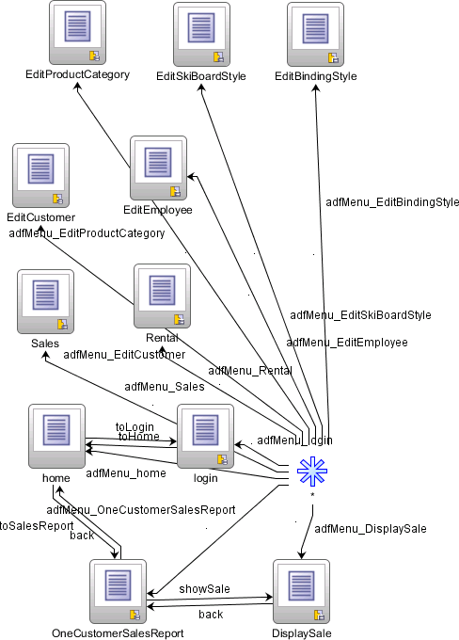
adfc-config.xml

Slide 66
Custom Menu

Slide 67
HTML Help
Help File
Helpset: AllPowderHelp.hs
Map: map.xml
Index: index.xml
TOC: toc.xml
Search: search.idx
HTML Topic
HTML Topic
1 Topic_A
2 Topic_B
3 Topic_C
4 Topic_D
5 Topic_E
6 Topic_F
HTML Topic
HTML Topic
Form
HTML Topic
HTML Topic
Help Topic ID:
Topic_A
http://www.oracle.com/technology/tech/java/help/index.html

Slide 68
Action
Action
Create at least three HTML Help files for the All Powder forms using an HTML editor or Wordpad.
If necessary, download and install the Oracle Web Help and Java Help systems.
Create the Map, Index, TOC, and Link files.
Build the search.idx file.
Create the new HelpSystem .hs file.
Edit the ohwconfig.xml file to add your helpsystem project.
Copy your files to the server and test the project.
Add a help link to a page using http://localhost:7101/ohw-rcf-demo-thin/APHelp?topic=Customers.help.

Slide 69
HTML Help Files
<html><head>
<title>All Powder Board and Ski Shop</title>
<link rel="stylesheet" type="text/css" href="Styles.css">
</head><body>
<h1>Introduction to the All Powder Board and Ski Shop</H1>
<table><tr>
<td><img src="BoardLogo1.gif" border="0"></td>
<td>All Powder Board and Ski Shop sells and rents snowboards and skis for all levels of riders and skiers.</td>
</tr></table>
<h2>The Board and Ski Shop</h2>
<ul><li><a href="Customers.html">Customers</a></li>
<li><a href="Sales.html">Sales </a></li>
</ul></body></html>
For examples, search your computer for *.hs and look at files in the folder.

Slide 70
Topics Map File
<?xml version='1.0' ?>
<map version="1.0">
<mapID target="AllPowder_help" url="AllPowder.html" />
<mapID target="Customers_help" url="Customers.html" />
<mapID target="Sales_help" url="Sales.html" />
</map>

Slide 71
Table of Contents (TOC) file
<?xml version='1.0' ?>
<toc version="1.0">
<tocitem text="Introduction to All Powder Board and Ski Shop">
<tocitem target="AllPowder_help" text="The Board and Ski Shop" />
<tocitem text="Sales Options" target="Sales_help" />
</tocitem>
<tocitem text="Customer Options">
<tocitem target="Customers_help" text="Adding New Customers" />
<tocitem target="Sales_help" text="Sales Options" />
</tocitem>
</toc>

Slide 72
Index File
<?xml version='1.0' ?>
<index version="1.0">
<indexitem text="All Powder“ >
<indexentry text= "AllPowder“target="AllPowder.html“ />
</indexitem>
<indexitem text=“Management”>
<indexientry text =“AP Management” target="AllPowder.html“ />
</indexitem>
…
<indexitem text="Introduction">
<indexentry target="AllPowder.html" text="The Company" />
<indexentry target="Customers.html" text="Customers" />
<indexentry target="Sales.html" text="Sales" />
</indexitem>
</index>

Slide 73
Search File
Is a proprietary binary file that must be generated.
Commercial systems can create the file: Adobe RoboHelp
Can download the Text Search Indexer from Oracle.
Can also download OHJ (Java version) from Oracle and use that to create basic control files.

Slide 74
HelpSystem File (1)
<?xml version='1.0' ?>
<helpset>
<title>All Powder Board and Ski Shop</title>
<maps>
<mapref location=“map.xml" />
</maps>
<links>
<linkref location="link.xml"/>
</links>

Slide 75
HelpSystem File (2)
<view>
<label>Contents</label>
<type>oracle.help.navigator.tocNavigator.TOCNavigator</type>
<data engine="oracle.help.engine.XMLTOCEngine">toc.xml</data>
</view>
<view>
<label>Index</label>
<type>oracle.help.navigator.keywordNavigator.KeywordNavigator</type>
<title>All Powder Board and Ski Shop</title>
<data engine="oracle.help.engine.XMLIndexEngine">index.xml</data>
</view>
<view>
<label>Search</label>
<title>All Powder Board and Ski Shop</title>
<type>oracle.help.navigator.searchNavigator.SearchNavigator</type>
<data engine="oracle.help.engine.SearchEngine">search.idx</data>
</view>
</helpset>

Slide 76
ohwconfig.xml
<?xml version=‘1.0’ encoding=‘UTF-8’ ?>
<helpConfiguration …>
<brandings>
<branding text=“title” />
</brandings>
<locales>
<locale language=“en”>
<books>
<helpSet id=“APHelp” location=“APHelp/APHelp.hs” />
</books>
</locale>
…
</locales>
<parameters>
<combineBooks>true</combineBooks>
<useLaelInfo>true</useLabelInfo>
</parameters>
</helpConfiguration>
Add or edit this line into ohw-rcf-demo-thin project file.

Slide 77
Initial Help File

Slide 78
adf-settings.xml file
<?xml version="1.0" encoding="windows-1252" ?>
<adf-settings xmlns="http://xmlns.oracle.com/adf/settings">
<help-provider>
<help-provider-class>oracle.help.web.rich.helpProvider.OHWHelpProvider</help-provider-class>
<property>
<property-name>ohwConfigFileURL</property-name>
<value>/helpsets/APHelp/ohwconfig.xml</value>
</property>
<!--property>
<property-name>group</property-name>
<value>null</value>
</property-->
<property>
<property-name>baseURI</property-name>
<value>http://localhost:7101/ohw-rcf-demo-thin/ohguide/</value>
</property>
</help-provider>
</adf-settings>
Must be manually created in the JDeveloper folder: .adf/META-INF

Slide 79
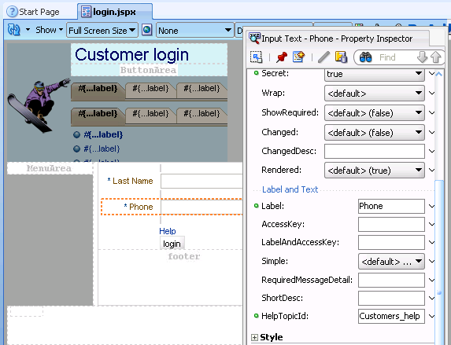
Context-Sensitive Help
Probably does not work. I do not know why.

Slide 80
Challenges
Problems getting Help Provider registered to work within JDeveloper.
And problems downloading ohw-links.ear.
Can make help work with the thin-client, but not context-sensitive.
Find directory used by thin-client. Search for Shakespeare (their example). But three folders, find the right one by testing ohwconfig.
Example: C:\Users\JPost\AppData\Roaming\JDeveloper\system11.1.1.2.36.55.36\DefaultDomain\servers\DefaultServer\tmp\_WL_user\ohw-rcf-demo-thin\ehn3p4\war\helpsets
Copy APHelp folder into that directory and add
<helpSet id="APHelp" location="APHelp/APHelp.hs"/>

Slide 81
Deploying an Application
Application server
Database scripts
Data loading
Compiled forms
Compiled reports
Help files
Developer files
Application users

Slide 82
Action
Action
Create SQL scripts to rebuild your database on a new server.
Try to get to an Oracle Application Server.
Have a DBA configure a new database and the AS for a new application.
Change your global variables to point to the new locations.
Build the new database.
Compile and transfer the application files.
Test everything.

