Slide 1
All Powder Board and Ski
Oracle 11g Workbook
Chapter 9: Data Warehouses and Data Mining
Jerry Post
Copyright © 2010

Slide 2
Oracle Relational Approach
Meta-Data
Relational Tables
Materialized Views
Star Design
Dimension
Dimension
Customer
Sale
Sale +
Customer
SaleItem
Fact Measure
Item
Dimension
Dimension

Slide 3
Oracle References
http://www.oracle.com/technology/products/bi/olap/index.html | Main Business Intelligence site.
http://www.oracle.com/technology/products/bi/odm/index.html | Oracle Data Mining including download
http://www.oracle.com/technology/products/discoverer/index.html | Discoverer
http://www.oracle.com/technology/software/products/ias/htdocs/101320bi.html | OTN BI Suite EE
http://www.oracle.com/technology/products/bi/olap/olap_downloads.html | Analytic Workspace Manager Download

Slide 4
Permissions for Data Mining
CREATE MATERIALIZED VIEW
CREATE CUBE
CREATE CUBE DIMENSION
OLAP_USER
CREATE MINING MODEL
CREATE JOB
CREATE TYPE
CREATE SYNONYM
Optional: EXECUTE ON ctxsys.ctx_ddl for text mining

Slide 5
Desired Sales Cube Dimensions
Sales Dimensions
State (ship)
Month
Category
Style
SkillLevel
Size
Color
Manufacturer
BindingStyle
WeightMax?
ItemMaterial?
WaistWidth?
Jump to Second Lesson

Slide 6
Early Data: Spreadsheets

Slide 7
Action
Action
Delete all sales with SaleID>2000.
Disable the trigger that creates SaleID keys:
ALTER TRIGGER GenKeyForSale Disable;
Modify and run the code to create the external tables for the old Sale and Rental data.
Insert CustomerID 0 and EmployeeID 0.

Slide 8
External Tables: Attach to CSV
create or replace directory csv_dir as ‘D:\students\BuildAllPowder\AllPowderSampleDataCSV';
create table OldSale_Ext
( SaleID INTEGER,
SaleDate DATE,
ShipState VARCHAR2(50),
ShipZIP VARCHAR2(50),
PaymentMethod VARCHAR2(50),
SKU VARCHAR2(50),
QuantitySold INTEGER,
SalePrice NUMBER(10,2)
ModelID VARCHAR2(250),
ItemSize NUMBER,
ManufacturerID INTEGER,
Category VARCHAR2(50),
Color VARCHAR2(50),
ModelYear INTEGER,
Graphics VARCHAR2(50),
ItemMaterial VARCHAR2(50),
ListPrice NUMBER(10,2),
Style VARCHAR2(50),
SkillLevel INTEGER,
WeightMax NUMBER,
WaistWidth NUMBER,
BindingStyle VARCHAR2(50)
)
Continued on next slide
Warning: currency columns cannot have $ symbols or commas

Slide 9
External File Definition
organization external (
type oracle_loader
default directory csv_dir
access parameters (
records delimited by newline
fields terminated by ','
optionally enclosed by '"' lrtrim
missing field values are null
(
SaleID,
SaleDate char date_format date mask "mm/dd/yyyy",
ShipState, ShipZIP, PaymentMethod, SKU, QuantitySold, SalePrice,
odelID, ItemSize, ManufacturerID, Category, Color, ModelYear,
Graphics, ItemMaterial, ListPrice, Style, SkillLevel, WeightMax,
WaistWidth, BindingStyle
)
)
location ('Lab 08-01 Early Sales.csv')
)
reject limit unlimited;

Slide 10
Create Customer and Employee
CustomerID and EmployeeID are missing from the old data.
Instead of relying on blank cell values, create a new customer called “Walk-in” and a new employee called “Employee”
Write down the ID numbers generated for these anonymous entries.
If you use SQL, you can assign a value of zero to these entries.
INSERT INTO Customer (CustomerID, LastName)
Values (0,'Walk-in')
INSERT INTO Employee (EmployeeID, LastName)
Values (0,'Staff')

Slide 11
Extract Model Data
SELECT DISTINCT OldSale_ext.ModelID, OldSale_ext.ManufacturerID, OldSale_ext.Category, OldSale_ext.Color, OldSale_ext.ModelYear, OldSale_ext.Graphics, OldSale_ext.ItemMaterial, OldSale_ext.ListPrice, OldSale_ext.Style, OldSale_ext.SkillLevel, OldSale_ext.WeightMax, OldSale_ext.WaistWidth, OldSale_ext.BindingStyle
FROM OldSale_ext;

Slide 12
UNION Query for Models
SELECT DISTINCT ModelID, ManufacturerID, Category, …
FROM OldSales_ext
UNION
SELECT DISTINCT ModelID, ManufacturerID, Category, …
FROM OldRentals_ext

Slide 13
Action
Action
Create a new query that retrieves DISTINCT values from the saved UNION query.
Verify that it works.
Add an INSERT INTO statement above the SELECT statement to copy the data to the ItemModel table.
Run the query.
Use a similar process to add SKU, ModelID, and Size to the Inventory table.
Follow a similar process to copy the Sale, Rental, SalesItem, and RentalItems tables.

Slide 14
Insert Model Data into ItemModel
INSERT INTO ItemModel (ModelID, ManufacturerID, Category, Color, ModelYear,
Graphics, ItemMaterial, ListPrice, Style, SkillLevel, WeightMax, WaistWidth, BindingStyle)
SELECT DISTINCT qryOldModels.ModelID, qryOldModels.ManufacturerID, qryOldModels.Category,
qryOldModels.Color, qryOldModels.ModelYear, qryOldModels.Graphics, qryOldModels.ItemMaterial,
qryOldModels.ListPrice, qryOldModels.Style, qryOldModels.SkillLevel, qryOldModels.WeightMax,
qryOldModels.WaistWidth, qryOldModels.BindingStyle
FROM qryOldModels;

Slide 15
Insert SKU Data into Inventory
CREATE VIEW qryOldInventory AS
SELECT DISTINCT ModelID, SKU, ItemSize
FROM OldSale_ext
UNION
SELECT DISTINCT ModelID, SKU, ItemSize
FROM OldRental_ext;
INSERT INTO Inventory (ModelID, SKU, ItemSize, QuantityOnHand)
SELECT DISTINCT qryOldInventory.ModelID, qryOldInventory.SKU, qryOldInventory.ItemSize, 0 As QuantityOnHand
FROM qryOldInventory;
Note the use of the column alias to force a zero value for QuantityOnHand for each row

Slide 16
Copy Sales Data
INSERT INTO Sale (SaleID, SaleDate, ShipState, ShipZIP, PaymentMethod)
SELECT DISTINCT OldSales_ext.SaleID, OldSales_ext.SaleDate, OldSales_ext.ShipState, OldSales_ext.ShipZIP, OldSales_ext.PaymentMethod
FROM OldSales_ext;
Note that if you have added data to your Sales table, your existing SaleID values might conflict with these
You can solve the problem by adding a number to these values so they are all larger than your highest ID
INSERT INTO Sale (SaleID, SaleDate, ShipState, ShipZIP, PaymentMethod)
SELECT DISTINCT OldSales_ext.SaleID+5000, OldSales_ext.SaleDate, OldSales_ext.ShipState, OldSales_ext.ShipZIP, OldSales_ext.PaymentMethod
FROM OldSales_ext;

Slide 17
Copy SaleItem Rows
INSERT INTO SaleItem (SaleID, SKU, QuantitySold, SalePrice)
SELECT DISTINCT OldSale_ext.SaleID+5000, OldSale_ext.SKU, OldSale_ext.QuantitySold, OldSale_ext.SalePrice
FROM OldSale_ext;
If you transformed the SaleID in the prior step for the Sale data, you must do the exact same calculation for SaleID in the SaleItem table

Slide 18
Copy Rental Data
INSERT INTO Rental (RentID, RentDate, ExpectedReturn, PaymentMethod)
SELECT DISTINCT OldRental_ext.RentID+5000, OldRental_ext.RentDate, OldRental_ext.ExpectedReturn, OldRental_ext.PaymentMethod
FROM OldRental_ext;
INSERT INTO RentItem (RentID, SKU, RentFee, ReturnDate)
SELECT DISTINCT OldRental_ext.RentID+5000, OldRental_ext.SKU, OldRental_ext.RentFee, OldRental_ext.ReturnDate
FROM OldRental_ext;

Slide 19
Action: Analytic Workspace
Action
If you skipped the first activity, run the DeleteTables and BuildAllPowder files for this chapter.
Run the Analytic Workspace Manager and connect to the database with your login.
Right-click Analytic Workspaces, to create a new Analytic Workspace.
Name it AllPowder and accept the default tablespace.
Expand the new workspace and check out the various options.

Slide 20
Analytic Workspace Manager

Slide 21
Starting Empty

Slide 22
Action: Time Dimension
Action
Right-click the Dimension entry and choose the option to create a new dimension.
Name it: Dim_Sale_Date
Select the option to make it a Time dimension (not user).
Click the Levels tab and add: Sale_Year, Sale_Quarter, Sale_Month
Click the Implementation Details tab and select to use Keys from Data Source, not the surrogate keys.
Expand the new dimension and right-click Hierarchies to add a new hierarchy.
Name: Sale_Calendar
Choose the levels in order: Year, Quarter, Month

Slide 23
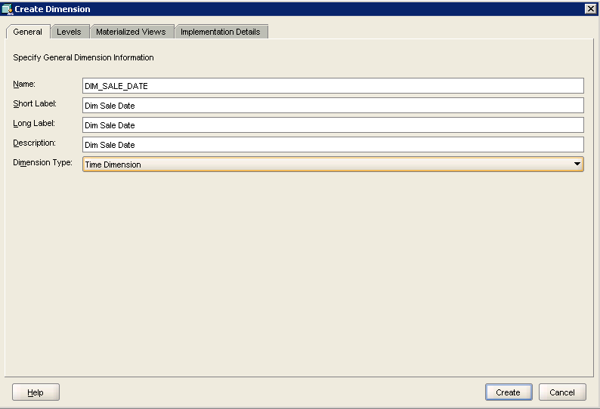
New Dimension: Sale Date

Slide 24
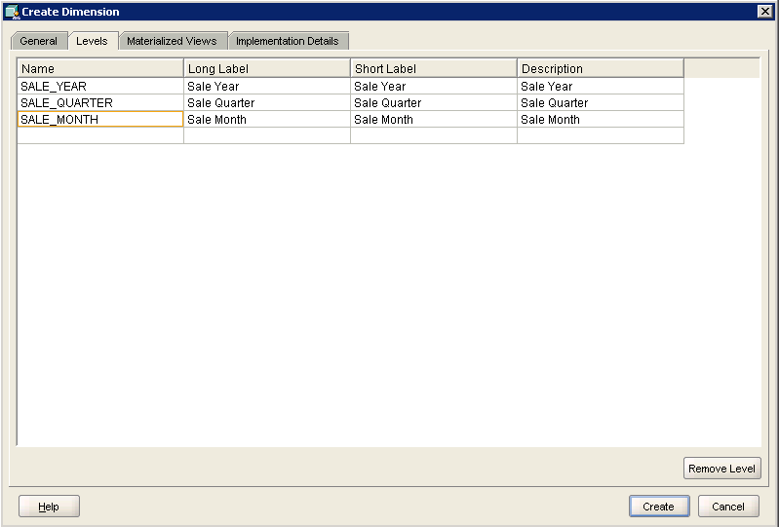
Levels by Time
Use complex names for everything! Very high risk that simple names will collide with reserved words and cube will fail for strange reasons later (bug).

Slide 25
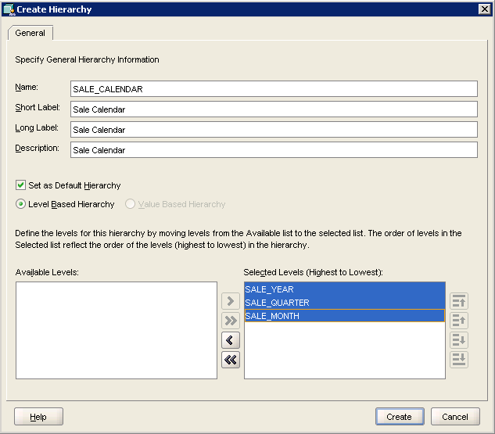
Hierarchy: Calendar

Slide 26
Action: Data for Time Dimension
Action
Click the Attributes entry for the dimension to see the data needed for each level.
Create three queries (year, quarter, month) to build the data needed for the dimension.
Select the Mappings entry in the new time dimension.
Set the Snowflake schema instead of star.
Drag the entries from the time views and drop them onto the matching rows in the dimension.
Click the Apply button.
Right-click the dimension in the navigator and choose Maintain… to load the data.
Right-click the dimension and choose View Data.
Verify that the hierarchy and data are correct.

Slide 27
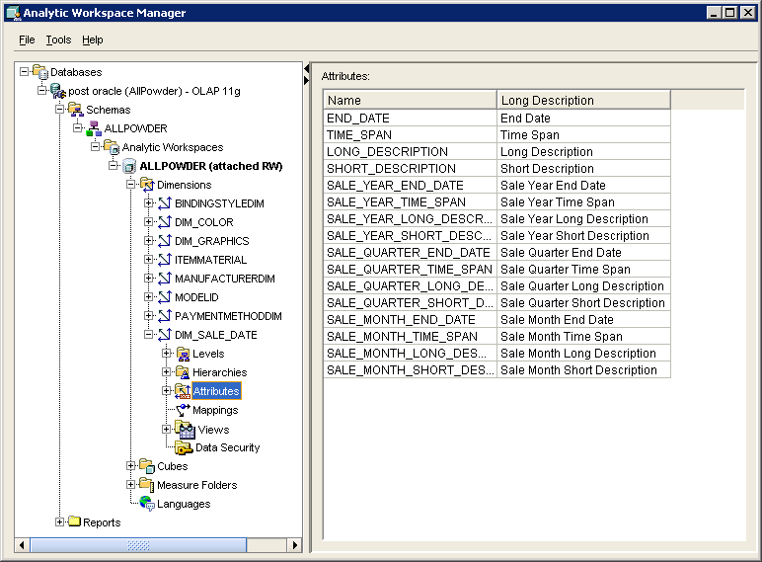
Data Needed for Calendar

Slide 28
View For Year Time Data
CREATE or REPLACE VIEW SaleYears AS
SELECT DISTINCT To_Char(SaleDate,'YYYY') As YearID,
To_Char(SaleDate,'YYYY') As YearValue,
To_Date(Extract(Year from SaleDate) || '1231', 'YYYYMMDD') As YearEnd,
To_Date(Extract(Year from SaleDate) || '1231', 'YYYYMMDD')-To_Date(Extract(Year from SaleDate)-1 || '1231', 'YYYYMMDD') As YearSpan,
TO_CHAR(SaleDate, 'YYYY') As YearDesc, TO_CHAR(SaleDate, 'YYYY') As YearLongDesc
FROM SALE
ORDER BY YearValue;
Tricky date functions. Use cut-and-paste to copy.

Slide 29
View For Quarter Time Data
CREATE or REPLACE VIEW SaleQuarters AS
SELECT DISTINCT To_Char(SaleDate,'YYYY') As YearID,
To_Char(SaleDate,'YYYYQ') As QuarterID,
To_Char(SaleDate, 'Q') As QuarterValue,
Add_Months(TO_DATE((Extract(Year from SaleDate)*100 + TO_CHAR(SaleDate, 'Q')*3 )*100 +1, 'YYYYMMDD'),1)-1 As QuarterEnd,
Add_Months(TO_DATE((Extract(Year from SaleDate)*100 + TO_CHAR(SaleDate, 'Q')*3 )*100 +1, 'YYYYMMDD'),1)
-Add_Months(TO_DATE((Extract(Year from SaleDate)*100 + TO_CHAR(SaleDate, 'Q')*3 )*100 +1, 'YYYYMMDD'),-2) As QuarterSpan,
TO_CHAR(SaleDate,'YYYY-Q') As QuarterDesc,
TO_CHAR(SaleDate,'YYYY-Q') As QuarterLongDesc
FROM SALE
ORDER BY QuarterDesc;
Tricky date functions. Use cut-and-paste to copy.

Slide 30
View For Month Time Data
CREATE OR REPLACE VIEW SaleMonths AS
SELECT DISTINCT To_Char(SaleDate,'YYYYQ') As QuarterID,
To_Char(SaleDate,'YYYYMM') As MonthID,
To_Char(SaleDate, 'MM') As MonthValue,
Add_Months(To_Date(Extract(Year from SaleDate)*10000+Extract(Month from SaleDate)*100+1,'YYYYMMDD'),1)-1 As MonthEnd,
Add_Months(To_Date(Extract(Year from SaleDate)*10000+Extract(Month from SaleDate)*100+1,'YYYYMMDD'),1)
-To_Date(Extract(Year from SaleDate)*10000+Extract(Month from SaleDate)*100+1,'YYYYMMDD') As MonthSpan,
TO_CHAR(SaleDate, 'YYYY-MM') As MonthDesc,
TO_CHAR(SaleDate, 'YYYY-Mon') As MonthLongDesc
from sale
ORDER BY MonthID;
Tricky date functions. Use cut-and-paste to copy.

Slide 31
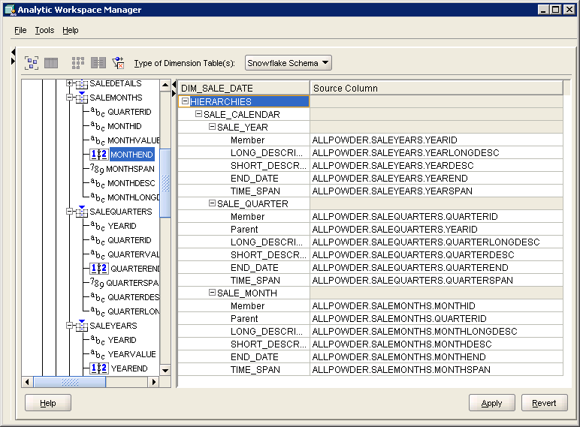
Mapping Time Dimension

Slide 32
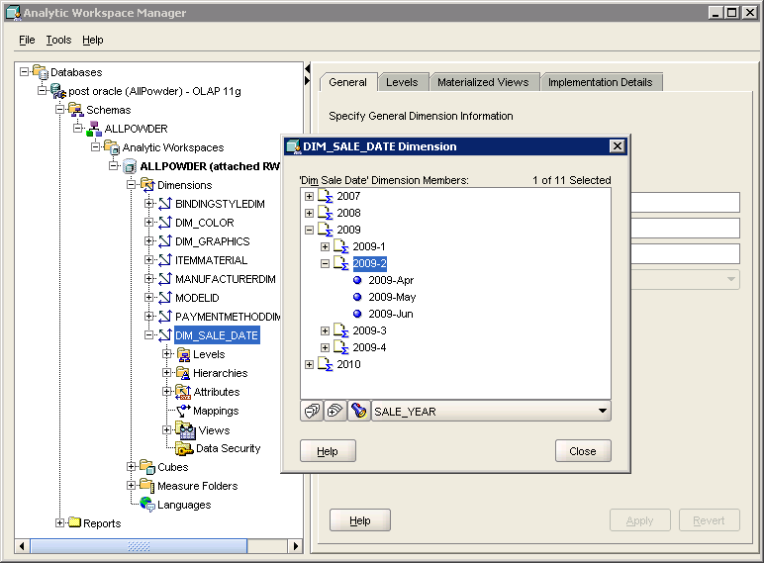
Verify Data in Dimension

Slide 33
Action: Create other Dimensions
Action
Create views for location (ShipState and ShipCity).
Create dimensions with hierarchies for location and product category style.
Create views to retrieve distinct data for Color, Graphics, and ItemMaterial.
Define dimensions for other attributes: Color, ItemMaterial, BindingStyle, ManufacturerID (with Name), Graphics, PaymentMethod, and ModelID.
Load data (Maintain) into each dimension and test them.

Slide 34
Location Dimension Queries
CREATE VIEW ShipStates AS
SELECT DISTINCT ShipState
FROM Sale
ORDER BY ShipState;
CREATE VIEW ShipStateCities AS
SELECT DISTINCT ShipState, ShipCity
FROM Sale
ORDER BY ShipState, ShipCity;

Slide 35
More Dimension Queries
CREATE OR REPLACE VIEW ItemColorList AS
SELECT DISTINCT COLOR As ItemColor
FROM ITEMMODEL
ORDER BY ItemColor;
CREATE OR REPLACE VIEW GraphicsList AS
SELECT DISTINCT GraphicsName
FROM ITEMMODEL
ORDER BY GraphicsName;
CREATE OR REPLACE VIEW ItemMaterialList AS
SELECT DISTINCT ItemMaterial
FROM ITEMMODEL
ORDER BY ItemMaterial;

Slide 36
Action: Create Cube
Action
Create a view to retrieve data from multiple tables: Sale, SaleItem, Inventory, ItemModel.
Create a new Cube and assign all of the dimensions.
Create a measure (Sales_Value).
Map the columns from the data view to the Cube values.
Create join conditions to match the cube data to the view columns.
Load the cube data through the Maintain option.
View the data in the View that was generated.
Test the cube browser.

Slide 37
Data View to Multiply
CREATE OR REPLACE VIEW SaleDetails AS
SELECT SaleDate, CustomerID, EmployeeID, ShipCity, ShipState, PaymentMethod, To_Char(SaleDate, 'YYYY') As SaleYear,
To_Char(SaleDate, 'YYYYQ') As SaleQuarterID, To_Char(SaleDate, 'YYYYMM') As SaleMonthID, QuantitySold,
SalePrice*QuantitySold As SaleValue,
Inventory.SKU, Inventory.ModelID, ItemSize, QuantityOnHand,
ManufacturerID, Category As ProductCategory, Color As ColorName, Cost As ItemCost, ModelYear, Graphics As GraphicsName, ItemMaterial, ListPrice, Style As SkiStyle, SkillLevel, WeightMax, WeightMin, WaistWidth, EffectiveEdge, BindingStyle, RentalRate
FROM SALE
INNER JOIN SaleItem ON Sale.SaleID=SaleItem.SaleID
INNER JOIN Inventory ON SALEITEM.SKU=Inventory.SKU
INNER JOIN ItemModel ON Inventory.ModelID=ItemModel.ModelID;

Slide 38
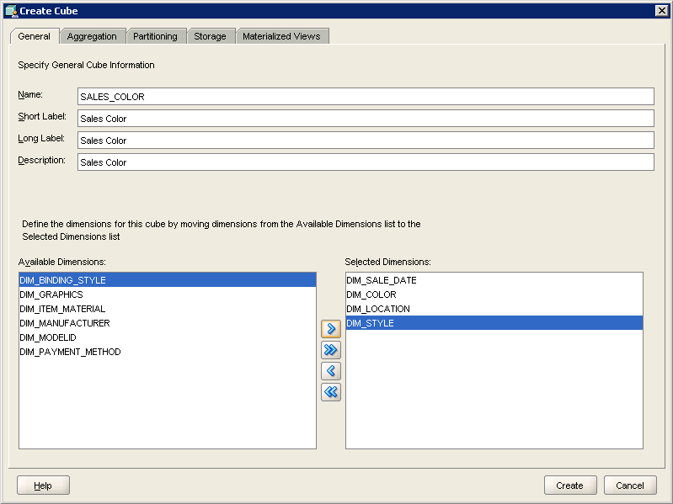
Cube Dimensions
Use a limited number of dimensions. Because of a bug, the cube browser does not support the ALL option.
So adding dimensions becomes restrictive.

Slide 39
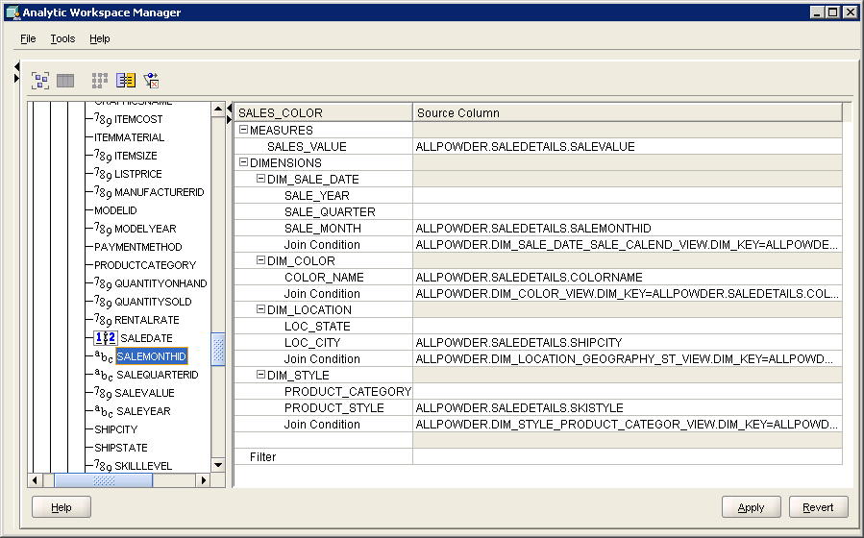
Cube Mapping
ALLPOWDER.SALEDETAILS.SALEMONTHID
=ALLPOWDER.DIM_SALE_DATE_SALE_CALEND_VIEW.DIM_KEY

Slide 40
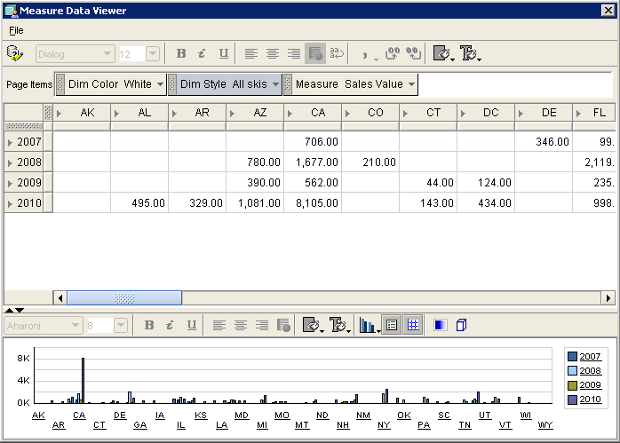
The Small Cube
Notice that you cannot select ALL for the page dimensions so every dimension is highly restrictive.

Slide 41
Action: SQL Analytic Functions
Action
Create a view to compute the total sales per month using TO_CHAR(SaleDate, ‘YYYY-MM’) to get the month.
Create a query to display the Month, SalesValue, and the Sales Value from the prior month using the LAG function.
Create a query to compute the 3-month moving average of the sales.
Copy the data to Excel and draw a chart showing sales and the 3-month moving average.

Slide 42
Lagged Data Query
SELECT SaleMonth, SalesValue, LAG(SalesValue, 1, 0)
OVER (PARTITION BY 1 ORDER BY SaleMonth) AS PriorSales
FROM MonthlySales
ORDER BY SaleMonth;
Normally, you would partition by another variable/column, such as department or category.
OVER (PARTITION BY ProductCategory ORDER BY ...)
Can also skip the partition statement

Slide 43
Time Series MA Query
SELECT SaleMonth, SalesValue, Avg(SalesValue)
OVER (ORDER BY SaleMonth
ROWS 2 PRECEDING) AS MA3
FROM MonthlySales
ORDER BY SaleMonth;

Slide 44
Time Series Chart (Excel)

Slide 45
Action: Data Miner Introduction
Action
Download, install, and start Oracle Data Miner.
Set the initial database connection.
Create a SaleGroups view to compute subtotals.
Create a SaleTreeData view to classify the sales totals into four categories.
Run the Classification/Decision Tree analysis.
Set the target as the new classification column.
Explore the results.

Slide 46
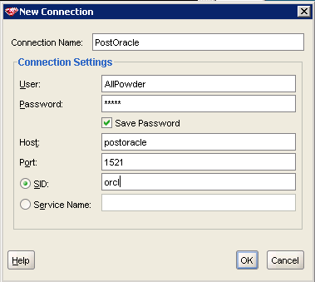
Oracle Data Miner

Slide 47
Data Query
CREATE VIEW SaleGroups AS
SELECT ShipState, ColorName,ProductCategory, SkiStyle, PaymentMethod, SaleYear, SUM(SaleValue) As SalesTotal
FROM SaleDetails
GROUP BY ShipState, ColorName, ProductCategory, SkiStyle, PaymentMethod, SaleYear;
CREATE VIEW SaleTreeData AS
SELECT ShipState, ColorName, ProductCategory, SkiStyle, PaymentMethod, SaleYear, SalesTotal,
CASE
WHEN SalesTotal<100 THEN 'Very Low'
WHEN SalesTotal BETWEEN 100 AND 300 THEN 'Low'
WHEN SalesTotal BETWEEN 300.01 AND 500 THEN 'Average'
WHEN SalesTotal>500 THEN 'High'
END As SalesCat
FROM SaleGroups;

Slide 48
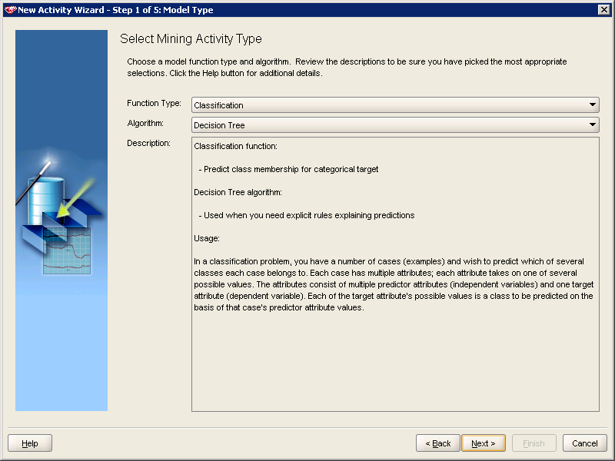
Classification: Decision Tree

Slide 49
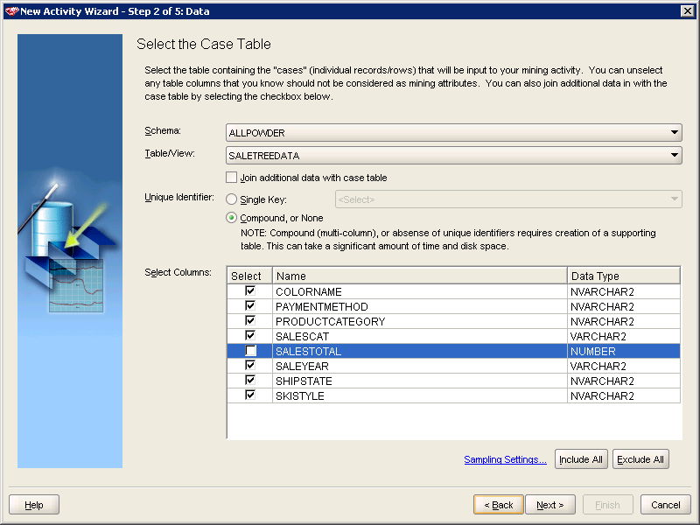
Data Table

Slide 50
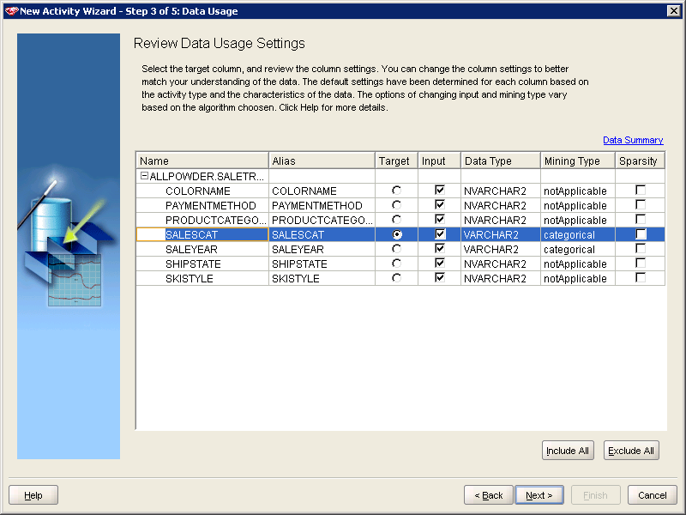
Data Target

Slide 51
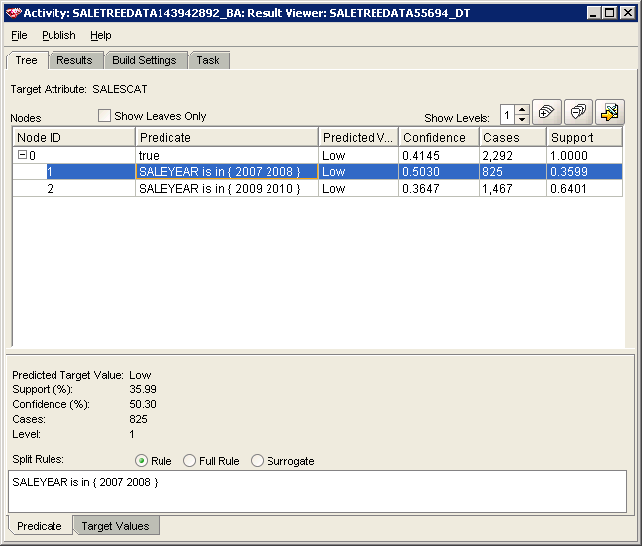
Decision Tree Results

Slide 52
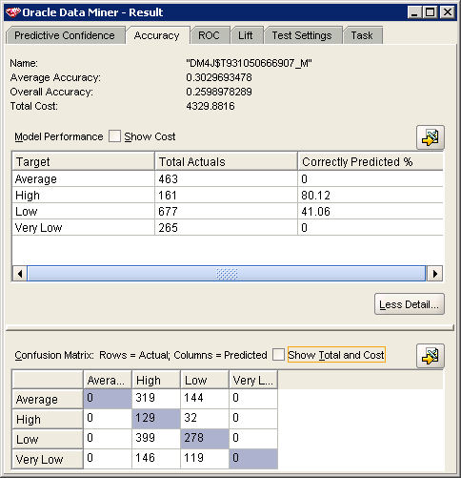
Classification Details

Slide 53
Action: Multiple Regression
Action
Create a new table to hold the demographic data.
Read the data from the CSV file into the new table.
Create a view that computes total sales by state for 2008.
Create a view that combines the state sales and demographic data.
In ODM, select Action/Build and choose the Regression: Multiple Regression (GLM) model.
Use SPI2008, GDP2008, POP2008, and Sales2008 in the model.
Set Sales2008 as the target.
Run the analysis and explore the results.

Slide 54
Query to Create Table
CREATE TABLE StateDemo
(
FIPS NUMBER(5,0),
StateCode NVarchar2(10),
AreaName NVarchar2(100),
DPI2008 NUMBER(10,0),
GDP2008 NUMBER(10,0),
POP2008 NUMBER(10,0),
CONSTRAINT pk_StateDemo PRIMARY KEY (FIPS)
)

Slide 55
Connect to CSV File
CREATE OR REPLACE directory csv_dir AS 'C:\Database\';
CREATE TABLE StateDemoCSV
( FIPS NUMBER(5,0),
StateCode NVarchar2(10),
AreaName NVarchar2(100),
DPI2008 NUMBER(10,0),
GDP2008 NUMBER(10,0),
POP2008 NUMBER(10,0) )
organization external (
default directory csv_dir
access parameters (
records delimited by newline fields terminated by ',‘
optionally enclosed by '"' lrtrim missing field values are null
)
location ('StateDemogBEA2008.csv')
) reject limit unlimited;

Slide 56
Transfer Data
INSERT INTO StateDemo(FIPS, StateCode, AreaName, DPI2008, GDP2008, POP2008)
SELECT FIPS, StateCode, AreaName, DPI2008, GDP2008, POP2008
FROM StateDemoCSV;
DROP TABLE StateDemoCSV;

Slide 57
View: Total Sales By State
CREATE VIEW SalesByState AS
SELECT ShipState, Sum(SaleValue) As StateTotal
FROM SaleDetails
WHERE SaleYear=2010 GROUP BY ShipState;

Slide 58
View: Combine Sales and Econ
CREATE VIEW StateEconSales AS
SELECT ShipState, DPI2008, GDP2008, POP2008, StateTotal
FROM SALESBYSTATE
INNER JOIN StateDemo ON SalesByState.ShipState=StateDemo.StateCode

Slide 59
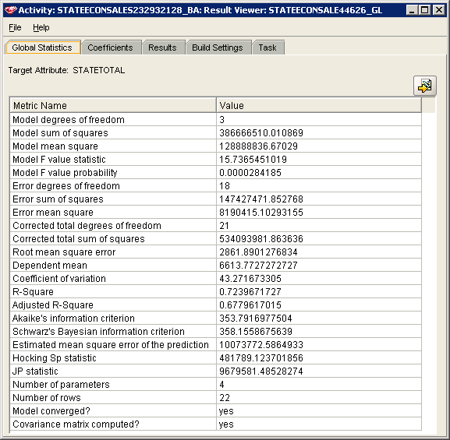
Regression Summary

Slide 60
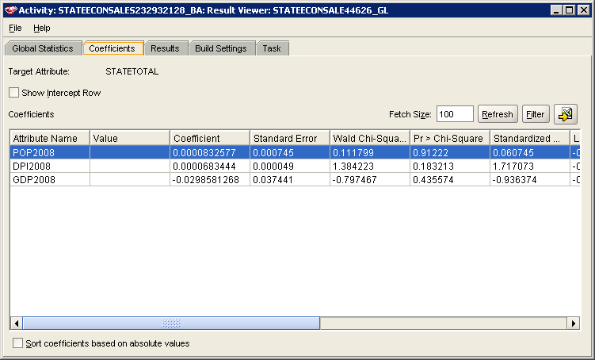
Regression Coefficients

Slide 61
Action: Association Analysis
Action
Create a query that lists the SaleID and a concatenation of Category and Style.
Create a new Activity / Build in Oracle Data Miner.
Choose Association Rules: Apriori algorithm.
Choose the new view as the data source and set the ItemCategory as the ItemID.
For TransactionID, select SaleID.
Click the Results link then the Get Results button.
Explore the results.

Slide 62
Query for Sales by Category
CREATE VIEW CategoryItemsSold AS
SELECT SaleID,
ItemModel.Category || N'-' || ItemModel.Style As ItemCat
FROM SALEITEM
INNER JOIN Inventory ON SaleItem.SKU=INVENTORY.SKU
INNER JOIN ItemModel ON Inventory.ModelID=ITEMMODEL.MODELID
ORDER BY SaleID;

Slide 63
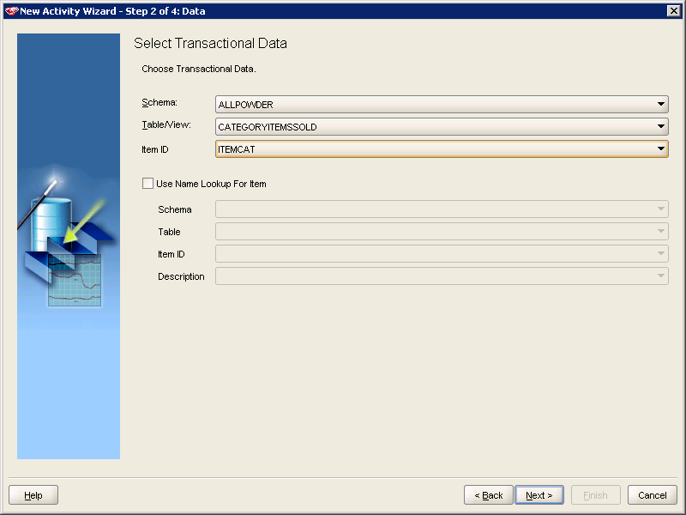
Association Rules

Slide 64
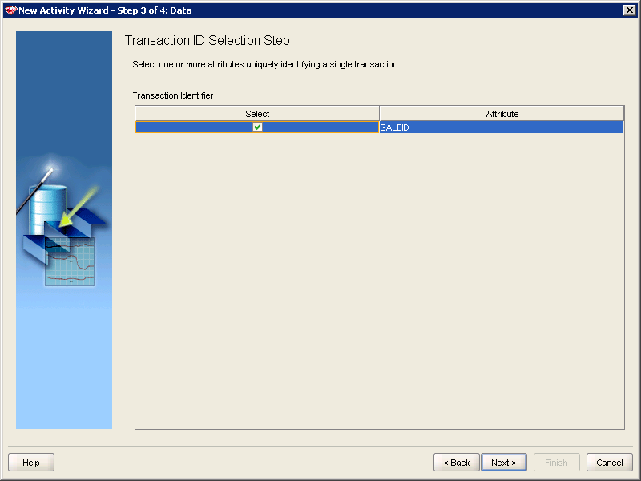
Transaction Identifier

Slide 65
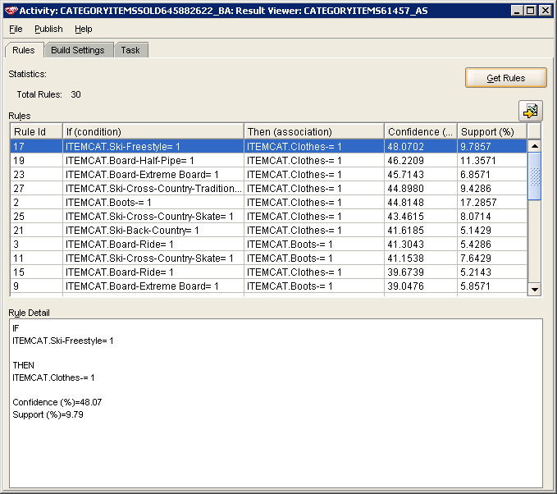
Results: Click Button

Slide 66
GIS: Microsoft MapPoint
A dynamic copy of this sheet is used to remove the top rows

Slide 67
MapPoint Data Wizard

Slide 68
GIS Analysis of Sales

