Slide 1
All Powder Board and Ski
Oracle 11g Workbook
Chapter 10: Database Administration
Jerry Post
Copyright © 2010

Slide 2
Oracle System Tables (Synonyms): Metadata
Prefixes | Synonym | Description
ALL_ DBA_ USER_ | CONSTRAINTS IND_COLS MVIEWS SEQUENCES SYNONYMS TAB_COLUMNS TABLES TRIGGER_COLS TRIGGERS TYPES USERS VIEWS | Table constraints and keys Indexed columns Materialized views Sequences Synonyms Table columns Tables Trigger columns Triggers User-defined data types Users Views (saved queries)
SELECT Table_Name, Pct_Free FROM USER_TABLES

Slide 3
Oracle Data Storage
Tablespace
Tablespace
Table Data
Rollback segments
Redo logs
Disk Drive
Disk Drive
Data Files
Data Files
Data Files
Data Files
RAID drives automatically spread files across multiple drives.
Even without RAID you can manually assign table data and rollback segments to different drives.
Goal: Substantially improved performance and recovery in case of hardware failure.

Slide 4
Action
Action
Log into the enterprise manager and click the Performance tab.
Select the Advisor Central link under the Related Links.
Select the Tuning Advisor and then the Top SQL link.
Open a PL SQL session and issue several queries while you monitor the database performance.
Run some reports or get several people to alter data at the same time.

Slide 5
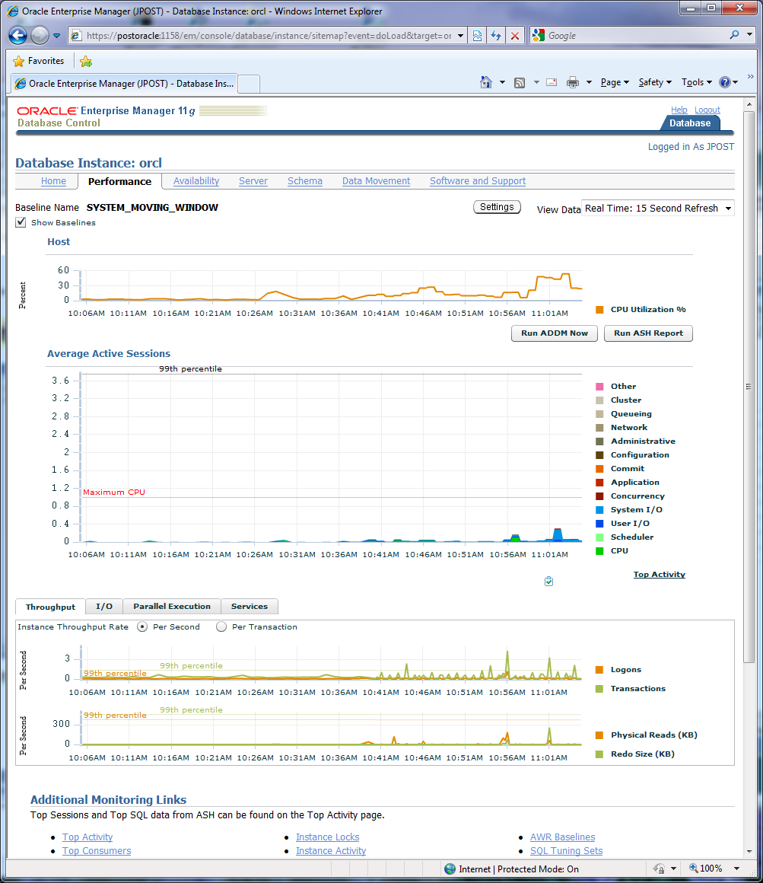
Monitor 11g Minimal Activity

Slide 6
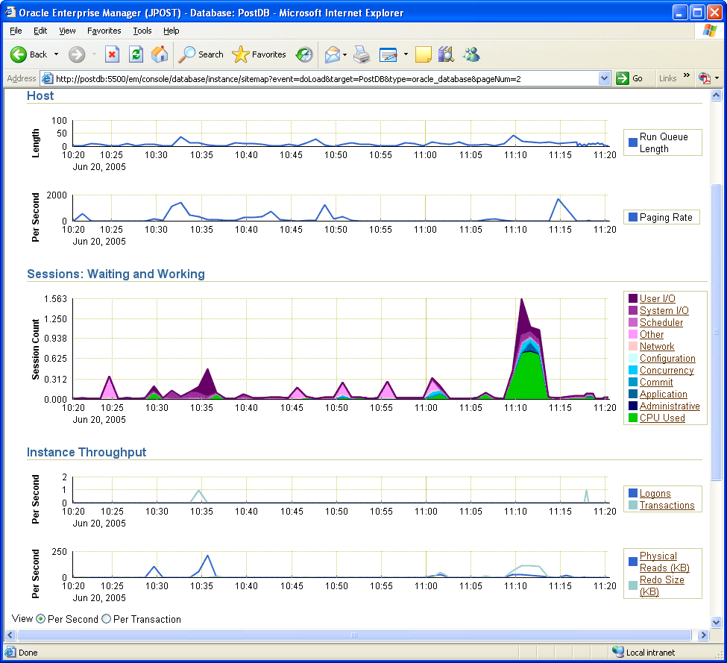
Enterprise Manager Monitor 10g
Activity monitors
Click for details

Slide 7
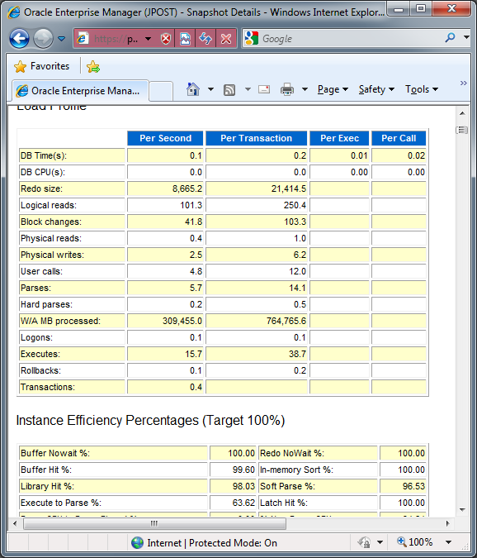
Performance Diagnostic: ADDM

Slide 8
Gather Statistics
Statistics about the data within each table tell Oracle how to optimize queries. The tuning system also uses the statistics to make recommendations about indexes to improve performance.
The older command is: Analyze Table Customer compute statistics;
Oracle now recommends that you use the DBMS_STATS package instead to analyze the entire database (or schema) at one time.
Exec DBMS_STATS.Gather_Database_Stats
Or
Exec DBMS_STATS.Gather_Schema_Stats(‘powder’)
Or
Exec DBMS_STATS.Gather_Table_Stats (‘powder’, ‘Customer’)
You need Sys DBA permissions to run the first one.

Slide 9
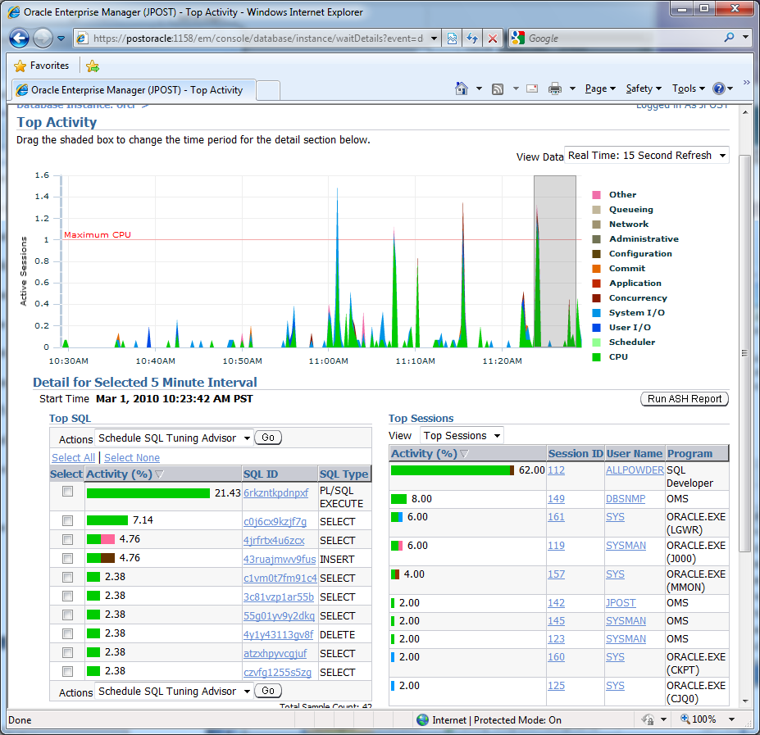
Top Activity
Slide to choose interval
Select statement to run advisor

Slide 10
Action
Action
Run a SQL query in SQL Developer.
Use the SQL Search to find it.
Run the SQL Tuning Wizard.
Click the button to implement any suggestions.
Run the Gather_Statistics command.

Slide 11
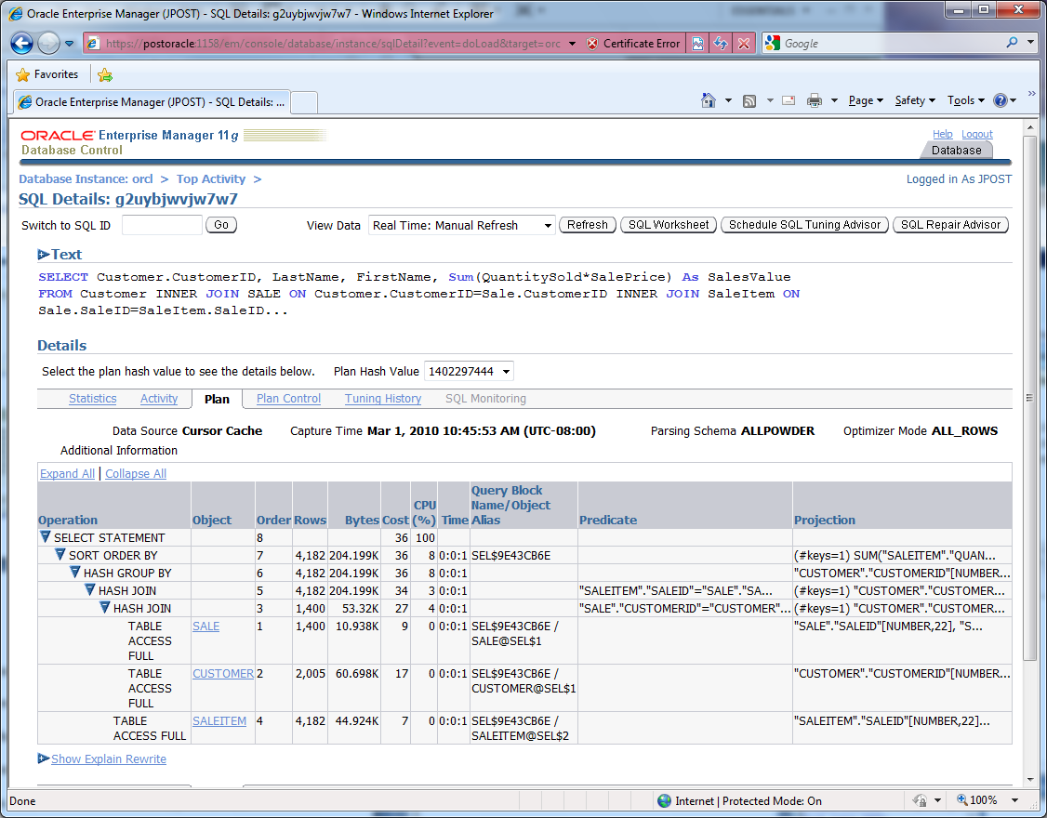
SQL Search Plan

Slide 12
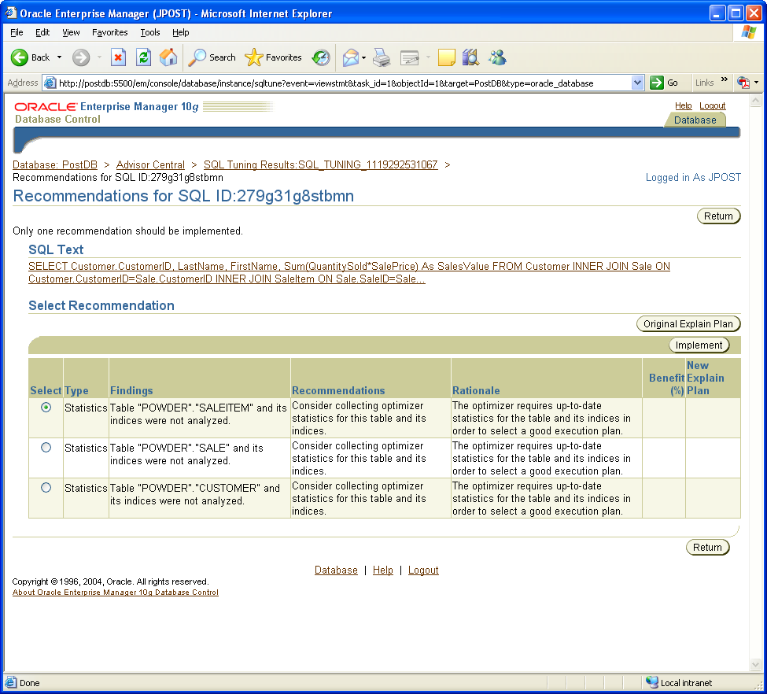
Tuning: Recommendations
Main recommendation

Slide 13
Action
Action
Run several queries from Chapters 4 and 5 to establish base data.
Run the SQL Access Advisor.
Pick the option for Both Indexes and Materialized Views.
View the recommendations and examine the proposed SQL.

Slide 14
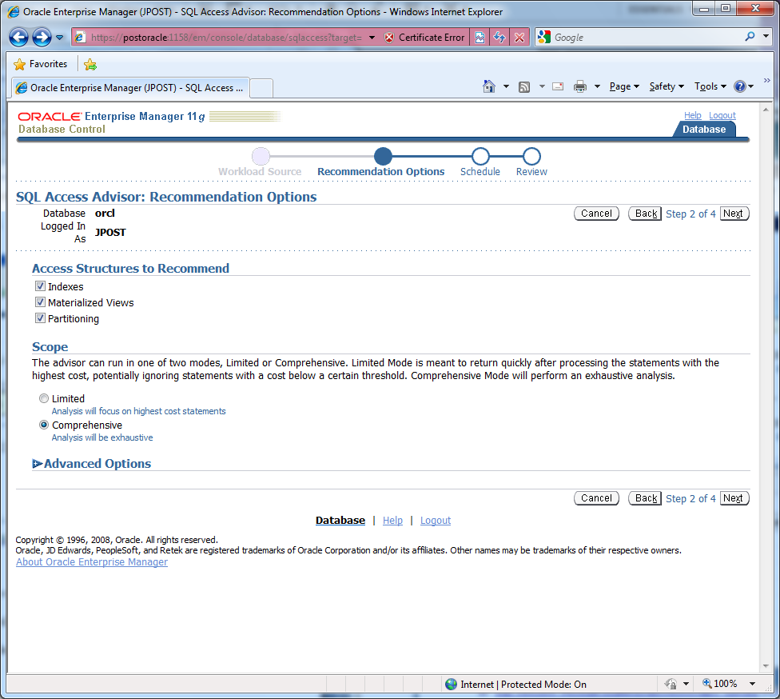
SQL Access Advisor
Choose all options

Slide 15
Expert Recommendations
Primary materialized view joining Sale and Customer
CREATE MATERIALIZED VIEW "JPOST"."MV$$_00160000"
REFRESH FAST WITH ROWID
ENABLE QUERY REWRITE
AS SELECT POWDER.SALE.ROWID C1, POWDER.CUSTOMER.ROWID C2, "POWDER"."CUSTOMER"."ADDRESS"
M1, "POWDER"."CUSTOMER"."CITY" M2, "POWDER"."CUSTOMER"."CUSTOMERID" M3,
"POWDER"."CUSTOMER"."DATEOFBIRTH" M4, "POWDER"."CUSTOMER"."EMAIL" M5,
"POWDER"."CUSTOMER"."FIRSTNAME" M6, "POWDER"."CUSTOMER"."GENDER" M7, "POWDER"."CUSTOMER"."LASTNAME"
M8, "POWDER"."CUSTOMER"."PHONE" M9, "POWDER"."CUSTOMER"."STATE" M10, "POWDER"."CUSTOMER"."ZIP"
M11, "POWDER"."SALE"."CUSTOMERID" M12, "POWDER"."SALE"."EMPLOYEEID" M13,
"POWDER"."SALE"."PAYMENTMETHOD" M14, "POWDER"."SALE"."SALEDATE" M15, "POWDER"."SALE"."SALEID"
M16, "POWDER"."SALE"."SALESTAX" M17, "POWDER"."SALE"."SHIPADDRESS" M18,
"POWDER"."SALE"."SHIPCITY" M19, "POWDER"."SALE"."SHIPSTATE" M20, "POWDER"."SALE"."SHIPZIP"
M21 FROM POWDER.SALE, POWDER.CUSTOMER WHERE POWDER.CUSTOMER.CUSTOMERID
= POWDER.SALE.CUSTOMERID;
begin
dbms_stats.gather_table_stats('"JPOST"','"MV$$_00160000"',NULL,dbms_stats.auto_sample_size);
end;
Gather statistics for the new view

Slide 16
DBMS_ADVISOR Scripts
Script to run the advisor
DBMS_ADVISOR.CREATE_TASK(…);
DBMS_ADVISOR.CRAETE)SQLWKLD(…);
DBMS_ADVISOR.ADD_SQLWKLD_REF(…);
Sql_text := ‘SELECT …’;
DBMS_ADVISOR.ADD_SQLWKLD_STATEMENT(…);
DBMS_ADVISOR.EXECUTE_TASK(task_name);
See the results
VARIABLE buf CLOB;
Set long 50000;
Execute :buf := DBMS_ADVISOR.GET_TASK_SCRIPT(‘First_Task’);
Print :buf;

Slide 17
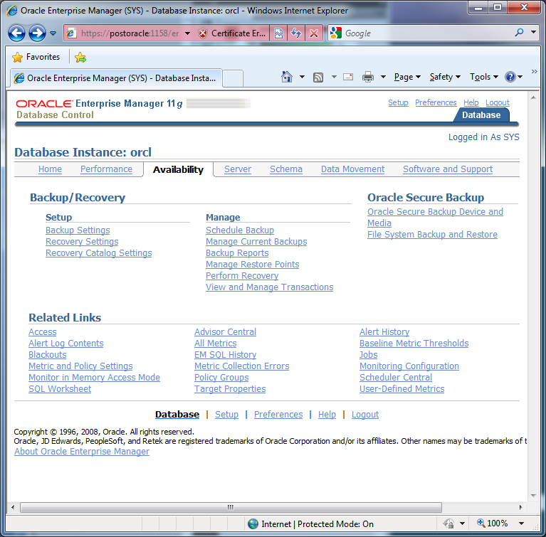
Backup and Recovery: EM

Slide 18
Backup and Recovery
You could shut down the database and copy the data files and the control file
Make sure the Oracle Management Server is installed and running.
You might have to install it from the main install wizard
Make sure the Oracle ManagementServer service is running (it is set to Manual start)
Use the Enterprise Manager Console to log in.
You need Archive Log mode set to handle a running backup
Select the database/Instance/Configuration in the tree view
Under the Recovery tab, check the Archive Log mode
This option will generate lots of data files since all changes to the database will be saved in these archive files
Run or schedule the backup
Tools/Database Tools/Backup Management/Backup

Slide 19
Action
Action
Start the Enterprise Manager as SYSDBA and switch to the Availability tab.
Click the Recovery Settings option to check the NoArchiveLog status.
Return to Availability and check the Backup Settings link.
If you have permission, and if you have drive or tape facilities you can try to create a backup.

Slide 20
User-Level Security
Database Administrator
Database Application
Assign permissions
credentials
Form1
Form 2
Form 3
Form 4
login
Workgroup database
Usernames and passwords
User 1
User 2

Slide 21
Action
Action
Identify the SalesClerk and SalesManagers roles and determine what permissions are needed on the basic Sale, SaleItem, Customer, and Inventory tables.
Create three new users and assign them simple passwords.

Slide 22
User Groups
 | Sales table | Customer table | Item table
Sales clerks | S,U,I | S,U,I | S
Sales Managers | S,U,I,D | S,U,I | S
Rental Managers |  | S,U,I | S
Sales Managers
Sales clerks
Assign permissions to groups or roles based on tasks, and assign users to groups. Permissions only have to be set once. Employee changes are handled by moving individuals into or out of groups.
Individual users

Slide 23
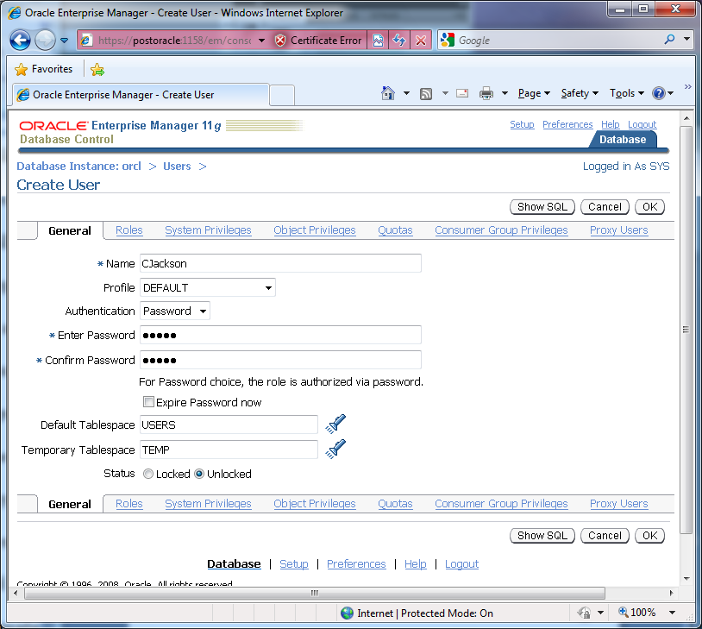
Create New Users
Internal or external authentication
Need to assign quota later
For many accounts at once, use SQL

Slide 24
Action
Action
Create the SalesClerk and SalesManager roles.
Assign appropriate table permissions to the new roles.
Assign one of the roles to each of the new users.
Use the Sales form to test the accounts and roles.

Slide 25
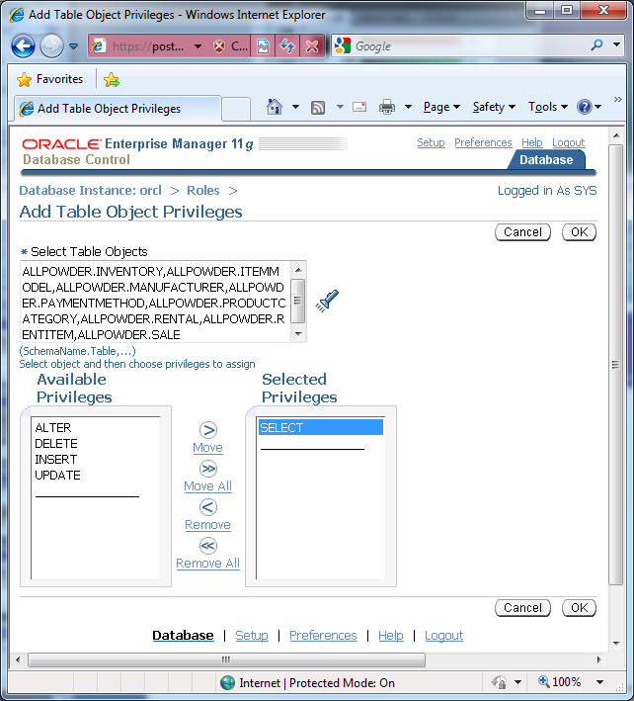
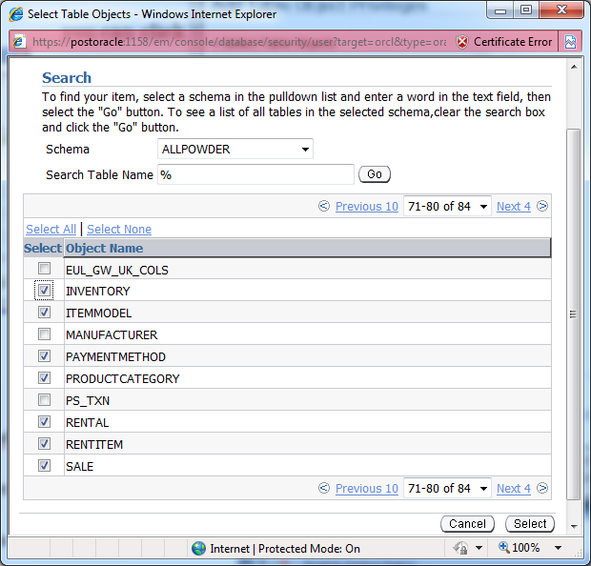
Grant Permissions to Role
Select table object
Grant permissions

Slide 26
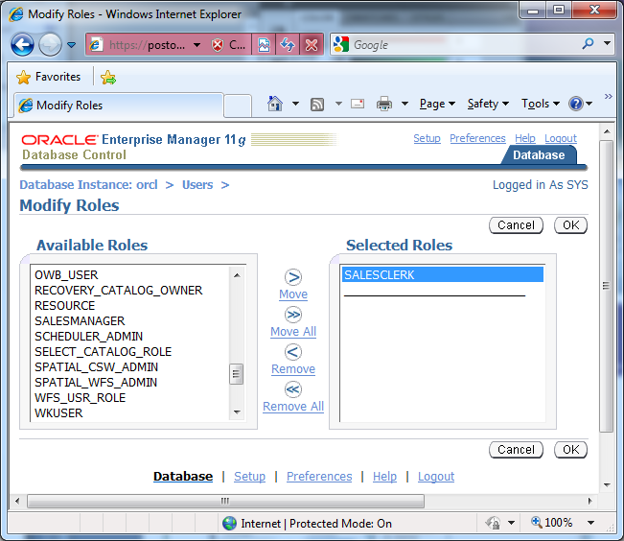
Assign Roles to Users

