Slide 1
All Powder Board and Ski
Oracle 11g Workbook
Chapter 11: Distributed Databases
Jerry Post
Copyright © 2010

Slide 2


All Powder LAN
Server
Network Switch
Offices/Managers
Checkout
Rental Desk

Slide 3
Action
Action
If necessary, create a second database, preferably on a different machine.
Create a small Customer table and load it with four or five rows of data.
Return to your main database and create a database link to the target.
Run an SQL statement that retrieves data across the link.

Slide 4
Create Target Database and Table
Create a new database if necessary:
Start/All Programs/Oracle…/Configuration and Migration Tools/ Database Configuration Assistant
Creates a new management link. Use it to define a new user.
Log in and create a new user/schema or use the system schema
Create a small table
CREATE TABLE Customer
( CustomerID INTEGER,
LastName VARCHAR2(15),
FirstName VARCHAR2(15),
Constraint pk_Customer Primary Key (CustomerID)
);
INSERT INTO Customer (CustomerID, LastName, FirstName) Values (1,'Smith', 'Adam');
INSERT INTO Customer (CustomerID, LastName, FirstName) Values (2,'Keynes', 'John');
INSERT INTO Customer (CustomerID, LastName, FirstName) Values (3,'Samuelson', 'Paul');
INSERT INTO Customer (CustomerID, LastName, FirstName) Values (4,'Robinson', 'Joan');
Commit;

Slide 5
Link to Target Database
Create a descriptive name for the link
CREATE DATABASE LINK NewYork
CONNECT TO RemoteUser IDENTIFIED BY “password”
USING ‘SID’;
SELECT * FROM Customer@NewYork;
User account and password on the target database
Can include hostname:port:SID
Table name@link name

Slide 6
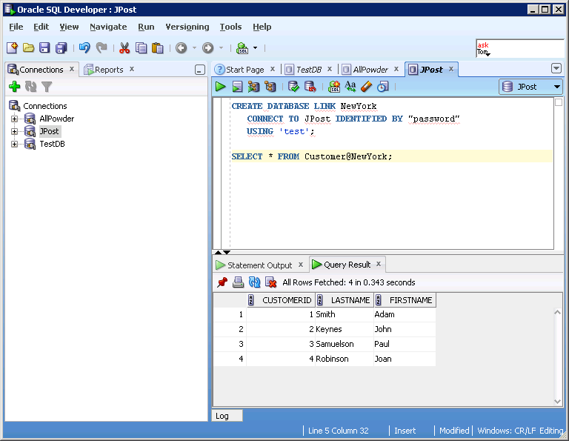
SQL Developer Connections

Slide 7
Database Replicas
Master Site
Deployment Template
Replication Group
Link Schedule
Synchronize
Materialized View (Replica)
Materialized View (Replica)
Materialized View (Replica)

Slide 8
Action
Action
In the Enterprise Manager select the Schema tab.
Click the Materialized Views link.
Click the Create button.
Create the EmployeeMV.

Slide 9
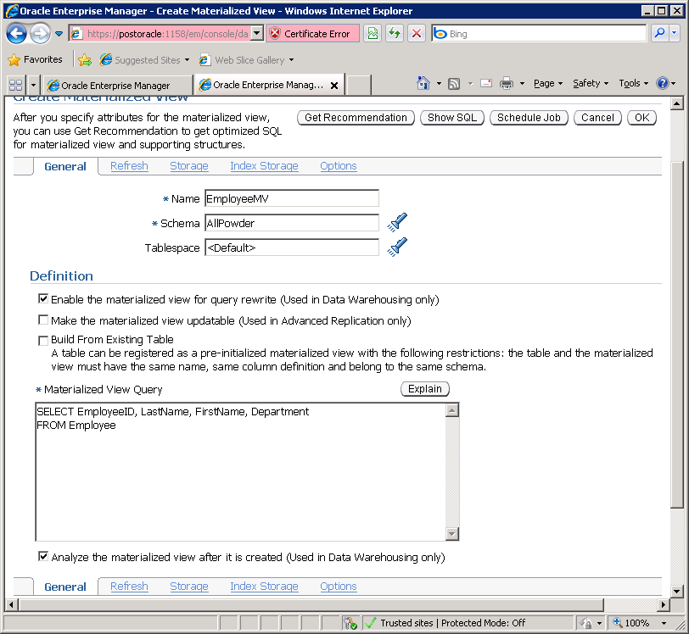
Create Materialized View
Specify refresh interval
Enter SELECT query to retrieve data

Slide 10
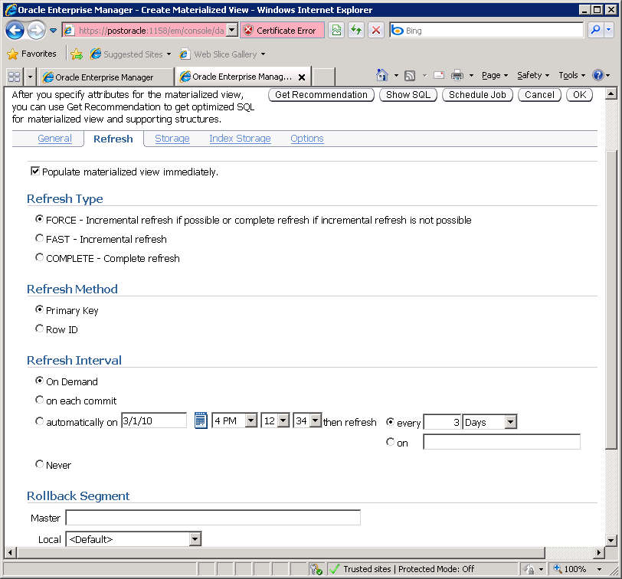
Refresh Schedule

Slide 11
Create Materialized View
CREATE MATERIALIZED VIEW Powder.Customer FOR UPDATE AS
SELECT * FROM Powder.Customer@host_database_link;

Slide 12
Transfer Data with XML
spool C:\Database\EmployeeList.xml
SELECT DBMS_xmlgen.getXml(
'SELECT EmployeeID "EID",
LastName "LastName",
FirstName "FirstName",
Department "Department"
FROM Employee'
,0 ) from dual;
spool off

Slide 13
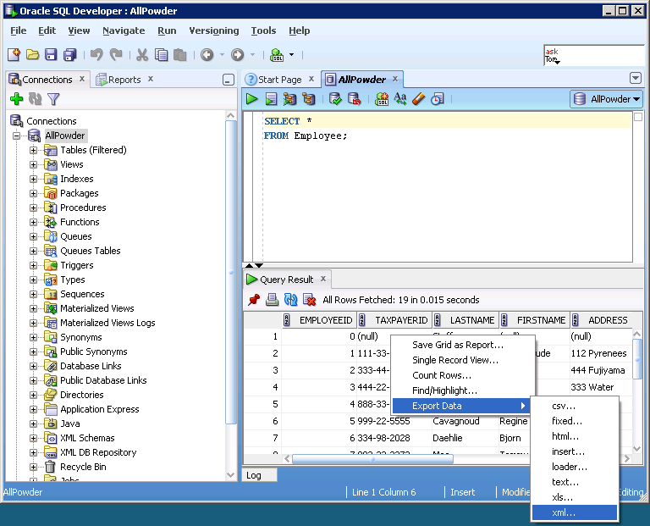
SQL Developer Export

Slide 14
Action
Action
Run the DBMS_xmlgen command to export some employee data.
Edit the file to remove the header.
Verify that it works using the browser.
Write an SQL query in SQL Developer and right-click the results to Export the data to an XML file.

Slide 15
XML File
<?xml version="1.0"?>
<ROWSET>
<ROW>
<EID>0</EID>
<LastName>Staff</LastName>
</ROW>
<ROW>
<EID>1</EID>
<LastName>Killy</LastName>
<FirstName>Jean-Claude</FirstName>
<Department>Ski-Alpine</Department>
</ROW>
<ROW>
<EID>2</EID>
<LastName>Miyahira</LastName>
<FirstName>Hideharu</FirstName>
<Department>Ski-Alpine</Department>
</ROW>
…
</ROWSET>

Slide 16
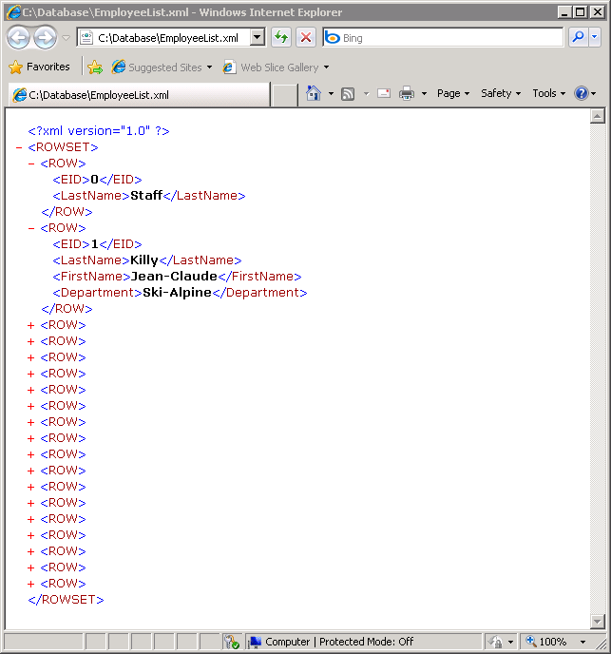
XML in Explorer

