Slide 1
Data Mining: Setup

Slide 2
Tools
Microsoft SQL Server 2008
Developer Edition or Enterprise Edition
Standard Edition, some limits in Analysis Services
Cannot use Express—it does not have Analysis Services
Obtain from MSDN-Academic Alliance http://www.msdnaa.net
Or download trial version for 180 days
Open Source
Weka: http://www.cs.waikato.ac.nz/ml/weka/.
gretl: http://gretl.soruceforge.net
R (powerful but not used in this book)
http://www.r-project.org
http://rattle.togaware.com (rattle, graphical interface)

Slide 3
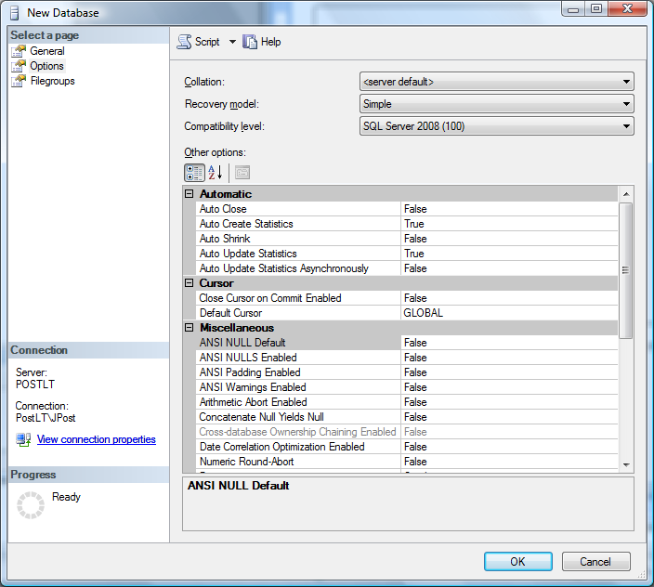
Database Installation
Download ZIP files from book site.
Extract into separate folders
Start Microsoft SQL Server Management Studio as DBA
Create a new database
Name: (RT, Bakery, etc.)
Possibly change file locations (optional)
Select Options page
Change Recovery mode to Simple instead of Full to avoid creating huge log files.

Slide 4
Database Script
Create a new query.
Right-click the database name and choose New Query.
Load the SQL script for the database into the window.
Windows Explorer, navigate to the downloaded files and drag the SQL file into the query window.
Change the <DB> entry in the script to the name you created.
Ctrl-H, replace <DB> with RT (or whatever name you created).
Replace all.
Change the <PATH> to the location folder of the CSV files.
Ctrl-H, replace <PATH> with C:\Downloads\RTData\
Replace all
Note that you must include the brackets in both cases: <DB>, <PATH>
Note that you must include the ending backslash in the path (\)
Execute the script.
You should see a list of the tables and a count of the number of rows.
If you get errors, reload the script and do the replacements more carefully.

