Slide 1
1: Introduction
Data Mining Applications
Jerry Post
Copyright © 2013

Slide 2
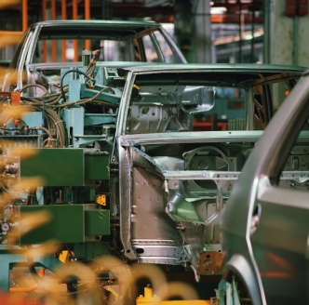


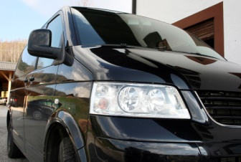



General Motors
Focus Groups and Surveys
What features do people want?
What will they want in three years?
Can the vehicle be produced efficiently?
What are competitors doing?
Customers
New Cars
Data
Sales and Dealers
Engineers
Management

Slide 3
GM Questions
Why was GM unable to identify trends and build vehicles that people wanted?
See Barraba and Zaltman (1991) Hearing the Voice of the Market.
Analyze the data and overcome personal biases. Believe in the forecasts.
Do not focus on a single product. When you have multiple subdivisions, create different products for different customers.

Slide 4



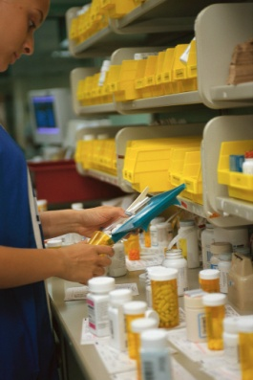


Pfizer
Business aspects are increasingly important. Can a new product be produced efficiently and will customers and physicians prefer it over existing treatments?
Drug trials
Safety
Effectiveness
Usability
Production and Quality Control
Sales and Pricing

Slide 5

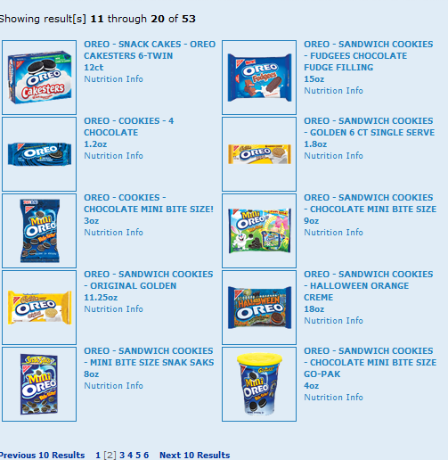
Retail Stores: Shelf Space
Do stores really need to carry 53 varieties of Oreos?
How can a retailer decide which items to stock?
How can vendors convince retailers to carry new products?
Nabisco Web site 2009-08 link

Slide 6
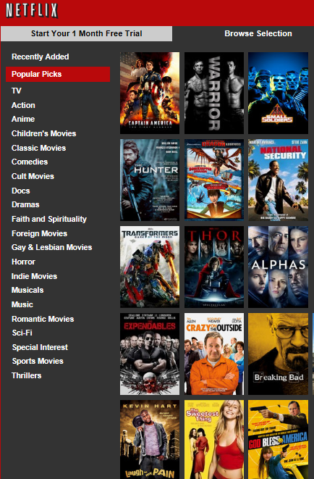
NetFlix
Data
Customer rentals.
Customer ratings.
Movie ratings/sales.
Goal
Recommend movies that customers will enjoy.
Convince customers to rent older movies.

Slide 7

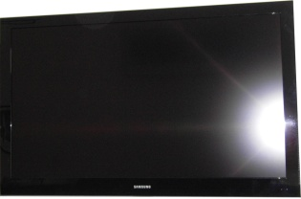

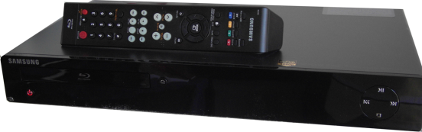


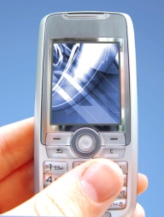
Zoran
Zoran: Designs video and audio chips
Retail stores
Components
Chip manufacturers: Largely in Taiwan and China, create chips.
Products
Demand and sales of Zoran’s products depends on several levels of the supply chain—ultimately driven by retail stores. But production lags require accurate forecasts at every step.

Slide 8


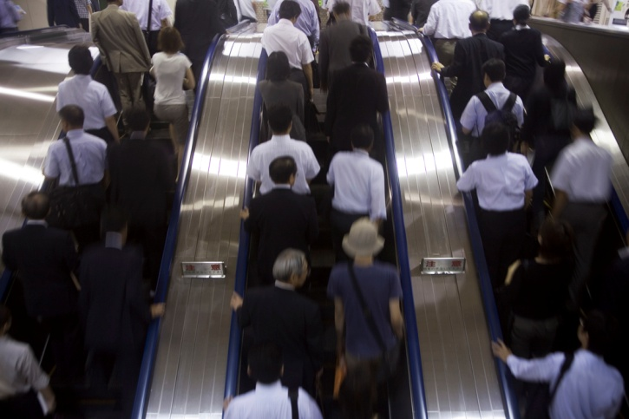




Google
Startup:
Hire the best and brightest.
Fast growth and new projects.
Stock options.
Growth:
20,000 employees is a crowd.
Harder for individuals to contribute and be heard.
Underutilized employees leave for new startups and challenges.
Data mining: Monitor evaluations and pay. Find employees who might be planning to leave.

Slide 9




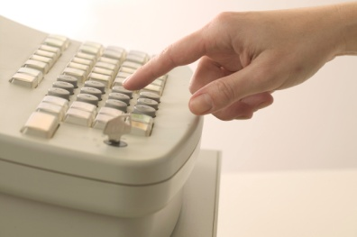
AnnTaylor Stores Corp.
Schedule and Tracking
Time | Mary | Jane | Zhu
14:00 | $154 |  | $79
15:00 | $75 | $235 | $93
16:00 | $129 | $54 | $101
17:00 | $182 | $82 | $137
18:00 | $67
19:00 |  |  | $67
When are the busiest times?
How many salespeople are needed?
Who are the best salespeople?

Slide 10
Perspectives
Machine Learning
Probability and Statistics
Applications
Algorithms for Large Data Sets

Slide 11
Online Transaction Processing (OLTP)
SaleID | SaleDate | CustomerID | EmployeeID
1001 | 9/12/…. | 15 | 7
1002 | 9/12/…. | 61 | 3
1003 | 9/13/…. | 83 | 7
1004 | 9/13/…. | 15 | 2
Tables optimized for recording new data quickly and safely.
Retrieving data requires linking the tables.
SaleID | ItemID | Quantity | SalePrice
1001 | 9301 | 2 | 5.95
1001 | 2932 | 4 | 12.39
1002 | 9301 | 6 | 5.75
1002 | 3351 | 1 | 12.15
1002 | 8371 | 2 | 16.39

Slide 12
ETL: Extraction, Transformation, Loading
ID | LastName | FirstName | Phone
32 | Jones | Martha | 111-3333
35 | Brown | Jack | 222-3555
36 | Smith | Jonathon | 777-0222
39 | Masters | Penny | 333-4444
ID | LastName | FirstName | Email
1009 | Smith | Jon | J_Smith@gmail.com
1010 | Sanchez | Emir | E_San332@gmail.com
1011 | James | Jeff | Jeff_J009@live.com
1013 | Monday | Mary | MandM19@gmail.com
1014 | Stiles | Donna | Dstiles@live.com
NewID | LastName | FirstName | Phone | Email
1 | Jones | Martha | 111-3333
2 | Brown | Jack | 222-3555
3 | Smith | Jonathon | 777-0222 | J_Smith@gmail.com
4 | Masters | Penny | 333-4444
5 | Sanchez | Emir |  | E_San332@gmail.com
6 | James | Jeff |  | Jeff_J009@live.com
7 | Monday | Mary |  | MandM19@gmail.com
8 | Stiles | Donna |  | Dstiles@live.com
Match the data where possible.
Convert numbers if necessary.
Create a new ID value.
Store the new ID value in each of the source data sets (if possible).
Use the new ID as a link for future updates.

Slide 13
SQL Server Analysis Services
.
Database Server (warehouse)
Analysis Server
(includes SQL Server instance)
data
data and results
data
projects
Client Access
Excel
SQL Reporting Server (Web)
ProClarity
Developer Tools (Visual Studio BI)

Slide 14
Other Tools
Tool | Purpose | Web
Weka | Data mining, general purpose | http://www.cs.waikato.ac.nz/ml/weka/
gretl | Econometrics, Regression, Time Series | http://gretl.sourceforge.net/
R | R statistical programming | http://www.r-project.org/
Data mining with R | Reference links | http://www.the-data-mine.com/Software/Rhttp://www.togaware.com/datamining/
Rattle | Gnome graphical interface for R | http://rattle.togaware.com/

Slide 15
Potential Dangers
Human Errors
Mistakes—Create and follow a process
Biases
Insufficient Data
Bad Data
Over fitting
Random Chance
Estimation Instability
Model Instability

Slide 16
Basic Errors
Record data incorrectly
Convert numbers with wrong values
Record results incorrectly
Typographical errors
Interpreting results incorrectly
Choosing the wrong tool
Extending results to data that does not match assumption

Slide 17
Human Biases
Acquisition/Input
  Data availability
  Selective perception
  Frequency
  Concrete information
  Illusory correlation
Processing
  Inconsistency
  Conservatism
  Non-linear extrapolation
  Heuristics: Rules of thumb
  Anchoring and adjustment
  Representativeness
  Sample size
  Justifiability
  Regression bias
  Best guess strategies
  Complexity
  Emotional stress
  Social pressure
  Redundancy
Output
  Question format
  Scale effects
  Wishful thinking
  Illusion of control
Feedback
  Learning on irrelevancies
  Misperception of chance
  Success/failure attribution
  Logical fallacies in recall
  Hindsight bias
Barabba, Vincent and Gerald Zaltman, Hearing the Voice of the Market, Harvard Business Press: Cambridge, MA, 1991
(Lists over 100)

Slide 18
Insufficient Data
Bigger problem with research statistics
Data mining often has plenty of data, but watch for small sets with annual data or a small set of employees or customers or with too many attributes
Bootstrapping: Building new datasets by random sampling of the original data.
  Models still apply only to the underlying data quirks.
  With small datasets, not reliable. See Isaksson 2008.

Slide 19
Bad Data
Financial data is usually audited and verified (but not always)
Survey data depends on how questions are framed and whether respondents are interested in telling the truth.
Online Web questions by companies often collect bad data. People do not want to answer and will randomly select values if forced to fill out a survey.

Slide 20
Over Fitting
Y
Model over fit to data (zigzag prediction)
More general, simpler prediction applies to other data (straight line)
X

Slide 21
Random Chance
Even low-probability events happen—it does not mean a rule or process or cause exists.
Lottery
  Odds of an individual winning might be 1/170,000,000 or lower.
  But someone eventually wins. That person receives publicity. Should we believe there is a reason or that the win represents a pattern?
Investments
  Some individual (or data mining method) succeeds for several years/quarters/months in a row. The press, and rankings, report the “winning method.” Is it really a pattern and method or random chance?
  See David Leinweber: Nerds on Wall Street.

Slide 22
Estimation Instability
y= b₀ + b₁ x + b₂ x² + b₃ x³ + b₄ x⁴
1 10 -5 -0.1 0.05
1 10 -5 -0.1 0.03
Nonlinear equations are highly sensitive to small coefficient changes.
Nonlinear forecasts are highly risky—particularly exponential forecasts.

Slide 23
Model Instability
Coefficient estimates are stable
Model itself leads to rapidly expanding (or contracting) forecasts
Common in time series data: Yt = aYt-1 + bX
  Unstable difference equation
  Depends on coefficient values
Test all models over wide ranges of input values and forecasts. Find the ranges that are stable and unstable. Avoid using the model in unstable regions.

Slide 24



Cases
 | Company | ZIP size (MB) | DB size (MB)
 | Rolling Thunder Bicycle Company | 11 | 78.8
 | Diner | 0.6 | 11.2
 | Corner Med | 1.5 | 55.3
 | Basketball | 1.3 | 29.7
 | Bakery | 47 | 349
 | Cars | 0 | 3
Warning: Log files are much larger than the database files (2-7 GB for Bakery).
Most data warehouses: Configure database without transaction logging!
Option/Recovery Mode = Simple

Slide 25
Rolling Thunder Bicycles
Customer
Bicycle
BicycleTube
Groupo
BikeTubes
CompGroup
GroupName
BikeType
Year
EndYear
Weight
TubeMaterial
CustomerID
Phone
FirstName
LastName
Address
ZipCode
CityID
BalanceDue
SerialNumber
CustomerID
ModelType
PaintID
FrameSize
OrderDate
StartDate
ShipDate
ShipEmployee
FrameAssembler
Painter
Construction
WaterBottle
CustomName
LetterStyleID
StoreID
EmployeeID
TopTube
ChainStay
HeadTubeAngle
SeatTueAngle
ListPrice
SalePrice
SalesTax
SaleState
ShipPrice
FramePrice
ComponentList
ModelType
SerialNumber
TubeID
Quantity
SerialNumber
TubeName
TubeID
Length
TubeID
Material
Description
Diameter
Thickness
Roundness
Weight
Stiffness
ListPrice
Construction
ModelType
Description
ComponentID
ModelSize
Paint
ModelType
MSize
TopTube
ChainStay
TotalLength
GroundClearance
HeadTubeAngle
SeatTubeAngle
BikeParts
Component
PaintID
ColorName
ColorStyle
ColorList
DateIntroduced
DateDiscontinued
SerialNumber
ComponentID
SubstituteID
Location
Quantity
DateInstalled
EmployeeID
ComponentID
ManufacturerID
ProductNumber
Road
Category
Length
Height
Width
Weight
Year
EndYear
Description
ListPrice
EstimatedCost
QuantityOnHand
CustomerTrans
GroupCompon
CustomerID
TransDate
EmployeeID
Amount
Description
Reference
GroupID
ComponentID
LetterStyle
Employee
LetterStyle
Description
PurchaseItem
ComponentName
EmployeeID
TaxpayerID
LastName
FirstName
HomePhone
Address
ZipCode
CityID
DateHired
DateReleased
CurrentManager
SalaryGrade
Salary
Title
WorkArea
PurchaseID
ComponentID
PricePaid
Quantity
QuantityReceived
ComponentName
AssemblyOrder
Description
PurchaseOrder
RetailStore
PurchaseID
EmployeeID
ManufacturerID
TotalList
ShippingCost
Discount
OrderDate
ReceiveDate
AmountDue
StoreID
StoreName
Phone
ContacFirstName
ContactLastName
Address
Zipcode
CityID
Manufacturer
ManufacturerTrans
City
ManufacturerID
ManufacturerName
ContactName
Phone
Address
ZipCode
CityID
BalanceDue
ManufacturerID
TransactionDate
EmployeeID
Amount
Description
Reference
CityID
ZipCode
City
State
AreaCode
Population1990
Population1980
Country
Latitude
Longitude
StateTaxRate
State
TaxRate

Slide 26
Diner
DinerID
DineDate
DOW
MealTime
Gender
Number
BillTotal
Dessert
Data for 2009.
DOW: Day of Week (Sun, Mon, …)
MealTime: Lunch, Dinner, Evening (late)
Number: Number of people at the table
Dessert: Yes/No ordered dessert

Slide 27
Corner Med
Patient
ICD9DiagnosisCodes
PatientID
LastName
FirstName
DateOfBirth
Gender
Telephone
Address
City
State
ZIPCode
Race
TobaccoUse
Visit
ICD9Diagnosis
ShortDescription
VisitID
PatientID
VisitDate
Ins.Company
Ins.GroupCode
Ins.MemberCode
PatientAmountPaid
DateBillSubmitted
DateIns.Paid
AmountIns.Paid
Diastolic
Systolic
VisitDiagnoses
VisitID
ICD9Diagnosis
Comments
ICD9ProcedureCodes
ICD9Procedure
ShortDescription
SetDAte
BaseCost
PhysicianRole
TechnicianRole
PhysicianAssistant
VisitProcedures
VisitID
ICD9Procedure
EmployeeID
AmountCharged
DrugCodes
Employee
EmployeeVacation
DrugCode
DrugName
DrugDescription
VisitMedications
EmployeeID
LastName
FirstName
EmployeeCategory
DateHired
DateLeft
EmergencyPhone
EmployeeID
VactationStart
VacationEnd
VisitID
DrugCode
Comments
EmployeeCategory
EmployeeCategory

Slide 28
Basketball: NBA 2008-2011
GameResults
Games
GameID
TeamID
Points
Won_Loss
GameDate
OpponentID
OpponentPoints
IsHomeTeam
IsPlayoff
Comments
GameID
GameNumber
GameDate
HomeTeam
Playoff
BaseTeam
Comments
PlayerGameStats
Players
GameID
PlayerID
TeamID
MintesPlayed
FG
FGA
TP
TPA
FT
FTA
ORB
DRB
TRB
AST
STL
BLK
TOV
PF
PTS
PlayerID
FirstName
MiddleName
LastName
Suffix
NickName
DateOFBirth
BirthCity
BirthCountry
Height_Feet
Height_Inches
Weight
Position
College
CollegeState
HighSchool
HighSchoolCity
HighSchoolState
DraftYear
DraftPosition
DraftTeamCode
Teams
TeamID
TeamName
City
Abreviation
Conference
Division

Slide 29
Basketball Abbreviations
Code | Name
FG FGA TP TPA FT FTA ORB DRB TRB AST STL BLK TOV PF PTS | Field goals made Field goals attempted Three pointers made Three pointers attempted Free throws made Free throws attempted Offensive rebounds Defensive rebounds Total rebounds Assists Steals Blocked shots Turnovers Personal fouls Points (total)

Slide 30
Bakery
Sale
SaleItem
Product
ProductCategory
SaleID
SaleDate
SaleID
ProductID
Quantity
SalePrice
Seq
ProductID
CategoryID
ProductName
Size
Description
ListPrice
CategoryID
Category

Slide 31
Cars
CarID
Year
Make
Model
SecTo60
Category
CityMPG
Price
Weight
Cylinders
HP
Seats
YearMonth
TotalSales
Domestic
Foreign
U.S. data on monthly sales counts of vehicles (thousands) from 1967-01 through 2012-01
Over 300 vehicles for the 2012 model year with real data.

