Slide 1
2: Database Management Systems
Data Mining Applications
Jerry Post
Copyright © 2013

Slide 2
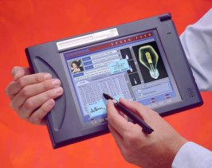
Database Management System
Reports and
ad hoc queries
Database
DBMS
Programs
Sales and transaction data

Slide 3
Tables
Primary key: Identify a row
Columns: Properties
Customers
CID | LastName | FirstName | Phone | Address | City | State | ZIP
101 | Jones | Jack | 222-3333 | 123 Elm | Boise | ID | 83701
102 | Smith | Susan | 333-4444 | 456 Oak | Hartford | CT | 06101
103 | Mendes | Maria | 555-6666 | 789 Pine | Phoenix | AZ | 85041
104 | Brown | Bob | 747-3733 | 910 Pear | Sacramento | CA | 94201
Rows: Data - instance

Slide 4
Tables Linked by Data
Sales
SaleID | SaleDate | CID
1001 | 7/13/…. | 102
1002 | 7/14/…. | 291
1003 | 7/14/…. | 103
1004 | 7/15/…. | 102
Customers
CID | LastName | FirstName | Phone | Address | City | State | ZIP
101 | Jones | Jack | 222-3333 | 123 Elm | Boise | ID | 83701
102 | Smith | Susan | 333-4444 | 456 Oak | Hartford | CT | 06101
103 | Mendes | Maria | 555-6666 | 789 Pine | Phoenix | AZ | 85041
104 | Brown | Bob | 747-3733 | 910 Pear | Sacramento | CA | 94201

Slide 5
Rolling Thunder Bicycles: Relationship Diagram
Customer
Bicycle
BicycleTube
Groupo
BikeTubes
CompGroup
GroupName
BikeType
Year
EndYear
Weight
TubeMaterial
CustomerID
Phone
FirstName
LastName
Address
ZipCode
CityID
BalanceDue
SerialNumber
CustomerID
ModelType
PaintID
FrameSize
OrderDate
StartDate
ShipDate
ShipEmployee
FrameAssembler
Painter
Construction
WaterBottle
CustomName
LetterStyleID
StoreID
EmployeeID
TopTube
ChainStay
HeadTubeAngle
SeatTueAngle
ListPrice
SalePrice
SalesTax
SaleState
ShipPrice
FramePrice
ComponentList
ModelType
SerialNumber
TubeID
Quantity
SerialNumber
TubeName
TubeID
Length
TubeID
Material
Description
Diameter
Thickness
Roundness
Weight
Stiffness
ListPrice
Construction
ModelType
Description
ComponentID
ModelSize
Paint
ModelType
MSize
TopTube
ChainStay
TotalLength
GroundClearance
HeadTubeAngle
SeatTubeAngle
BikeParts
Component
PaintID
ColorName
ColorStyle
ColorList
DateIntroduced
DateDiscontinued
SerialNumber
ComponentID
SubstituteID
Location
Quantity
DateInstalled
EmployeeID
ComponentID
ManufacturerID
ProductNumber
Road
Category
Length
Height
Width
Weight
Year
EndYear
Description
ListPrice
EstimatedCost
QuantityOnHand
CustomerTrans
GroupCompon
CustomerID
TransDate
EmployeeID
Amount
Description
Reference
GroupID
ComponentID
LetterStyle
Employee
LetterStyle
Description
PurchaseItem
ComponentName
EmployeeID
TaxpayerID
LastName
FirstName
HomePhone
Address
ZipCode
CityID
DateHired
DateReleased
CurrentManager
SalaryGrade
Salary
Title
WorkArea
PurchaseID
ComponentID
PricePaid
Quantity
QuantityReceived
ComponentName
AssemblyOrder
Description
PurchaseOrder
RetailStore
PurchaseID
EmployeeID
ManufacturerID
TotalList
ShippingCost
Discount
OrderDate
ReceiveDate
AmountDue
StoreID
StoreName
Phone
ContacFirstName
ContactLastName
Address
Zipcode
CityID
Manufacturer
ManufacturerTrans
City
ManufacturerID
ManufacturerName
ContactName
Phone
Address
ZipCode
CityID
BalanceDue
ManufacturerID
TransactionDate
EmployeeID
Amount
Description
Reference
CityID
ZipCode
City
State
AreaCode
Population1990
Population1980
Country
Latitude
Longitude
StateTaxRate
State
TaxRate

Slide 6
Data Types
Data Type | SQL Server | Size
Text Fixed Variable Unicode Memo XML | char varchar nchar, nvarchar text xml | 8K 8K 4K 2G, 1G 2G
Number Byte Integer Long 64-bits Fixed precision Float Double Currency Yes/No | tinyint smallint int bigint decimal(p,s) real float money bit | 255 +/- 32767 +/-2B 18 digits p: 1 to 38 +/- 1E 38 +/- 1E 308 +/- 900.0000 trillion (8 bytes) 0/1
Date/Time Interval | datetime smalldatetime interval year, … | 1/1/1753 – 12/31/9999 (3 ms) 1/1/1900 – 6/6/2079 (1 min)
Image | image | 2GB

Slide 7
XML
<order>
<orderID>111</orderID>
<customer>
<cID>99</cID>
<lastName>Smith</lastName><firstName>Mary</firstName>
</customer>
<itemList>
<item>
<itemid>290</itemid><description>red dress</description>
<salePrice>132.99</salePrice><quantity>1</quantity>
</item>
<itemid>171</itemid><description>shoes</description>
<salePrice>79.89</salePrice><quantity>1</quantity>
<item>
</item>
</itemList>
</order>
To analyze this data it needs to be extracted and stored as individual elements.

Slide 8
Four Questions to Retrieve Data
What output do you want to see?
What do you already know (or what constraints are given)?
What tables are involved?
How are the tables joined?

Slide 9
Join Problem: Cross-Join
Customer
Bicycle
CustomerID
LastName
FirstName
Phone
Address
SerialNumber
ModelType
OrderDate
FrameSize
EmployeeID
No join!
Cross join: Match every row in Customer to every row in Bicycle.
It does not make any logical sense.
Size! 26190 x 31823 = 833,444,370 rows of output!

Slide 10
Join Problem: Loops
Customer
Bicycle
CustomerID
LastName
FirstName
Phone
Address
CityID
SerialNumber
ModelType
OrderDate
CustomerID
EmployeeID
Employee
EmployeeID
LastName
FirstName
Phone
Address
CityID
City
CityID
Name
State
ZIPCode
Population
Customer – City
Employee – City
Returns match ONLY if Customer lives in the same city as the Employee!

Slide 11
Basic Queries
Which bicycles were ordered between 12/1/2008 and 12/15/2008?
Which race bicycles in 2008 were larger than 61 cm?
Which race bicycles in 2007 had a list price over 7000?
In December 2008, which mountain or mountain full suspension bicycles sold for more than 5500?
What is the total value of all bikes sold in December 2008?
What it the total value of items on purchase order 101?
How many Race bikes were sold in November 2008?
What is the number of bicycles sold of each model type in November 2008?
Who is the best sales person?
List the CustomerID of everyone who bought a bicycle on December 1, 2008.
List Names and Phone numbers for everyone who purchased a bike on 01-DEC-2008.
List customers from Miami, FL who purchased bicycles in December 2008.
List customers from Miami, FL who purchased bicycles in December 2008.
Which model types were not sold in December 2008?

Slide 12
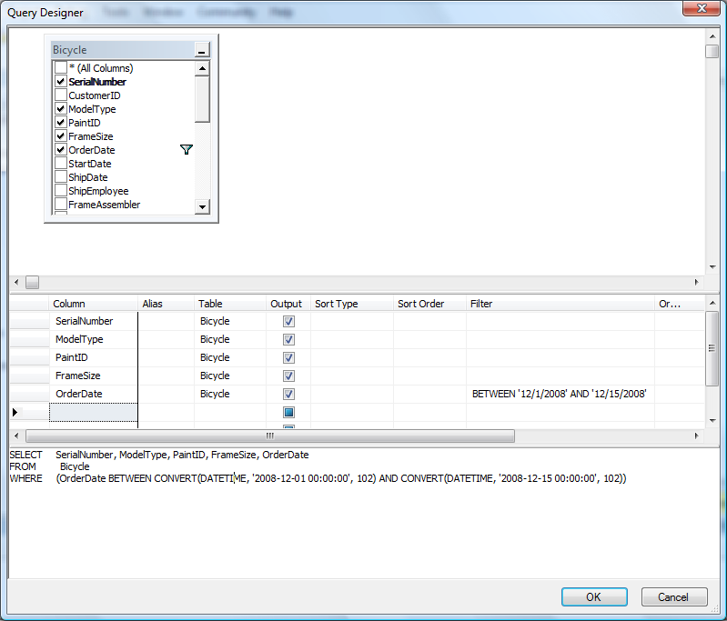
Sample Query
Getting Started:
SQL Server Management Studio
Expand Database list.
Right-click RT choose New Query
(otherwise need to type USE RT;)
Right-click query window and select Edit Query in Designer.
Choose the Bicycle table and close the table window.
Which bicycles were ordered between 12/1/2008 and 12/15/2008?

Slide 13
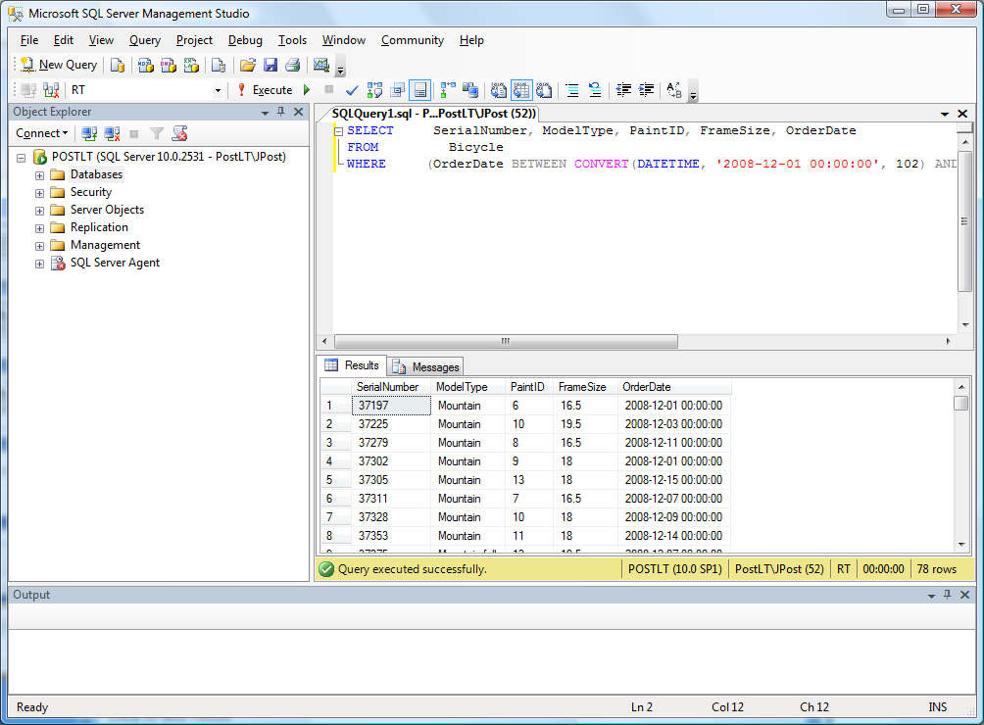
Results

Slide 14
SQL Introduction
SELECT columns What do you want to see?
FROM tables What tables are involved?
JOIN conditions How are the tables joined?
WHERE criteria What are the constraints?
SELECT SerialNumber, ModelType, PaintID, FrameSize, OrderDate
FROM Bicycle
WHERE (OrderDate BETWEEN
CONVERT(DATETIME, '2008-12-01 00:00:00', 102) AND CONVERT(DATETIME, '2008-12-15 00:00:00', 102))

Slide 15
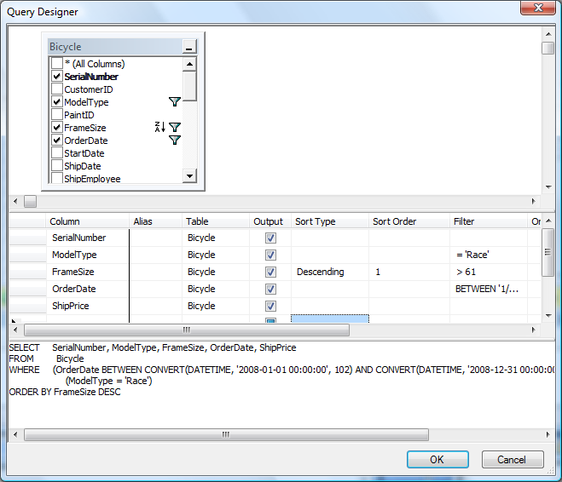
Sorting: ORDER BY
Which race bicycles in 2008 were larger than 61 cm?

Slide 16
SQL
SELECT SerialNumber, ModelType, FrameSize, OrderDate, ShipPrice
FROM Bicycle
WHERE (OrderDate BETWEEN
CONVERT(DATETIME, '2008-01-01 00:00:00', 102)
AND CONVERT(DATETIME, '2008-12-31 00:00:00', 102))
AND (FrameSize > 61)
AND (ModelType = 'Race')
ORDER BY FrameSize DESC
Which race bicycles in 2008 were larger than 61 cm?

Slide 17
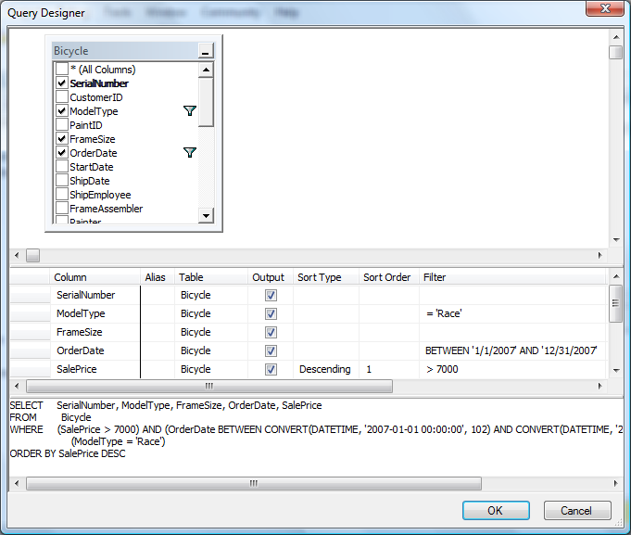
Criteria: AND, OR, NOT
Which race bicycles in 2007 had a list price over 7000?

Slide 18
Criteria: SQL
SELECT SerialNumber, ModelType, FrameSize, OrderDate, SalePrice
FROM Bicycle
WHERE (SalePrice > 7000)
AND (OrderDate
BETWEEN CONVERT(DATETIME, '2007-01-01 00:00:00', 102)
AND CONVERT(DATETIME, '2007-12-31 00:00:00', 102))
AND (ModelType = 'Race')
ORDER BY SalePrice DESC
Which race bicycles in 2007 had a list price over 7000?

Slide 19
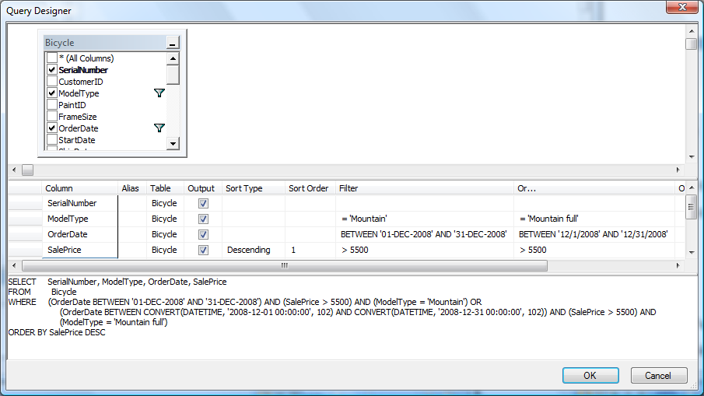
OR Connectors
In December 2008, which mountain or mountain full suspension bicycles sold for more than 5500?

Slide 20
SQL With OR
SELECT SerialNumber, ModelType, OrderDate, SalePrice
FROM Bicycle
WHERE (OrderDate BETWEEN '01-DEC-2008' AND '31-DEC-2008')
AND (SalePrice >5500)
AND (ModelType='Mountain' OR ModelType='Mountain full')
ORDER BY SalePrice DESC;
Parentheses make the OR condition easier to create and to read.
Display the query in the designer to see that all conditions are listed in a single filter column. The ModelType cell contains: ‘Mountain’ OR ‘Mountain full’
List bicycles sold in December 2008 that were Mountain or Mountain full (suspension) model types and cost more than 5500.

Slide 21
LIKE Comparison
ModelType LIKE ‘Mountain%’
AND …
% (percent) matches any characters
_ (underscore) matches exactly one character.
To find a single word within a string of text, such as “bicycle” in a sentence:
WHERE Comment LKE %bicycle%
The ModelType names Mountain and Mountain full were deliberately chosen to both start with the word “Mountain,” so that the LIKE command could be used to return both types without needing an OR condition.

Slide 22
Useful WHERE Conditions
Comparisons | Examples
Operators | <, =, >, <>, >=, BETWEEN, LIKE, IN
Numbers | SalePrice > 6000
Test Simple Match one character Match many | LastName > ‘Jones’ License LIKE ‘A_ _ 82_’ LastName LIKE ‘S%’
Dates | SaleDate BETWEEN ’01-DEC-2008’ AND ’15-DEC-2008’
Missing Data | LastName Is NULL
Negation | FirstName IS NOT NULL NOT (ModelType=’Race’)
Sets | ModelType IN (‘Race’, ‘Road’, ‘Tour’)
Be careful with Null (missing values).
City IS NULL Correct
City = NULL Wrong. Never returns any matches because Null is not a value.

Slide 23
SQL Computations
Data mining and other serious computations are handled in an external programming language.
SQL is used for row-by-row computations and functions.
SQL can be used for simple subtotals.

Slide 24
Row-by-Row Calculations
SaleItem(SaleID, ItemID, SalePrice, Quantity)
SELECT SaleID, ItemID, SalePrice, Quantity,
SalePrice*Quantity As Extended
FROM SaleItem;
SaleID | ItemID | Price | Quantity | Extended
24 | 25 | 2.70 | 3 | 8.10
24 | 26 | 5.40 | 2 | 10.80
24 | 27 | 31.50 | 1 | 31.50

Slide 25
Aggregation: SQL
SELECT SUM(SalePrice) As TotalSales
FROM Bicycle
WHERE OrderDate BETWEEN '01-DEC-2008' AND '31-DEC-2008';
Result: 814,250.00
What is the total value of all bikes sold in December 2008?

Slide 26
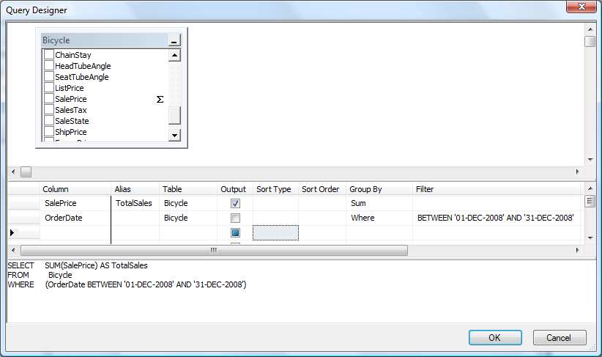
Aggregation: Designer
Right-click: Add GROUP BY
Set WHERE for Date conditions.
Leaving Dates as GROUP BY will compute totals FOR EACH day. Usually not what is needed.

Slide 27
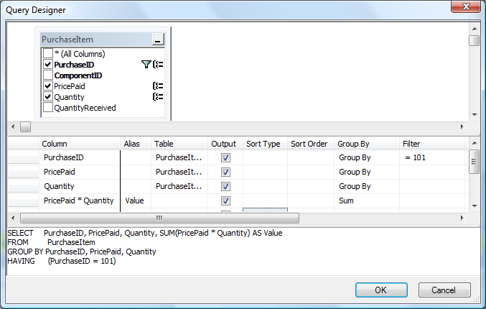
Calculation with Aggregation
SELECT PurchaseID, PricePaid, Quantity, SUM(PricePaid * Quantity) AS Value
FROM PurchaseItem
WHERE (PurchaseID = 101)
GROUP BY PurchaseID, PricePaid, Quantity

Slide 28
Functions (tiny list)
Task | SQL Server
Strings Concatenation Length Upper case Lower case Partial string | FName + ‘ ‘ + LName Length(LName) Upper(LName) Lower(LName) Substring(LName,2,3)
Dates Today Month Day Year Date arithmetic | GetDate() DateName(month, myDate), Month(myDate) DatePart(day, myDate) DatePart(year, myDate), Year(myDate) DateAdd DateDiff
Formatting | Str(item, length, decimal) Cast, Convert
Numbers Math functions Exponentiation Aggregation Statistics | Cos, Sin, Tan, Sqrt Power(2, 3) Min, Max, Sum, Count, Avg, StDev, Var, LinReqSlope, Correlation

Slide 29
Subtotal Introduction
SELECT Count(SerialNumber) As Nbikes
FROM Bicycle
WHERE ModelType=‘Race’
AND OrderDate BETWEEN ’01-NOV-2008’ AND ’30-NOV-2008’
How many Race bikes were sold in November 2008?

Slide 30
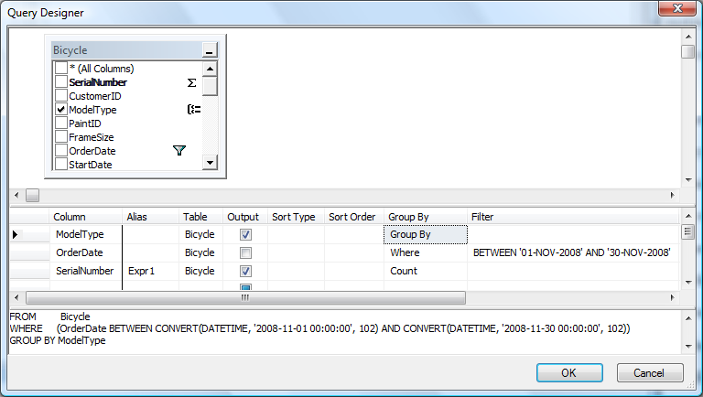
Subtotal: Sales by ModelType
What is the number of bicycles sold of each model type in November 2008?

Slide 31
Subtotal: SQL and Results
SELECT ModelType, COUNT(SerialNumber) AS NBikes
FROM Bicycle
WHERE (OrderDate
BETWEEN CONVERT(DATETIME, '2008-11-01 00:00:00', 102)
AND CONVERT(DATETIME, '2008-11-30 00:00:00', 102))
GROUP BY ModelType
Mountain 13
Mountain full 57
Race 52
Road 47
Tour 13

Slide 32
HAVING: Restrict Output
SELECT ModelType, COUNT(SerialNumber) AS NBikes
FROM Bicycle
WHERE (OrderDate
BETWEEN CONVERT(DATETIME, '2008-11-01 00:00:00', 102)
AND CONVERT(DATETIME, '2008-11-30 00:00:00', 102))
GROUP BY ModelType
HAVING Count(SerialNumber) > 15;

Slide 33
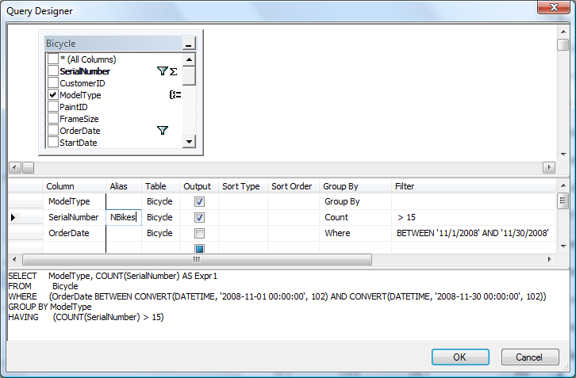
HAVING v. WHERE
WHERE filters individual rows.
HAVING filters the subtotal or output list.
But it is hard to see the difference in the designer.

Slide 34
Best Salesperson
Quantity or revenue? Use Revenue/SalePrice
Try:
SELECT EmployeeID, Max(SalePrice) FROM Bicycle GROUP BY EmployeeID;
Which returns a list of employees and the most expensive bicycle sold by each employee. It does not return the totals.
Try:
SELECT EmployeeID, Max(Sum(SalePrice)) FROM Bicycle GROUP BY EmployeeID;
Which does not even run.
Answer:
SELECT EmployeeID, Sum(SalePrice) AS Revenue
FROM Bicycle
GROUP BY EmployeeID
ORDER BY Sum(SalePrice) DESC

Slide 35
Joins: Introduction
19114
31202
31335
31651
32631
32687
SELECT CustomerID
FROM Bicycle
WHERE OrderDate = '01-DEC-2008';
List CustomerIDs for everyone who purchased a bike on 01-DEC-2008.

Slide 36
Joins: Bicycle + Customer
SELECT Bicycle.CustomerID, Customer.FirstName,
Customer.LastName, Customer.Phone
FROM Bicycle
INNER JOIN Customer
ON Bicycle.CustomerID = Customer.CustomerID
WHERE (Bicycle.OrderDate = '01-DEC-2008')
CID | FirstName | LastName | Phone
19114 | James | Dugan | (405) 015-0612
31202 | Michael | Macdonald | (803) 408-1618
31335 | Theresa | Raux | (540) 689-8730
31651 | Kwok | Lawrence | (850) 136-9460
32631 | Joseph | Despirito | (814) 732-0324
32687 | B | Wagman | (863) 989-8229
List Names and Phone numbers for everyone who purchased a bike on 01-DEC-2008.

Slide 37
Table.Column
ON Bicycle.CustomerID = Customer.CustomerID
Because the same column name is used in both tables, the table.column syntax is required to tell them apart.
This syntax can be used anywhere in the query.
SQL Server tables:
Database
Schema -- typically a role, often dbo (database owner)
Table
SELECT *
FROM RT.dbo.ModelType

Slide 38
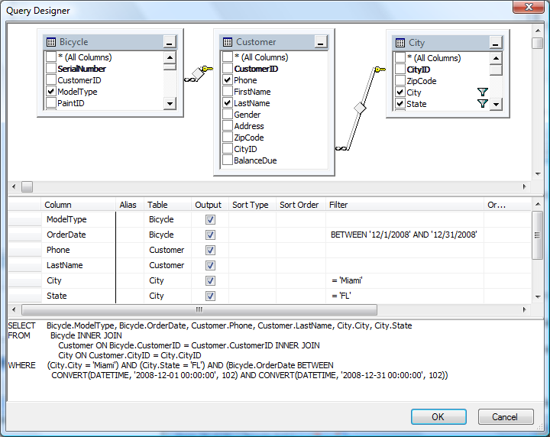
Joining Multiple Tables
List customers from Miami, FL who purchased bicycles in December 2008.

Slide 39
SQL Multiple Joins
SELECT Bicycle.ModelType, Bicycle.OrderDate, Customer.Phone,
Customer.LastName, City.City, City.State
FROM Bicycle
INNER JOIN Customer
ON Bicycle.CustomerID = Customer.CustomerID
INNER JOIN City
ON Customer.CityID = City.CityID
WHERE (City.City = 'Miami')
AND (City.State = 'FL')
AND (Bicycle.OrderDate BETWEEN
CONVERT(DATETIME, '2008-12-01 00:00:00', 102)
AND CONVERT(DATETIME, '2008-12-31 00:00:00', 102))

Slide 40
View: Saved Query
CREATE VIEW December2008Sales AS
SELECT SerialNumber, CustomerID, ModelType, PaintID, FrameSize,
OrderDate, StartDate, ShipDate, LetterStyleID, StoreID,
EmployeeID, SalePrice, ListPrice, SalesTax, SaleState, ShipPrice
FROM Bicycle
WHERE (OrderDate BETWEEN
CONVERT(DATETIME, '2008-12-01 00:00:00', 102)
AND CONVERT(DATETIME, '2008-12-31 00:00:00', 102))

Slide 41
Complex Questions
Which customers bought bicycles in 2007 and 2008?
Could try:
SELECT *
FROM Customer
INNER JOIN Bicycle
ON Customer.CustomerID=Bicycle.CustomerID
WHERE Year(OrderDate)=2007 AND Year(OrderDate)=2008;
It will run but will never return any matches. Why?
Build as two queries and save them: Customers2007, Customers2008
Using one year condition each. Then join them to handle the “AND” condition.
SELECT *
FROM Customers2007
INNER JOIN Customers2008
ON Customers2007.CustomerID=Customers2008.CustomerID

Slide 42
Left Join
SELECT ModelType.ModelType
FROM ModelType
LEFT JOIN December2008Sales
ON ModelType.ModelType=December2008Sales.ModelType
WHERE December2008Sales.SerialNumber Is Null
;
Using an INNER JOIN would match only the model types that do exist in the Sales.
A LEFT JOIN is needed to keep ALL rows from the ModelType table.
The Is Null test shows the model types that do not exist in the Sales table.
Hybrid
Track
Which model types were not sold in December 2008?

Slide 43
Left Join Data
ModelType | Serial | CID | ModelType
Mountain full | 37774 | 10433 | Mountain full
Mountain full | 37486 | 31386 | Mountain full
Mountain | 37232 | 31132 | Mountain
Race | 38080 | 31980 | Race
Race | 38123 | 32023 | Race
Road | 38359 | 32259 | Road
Hybrid | Null | Null | Null
Tour | 38787 | 32687 | Tour
Track | Null | Null | Null

Slide 44
UNION: Combine Rows
Example:
Company with two divisions: East and West
Keeps two separate employee tables: Employees East, EmployeesWest
SELECT EID, LastName, FirstName, Gender, Phone, ‘East’ As Division
FROM EmployeesEast
UNION
SELECT EID, LastName, FirstName, Gender, Phone, ‘West’ As Division
FROM EmployeesWest
EID | LastName | FirstName | Gender | Phone | Division
113 | Jones | Jack | Male | 2222 | East
114 | Smith | Sarah | Female | 4444 | East
225 | Hart | Hank | Male | 6624 | West
256 | Eccles | Ephraim | Male | 4432 | West

Slide 45
UPDATE
UPDATE Component
SET ListPrice = 1.10*ListPrice
WHERE Year>=2006
Multiple columns can be updated at a time.
SET col1=x, col2=y, col3=z
Use a SELECT statement to test the query first!
SELECT 1.10*ListPrice AS NewPrice
FROM Component
WHERE Year >= 2006
Increase the List Price of components that were introduced in 2006 or later.

Slide 46
INSERT: To Copy Data
INSERT INTO newTable (SerialNumber, CustomerID, OrderDate, ModelType)
SELECT SerialNumber, CustomerID, OrderDate, ModelType
FROM Bicycle
WHERE OrderDate BETWEEN ’01-JAN-2008’ AND ’31-DEC-2008’;
Test the SELECT statement first!
Then add the INSERT line to copy the output to the new table.
The SELECT statement can also be used to make minor changes to the data as it is being transferred.

Slide 47
DELETE
DELETE
FROM Manufacturer
WHERE ManufacturerID=1000;
Example deletes a single row (if it exists).
DELETE is probably too powerful.
And you rarely need to delete data.
Build the query first as a SELECT statement to see which rows will be deleted.
Then replace SELECT * at the top with DELETE.
Remember that delete operations cascade through the database. The example would delete all components and all purchase orders involving that manufacturer.
Deleting a customer or employee can remove huge chunks of data from the database.

Slide 48
Reporting Services
SQL Server Database
SQL Server Reporting Services
Business Intelligence Studio
Managers/Users
Developer/Designer

Slide 49
Report Services Administration
http://msdn.microsoft.com/en-us/library/bb630430.aspx
Start browser/Internet Explorer with: Run as Administrator
Open report folder: http://<server>/Reports http://localhost/Reports
Use Tools/Options to add site as trusted site: http://localhost
At reports site: Click the Properties tab
Click button: New Role Assignment
Enter your Windows user account: <domain>\<user>
Click the option for: Content Manager
Click the OK button
Click the Site Settings link (top right)
Select Security tab/option (left side)
Click: New Role Assignment
Enter your Windows user account: <domain>\<user>
Check option: System Administrator
Click OK

Slide 50
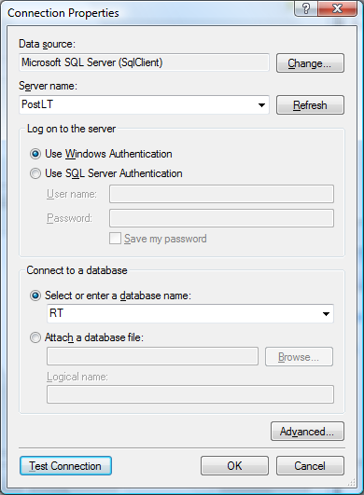
Report Data Source Connection

Slide 51
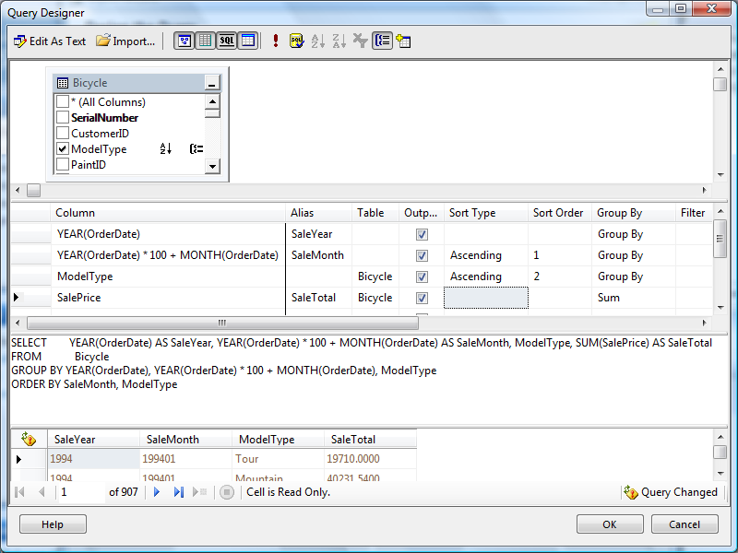
Report Query Builder

Slide 52
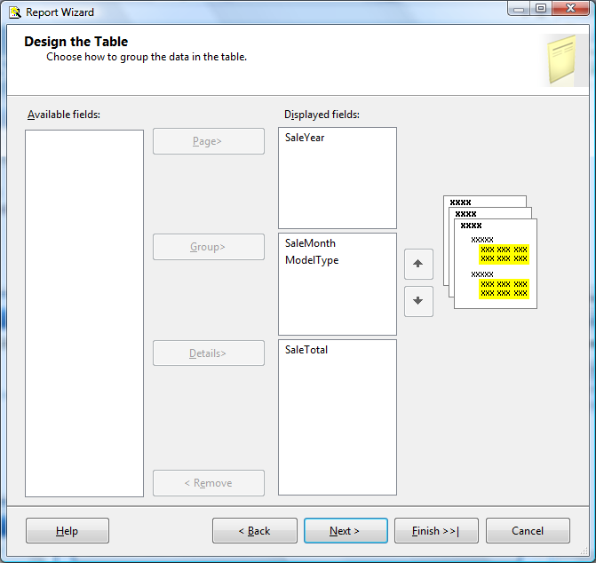
Report Structure: Levels

Slide 53
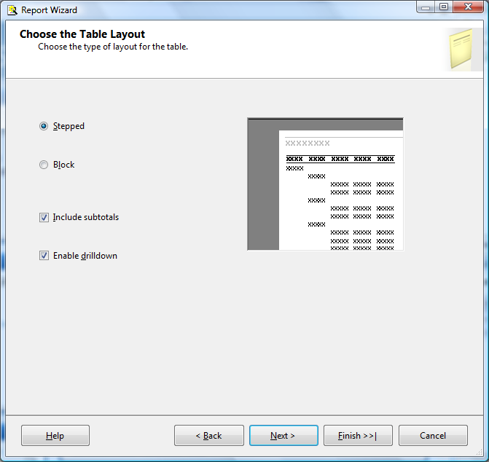
Layout: Tabular

Slide 54
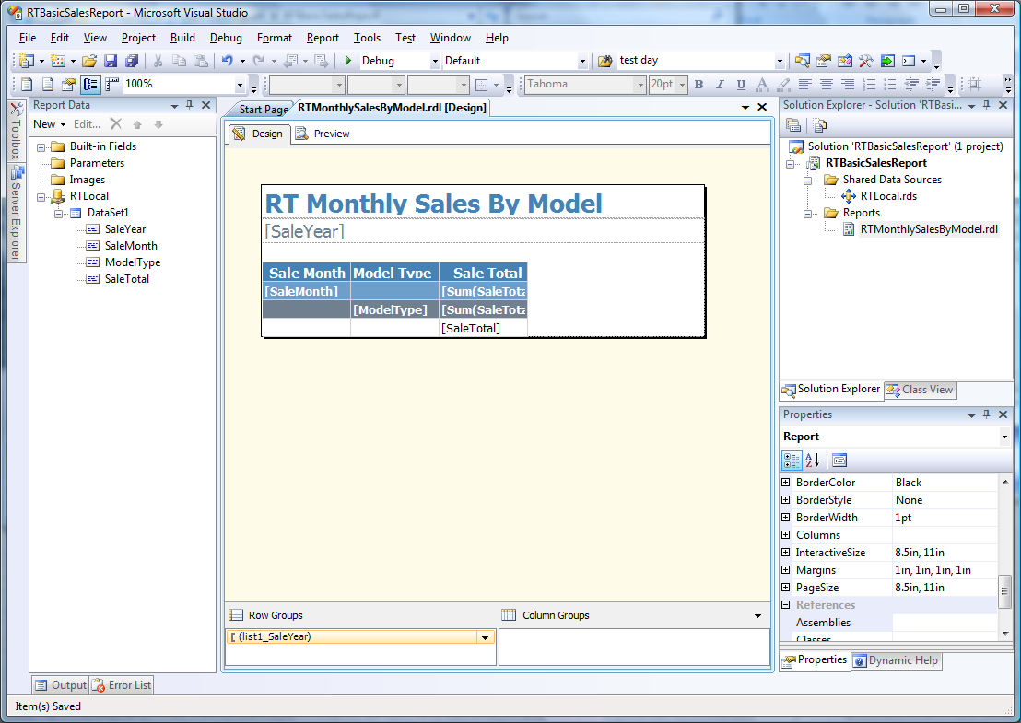
Initial Report Design

Slide 55
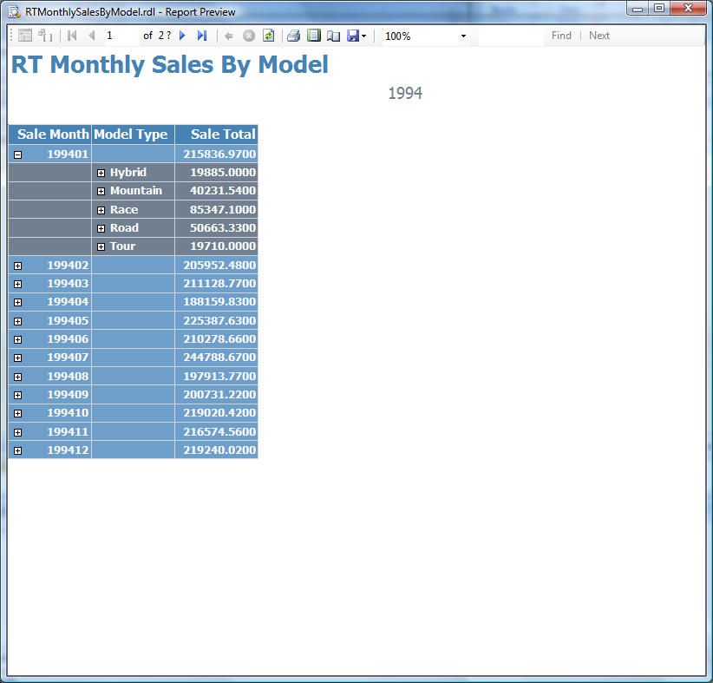
Initial Report

Slide 56
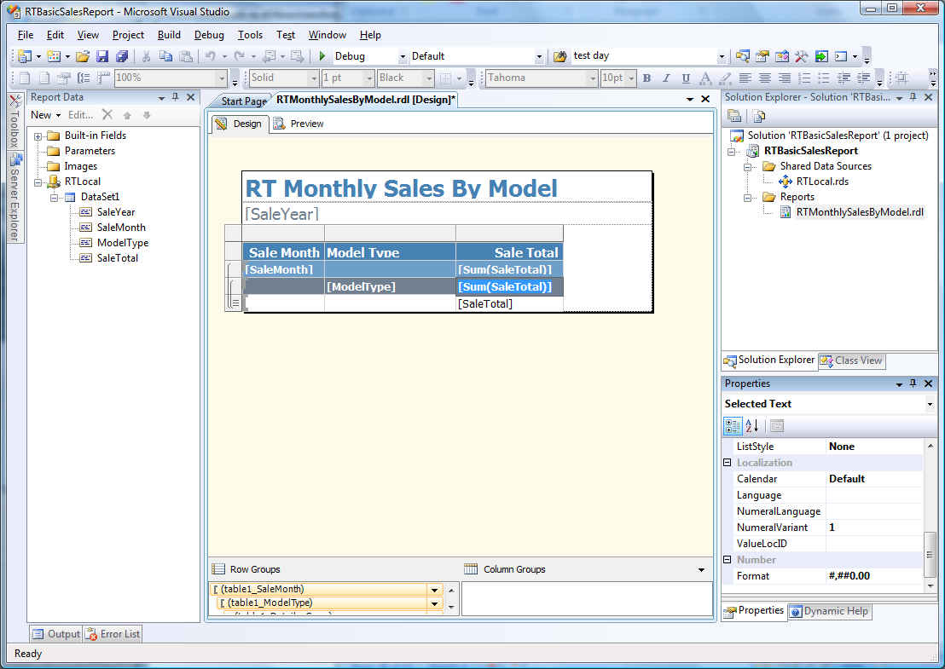
Improvements
Expand the columns
Set formats: #,##0.00

Slide 57
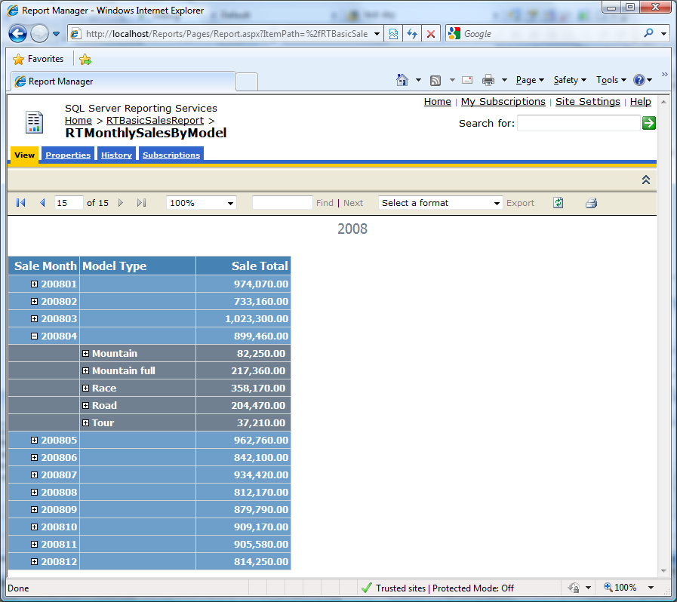
Improved Report in Web Browser
http://localhost/reports

Slide 58
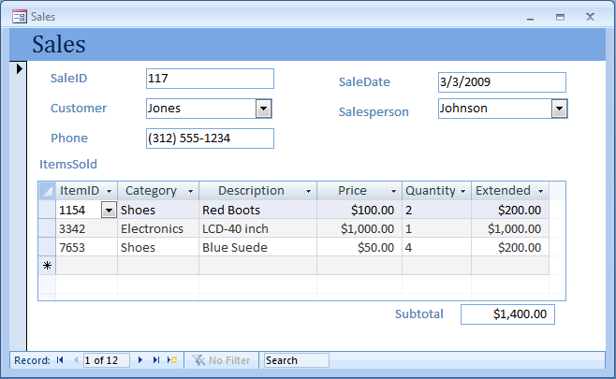
Database Design (optional)
Start with a form—what tables are needed to hold the data?

Slide 59
Notation
Table name
Table columns
Customer (CustomerID, LastName, Phone, Street, City, AccountBalance)
CustomerID | Last Name | Phone | Street | City | AccountBalance
12345 | Jones | (312) 555-1234 | 125 Elm Street | Chicago | $197.54
28764 | Adamz | (602) 999-2539 | 938 Main Street | Phoenix | $526.76
29587 | Smitz | (206) 676-7763 | 523 Oak Street | Seattle | $353.76
33352 | Sanchez | (303) 444-1352 | 999 Pine Street | Denver | $153.00
44453 | Kolke | (303) 888-8876 | 909 West Avenue | Denver | $863.39
87535 | James | (305) 777-2235 | 374 Main Street | Miami | $255.93

Slide 60
1st: Repeating
SaleForm(SaleID, SaleDate, CustomerID, Phone, Name, Street, (ItemID, Quantity, Description, Price ) )
Repeating Section
Causes duplication
SaleID | SaleDate | CustomerID | Name | Phone | Street | ItemID | Quantity | Description | Price
117 | 3/3/2009 | 12345 | Jones | (312) 555-1234 | 125 Elm Street | 1154 | 2 | Red Boots | $100.00
117 | 3/3/2009 | 12345 | Jones | (312) 555-1234 | 125 Elm Street | 3342 | 1 | LCD-40 inch | $1,000.00
117 | 3/3/2009 | 12345 | Jones | (312) 555-1234 | 125 Elm Street | 7653 | 4 | Blue Suede | $50.00
125 | 4/4/2009 | 87535 | James | (305) 777-2235 | 374 Main Street | 1154 | 4 | Red Boots | $100.00
125 | 4/4/2009 | 87535 | James | (305) 777-2235 | 374 Main Street | 8763 | 3 | Men's Work Boots | $45.00
157 | 4/9/2009 | 12345 | Jones | (312) 555-1234 | 125 Elm Street | 7653 | 2 | Blue Suede | $50.00
169 | 5/6/2009 | 29587 | Smitz | (206) 676-7763 | 523 Oak Street | 3342 | 1 | LCD-40 inch | $1,000.00
169 | 5/6/2009 | 29587 | Smitz | (206) 676-7763 | 523 Oak Street | 9987 | 2 | Blu-Ray Player | $400.00
178 | 5/1/2009 | 44453 | Kolke | (303) 888-8876 | 909 West Avenue | 2254 | 1 | Blue Jeans | $12.00
188 | 5/8/2009 | 29587 | Smitz | (206) 676-7763 | 523 Oak Street | 3342 | 1 | LCD-40 inch | $1,000.00
188 | 5/8/2009 | 29587 | Smitz | (206) 676-7763 | 523 Oak Street | 8763 | 4 | Men's Work Boots | $45.00
201 | 5/23/2009 | 12345 | Jones | (312) 555-1234 | 125 Elm Street | 1154 | 1 | Red Boots | $100.00

Slide 61
First Normal
SalesForm with repeating data
SaleID | SaleDate | CustomerID | Name | Phone | Street | ItemID, Quantity, Description, Price
117 | 3/3/2009 | 12345 | Jones | (312) 555-1234 | 125 Elm Street | 1154, 2, Red Boots, $100.00 3342, 1, LCD-40 inch, $1,000.00 7653, 4, Blue Suede, $50.00
125 | 4/4/2009 | 87535 | James | (305) 777-2235 | 374 Main Street | 1154, 4, Red Boots, $100,00 8763, 3, Men’s Work Boots, $45.00
157 | 4/9/2009 | 12345 | Jones | (312) 555-1234 | 125 Elm Street | 7653, 2, Blue Suede, $50.00
169 | 5/6/2009 | 29587 | Smitz | (206) 676-7763 | 523 Oak Street | 3342, 1, LCD-40 inch, $1,000.00 9987, 2, Blu-Ray Player, $400.00
178 | 5/1/2009 | 44453 | Kolke | (303) 888-8876 | 909 West Avenue | 2254, 1, Blue Jeans, $12.00
188 | 5/8/2009 | 29587 | Smitz | (206) 676-7763 | 523 Oak Street | 3342, 1, LCD-40 inch, $1,000.00 8763, 1, Men’s Work Boots, $45.00
201 | 5/23/2009 | 12345 | Jones | (312) 555-1234 | 125 Elm Street | 1154, 1, Red Boots, $100.00
Not in First Normal Form

Slide 62
1st: Split
SaleForm(SaleID, SaleDate, CustomerID, Phone, Name, Street, (ItemID, Quantity, Description, Price ) )
SaleForm2(SaleID, SaleDate, CustomerID, Phone, Name, Street)
SaleID | SaleDate | CustomerID | Name | Phone | Street
117 | 3/3/2009 | 12345 | Jones | (312) 555-1234 | 125 Elm Street
117 | 3/3/2009 | 12345 | Jones | (312) 555-1234 | 125 Elm Street
117 | 3/3/2009 | 12345 | Jones | (312) 555-1234 | 125 Elm Street
125 | 4/4/2009 | 87535 | James | (305) 777-2235 | 374 Main Street
125 | 4/4/2009 | 87535 | James | (305) 777-2235 | 374 Main Street
SaleLine(SaleID, ItemID, Quantity, Description, Price)
SaleID | ItemID | Quantity | Description | Price
117 | 1154 | 2 | Red Boots | $100.00
117 | 3342 | 1 | LCD-40 inch | $1,000.00
117 | 7653 | 4 | Blue Suede | $50.00
125 | 1154 | 4 | Red Boots | $100.00
125 | 8763 | 3 | Men's Work Boots | $45.00
157 | 7653 | 2 | Blue Suede | $50.00
169 | 3342 | 1 | LCD-40 inch | $1,000.00
169 | 9987 | 2 | Blu-Ray Player | $400.00
178 | 2254 | 1 | Blue Jeans | $12.00
188 | 3342 | 1 | LCD-40 inch | $1,000.00
188 | 8763 | 4 | Men's Work Boots | $45.00
201 | 1154 | 1 | Red Boots | $100.00
Note: replication
Note: replication

Slide 63
2nd: Split
Column depends on entire (whole) key.
SalelLine(SaleID, ItemID, Quantity, Description, Price)
ItemsSold(SaleID, ItemID, Quantity )
Items(ItemID, Description, Price)
SaleID | ItemID | Quantity
117 | 1154 | 2
117 | 3342 | 1
117 | 7653 | 4
125 | 1154 | 4
125 | 8763 | 3
157 | 7653 | 2
169 | 3342 | 1
169 | 9987 | 2
178 | 2254 | 1
188 | 3342 | 1
ItemID | Description | Price
1154 | Red Boots | $100.00
2254 | Blue Jeans | $12.00
3342 | LCD-40 inch | $1,000.00
7653 | Blue Suede | $50.00
8763 | Men's Work Boots | $45.00
9987 | Blu-Ray Player | $400.00

Slide 64
3rd: Split
SaleForm2(SaleID, SaleDate, CustomerID, Phone, Name, Street)
Sales(SaleID, SaleDate, CustomerID )
SaleID | SaleDate | CustomerID | SalespersonID
117 | 3/3/2009 | 12345 | 887
125 | 4/4/2009 | 87535 | 663
157 | 4/9/2009 | 12345 | 554
169 | 5/6/2009 | 29587 | 255
178 | 5/1/2009 | 44453 | 663
188 | 5/8/2009 | 29587 | 554
Customers(CustomerID, Phone, Name, Address, City, State, ZipCode)
CustomerID | Name | Phone | Street | City | AccountBalance
12345 | Jones | (312) 555-1234 | 125 Elm Street | Chicago | $197.54
28764 | Adamz | (602) 999-2539 | 938 Main Street | Phoenix | $526.76
29587 | Smitz | (206) 676-7763 | 523 Oak Street | Seattle | $353.76
33352 | Sanchez | (303) 444-1352 | 999 Pine Street | Denver | $153.00
44453 | Kolke | (303) 888-8876 | 909 West Avenue | Denver | $863.39
87535 | James | (305) 777-2235 | 374 Main Street | Miami | $255.93

Slide 65
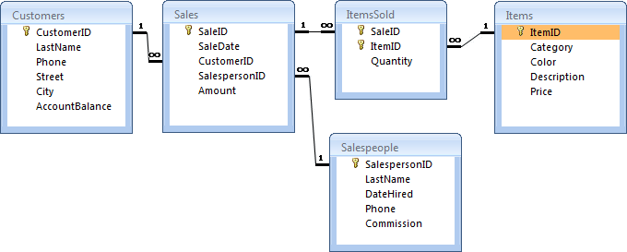
3NF Tables

