Slide 1
3: OLAP Cubes
Data Mining Applications
Jerry Post
Copyright © 2013

Slide 2
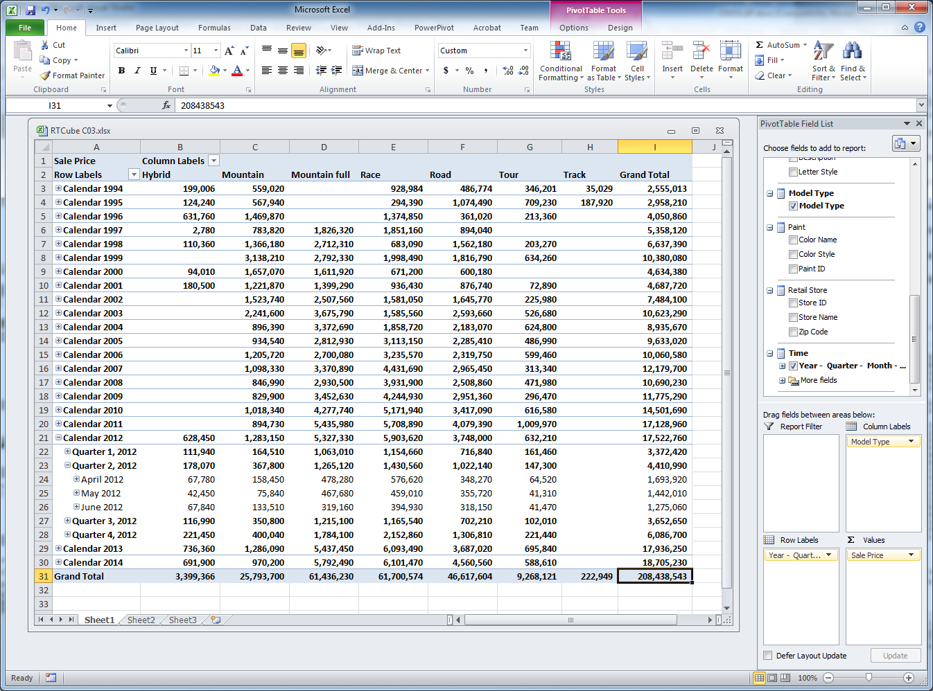
Sample OLAP Cube

Slide 3
Relational Joins
Indexes
Item
ItemID | Description | ListPrice | Category
1 | French Loaf | $3.99 | Bread
60 | Angel Cake | $7.99 | Cake
44 | Apple Pie | 11.99 | Pie
46 | Pecan Pie | 11.99 | Pecan Pie
ItemID
Category
SaleItem
SaleID | ItemID | Quantity | SalePrice
1 | 1 | 1 | 3.99
2 | 44 | 1 | 11.99
2 | 60 | 1 | 7.99
3 | 46 | 2 | 11.99
SaleID
ItemID
Sale
SaleID | SaleDate | EmployeeID
1 | 7/19/…. | 111
2 | 7/19/…. | 123
3 | 7/20/…. | 356
SaleID
SaleDate
EmployeeID
Employee
EmployeeID | LastName | FirstName | DateHired…
111 | Jones | Jane | 3/15/….
123 | Smith | Steve | 6/21/….
356 | Jackson | Jill | 4/13/….
EmployeeID
…

Slide 4
Problems with Indexes
Joins require indexes to improve performance.
Queries often require additional indexes.
So, retrieving data is often much faster if tables have many indexes.
But, adding or changing data requires updating every index.
If every column is indexed, a simple insert row for a transaction could require updates of dozens of indexes.
Transactions must remain fast or the DB cannot handle transactions.
More indexes ➔ Faster queries
More indexes ➔ Slower transactions
Answer: Pull data from OLTP relational database
Store in data warehouse with many indexes and even pre-joins

Slide 5







Data Warehouse
Data and Reports
OLTP: Relational DBMS
OLAP: Data warehouse
Transactions
Production Data

Slide 6
Extraction, Transformation, Loading
Current OLTP database
MySQL
SQL Server
SalesID
Old OLTP database
CustomerID
SQL Server
SalesID
Data Warehouse
Match data?
Data in the warehouse has to be clean and consistent.
Missing data is OK, bad data and data that does not match is not.
ETL process must be automated!
ReceiptID
ClientID
Merger company
OLTP database
Oracle

Slide 7
MOLAP, ROLAP, HOLAP
Multidimensional OLAP
Data is physically transferred from the source, processed as necessary, and stored in the data warehouse. The physical data structure matches the logical structure of the warehouse. It requires processing time to extract, transform, and load the data.
Relational OLAP
Data is physically stored in the original data source. Analysis retrieves whatever data is needed when it attempts to answer queries. To the manager, data is always live. Minimal upfront processing is used, but the metadata is stored in the warehouse.
Hybrid OLAP
An attempt to capture features from both approaches. The row source data remains in the original DBMS. Aggregations or subtotals are computed and stored in the data warehouse to improve performance. Overall, HOLAP is only slightly aster than ROLAP
SQL Server Analysis Services partitions
Partitions can hold data in one of the three forms, and the resulting data is treated the same regardless of where it is stored. Data that needs to be live can be stored in ROLAP partitions. Other data can be stored in MOLAP partitions to improve overall performance.

Slide 8
Cubes
Hybrid
Category
Full S
MTB
Road
Race
CA
1420
1258
1184
1098
1578
MI
437
579
683
873
745
Customer Location
NY
1011
1257
985
874
1256
TX
880
750
935
684
993
Hyper cubes display measures about a fact.
The attributes are cube dimensions.
The cube browser displays subtotals or different slices of the cube.
Jan
Feb
Mar
Apr
May
Time
Sale Month

Slide 9
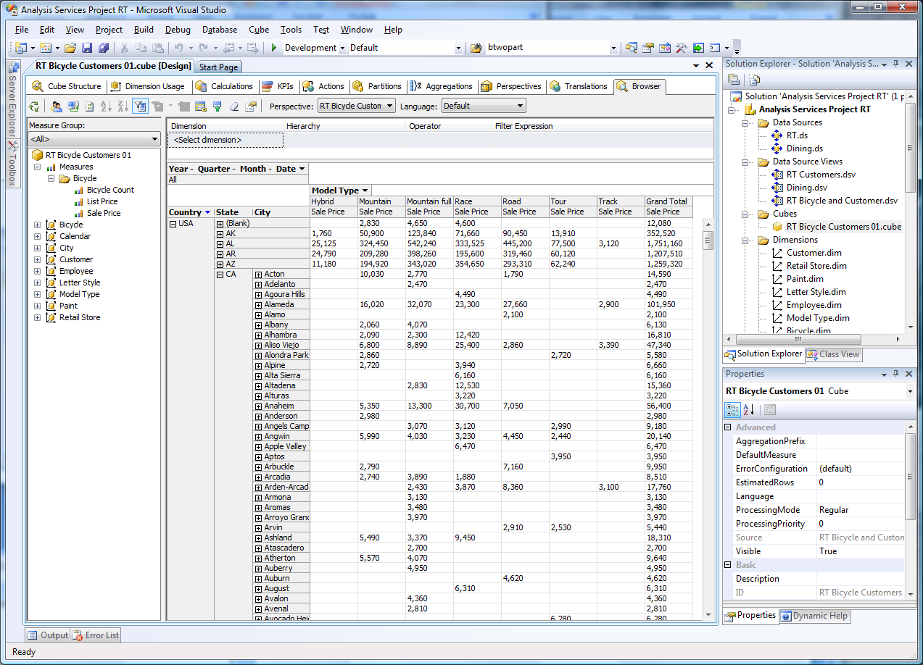
Cube Browser (old)

Slide 10
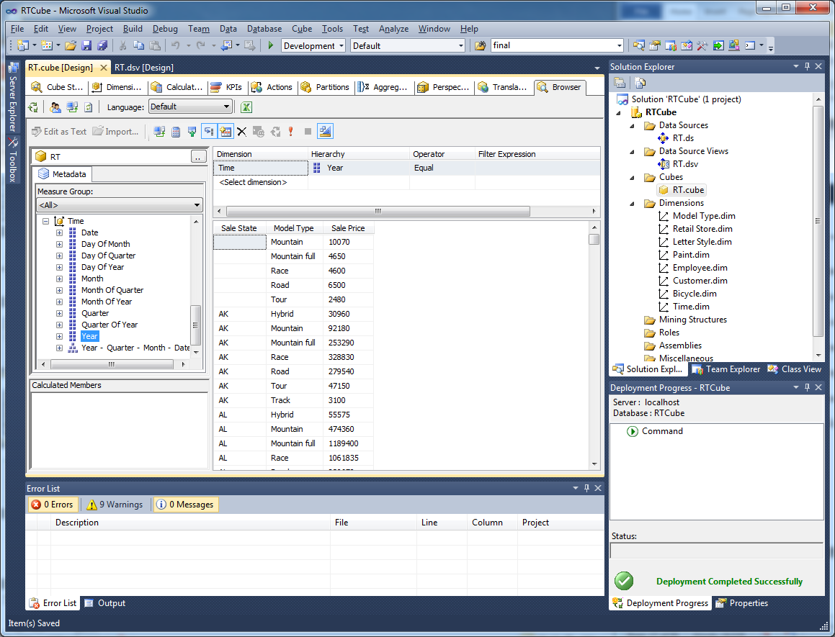
Cube Browser (2012)
Dimensions only appear on rows, not columns. But easy to display multiple measures.

Slide 11
Terminology
Facts and measures: Data to be evaluated. Sum is the default.
Dimensions: Attributes that analysts and managers want to investigate. The cube browser shows subtotals for each of the dimensions.
Hierarchy: Levels.
Location: Country-State-City-ZIP
Time: Year-Quarter-Month-Day

Slide 12
Common Business Dimensions
Measures: Sales Value = Price * Quantity, also count or total number of items
Product
Category
Color
Size
Manufacturer
Customer
Location: City
Gender
Age
Experience
Store
Country
Region
City
Department
Salesperson
Sale
Date
Time of day

Slide 13
Star Design
Product
Customer
Category
Color
Size
Manufacturer
Location: City
Gender
Age
Experience
Fact Table: Measures
Sales=Price*Quantity
Quantity
Store
Sale
Country
Region
City
Department
Salesperson
Date
Time of Day
Discount

Slide 14
Snowflake Design
Product
Customer
Category
Color
Size
Manufacturer
Gender
Age
Experience
Location
Country
State
City
Fact Table: Measures
Sales=Price*Quantity
Quantity
Store
Sale
Country
Region
City
Department
Salesperson
Date
Time of Day
Discount

Slide 15
Hierarchies
Country
Year
Year
State or Province
Roll up to summarize
Quarter
Quarter
City
Drill down for details
Month
Week
Postal Code
Day
Day

Slide 16
Creating a Cube with SSAS
Data Source
Data Connection
Data Source View
Relational DBMS
Table1
Table2
Data Source
Data Connection
Fact Measures
Data Source
Data Connection
Table3
Table4
Other data sources
Cubes
Dimensions
Attributes
Hierarchies
Measures
Dimensions

Slide 17
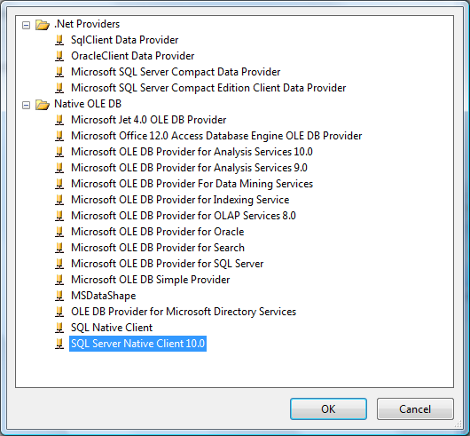
Data Sources
Access old and new
Oracle
SQL Server

Slide 18
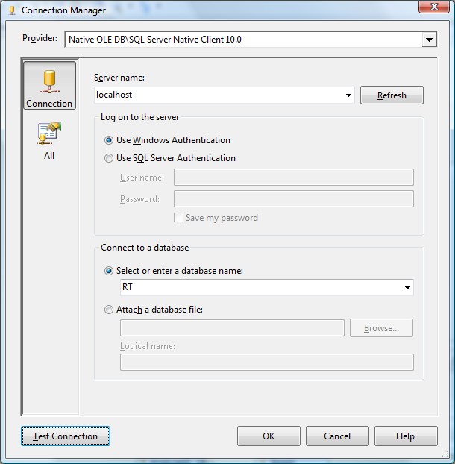
SQL Server Connection
Standard connection form.
But, best to use Windows authentication.
Some problems (bugs?) exist with trying to create dimension hierarchies when using SQL authentication.
Always test the connection!

Slide 19
Multiple Sources
Data Source
Data Connection
Data Source View
SQL Server
Table1
Table2
Fact Measures
Data Source
Data Connection
Table3
Table4
Oracle DBMS
Tables can come from any of the data sources.
The OLAP engine automatically integrates the data and handles relationships—even across different DBMSs.

Slide 20
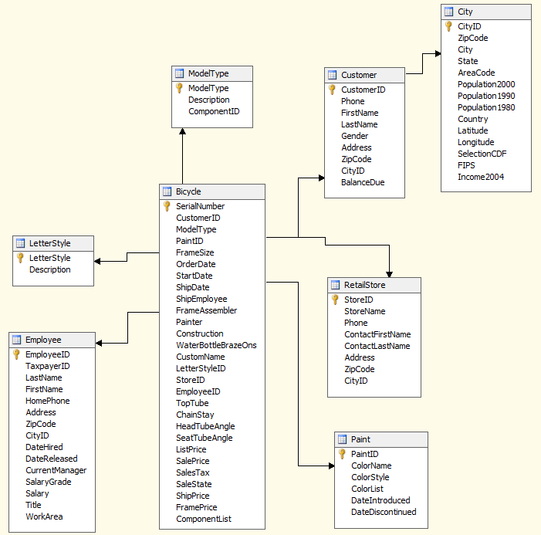
Data Source View
Notice the basic star design (except for the City table as a lookup).

Slide 21
Multiple Views
Data for cubes and data mining analysis MUST come from a view.
A single view with dozens of tables gets messy.
Often better to create multiple data source views.
Create for a project—logical data that belongs together.
Create for a user group—easier to assign security.
Can also create separate diagrams within a view to show just a subset of the data.
But, the diagram only simplifies the display within the data source view. It is not used outside the diagram window so it cannot be used to simplify selecting data for cubes or mining.

Slide 22
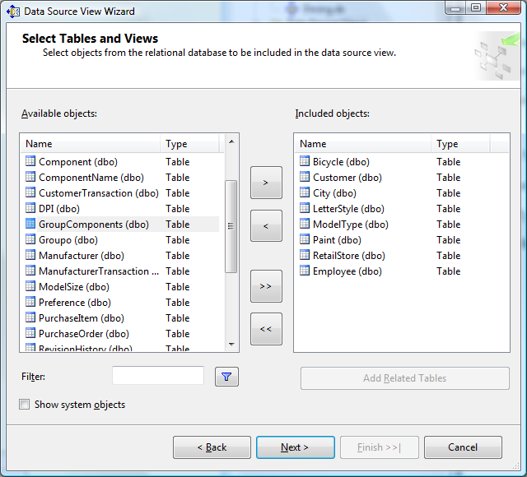
Create a Data Source View
Right-click Data Source Views in the Solution Explorer and pick New.
Choose the appropriate Data Source.
Pick the desired tables and views from the database.
Give the Data Source View a name that everyone will recognize (next screen).

Slide 23
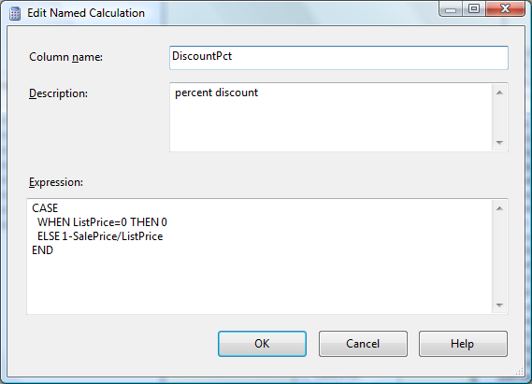
Named Calculation
Right-click the title bar of the Bicycle table.
Not the middle of the table!
Expressions are SQL Server functions and calculations
Calculations are row-by-row within the table.

Slide 24
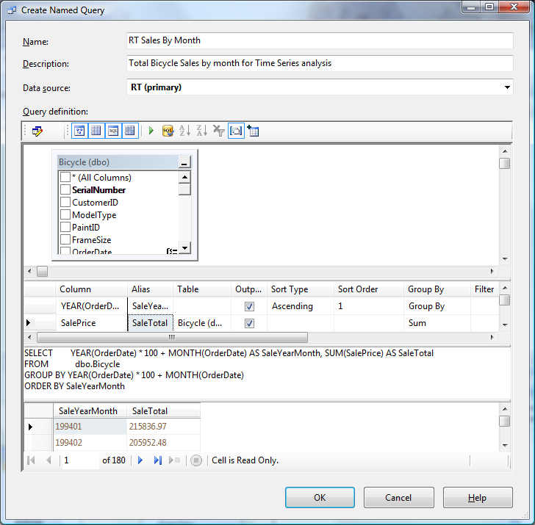
Named Query
Most of the data mining tools require some data preparation.
Example: Time Series to compute total sales by month.

Slide 25
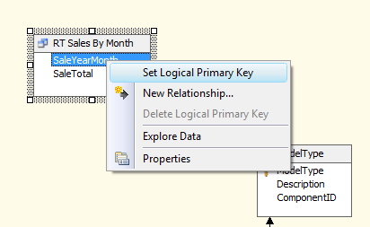
Logical Primary Key
All of the tools require a primary key. Best to set it in the data source view.
Right-click the column name and set it.

Slide 26
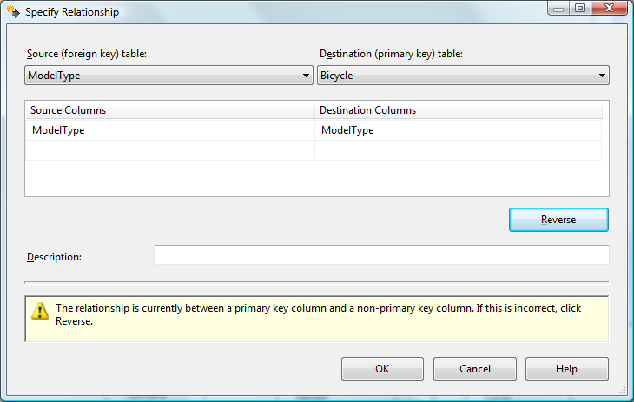
Create Relationships

Slide 27
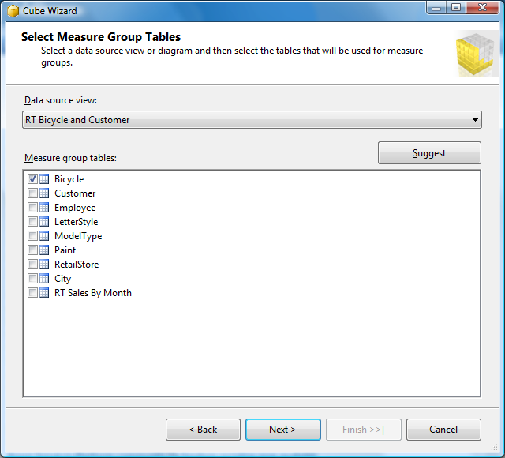
Creating a Cube: Measure Tables
Right-click Cubes in Solution Explorer and pick New Cube.
Use Existing tables.
Select the data source view and select the table(s) containing the measures/facts.

Slide 28
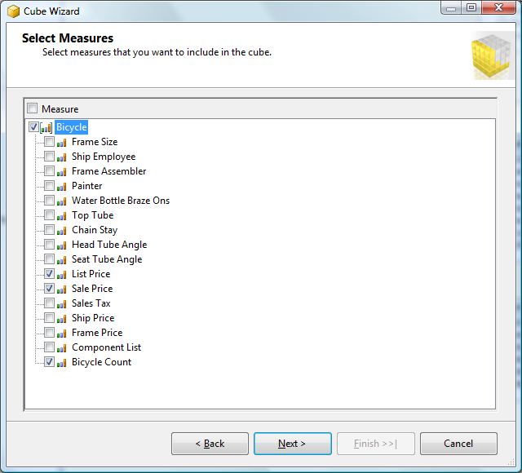
Measures

Slide 29
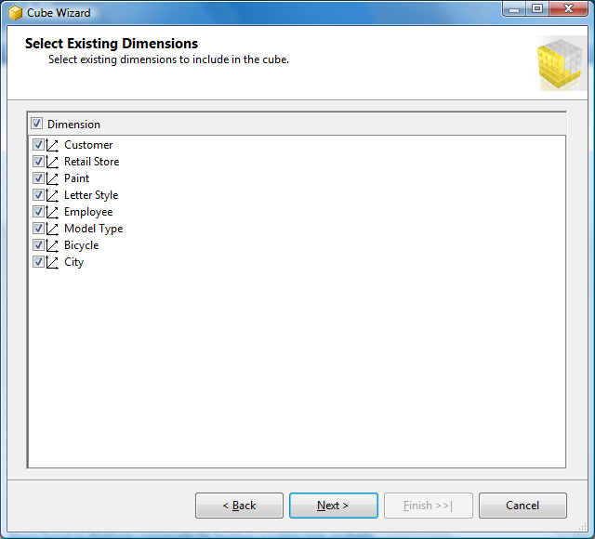
Dimension Tables
Tables in the data source view with links to the fact table are included automatically as dimensions.
Here, they serve as lookup tables to provide names for the ID values stored in the Bicycle table.
City works through the Customer table and can be removed later when a location hierarchy is created.

Slide 30
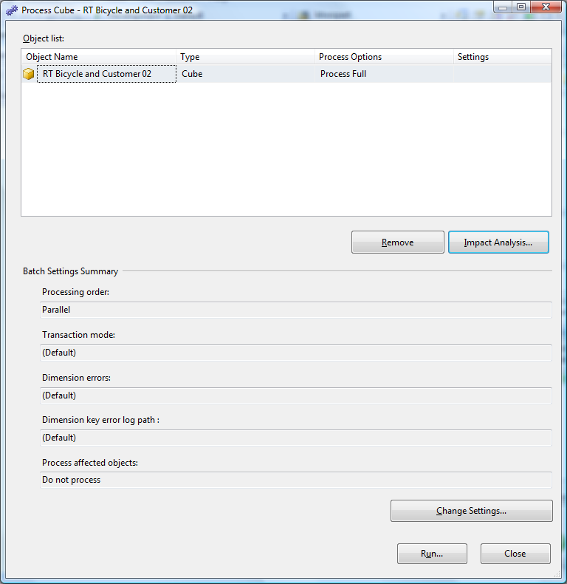
Processing
The data connections, data source views, and cube definition have to be deployed to the server. (Screen before this one.)
This form starts the processing that loads the data and pre-computes subtotals.
Huge projects might take resources and time to process, so processing might be deferred to run overnight or assigned fewer resources (processors).

Slide 31
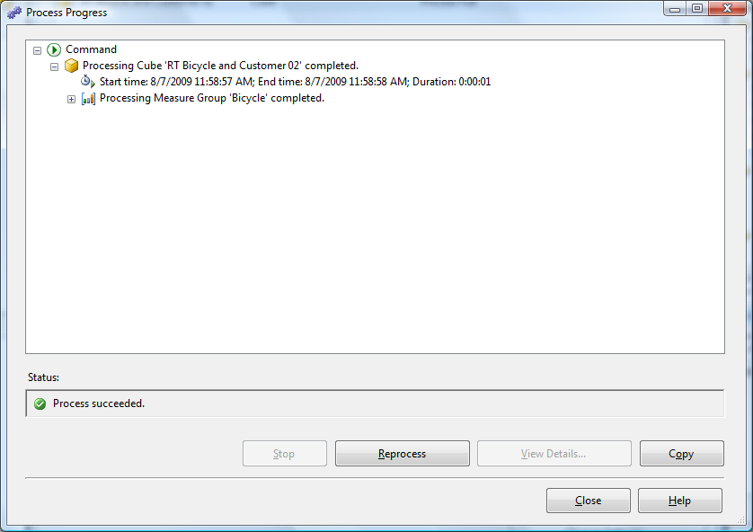
Processing Results
Any errors in processing will be displayed on this form. All errors must be corrected for the cube to be created.
Some error messages can be confusing.
Common problems:
(1) The server is not running or not connecting or you do not have enough permissions.
(2) Errors in the dimensions—particularly with hierarchies.

Slide 32
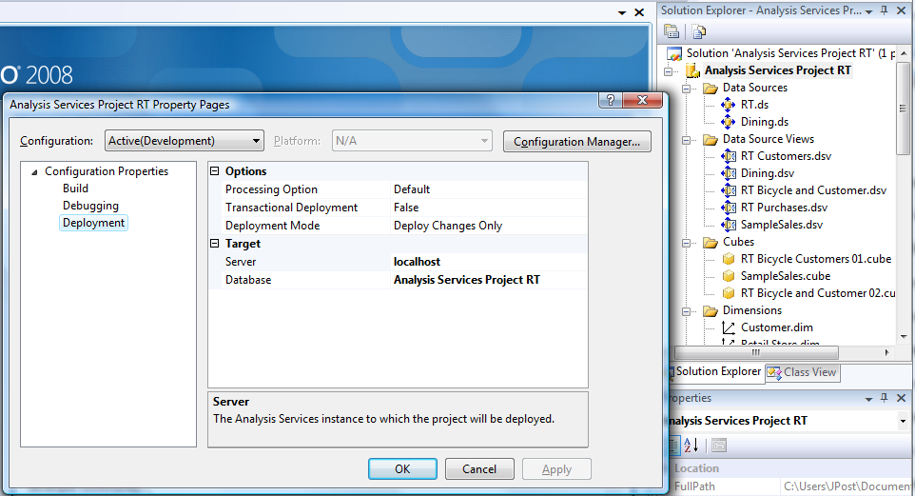
Change Deployment Server
By default, projects are set to deploy to the local host. If Analysis Services is installed on a central server, right-click the main project in the Solution Explorer and choose Properties. Click the Deployment property and change the name of the Server.

Slide 33
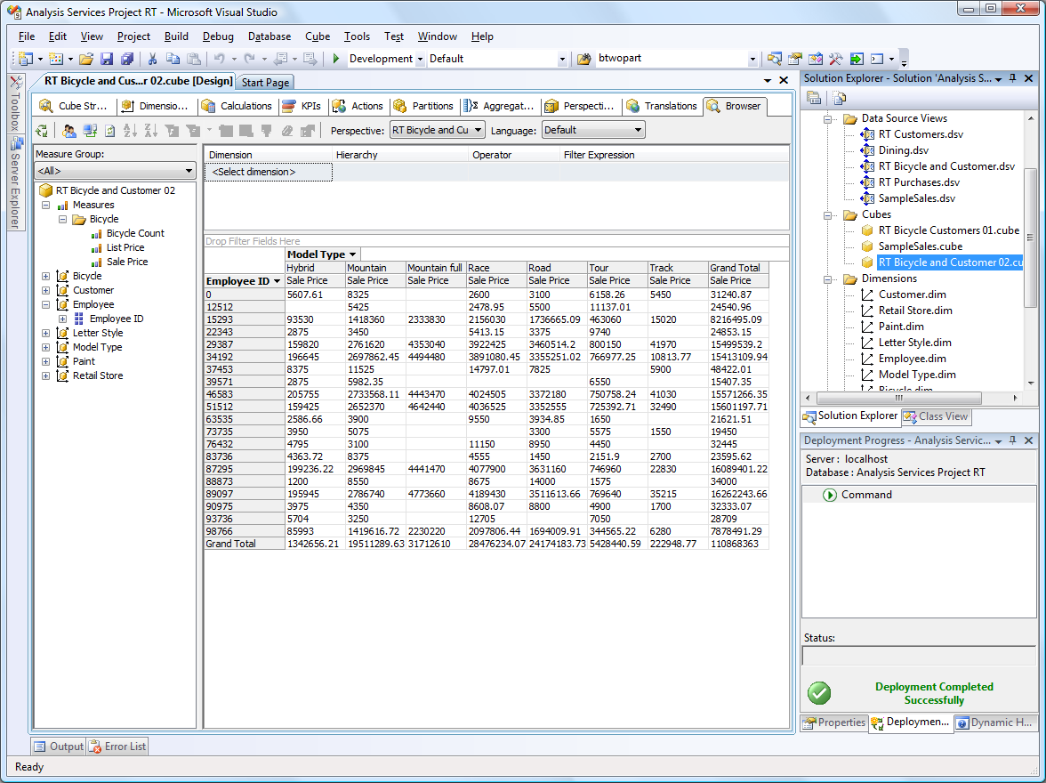
Browse Initial Cube: Old
Drag Sale Price measure to the middle.
Drag Model Type to the top/columns.
Drag Employee ID to the left/rows

Slide 34
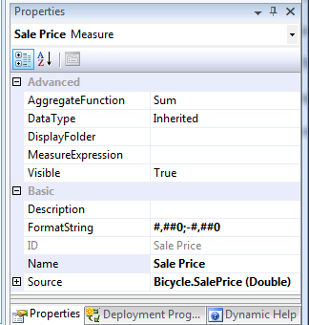
Format Measures
Measures
Bicycle
List Price
Sale Price
Change the display format for the prices to drop the decimals and add commas to the values are easier to read.

Slide 35
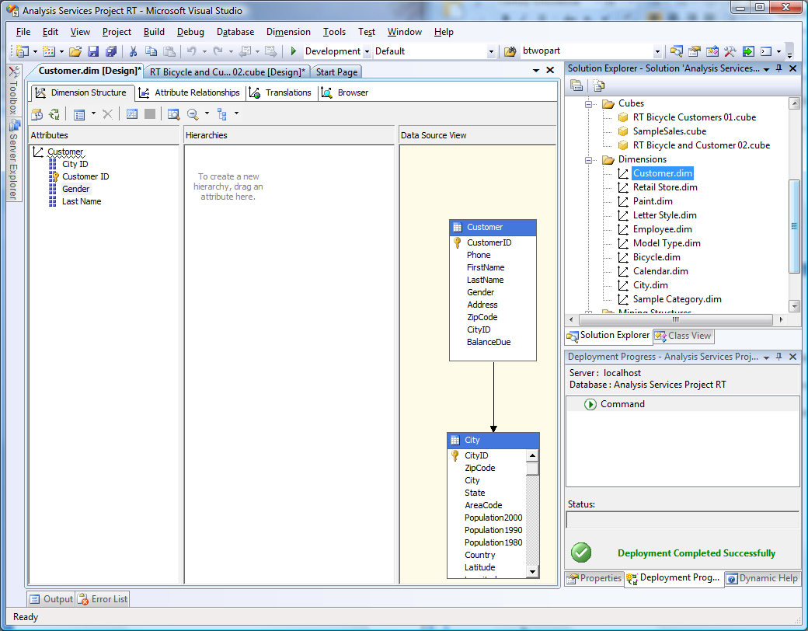
Improve Dimensions: Customer
Dimensions are defined independently and added to a cube.
Double-click the Customer dimension in the main list to open it.
Drag Last Name and Gender from the Customer table into the dimension panel on the left.

Slide 36
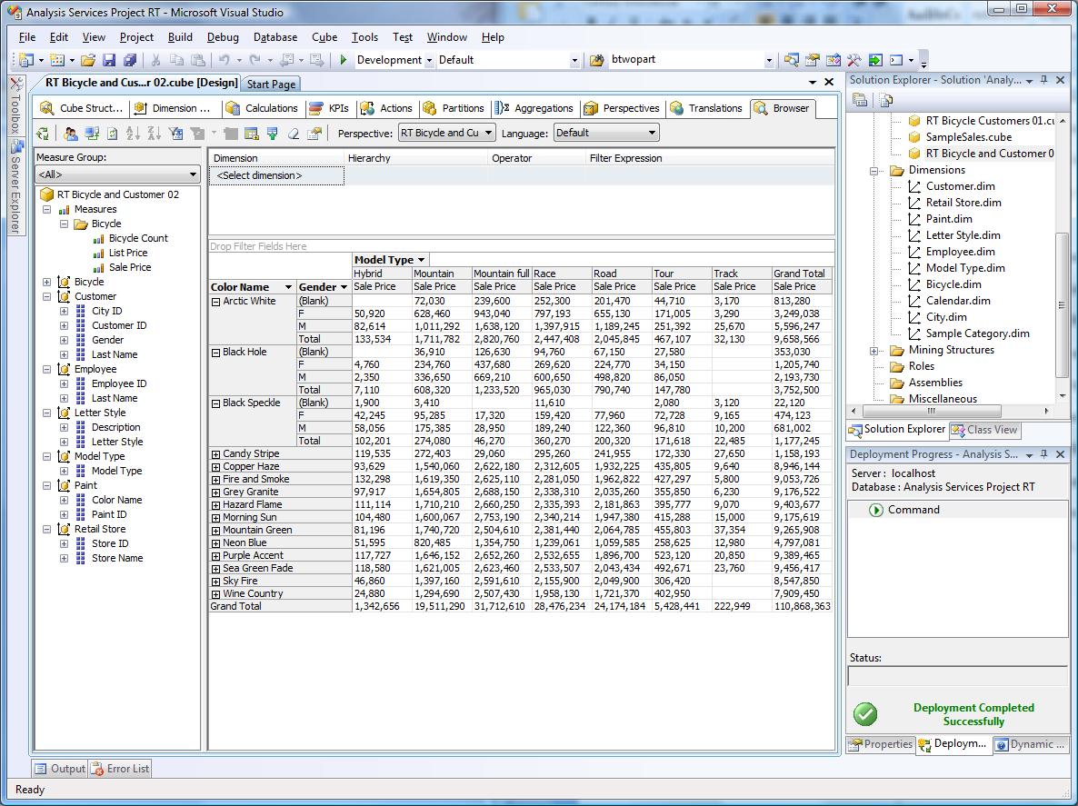
Better Cube: Old

Slide 37
Cube Browser: PivotTable

Slide 38
Hierarchies
Common business hierarchies
Date Year-Quarter-Month-Day Time Hierarchy, based on single date.
Location Nation-State-City-PostalCode Geography, need table
These first two have wizards to help create them.
Manager or Division-Region-Department Custom, build from table
Product Category-… Custom, build from table

Slide 39
Time Hierarchy
Hierarchies are dimensions and all data for dimensions must be stored in tables.
For a time hierarchy, all years, quarters, months, and days need to be stored.
Two primary choices:
Create a new table in the data source
Create a table on the Analysis Server
Both can be generated automatically.
Creating it in the data source ultimately provides more control because it is then possible to edit the results or add new columns. But it requires that you have CREATE TABLE permission on the data source server.
Creating the table on the analysis server might be easier in terms of security.
But starting and ending dates have to be specified ahead of time.
In testing, this permission only worked by using a data connection with a Windows logon. It did not work with a SQL Server connection to the DBO account that clearly had CREATE TABLE permission.

Slide 40
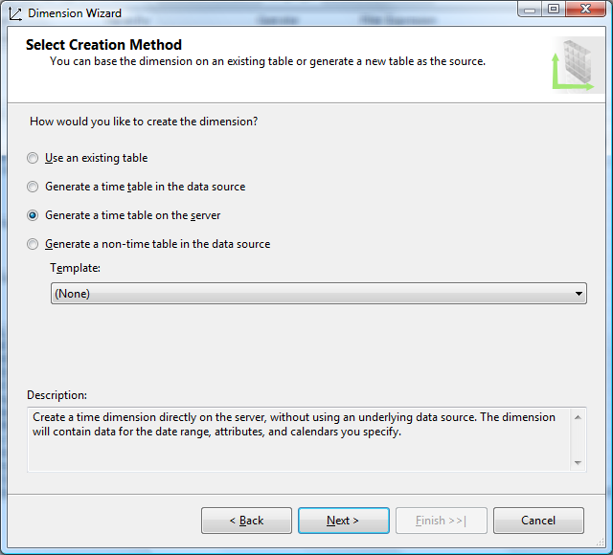
New Time Hierarchy
Two main choices for time, although it is also possible to use an existing table if you have one.

Slide 41
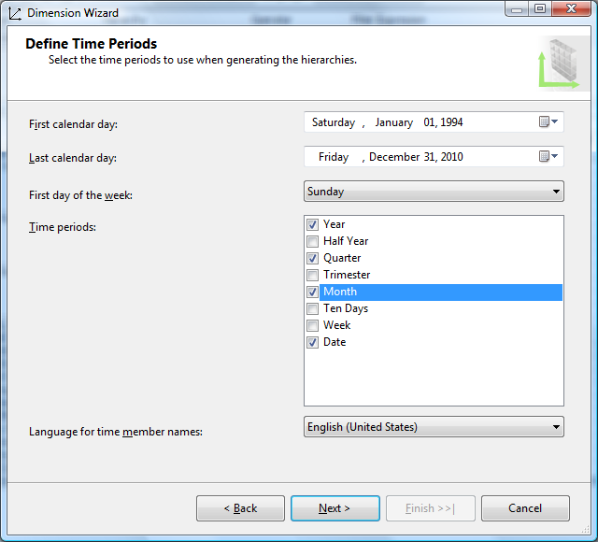
Date Levels
RT starts 1994-01-01
Ending data is 2008-12-31 but additional years can be added here and will not be displayed if they are not available.
Standard hierarchy options.

Slide 42
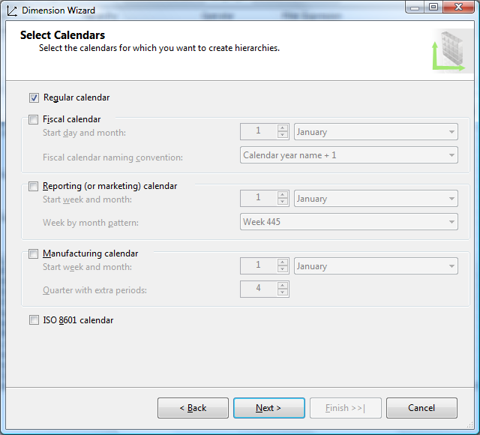
Calendar Types

Slide 43
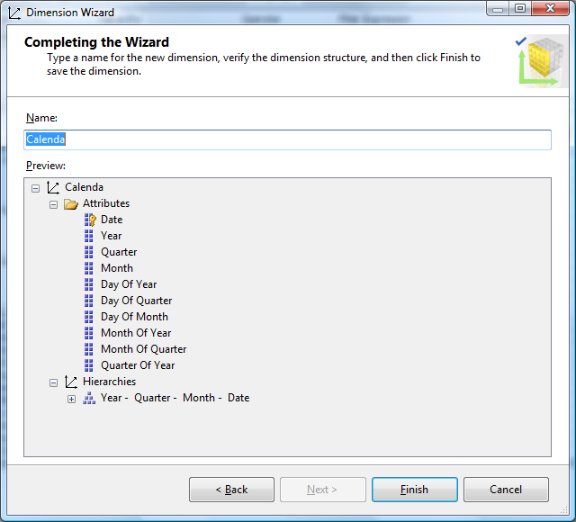
Proposed Calendar

Slide 44
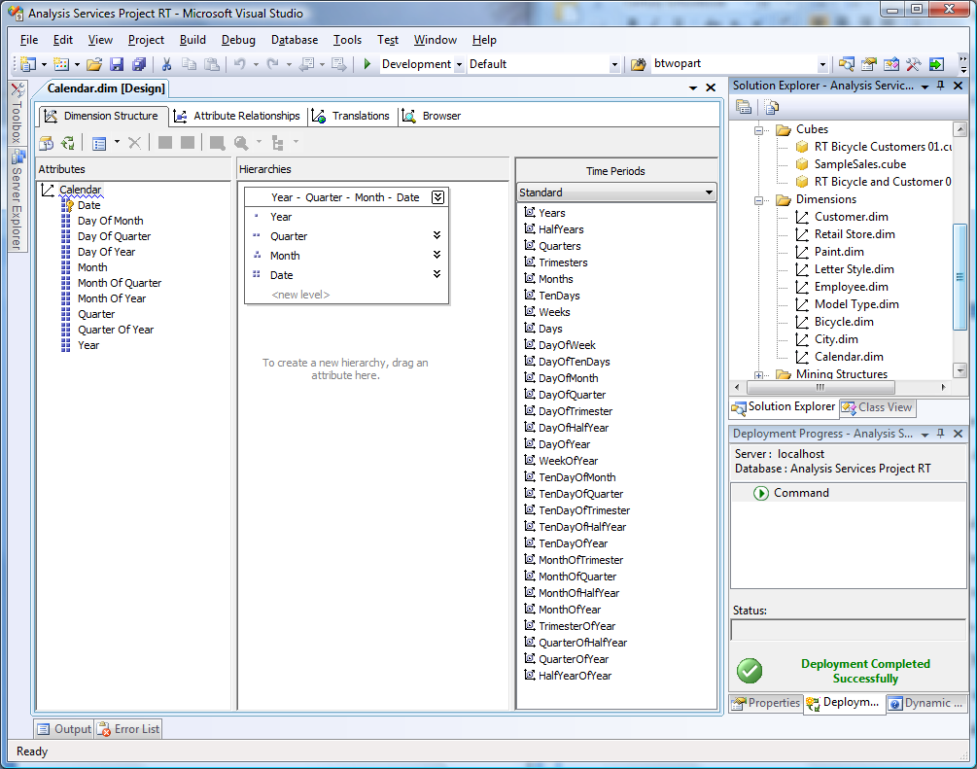
Calendar Hierarchy

Slide 45
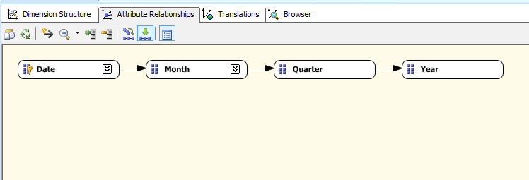
Attribute Relationships

Slide 46
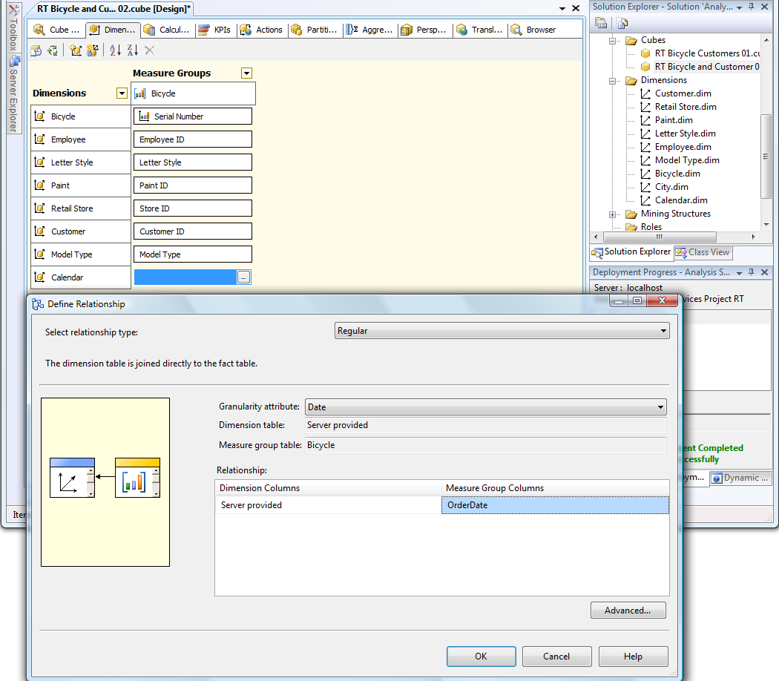
Add Dimension to Cube
Open the Cube.
Click the Dimension tab.
Right-click the main window and pick New Cube Dimension.
Choose Calendar from the list.
Select the gray box next to the new dimension and click the ellipses button.
Choose Regular as the Relationship type.
Select Date.
Select OrderDate.

Slide 47
Cube with Calendar Hierarchy

Slide 48
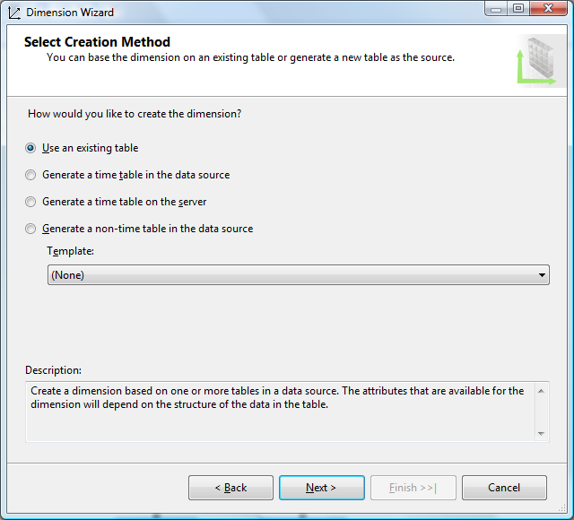
Geographic Hierarchy
Data on cities, states, countries, and probably ZIP/Postal codes should already exist in a table.
RT: City

Slide 49
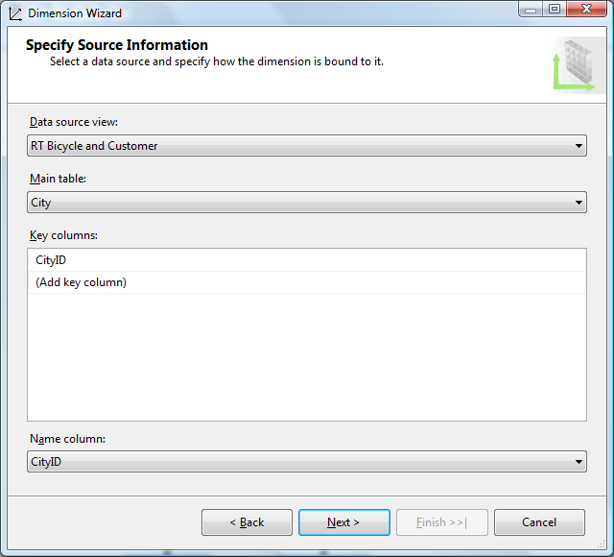
Choosing the City Table
If you do not want to include City (name) in the hierarchy, you can assign the name column here.
But the hierarchy works better if you leave CityID.

Slide 50
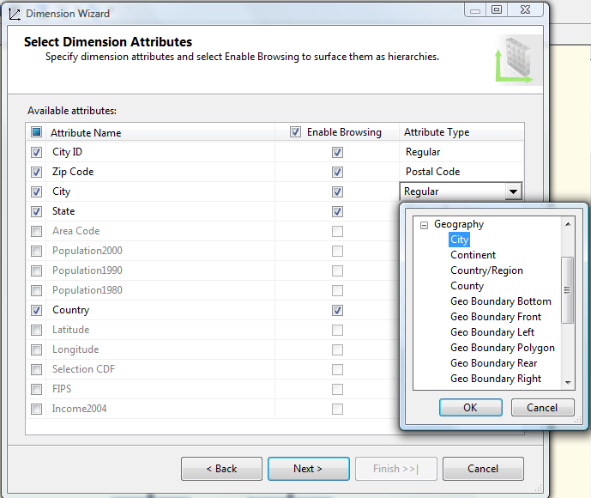
Assign Geographic Levels
The wizard understands common geographic levels, but you have to assign them to the columns in your table.
You must include the primary key CityID and leave it as “Regular.”

Slide 51
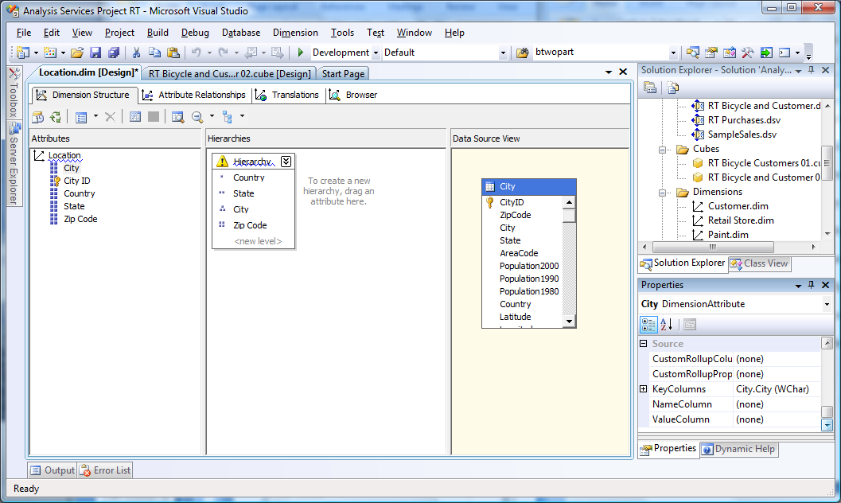
Create the Hierarchy

Slide 52
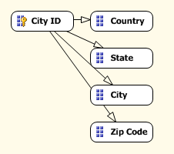
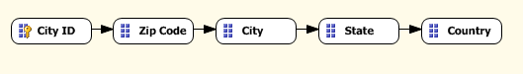
Create Attribute Relationships
Initial
Work bottom up.
Drag Zip Code onto City, City onto State, State onto Country
Double-click each relationship arrow,
Use the drop-down list to set it as Fixed instead of Flexible.
Final

Slide 53
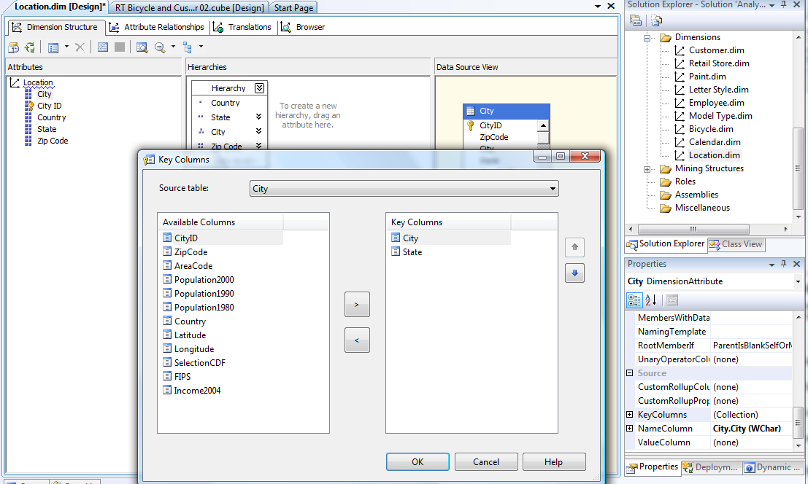
Key Columns
Attribute must have a one-to-many relationship. A City name can be in many states
So Add the State as one of the Key columns. Set Name to City.

Slide 54
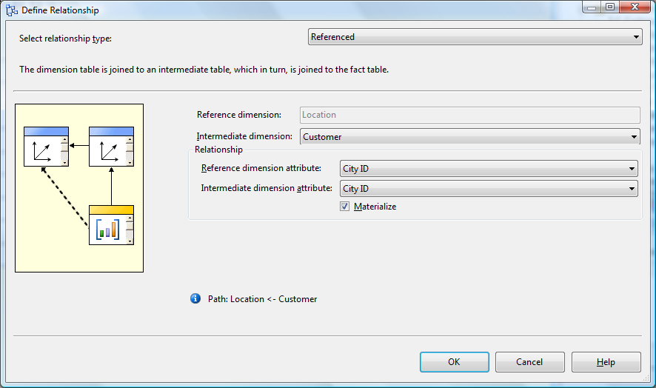
Referenced Relationship
City links to Bicycles through Customer (snowflake), which requires a Referenced relationship.

Slide 55
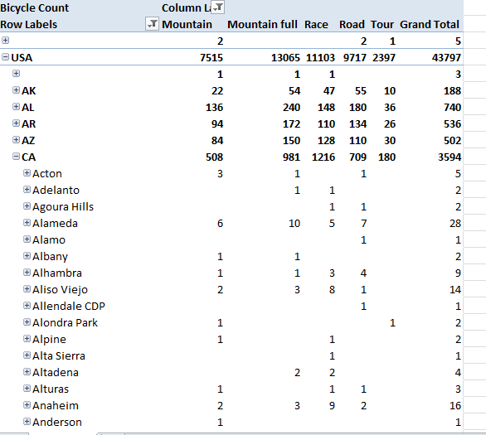
New Cube
Drop down list to remove little-used data (Italy, Unknown, Blank)

Slide 56
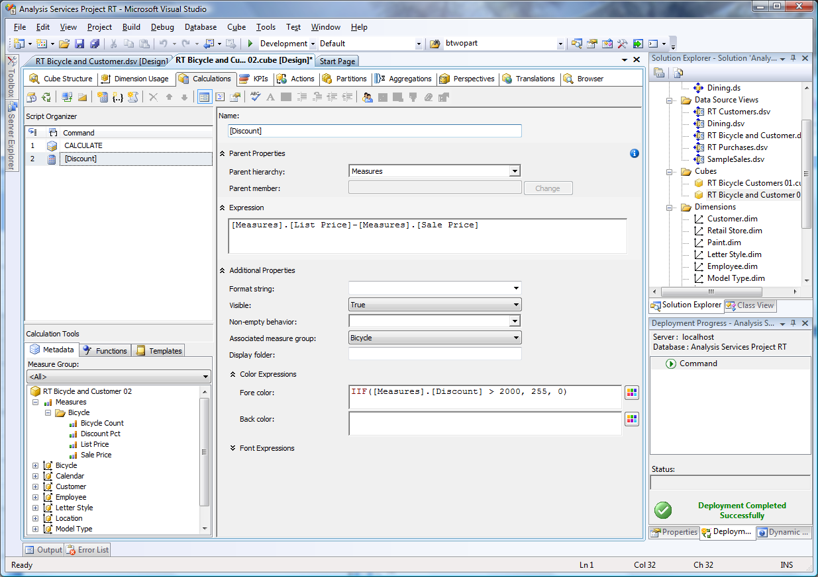
Calculations
Drag and add -
Use color picker.

Slide 57
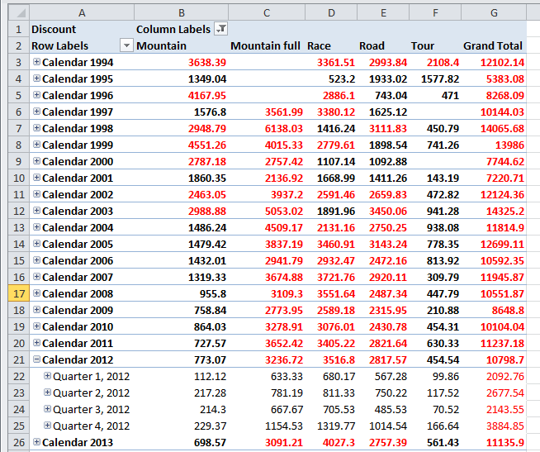
Discount Results
Notice that the color conditions (and the calculations) apply to the TOTAL values. Or, the values as they are displayed.
With VS 2012, these colors transfer to Excel, but do not display in the VS Cube browser.

Slide 58
Calculations are on SUMS
X | Y | X * Y
100 | 2 | 200
5 | 10 | 50
105 | 12 | 1,260 or 250
It makes a huge difference whether you multiply first or add first.
Calculations defined at the cube level always ADD FIRST.
The calculations are performed on the subtotals as they are displayed.
A cube browser would compute it as 1,260 = Sum(X)*Sum(Y).
This sequence is rarely useful for multiplication and division, so:
Only use addition and subtraction in cube calculations.
Use multiplication and division in row-level calculations in the data source view or the underlying query.

Slide 59
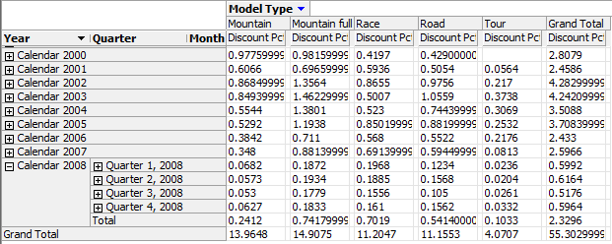
Discount Percent
In data source view: Bicycle: Named Calculation: Discount Pct = 1 - SalePrice/ListPrice
Look at the totals.
How can a percentage be greater than one?
Because the default method of the Cube is to SUM the data.

Slide 60
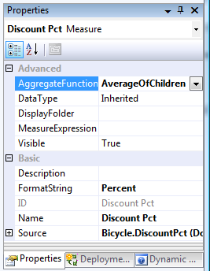
Cube Averages
Cube Structure Window
Select Discount Pct measure
Open Properties window
Change Aggregate Function from Sum
To AverageOfChildren
Set FormatString to Percent
Save everything, process the cube, browse, and reconnect.

Slide 61
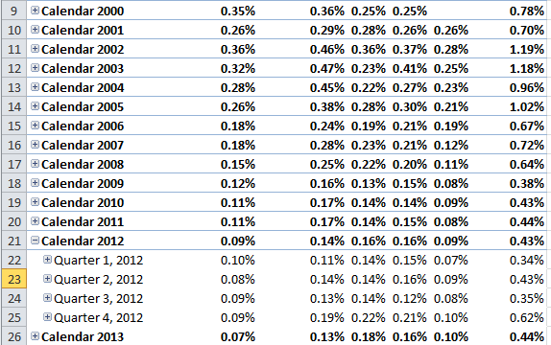
Discount Percent: Average
Warning:
(1) Be careful when making calculations.
(2) Document your work so managers and analysts know what you did.

Slide 62
How to Segment Problems
Large organizations can have dozens of measures and hundreds of attribute dimensions. Building a single OLAP cube would create a huge configuration that is hard to understand, hard to control security, and take a long time to process.
Ways to segment problems:
Create separate data source views.
Define separate cubes for specific problems or users.
Reduce a cube by creating perspectives.
Perspectives are mostly useful if several users share the same basic data, but want to use different dimensions, or the dimensions need to be controlled so some users do not see them (e.g., Employee information). Creating multiple cubes on the same data costs processing time.

Slide 63
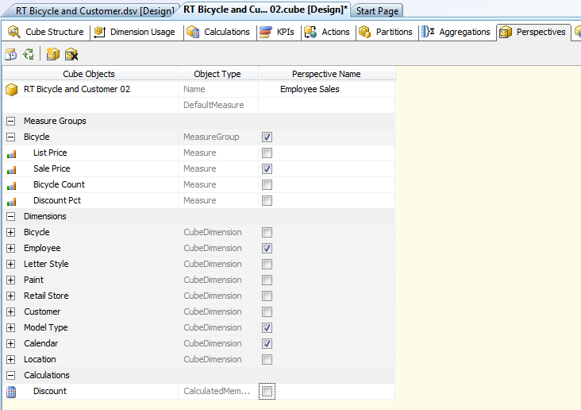
Perspective
Right-click main space: Add new perspective. Enter a name.
Uncheck items to reduce the measures and dimensions available.

Slide 64
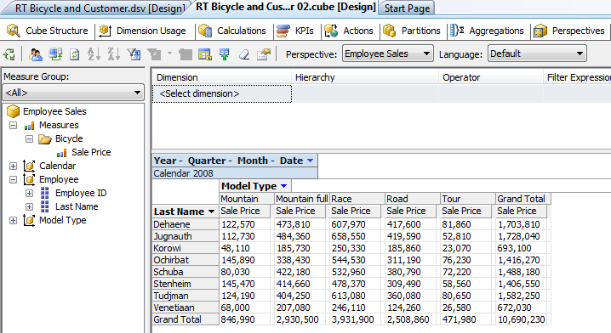
Browse Perspective
Choose perspective.
Restricts measures and attributes.

Slide 65
Translations: Multiple Languages
Two types of data:
Dimension data
Titles
Example:
Neon Blue, Arctic White, Sea Green Fade, …
Paint Color name (title)

Slide 66
Dimension Translations
PaintID | ColorName | SpanishName
1 | Neon Blue | Neón Azul
2 | Arctic White | Blanco Ártico
3 | Sea Green Fade | Verde Mar
4 | Black Speckle | Salpicaduras Negras
5 | Candy Stripe | Caramelo Banda
6 | Fire and Smoke | Fuego y el Humo
7 | Mountain Green | Montañas Verdes
8 | Purple Accent | Morado Acento
9 | Hazard Flame | Llama Peligro
10 | Morning Sun | Sol por la Mañana
11 | Grey Granite | Granito Gris
12 | Copper Haze | Neblina Cobre
13 | Sky Fire | Cielo de Bomberos
14 | Wine Country | Vino País
15 | Black Hole | Agujero Negro
Create new columns in the data table that have the translated names.

Slide 67
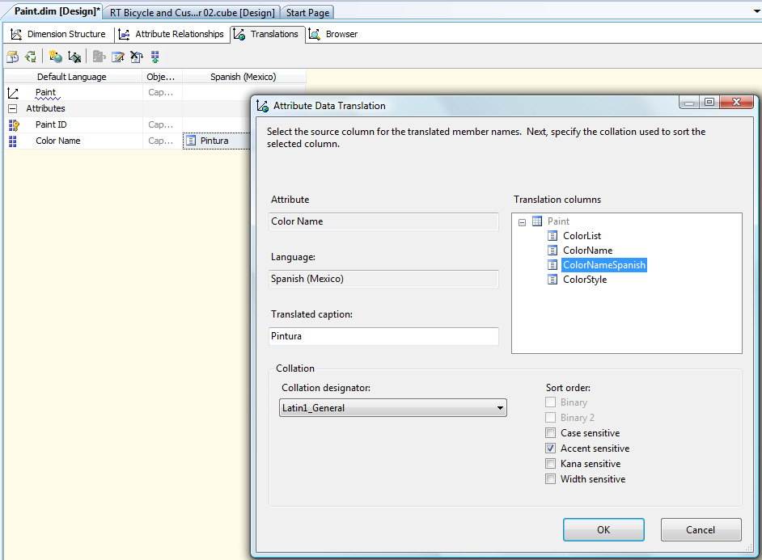
Assign Dimension Translations
Open Dimension, click the Translations tab.
Right-click to Add a new translation, pick the language.
For the attribute (Color Name), click the ellipses button to open edit form.
Select the matching column name. Translate the caption.

Slide 68
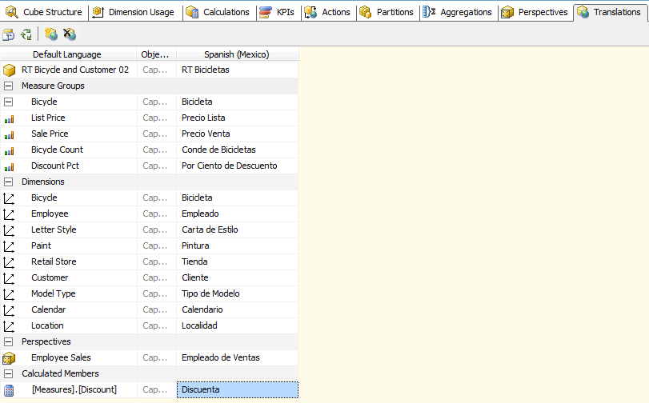
Translate Cube Metadata
Cube Translation tab.
Right-click: New Translation.
Pick language.
Enter translated titles into boxes.

Slide 69
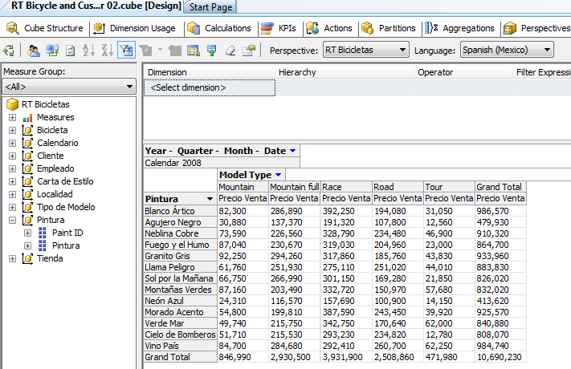
Select Language

Slide 70
Partitions and Aggregations
Performance tuning is beyond the scope of this book.
But, several options exist to help with extremely large problems.
Partitions are used to physically break data into multiple pieces.
Microsoft recommends a partition contain no more than 20 million rows.
Partitions can have different storage structures (MOLAP, ROLAP, hybrid), be stored in different locations (servers), and be assigned different security permissions.
Partitions can be assigned different aggregations.
Wizards can help design aggregations and partitions based on usage patterns.
Partitions take advantage of parallel processing, and limit the processing needed to smaller sets of data.

Slide 71
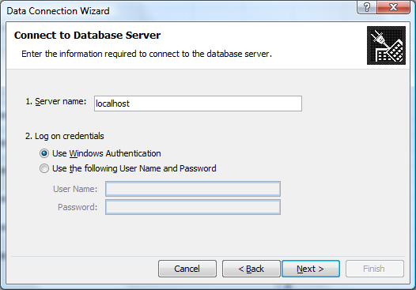
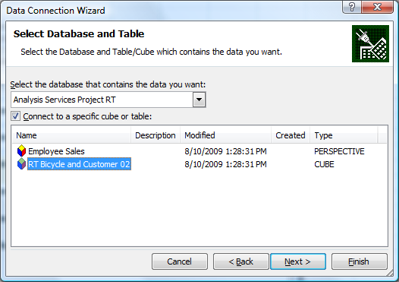
Front End: Excel
SSAS delivers cube data through standard Microsoft data connection tools.
So many front-end tools can retrieve the data: Excel, Reporting Services, SharePoint, …
Excel: Insert/Tables/PivotTable—starts the PivotTable wizard.
Select and External connection and follow wizard to define a new connection source.
If building on one machine, use localhost and Windows to connect.
Otherwise, need server name and login information from adminstrator.
Select the project and choose the desired cube or perspective.

Slide 72
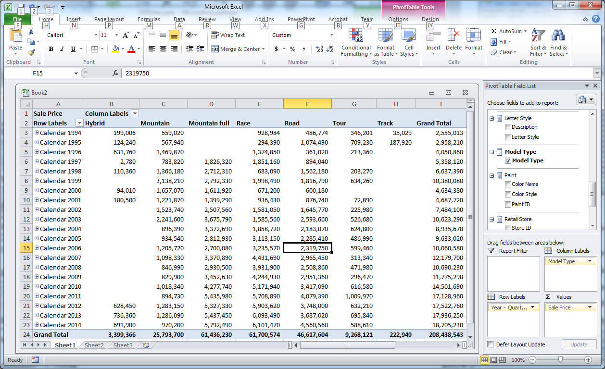
Excel PivotTable

Slide 73
Excel PivotChart
One click to create.
Changing cube changes the chart.
Changing filter values updates the chart.

Slide 74
Actions
Select a value or dimension or other aspect of the cube and take some specified action. Data from the cube or attributes can be passed to a new program or Web site.
Some examples:
Drill through to display detail rows that make up a subtotal.
Create a URL that opens a SQL Server Report with related information.
Open a Google map to display a City.
Run a command line program to execute a custom program.

Slide 75

Open a Map
Probably will not work with VS 2012.
Action name people understand
Right click / New Action
Attribute members
Location. City
Action URL

Slide 76
URL Action for Google
"http://maps.google.com/maps?q=" +
[Location].[City].CurrentMember.Name +
"," + [Location].[State].CurrentMember.Name +
" " + [Location].[Country].CurrentMember.Name
Google URL format for query
Values for selected City, State Country

Slide 77

Action Link
Right-click.
Choose new action.
Note the importance of the recognizable name!

Slide 78
KPI: Key Performance Indicators
Provide a visual display of important data. Digital Dashboard.
Indicators can vary by management and manager.
Common ones in business include Sales revenue, Expenses, Profit, and so on.
Analysis Services: Define the KPI measure centrally so it is easy to change and everyone can view the same values.
To define a KPI, need
Value, usually a measure from the cube: Total Sales
Goal, a fixed value (new measure) or a percentage change
Status, Gauge: -1, 0, 1 (or continuous between -1 and 1): poor, neutral, good
Trend, change over time, Arrow: -1, 0, 1

Slide 79
Multidimensional Expression Query MDX
Led by Microsoft, several vendors support MDX queries.
It has no relationship to SQL.
It is designed to retrieve data from OLAP cubes.
It is the foundation of everything in Analysis Services. The wizards and editors are actually building MDX queries.
Some simple examples will be used in this chapter for KPI expressions.
More complex systems require a greater knowledge of MDX.

Slide 80

Create a KPI
KPIs tab
Right-click KPI Organizer: New KPI
Name
Value
Goal
Status
Trend

Slide 81
Value and Goal
Value: [Measures].[Sale Price]
Drag Measure/Sale Price into Expression box
Goal:
1.05*
(
[Measures].[Sale Price],
ParallelPeriod
(
[Calendar].[Year].[Year], 1,
[Calendar].[Year].CurrentMember
)
)
Note that the 5% is hard-wired into the MDX
ParallelPeriod is an MDX function, Three parameters
Hierarchy level (in this case Year from the Calendar hierarchy)
# of time periods (1)
Applied to current year
Example: Retrieves the total annual sales from the prior year.

Slide 82
Status Expression
CASE
WHEN KpiValue(“Annual Sales KPI")/KpiGoal(“Annual Sales KPI")>=0.90
THEN 1
WHEN KpiValue(“Annual Sales KPI")/KpiGoal(“Annual Sales KPI")< 0.75
THEN -1
ELSE 0
END
Return values between -1 and 1. Often return only -1, 0, 1
Easiest to define.
Set 1 for values exceeding some number. (Good)
Set -1 for values below some value. (Bad)
Rest are 0. (Neutral)
Here: Ratio of Value/Goal.
Again, values are hard-wired, need to rewrite expression to change cutoffs.

Slide 83
Trend Expression
CASE
WHEN
(KpiValue("Annual Sales KPI")/
(KpiValue("Annual Sales KPI"),
ParallelPeriod(
[Calendar].[Year].[Year], 1,
[Calendar].[Year].CurrentMember
)) -1
) <= -0.05
THEN -1
WHEN
(KpiValue("Annual Sales KPI")/
(KpiValue("Annual Sales KPI"),
ParallelPeriod(
[Calendar].[Year].[Year], 1,
[Calendar].[Year].CurrentMember
)) -1
) > 0.05
THEN 1
ELSE 0
END
Three values: -1, 0, 1
Percent change from prior period: (new-old)/old
new/old -1
Example assigns
-1 if pct growth < 5%
1 if pct growth > 5%
0 for between -5 and 5
Note the use of the Year.
Need to define similar KPIs for Quarter and Monthly. Maybe Weekly or Daily depending on managers.

Slide 84

Browse KPI
Filter: Drag from list.
Pick a year.
KPI Browse button
Numbers and gauges for selected year.

