Slide 1
5: Clusters
Data Mining Applications
Jerry Post
Copyright © 2013

Slide 2
Simple Clusters
Are all customers the same? Or do they fall into groups?

Slide 3
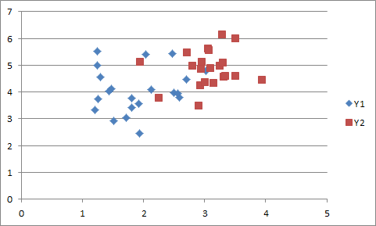
Overlapping Clusters
P1=.85
P2=.15
P1=.55
P2=.45
Each point has a probability of belonging to each cluster.
Examples are demonstration (not computed).

Slide 4
Clustering Applications
Groups of people
Customers
Suppliers
Employees
Production
Products
Production lines, Factories
Investments
MIS
User groups
Projects
Security threats
Web page sequences (sequence clustering—a different chapter)
Dimension reduction
Some business applications. Many others exist in science.

Slide 5
Attributes
Clusters are defined in terms of distance.
Based on measures of attributes, clusters are collections of observed items that have a minimal distance to the center of the cluster and a maximal distance to other clusters.
Choosing and measuring attributes is critical to the success of clustering.
Ranges of attributes define the clusters.

Slide 6
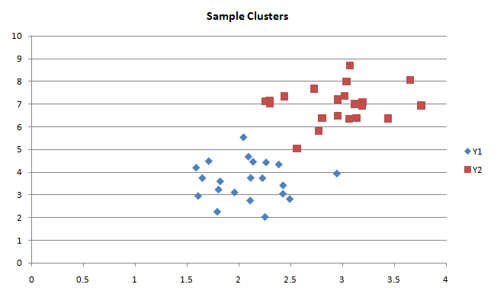
Distance
Internal distance
External distance
Common measure of distance: Euclidian (square).
But it is not the only measure.
Different measures yield different clusters.

Slide 7
Distance
Euclidian distance -- common
Absolute value
Correlation distance
Averages are over attributes.
Ordinal/ordered data: 1, 2, …
Center the interval: -1/2

Slide 8
Distance with Categorical Data
Categorical data, or nominal variables, with M values
Create M x M matrix. Diagonal i=k, distance = 0
Off-diagonal i ≠ k, distance = 1; but could create weights.
Distance | Female | Male
Female | 0 | 1
Male | 1 | 0
Distance | Dept A | Dept B | Dept C | Dept D
Dept A | 0 | 1 | 1 | 1
Dept B | 1 | 0 | 1 | 1
Dept C | 1 | 1 | 0 | 1
Dept D | 1 | 1 | 1 | 0
If dissimilarities exist across departments, unequal distance weights could be assigned.
If the tool does not support manually entering the weights, use SQL to define a new column and assign numbers to the various departments that reflect the differences—turning it into a continuous data item.

Slide 9
K-Means
Start with number of clusters (K).
Assign each point to exactly one cluster based on distance.

Slide 10
K-Means Process
Select the number of clusters: K
Select starting points for the clusters (means)
For given cluster assignments, minimize the total cluster variance to find the central point or mean with respect to all p attributes.
Given the current set of means, assign each of N points to a cluster so that the within-cluster Euclidean distance is minimized.
Repeat until points no longer switch to other clusters.

Slide 11
Problems with K-Means
Need to choose K
Need starting point for clusters
Routine tends to find local optimum, not global
Each point is assigned to exactly one cluster
Is computationally expensive
A heuristic exists for choosing K
First pass, look at various values, find kink.
Most routines automate the choice, but can override
Most routines have methods to choose starting points.
A good practice is to select multiple starting points and run to convergence. Then choose best solution. Hopefully closer to global optimum.

Slide 12
Statistical Mixture Model
Assume each point is an observation from a population that follows some distribution function. Each group/cluster is defined by a specific distribution. Each point could be a combination or mixture of those groups.
Example: One dimension.
Two groups with standard deviation of 1.0 and different means (3 and 5).
Consider point shown by line at 4.4; and Gaussian (normal) distributions.
The point is partially a member of group G2 and G1.

Slide 13
Cumulative/Responsibilities
Responsibility: relative density: g₀/(g₀+g₁) and g₁ (g₀+g₁)
In the example, where x=4.4, responsibilities are 0.31 and 0.69
Key: A point can “belong” to more than one cluster. It is derived from the mixed distribution of the clusters. There is a mixture parameter that defines the percentage from each distribution.

Slide 14
Expectation Maximization (EM)
Start with initial mixture value (π = 0.5), and initial distribution parameters for each cluster.
Compute responsibilities for each observation and compute parameter.
Use parameters to estimate mean and variance for cluster distributions, and new estimate of mixture value.
Repeat until parameters are stable.

Slide 15
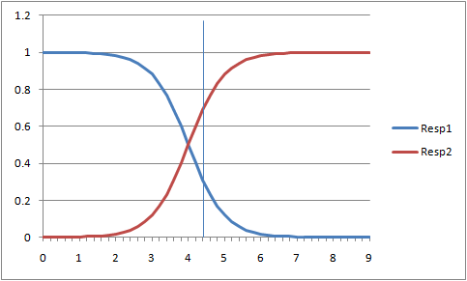
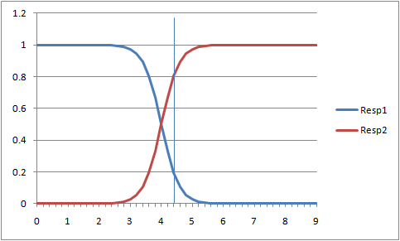
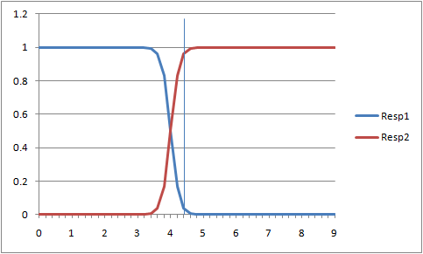
Standard Deviation
Std Dev=1
Std Dev=0.75
Std Dev=0.5
Standard deviation for the cluster distributions is estimated as part of the EM process.
As standard deviation approaches zero, each point is more closely associated with a single cluster. It falls into the responsibility of a single distribution.
If standard deviation is high, the mixture parameter is about 0.5, indicating it is equally affected by both cluster distributions.

Slide 16
EM Problems
The number of clusters is not computed but must be set at the start. The same process used for K-means is often used for EM.
The starting means and standard deviations of the clusters must be specified.
EM suffers similar issues of local minima as K-means. The choice of the starting point can result in convergence to a local minima that is suboptimal.
With high overlap and high standard deviations, the cluster assignments might be ambiguous—providing little useful information.

Slide 17
Microsoft Sample
Corner Med example of customers/patients. Note the mean and SD for Age.
Note that Gender seems balanced across groups, so probably not a useful classifier.

Slide 18
Hierarchical Clustering: Divisive
All data
Top-down: Divisive
Choose most-dissimilar item and put into new cluster.
Repeat: Find item with most net gain to move to new cluster.
Continue until one item in each cluster.
Or, stop when some max number of clusters is reached or the differences in splitting are minor.
Commonly used in data compression, because easy to control number of clusters—which represents data size.

Slide 19
Hierarchical Clustering: Agglomerative
All data
Start at the bottom.
Find two most similar clusters and combine time to form next level.
Repeat until all data is grouped into one cluster.
Need distance measure between clusters. Starts with distance between points, but must consider all pair-wise points in the two target clusters.
Single linkage: min d(c1, c2)
Complete linkage: max d(c1,c2)
Group average: sum d(c1,c2)/N1N2

Slide 20
Distance Measure Problems
Single linkage: min d(c1, c2) produces clusters with large diameters.
Some items within clusters are not very close to each other.
Arises because distance is evaluated on only the smallest difference.

Slide 21
Complete Linkage Problem
Complete linkage: max d(c1, c2) produces clusters with small diameters.
An item can be excluded from a cluster even though it is close on average.
Arises because one distance might be large.

Slide 22
Group Average
Best method on balance, with good cluster diameters.
Has good mathematical properties and fits reference to statistical clusters.
But, results depend on the numerical scale of the attributes.
For example, changing an income measure from dollars to thousands of dollars could change the resulting clusters.

Slide 23
Dendrogram
Shows clusters at each level.
The height is proportional to the dissimilarity measure between the two children. So, taller/longer stretches indicate large dissimilarities between the two children (which is good).
For example, the split to obtain nodes C, D has greater dissimilarity than the split to obtain nodes A, B.
A
B
C
D

Slide 24
Principal Components
Goal: Find the orthogonal components in order from highest variance to lowest.
Use: Dimension reduction. Particularly if problem is too big or multicollinearity. Drop the dimensions with the least contribution to variance.
Singular Value Decomposition (SVD): X = U D V’
U’U = Ip, V’V = Ip, (orthogonal) D is diagonal. Principal components are the column vectors of U D. SVD is a common statistical and numerical analysis technique.
Ding and He, 2004 showed that PCA is equivalent to K-means clustering as a continuous solution (points assigned to more than one category).

Slide 25
PCA Example
eigenvalue | proportion | cumulative
2.87027 | 0.57405 | 0.57405 | 0.536X3+0.497X5+0.479X2+0.475X1+0.101X4
1.35739 | 0.27148 | 0.84553 | 0.826X4+0.414X5-0.337X1-0.137X3-0.116X2
0.44212 | 0.08842 | 0.93396 | -0.824X2+0.459X3+0.285X5-0.163X4+0.05 X1
0.29819 | 0.05964 | 0.99359 | 0.811X1-0.391X3+0.301X4-0.278X2-0.147X5
V1 | V2 | V3 | V4
0.4752 | -0.3374 | 0.0499 | 0.8110 | X1
0.4788 | -0.1161 | -0.8245 | -0.2783 | X2
0.5363 | -0.1366 | 0.4586 | -0.3907 | X3
0.1007 | 0.8260 | -0.1625 | 0.3012 | X4
0.4971 | 0.4145 | 0.2846 | -0.1468 | X5
Simulated data. X1-X5 => X6
If choose eigenvalues > 1, (Kaiser 1960) would have 2 vectors: V1, V2
Use eigenvectors to define new data columns. Use the reduced set of dimensions in analysis.
Here, can reduce 5 dimensions down to 4 (99.4% variation) or possibly 2 (84.6% variation).
V1: 0.475 X1 + 0.479 X2 + 0.536 X3 + 0.101 X4 + 0.497 X5
V2: -0.337 X1 -0.116 X2 - 0.137 X3 + 0.826 X4 + 0.415 X5
V3: 0.050 X1 – 0.825 X2 + 0.459 X3 – 0.163 X4 + 0.285 X5
V4: 0.811 X1 – 0.278 X2 – 0.391 X3 + 0.301 X4 – 0.147 X5

Slide 26
Data
PatientID | Age | Race | Gender | Tobacco | Insurer | Amount
1 | 58 | 1 | Female | False | Cigna | 75
2 | 2 | 1 | Male | False | United Healthcare | 75
3 | 1 | 3 | Male | False | Cigna | 75
4 | 45 | 1 | Female | False | UniversalCare | 75
5 | 35 | 1 | Female | False | Assurant | 150
Similar to database tables and queries, attributes are represented by columns, and each row contains a single observation.
Continuous data is better than categorical, but tools will assign a zero or one distance to categorical data.

Slide 27
Data: Convert Categorical to Continuous
SELECT Visit.InsuranceCompany,
InsV =
CASE Visit.InsuranceCompany
WHEN 'Humana' THEN 10
WHEN 'Self' THEN 15
WHEN 'Medicaid' THEN 1
WHEN 'Medicare' THEN 1
WHEN 'Blue Cross/Blue Shield' THEN 11
WHEN 'Charity' THEN 0
ELSE 9
END
FROM Visit
Managers or analysts might have a subjective view of the categorical data.
If it exists, these numbers can be assigned to a new variable.
In the healthcare example, physicians might receive different payments from each insurance company. In particular, the government (Medicare and Medicaid) place limits on payments and fees. This partial query recodes the insurance data to incorporate a subjective measure of payment experience.

Slide 28
Missing Data
Clustering does not support missing data.
Typically, rows with missing attribute values are dropped.
That can be a problem if one column has many missing values—too many rows will be deleted. It is probably better to drop the column.
Sometimes missing data is replaced with (a) a constant, (b) a mean, or (c) an average of the two nearest values. The mean is probably OK for a few observations. If a large percentage of rows are replaced, the results might be inaccurate.
Missing data for categories is often treated as simply a new value.
Gender: Female, Male, Missing.

Slide 29
Sample Car Data
CarID | Year | Make | Model | SecTo60 | Category | MPGCity | Price | Weight | Cylinders | HP | Seats
769 | 2012 | Mitsubishi | i-MiEV | 11.9 | Hatchback | 126 | 29125 | 2579 | 0 | 66 | 4
781 | 2012 | Nissan | Leaf | 7.9 | Hatchback | 106 | 35200 | 3385 | 0 | 107 | 5
595 | 2012 | Chevrolet | Volt Hatchback | 8.53 | Hatchback | 95 | 39145 | 3781 | 0 | 149 | 4
839 | 2012 | Toyota | Prius Plug-in | 10.9 | Hatchback | 95 | 32000 | 3165 | 4 | 98 | 5
615 | 2012 | Fisker | Karma | 5.9 | Sedan | 52 | 95900 | 5300 | 0 | 403 | 4
838 | 2012 | Toyota | Prius | 9.7 | Hatchback | 51 | 23015 | 3042 | 4 | 98 | 5
648 | 2012 | Honda | Civic Hybrid | 5.7 | Sedan | 44 | 24050 | 2853 | 4 | 93 | 5
705 | 2012 | Lexus | CT 200h | 10.4 | Hatchback | 43 | 29120 | 3206 | 4 | 98 | 5
832 | 2012 | Toyota | Camry Hybrid | 7.2 | Sedan | 43 | 25900 | 3435 | 4 | 156 | 5
630 | 2012 | Ford | Fusion Hybrid | 8.7 | Sedan | 41 | 28775 | 3720 | 4 | 156 | 5

Slide 30
Car Data 3D
color: price
Miner 3D (expensive)

Slide 31
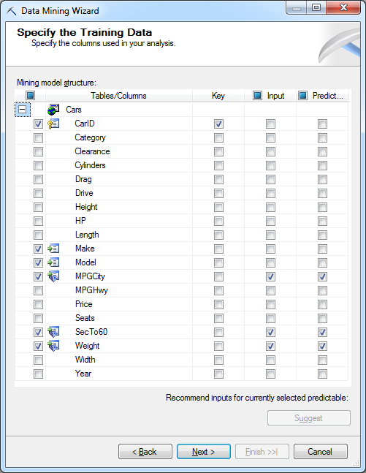
Microsoft Clustering: Columns

Slide 32
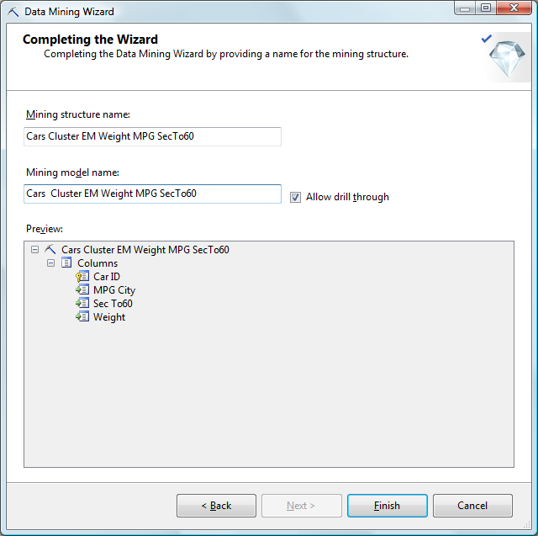
Drill Through is Important

Slide 33
Cluster Diagram: Cluster Overview
Cluster coloring—darker ones have more observations/support.
Links indicate clusters that are similar/close.

Slide 34
Cluster Diagram: MPG

Slide 35
Cluster Profile

Slide 36
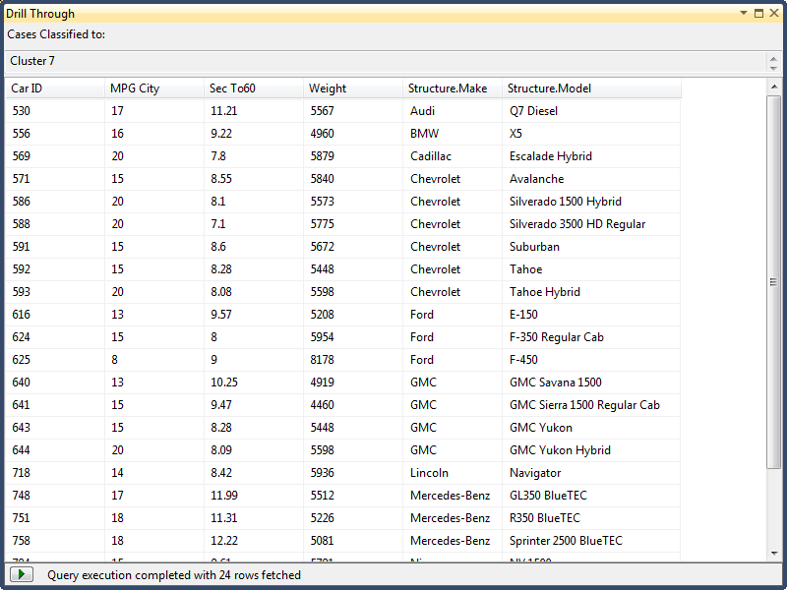
Cluster: Drill Through with Structure

Slide 37
Cluster Characteristics

Slide 38
Cluster Discrimination
Compare one cluster to (a) any other or (b) all others (complement).

Slide 39
Prediction
Result: Cluster 3
Change Field to: ClusterProbability and result is: 0.7946

Slide 40
More Attributes and Parameters
Choose most of the attributes as Input and Predictable.
Right-click the Microsoft_Clustering cell and Set Parameters.
Change CLUSTER_COUNT to 0.

Slide 41
Complete Results

Slide 42
K-Means on All Attributes
Only 3 clusters!
And almost all vehicles are in Cluster 1 (343)

Slide 43
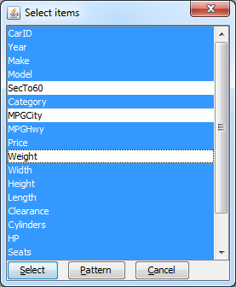
Weka: Import Cars.csv
Ignore all attributes EXCEPT:
SecTo60, MPGCity, Weight
Use Ctrl+Click to de-select

Slide 44
Weka Results: 3 Attributes
 | Cluster 0 | Cluster 1 | Cluster 2 | Cluster 3 | Cluster 4 | Cluster 5 | Cluster 6
N/Pct | 0.15 | 0.26 | 0.07 | 0.06 | 0.14 | 0.19 | 0.13
SecTo60
mean | 8.293 | 6.629 | 8.424 | 6.204 | 4.458 | 8.231 | 8.693
std. dev. | 1.446 | 1.032 | 2.181 | 1.342 | 0.603 | 0.896 | 0.899
MPGCity
Mean | 16.490 | 17.917 | 46.397 | 11.601 | 13.905 | 21.722 | 27.284
std. dev. | 2.353 | 1.208 | 27.227 | 1.308 | 1.834 | 1.350 | 1.983
Weight
mean | 5048 | 3929 | 3317 | 5722 | 3849 | 3362 | 2717
std. dev. | 582.5 | 421.8 | 792.6 | 751.9 | 406.0 | 295.3 | 234.8

Slide 45
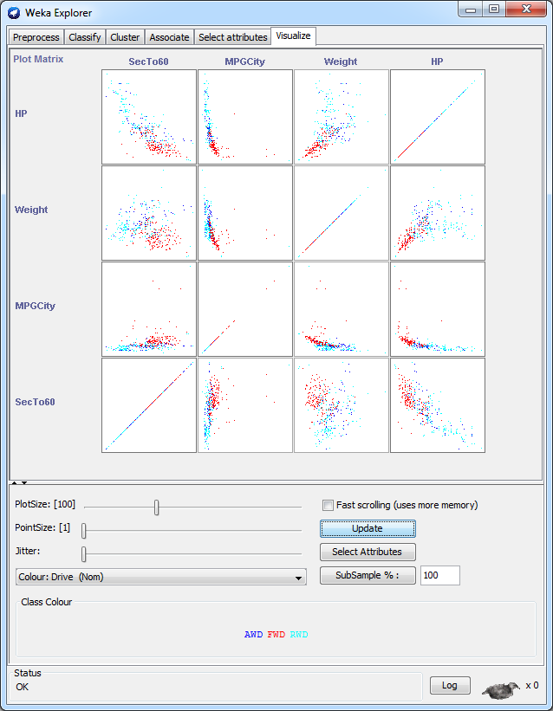
Weka 2D Clustering Charts
Humans have trouble visualizing relationships above two dimensions. Hence, the benefit of presenting an entire panel of pair-wise two-dimensional charts.

Slide 46
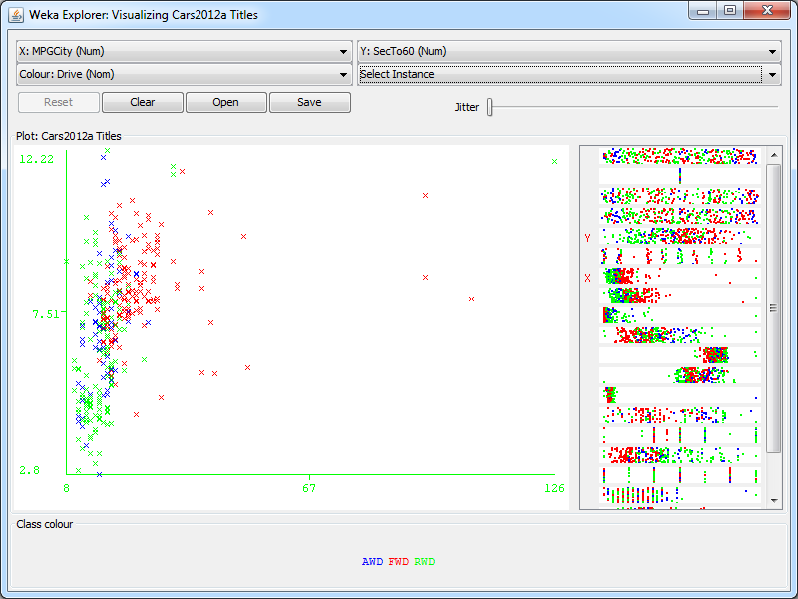
Weka Larger Chart
A third attribute (Drive) is added through color coding.

Slide 47
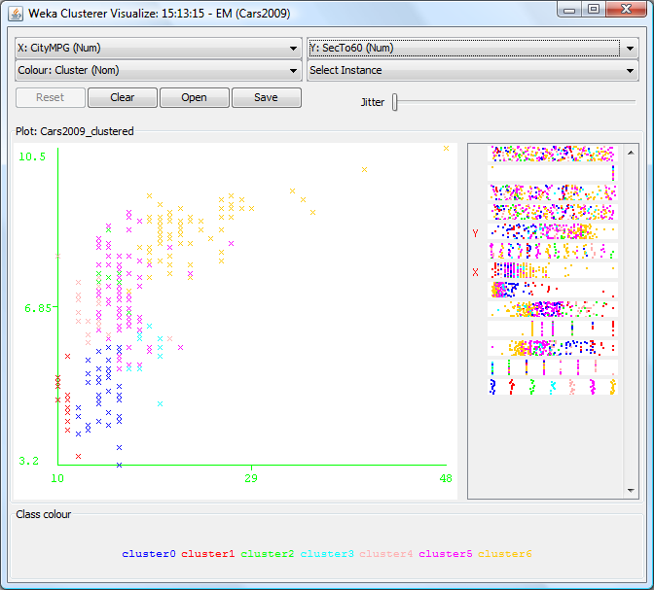
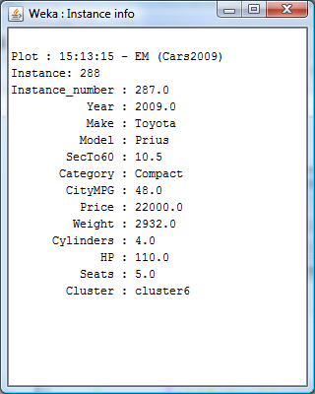
Weka: Cluster Chart
Select a point to drill through.
Right-click Result list entry and choose Visualize.

Slide 48
Weka K-Means on All Attributes
Attribute | All | 0 | 1 | 2 | 3 | 4 | 5 | 6 | 7 | 8
N | 370 | 21 | 85 | 33 | 44 | 34 | 86 | 32 | 15 | 20
SecTo60 | 7.26 | 4.48 | 6.54 | 4.67 | 7.72 | 9.42 | 8.36 | 8.67 | 8.50 | 4.92
MPGCity | 20.7 | 14.5 | 18.7 | 15.0 | 16.1 | 20.2 | 30.3 | 25.2 | 15.0 | 11.7
Price | 58,533 | 127,436 | 40,632 | 89,370 | 42,203 | 31,426 | 21,042 | 25,440 | 27,856 | 330,557
Weight | 3,879 | 3,421 | 3,977 | 4,020 | 5,124 | 3,943 | 3,030 | 2,948 | 5,278 | 4,947
Height | 61.0 | 49.7 | 60.0 | 55.5 | 72.9 | 65.3 | 58.8 | 57.3 | 77.9 | 5.1
Cylinders | 5.9 | 7.9 | 5.7 | 7.7 | 7.0 | 4.5 | 3.9 | 3.9 | 6.8 | 12.0
HP | 274 | 434 | 281 | 456 | 303 | 191 | 153 | 158 | 290 | 539
Seats | 4.7 | 2.0 | 4.7 | 4.4 | 6.9 | 5.1 | 5.0 | 3.3 | 2.7 | 4.1
Drag | 0.326 | 0.325 | 0.323 | 0.313 | 0.358 | 0.341 | 0.312 | 0.328 | 0.334 | 0.325
Better variation than Microsoft K-Means cluster.
Start by finding an attribute that is different across most clusters: Price.
Where Price is similar (Cluster 4 v. Cluster 5), look for secondary classifier: Weight and Seats.
Cluster 4 is likely high-end SUVs (heavy and plenty of seats).
Cluster 5 is probably mid-price sports sedans.

Slide 49
Compare: Microsoft EM
Attribute | C1 | C2 | C3 | C4 | C5 | C6 | C7 | C8 | C9
Cylinders | 4.0 | 6.0 | 5.9 | 9.6 | 4.0 | 8.6 | 7.2 | 4.0 | 2.4
Drag | 0.32 | 0.35 | 0.30 | 0.33 | 0.33 | 0.38 | 0.30 | 0.30 | 0.29
Height | 60.1 | 69.0 | 57.3 | 51.7 | 57.6 | 73.7 | 55.6 | 61.4 | 59.0
HP | 159 | 263 | 282 | 516 | 184 | 375 | 397 | 150 | 150
MPGCity | 24.4 | 17.2 | 18.3 | 13.1 | 23.3 | 13.8 | 16.8 | 31.2 | 64.3
Price | 19660 | 36225 | 38434 | 178041 | 28656 | 126770 | 77806 | 25946 | 35557
Seats | 5.0 | 5.4 | 4.4 | 3.3 | 4.0 | 5.5 | 4.5 | 4.6 | 4.0
SecTo60 | 8.51 | 7.93 | 6.30 | 4.40 | 8.23 | 7.39 | 5.21 | 7.97 | 9.47
Weight | 3080 | 4562 | 3729 | 4012 | 3227 | 5743 | 4023 | 3424 | 3135
N | 87 | 66 | 47 | 37 | 42 | 35 | 31 | 14 | 11
Example | Toyota Camry | Jeep Liberty | Chevrolet Camaro | Mercedes CL63 AMG | Mini Cooper | Cadillac Escalade | Ford Shelby GT500 | Toyota Prius | Nissan Leaf
Description | Basic Sedans | Basic SUVs | Mid-performance | High-price performance | Mid-price performance | Big SUVs | High-Performance | Hybrids | Electrics

Slide 50
Compare: Weka EM
Attribute | C0 | C1 | C2 | C3 | C4 | C5 | C6 | C7
SecTo60 | 7.89 | 7.96 | 4.55 | 9.67 | 4.80 | 6.65 | 8.45 | 7.72
MPGCity | 15.34 | 17.23 | 14.84 | 59.09 | 11.70 | 18.40 | 24.63 | 21.13
Price | 44,916 | 37,046 | 100,641 | 24,396 | 320,150 | 40,345 | 21,838 | 35,760
Weight | 5390 | 4833 | 3837 | 2738 | 4751 | 3910 | 3146 | 3722
Cylinders | 7.1 | 6.5 | 7.7 | 2.9 | 11.9 | 5.8 | 4.0 | 4.9
HP | 321 | 278 | 457 | 97 | 539 | 278 | 163 | 220
Seats | 4.8 | 7.3 | 3.7 | 4.0 | 3.8 | 4.7 | 4.9 | 2.3
Height | 73.3 | 71.6 | 53.4 | 58.7 | 54.3 | 59.4 | 59.6 | 62.9
Drag | 0.36 | 0.35 | 0.32 | 0.30 | 0.33 | 0.32 | 0.32 | 0.33
Count | 35 | 31 | 44 | 12 | 23 | 82 | 120 | 23
Example | Cadillac Escalade | Volkswagen Routan | Porsche 911 | Toyota Prius | Maybach and Rolls | Volvo XC70 | Toyota Camry | Mitsubishi Eclipse Spyder
Descrip. | Big SUVs | Mid-SUVs | High Perf. | Hybrids + Electrics + Small | High Luxury | Faster SUVs | Basic Sedans | Small+Perf.

Slide 51
Categorical Data: Corner Med
Customer data often includes categorical attributes.
Corner Med patient data is similar to customers with some different attributes.
Create a named query to obtain: Age, Gender, Race, TobaccoUse, InsuranceCompany, and AmountTotal.
SELECT dbo.Patient.PatientID, DATEDIFF(yyyy, dbo.Patient.DateOfBirth,
CONVERT(DATETIME, '2011-01-01 00:00:00', 102)) AS Age, dbo.Patient.Race,
dbo.Patient.Gender, dbo.Patient.TobaccoUse, dbo.Visit.InsuranceCompany,
SUM(dbo.VisitProcedures.AmountCharged) AS AmountTotal
FROM dbo.Patient
INNER JOIN dbo.Visit ON dbo.Patient.PatientID = dbo.Visit.PatientID
INNER JOIN dbo.VisitProcedures ON dbo.Visit.VisitID = dbo.VisitProcedures.VisitID
GROUP BY dbo.Patient.PatientID, DATEDIFF(yyyy, dbo.Patient.DateOfBirth,
CONVERT(DATETIME, '2011-01-01 00:00:00', 102)), dbo.Patient.Race,
dbo.Patient.Gender, dbo.Visit.InsuranceCompany, dbo.Patient.TobaccoUse

Slide 52
Microsoft Clusters: Corner Med

Slide 53
Weka Clusters: Corner Med
 | 0 | 1 | 2 | 3 | 4 | 5 | 6
Count | 4309 | 7723 | 526 | 10 | 820 | 285 | 5
Age | 80.4 | 42.5 | 41.3 | 74.6 | 51.5 | 31.5 | 51.4
TotalAmount | 122.23 | 111.65 | 120.57 | 125.72 | 115.94 | 92.14 | 123.02
Race | 1.04 | 1.20 | 1.30 | 1.04 | 1.08 | 3.43 | 1.02
TobaccoUse | 0.00 | 0.00 | 0.99 | 0.00 | 1.00 | 0.23 | 0.27
Gender
Female | 0.996 | 0.626 | 0.989 | 0.001 | 0.416 | 0.229 | 0.592
Male | 0.004 | 0.374 | 0.011 | 0.999 | 0.584 | 0.771 | 0.408
Insurance
Cigna | 0.002 | 0.062 | 0.021 | 0.050 | 0.062 | 0.201 | 0.455
United Healthcare | 0.002 | 0.065 | 0.038 | 0.003 | 0.055 | 0.022 | 0.023
UniversalCare | 0.002 | 0.068 | 0.062 | 0.010 | 0.063 | 0.028 | 0.047
Assurant | 0.002 | 0.074 | 0.068 | 0.005 | 0.050 | 0.049 | 0.046
Humana | 0.002 | 0.077 | 0.074 | 0.007 | 0.054 | 0.064 | 0.050
Blue Cross/Blue Shield | 0.002 | 0.072 | 0.067 | 0.005 | 0.055 | 0.053 | 0.043
Pacificare | 0.002 | 0.077 | 0.082 | 0.007 | 0.055 | 0.029 | 0.052
Aetna | 0.002 | 0.061 | 0.115 | 0.048 | 0.040 | 0.162 | 0.028
Kaiser Permanente | 0.002 | 0.069 | 0.049 | 0.008 | 0.049 | 0.040 | 0.045
Medicare | 0.974 | 0.123 | 0.033 | 0.838 | 0.243 | 0.088 | 0.025
Medicaid | 0.002 | 0.099 | 0.255 | 0.001 | 0.093 | 0.161 | 0.039
Self | 0.002 | 0.060 | 0.059 | 0.003 | 0.079 | 0.016 | 0.043
Nationwide | 0.002 | 0.072 | 0.043 | 0.008 | 0.057 | 0.055 | 0.045
Worker | 0.002 | 0.015 | 0.021 | 0.005 | 0.036 | 0.022 | 0.034
Charity | 0.002 | 0.004 | 0.013 | 0.001 | 0.010 | 0.008 | 0.025
Notice how clusters differ from Microsoft Clustering.
Categorical/ nominal attributes were converted to percentages in Excel.

