Slide 1
6: Association and Market Baskets
Data Mining Applications
Jerry Post
Copyright © 2013

Slide 2

Market Basket Analysis
What items do customers buy together?
Classic store (might not be true because no one seems to know details).
Retail store found on weekend nights that there was a strong relationship between sales of baby diapers and beer.
The hard question: What do you do with this knowledge?

Slide 3
Business Applications
What products are purchased together?
What products can be used in marketing to attract customers with a low price so they buy higher-profit items?
What events commonly happen together?
Do some employees work better together?

Slide 4
The Bakery
Bread
Cake
Candy
Cookie
Crepes
Cupcake
Miscellaneous
Muffin
Pastry
Pie
Rolls
Scone
Sweet Rolls
Need a consistent set of products for multiple years. Basic products consist of 141 items grouped into traditional categories.
Initial sales from 01-JAN-1995 through 31-DEC-2008.
Sales generated with patterns and associations.
Almost 2 million sales records with over 6 million items sold.

Slide 5
Sample Rules
Cookie -> Muffin (13.3, 30.8)
Rolls -> Muffin (10.5, 24.4)
Cake -> Pie ( 8.1, 19.7)
People who bought cookies tended to also buy muffins.
Support: 13.3 percent of the transactions included both items.
Confidence: 30.8 percent estimated probability of buying a muffin given that a cookie has been purchased.
More complex rule:
Scone, Sweet Rolls -> Muffin
Customers who bought both a scone and sweet rolls were likely to buy muffins as well.

Slide 6
Dimension Problem
As the number of items being compared increases, the number of combinations and computer operations increase exponentially. (Details in the Model section.)
The antecedent (left side) could include any combination of the items. But, how would managers be able to interpret a list of 20, 50, 100, or 1000 items?
Often look for a hierarchy of products—Group items by categories, departments, vendors, and so on. Not very useful for recommendation engines (e.g., books, movies); but important for sales. Also useful in other business problems, including HRM, Finance, and so on.
Interpretation of grouped results is sometimes different than at the product level. But still useful. The analyst needs to work with managers to determine what questions need to be addressed.
Typically, start at the higher group levels and work down to detail. It might not make sense to run detailed associations across the entire store. But, it could be done within departments or other groups.

Slide 7
Sample Levels of Analysis
Store
Are sales at one store associated with sales at another store?
1132, 1053, 893, 757, …
Toys, Garden, Auto, Shoes,…
Department
Do sales in one department increase sales in others? Good for loss leaders.
Dolls, Balls, Trucks, Stuffed, …
Category
Are categories of items commonly purchased together? Product display.
Girls, Boys, Baby, Fashion, …
Subcategory
Do subcategories affect each other? Handled within departments.
Product
Which items are purchased together? Usually within department or category.
Barbie, Princess, Corolle, …
Thumbelina, Supergirl, …
Size, Color
Which color items are associated? Useful for clothing.

Slide 8
Model
Find combinations that are frequent and that have interesting results.

Slide 9
Assign a Value to Combinations
Algorithm: Search the combinations of attributes, assign a value, report the rules that have a high enough value.
The numeric values will be used to identify frequent and interesting combinations. Several choices and all have different strengths and weaknesses.
Measure | Definition
Support | P(A and B)
Confidence | P(B | A) P(A and B) / P(A) =Support/P(A)
Lift | P(A and B) / [P(A)P(B)] =Confidence/P(B)
Relative Risk | P(B | A) / P(B | ~A) =Confidence/P(B | ~A)

Slide 10
Support
Frequency, an estimate of the probability of the itemset.
P(A) = # times A occurs in a transaction / total number of transactions.
P(A and B) = P(A ∩ B) : The percent of transactions containing both A and B.
Note the symmetry: P(A ∩ B) = P(B ∩ A)
Support only shows the number of times the two itemsets occur together.
It does not provide any indication of which might lead to the other.
Still, it is one of the most important rules for tuning the association algorithm.

Slide 11
Confidence
P(B | A) = P(A ∩ B) / P(A)
= support(A and B) / support(A)
Confidence is the conditional probability that itemset B is chosen given that itemset A has already been selected.
Note that P(B | A) is different from P(A | B).
It provides an estimate of the probability that once itemset A is selected, B will also be chosen.
Hence the name. If the conditional probability is high, it provides confidence that the combination/rule will occur in the future.

Slide 12
Lift
Lift = P(A ∩ B) / [P(A)P(B)]
= P(B | A) / P(B)
= confidence (B, A)/ support(B)
Lift attempts to measure the gain (lift) provided by the proposed rule. If this rule is true, how much does the probability increase compared to no rule?
Focus on the ratio: P(B | A) / P(B)
It is the relative difference between having itemset A in the market basket versus not having A in the basket.
Values greater than 1 indicate a positive effect.
Values less than 1 indicate a negative effect.
Example: Lift = 1.2 means that the rule leads to a 20 percent increase in probability that B will be purchased.

Slide 13
Relative Risk
P(B | A) / P(B | ~A)
Probability of B given A divided by probability of B given not A
Similar in principle to Lift.
What is the gain in probability of purchasing B when A is present versus when A is not present.
This rule does not work well if A and B are the only two items.
It works best when many other items exist, so ~A is relatively large.
P(B | ~A) = P(B ∩ ~A) / P(~A)
P(~A) = P(B ∩ ~A) + P(~B ∩ ~A)
If A and B are the only items, then P(~B ∩ ~A) = 0, so P(B|~A)=1
Leaving just P(B | A) or confidence.

Slide 14
Venn Diagram
A
B
A
B
A ∩ B
A ∩ B
Support:
(A ∩ B) / Total
~A ∩ ~B
~A ∩ ~B
A
B
A ∩ B
Confidence:
(A ∩ B) / A
~A ∩ ~B
The measure values are the ratios of the indicated colored areas.
Relative Risk: denominator
P(B | ~A)
= (B ∩ ~A ) / ~A
A
B
A ∩ B
~A ∩ ~B

Slide 15
Example
Pie | Sweet Rolls | Cake | Sweet Rolls
Sweet Rolls | Cookie | Cookie | Muffin
Pie | Pastry | Cookie | Sweet Rolls
Pastry | Cookie | Cookie | Muffin
Cupcake | Cake | Bread | Pie
Cookie | Sweet Rolls | Sweet Rolls
Muffin | Cake | Cake | Pie
Cake | Cupcake | Pastry
Rolls | Cake | Pie | Pie
Pastry | Cake | Rolls
Cake | 0.6
Pie | 0.5
Sweet Rolls | 0.4
Cookie | 0.4
Muffin | 0.3
Pastry | 0.4
Support by category
Pie and Cake: 4/10
Sample transactions. Total Count=10

Slide 16
Support and Confidence by Pairs
Highlight support > 0.2
Support | Cake | Pie | Sweet Rolls | Cookie | Muffin | Pastry
Cake | 0.1 | 0.4 | 0.1 | 0.0 | 0.1 | 0.2
Pie | 0.4 | 0.1 | 0.2 | 0.1 | 0.1 | 0.1
Sweet Rolls | 0.1 | 0.2 | 0.2 | 0.3 | 0.1 | 0.1
Cookie | 0.0 | 0.1 | 0.3 | 0.2 | 0.2 | 0.2
Muffin | 0.1 | 0.1 | 0.1 | 0.2 | 0.0 | 0.1
Pastry | 0.2 | 0.1 | 0.1 | 0.2 | 0.1 | 0.0
0.6
0.5
0.4
0.4
0.3
0.4
0.4/0.6 = 0.67
Highlight confidence> 0.4; Row-> Column
Confidence | Cake | Pie | Sweet Rolls | Cookie | Muffin | Pastry
Cake | 0.17 | 0.67 | 0.17 | 0.00 | 0.17 | 0.33
Pie | 0.80 | 0.20 | 0.40 | 0.20 | 0.20 | 0.20
Sweet Rolls | 0.25 | 0.50 | 0.50 | 0.75 | 0.25 | 0.25
Cookie | 0.00 | 0.25 | 0.75 | 0.50 | 0.50 | 0.50
Muffin | 0.33 | 0.33 | 0.33 | 0.67 | 0.00 | 0.33
Pastry | 0.50 | 0.25 | 0.25 | 0.50 | 0.25 | 0.00

Slide 17
Lift
Confidence | Cake | Pie | Sweet Rolls | Cookie | Muffin | Pastry
Cake | 0.17 | 0.67 | 0.17 | 0.00 | 0.17 | 0.33
Pie | 0.80 | 0.20 | 0.40 | 0.20 | 0.20 | 0.20
Sweet Rolls | 0.25 | 0.50 | 0.50 | 0.75 | 0.25 | 0.25
Cookie | 0.00 | 0.25 | 0.75 | 0.50 | 0.50 | 0.50
Muffin | 0.33 | 0.33 | 0.33 | 0.67 | 0.00 | 0.33
Pastry | 0.50 | 0.25 | 0.25 | 0.50 | 0.25 | 0.00
0.6
0.5
0.4
0.4
0.3
0.4
0.67/0.5 = 1.33
Lift = Confidence/P(column)
Lift | Cake | Pie | Sweet Rolls | Cookie | Muffin | Pastry
Cake | 0.28 | 1.33 | 0.42 | 0.00 | 0.56 | 0.83
Pie | 1.33 | 0.40 | 1.00 | 0.50 | 0.67 | 0.50
Sweet Rolls | 0.42 | 1.00 | 1.25 | 1.88 | 0.83 | 0.63
Cookie | 0.00 | 0.50 | 1.88 | 1.25 | 1.67 | 1.25
Muffin | 0.56 | 0.67 | 0.83 | 1.67 | 0.00 | 0.83
Pastry | 0.83 | 0.50 | 0.63 | 1.25 | 0.83 | 0.00

Slide 18
Combinations of Dimensions
A -> B
both are itemsets, both could be any combination of items
Combinations
Try simple: items a, b, c, d
How many ways can these 4 items be arranged without caring about order?
1
a
b
c
d
2
a | a
a | b
a | c
a | d
b | c
b | d
3
a | b | c
a | b | d
a | c | d
b | c | d
4
a | b | c | d
4 | combinations
0 | 1
1 | 4
2 | 6
3 | 4
4 | 1
total | 16

Slide 19
Curse of Dimensions
Assuming the conclusion side (B) is a single item, the total number of combinations of itemsets on the left (A) side is: 2^{d}
dimensions | 2^d
5 | 32
10 | 1024
20 | 1048576
50 | 1.126E+15
100 | 1.268E+30
200 | 1.607E+60
Dimensions can be categories, departments, or even products.
At even 100 dimensions, the problem is likely to be too big.
What happens with companies that have 50,000 or more products?
Reduce the number of dimensions—use categories instead of products.
Tools (a priori algorithm) check rules in a specific order, extending only if prior rules have sufficient support. Start with one item, then two, etc.

Slide 20
A Plan to Set Min Support and Confidence
Start with minimum support high.
Start with minimum confidence low.
Reduce minimum support carefully until rules appear.
Increase minimum confidence to filter out the results, or use sorting and queries if available.
With large problems (particularly many dimensions), support cutoff exponentially reduces the processing time. The goal on the first pass is to get few or no rules and judge the processing time.
Confidence is usually just used as a display filter. Leave it low until the support value is set correctly. Otherwise, the support value might be allowing too many rules but they are hidden by the display cutoff.
Be cautious reducing the minimum support value. The data are not uniformly distributed. Typically, below some point, a huge number of itemsets fall into the accepted level.

Slide 21
Simpson’s Paradox or Yule-Simpson Effect
Example: Men and Women applied for jobs at a company.
In total: 73.9% of the men were hired and 65.8% of the women were hired.
But, look at the detailed results:
 | Men | Women
Dept A | 33.3% | 60.0%
Dept B | 80.0% | 87.5%
In each department, a greater percentage of women were hired than men.
→ The results for the aggregate comparison are different from the detailed comparisons.
One explanation: More women applied for the job that was harder to get.
Or, the data depend on a factor that is not included in the analysis.

Slide 22
Simpson’s Paradox in Association
Think of the percentages as conditional probabilities: P(Hired | Man) and P(Hired | Woman)
Analyzing data at different levels can lead to reversals in association rules.
Rules that appear one way at the corporate level might be reversed at the store or department level.
Which rule is right?
The answer often depends on the goals of the analysis and how the problem is stated.
A classic example is in games, such as batting averages in baseball.
One player could have the best average in each of two games, but the second player might have the best overall average. Which is better? It depends on how the question is phrased.
In many cases (but probably not the baseball example), the detail results might be preferred to the aggregate values, because they incorporate more specific data (department, store, gender, etc.).

Slide 23
Guidelines for Simpson’s Paradox
If detail subgroups exist, always check the rules against the aggregate values. If no paradox exists and the rules match, it provides confirmation.
If Simpson’s paradox does arise and the subgroups provide different results than the aggregation, determine which level addresses the questions being asked.
In most cases, the detail results will be preferred because they incorporate more information.
Try to find a factor or reasons that explain the paradox.

Slide 24
Skewed Support
Most items are rarely purchased (perhaps expensive), with a few items purchased in almost every basket.

Slide 25
Problems with Skewed Support
For common levels of the minimum support parameter, only the handful of high-volume items will appear in the analysis.
The low-volume items could be important
  Perhaps expensive items (caviar -> vodka).
  Perhaps still important volume, just dwarfed by the top 5.
Dropping support to almost zero will bring in virtually all of the items, which could adversely affect performance.
Spurious results because of cross-support

Slide 26
Cross-Support Problem
 | A | B | A & B | P(B|A) | P(A|B)
Typical | 0.4 | 0.5 | 0.3 | 0.75 | 0.6
Cross-support | 0.1 | 0.9 | 0.09 | 0.9 | 0.1
Proposed rule: A => B
Typical example: P(A) and P(B) are similar, so confidence P(B | A) makes sense.
Cross-support: B occurs in almost every basket, A is rare.
A shows up with B almost every time A appears simply because B is already there.
Confidence P(B|A) is going to be high in every case of cross-support.
But A does not cause or lead to B, the joint appearance could be random.
So high values of P(B | A) do not mean confidence.
Perversely, low values of P(B | A) when P(B) is high would be more interesting—indicating that item A is only purchased without B.

Slide 27
Continuous Data
Income | Count | Cumulative | Groups
5000 | 100 | 100
10000 | 150 | 250
15000 | 200 | 450
20000 | 400 | 850
25000 | 800 | 1650
30000 | 1200 | 2850 | 2850 | low
35000 | 2000 | 4850
40000 | 1800 | 6650 | 3800 | medium
45000 | 1200 | 7850
50000 | 900 | 8750
55000 | 700 | 9450
60000 | 500 | 9950
65000 | 300 | 10250
70000 | 150 | 10400
75000 | 100 | 10500
80000 | 80 | 10580
85000 | 50 | 10630
90000 | 40 | 10670 | 2820 | high
 | 10670 | 3556.666667
Example: Income
Need to break into groups, which become dimensions.
Often try for equal number of observations in each group.

Slide 28
Continuous Group Advice
Try to keep the number of groups small—they become dimensions.
Try to use “natural” groupings that fit the problem definition.
Can use groups with equal number of observations.
Watch for break points that might contain useful information.
Might use clustering software to define groups.

Slide 29
Quantity
Quantity is ignored in association/market basket tools.
Product purchases are all equal/binary. An item exists in the basket or not.
A basket containing 1 banana is equivalent to a basket containing 20.
You an add quantity to the analysis by creating new categories/dimensions.
Identify which products might be affected by quantity purchases.
Find split points for each product and define unique product categories.
Run the market basket analysis.
Example:
1 jacket = Jacket1
2-5 jackets = Jacket5
6+ jackets = JacketM
Still hard to find split points.

Slide 30
Data Structure: DBMS
SaleID | SaleDate | CustomerID | EmployeeID
1101 | 7/8/2010 | 393 | 115
1102 | 7/9/2010 | 559 | 089
1103 | 7/9/2010 | 198 | 115
Sale
SaleID | ItemID | Quantity | SalePrice
1101 | 22902 | 1 | $3.95
1101 | 11983 | 5 | $10.00
1102 | 22902 | 2 | $3.75
1103 | 83932 | 3 | $2.00
SaleItem
ItemID | Description | Category | ListPrice
11983 | Blackberry | Pie | $10.95
22902 | Raisin | Bread | 3.95
83932 | Blueberry | Muffin | 2.50
Item

Slide 31
Data Structure: Basket
22902, 11983
22902
83932
19384, 44032, 39382
Bread, Pie
Bread
Muffin
Scone, Cake, Muffin
Each row lists items in one basket.
Items need a separator, often a comma or tab character.
Converting to this format from a DBMS can be challenging.
Usually need custom programming code.
If you can create a unique sale separator,
it might be possible to specify \n (newline) as a separator for items.

Slide 32
CREATE PROCEDURE BuildBasket
AS
BEGIN
-- WARNING: A single line cannot exceed 4000 unicode characters!
DECLARE db_cursor CURSOR FOR
SELECT SaleID, Category
FROM SaleItem
INNER JOIN Product ON SaleItem.ProductID = Product.ProductID
INNER JOIN ProductCategory ON Product.CategoryID=ProductCategory.CategoryID
ORDER BY SaleID, Seq;
DECLARE @SaleID integer, @Category nvarchar(250), @PriorSaleID integer;
DECLARE @iCount integer, @strLine nvarchar(4000);
OPEN db_cursor;
FETCH NEXT FROM db_cursor INTO @SaleID, @Category;
SELECT @iCount = 0, @strLine = '';
WHILE @@FETCH_STATUS = 0
BEGIN
IF (@iCount > 0) SELECT @strLine = @strLine + ',';
SELECT @strLine=@strLine + @Category;
SELECT @PriorSaleID = @SaleID;
select @iCount = @iCount + 1;
FETCH NEXT FROM db_cursor INTO @SaleID, @Category;
IF (@@FETCH_STATUS = 0)
BEGIN
IF (@PriorSaleID <> @SaleID)
BEGIN
PRINT @strLine
SELECT @iCount = 0, @strLine ='';
END
END
END
CLOSE db_cursor;
DEALLOCATE db_cursor;
END
Sample code for Bakery.
Code is limited to 4,000 Unicode characters per output row. It works for the Bakery because of limited number of products per sale.
Also, better to write data to a file or perhaps a new database table instead of the output screen. Too many rows!

Slide 33
File Write Code Segment
http://vstoolsforum.com/blogs/sqlserver/archive/2007/03/23/writing-to-a-text-file-with-sql-server-2000.aspx
--===================================================================================
-- write the results to a text file
--===================================================================================
DECLARE
@vchrFile VARCHAR(1000) ,
@vchrFileID INT ,
@FS INT ,
@RC INT
--this will be on the sql server, not your pc
SET @vchrFile = 'c:\export.txt'
EXEC @RC = sp_OACreate 'Scripting.FileSystemObject', @FS OUT
IF @RC <> 0
BEGIN
PRINT 'Error: Creating the file system object'
END
-- Opens the file specified by the @vchrFile input parameter
EXEC @RC = sp_OAMethod @FS , 'OpenTextFile' , @vchrFileID OUT , @vchrFile , 8 , 1
-- Prints error if non 0 return code during sp_OAMethod OpenTextFile execution
IF @RC <> 0
BEGIN
PRINT 'Error: Opening the specified text file'
END

Slide 34
File Write Code Segment 2
-- =============================================
-- =============================================
DECLARE curLines CURSOR KEYSET FOR
SELECT top 5 Name from sysobjects where xtype = 'p' order by Name
DECLARE @vchrText AS VARCHAR(1000)
-- sp_help SOP30300
OPEN curLines
FETCH NEXT FROM curLines INTO @vchrText
WHILE (@@fetch_status = 0)
BEGIN
-- Appends the string value line to the file specified by the @vchrFile input parameter
EXEC @RC = sp_OAMethod @vchrFileID, 'WriteLine', Null , @vchrText
-- Prints error if non 0 return code during sp_OAMethod WriteLine execution
IF @RC <> 0
BEGIN
PRINT 'Error: Writing string data to file'
END
FETCH NEXT FROM curLines INTO @vchrText
END
CLOSE curLines
DEALLOCATE curLines
EXECUTE @RC = sp_OADestroy @vchrFileID
EXECUTE @RC = sp_OADestroy @FS
GO
Replace @vchrText with @strLine

Slide 35
Apriori with Bakery Data
Sweet_Rolls Sweet_Rolls Cupcake Scone
Scone Cookie Crepes Pastry
Cupcake Muffin Cupcake
Cupcake Muffin Bread Candy Miscellaneous
Crepes Scone Scone
Candy Cookie Scone Miscellaneous
Crepes Pastry Muffin
Rolls Muffin Bread Cake Candy
Muffin Pie Pie Sweet_Rolls
Pie Muffin Cupcake Muffin Bread
Muffin Cookie Sweet_Rolls Miscellaneous
Sweet_Rolls Cookie Cupcake Crepes
Muffin Bread Rolls
Miscellaneous Pie Cake Pie
Candy Muffin Pie Scone
Bread Sweet_Rolls Rolls
Miscellaneous Rolls Muffin
Pastry Muffin Cake Crepes Pastry
Cake Pastry Crepes
Candy Scone Candy Muffin
Miscellaneous Miscellaneous Pie
http://www.borgelt.net/apriori.html
File is a problem because it requires a text file with one basket as one line. Created with code.
apriori –tr –o –s10 –c20 cat2.txt cat2out.txt
Support is measured with only the antecedent. The –o flag should use the original version with both antecedent and consequent but does not work with version in July 2009.

Slide 36
Apriori Partial Results
Muffin | <- | Bread |  | 33.4 | 47.6
Pie | <- | Cake |  | 17.5 | 42.9
Muffin | <- | Rolls |  | 21.6 | 41.1
Muffin | <- |  |  | 100.0 | 40.9
Bread | <- | Rolls |  | 21.6 | 40.2
Bread | <- | Muffin |  | 40.9 | 38.9
Muffin | <- | Pie |  | 36.2 | 38.3
Muffin | <- | Cookie |  | 28.3 | 38.0
Pie | <- | Cupcake |  | 32.8 | 37.1
Muffin | <- | Cupcake |  | 32.8 | 37.0
Pie | <- |  |  | 100 | 36.2
Muffin | <- | Pastry |  | 25.6 | 35.4
Scone | <- | Sweet_Rolls |  | 26.3 | 34.9
Pastry | <- | Crepes |  | 25.4 | 34.9
Crepes | <- | Pastry |  | 25.6 | 34.7
Muffin | <- | Candy |  | 21.3 | 34.7
Bread | <- | Candy |  | 21.3 | 34.5
Pie | <- | Muffin |  | 40.9 | 33.9
Cupcake | <- | Pie |  | 36.2 | 33.6
Bread | <- |  |  | 100.0 | 33.4
Cupcake | <- |  |  | 100.0 | 32.8
Cookie | <- | Pastry |  | 25.6 | 32.8
Pie | <- | Cupcake | Muffin | 12.2 | 32.3
Muffin | <- | Cupcake | Pie | 12.2 | 32.2
Standalone items: Muffin (40.9), Bread (33.4), Cupcake (32.8)
Pairs: Bread -> Muffin, Cake ->Pie, Rolls -> Muffin
Triple: Pie, Cupcake, Muffin (3rd rule not shown is 28.3).

Slide 37
Business Interpretation
Standalone items: Muffin (40.9), Bread (33.4), Cupcake (32.8)
Pairs: Bread -> Muffin, Cake ->Pie, Rolls -> Muffin
Triple: Pie, Cupcake, Muffin (3rd rule not shown is 28.3).
Standalone items, could target advertising.
Pairs: rearrange the store to display paired items together.
Pairs: Bread, possible loss-leader to get people in the door, lead them to Muffins with a higher profit margin.
Triple: Good candidate for package advertising; particularly during slow business times.

Slide 38
Microsoft Data Configuration
SELECT dbo.SaleItem.SaleID, dbo.SaleItem.ProductID,
dbo.SaleItem.Quantity, dbo.SaleItem.SalePrice,
dbo.Product.CategoryID, dbo.ProductCategory.Category,
dbo.Product.ProductName
FROM dbo.SaleItem
INNER JOIN dbo.Product
ON dbo.SaleItem.ProductID = dbo.Product.ProductID
INNER JOIN dbo.ProductCategory
ON dbo.Product.CategoryID = dbo.ProductCategory.CategoryID
Data Source View with all four main tables.
Named query to join SaleItem, Product, ProductCategory
So that SaleID and Category are linked together.

Slide 39
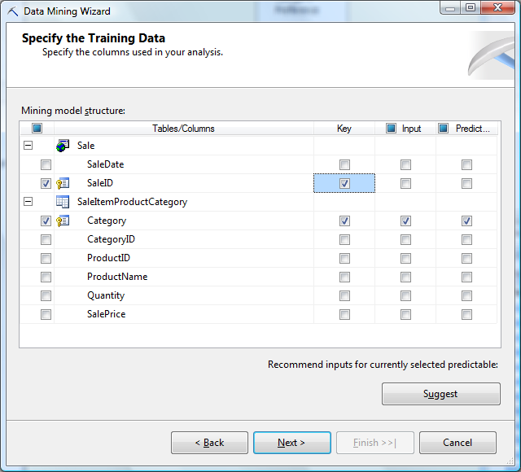
Microsoft Association Setup
Choose Sale table as the main Case table.
Choose the new named query as the Nested table. (SaleItemProductCategory)

Slide 40
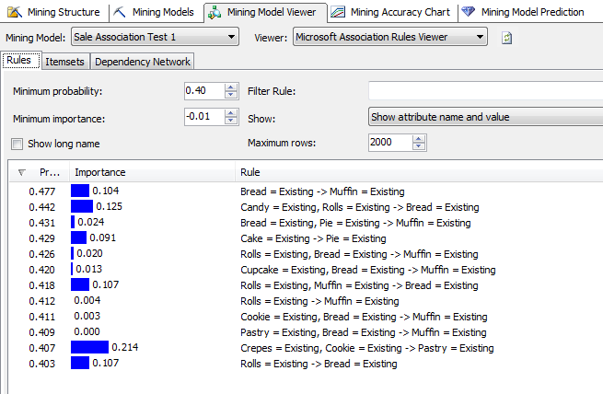
Microsoft Association: Bakery
Importance: log10 (Pr(result | conditions)/
Pr( result | not conditions)
Confidence: Pr(result | conditions)

Slide 41
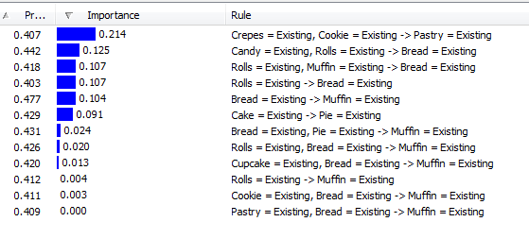
Rules: Importance

Slide 42
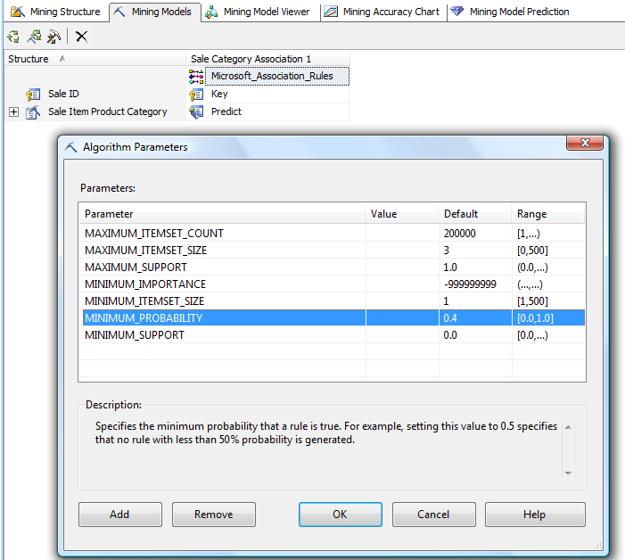
Changing Parameters
Right click: Set Algorithm Parameters
Most critical

Slide 43
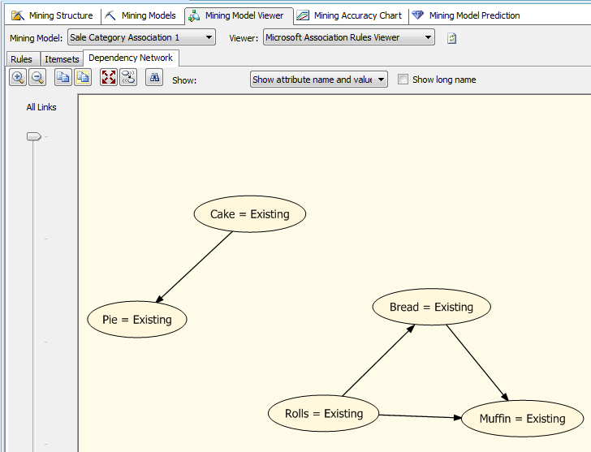
Dependency Network

Slide 44
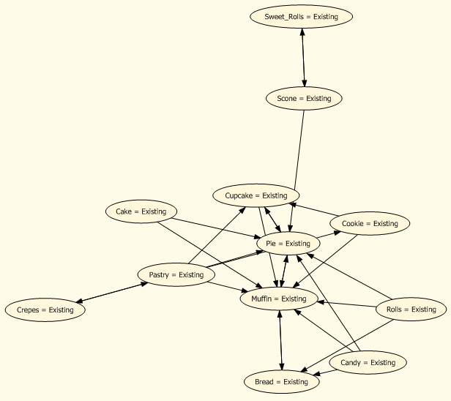
Dependency Network p=0.3
Network model is much more interesting (complex) with minimum probability set to 0.3

Slide 45
Comparison of Tools
Sort both result sets by confidence (probability).
The Microsoft set has all of the rules from the traditional tool—for confidence > 0.4 which was the cutoff used in the Microsoft tool. Slight differences in probability numbers can arise because the Microsoft tool holds out 30 percent of the observations for testing.
Bread -> Muffin (0.476)
Cake -> Pie (0.43)
Rolls -> Muffin (0.41)
Rolls -> Bread (0.40)
Important rules in the Microsoft results not in the Traditional results:
Crepes, Cookie -> Pastry (0.407, 0.214)
Candy, Rolls -> Bread (0.442, 0.126)
The two rules with the highest importance are not in the Traditional set.

