Slide 1
7: Evaluation of Dimensions
Data Mining Applications
Jerry Post
Copyright © 2013

Slide 2
Models
Income
Population
Year
Sales by City
Sales = b₀ + b₁ Population + b₂ Income + b₃ Year
Sale Year >= 2006
Sale Price = 4938 + 74.45*(SaleYear-2007)
+ 26*(FrameSize-39.75)
All
+
Sale Year < 1996
Sale Price = 2489 – 106*(SaleYear-1994)
+ 18.5*(FrameSize-43.6)
+

Slide 3
Data
CityID | Pop | Income | Year | Sales
4650 | 48950 | 34004 | 1994 | 2700
14438 | 2049 | 23020 | 1996 | 2430
4943 | 13064 | 31282 | 2001 | 2680
17664 | 2662 | 45101 | 2004 | 2420
342 | 16844 | 23153 | 2007 | 3910
4586 | 8491 | 39605 | 1997 | 1790
2625 | 7173 | 32016 | 1997 | 2630

Slide 4
Tools and Data Requirements
Tool/Method | Dependent | Independent
Linear Regression | Numeric: continuous | Numeric: continuous Numeric: discrete
Logistic Regression | Numeric: discrete | Numeric: continuous Numeric: discrete
Decision Tree Naïve Bayes | Numeric: continuous Numeric: discrete Categorical | Numeric: continuous Numeric: discrete Categorical
Neural Network | Numeric: continuous* Numeric: discrete Categorical | Numeric: continuous* Numeric: discrete Categorical
*Some options in neural networks are available only with continuous data.

Slide 5
Microsoft: Key Column
Microsoft BI tools require a single column as the key.
It must uniquely identify rows. It can be only one column!
Often, you will need to concatenate columns in a query.
CustomerID | Year | Sales | CustomerYear
152 | 2008 | 173 | 152-2008
193 | 2008 | 113 | 193-2008
152 | 2009 | 192 | 152-2009
193 | 2009 | 135 | 193-2009
Cast(CustomerID as nvarchar) + ‘-’ + Cast(Year as nvarchar)

Slide 6
Linear Regression
Income
Population
Year
Sales by City
Sales = -483876+ 0.022726*Population
+ 0.036256*Income + 243.14*Year

Slide 7
Regression: Fitting Lines
Slope=0.0138
^
Y-Y
21.9
Sales = 21.897 + 0.0138*Income

Slide 8
Categorical to Numeric
CustomerID | Gender | NewGender
1 | F | 1
2 | M | 2
3 | M | 2
4 | M | 2
5 | M | 2
6 | M | 2
7 | M | 2
8 | F | 1
9 | M | 2
SELECT CustomerID, Gender,
CASE Gender
WHEN 'F' THEN 1
WHEN 'M' THEN 2
ELSE 0
END As NewGender
FROM Customer

Slide 9
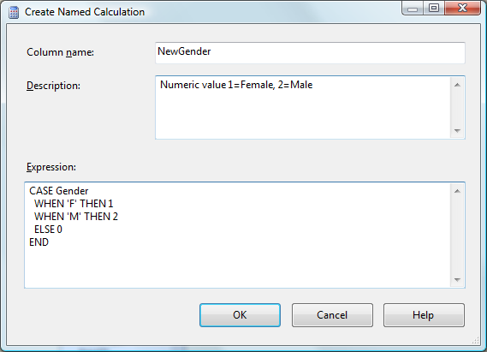
Recode in Data Source View
Open the data source view .
In the Design screen, right-click the Customer table.
Choose New Named Calculation.
Enter the values shown.

Slide 10
Data: Query
SELECT City.CityID, Population2010, Income2009, YEAR(Bicycle.OrderDate) As SaleYear, SUM(SalePrice) As TotalSales
FROM City
Inner Join Customer
ON City.CityID=Customer.CityID
INNER JOIN Bicycle
ON Bicycle.CustomerID = Customer.CustomerID
WHERE Population2010 Is Not Null
And Income2009 Is Not Null
GROUP BY City.CityID, Population2010, Income2009, YEAR(Bicycle.OrderDate);

Slide 11
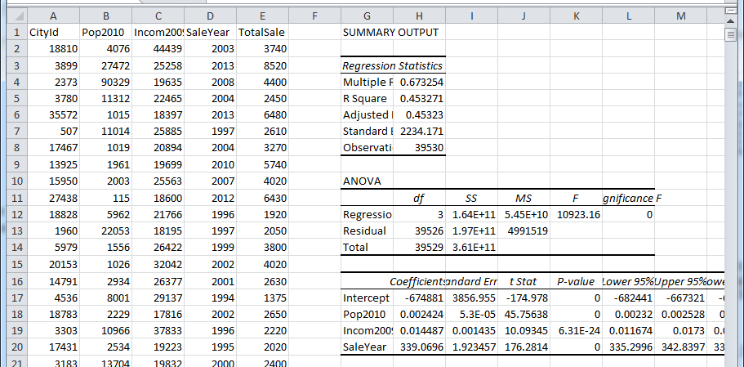
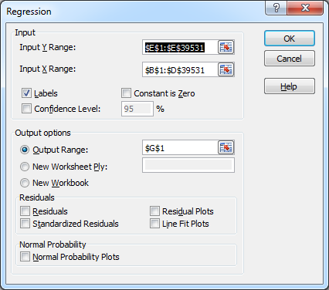
Least Squares: Excel
Independent columns must be contiguous.
R²
Standard Error
Include labels so they are displayed in the results.

Slide 12
Least Squares: gretl
coefficient std. error t-ratio p-value
---------------------------------------------------------------
const -674881 3856.96 -175.0 0.0000 ***
Pop2010 0.00242397 5.29756e-05 45.76 0.0000 ***
Incom2009 0.0144869 0.00143528 10.09 6.31e-024 ***
SaleYear 339.070 1.92346 176.3 0.0000 ***
Mean dependent var 5272.920 S.D. dependent var 3021.440
Sum squared resid 1.97e+11 S.E. of regression 2234.171
R-squared 0.453271 Adjusted R-squared 0.453230
F(3, 39526) 10923.16 P-value(F) 0.000000
Log-likelihood -360929.2 Akaike criterion 721866.4
Schwarz criterion 721900.7 Hannan-Quinn 721877.3

Slide 13
Results: Interpretation
Sales = -674881+ 0.002424Population + 0.014487 Income + 339.07 Year
(-175.0) (45.76) (10.09) (176.28) (T-stats)
R² = 0.2655
The R² value indicates the percentage of the Y-variation that is explained by the X variables. A value of 1.00 would be a perfect line.
The coefficient values are important because they are the slope or change in the Y value that will occur for a one-unit change in the input X-value. In the example, sales increase by 339 each year. An increase of 1,000 in Income increases sales by 14.49.
Coefficients can be examined by a T-test to see if they are significantly different from zero. The T-value is computed as Coefficient/Std. Error. Loosely, if the value is greater than 2, the coefficient is significantly different from zero—so it is important in the equation.

Slide 14
SQL Data Mining: Linear Regression
In Data Source View, Create a Named Query: SalesByCity
SELECT CAST(dbo.Customer.CityID AS nvarchar) + N' -' + CAST(YEAR(dbo.Bicycle.OrderDate) AS nvarchar) AS CityYear, dbo.City.Population2000,
dbo.City.Income2004, YEAR(dbo.Bicycle.OrderDate) AS SaleYear, SUM(dbo.Bicycle.SalePrice) AS SaleTotal, dbo.Customer.CityID
FROM dbo.Bicycle
INNER JOIN dbo.Customer
ON dbo.Bicycle.CustomerID = dbo.Customer.CustomerID
INNER JOIN dbo.City
ON dbo.Customer.CityID = dbo.City.CityID
WHERE (dbo.City.Population2000 IS NOT NULL) AND (dbo.City.Income2004 IS NOT NULL)
GROUP BY CAST(dbo.Customer.CityID AS nvarchar) + N' -' + CAST(YEAR(dbo.Bicycle.OrderDate) AS nvarchar), dbo.City.Population2000, dbo.City.Income2004,
YEAR(dbo.Bicycle.OrderDate), dbo.Customer.CityID

Slide 15
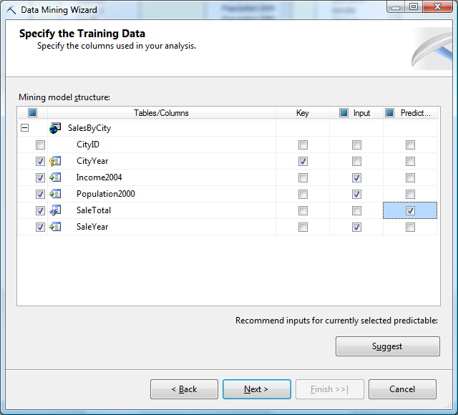
Data Mining: Regression
Right-click Mining Structures and pick New Mining Structure.
Choose the Data Source View that contains the named query and select it as the Case table.
Select CityYear as the key column if it is not already checked.
Select SalesTotal as the predictable attribute.
For Income, Population, and SaleYear, check the Input box.

Slide 16
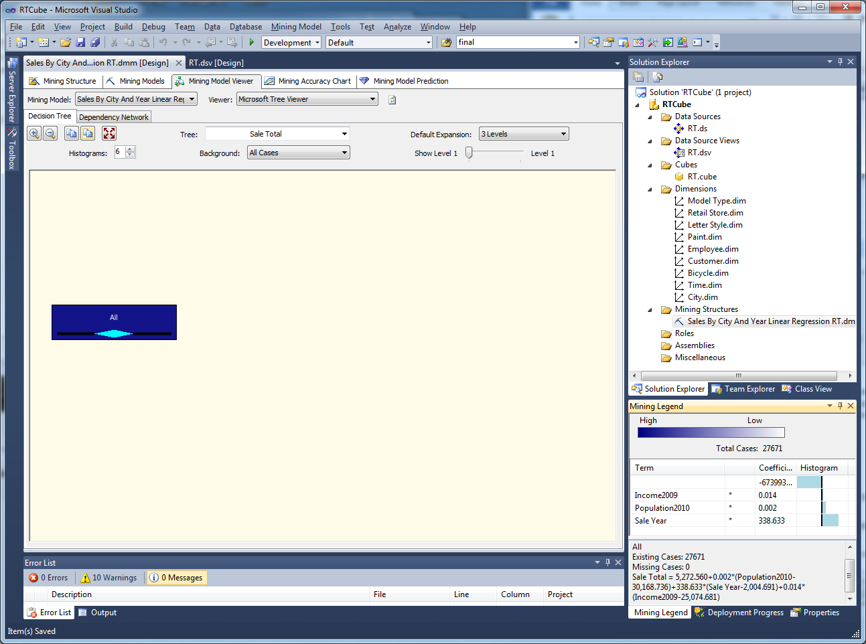
Single Node Results

Slide 17
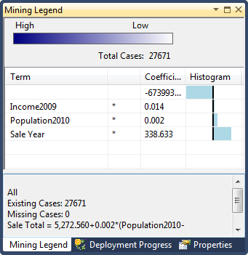
Regression Results: Microsoft

Slide 18
Regression: Scatter Chart
Mining Accuracy Chart: Scatter chart of predicted v. actual Y values taken from the holdout dataset.

Slide 19
Cross Validation
Goal: Test if some groups of data have a different effect on the results.
Set the number of folds (partitions of data): 5.
Set Max Cases (number of data rows) to 0 to use all training data.
Get Results.
Root mean square error (RMSE) is a measure of the difference between actual and predicted values. Mean absolute deviation (MAD) is similar but uses absolute value instead of squaring the errors. Values should be roughly equal across partitions.
RMSE should match the standard error from least-squares regression.
RMSE =
MAD=
2230 v. standard error of 2234

Slide 20
Attribute Evaluation: Elasticity
Elasticity = percent change in Y / percent change in X
Attribute | Coefficient | Average | Elasticity
Sales |  | 5272.92
Year | 339.07 | 2004.66 | 128.908
Population | 0.002424 | 29505 | 0.014
Income | 0.014487 | 25060 | 0.069

Slide 21
Prediction
For some x values (population, income, year):
Sales = -674881+ 0.002424 (80000) + 0.014487 (65000) + 339.07 (2012)
= 8462.6
Forecast error/variance:
Example 95% confidence intervals (moderate is actual):
(6848, 7000) low variance, good information with tight range
(6453, 4380) moderate variance, a ball-park estimate
(4084, 12842) high variance, forecast is weak
Variance is complex to compute. Let software do it.

Slide 22
BI Prediction Pane/singleton
Right-click and switch to Results: 8446.5

Slide 23
Logistic Regression
Linear regression requires a continuous dependent Y variable.
To handle cases of discrete values (0, 1, and so on), use logistic regression.
For any value of z, the probability (p) is between zero and one.
To estimate p, z is a linear function of the attributes:
Z = b₀ + b₁x₁ + b₂x₂ + …
Log of the odds ratio.
Traditional logit, but not used by Microsoft.

Slide 24
SQL CASE to get Discrete Numbers
SELECT Bicycle.SerialNumber, City.Population2010/1000 As Population,
City.Income2009/1000 As Income,
YEAR(Bicycle.OrderDate) AS SaleYear,
CASE
WHEN ModelType='Race' THEN 1
WHEN ModelType='Road' THEN 2
WHEN ModelType='Track' THEN 3
WHEN ModelType='Tour' THEN 4
WHEN ModelType='Mountain' THEN 5
WHEN ModelType='Mountain full' THEN 6
ELSE 0
END AS NModelType,
CASE
WHEN Gender='F' THEN 1
WHEN Gender='M' THEN 2
ELSE 0
END AS Ngender
FROM Bicycle
INNER JOIN Customer
ON Bicycle.CustomerID = Customer.CustomerID
INNER JOIN City
ON Customer.CityID = City.CityID

Slide 25
Data for Microsoft Logistic Regression
SELECT dbo.Bicycle.ModelType, dbo.Bicycle.SalePrice, dbo.Bicycle.SerialNumber, dbo.Bicycle.FrameSize,
YEAR(dbo.Bicycle.OrderDate) AS SaleYear,
dbo.Bicycle.LetterStyleID, dbo.Bicycle.StoreID,
dbo.Bicycle.EmployeeID, dbo.City.Population2010,
dbo.City.Income2009, dbo.Customer.Gender
FROM dbo.Bicycle
INNER JOIN dbo.Customer
ON dbo.Bicycle.CustomerID = dbo.Customer.CustomerID
INNER JOIN dbo.City
ON dbo.Customer.CityID = dbo.City.CityID
Choose a dependent/predictable variable—ModelType
Choose attributes that
Might influence the dependent variable
Can be controlled in some fashion
Can provide useful explanations of consumer behavior

Slide 26
Traditional Logistic Results
Model | Constant | Pop | Income | Year | Gender
Race | -245.6** | 0.00027** | 0.0058 | 0.124** | -0.199**
Road | -225.8** | 0.00013 | -0.0062 | 0.114** | -0.203**
Track | 1967.4** | 0.00007 | -0.0015 | -0.986** | -0.273
Tour | -111.1** | 0.00009 | -0.0099* | 0.056** | -0.251**
Mountain | 5.20 | 0.00010 | -0.0055 | -0.001 | -0.174**
Mountain full | -212.8 | 0.00014 | -0.0072 | 0.108** | -0.205**
Cases correctly predicted: 30.2% gretl: http://gretl.sourceforge.net/
Most results make sense—note that Track bikes were discontinued in 1996.
Gender is coded 0=missing, 1=Female, 2=Male.

Slide 27
Gender Investigation
SELECT Bicycle.ModelType, Customer.Gender,
COUNT(Bicycle.SerialNumber) AS NBikes
FROM Bicycle
INNER JOIN Customer
ON Bicycle.CustomerID = Customer.CustomerID
GROUP BY Customer.Gender, Bicycle.ModelType
ORDER BY ModelType, Gender
Clearly men buy more of each model type.
Do they buy more after controlling for the other variables?
Try removing the missing values.
Hybrid | NULL | 9 | .1%
Hybrid | F | 396 | 39%
Hybrid | M | 601 | 60%
Mountain | NULL | 346 | 5%
Mountain | F | 2791 | 37%
Mountain | M | 4381 | 58%
Mountain full | NULL | 965 | 7%
Mountain full | F | 4554 | 35%
Mountain full | M | 7556 | 58%
Race | NULL | 877 | 8%
Race | F | 3743 | 34%
Race | M | 6483 | 58%
Road | NULL | 756 | 8%
Road | F | 3303 | 34%
Road | M | 5660 | 58%
Tour | NULL | 180 | 8%
Tour | F | 848 | 35%
Tour | M | 1370 | 57%
Track | NULL | 3 | 4%
Track | F | 28 | 38%
Track | M | 42 | 58%

Slide 28
Microsoft Logistic Results

Slide 29
Logistic Details

Slide 30
Mining Accuracy Chart
Series, Model | Score | Population correct | Predict probability
Bike City | 0.30 | 30.2% | 24.8%
Ideal Model |  | 100.00%

Slide 31
Traditional Logistic Prediction
Model | Constant | Population | Income | Year | Gender
Race | -245.6 | 0.00027 | 0.0058 | 0.124 | -0.199
Road | -225.8 | 0.00013 | -0.0062 | 0.114 | -0.203
Track | 1967.4 | 0.00007 | -0.0015 | -0.986 | -0.273
Tour | -111.1 | 0.00009 | -0.0099 | 0.056 | -0.251
Mountain | 5.2 | 0.0001 | -0.0055 | -0.001 | -0.174
Mountain full | -212.8 | 0.00014 | -0.0072 | 0.108 | -0.205
Sample | 1 | 80 | 65 | 2012 | 1
 | Sum: XB | exp(XB)
Race | 4.0876 | 59.59668788 | 0.417531477
Road | 2.9724 | 19.53875638 | 0.136887571
Track | -16.7969 | 5.07223E-08 | 3.55358E-10
Tour | 0.6847 | 1.983176793 | 0.01389404
Mountain | 2.6645 | 14.36076737 | 0.100610833
Mountain full | 3.8342 | 46.25640774 | 0.324070128
 |  | 141.7357962 | 0.007005951
+
*
*
*
*
sum

Slide 32
Microsoft Prediction
Results
Single row
Data to predict
Select Data Source and then Prediction Function
Select Prediction Probability and enter: [Model Type]
Test it. Mountain full and Race types seem to appear quite frequently.
You should then see the need to look at accuracy.

Slide 33
Prediction Results

Slide 34
Classification Matrix: Logit
Predicted | MTN full (actual) | Track (actual) | Tour (actual) | Mountain (actual) | Hybrid (actual) | Race (actual) | Road (actual)
MTN full | 3326 | 0 | 483 | 1530 | 138 | 2696 | 2460
Track | 0 | 0 | 0 | 0 | 0 | 0 | 0
Tour | 0 | 0 | 0 | 0 | 0 | 0 | 0
Mountain | 444 | 21 | 186 | 671 | 158 | 567 | 426
Hybrid | 0 | 0 | 0 | 0 | 0 | 0 | 0
Race | 111 | 1 | 14 | 83 | 11 | 78 | 57
Road | 0 | 0 | 0 | 0 | 0 | 0 | 0
Values on the diagonal are correct predictions. Others show errors.
Example: 444 times the model predicted purchases of mountain bikes that were actually full suspension mountain bike sales.
The model seems to have the most trouble with Road and Tour predictions.

Slide 35
Naïve Bayes
Goal: Find P(Y=y_{i}| X=x_{j})
Probability of specific y-event occurring given a specific value of an x-attribute.
Minimal supervision of learning. Choose the dependent variable, select as many X-attribute as desired. System returns probability estimates.
Data: All attributes must be discrete.
Microsoft BI can convert continuous data into discrete bins,
But easier to understand if dependent attribute is legitimately discrete.

Slide 36
Bayes’ Theorem
Gender/Purchase | Yes | No | Total
Female | 89 | 65 | 154
Male | 172 | 139 | 311
total | 261 | 204 | 465
Table of observations is count of customers who made purchases or not. It represents the joint probability distribution.
P(Y | F) = 89/154 --look only at the given data: female row
P(M | N) = 139/204 --look only at the No column
P(F | Y) = 89/261 --easy because we have entire distribution
Bayes’ genius: If we do not have the entire distribution, it can still be computed.
P(F) = P(F|Y)P(Y) + P(F|N)P(N)

Slide 37
Interpretation of Bayes
What is the difference between these two equations?
In letters and mathematics: Nothing.
And given the complete joint probability distribution, either value can be computed directly.
The real difference lies in interpretation and the availability of data. The difference consists of which event happens first and which needs to be predicted.
Interpretation:
P(Y) is neutral prior distribution
P(F|Y)/P(F) is the information gained.
P(Y|F) is the posterior distribution
The probability of a state I arising given information I.
Data: P(S_{i}) -- usually neutral values
P(I | S_{i}) -- information obtained in each state i.

Slide 38
Bayes: Partial Example
Model/Gender | Male | Female | Missing
All | 0.584 | 0.352 | 0.064
Track | 0.615 | 0.346 | 0.038
Race | 0.591 | 0.331 | 0.078
Tour | 0.570 | 0.360 | 0.069
Road | 0.579 | 0.348 | 0.073
MTN full | 0.577 | 0.355 | 0.068
Hybrid | 0.611 | 0.387 | 0.002
Mountain | 0.591 | 0.371 | 0.038
Compute the probability each attribute value (Gender) leads to a specific outcome (Model Type). In this partial table, 58.4 percent of the customers are Male. There is a 61.5 percent chance that a Track bike will be purchased by a man.

Slide 39
Bayes’ Theorem for Data
To use as classification: Probability that Y=value for a given value of X.
Likelihood/information
Posterior distribution
Constant/normalize
Prior distribution
Estimate probabilities as density functions—based on means and variances. Typically use a maximum likelihood method.
Smooth the observed probabilities to handle low counts within cells.

Slide 40
Named Query for Bayes
SELECT dbo.Bicycle.ModelType, dbo.Bicycle.SalePrice,
dbo.Bicycle.SerialNumber, dbo.Bicycle.FrameSize,
YEAR(dbo.Bicycle.OrderDate) AS SaleYear,
dbo.Bicycle.LetterStyleID, dbo.Bicycle.StoreID,
dbo.Bicycle.EmployeeID, dbo.City.Population2010,
dbo.City.Income2009, dbo.Customer.Gender
FROM dbo.Bicycle
INNER JOIN dbo.Customer
ON dbo.Bicycle.CustomerID = dbo.Customer.CustomerID
INNER JOIN dbo.City
ON dbo.Customer.CityID = dbo.City.CityID

Slide 41
Naïve Bayes Results

Slide 42
Attribute Evaluation

Slide 43
Attribute Discrimination

Slide 44
Prediction: Single Row
Result: Race

Slide 45
Classification Matrix: Bayes
Predicted | MTN full (actual) | Track (actual) | Tour (actual) | Mountain (actual) | Hybrid (actual) | Race (actual) | Road (actual)
MTN full | 2959 | 0 | 386 | 1384 | 102 | 1667 | 1982
Track | 0 | 0 | 0 | 0 | 0 | 0 | 0
Tour | 0 | 0 | 0 | 0 | 0 | 0 | 0
Mountain | 233 | 6 | 144 | 438 | 118 | 237 | 297
Hybrid | 0 | 0 | 0 | 0 | 0 | 0 | 0
Race | 837 | 16 | 155 | 394 | 62 | 1430 | 614
Road | 0 | 0 | 0 | 0 | 0 | 0 | 0

Slide 46
Decision Trees
Portion of a decision tree.
The nodes represent split points where an attribute has a significantly different effect on the outcome variable (Model Type)

Slide 47
Tree as Bayesian Network
Purchase=Yes
P(Y | F)
Gender=Female
Purchase=No
P(N | F)
All
Purchase=Yes
P(Y | M)
Gender=Male
Purchase=No
P(N | M)
Choose a decision tree/split based on maximum likelihood improvements in the Bayesian distribution. Prior distributions are usually either diffuse/even or Dirichlet—for its computability.

Slide 48
Shannon Entropy/Information
Purely random/even distribution.
High entropy (H), low information.
Highly variable probabilities.
Lower entropy (H), more information.
More interesting.

Slide 49
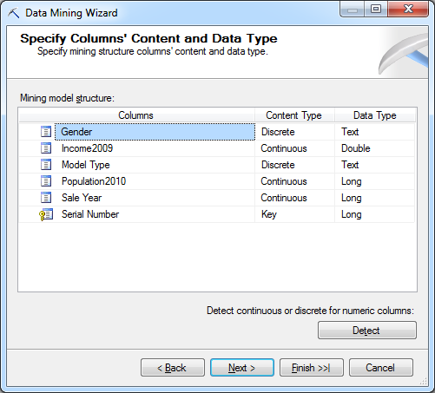
Microsoft Decision Tree
SaleYear is seen as continuous. Leaving it that way enables the tool to find ranges of values instead of focusing on single years.

Slide 50
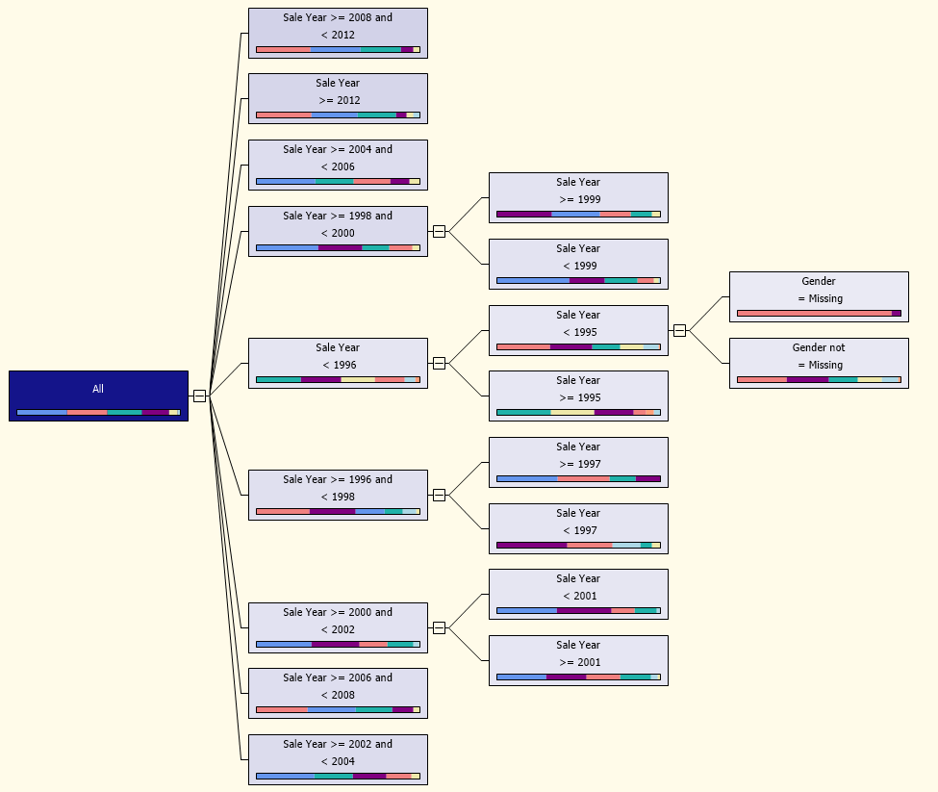
Decision Tree Results

Slide 51
Mining Legend

Slide 52
Attribute Evaluation
Example: Find nodes where full suspension bikes are the best sellers.
Light blue bar.
Top 3 from left:
SaleYear >= 1998 and < 2008
But NOT lead in 1999
SaleYear >= 2000 and < 2002
SaleYear >= 2004 and < 2006
Bottom from left:
SaleYear >= 2002 and < 2004
After 2006,
Income > 32,500 Race is first
Income < 32,500 MTB is first
Full suspension introduced around 1998, so early buyers bought in the first year. Others held off until after 1999.

Slide 53
Prediction: Manually
Year: 1997
Income: 60,000
Population: 80,000
Gender: M
Note: Only two classifiers for 1997 and later.
Income, population, and gender do not play any roles.

Slide 54
Prediction
Result: Mountain full

Slide 55
Classification Errors: Tree
Predicted | MTN full (actual) | Track (actual) | Tour (actual) | Mountain (actual) | Hybrid (actual) | Race (actual) | Road (actual)
MTN full | 1901 | 0 | 212 | 1029 | 53 | 1074 | 1147
Track | 0 | 0 | 0 | 0 | 0 | 0 | 0
Tour | 0 | 0 | 0 | 0 | 0 | 0 | 0
Mountain | 239 | 0 | 76 | 530 | 110 | 374 | 166
Hybrid | 0 | 0 | 0 | 0 | 0 | 0 | 0
Race | 1773 | 2 | 339 | 577 | 135 | 1849 | 1494
Road | 0 | 19 | 93 | 83 | 25 | 37 | 124

Slide 56
Cross Validation
Error | Pass | Fail | Log Like. | Lift | RMSE
1 | 2092 | 4189 | -1.4654 | 0.1198 | 0.6676
2 | 2097 | 4185 | -1.4662 | 0.1189 | 0.6677
3 | 2097 | 4186 | -1.4664 | 0.1190 | 0.6674
4 | 2095 | 4187 | -1.4658 | 0.1202 | 0.6674
5 | 2092 | 4191 | -1.4693 | 0.1167 | 0.6676
Avg | 2094.6 | 4187.6 | -1.4666 | 0.1189 | 0.6675
The data set is divided into folds (1…5). A model is estimated on 5 data sets which contain all data except that in one of the folds. The holdout data is used for testing.
The error measures should be roughly equal across all estimates.
If they are radically different, then the model depends too heavily on that specific set of data and is probably not going to work well on other data sets.
The results here show highly consistent error measures so the model is likely to be robust and work equally well on other data.

Slide 57
Error Measures
The pass/fail measures are counts of the number of predictions correct or incorrect. Each fold has about 6282 observations.
The log likelihood value is derived from the probability density function. Likelihood is the probability of each probability arising and is computed as the product of all of the probabilities.
Lift is the gain in predictive value of the model compared to random selection. Microsoft’s technical notes state that it is measured from the log of the actual probability.
RMSE for a categorical variable is slightly different from that used for continuous data. It is the square root of the mean of the squares of the complement of the probability scores (logs).

Slide 58
Neural Networks
A single neuron receives inputs from other neurons.
It produces an output signal based on the weighted inputs, modified by a sigmoid function.
V₁
w₁
S=Σw_{i}V_{i}
V_{o}=s(u/T)
V₂
w₂
w₃
V₃
Sigmoid function s: typically tanh
Or logistic
T: threshold value

Slide 59
Layers are Critical
Output layer: Values of output variable
Hidden layer: Required
Input layer: Values of all X-attribute variables

Slide 60
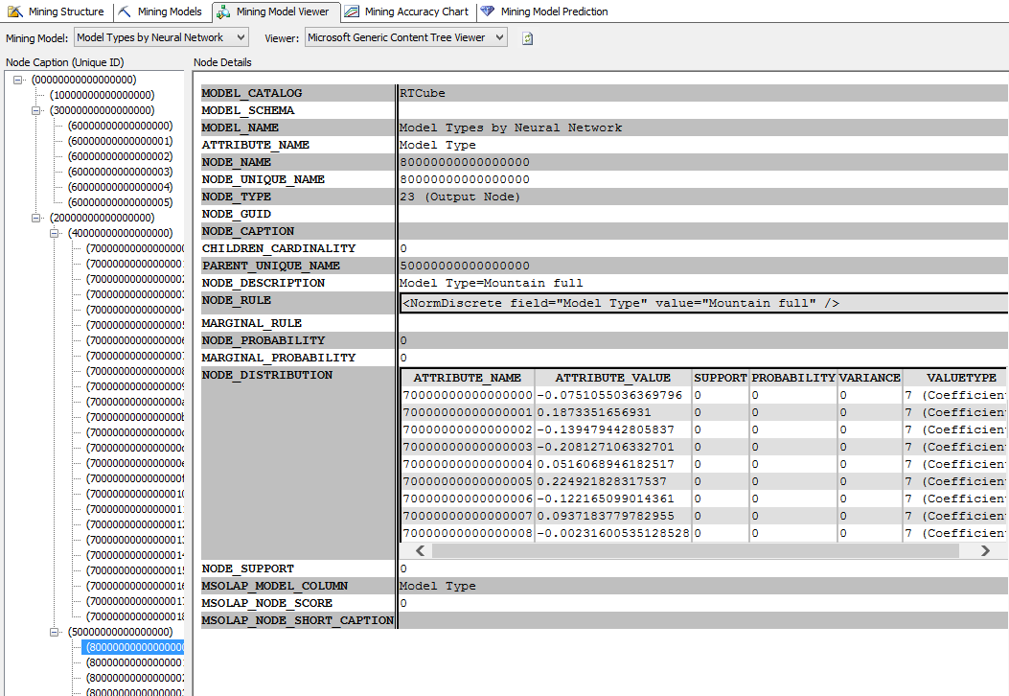
RT Neural Network Results
Input
Hidden
Output
Weights per Input

Slide 61
Attribute Evaluation
Compare two models
Evaluate attributes singly

Slide 62
Prediction
Result: Race

Slide 63
Classification Errors: NN
Predicted | MTN full (actual) | Track (actual) | Tour (actual) | Mountain (actual) | Hybrid (actual) | Race (actual) | Road (actual)
MTN full | 3015 | 0 | 470 | 1337 | 123 | 2523 | 2237
Track | 0 | 0 | 0 | 0 | 0 | 0 | 0
Tour | 0 | 0 | 0 | 0 | 0 | 0 | 0
Mountain | 554 | 23 | 206 | 708 | 149 | 570 | 525
Hybrid | 0 | 0 | 0 | 0 | 0 | 0 | 0
Race | 189 | 1 | 43 | 189 | 12 | 295 | 201
Road | 0 | 0 | 0 | 1 | 0 | 1 | 1

Slide 64
Modeling Comparison: Prediction
Predicted | MTN full (actual) | Track (actual) | Tour (actual) | Mountain (actual) | Hybrid (actual) | Race (actual) | Road (actual)
Full Logistic Bayes Tree Neural | 3326 2959 1901 3015 |  | 483 386 212 470 | 1530 1384 1029 1337 | 138 102 53 123 | 2696 1667 1074 2523 | 2460 1982 1147 2237
Track logistic Bayes Tree Neural | 0 0 0 0 | 0 0 0 0 | 0 0 0 0 | 0 0 0 0 | 0 0 0 0 | 0 0 0 0 | 0 0 0 0
Tour Logistic Bayes Tree Neural | 0 0 0 0 | 0 0 0 0 | 0 0 0 0 | 0 0 0 0 | 0 0 0 0 | 0 0 0 0 | 0 0 0 0
MTN Logistic Bayes Tree Neural | 444 233 239 554 | 21 6 0 23 | 186 144 76 206 | 671 438 530 708 | 158 118 110 149 | 567 237 374 570 | 426 297 166 525
Hybrid Logistic Bayes Tree Neural | 0 0 0 0 | 0 0 0 0 | 0 0 0 0 | 0 0 0 0 | 0 0 0 0 | 0 0 0 0 | 0 0 0 0
Race Logistic Bayes Tree Neural | 111 837 1773 189 | 1 16 2 1 | 14 155 339 43 | 83 394 577 189 | 11 62 135 12 | 78 1430 1849 295 | 57 614 1494 201
Road Logistic Bayes Tree Neural | 0 0 0 0 | 0 0 19 0 | 0 0 93 0 | 0 0 83 1 | 0 0 25 0 | 0 0 37 1 | 0 0 124 1

Slide 65
Correct Percentage
Method | # Correct | Percent | RMSE
Logistic | 1915.6 | 30.5 | 0.647
Bayes | 2175.2 | 34.6 | 0.657
Tree | 2094.6 | 33.4 | 0.668
Neural | 1928.8 | 30.7 | 0.622
Decision Tree is the only method to predict any sales of Road bikes. But percent is highest for Bayes.
Correct/Percent table is based on averages from cross-validation results.

Slide 66
Forecast Model Percent of Sales
 | Logistic | Bayes | Tree | Neural net | 2012 sales
MTN full | 79.0 | 63.0 | 40.2 | 72.6 | 28.41
Track | 0.0 | 0.0 | 0.0 | 0.0 | 0.0
Tour | 0.0 | 0.0 | 0.0 | 0.0 | 4.62
Mountain | 18.4 | 10.9 | 11.1 | 20.5 | 7.32
Hybrid | 0.0 | 0.0 | 0.0 | 0.0 | 4.58
Race | 2.6 | 26.1 | 45.8 | 6.9 | 31.02
Road | 0.0 | 0.0 | 2.8 | 0.0 | 24.05
Model Type percentages, forecast average and actual for all years.
All forecasts are very low for predictions of Race, and Road and are over predicting Mountain full sales.
The problem is with the lack of data available on other attributes.
Could do much better if forecast as a time series.
But the primary goal was to examine attributes of customers.

Slide 67
Model Comparison: Attributes
Logistic | Sale Year | Gender | Population | Income
Bayes | Gender | Sale Year | Population
Decision Tree | Sale Year | Gender
Neural Net | Sale Year | Population | Income | Gender
Primarily comparison of mountain full v mountain.

Slide 68
Nonlinearity
y= b₀ + b₁ x + b₂ x² + b₃ x³ + b₄ x⁴
1 10 -5 -0.1 0.05
1 10 -5 -0.1 0.03
Nonlinear equations are highly sensitive to small coefficient changes.
Nonlinear forecasts are highly risky—particularly exponential forecasts.

