Slide 1
8: Time Series Analysis
Data Mining Applications
Jerry Post
Copyright © 2013

Slide 2
Simple Time Series
Prediction can be based on what happened in the prior periods.

Slide 3
Time Series Components

Slide 4
Auto Regression
Y_{t} = a₀ + a₁Y_{t-1} + a₂Y_{t-2} + … + a_{p}Y_{t-p} + ε_{t}
mean
lags
error
a: Coefficients to be estimated

Slide 5
AR(1) Different Coefficients
Different values of AR(1). Mean a0 was adjusted each time to keep predictions within similar ranges.
Notice that when AR(1) = 0.9 (high correlation), the series is smoother because a high proportion of value is retained each period.

Slide 6
AR(1)-AR(4) Same Coefficients
Lag coefficient of 0.1 in all cases (or 0).
AR(1) is one lag, AR(4) includes one through four lags.
No random component (zero).
AR(4) picks up the lag dips and the early peak, but all level off.

Slide 7
Simple Moving Average
Time | Sales | MA 3-c | MA 5-c
1 | 75
2 | 89 | 85.3
3 | 92 | 90.3 | 89.6
4 | 90 | 94.7 | 94.2
5 | 102 | 96.7 | 97.6
6 | 98 | 102.0 | 97.8
7 | 106 | 99.0 | 97.2
8 | 93 | 95.3 | 96
9 | 87 | 92.0 | 96.6
Centering the moving average keeps the alignment.
Notice that averaging smooths the series. A wider average (higher number) is smoother yet. An average equal to annual (4 or 12) would eliminate seasonality.

Slide 8
Moving Average Model
Simple model, assume four seasons and that effects in each season are independent.
Y₁ = μ + S₁
Y₂ = μ + S₂
Y₃ = μ + S₃
Y₄ = μ + S₄
Compute the average: (Y₁ + Y₂ + Y₃ + Y₄)/4 = μ + Avg(S_{i})
If the seasonal effects are neutral (e.g., stationary), then Avg(S_{i}) = 0.
So the moving average that covers the entire season yields the overall mean with no seasonal effect.

Slide 9
Moving Average
Y_{t} = μ + ψ₀ε_{t} + ψ₁ε_{t-1} + ψ₂ε_{t-2} + …
mean
Lagged errors
ψ: Coefficients to be estimated
No longer simple. It is a weighted, exponential average.
Each coefficient transfers the effect from one period to another.
Under basic conditions, a moving average can be converted into auto regressive.

Slide 10
Moving Average General Model
Y_{t} = μ + ψ₀ε_{t} + ψ₁ε_{t-1} + ψ₂ε_{t-2} + …
General Model:
Example:
Quarterly, 4-period MA
 |  | S₁ | S₂ | S₃ | S₄ | S₁ | S₂ | S₃
Y_{t} | μ | +ψ₀ε_{t} | +ψ₁ε_{t-1} | +ψ₂ε_{t-2} | +ψ₃ε_{t-3}
Y_{t-1} | μ |  | +ψ₀ε_{t-1} | +ψ₁ε_{t-2} | +ψ₂ε_{t-3} | +α₃ε_{t-4}
Y_{t-2} | μ |  |  | +ψ₀ε_{t-2} | +ψ₁ε_{t-3} | +ψ₂ε_{t-4} | +ψ₃ε_{t-5}
Y_{t-3} | μ |  |  |  | +ψ₀ε_{t-3} | +ψ₁ε_{t-4} | +ψ₂ε_{t-5} | +ψ₃ε_{t-6}
Avg | μ + Wtd. Avg (S₁) + Wtd. Avg(S₂) + Wtd. Avg(S₃) + Wtd. Avg(S₄)

Slide 11
MA(1) Different Coefficients
Time | MA 0.1 | MA 0.5 | MA 0.9
1 | 80 | 80 | 80
2 | 85 | 85 | 85
3 | 107 | 107 | 107
4 | 83 | 83 | 83
5 | 110 | 110 | 110
6 | 105.7238 | 113.7188 | 127.1378
7 | 104.8776 | 100.1406 | 84.26603
8 | 105.0522 | 106.4297 | 123.6606
9 | 105.0148 | 103.0352 | 91.44548
10 | 104.9485 | 105.2324 | 113.9591
11 | 105.0451 | 106.1338 | 96.12684
12 | 105.0355 | 103.4331 | 114.6058
13 | 104.9765 | 106.0334 | 99.59474
14 | 105.0324 | 104.4833 | 109.8647
15 | 105.0368 | 105.5084 | 96.57174
16 | 105.0063 | 104.4958 | 111.7754
17 | 105.0494 | 105.7521 | 102.9521
18 | 105.0251 | 105.374 | 110.0831
19 | 104.9775 | 103.563 | 104.4752
20 | 105.0023 | 106.4685 | 107.0923
21 | 104.9898 | 103.0158 | 100.6869
22 | 105.051 | 106.2421 | 104.8318
23 | 105.0449 | 105.6289 | 101.9114
24 | 105.0155 | 104.4355 | 106.1597
MA(1)=0.1 quickly dampens down
MA(1)=0.9 keeps initial series variability for longer.

Slide 12
MA(1)-MA(4) Same Coefficients
Coefficients: 0.5
No added error.
Using more terms increases the variation in the prediction.
Compare MA(1) to MA(4)
The additional terms pick up more of the initial variation.
Variation dies down over time.

Slide 13
Trend
Long-term change in data.
Usually predict as linear, can use linear regression.
Exponential growth forecasts are highly risky.
Chart shows three trends with forecast.
Most likely forecast is probably linear based on the last few points.

Slide 14
ARIMA
Auto-regressive integrated moving average.
y_{t} = θ₁y_{t-1} + θ₂y_{t-2} + … + θ_{p}y_{t-p} + ε_{t} + ψ₁ε_{t-1} + ψ₂ε_{t-2} + … + ψ_{q}ε_{t-q}
AR: auto-regressive, p lags
MA: moving average, q lags
ARMA(p, q)
A series value is determined from information in prior values, plus information from prior variations, such as seasonality.
ARIMA or Box-Jenkins tools estimate the coefficients of the equation to identify the time series pattern.
The coefficients make it easy to predict new values.

Slide 15
ARIMA: No Trend
ARMA cannot be estimated if a trend exists in the series (is not stationary).
ARIMA: Remove trends by differencing: z_{t} = y_{t} – y_{t-1}
Difference once if linear, twice if nonlinear.
Extreme cases, define z_{t} = log(y_{t}) and then difference.
ARIMA(p, d, q)
p: max lag for auto-regressive (AR)
d: number of differences to remove trend (0, 1, 2)
q: max lag for moving average (MA)

Slide 16
Choose p, q for ARMA
Many time series can be estimated with p, q from 1-3.
You might be able to choose relatively high-order lags;
but it takes a lot of data to estimate and the intermediate lags might be unimportant.
Still, with monthly data, to pick up an annual/seasonal effect, need p or q of 12,
And it is unlikely that intermediate lags are important.
Most tools you can enter specific lags: such as 1, 2, 3, 12
Skipping the intermediate values.
But, then you have to know which values to enter.
Some tools (e.g., Microsoft BI) use other statistical methods to guess which lags will be important. Sometimes the guesses are good, sometimes they need help.

Slide 17
Time Series (RT Sales by Month)
original
difference=1
difference=2
Appears to be a linear trend.
One differencing seems to have eliminated the trend and centered the variations on zero.

Slide 18
Autocorrelation and Partial Autocorrelation
Autocorrelation function (ACF)
Partial autocorrelation function (PACF)
Used to check for trends/stationary and likely AR and MA lags.
Autocorrelation: -1 <= r <= 1
Partial Autocorrelation: -1 <= r <= 1
Without effects of intermediate lags.

Slide 19
Correlogram
Dies down over time.
Stable, no trend.
Probably not Moving Average.
ACF cutoff reveals MA lags.
Cuts off after 2 or 3 lags.
Stable, no trend.
Most likely AR(2)
PACF cutoff reveals AR lags.
If patterns were reversed, then most likely it would be MA(2).
If either chart does not die down or cut off then series is not stable and need differencing.

Slide 20
Cross Correlation
ARIMA is purely internal patterns.
Primary series might depend on external factors—particularly economic.
Can include lagged effects.
Essentially combines economic model with time series.
Example matches Sales to Unemployment rate (simple correlation = -0.91).
Another problem type: New product or new region with insufficient data (need 50+).
Use sales from another region or overall to correlate with new data.
One drawback: You have to predict any series used.

Slide 21
Evaluating Models
Box-Jenkins Chi-Square, measures autocorrelation remaining in the K residuals
RMSE.
More commonly evaluated by variations (using logs and some minor transformations)
Akaike Information Criterion (AIC)
Schwarz Criterion

Slide 22
Data
Year(SaleDate)*100+Month(SaleDate) As YearMonth
Numeric and sorts correctly.
Do not subtract to get distance.
Works well with Microsoft Time Series.
Can be used as a JOIN column if importing data from an external (government) source.
YearMonth | Sales
200801 | 5592
200802 | 6582
… | …
200901 | 7839
… | …
Missing data options:
Average the two nearest values.
Copy the nearest older neighboring value into the missing value,.
Compute an average of all data for that time slot (e.g., quarter 1 or specific month).
Only works for limited number of missing values.
Best to aggregate to wider interval. Weeks → Months

Slide 23
Traditional ARIMA
SQL Query to get total sales by month:
SELECT YEAR(OrderDate)*100+MONTH(OrderDate) As YearMonth,
SUM(SalePrice) As Sales
FROM Bicycle
GROUP BY YEAR(OrderDate)*100+MONTH(OrderDate)
ORDER BY 1
YearMonth Sales
199401 215836.97
199402 205952.48
199403 211128.77
199404 188159.83
199405 225387.63
199406 210278.66
199407 244788.67
199408 197913.77
199409 200731.22
199410 219020.42
199411 216574.56
199412 219240.02
199501 240050.00
199502 274500.00

Slide 24
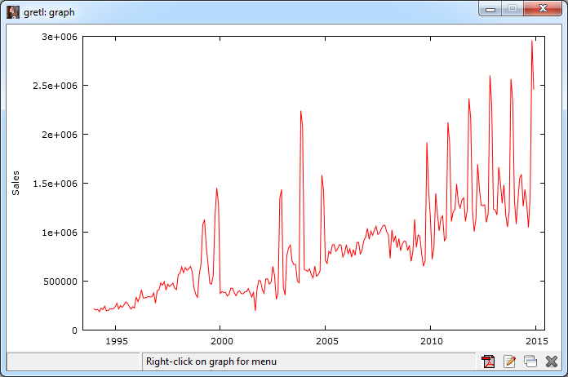
Rolling Thunder Monthly Sales
Possible seasonal peaks
trend
gretl: View/Graph/Time Series

Slide 25
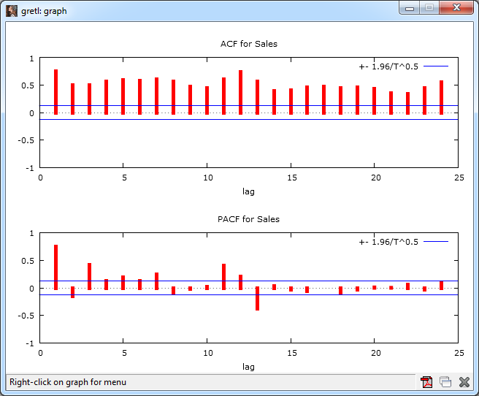
Correlogram on Raw Data
ACF does not cut off or die down so need to difference the data.
Create new series in gretl: Sales2=diff(Sales)
gretl: righ-click Sales column and pick correlogram

Slide 26
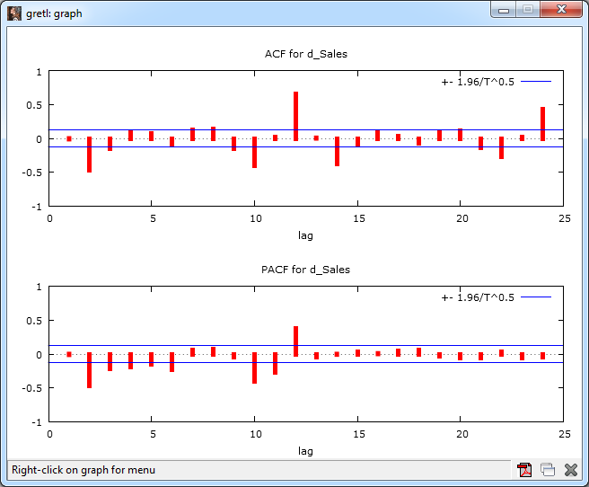
ACF and PACF for diff(Sales)
Cuts off, but has peaks at lags 2, 8, 10, 12, and 14
Dies down, with additional peaks at lags 10 and 12.
Try initial ARIMA(4, 1, 3) with an additional MA 12: MA 1,2,3,12

Slide 27
Initial Estimate
Try initial ARIMA(4, 1, 3) with an additional MA 12
 | Coeff. | Std. Err. | Z | P-value
const | 6607.7 | 7364.5 | 0.8972 | 0.3696
phi_1 | -0.1559 | 0.0991 | -1.5730 | 0.1157
phi_2 | -0.6170 | 0.0981 | -6.2910 | 0.0000 | ***
phi_3 | -0.0234 | 0.0777 | -0.3009 | 0.7635
phi_4 | -0.2196 | 0.0764 | -2.8750 | 0.0040 | ***
theta_1 | -0.0594 | 0.0794 | -0.7484 | 0.4542
theta_2 | 0.0363 | 0.0734 | 0.0494 | 0.6213
theta_3 | -0.4407 | 0.0659 | -6.6850 | 0.0000 | ***
theta_12 | 0.5127 | 0.0517 | 9.9160 | 0.0000 | ***
AR terms
MA terms
Akaike criterion: 6930.493
Schwarz criterion: 6965.747
Hannan-Quinn: 6944.680

Slide 28
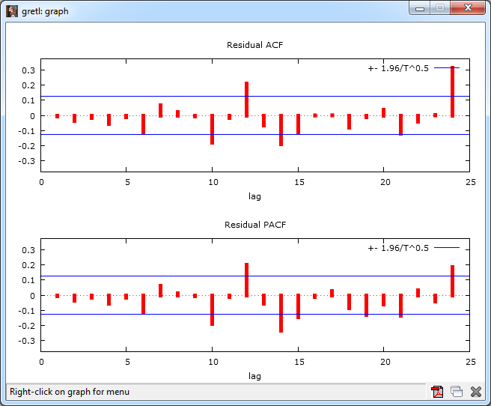
Residual Correlogram

Slide 29
New Model
 | Coeff | std. error | t-ratio | p-value
const | 5589.04 | 757.496 | 7.378 | 0.0000 | ***
phi_1 | 0.0255 | 0.0795 | 0.3208 | 0.7484
phi_2 | -0.2282 | 0.0779 | -2.9290 | 0.0034 | ***
phi_3 | -0.0000 | 0.0626 | -0.0005 | 0.9996
phi_4 | -0.0917 | 0.0504 | -1.8180 | 0.0690
phi_12 | 0.6707 | 0.0492 | 13.640 | 0.0000 | ***
theta_1 | -0.3340 | 0.1031 | -3.2410 | 0.0012 | ***
theta_2 | -0.2690 | 0.1139 | -2.3610 | 0.0182 | **
theta_3 | -0.2348 | 0.0963 | -2.4370 | 0.0148 | **
theta_10 | -0.1499 | 0.0567 | -2.6410 | 0.0083 | ***
theta_14 | -0.0124 | 0.0611 | -0.2032 | 0.8390
Akaike criterion: 6863.546
Schwarz criterion: 6905.851
Hannan-Quinn: 6880.571
ARIMA(1 2 3 4 12, 1, 1 2 3 10 14 )

Slide 30
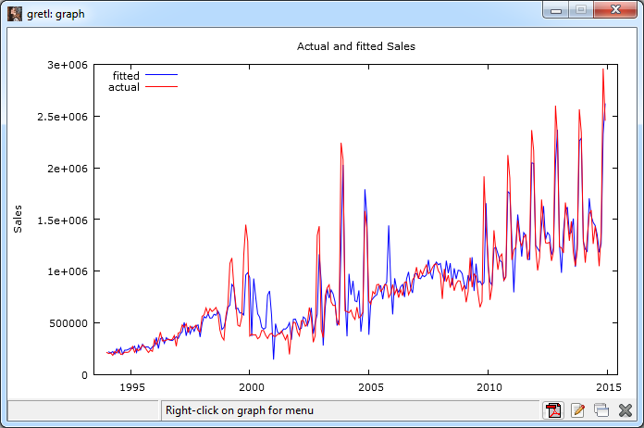
Prediction v. Actual
Some over-estimation in 2001.
Probably an external effect. (9/11? E-Commerce crash?)

Slide 31
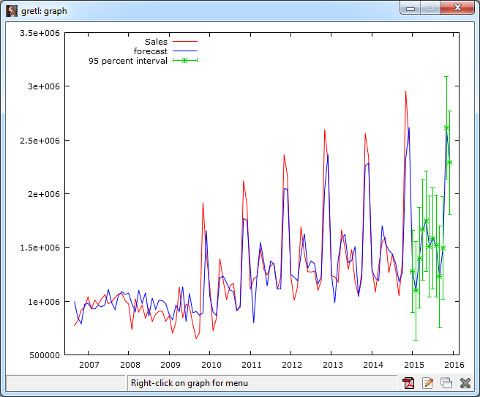
Forecast

Slide 32
Forecast Values
2015:01 | 1276797
2015:02 | 1097255
2015:03 | 1402733
2015:04 | 1663312
2015:05 | 1746264
2015:06 | 1510111
2015:07 | 1587235
2015:08 | 1515373
2015:09 | 1228551
2015:10 | 1494301
2015:11 | 2617069
2015:12 | 2290510
gretl also provides standard errors and 95% confidence interval

Slide 33
Seasonal Effects
SELECT Year(OrderDate)*100+Month(OrderDate), Sum(SalePrice)
FROM Bicycle
WHERE Month(OrderDate)=1
GROUP BY Year(OrderDate)*100+Month(OrderDate)
ORDER BY Year(OrderDate)*100+Month(OrderDate) ;
Avg, Pct, and chart are created in Excel

Slide 34
Microsoft ARTxp
Income > 50,000
Time < 2003
ARIMA - 2
All Data
Income <= 50,000
Time >= 2003
ARIMA - 3
ARIMA - 1
ARTxp (and MIXED) tries to find the points where a different model can produce better estimates. These node splits can be based on the data (time) or a secondary attribute (e.g., Income).
Mixed with ARIMA, each leaf node creates a new set of estimates for the ARIMA model.

Slide 35
Microsoft Time Series Data
Named query to get time key column and subtotal data:
SELECT YEAR(OrderDate) * 100 + MONTH(OrderDate) AS SaleYearMonth, SUM(SalePrice) AS MonthlySales
FROM dbo.Bicycle
GROUP BY YEAR(OrderDate) * 100 + MONTH(OrderDate)

Slide 36
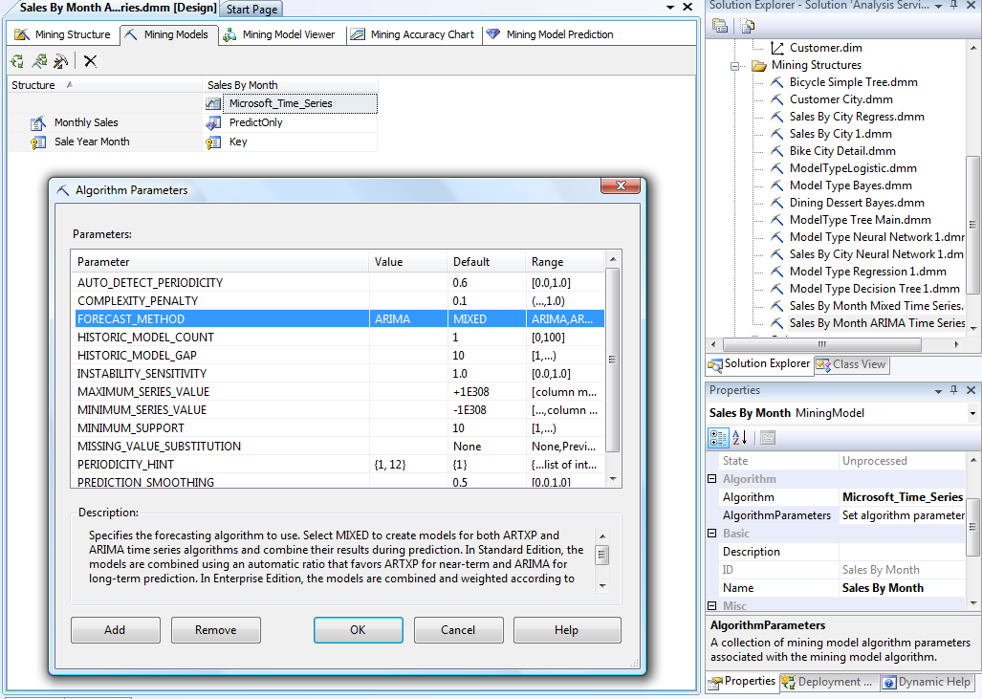
Microsoft Seasonal ARIMA
Enter ARIMA
Enter {1, 12}

Slide 37
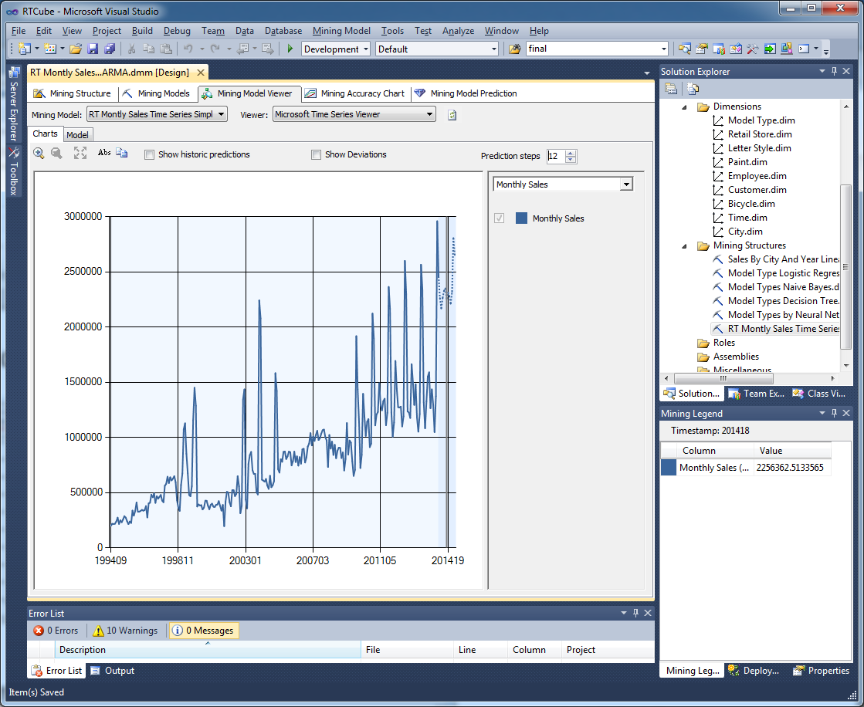
Microsoft ARIMA Results Chart

Slide 38
Microsoft ARIMA Results with Periodicity Hints
ARIMA equation:
ARIMA (
{1,0.23311204599679}, AR(1)
1, difference
{1,-0.140261553333308}) MA(1)
X (
{1,-0.397745131343896,5.34084824481309E-02}, SAR(12)
0, S difference
{1,-6.72065385064266E-02}) SMA(12)
(12)
Intercept:7225.83418153909

Slide 39
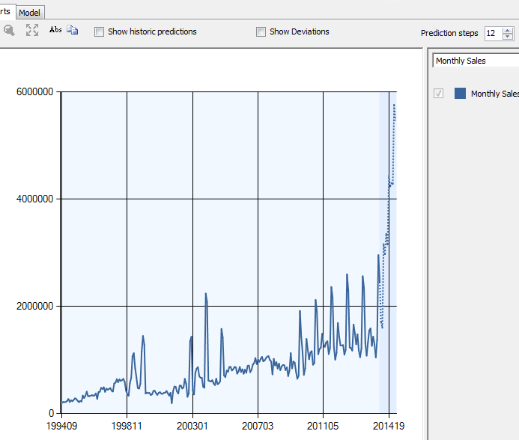
Base Microsoft ARTxp Forecast
Note the big forecast gain.
Compare to ARIMA.

Slide 40
Microsoft ARIMA Coefficients without Periodicity Hints
ARIMA (
{1,-1.45534E-02}, AR(1)
1, Diff.
{1,-0.74364}) X MA(1)
({1,0.27151, SAR (6)
4.86931661E-02}, SAR(12)
0, Diff.
{1,0.767121})(6) X SMA(6)
({1,0.10754, SAR(4)
0.09174323}, SAR(8)
1, Diff.
{1,2.832889E-02})(4) SMA(4)
Intercept:7293.6173

Slide 41
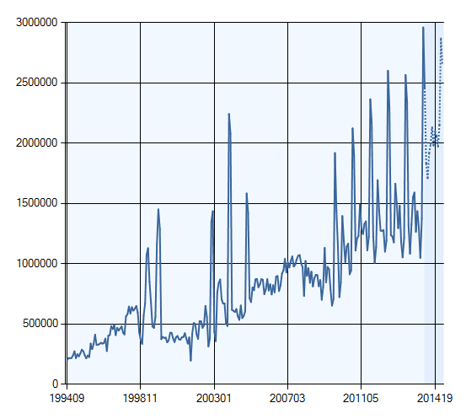
Microsoft Mixed Model: Monthly
Build a new Time Series model and make one change from the default.
Set the PERIODICITY_HINT to {1, 12}

Slide 42
Mixed Model Monthly: ARIMA
ARIMA (
{1, 0.23311}, AR(1)
1, diff.
{1,-0.14026}) MA(1)
X (
{1,-0.39775, SAR(12)
0.0534085}, SAR(24)
0, diff.
{1,-0.06721})(12) SMA(12)
Intercept:7225.8342
With periodicity hint: {1, 12}
The ARIMA model is for the root node of the ARTxp model.

Slide 43
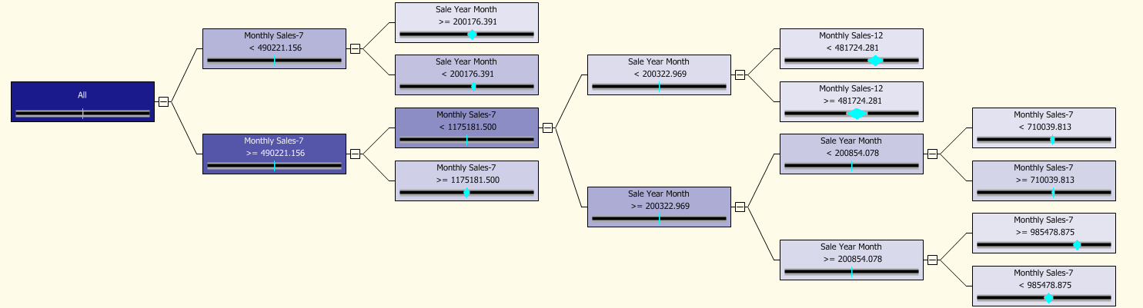
Microsoft Mixed Model
YearMonth >=200176.3
Sales-12 < 481724.3
Sales-7 <490221
YearMonth < 200322.9
YearMonth <200176.3
Sales-12 >= 481724.3
Sales-7 < 710039.8
All
Sales-7 >=490221
Sales-7 >= 710039.8
Sales-7 < 1175181.5
YearMonth < 200854.1
YearMonth >= 200322.9
Sales-7 >= 1175181.5
YearMonth >= 200854.1
Sales-7 >= 985478.9
Sales-7 < 985478.9

Slide 44
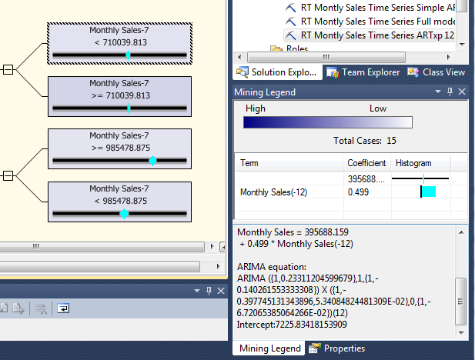
Node Differences
Monthly Sales = 395688.159 + 0.499 * Monthly Sales(-12)
ARIMA is unchanged.

Slide 45
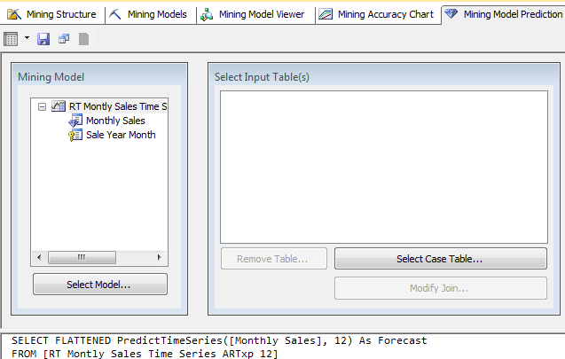
Time Series Forecast
SQL
Results
SELECT FLATTENED PredictTimeSeries([Monthly Sales], 12) As Forecast
FROM [RT Monthly Sales Time Series ARTxp 12]

Slide 46
Time Series Forecast
SELECT FLATTENED
(SELECT *, PredictStdev([Monthly Sales]) As [StDev]
FROM PredictTimeSeries([Monthly Sales], 12))
As Forecast
FROM [RT Monthly Sales Time Series ARTxp 12]
Time | Sales | StDev
201413 | 1831835 | 115390
201414 | 1709642 | 113679
201415 | 1914923 | 110646
201416 | 1991393 | 77833
201417 | 2130782 | 105124
201418 | 1980396 | 102778
201419 | 2098216 | 100685
201420 | 2056840 | 102464
201421 | 1971231 | 106954
201422 | 2148194 | 91530
201423 | 2868532 | 96244
201424 | 2647986 | 93432
Compute standard deviation for each forecast value.
Can be used to obtain 95% confidence interval.

Slide 47
Tricky Forecast: New Model
New model has only 6 months of sales. Not enough to forecast by itself.
Goal: Apply pattern from total sales to the limited data for the new model.
SELECT FLATTENED
PredictTimeSeries([Monthly Sales], 24, REPLACE_MODEL_CASES)
FROM [RT Monthly Sales Time Series ARTxp 12]
PREDICTION JOIN
( SELECT 201407 AS [Sale Year Month], 25621 As [New Model]
UNION SELECT 201408 AS [Sale Year Month], 25621 As [New Model]
UNION SELECT 201409 AS [Sale Year Month], 11592 As [New Model]
UNION SELECT 201410 AS [Sale Year Month], 32119 As [New Model]
UNION SELECT 201411 AS [Sale Year Month], 27559 As [New Model]
UNION SELECT 201412 AS [Sale Year Month], 18225 As [New Model]
) AS t
ON [RT Monthly Sales Time Series ARTxp 12].[Sale Year Month] = t.[Sale Year Month]
AND [RT Monthly Sales Time Series ARTxp 12].[Monthly Sales] = t.[New Model]

Slide 48
Tricky Forecast Results
Seasonal pattern from overall sales applied to limited set of data for the new model.

Slide 49
Seasonality Evaluation
ARTxp uses an auto-regressive model, not moving average.
It can pick up some 12-month patterns but they are somewhat limited.
Instead, focus on the ARIMA model –particularly the SMA terms:
-0.398 SAR(12)
0.053 SAR(24)
-0.067 SMA(12)

Slide 50
Cross Correlation
Add a series that is likely to be correlated with the original data series.
Need to predict the new series to forecast the primary series.
Often use economic data.
  www.fedstats.gov
  Much economic data is seasonally adjusted but that is often OK.
Need to import the data.
  Usually use CSV.
  Need to include time key column so data can be joined to internal series.
Common tools:
  Microsoft ARTxp, decision tree—loosely a piece-wise linear regression.
  ARMAX (Box-Jenkins) extension to ARIMA.
  Linear regression with custom X-variables (lags, time, seasons, …)

Slide 51
Microsoft ARTxp: Cross Correlations
SELECT t.SaleYearMonth, t.MonthlySales, dbo.DPI.DPI, dbo.DPI.PCI
FROM dbo.DPI INNER JOIN
(SELECT YEAR(OrderDate) * 100 + MONTH(OrderDate) AS SaleYearMonth,
SUM(SalePrice) AS MonthlySales
FROM dbo.Bicycle
GROUP BY YEAR(OrderDate) * 100 + MONTH(OrderDate)) AS t
ON dbo.DPI.YearMonth = t.SaleYearMonth
The tricky part is getting the downloaded DPI data joined to the computed monthly sales totals. Named queries cannot pull data from other named queries. Plus, one-to-one joins in the data source seem problematic.
Could create the first view within SQL Server and then join to it.
The trick to building the entire query as a named query is to write an inner SELECT query that is handled as a temporary table; then join this table to the downloaded DPI data.
>>> Note that you should be cautious about performance issues. This approach might be slow with huge data sets.

Slide 52
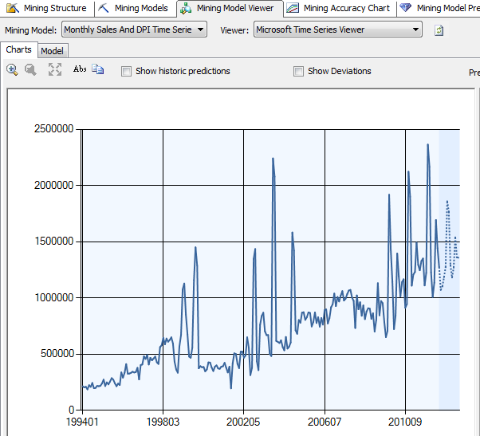
Prediction with Cross Correlations
Economic data was only available through 2012.06

Slide 53
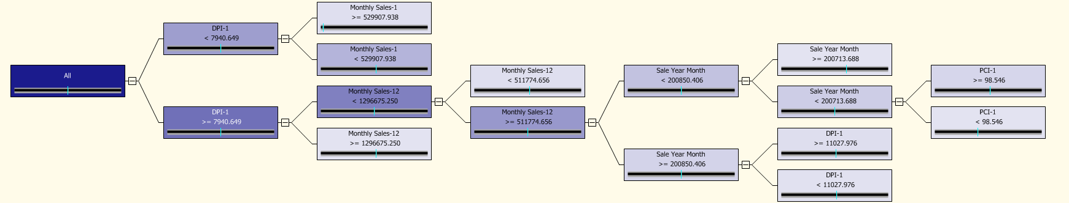
Microsoft ARTxp Results
Sales-1 >= 529908
Month >= 200713.7
DPI-1 < 7940.6
Month < 200850
Sales-1 < 529908
Month < 200713.7
Sales-12 < 511775
Sales-12 < 1296675
DPI-1 >= 7940.6
Sales-12 >= 511775
DPI-1 >= 11028
Sales-12 >= 1296675
Month>=200850
DPI-1 < 11028
PCI-1 >= 98.5
PCI-1 < 98.5

Slide 54
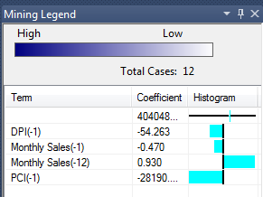
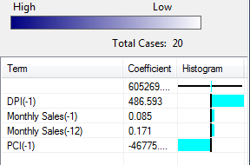
ARTxp Results
YearMonth > 200713
YearMonth > 200813 and
DPI-1 >= 11028

Slide 55
ARMAX: ARIMA with Other Series
 | coefficient | std. error | t-ratio | p-value
const | -8710.8 | 8019.9 | -1.086 | 0.2774
phi_1 | 0.0286 | 0.0812 | 0.3529 | 0.7242
phi_12 | 0.5701 | 0.0591 | 9.6520 | 0.0000 | ***
theta_1 | -0.2700 | 0.0950 | -2.8420 | 0.0045 | ***
theta_2 | -0.4881 | 0.0802 | -6.0870 | 0.0000 | ***
theta_3 | -0.0854 | 0.0892 | -0.9572 | 0.3885
theta_10 | -0.1565 | 0.0552 | -2.8350 | 0.0046 | ***
DPI | 220.61 | 187.1 | 1.1790 | 0.2385
PCI | 37251.3 | 42794 | 0.8705 | 0.3840

Slide 56
Linear Regression
Auto-regressive terms
Sales = b₀ + b₁Sales(-1) + b₂Sales(-2) + b₃Sales(-3) + b₄Sales(-12)
Trend
Sales = b₀ + b_{i}Sales(-i) + b_{y}Year
Seasonal
M02=(Month==2)
Sales = b₀ + b_{i}Sales(-i) + b_{y}Year + b _{m2}M02 + … b_{m12}M12
Sales = b₀ + b_{i}Sales(-i) + b_{y}Year + b _{m2}M02 + … b_{m12}M12 + b_{d}DPI + b_{p}PCI
Other variables, can also include lags
Dummy variable note: Cannot include all 12 months and the constant term.
Those 13 would be perfectly linearly correlated (perfect multicolinearity).
Drop constant term or typically, first month.

Slide 57
Linear Regression Results
 | coefficient | std. error | t-ratio | p-value
const | -173894000 | 64787700 | -2.684 | 0.0079 | ***
DPI_1 | -105.5 | 181.089 | -0.582 | 0.5610
DPI_3 | -137.9 | 186.6 | -0.739 | 0.4608
PCI_1 | 7500.1 | 45595.8 | 0.1645 | 0.8695
PCI_3 | 7349.5 | 44302.2 | 0.1659 | 0.8684
M02 | 51363.2 | 78077.0 | 0.6579 | 0.5114
M03 | 105546 | 81738.7 | 1.291 | 0.1982
M04 | 136553 | 78115.6 | 1.748 | 0.0821 | *
M05 | 78413.0 | 73504.1 | 1.067 | 0.2874
M06 | 98425.6 | 73524.4 | 1.339 | 0.1823
M07 | 123598 | 76786.4 | 1.610 | 0.1092
M08 | 98079.3 | 78434.4 | 1.250 | 0.2127
M09 | 68710.6 | 77535.8 | 0.8862 | 0.3767
M10 | 146903 | 78651.6 | 1.868 | 0.0634 | *
M11 | 438455 | 82203.4 | 5.334 | 0.0000 | ***
M12 | 130437 | 83798.5 | 1.557 | 0.1213
Year | 87203.4 | 32756.3 | 2.662 | 0.0084 | ***
Sales_1 | 0.6043 | 0.0709 | 8.527 | 0.0000 | ***
Sales_2 | -0.3251 | 0.0829 | -3.925 | 0.0001 | ***
Sales_3 | 0.1356 | 0.0826 | 1.642 | 0.1023
Sales_4 | -0.02148 | 0.0734 | -0.3051 | 0.7606
Sales_12 | 0.2702 | 0.0615 | 4.395 | 0.0000 | ***
Seasonal:
M04 +
M10 +
M11 +
Trend:
Year: 87,203
Lags/AR:
1 0.604
2 -0.325
12 0.270
R² = 0.7799

Slide 58
Compare Forecasts

Slide 59
Compare Seasonality
Lag | ARIMA/MA | Microsoft/MA | Regression/AR
1 | -0.3340 | -0.1403 | 0.6043
2 | -0.2690 |  | -0.3251
3 | -0.2348 |  | 0.1356
4 | -0.0917 |  | -0.0215
10 | -0.1499
12 | 0.0124 | -0.0672 | 0.2702
Hard to compare because ARIMA results rely on MA terms, Regression relies on AR terms, and Microsoft ARTxp combines both AR and MA; plus other data.
The 2-period lag (also picked up by Microsoft MA(1) is interesting because it is negative, or a damping effect.

