Slide 1
9: Sequence and Geographic Analysis
Data Mining Applications
Jerry Post
Copyright © 2013
Geographic section

Slide 2
Common Sequence Examples
DNA: Items are Nucleobases:
Cystine C
Guanine G
Adenine A
Thymine T
Written as a sequence of the bases.
(Very short) example: ACAATGCTGATC
Web browsing: Items are pages
Pages available (by name or create a notation)
Order that a person (or IP address) browses
(Abbreviated) example: Default, ItemList, Description, Cart

Slide 3
Sequence Definitions
A sequence (S) is a set of discrete items arranged in a specific order.
In general form it can be written: S₁, S₂, … S_{n}
The discrete set of items is sometimes called the alphabet (A).
In DNA terms, the alphabet consists of only the letters: C, G, A, T
In Web site terms, the alphabet consists of the names of the Web pages.
A sequence represents a path defined by a single object or person.
For example, it is one track in a single Web browsing setting or one strand of DNA.
Analysis requires multiple sequences for the same task,
Such as Web browsing sessions by several people, or DNA from multiple sources.
Sequence clustering involves finding several similar sequences,
Where a group has taken a similar path through the data items,
And this “average” path or sequence is different from that of other clusters.

Slide 4
Common Sequence Mining Goals
Classification
Researcher has an outcome and possibly a pattern
Find sequences that have the pattern
Or find sequences unique that occur in the outcome group
Example: Patients with rare disease (outcome); compare DNA sequences to see if they have (partial) sequences in common.
Example: Customers who make a Web purchase versus those who do not. How do their browsing sequences differ?
Clustering
Data consists of many random sequences or paths through the events/items
Find groups (clusters) of sequences that are similar to each other but different from other clusters.
Example: Do different groups of customers browse differently on a Web site?

Slide 5
Sequences: Comparison Issues
Items/Alphabet: List of possible item values
DNA: C, G, A, T
Web site: List of pages
Sequence: S: S₁, S₂, S₃, S₄, …, S_{i}
The order is crucial.
Need multiple sequence instances, usually generated by multiple people.
Comparing sequences can be a challenge.
Subsets and Alignment/Starting Point:
CCGATATC
TGATATG
Gaps. Do they match? It depends on the problem and the allowable gap.
CCGATATC
TTGAGGTAT

Slide 6
Clustering
Default
List
Describe
Search
Comment
Cart
Register
Checkout
Remove
Confirm
Update
Possible results/clusters:
Explorers: Default, List, Search, Describe
Interested: Default, Search, Comment, Cart
Purchasers: Default, Search, Describe, Cart, Register, List, Cart, Checkout, Confirm

Slide 7
Distance Measures
Clustering requires a distance function.
Levenshtein or edit distance: Minimal number of edits to create match.
Examples:
dollar -> holler 2 change “d” to “h” and “a” to “e”
dollar -> pound 5 change “d” to “p”, “l” to “u”, “l” to n”, “a” to “d”, delete “r”
Other measures might use unequal weights for change v. insert/delete,
Others can accommodate gaps and alignment issues.
Common algorithms include: BLAST, BLOSUM, PAM, FASTA, and Smith-Waterman
You rarely need to know the differences/details because the researcher rarely gets to choose the distance function. However, different tools use different measures so you will get different results. Ultimately, it helps to pick the tool that best matches the data types.
Currently, there are no rules, so you will need to experiment.

Slide 8
Markov Chain
A set of states (or sequence items) with probabilities attached to the “next” item appearing, which is the transition probability.
The transition probability can depend on prior states, with the limit specified by the order (k). Example: k=3 so p_{i} can depend on p_{i-1}, and p_{i-2}
In general,
P(S) = P(S_{m} | S_{m-1}) P(S_{m-1} | S_{m-2}) … P(S₂ | S₁) P(S₁)
Which illustrates how the “chained” probabilities affect each item in the sequence.

Slide 9
Transition Probabilities
Sample Markov Results
States with some of the transition probabilities
0.8
0.2
Default
List
Describe
0.5
0.1
0.1
Comment
Search
Each state or sequence item has a transition probability into another state.
These probabilities are estimated and can be based on prior values, or how the sequence arrived at that state.
Combined with clustering, the probabilities indicate within that cluster that from a given state the chances of each other state occurring next.

Slide 10
Business Applications
Most applications use clustering
Discrete events or items where order is important
Multiple, random paths through the items
Typically involves customers to be random
Production is usually a fixed sequence
Sometimes possible to use time between events
Adds random component
Discretize: Define bins or categories

Slide 11
Organizing Data
The DNA example is easy to write and visualize:
ACAGGTACTGGA…
CCAGGAATACGG…
ACATTACTGAAG…
M, 32, …
F, 45, …
M, 62, …
Each string represents a sequence for a single individual.
The order is contained within the data string (left-to-right).
Additional data might exist for each individual (gender, age, …)

Slide 12
Organizing Web Log Data
ID | WebDateTime | SCStatus | TimeTaken | UserIP | CSMethod | Bytes | URIStem | CSBytes | Referer
1 | 01:28.0 | 200 | 250 | 207.46.199.39 | GET | 29247 | /DBMS/DBMSSyllabus.html | 344 | NULL
2 | 03:11.0 | 200 | 46 | 173.192.34.91 | GET | 0 | / | 162 | NULL
3 | 08:11.0 | 200 | 46 | 173.192.34.91 | GET | 0 | / | 162 | NULL
4 | 11:16.0 | 200 | 140 | 62.212.73.211 | GET | 318 | /robots.txt | 327 | NULL
5 | 11:17.0 | 200 | 140 | 62.212.73.211 | GET | 715 | /petstore/sallyclass.html | 364 | NULL

Slide 13
DNA Data Stored in a Table
PersonID | Seq | Item
1 | 1 | A
1 | 2 | C
2 | 1 | C
1 | 3 | A
2 | 2 | C
3 | 1 | A
ACAGGTACTGGA…
CCAGGAATACGG…
ACATTACTGAAG…

Slide 14
Data Table for Individuals
PersonID | Gender | Age | …
1 | M | 32
2 | F | 45
3 | M | 62
If only the Web logs exist, no added data is available.
But tools often require a table with unique ID values.
So use a query:
SELECT DISTINCT UserIP
FROM WebLog
UserIP
62.212.73.211
173.192.34.191
207.46.199.39

Slide 15
Missing Data
Key values cannot be null.
Most business sequences avoid null values because they are varying length and simply record events that occurred.
Missing sequence data could be an issue for classification tools.
Possible to treat missing/null as a new item value.
In the DNA example, that would create five values: C, G, A, T, m
But, does the partial string: CCAmT
Match CCAGT or CCATT or neither one?
The answer depends on the problem and the researcher.
Ideally, it should be controllable through tool parameters.

Slide 16
Web Log Files
Web log files are text files—usually one for each day. Often stored in a standard format with one line for each event and multiple dimensions stored on the line.
Need to convert from text file and load into a database.
Download the log files.
Convert them (parser).
Load them into a database table.
Best to use a Log Parser
Microsoft: Log Parser 2.2 (command line; free download)
Log Parser Studio (graphical interface on top of Log Parser)
Log Parser reads data from multiple files, extracts desired elements, and reformats into CSV file.
Note: This section is only necessary if you want to read your own Web log files. It is not needed to load the sample databases for the book.

Slide 17
Log Parser 2.2 on IIS Logs
Needs to be entered as one single-row command. Split here for readability.
"c:\Program Files (x86)\Log Parser 2.2\LogParser"
"SELECT OUT_ROW_NUMBER() AS ID,
ADD(TO_STRING(date,'MM/dd/yyyy'), TO_STRING(time,' hh:mm:ss')) AS dt,
sc-status,
time-taken,
REPLACE_CHR(SUBSTR(cs(User-Agent),0,512), ',',';') AS User-Agent,
c-ip, cs-method, sc-bytes, cs-version,
REPLACE_CHR(SUBSTR(cs-uri-stem,0,512), ',',';') AS CS_URI_Stem,
cs-bytes,
REPLACE_CHR(SUBSTR(cs(Referer),0,512), ',',';') AS CS_Referrer
INTO temp.csv
FROM *.log
ORDER BY dt“
-i:IISW3C -o:CSV
Generated ID #
Combine date and time into one.
Limit length and change commas to semicolons
Specify Web log format as input and CSV as output

Slide 18
Database Table for Logs
CREATE TABLE WebLogs
(
ID int identity(1,1) NOT NULL,
WebDateTime datetime NULL,
SCStatus int NULL,
TimeTaken int NULL,
UserAgent nvarchar(512) NULL,
UserIP nvarchar(250) NULL,
CSMethod nvarchar(250) NULL,
Bytes bigint NULL,
CSVersion nvarchar(250) NULL,
URIStem nvarchar(512) NULL,
CSBytes bigint NULL,
Referer nvarchar(512) NULL,
CONSTRAINT pk_WebLogs PRIMARY KEY (ID)
)
;

Slide 19
Loading the CSV Data to a Table
DECLARE @data_path nvarchar(256);
SELECT @data_path = '<PATH>';
--
EXECUTE (N'BULK INSERT Weblogs FROM ''' + @data_path + N'temp.csv''
WITH (
CHECK_CONSTRAINTS,
CODEPAGE=''ACP'',
DATAFILETYPE = ''char'',
FIELDTERMINATOR= '','',
ROWTERMINATOR = ''\n'',
KEEPIDENTITY,
TABLOCK
);');
Change <PATH> to the location of your CSV file, such as C:\Temp\

Slide 20
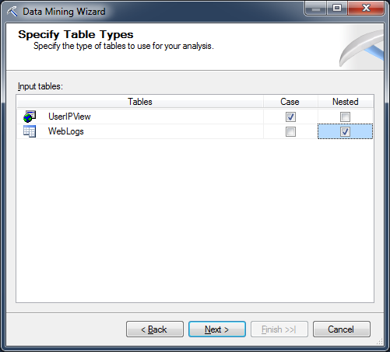
Sequence Cluster: Case + Nested
UserIPView is a Named Query created by: SELECT DISTINCT UserIP FROM WebLogs;
The Case table (UserIPView) contains a row for each person.
The Nested table (WebLogs) contains a row for each person each item in the sequence.

Slide 21
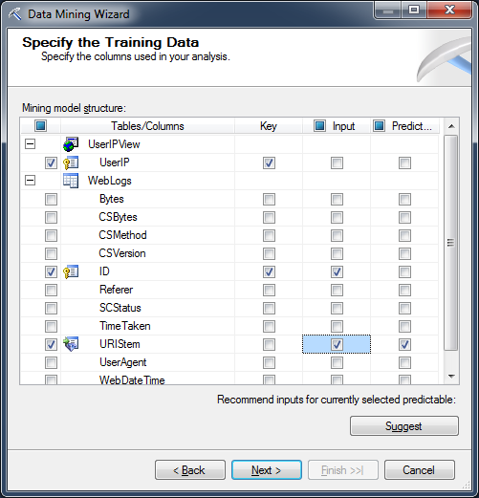
Choose Columns: Keys + Sequence
Case key is set to the individual. Only have UserIP here.
Critical: Pick the column holding the sequence item values: URIStem in this case is the name of each page.
Nested key is ID because WebDateTime is not unique in this case (multitasking server).
The keys define the sort order.

Slide 22
Processing Options
Parameter | Default | Range
CLUSTER_COUNT | 10 | [0,…)
MAXIMUM_SEQUENCE_STATES | 64 | 0, [2,65535]
MAXIMUM_STATES | 10 | 0, [2,65535]
MINIMUM_SUPPORT | 10 | [0,…)
CLUSTER_COUNT is a hint not a fixed constraint.
A value of zero uses a heuristic to estimate the best number.
MAXIMUM_SEQUENCE_STATES controls the number of item values.
64 is low for a Web site (pages) , and will generate a warning message.
But Microsoft says values greater than 100 can result in meaningless models.

Slide 23
Results: Cluster Diagram
Option: Changing from Population to URI Stem (state variable).
Then pick a specific state item (page) to see which sequences use it.
Try with \robots.txt to see search engine clusters.

Slide 24
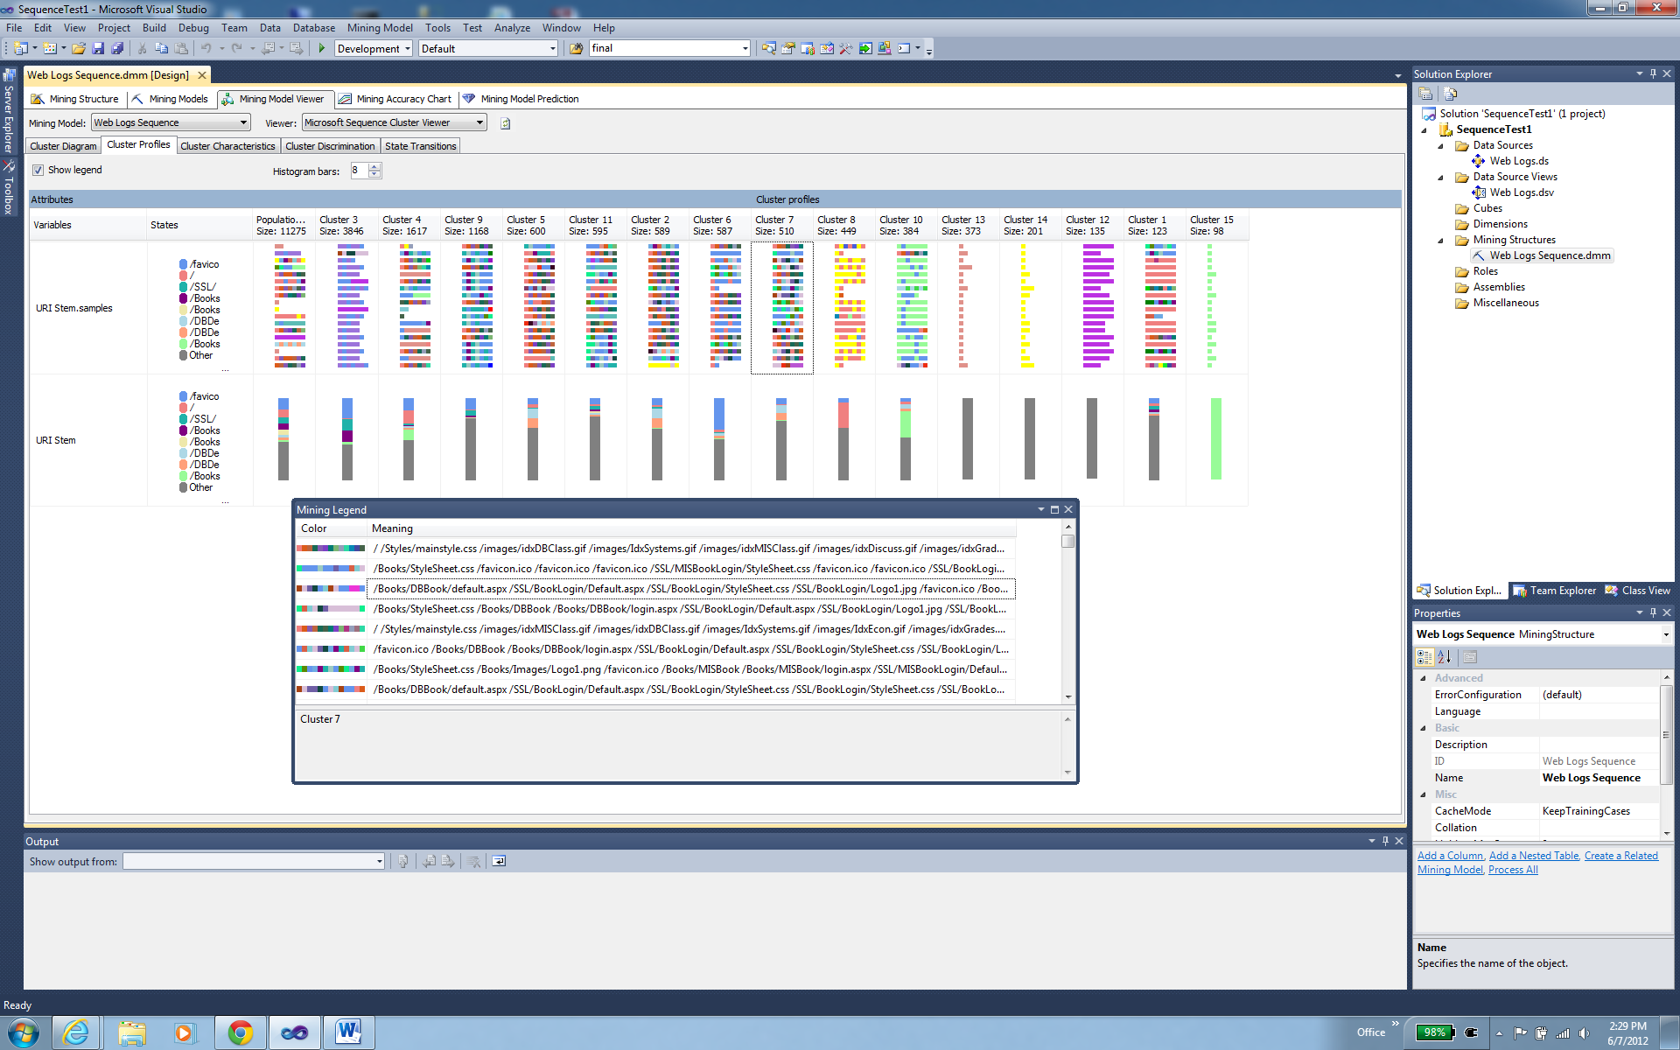
Results: Cluster Profile/Sequence

Slide 25
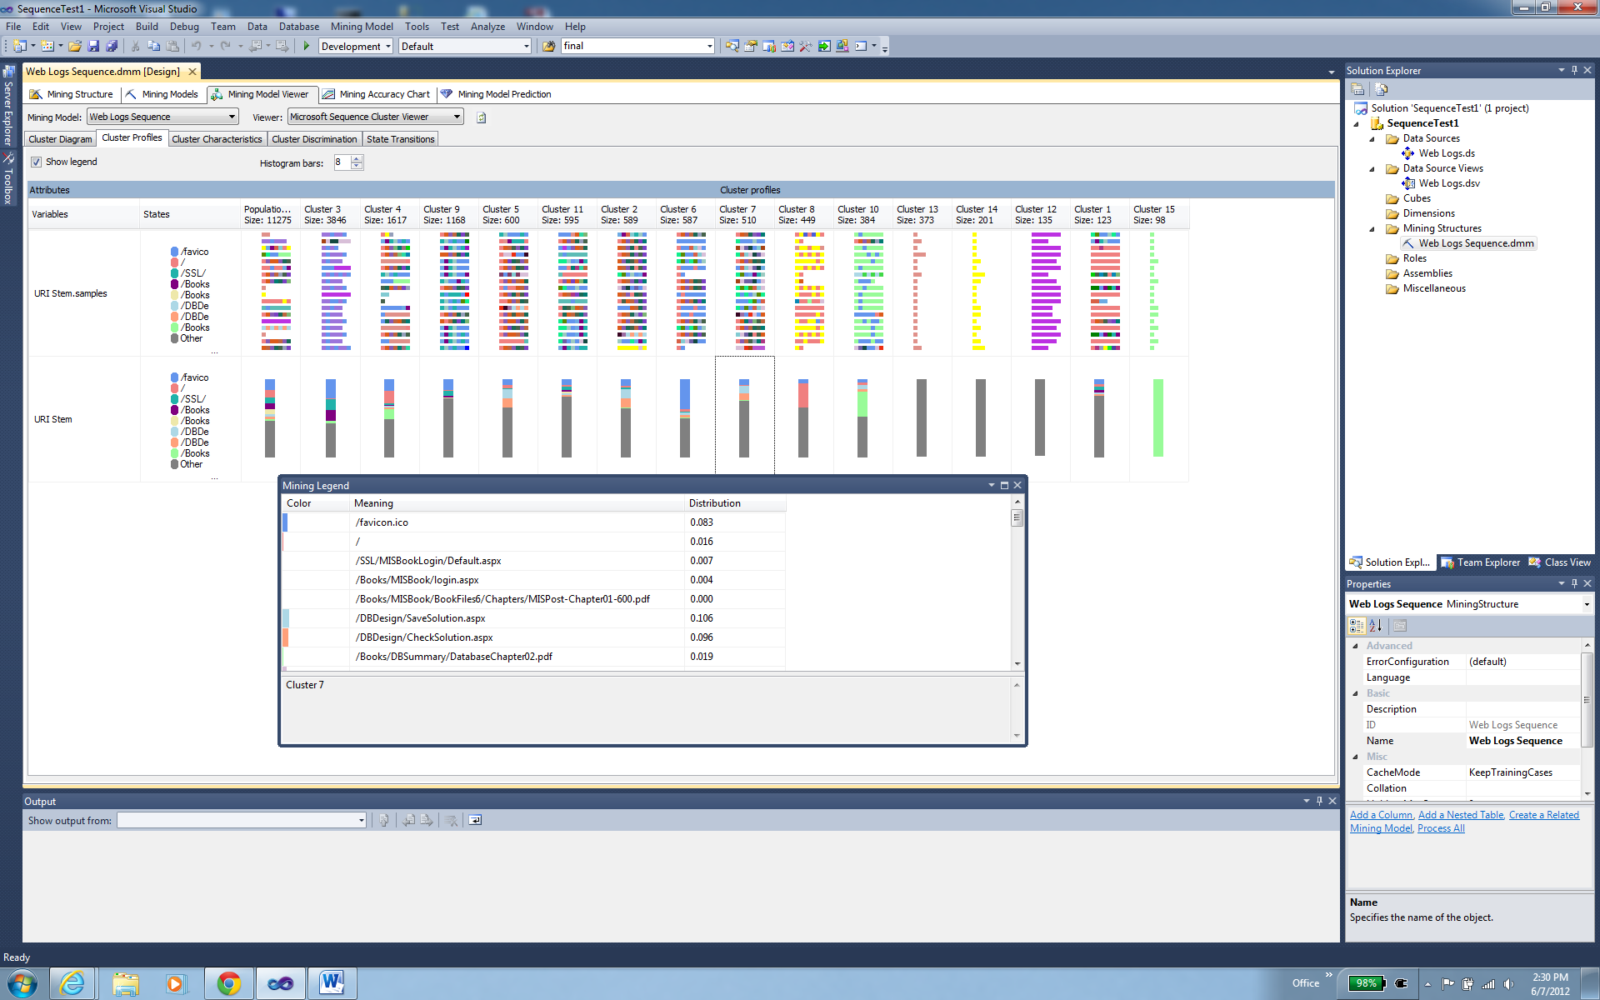
Results: Cluster Profile/Pages
The probability numbers on the page cluster indicate that Cluster 7 represents interactions with the DBDesign tool on the Web site (Save and Grade pages).

Slide 26
Results: Cluster Characteristics
The main pages for Cluster 7 are the database book login, DBDesign, and chapters 1-3 for the database book.
So Cluster 7 represents students working on database design.

Slide 27
Results: Cluster Discrimination
Compare to complement (not in) or to a second cluster.
Note that Cluster 7 emphasizes database concepts as opposed to the MIS book.

Slide 28
Results: State Transitions
Page probabilities based on the population (everyone) cluster.
Note the two or three main page collections: MIS Book, Database book, DBDesign.

Slide 29
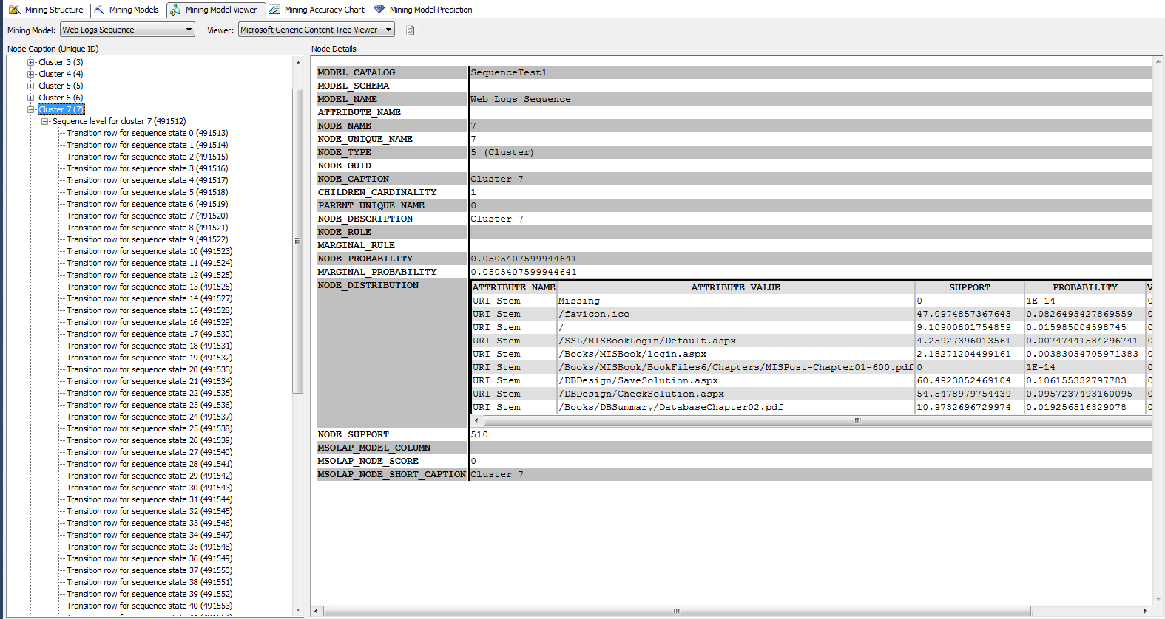
Results: Tree Viewer Details
Transition probabilities. Left window to select a starting state/page (64 entries).
Scroll window in the middle to see target states and probabilities.
Note that support is count of support modified by cluster probability.

Slide 30
Sample GIS Layer: Per Capita Income (2007)
Microsoft MapPoint

Slide 31
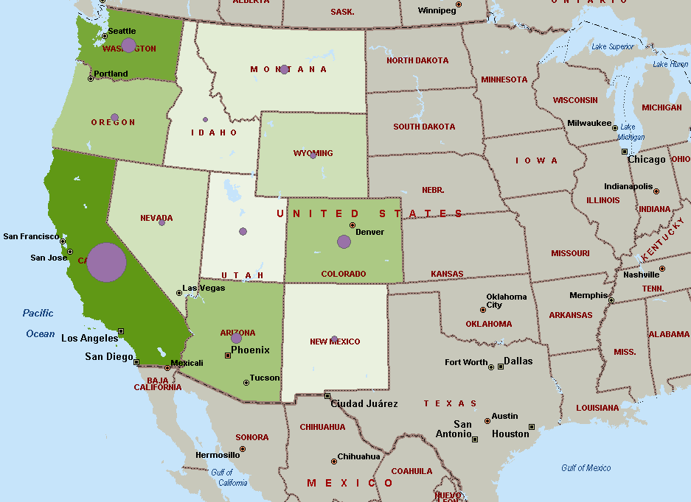
Correlation Example
Shading -> Income
Circle size -> Sales
Is there a correlation?
Is it significant?
Correlation coefficient is 0.86 so yes.

Slide 32
Indirect Correlation
The correlation in the example is between two dimensions (sales and income).
Sales are not directly related to geography (such as east/west or water, and so on)
The statistical tests provide numeric measures and significance tests.
Geography comes into play because income is related to location, so finding new sales territories suggests looking for regions of higher income.
The GIS mapping tools can be helpful in these cases but the statistical tools are more useful when the correlation is not directly tied to location.

Slide 33
RT Query: Sales by State for 2012
SELECT Bicycle.SaleState, Sum(Bicycle.SalePrice) AS SumOfSalePrice
FROM Bicycle
WHERE (Bicycle.OrderDate Between ’01-Jan-2012’ And ’31-Dec-2012’)
GROUP BY Bicycle.SaleState;
Save query as a view so MapPoint can access it directly.

Slide 34
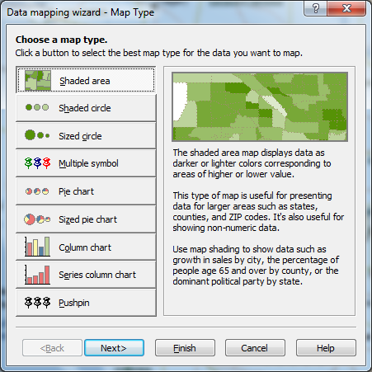
MapPoint Data Wizard

Slide 35
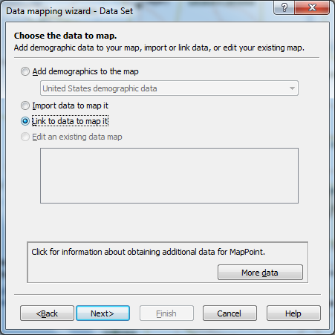
Import or Link the Data

Slide 36
RT Sales on MapPoint

Slide 37
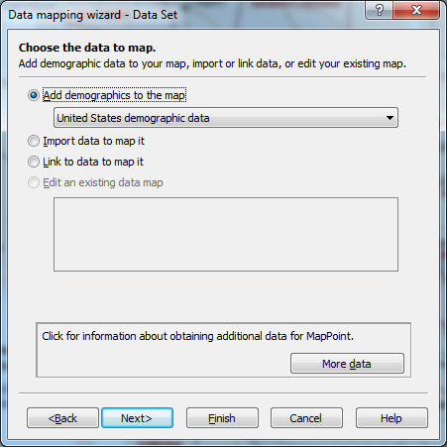
RT With Demographics

Slide 38
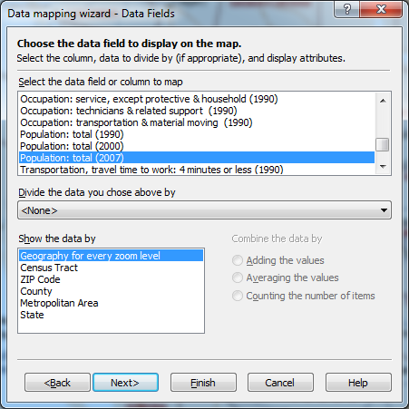
Population

Slide 39
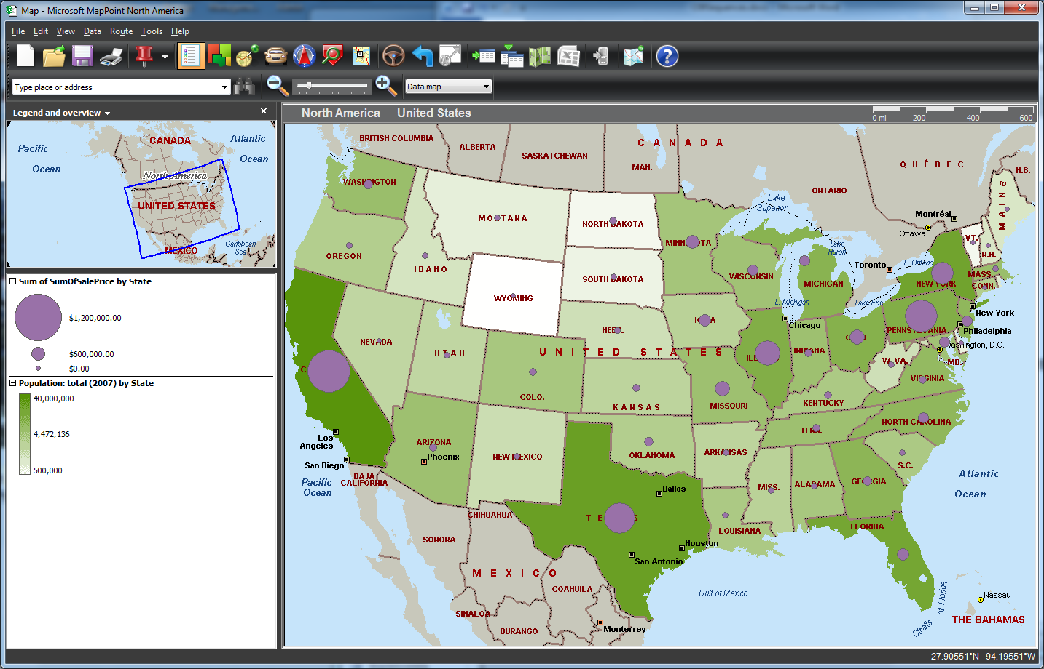
Sales v. Population
MapPoint allows only one series as a shaded region.

Slide 40
Other Tools
Esri
ArcGIS (old name was ArcInfo)
Desktop/Server: Subscription
Web based—free base maps and some GIS capabilities
Often used by government agencies
Google
Online Maps
Google Earth for desktop interaction
Bing (Microsoft)

Slide 41
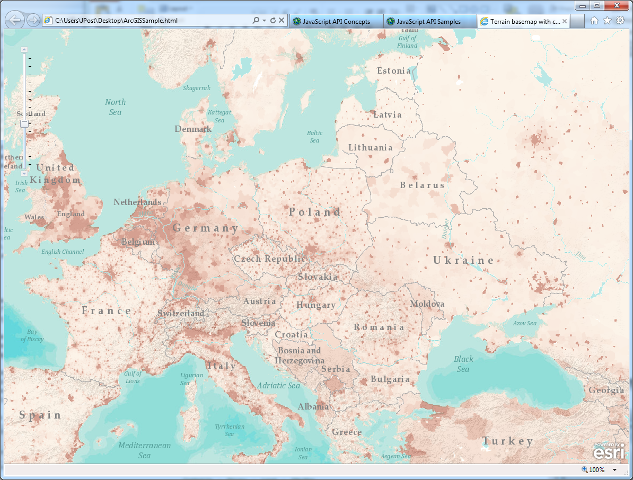
ArcGIS Sample
http://help.arcgis.com/en/webapi/javascript/arcgis/help/jssamples_start.htm#jssamples/map_terraindemographic.html
A population map generated solely with an HTML file using JavaScript.

Slide 42
HTML/Javascript for Esri: setup
<!DOCTYPE HTML PUBLIC "-//W3C//DTD HTML 4.01//EN" "http://www.w3.org/TR/html4/strict.dtd">
<html>
<head>
<meta http-equiv="Content-Type" content="text/html; charset=utf-8">
<meta http-equiv="X-UA-Compatible" content="IE=7,IE=9" />
<!--The viewport meta tag is used to improve the presentation and behavior of the samples on iOS devices-->
<meta name="viewport" content="initial-scale=1, maximum-scale=1,user-scalable=no"/>
<title>Terrain basemap with custom data</title>
<link rel="stylesheet" type="text/css" href="http://serverapi.arcgisonline.com/jsapi/arcgis/3.0/js/dojo/dijit/themes/claro/claro.css">
<style>
html, body { height: 100%; width: 100%; margin: 0; padding: 0; }
#map{padding:0;}
</style>
<script type="text/javascript">var djConfig = {parseOnLoad: true};</script>
<script type="text/javascript" src="http://serverapi.arcgisonline.com/jsapi/arcgis/?v=3.0"></script>
<script type="text/javascript">
dojo.require("dijit.layout.BorderContainer");
dojo.require("dijit.layout.ContentPane");
dojo.require("esri.map");

Slide 43
HTML/Javascript for Esri: functions
var map;
function init() {
var initExtent = new esri.geometry.Extent({"xmin":-5.54,"ymin":40.81,"xmax":44.46,"ymax":58.35,"spatialReference":{"wkid":4326}});
map = new esri.Map("map",{
extent:esri.geometry.geographicToWebMercator(initExtent)
});
//Add the terrain service to the map. View the ArcGIS Online site for services http://arcgisonline/home/search.html?t=content&f=typekeywords:service
var basemap = new esri.layers.ArcGISTiledMapServiceLayer("http://server.arcgisonline.com/ArcGIS/rest/services/World_Terrain_Base/MapServer");
map.addLayer(basemap);
//add custom services in the middle. This is typically data like demographic data, soils, geology etc.
//This layer is typically partly opaque so the base layer is visible.
var operationalLayer = new esri.layers.ArcGISDynamicMapServiceLayer("http://sampleserver1.arcgisonline.com/ArcGIS/rest/services/Demographics/ESRI_Population_World/MapServer", {"opacity":0.5});
map.addLayer(operationalLayer);
//add the reference layer
var referenceLayer = new esri.layers.ArcGISTiledMapServiceLayer("http://server.arcgisonline.com/ArcGIS/rest/services/Reference/World_Reference_Overlay/MapServer");
map.addLayer(referenceLayer);
dojo.connect(map, 'onLoad', function(theMap) {
//resize the map when the browser resizes
dojo.connect(dijit.byId('map'), 'resize', map,map.resize);
});
}

Slide 44
HTML/Javascript for Esri: HTML
dojo.addOnLoad(init);
</script>
</head>
<body class="claro">
<div dojotype="dijit.layout.BorderContainer" design="headline" gutters="false"
style="width: 100%; height: 100%; margin: 0;">
<div id="map" dojotype="dijit.layout.ContentPane" region="center" style="overflow:hidden;">
</div>
</div>
</body>
</html>

Slide 45
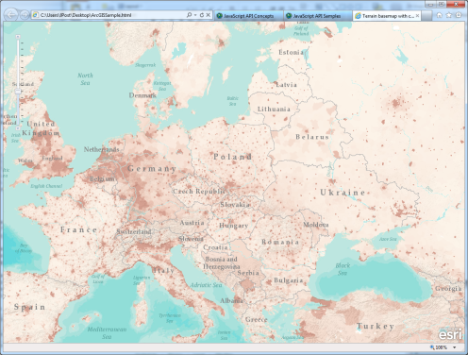
Web Tiers
Map server:
Esri, Google, Bing, …
Web server
Database server
Browser Client: Display
A custom Web application has to retrieve the desired data and convert it to a form acceptable to the Map server. And it has to function as a Web service.

Slide 46
Government Map Sources
Census
www.census.gov
USGS
www.usgs.gov
Geospatial
geo.data.gov
FAA
aeronav.faa.gov
NOAA
www.nauticalcharts.noaa.gov
NGA: National Geospatial Intelligence Agency
msi.nga.mil
Others: Many use maps to display data
Local/County: Many use Esri to display property maps and local data. Search for the county assessor.
Canada
www.fedmaps.com
United Nations
www.un.org/Depts/Cartographic/english/htmain.hml
http://www.grida.no/graphicslib

Slide 47
OpenStreetMap.Org
Open source mapping data
http://www.openstreetmap.org
The data is largely contributed by individuals using personal GPS tracks. (A few companies contributed early datasets.)
Most commercial datasets are copyrighted and collect by two main companies: Navteq (Nokia) and TomTom (Tele Atlas)

