Slide 1
10: MDX
Data Mining Applications
Jerry Post
Copyright © 2013

Slide 2
Multidimensional Expressions
MDX is a text-based language for retrieving data from OLAP cubes.
It is a query language but has no relationship to SQL.
Values returned are subtotals.
Cubes
Data is in terms of measures (numeric data)
Subtotals are by dimensions (attributes)
Dimensions can be hierarchical (Date, Location, …)

Slide 3
Sample OLAP Cube for RT
Hybrid
Category
Full S
MTB
Road
Race
CA
1420
1258
1184
1098
1578
MI
437
579
683
873
745
Customer Location
NY
1011
1257
985
874
1256
TX
880
750
935
684
993
Hyper cubes display measures about a fact.
The attributes are cube dimensions.
The cube browser displays subtotals or different slices of the cube.
Jan
Feb
Mar
Apr
May
Time
Sale Month

Slide 4
Hierarchies and Terminology
Q1
Jan
Feb
Mar
-2010
parallels
-Q1
Jan
Feb
Mar
Apr
May
Jun
Q2
+Q2
2010
+Q3
Jul
Aug
Sep
Q3
+Q4
Cube display:
Drill down and roll up
Oct
Nov
Dec
Q4
Parent / Children
Tree concepts

Slide 5
SQL Server Analysis Services
From SQL Server Developer Edition
Install SQL Server
Install Analysis Services Server
Install Visual Studio Client components
Basically, install everything
The Developer and Enterprise editions include SSAS. Other versions might not include it.

Slide 6
RT Bicycles OLAP Cube
If necessary, download and install the SQL Server RT database.
Start Visual Studio: New Project: Analysis Services, Multidimensional…
Add a new Data Source to connect to the SQL Server RT database.
Create a new Data Source View
Create a new Sales Cube

Slide 7
Data Source View: RT Sales
Tables:
Bicycle
Customer
City
Employee
RetailStore
LetterStyle
Paint
ModelType
Remove connection between Employee -> City
RetailStore -> City

Slide 8
New Cube
Right-click Cubes in Solution Explorer/New
Pick the Bicycle table only as the measures
As measures include at least: Sale Price, Sales Tax, List Price, and Bicycle Count.
For dimensions: include all of the other tables (default)

Slide 9
Date Hierarchy
Right-click Dimensions in Solution Explorer: New
Generate a time table on the server
Set
First calendar day: January 1, 1994
Last calendar day: December 31, 2015
Time periods: Year + Quarter + Month + Date
Name: Date Hierarchy

Slide 10
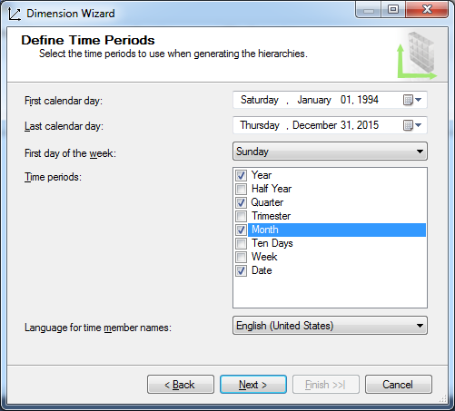
New Dimension: Date Hierarchy

Slide 11
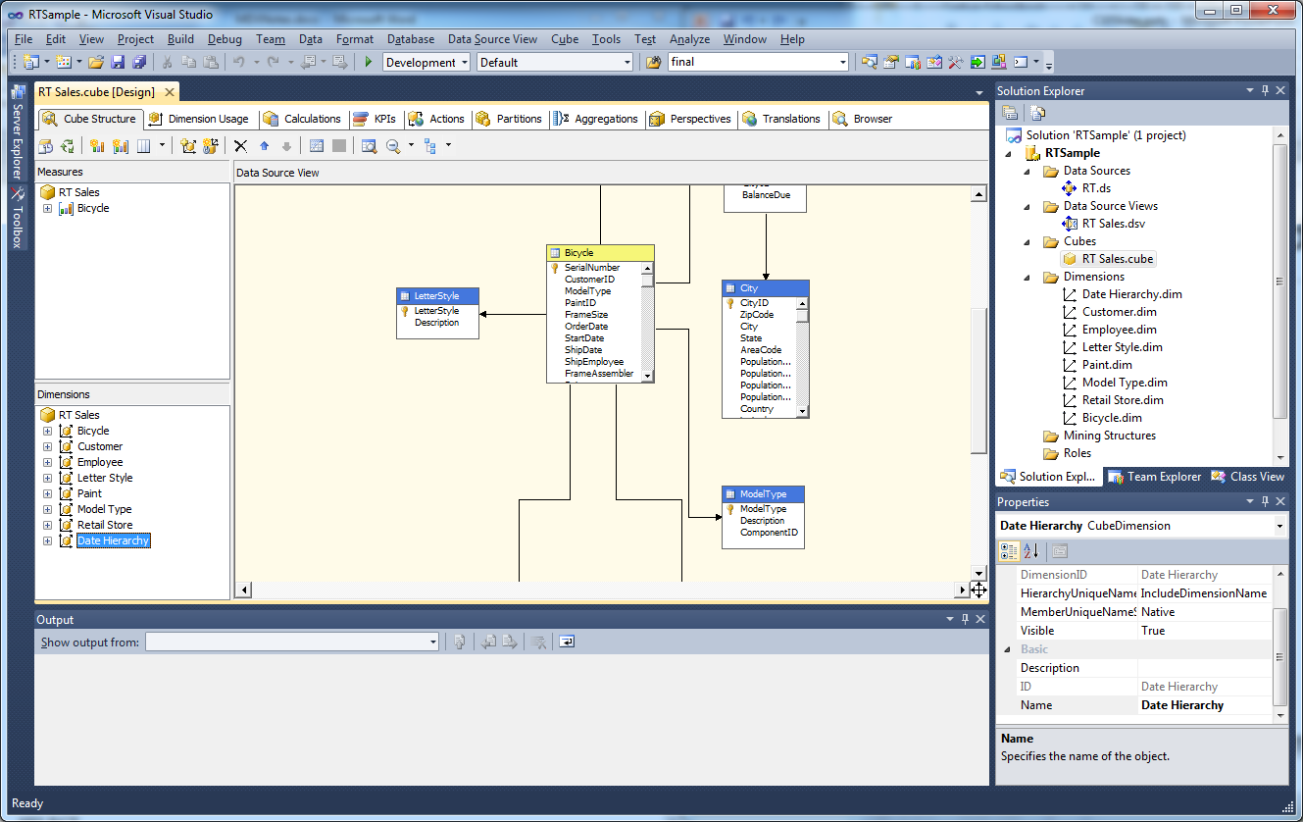
Add Date Hierarchy to Cube

Slide 12
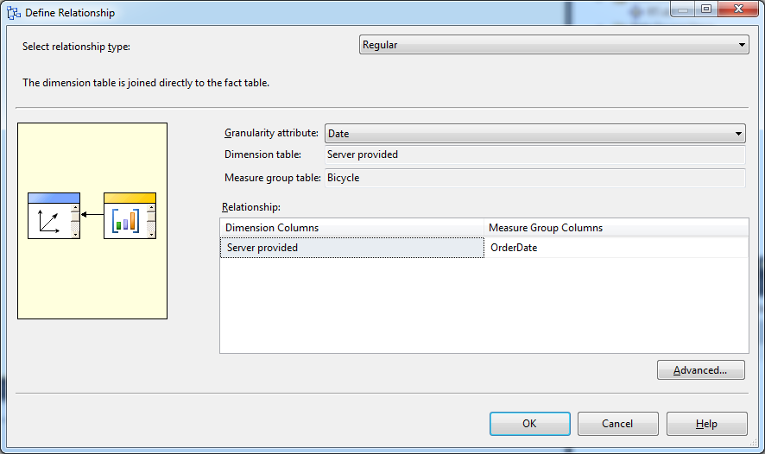
Cube: Dimension Edits
Drag new Date Hierarchy into Dimensions window
Click Dimension Usage tab.
Select box next to Date Hierarchy, Set
Relationship: Regular
Granularity: Date
Measure Group Column: OrderDate

Slide 13
Edit Cube: Customer Dimension
Drag to add Attributes:
Gender, State, ZIP Code

Slide 14
Basic MDX Terms/Concepts
Measures are numeric values to be totaled.
All results of an MDX query are summary computations (totals).
Most tools create a set called Measures
Item names are delimited with square brackets [ ] to allow spaces and unusual characters in the names.
Example: [Measures].[Sale Price]
[Model Type].Race
[Date Hierarchy].[Year – Quarter – Month – Date].[Date].members
Cubes have axes
Standard: Columns, Rows
Numbered: Axis(0), Axis (1)
Sets are delimited with curly braces { }
Axis lists rely on sets.
Simple: { [Model Type].members }
But can combine dimensions such as Model Type and State
Tuples: specify dimension values in parentheses
[Measures].[Sale Price] is total Sale Price across all dimensions.
( [Model Type].[Race], [Measures].[Sale Price] ) is total Sale Price for Race model.

Slide 15
Create and Test MDX Queries
Visual Studio
Analysis Project
Cube Browser
Turn Off the Designer
SQL Server Management Studio
Connect to Analysis Services Database
Right-click database (RT Sample)
New Query / MDX

Slide 16
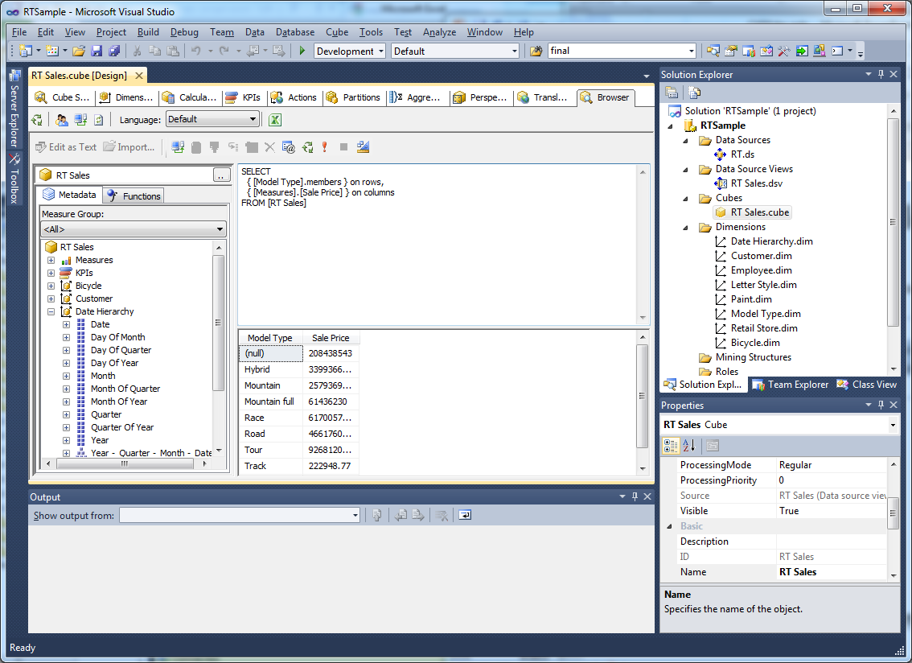
Visual Studio Query
Run
Designer
Browser
Cube

Slide 17
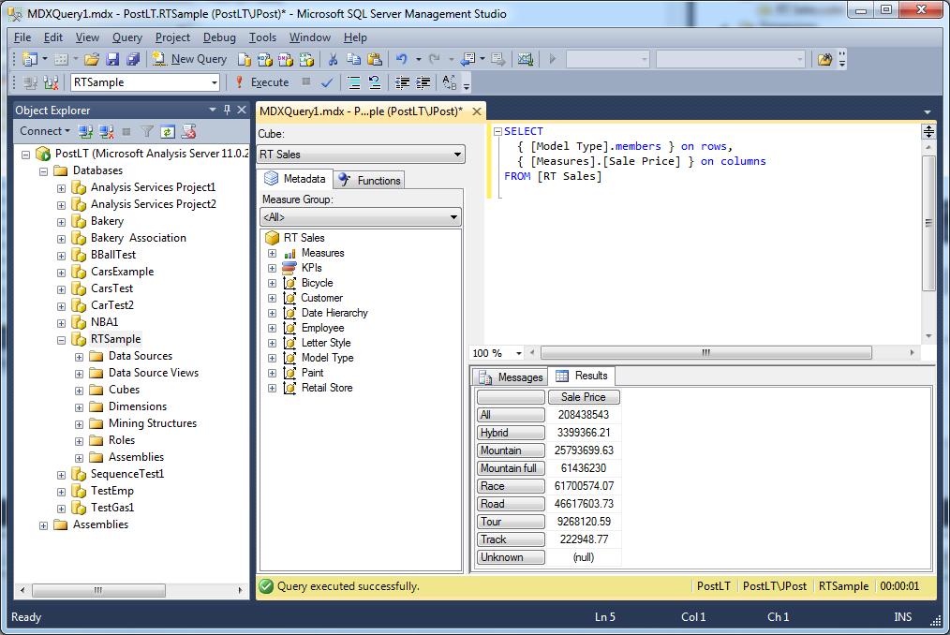
SQL Management Studio
Must connect to Analysis Services database, not the underlying SQL.
Run
New Query: MDX
Right-Click

Slide 18
MDX Main Syntax
WITH MEMBER create calculated values
SELECT define the axes by selecting dimensions
{ … } On Columns,
{ … } On Rows
FROM [cube name] name of the cube
WHERE ( … ) restrict results to specified dimension values

Slide 19
Initial Example: Easiest Syntax
Display total sales (Sale Price) by Model Type.
SELECT
{ [Model Type].members } on rows,
{ [Measures].[Sale Price] } on columns
FROM [RT Sales]
Model Type | Sale Price
(null) | 208438543
Hybrid | 3399366.21
Mountain | 25793699.63
Mountain full | 61436230
Race | 61700574.07
Road | 46617603.73
Tour | 9268120.59
Track | 222948.77
Unknown | (null)

Slide 20
Slice Cube for Specific Year
Display total sales (Sale Price) by Model Type for 2010.
SELECT
{ [Model Type].members } on rows,
{ [Measures].[Sale Price] } on columns
FROM [RT Sales]
WHERE ( [Year].[Calendar 2010] )
Model Type | Sale Price
(null) | 14501690
Hybrid | (null)
Mountain | 1018340
Mountain full | 4277740
Race | 5171940
Road | 3417090
Tour | 616580
Track | (null)
Unknown | (null)

Slide 21
Add a Second Condition (State)
Display total sales (Sale Price) by Model Type for 2010 in California.
SELECT
{ [Model Type].members } on rows,
{ [Measures].[Sale Price] } on columns
FROM [RT Sales]
WHERE ( [Year].[Calendar 2010] , [State].[CA])
Model Type | Sale Price
(null) | 895730
Hybrid | (null)
Mountain | 73530
Mountain full | 226640
Race | 290470
Road | 262160
Tour | 42930
Track | (null)
Unknown | (null)

Slide 22
Specifying NON EMPTY rows
Display total sales (Sale Price) by Model Type for 2010 in California.
SELECT NON EMPTY
{ [Model Type].members } on rows,
{ [Measures].[Sale Price] } on columns
FROM [RT Sales]
WHERE ( [Year].[Calendar 2010] , [State].[CA])
Model Type | Sale Price
(null) | 895730
Mountain | 73530
Mountain full | 226640
Race | 290470
Road | 262160
Tour | 42930

Slide 23
Selecting Individual Dimension Values
Display total sales (Sale Price) for Mountain and Mountain full in 2010 in CA
SELECT NON EMPTY
{ [Model Type].[Mountain], [Model Type].[Mountain full]} on rows,
{ [Measures].[Sale Price] } on columns
FROM [RT Sales]
WHERE ( [Year].[Calendar 2010] , [State].[CA])
Model Type | Sale Price
Mountain | 73530
Mountain full | 226640

Slide 24
Cross Join in MDX
Display total sales (Sale Price) cross join (*) the Date Hierarchy with Model Type
SELECT NON EMPTY
{ [Measures].[Sale Price] } ON COLUMNS,
NON EMPTY
{ ([Date Hierarchy].[Year - Quarter - Month - Date].[Date].ALLMEMBERS
* [Model Type].[Model Type].[Model Type].ALLMEMBERS ) } ON ROWS
FROM [RT Sales]
Year | Quarter | Month | Date | Model Type | Sale Price
Calendar 1994 | Quarter 1 | January | 01-JAN-1994 | Race | 2990
Calendar 1994 | Quarter 1 | January | 01-JAN-1994 | Road | 3490
Calendar 1994 | Quarter 1 | January | 02-JAN-1994 | Race | 2478.95
Calendar 1994 | Quarter 1 | January | 03-JAN-1994 | Mountain | 5020
Calendar 1994 | Quarter 1 | January | 03-JAN-1994 | Race | 10410
…
Each date crossed with each model type.
Note: Hyphens in [Year – Quarter … ] are picky. Copy from designer.

Slide 25
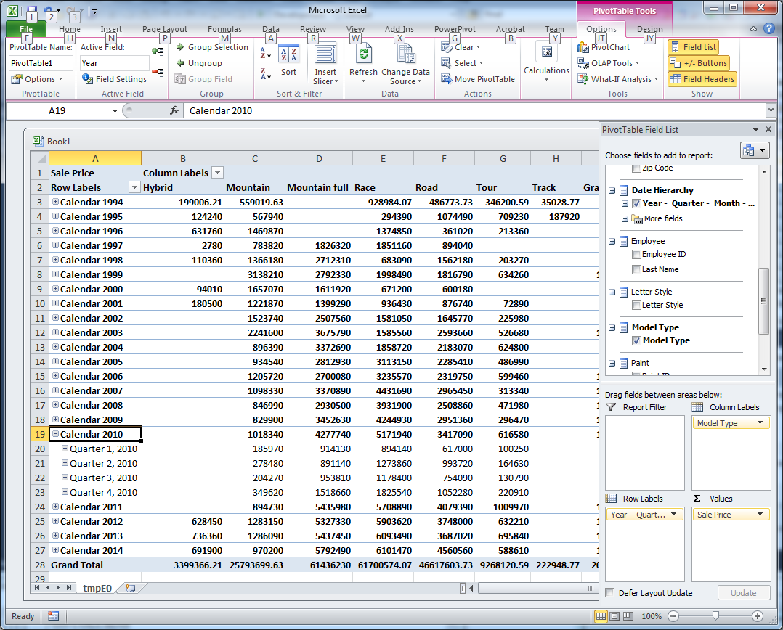
PivotTable for Cross Join Data

Slide 26
Calculated Measures
Compute profit margin for RT: Sale Price – Component List – Frame Price
WITH MEMBER [Measures].[Margin]
AS '[Measures].[Sale Price] - [Measures].[Component List] - [Measures].[Frame Price]'
SELECT
NON EMPTY { [Measures].[Margin], [Measures].[Sale Price] } On columns,
NON EMPTY { [Year].members * [Model Type].members } ON rows
FROM [RT Sales]
Year | Model Type | Margin | Sale Price
(null) | (null) | 47211482.32 | 208438543
(null) | Hybrid | 884842.47 | 3399366.21
…
Calendar 1994 | (null) | 261651.05 | 2555013
Calendar 1994 | Hybrid | 14310.22 | 199006.21
…

Slide 27
Advanced: Percentages
Show total sales by model type and show percent of total
WITH
MEMBER Measures.PctSales AS '([Model Type].CurrentMember, [Sale Price] )
/ ([Model Type].CurrentMember.Parent, [Sale Price])'
SELECT
{ [Measures].[Sale Price], [Measures].[PctSales] } ON 0,
{ [Model Type].Members } ON 1
FROM [RT Sales]
Model Type | Sale Price | PctSales
(null) | 208438543 | Infinity
Hybrid | 3399366.21 | 0.01631
Mountain | 25793699.63 | 0.12375
Mountain full | 61436230 | 0.29475
Race | 61700574.07 | 0.29601
Road | 46617603.73 | 0.22365
Tour | 9268120.59 | 0.04446
Track | 222948.77 | 0.00107

Slide 28
Cross Join and Percentages
Show total sales by model type and show percent of total for each year
WITH
MEMBER Measures.PctSales AS '([Model Type].CurrentMember, [Sale Price] ) / ([Model Type].CurrentMember.Parent, [Sale Price])'
SELECT NON EMPTY
{ [Measures].[Sale Price], [Measures].[PctSales] } ON COLUMNS,
NON EMPTY
{ ([Year].AllMembers
* [Model Type].[Model Type].[Model Type].ALLMEMBERS ) } ON ROWS
FROM [RT Sales]

Slide 29
Cross Join Percentage Results
Year | Model Type | Sale Price | PctSales
Calendar 1994 | Hybrid | 199006.21 | 0.07789
Calendar 1994 | Mountain | 559019.63 | 0.21879
Calendar 1994 | Race | 928984.07 | 0.36359
Calendar 1994 | Road | 486773.73 | 0.19052
Calendar 1994 | Tour | 346200.59 | 0.13550
Calendar 1994 | Track | 35028.77 | 0.01371
Calendar 1995 | Hybrid | 124240 | 0.04200
Calendar 1995 | Mountain | 567940 | 0.19199
Calendar 1995 | Race | 294390 | 0.99516
Calendar 1995 | Road | 1074490 | 0.36322
Calendar 1995 | Tour | 709230 | 0.23975
Calendar 1995 | Track | 187920 | 0.06352
Notice that the percentages are computed the way you want/expect.
The percentages are computed for each year because the divisor total uses the model type parent.

Slide 30
Compute Changes over Time
Compute totals sales by year and show the change from year-to-year
WITH
MEMBER [Measures].[Change] AS '[Measures].[Sale Price]
- ([Measures].[Sale Price], [Year].PrevMember)'
SELECT
{ [Measures].[Sale Price], [Measures].[Change] } ON COLUMNS,
{ [Date Hierarchy].[Year].Children } ON ROWS
FROM [RT Sales]
MDX assumes rows before the first are zero.
Year | Sale Price | Change
Calendar 1994 | 2555013 | 2555013
Calendar 1995 | 2958210 | 403197
Calendar 1996 | 4050860 | 1092650
Calendar 1997 | 5358120 | 1307260
…
Similar functions: NextMember, Lag, and Lead.
Note that PrevMember, Lag(1), and Lead(-1) all return the same value.

Slide 31
ParallelPeriod Function
Compute Monthly sales totals and compare to the matching month in the prior quarter.
WITH
MEMBER [Measures].[ParQtr] AS
'( [Measures].[Sale Price],
ParallelPeriod ( [Date Hierarchy].[Year - Quarter - Month - Date].[Quarter], 1 ) )'
SELECT NON EMPTY
{ [Measures].[Sale Price], [Measures].[ParQtr] } ON COLUMNS,
NON EMPTY
{ ([Date Hierarchy].[Year - Quarter - Month - Date].[Month].ALLMEMBERS ) } ON ROWS
FROM [RT Sales]
Year | Quarter | Month | Sale Price | ParQtr
Calendar 1994 | Quarter 1 | January | 215836.97 | (null)
Calendar 1994 | Quarter 1 | February | 205952.48 | (null)
Calendar 1994 | Quarter 1 | March | 211128.77 | (null)
Calendar 1994 | Quarter 2 | April | 188159.83 | 215836.97
Calendar 1994 | Quarter 2 | May | 225387.63 | 205952.48
Calendar 1994 | Quarter 2 | June | 210278.66 | 211128.77
…

Slide 32
ParallelPeriod Comments
MEMBER [Measures].[ParQtr] AS
'( [Measures].[Sale Price],
ParallelPeriod ( [Date Hierarchy].[Year - Quarter - Month - Date].[Quarter], 1 ) )'
The function returns members in a parallel section of the tree/hierarchy.
The function supports three parameters but can work with none by defaults.
The first is the level—usually one above the detail level.
The second is the number to go back.
January
February
March
Q1
Quarter, 1 back
Parallel values from prior quarter
April
May
June
Q2

Slide 33
MDX Functions (partial list)
Meta | Axis Count Hierarchy | Level Name Ordinal
Navigation | Ancestor Ascendants Children Cousin Current CurrentMember | DataMember FirstChild FirstSibling Lag LastChild LastSibling | Lead LinkMember NextMember Parent PrevMember Siblings
Logical | IIF IsAncestor IsEmpty | IsGeneration IsLeaf IsSibling | CoalesceEmpty
Sets | AllMembers BottomCount BottomPercent BottomSum Crossjoin Descendants Distinct Except | Exists Extract Filter Generate Head Hierarchize Intersect Members | NonEmpty Order Subset Tail TopCount TopPercent TopSum Union
Statistical | Avg Correlation Count Covariance DistinctCount | Max Median Min Rank RollupChildren | Stdev Sum Var VisualTotals LinReg…
Time | ClosingPeriod LastPeriods OpeningPeriod ParallelPeriod | Mtd Qtd Wtd Ytd | PeriodsToDate
http://www.mdxpert.com/Functions/FunctionList.aspx

Slide 34
EXCEPT
SELECT NON EMPTY
{ [Model Type].members } on rows,
{ [Measures].[Sale Price] } on columns
FROM [RT Sales]
WHERE ([State].[CA])
Sales by Model Type in California
SELECT NON EMPTY
{ [Model Type].members } on rows,
{ [Measures].[Sale Price] } on columns
FROM [RT Sales]
WHERE ( EXCEPT ( [State].Children, [State].[CA]) )
Sales by Model Type in all states EXCEPT California
Full list
Take out

Slide 35
Results for EXCEPT
Model Type | All | CA | EXCEPT CA
All | 208438543 | 16274614.3 | 192163928.7
Hybrid | 3399366.21 | 219987.38 | 3179378.83
Mountain | 25793699.63 | 1742601.88 | 24051097.75
Mountain full | 61436230 | 4362440 | 57073790
Race | 61700574.07 | 5879280.04 | 55821294.03
Road | 46617603.73 | 3380330 | 43237273.73
Tour | 9268120.59 | 654335 | 8613785.59
Track | 222948.77 | 35640 | 187308.77

Slide 36
IIF Function
Show total sales by model type and show percent of total
WITH
MEMBER [Measures].[ComponentPct] AS
'IIF(IsEmpty([Measures].[Sale Price]),
0,
[Measures].[Component List]/[Measures].[Sale Price])'
SELECT
{ [Year].members * [Model Type].members } on rows,
{ [Measures].[Sale Price], [Measures].[ComponentPct] } on columns
FROM [RT Sales]

Slide 37
IIF Results
Year | Model Type | Sale Price | ComponentPct
Calendar 1994 | All | 2555013 | 0.68167
Calendar 1994 | Hybrid | 199006.21 | 0.68211
Calendar 1994 | Mountain | 559019.63 | 0.64696
Calendar 1994 | Mountain full | (null) | 0
Calendar 1994 | Race | 928984.07 | 0.69753
Calendar 1994 | Road | 486773.73 | 0.70422
Calendar 1994 | Tour | 346200.59 | 0.64459
Calendar 1994 | Track | 35028.77 | 0.86555
Calendar 1994 | Unknown | (null) | 0
Null values of Sale Price result in a 0 for the percent instead of trying to divide.
Technically, dividing by null is safe because the result is always null.

Slide 38
CoalesceEmpty
[Measures].[Frame Price] + [Measures].[Component List]
If one value is null/missing then the total will also be null.
If buying components is optional and you still want to count the frame price (not become null), use the CoalesceEmpty function to convert missing values to zero before trying to add.
CoalesceEmpty is a simplified IIF just to handle missing data.
CoalesceEmpty([Measures].[Frame Price], 0)
+ CoalesceEmpty( [Measures].[Component List], 0)

Slide 39
TopCount Function
List the Top 5 states in terms of total sales.
SELECT
{ [Measures].[Sale Price] } ON Columns,
TOPCOUNT ( [State].Children, 5, [Measures].[Sale Price]) ON ROWS
FROM [RT Sales]
State | Sale Price
CA | 16274614.3
NY | 12437726.13
TX | 11914093.18
IL | 11408168.16
PA | 11294417.46

Slide 40
TopSum and TopPercent
TopSum( [State].Children, 50000000, [Measures].[Sale Price] )
TopPercent( [State].Children, 20, [Measures].[Sale Price] )
State | Sale Price
CA | 16274614.3
NY | 12437726.13
TX | 11914093.18
IL | 11408168.16
 | 52034601.77
TopSum lists the states from high to low sales until the aggregate total exceeds the target number (50,000,000).
TopPercent is similar to TopSum but adds up the Sale Price until the total exceeds the specified percentage of the aggregate total.

Slide 41
TopCount and Cross Join
SELECT
{ [Measures].[Sale Price] } ON Columns,
{ [Year].Children *
TopCount ( [State].Children, 5, [Measures].[Sale Price]) } ON ROWS
FROM [RT Sales]
Year | State | Sale Price
1994 | CA | 257734.3
1994 | NY | 188326.13
1994 | TX | 151563.18
1994 | IL | 158728.16
1994 | PA | 163677.46
1995 | CA | 286920
1995 | NY | 186600
Get top 5 states in each year.
SELECT
{ [Measures].[Sale Price] } ON Columns,
{ TopCount( [Year].Children * [State].Children, 5, [Measures].[Sale Price]) } ON ROWS
FROM [RT Sales]
Year | State | Sale Price
2014 | CA | 1160690
2012 | CA | 1157050
2007 | CA | 1150560
2014 | TX | 1142330
2013 | CA | 1091810
Get top 5 states across all years.

Slide 42
Moving Averages
Compute the MA(3) and MA(12) for monthly sales.
WITH
MEMBER [Measures].[MA03] AS
'Avg([Month].CurrentMember.Lag(2):[Month], [Measures].[Sale Price] )'
MEMBER [Measures].[MA12] AS
'Avg([Month].CurrentMember.Lag(11):[Month], [Measures].[Sale Price] )'
SELECT
{ [Measures].[Sale Price], [Measures].[MA03], [Measures].[MA12] } ON 0,
{ [Month].Children } ON 1
FROM [RT Sales]
Month | Sale Price | MA03 | MA12
1994-01 | 215837 | 215837 | 215837
1994-02 | 205952.5 | 210894.7 | 210894.7
1994-03 | 211128.8 | 210972.7 | 210972.7
1994-04 | 188159.8 | 201747 | 205269.5
1994-05 | 225387.6 | 208225.4 | 209293.1
1994-06 | 210278.7 | 207942 | 209457.4
1994-07 | 244788.7 | 226818.3 | 214504.7
The Lag function counts backwards from the current month.
The range operator ( : ) specifies all months from the start through the current.

Slide 43
Moving Averages: Chart
Note that the first two months for MA(3) include only 1 and 2 data points.
The calculations work because the Lag function returns null values before 1994/01, and the Avg function ignores null values. So the Avg just uses 1 and then 2 values.
The MA(12) smooths out more variability than the MA(3) values.

Slide 44
Sets
Several Set functions exist
Generate
Create Set
Create Subcube
Cubes are really sets and many functions use and create sets.
Use MDX to create intermediate cubes
Process these cubes with new MDX functions
Sometimes easier to solve complex problems by breaking it into stages

