Slide 1
Introduction to MIS
Chapter 1
Introduction
Jerry Post
Technology Toolbox: Search Engines
Technology Toolbox: Searching
Cases: Fast Food

Slide 2
Outline
How can MIS help you in your job?
What is MIS?
Why is information technology important? Why do all business majors need to study it?
What are e-commerce and e-business? Is e-business increasing or decreasing?
Do you know what a manager does? Do you know what a successful manager will do in the future?
How is business changing? What will managers need to know in the future?
Does technology alone improve a business?
How do you break businesses into smaller pieces to analyze them?
Why are strategic decisions so difficult? How do you begin searching for competitive advantage?

Slide 3
What is MIS?
Information
  Data that has been put into a meaningful and useful context. Usually to help make a decision.
Management Information System
  A combination of computers and people that is used to provide information to aid in making decisions and managing a firm.
Information Technology (IT)

Slide 4

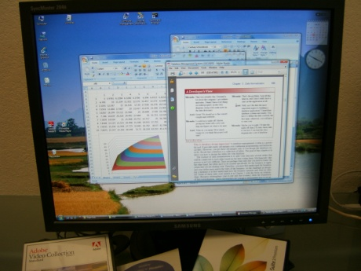

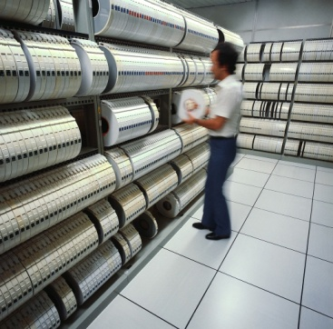
MIS Components
Hardware
Software
Backup data
Restart job
Virus scan
People
Data
Procedures

Slide 5
Goal of This Course
How can MIS help you do your job?
Understand the technology.
Analyze business problems.
An introduction to systems analysis.
Identify types of problems that MIS can help solve through cases.
Ability to classify problems.
Know when to call for help.

Slide 6
Why is MIS Important?
MIS affects all areas of business
  Manufacturing
  Accounting & Finance
  Human resources
  Marketing
  Top management
Performance evaluations—expectations

Slide 7
Chapters/Topics
Introduction
Technology Foundations
Networks
Databases
Security
Transactions and ERP
eCommerce
Teamwork
Decisions
Strategy
Entrepreneurship
Systems
MIS Organization
Society

Slide 8
Productivity Growth: Output per Worker
Managers need to use technology to increase productivity to be competitive.
With a 2.9% growth rate, in a decade, productivity increases 34%. Companies can produce the same output with half the workers. Will you be one of the workers replaced?
http://data.bls.gov:8080/PDQ/outside.jsp?survey=pr

Slide 9
What are e-Commerce and e-Business?
Business-to-Consumer (B2C)
  Selling retail products to consumers
Business-to-Business (B2B)
  Selling at the wholesale level to other businesses
E-Business
  Using Internet technologies to conduct any level of business
  E-Commerce
  Intranets
  Most areas of MIS

Slide 10
Retail E-Commerce Statistics
In 2010 EC was about 5 percent of total.
Remove autos and auto parts and EC is about 6 percent.
Notice the seasonal peak in the fourth quarter.
Notice the EC is growing faster than total retail sales.
http://www.census.gov/retail/index.html#ecommerce

Slide 11
Technology Excesses?
You can buy a new model item when it is released or wait for the price to drop.
You can keep buying new releases or continue to use an “old” model.
Answers depend on your needs, the features offered, and the reliability of the old items.
Plus the bling factor.

Slide 12
What do Managers do?
Traditional
  Organizing
  Planning
  Control
Mintzberg
  Interpersonal
  Informational
  Decisional
Luthans
  Traditional 50%
  Formal Communication 30%
  Networking 20%

Slide 13
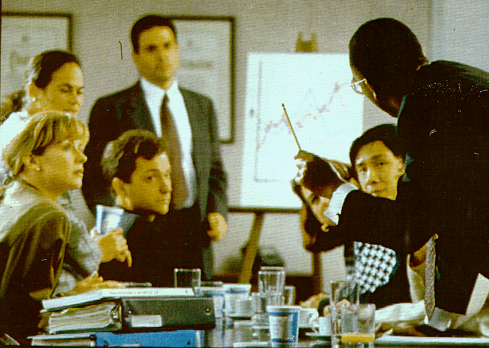
Meetings
Managers and professionals spend considerable time in meetings. Providing
support for teamwork and group decisions is an important issues in MIS.

Slide 14
Making Decisions
Methodology v Ad Hoc Decisions
Decision Process
  Collect Data
  Identify Problems & Opportunities
  Make Choices
2
3
1

Slide 15
Traditional Management
CEO
Condensed reports
Commands
VP
Finance
VP
Marketing
VP
Accounting
VP
HRM
VP
MIS
Analyze data
Layers of middle managers
Collect
data
Customers

Slide 16
Decentralization
Management Team
CEO
VP
Fin
VP
Mrkt
VP
Acct
VP
HRM
VP
MIS
Strategy
Finance
Team
Marketing
Team
Accounting
Team
HRM
Team
Corporate
Database
&
Network
Sales
Team
Methodology/Rules
Franchise
Customers

Slide 17
Business Trends
Changing business environment
  Specialization
  Management by Methodology and Franchises
  Mergers
  Decentralization and Small Business
  Temporary Workers
  Internationalization
  Service-Oriented Business
  Re-engineering
Need for faster responses and flexibility

Slide 18
Business Trends & Implications
Specialization
  Increased demand for technical skills
  Specialized MIS tools
  Increased communication
  Emphasis on Teamwork
Methodology & Franchises
  Reduction of middle management
  Increased data sharing
  Increased analysis by top management
  Computer support for rules
  Re-engineering
Mergers
  Larger companies
  Need for control and information
  Economies of scale
Decentralization & Small Business
  Communication needs
  Lower cost of management tasks
  Low maintenance technology

Slide 19
Business Trend Summary
Business Trend | Implications for Technology
Specialization | Increased demand for technical skills Specialized MIS tools Increased communication
Methodology & Franchises | Reduction of middle management Increased data sharing Increased analysis by top management Computer support for rules Re-engineering
Mergers | Four or five big firms dominate most industries Need for communication Strategic ties to customers and suppliers
Decentralization & Small Business | Communication needs Lower cost of management tasks Low maintenance technology
Temporary Workers | Managing through rules Finding and evaluating workers Coordination and control Personal advancement through technology Security
Internationalization | Communication Product design System development and programming Sales and marketing
Service Orientation | Management jobs are information jobs Customer service requires better information Speed

Slide 20
Business Trends & Implications
Temporary Workers
  Managing through rules
  Finding and evaluating workers
  Coordination and control
  Personal advancement through technology
  Security
Internationalization
  Communication
  Product design
  System development and programming
  Sales and marketing
Service Orientation
  Management jobs are information jobs
  Customer service requires better information
  Speed

Slide 21
Internationalization
http://www.bea.gov/national/nipaweb/Index.asp

Slide 22
International Web Browsers
http://www.internetworldstats.com/stats7.htm

Slide 23
Web Users (Counts)
Asia: 30 percent of population
North America: 75 percent
http://www.internetworldstats.com/stats.htm

Slide 24
US Employment Patterns
Categories and definitions have changed over time.
Management includes professional, sales, and administrative.
The key point is that most jobs are information-processing jobs.
But the numbers measure number of workers, not the value or sales.
http://www.bls.gov/webapps/legacy/cpsatab4.htm

Slide 25
Changing Business Environment
US History: Farmer Laborer Management
Year | Farm | Mfg | Mgt | Service
1920 | 29% | 44% | 22% | 6%
1940 | 23 | 38 | 30 | 8
1960 | 9 | 36 | 43 | 12
1980 | 3 | 32 | 52 | 13
2000 | 1 | 16 | 66 | 17
2010 | 1 | 11 | 68 | 20

Slide 26
MIS Organization
EIS
Strategic
Mgt.
ERP
ES
Tactical
DSS
Management
Transaction
Process Control
Business Operations

Slide 27
Operations, Tactics,Strategy

Slide 28
Decision Levels
Decision Level | Description | Example | Type of Information
Strategic | Competitive advantage, become a market leader. Long-term outlook. | New product that will change the industry. | External events, rivals, sales, costs quality, trends.
Tactical | Improving operations without restructuring the company. | New tools to cut costs or improve efficiency. | Expenses, schedules, sales, models, forecasts.
Operations | Day-to-day actions to keep the company functioning. | Scheduling employees, ordering supplies. | Transactions, accounting, human resource management, inventory.

Slide 29
Introduction to Strategy
Risk & Reward
Creativity
Porter’s External Agents
  Customers
  Suppliers
  Competitors
  Government

Slide 30
Strategy/Porter
Threat of
New Entrants
Bargaining Power
of Suppliers
Rivalry Among
Existing Competitors
Bargaining Power
of Buyers
Threat of Substitute
Products or Services

Slide 31
Baxter/Strategy
Typical Supply Relationship
Supplier
Hospital
American Hospital
Supply
Warehouse
Supply
Closets
Supplier
Supply storeroom
Supplier

Slide 32
Baxter/Strategy
AHS/Baxter Computer Link
Supplier
Baxter
Hospital
American Hospital
Monitor
Usage data
Supply
Warehouse
Supply Closets
Computer
Deliver
Supplies as
needed
Supplier
Free space
Accurate usage data
Supplier

Slide 33
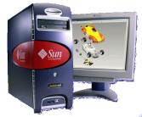

An Internet Approach for Hospital Supply
Daily Auction
Bid1
Bid2
Bid3 <<purchase
Supplier
Baxter
Hospital
Supply Closets
Internet
Supplier
Johnson
Winning bidder delivers supplies
Supplier

Slide 34
Strategy/Organization
Strength
  Source of strength
  Value of strength
  How can it be developed?
  What could undermine it?
  Development costs
  Additional benefits (opportunities)
Weaknesses
  Effect on company
  Possible solutions
  Cost of solution
  Result and cost of leaving as-is (do nothing)

Slide 35
Cloud Computing
As consumers and students, you are familiar with Web-based services.
  E-commerce, sales
  News, entertainment
  Communications
  Social networks and interaction
Businesses can use the same approaches and run software and data on Web servers with applications on laptops, tablets, and cell phones to access this data.
  Cloud computing consists of running the main servers, data, and business logic on Web-based servers in the Internet cloud.
  Each chapter explores impacts and implications for business of moving more operations into a Web-based system.

Slide 36
Technology Toolbox: Choosing a Search Engine
General purpose search engines
Google, Bing, Yahoo
Meta-searches across multiple engines
Dogpile
Encyclopedia
Wikipedia.org
Dictionary
Wiktionary.org (or click the research button in IE)
Phone book
Switchboard, Superpages
Products
Mysimon, Cnet
Government data
CIA.gov (World Factbook)
Fedstats.gov (main data source)
SEC.gov (EDGAR corporate filings)
Math and Science and some Data
Wolframalpha
Consider using multiple search engines because some of them filter responses based on your prior queries.
Other (and often better)
Your library databases

Slide 37
Quick Quiz: Search Engines
Where would you begin your search to answer the following questions?
1. Under the proposed IAU definition, which planetoid falls between Mars and Jupiter?
2. By revenue, which was the largest company in the world in 2010?
3. Find the best price on a 512 GB SSD.
4. Which U.S. professional basketball team had the fewest wins in the 2010-2011 season?
5. Which celebrities are still alive? Sophia Loren, Harman Killebrew, Phyllis Diller, Nancy Reagan, I.M. Pei.

Slide 38
Advanced Searches
Boolean searches: And/Or/Not
Phrases: “white knight”
“white knight” 126,000
“white knight” corporate 12,000
“white knight” corporate
–hackers –groups –Australia –resources 5,080
“white knight” corporate merger
–hackers –groups –resources 701
“white knight” corporate merger
–hackers –groups –resources –history –Australia 655
You can also search by date, domain (company), linked pages, and even reading level (with Google).

Slide 39
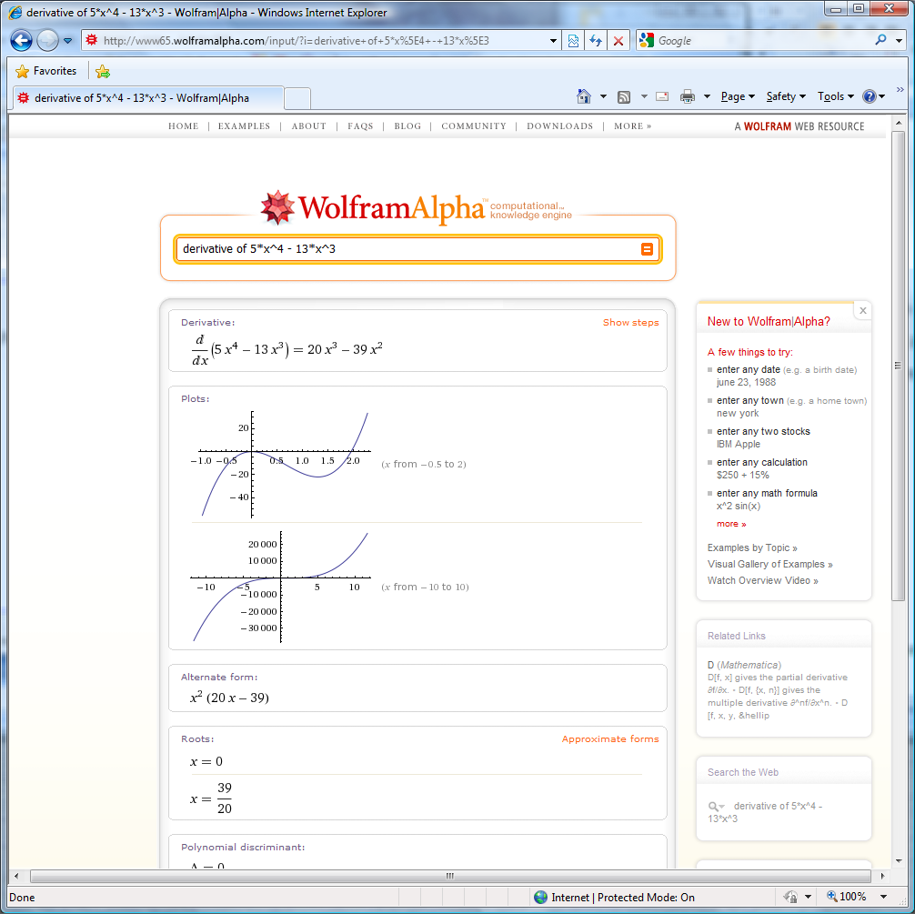
Wolfram Alpha (Mathematica)
http://www.wolframalpha.com/
Search:
derivative of 5*x^4 - 13*x^3
Other searches:
A date
A town
Two stocks

Slide 40
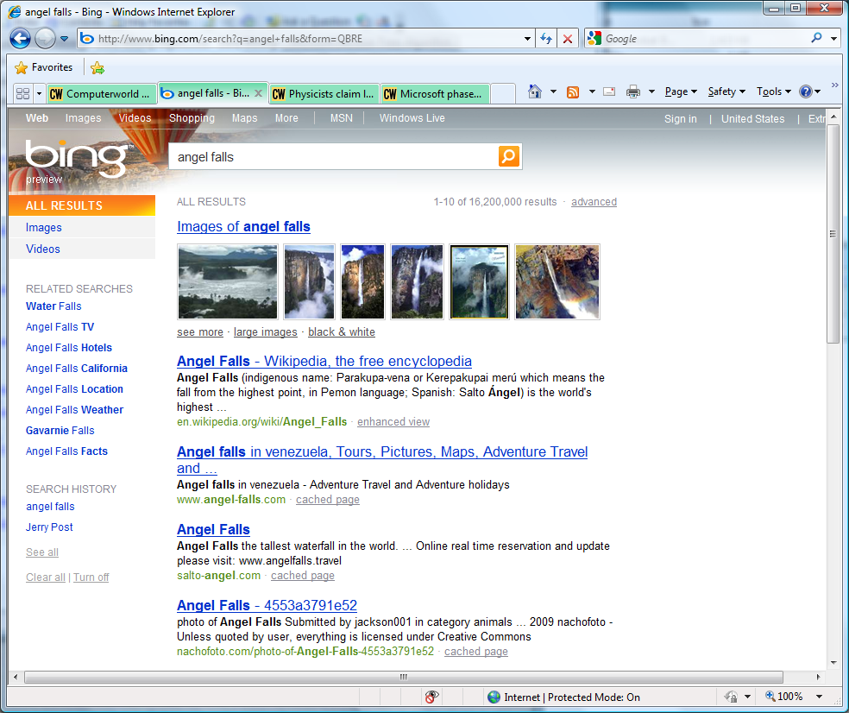
Bing (Microsoft)
http://www.bing.com
Organizing the results to help find answers and knowledge.
http://www.yippy.com
Was: http://www.clusty.com
(Vivisimo)

Slide 41
Technology Toolbox: Government Data
Agency | Main Types of Data | Site
Labor (BLS) | Employment and prices | www.bls.gov/data
Census | Demographic and maps | www.census.gov
Economic Analysis (BEA) | Economic summaries | www.bea.gov
Transportation Statistics | Airline, rail, and road | www.bts.gov
Justice Statistics | Crime and courts | bjs.ojp.usdoj.gov
Economic Research (Ag) | Food and farm economics | www.ers.usda.gov
Health (CDC) | Health and Healthcare | www.cdc.gov/nchs
Securities and Exchange (SEC) | Business filings | www.sec.gov (EDGAR)
http://www.fedstats.gov

Slide 42
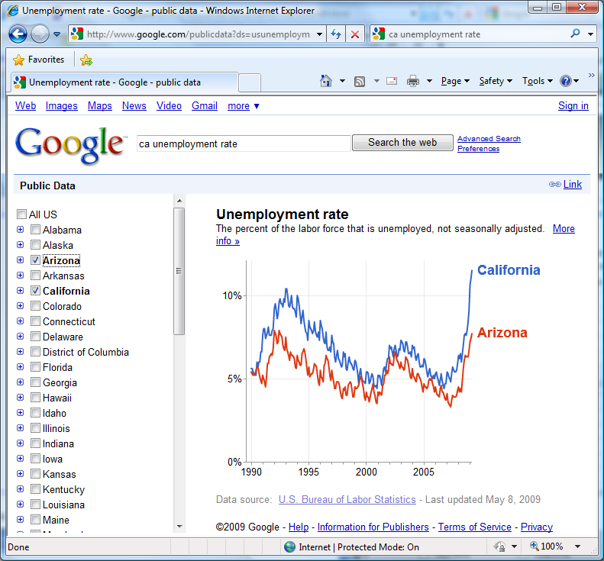
Google: Public Data (2009)
WolframAlpha
Search:
CA unemployment rate
Can use other standard statistics from government databases, including demographics.

Slide 43
Quick Quiz: Government Data
What was the U.S. monthly unemployment rate for the last year?
What is the current population of the U.S.?
What was the value of the U.S. trade deficit for the last year?

Slide 44
Cases: Fast Food Industry

