Slide 1
Introduction to MIS
Chapter 2
Information Technology Foundations
Jerry Post
Technology Toolbox: Voice Input
Technology Toolbox: Creating Effective Charts
Cases: The Computer Industry

Slide 2
Outline
What types of computers are needed for business applications?
What are the basic objects that computers process?
What are the main components of a computer?
Why is the operating system so important?
How does the Internet change the role of computers?
What are the main software applications used in business?

Slide 3
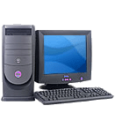
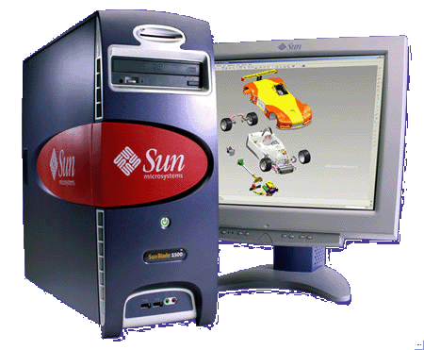
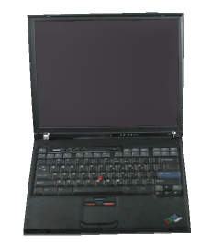
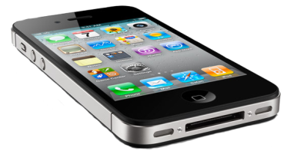
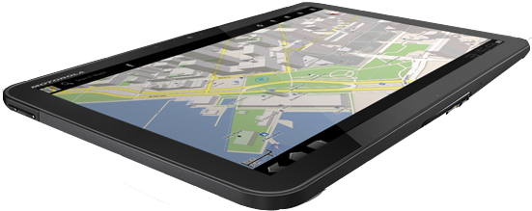
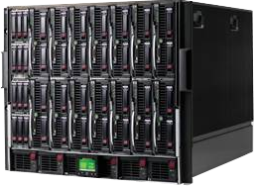
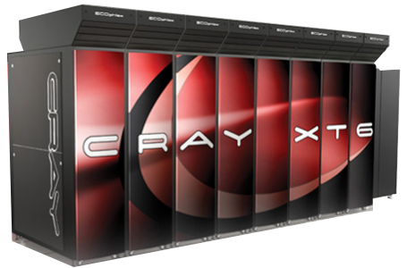
Changing Technology Selections
Desktop: $400-2,000
Workstation: $2,000-7,000
Sun (extinct)
Laptop:$600-2,000
Cell phone:$200-700
Tablet:$500-2,000
Apple
Enterprise Server:
$10,000-$1,000,000
Motorola
Super computer: $1,000,000+
Cray
HP

Slide 4
Trends
Hardware
  Size (capacity)
  Speed (performance)
  Reliability
  Mobility and physical size
  Price
  Data types: Text, Images, Audio, Video
Software and Operating System Trends
  Original: User/Programmer
  Early: Sequential Questions
  Easier: Menus
  Current: User/Event Driven

Slide 5
Technology Trends
Cost of workers increasing
Cost of technology decreasing
Capabilities increasing
  Processing speed
  Storage capacity
  Types of data
    text
    image
    sound
    video
  Quality and reliability
  Communications

Slide 6
Brief History of Computing
Forerunners
  1642 Pascal's mechanical adding machine
  1694 Leibnitz' calculator
  1750 Industrial Revolution in England
  1834 Babbage's analytical engine
  1880 Hollerith's punched-card system
1940
  1942 Atanasoff Berry Computer
  1946 ENIAC electronic digital computer
  1949 EDSAC stored program computer
1950
  1951 UNIVAC I: U.S. Bureau of Census
  1954 IBM 650: popular 1st generation
1960
  1965 IBM System/360: 3rd generation
  1965 DEC PDP-8: 1st minicomputer

Slide 7
Computing History
1970
  1970 IBM System/370 announced
  1975 MITS Altair 8800: micro kit
  1976 Cray I shipped supercomputer
  1978 TRS-80/I, Apple II introduced
1980
  1982 IBM Personal Computer
  1984 Apple Macintosh
  1988 32 bit microprocessors (I486 & M 68040)
  1989 RISC processors, LANs
1990
  Rapidly declining cost of small computers
  Software integration
  The Internet expansion, Web browsers
2000
  Ubiquitous computing
  Web 2.0 (interactive) and Social Networks
  Cell phones and mobile computing
2010
  Cloud computing?
  Touch and voice interfaces?

Slide 8
Binary Data: bits and Bytes
Single bit: one or zero (on or off)
8 bits = 1 Byte: 10101010
1 byte holds values from 0 – 255
2²⁰ = 1,048,576
2¹⁰ = 1024
2⁸ = 256
2⁷ = 128
2⁶ = 64
2⁵ = 32
2⁴ = 16
2³ = 8
2² = 4
2¹ = 2
2⁰ = 1
Bytes | bits | Power of 2
1 | 8 | 256
2 | 16 | 65,536
3 | 24 | 16,777,216
4 | 32 | 4,294,967,296
8 | 64 | 18,446,744,073,709,551,616
Note that 32-bit hardware/software cannot address more than 4 GB of memory. Windows 7/32 max is 3 GB.

Slide 9
Big Numbers (Terminology)
Term | Approximate | Power of 10 | Power of 2 | IEC term | Binary value
Kilo | Thousand | 3 | 10 | Kibi | 1024
Mega | Million | 6 | 20 | Mebi | 1,048,576
Giga | Billion | 9 | 30 | Gibi | 1,073,741,824
Tera | Trillion | 12 | 40 | Tebi | 1,099,511,627,776
Peta | Quadrillion | 15 | 50 | Pebi | 1,125,899,906,842,624
Exa | Quintillion | 18 | 60 | Exbi | 1,152,921,504,606,846,976
Zetta | Sextillion | 21 | 70 | Zebi | 1,180,591,620,717,411,303,424
Yotta | Septillion | 24 | 80 | Yobi | …
Some people use different names for powers of ten versus two.
Powers of ten use a base of 1000.
Powers of two use a base of 1024.
The IEC (electrical) standard in 1999 defines different terms for decimal versus binary numbers.

Slide 10
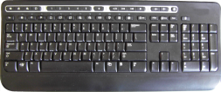
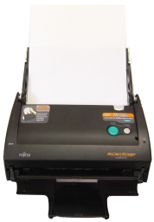
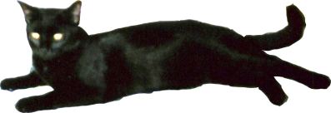
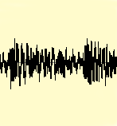
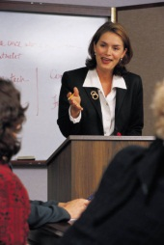
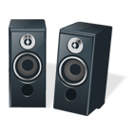

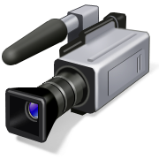
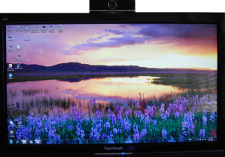
Data Types
Input
Process
Output
Numbers
12 + 8 = 20
000001100
000001000
---------------
000010100
20
Text
This is a test
84 104 73 115 …
This is a test
0010000000000000000
0100000000000001001
0110000011000011011
0111111111111001111
1111111111111011111
1111111111100011111
Images
pitch or
volume ↑
Time →
Sound
8 9 0 5 …
000001000 000001001 000010100 …
Video
00101010111
11010101010
01010101010
11110100011
00101011011
00101010111
11010101010
01010101010
11110100011
00101011011
00101010111
11010101010
01010101010
11110100011
00101011011
00101010111
11010101010
01010101010
11110100011
00101011011
00101010111
11010101010
01010101010
11110100011
00101011011

Slide 11
Application Objects
Primary Objects
  Text
  Numbers
  Pictures
  Sound
  Video
Primary Functions
  Cut
  Copy
  Paste
  Edit
  Save and Retrieve
  Align

Slide 12
Application Objects: Numbers
Numbers
  Attributes
    Display format
    Precision
    Value limits
  Functions
    Computations
    Aggregation
    Sorting
    Comparisons
Precision ROUND Format
function function
5.563
0.354
+ 6.864
12.781
5.56
0.35
+ 6.86
12.77
5.56
0.35
+ 6.86
12.78
Is the display precision the same as
the computation precision?
Yes No
Spreadsheet:
=Round(5.563,2)
Internal data formats decimal places
Integer -32,768 to 32767 0
Float +/- 3.4 x 10 ³⁸ 7
Double +/- 1.797 x 10 ³⁰⁸ 15

Slide 13
Alphabets
How many letters are there in the alphabet?
This is a trick question. You need to ask: Which alphabet?
Early | U.S. and England | ASCII and EBCDIC 127 characters => 7 bits/1 byte
1980s | Latin-based characters: tilde, accent, umlaut, … ñ, é, ö | Code pages and extended character sets 255 characters => 8 bits/1 byte
1990s+ | Asian ideograms, plus any language 日本語 中文 Российская | Unicode All modern languages and most dead languages 1 character => 2 (or 3) bytes

Slide 14
Application Objects: Text
Text
  Attributes
    Typeface
    Point size
    Color
    Bold, italic
    Underline . . .
  Functions
    Spelling
    Grammar
    Searching
    Sorting
Typeface Classification
Sans serif
Arial 20
Courier 18 (monospace)
Garamond 24
Serif
New Century Schoolbook 16
Times 22
Ornamental
Braggadocio 18
Brush Script 20
A
leading
72 points,
1 inch

Slide 15
Resolution
32
16
24
12
32/24 = (8/8)*(4/3)
16/12 = (4/4)*(4/3)
Total pixels: 24*32=768
Total pixels: 16*12=192
768 = 4*192
If the rectangles are measured in inches: 4” x 3” the resolution is 8 ppi and 4 ppi

Slide 16
Resolution and Color
100 dots per inch
6 inches
6*100 = 600 dots per line
400*600 = 240,000 pixels
4 inches
4*100 = 400 dots per column
How many colors per pixel?
How many colors can the human eye distinguish?
16,000,000: 2^24 = 16,777,216
24 bits = 3 bytes: Red + Green + Blue (RGB)
3 bytes per pixel => 3*240,000 raw data bytes = 720,000
Double resolution to 200 dpi => 4*720,000 = 2,880,000

Slide 17
Common Resolution Numbers
Video Displays
Video | Pixels
VGA | 640 x 480
XGA | 1024 x 768
SXGA | 1280 x 1024
UXGA | 1600 x 1200
WSXGA | 1680 x 1050
HDTV | 1920 x 1080
Computer displays are based on a 4/3 aspect ratio from the older TV standard.
HDTV uses a 16/9 aspect ratio.
Actual resolution depends on the physical size of the screen.
Look at what happens to resolution with the camera prints as the size increases.
Digital Camera: 7 megapixels
3072 x 2304
Printers
Method | Pixels Per Inch
Fax | 100-200
Ink jet | 300-700
Laser | 600-1200
Typeset | 2400
Print Size | Pixels Per Inch
3” x 4” | 768
4” x 6” | 512
8” x 10” | 307

Slide 18
Aspect Ratio
Aspect Ratio is the relationship between width and height.
Early films and NTSC televisions (U.S.) had an aspect ratio of 4:3, so initial computer displays copied that ratio.
  640 x 480 → 4/3
  1600 x 1200 → 4/3
  Photographs often used the same ratio.
But movies were created with a much wider screen and an aspect ratio closer to 1.85:1 or 2.40:1(check the back of a movie package).
HD TV was designed to come closer to the movie industry and standardized on 16:9.
  HD 1080p is 1920 x 1080 → 16:9
  Many computer screens have adopted that ratio.

Slide 19
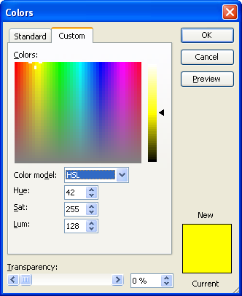
Colors
RGB: Red Green Blue, 1 byte each (0-255 values)
Visualize as lights:
255, 0, 0 is all red
0, 128, 0 is half green
255, 255, 0 is yellow
0, 0, 0 = black
Hue
Luminosity
CMYK: Cyan Magenta Yellow Key
Used for printing (Key is black)
Expressed as a percentage of pure color.
0, 0, 0, 0 = no color (white page)
Saturation
HSL: Hue, Saturation, Luminosity
Used in video/television.
x, 0, 0 = black

Slide 20
Sample Vector Image
Displays well at any scale.
Stored internally as mathematical objects:
Lines
Points
Rectangles
Circles

Slide 21
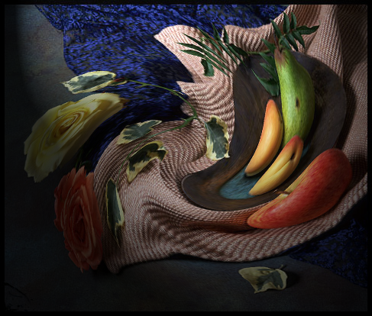

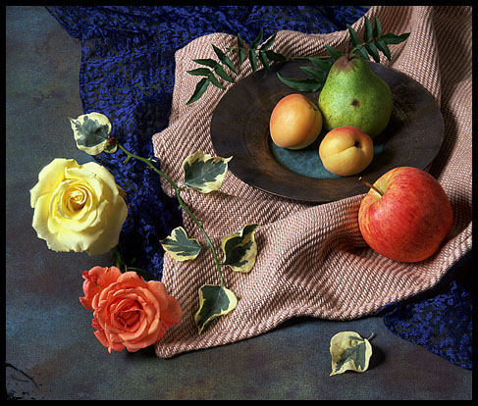
Bitmap Images: Adobe Photoshop
(1) Set a light source.
(2) Twirl.
Emboss
Hundreds of tools and options.
You can add and delete items from photographs.
Professional editing is hard to detect.
You need a really good monitor to edit photos.

Slide 22
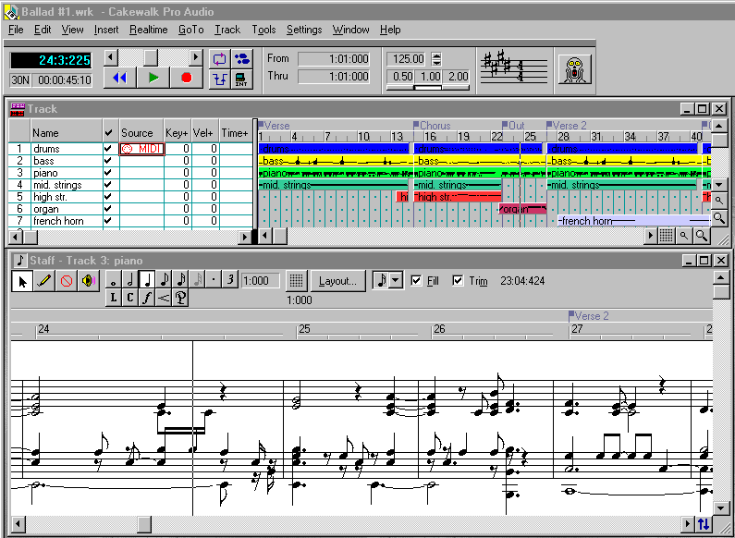
Audio: Cakewalk MIDI
MIDI editors provide complex editing tools for music.
You can assign instruments, set musical features, even edit individual notes.
Entire piece (1:39): 17,441 bytes

Slide 23
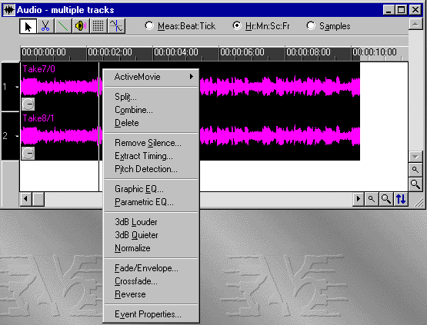
Audio capture: Cakewalk
When you capture audio, you can edit it.
Detailed options exist to match conventional audio studio facilities.
Or you can edit individual samples.
CD quality audio (44.1 KHz, stereo): 150 KB/sec or 9 MB/min
(6 MB/min compressed)

Slide 24
Audio Samples
frequency (pitch)
lower / higher
440.01
Frequency: (hertz) cycles per second
time
amplitude (volume)
37.15
Amplitude: height of the wave
time
How many measurements per second?
Two numbers, 16 bits each, times two for stereo.

Slide 25
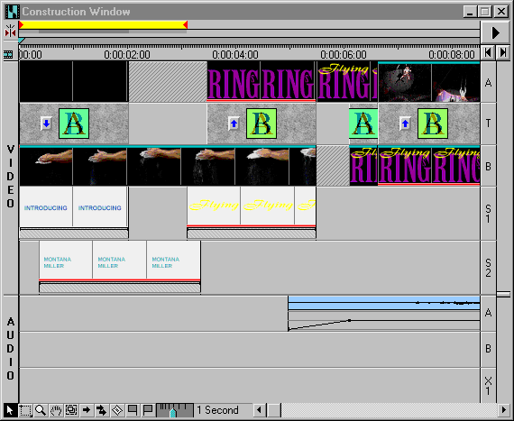
Video: Adobe Premiere
Video capture
or animation
Transition
Video overlay
Superimpose text
Superimpose text
Audio (2 channels)
with volume fade.
NTSC Video, full screen, 30 fps: 3 MB/sec (compressed)

Slide 26
Application Objects
Pictures & Video
  Attributes
    Size & resolution
    Colors
  Functions
    Display/Play
    Edit
Sound
  Attributes
    Amplitude/volume
    Frequency/pitch
    MIDI v samples
  Functions
    Record
    Play

Slide 27
Size Complications
Object | Raw | Compressed | Lossy
Text and numbers | 5 KB/page | 2.3 KB/page | N/A
Image (300 dpi, 24-bit color, 4 x 6 in.) 1958 x 1128 | 6.32 MB | 2.4 MB | 78 – 245 KB
Sound (44.1 KHz stereo) | 352 KB/sec | 170 KB/sec | 0.01 KB/sec
Video (DV 720 x 480 at 29.97 fps, stereo) | 25 MB/sec | 3.7 MB/sec | 1 MB/sec
HDTV (1080p: 1920 x 1080) (MP4) | 6.8 GB/min |  | 1.5 MB/sec
Compression:
Text uses a ZIP folder.
Image is JPEG at high quality (12), low (0) – medium (6)
Sound is WAV at 44.1 kbps and WMA at 64 kbps
Video is DV AVI and Microsoft WMV at 6383 kbps
HDTV is MP4
HDTV: http://www.microsoft.com/windows/windowsmedia/howto/articles/ understandinghdformats.aspx

Slide 28
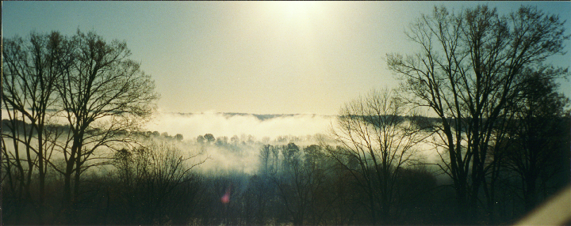
Data Compression
Storing every single pixel requires a huge amount of space. Compression looks for patterns. For example, instead of storing 1000 black dots in a row, it is much shorter to store a note that says 1000 black dots come next.
The JPEG standard supports lossy compression, which matches patterns if they are close—saving more space, but reducing quality.

Slide 29
Virtual Reality
Hardware
  Output
    3-D video
    Goggles
    3-D sound
  Input
    VR Glove
    Pressure suits
Software
  Limited resolution/speed
  Limited business applications
Potential

Slide 30
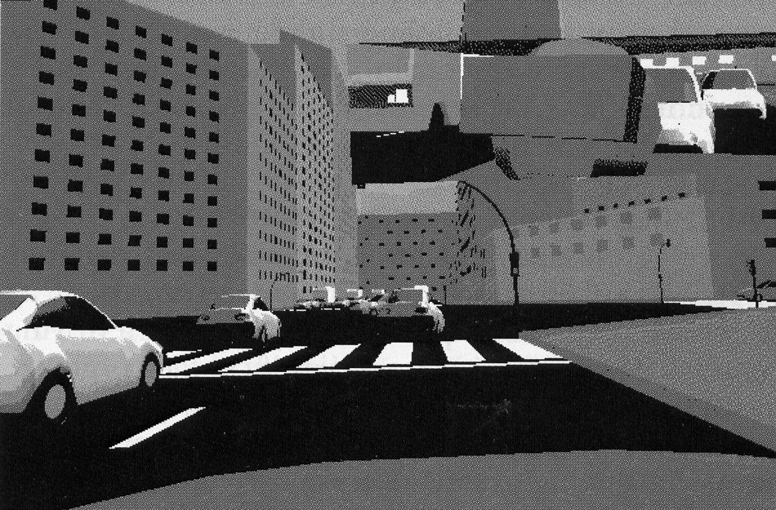
Virtual Reality Photo
Workers at LISITT (Laboratorio Integrado de Sistemas Inteligentes y Tecnologias de la informacion en Trafico) have developed a virtual reality driving simulator (SIRCA) to evaluate driver learning and road safety.

Slide 31

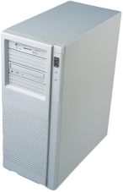

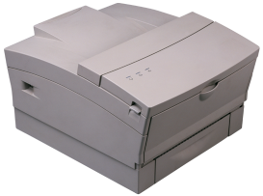
Computer Components
Input
Process
Output
seconds - milliseconds
nanoseconds
seconds - milliseconds
• Keyboard
• Mouse
• Optical scanner
• Voice input
• Bar code
• Touch screen
• Light pen
• MICR
• Magnetic strips
• Card reader
• Other computers
• Processor
• RAM
• Device controllers
• Video monitor
• Printer
• Plotter
• Process control
• Voice output
• Music synthesizers
• Other computers
Secondary
storage
milliseconds
• Magnetic Disk
• Floppy Disk
• Optical Disk
• Tape Drive
• USB Drive

Slide 32
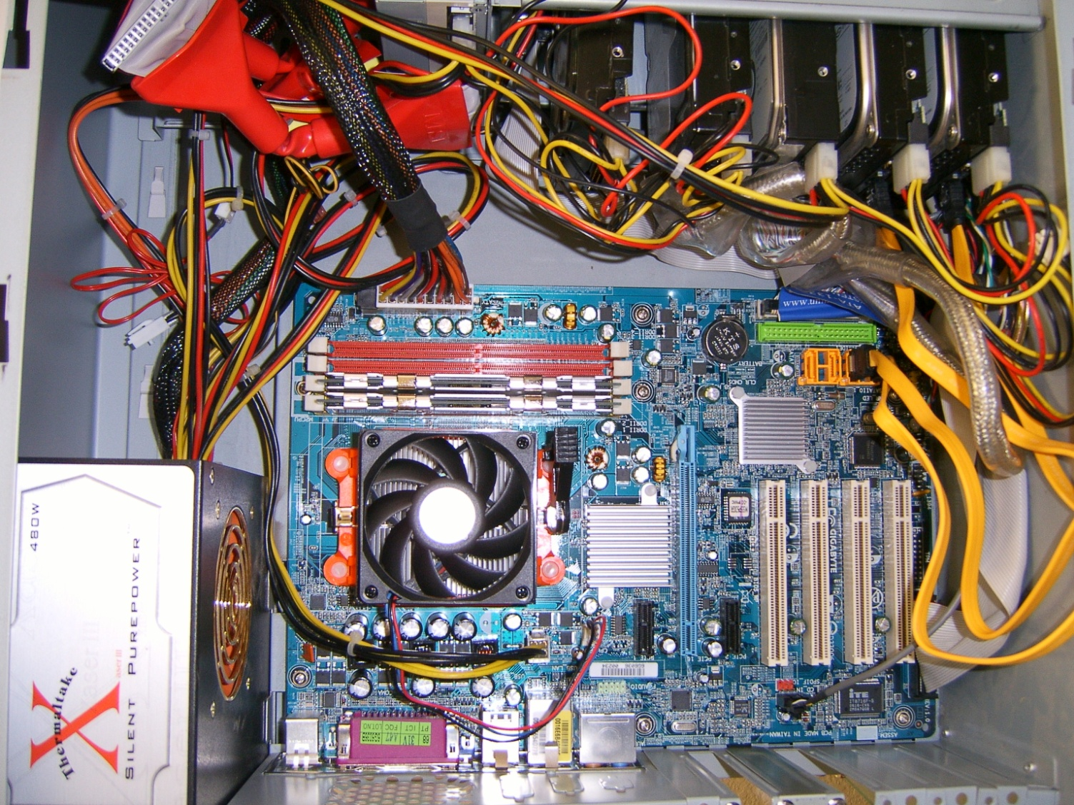
Basic Computer Board
Motherboard
Disk drives
RAM
IDE
Processor—under the fan and heat sink
SATA
Power supply
Keyboard, video,
and other connectors
Graphics
Onboard and
external
Expansion slots

Slide 33
Physical Size
Processor and RAM internal distances determine the size of internal components and the number of items.
  2011 common distance was 32 nanometers (nm).
  Next goal is 22 nm.
  Placing items closer together means more capacity per chip and it can reduce heat and power consumption, and improve performance.
Comparisons
  A nanometer is one-billionth of a meter.
  Paper thickness (20 pound): 0.004 inches = 0.1 millimeter = 100 micrometers = 100,000 nm.
  A green laser pointer has a wavelength of 532 nm.
  X-ray wavelength is from 0.01 to 10 nm.

Slide 34
Intel Processor Speeds by Year
Multi-core

Slide 35
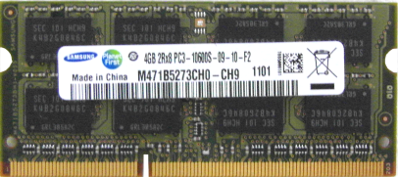
RAM Costs
1990 $250 for .008 GB $32,000/GB
2007: $59 for 1 GB 800 MHz $59/GB
2010: $45 for 4096 1333 MHz DDR3 $11.25/GB
www.newegg.com
Conclusion: RAM is free.

Slide 36
Parallel Processing
11 24 32 15
+ 27 33 57 84
= ___________________
Are 4 parallel processors four times faster than 1?
Crucial assumptions:
  There are multiple processors.
  Task can be split into as many parts as there are processors.
  Coordinating results does not take more time than processing.
23 xx
+54 +92
xx yyy

Slide 37
Cache Memory
Processor
Cache on Processor
File
Needed
Might need
Read ahead
Fast
Cache
Memory
Disk Drive
Processor is faster than disk drive.
Reads ahead and stores several pieces of the file into cache memory.
Pulls data from cache as needed.
Cache is used as a buffer between two devices of different speeds. Disk->RAM, RAM->Processor
Slow

Slide 38
Connecting Components
Method | Max Speed | Primary Purpose
PCI-e 2.0/x16 | 500 M Bytes/s*16 64 G bits/sec | Connect peripherals, graphics cards
SATA II | 3 G bits/sec | Disk drives
SATA 3 | 6 G bits/sec | Disk drives
Fibre Channel | 20 G bits/sec | SAN/external drives
Firewire 2.0 | 800 m bits/sec | Video, drives
HDMI | 3.4 G bits/sec *3 | HDTV video
USB 2.0 | 480 m bits/sec | External devices
USB 3.0 | 4.8 G bits/sec | External devices
Intel: Light Peak (Thunderbolt) | 10 – 100 Gbits/sec | External devices
LAN/gigabit | 1 G bits/sec | Computers, drives
Max speed is never achieved, but it can reveal bottlenecks.
Hard drive transfer rates are often limited by drive write speeds.
But, the newer methods (SATA 3 and USB 3.0) will improve the performance of large data transfers. These methods become more useful when connecting to a large solid state drive.

Slide 39
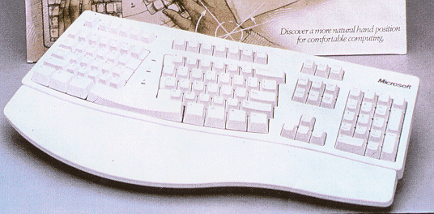
Input: Keyboards
There have been increasing complaints about injuries “caused” by repetitive typing tasks. Several manufacturers have experimented with new keyboard designs (like this one from Microsoft) that are claimed to relieve physical stress.

Slide 40
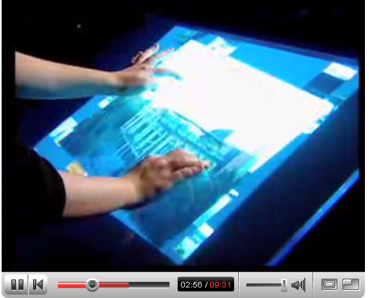
Input: Multi-touch
Jeff Han Presentation February 2006 time: 9:31
http://www.youtube.com/watch?v=QKh1Rv0PlOQ

Slide 41
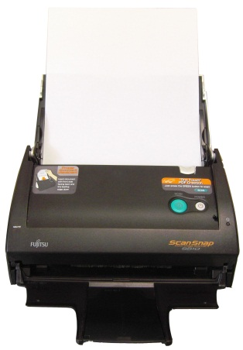

Input: Scanners
Scanners
  Format
    Hand-held
    Page
    Flatbed
  Optical Character Recognition
    Text and Graphics
    Columns
    Proportional v Fixed Fonts
    Training v Preprogrammed
  Gray scale and colors
OCR “reads”
pixels and converts
to letters and words.
But mistakes arise.
Text
In
Bitmap
Pixels

Slide 42
Input: Voice
Voice
  Microsoft Office includes a decent voice input system.
  It must be trained so that it adapts to your speech patterns.
  It is not perfect, but is relatively fast.
  It works best if you speak in full sentences—enabling the system to choose words based on context.
Speak in complete sentences
Speak in complete sentences.

Slide 43
Output: Printers
Quality (resolution: dots per inch)
  Ink Jet 300 - 1200 dpi
  Laser 600 - 1200 dpi
  Typeset/offset press 2400 dpi
Speed (pages per minute)
Cost
Duty cycle: Pages per week or month
Printer | Initial Cost (dollars) | Cost Per Page (cents) | Quality (dots/inch) | Speed (pages/min.)
Laser: B&W | 300 – 20,000 | 0.6 – 3 | 600 – 1200 | 4 – 8 – 17 – 150+
Laser: Color | 500+ | 5 – 75 | 600 – 1200 | 1 – 30
Ink jet: Color | 100 - 500 | 5 - 150 | 300 – 1200 | 1 - 20
Check Kodak’s strategy (2007) for lower-cost ink.

Slide 44
Secondary Storage
Evaluation of Secondary Storage
  Capacity
  Speed
  Cost
Magnetic Hard Drive
  80 GB – 1,000 GB [typical PC: 250]
  8 - 20 ms access [typical PC: 10]
  4200 rpm (old laptop), 5400 rpm, 7200 rpm, 10,000 rpm, 15,000 rpm
  $0.25 - $1.00 / GB [some large drives are much higher]
Optical Disk
  700 MB
  30 - 200 ms
  DVD: 4.77 - 9 GB
  Blu-Ray: 25-50 GB
USB 2.0 Flash Drive to solid-state drives (SSD)
  16 MB-1 GB
  Read: 8 MB/s
  Write: 1 - 5 MB/s
  $10-30/GB (2004 $350/GB, 2007 $10/GB)

Slide 45
Secondary Storage
Drive | Capacity (gigabytes) | Speed (Write MB/s) | Initial Cost (dollars) | Cost/GB (dollars)
Magnetic hard | 80 – 3,000 | 60 – 200 | 65 – 200+ | 0.07
SSD | 16 – 512 | 60 – 320 | 200 – 900 | 1.76
USB drive | 2-64 | 25 – 150 | 10 – 115 | 1.80
Tape | 250 – 800 | 20 – 120 | 300 – 5,000+ | 0.05 – 1.00
CD-ROM | 0.70 | 2 – 8 | 50 | 0.18
DVD | 4.77 (8.5 DL) | 2 – 21 | 50 | 0.04
Blu-Ray | 25 (50 DL) | 4.5 – 36 | 80 | 0.12
Blu-Ray BDXL, IH-BD | 128
Conclusion: Storage is free
But high-speed storage costs more
CD/DVD Speeds: http://www.osta.org/technology/dvdqa/dvdqa4.htm

Slide 46
SSD and USB Flash
USB Flash/thumb drive
Year | Capacity (GB) | Price | Read MB/s | Write MB/s
2007 | 2 | 50 | 8 | 5
2010 | 16 | 55 | 25 | 18
2011* | 64 | 200 | 100 | 70
*2011=> USB 3.0
SSD (laptop)
Year | Capacity (GB) | Price | Read MB/s | Write MB/s | Brand
2010 | 64 | 725 | 250 | 170 | Intel
2011 | 512 | 1400 | 230 | 180 | Kingston
2011 | 512 | 1500? | 415 | 260 | Micron

Slide 47
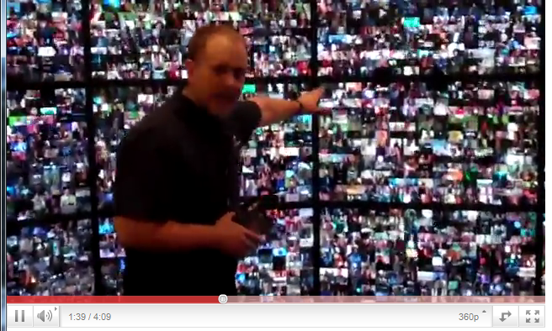
SSD Extreme: Fusion IO
http://www.youtube.com/watch?feature=player_embedded&v=9J5xGwdmsuo
20 servers, 12 processors each, delivering 225 videos each = 4500 videos.
All of them delivered from a single (monster) SSD.
The SSD has 8 controllers each capable of delivering 750 MB/s for a total of 6 gigabytes per second!

Slide 48
What is a Server?
Reliability
Easy backup
Easy maintenance
Multi-user
Scalability
  Product family consistency (IBM)
  Server Farm (Microsoft)

Slide 49
What is a Client/Browser?
Display device/standards
User interface
Data collection
New: Wireless
  Cell phones
  Tablets

Slide 50
Compatibility
Hardware standards?
Operating systems
  Unix
  Windows-NT
Software & Data
  Binary incompatibility
  File compatibility & conversion
    Leading software
    Limited standards (e.g., ASCII)
Error reading file
Invalid format.

Slide 51
Software Categories
Operating System
Utilities
Programming Languages and Tools
Application
  General purpose examples
    Word processing
    Spreadsheets
    Graphics
  Single purpose examples
    Accounting
    Tax preparation
    Games
    CAD-CAM
Database Management Systems (DBMS)

Slide 52


Operating Systems
Device
driver
Device
driver
Device
driver
Operating System
Operating system tasks.
  Identify user (security).
  User interface.
  Load applications.
  Coordinate devices.
Device drivers for independence.
    Input.
    Process.
    Output.
    Secondary storage.
Device
driver

Slide 53
Operating Systems: User Interface

Slide 54
Multitasking & Components
Components operate at different speeds
  Processor nanoseconds
  Input seconds or milliseconds
  Output seconds or milliseconds
  Secondary Storage milliseconds
Time comparison
  1 ns / 1 sec == 31.7 years
  1 micro / 1 sec == 11.6 days
  1 ms / 1 sec == 16:40 min:sec

Slide 55
Multitasking
Single Tasking
Task 1
Task 2
Task 3
Multitasking

Slide 56
Virtual Machine (VM)
One set of computer hardware configured to run multiple, independent operating systems.
One physical Computer
Multiple core processor
VM1: Windows Server
1 processor, 4 GB RAM
VM2: Linux Database Server
2 processors, 8 GB RAM
VM3: Windows PC
1 processor, 2 GB RAM
Shared Memory
Allocated disk space
Shared network
You have to purchase operating systems and software for each VM, but only one set of hardware.

Slide 57
Early Computer Languages
1st generation: Machine
  1110 1101 get data at 1101
  1001 1111 add value at 1111
  1101 0111 put result in 0111
2nd generation: Assembly
  MOV AX,[011E] get value at 011E
  ADD AX,[0100] add value at 0100
  MOV [0FEB],AX put result in 0FEB

Slide 58
Computer Languages
3rd generation: Procedural
  Four popular variations
    FORTRAN
    Basic
    COBOL
    C total = net + taxes;
4th generation: Database
  SQL: select net+taxes from sales;
5th generation: Not Exist Yet
  Artificial Intelligence
  Natural Language
  Example: What were gross sales last month?

Slide 59
Application Software
Research: Databases
Analysis: Calculations (spreadsheets and more)
Communication: Writing (word processors and more)
Communication: Presentation and Graphics
Communication: Voice and Mail (e-mail and more)
Organizing Resources: Calendars and Schedules

Slide 60
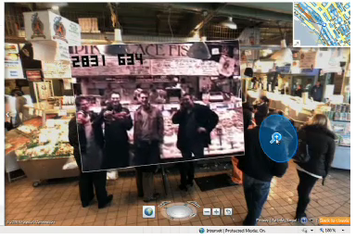
Augmented Reality
Layering data on images and video.
TED 2010: Blaise Aguera y Arcas (Microsoft)
http://www.ted.com/talks/blaise_aguera.html

Slide 61
Paperless Office?
Paper and Paperboard
Note leveling off in the U.S. and Canada.
Source: http://earthtrends.wri.org/searchable_db/index.php?theme=9l
Matches UN FAO data

Slide 62
Paper Consumption
http://earthrends.wri.org
Raw data from Food and Agriculture Organization of the UN
http://faostat.fao.org/site/626/DesktopDefault.aspx?PageID=626

Slide 63
Open Software Issues
Operating Systems: Linux (and others)
Applications: Sun Star Office (and others)
Development: GNU
A bunch of open questions:
  Total cost?
  Service and support?
  Training?
  Upgrades?
  Security?
These can be “religious” issues for some.
The Internet solved many of the issues with the client platform, can it solve the application battles?

Slide 64

Cloud Computing
Server and data
Display
browser
application

Slide 65
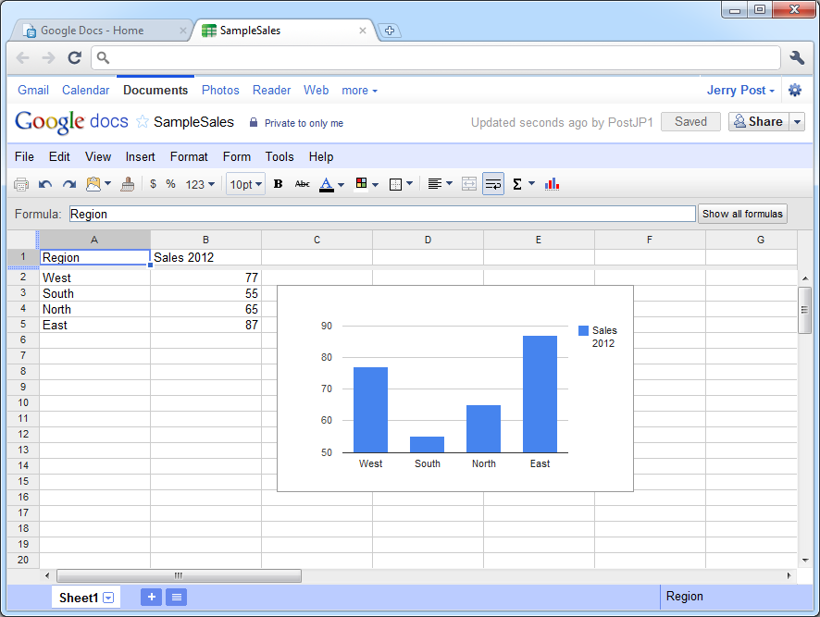
Cloud Computing: Google Docs
http://docs.google.com
Spreadsheet
Word processor
Presentation
Drawing
Form
Free (limited space)
Business Apps:
$50/user/year
Calendar, e-mail

Slide 66
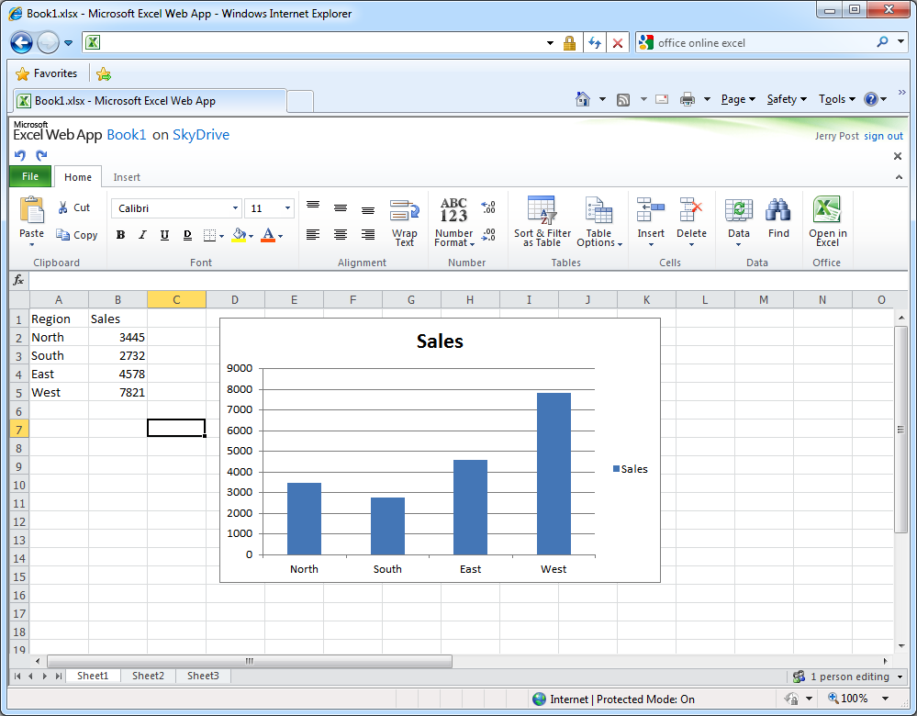
Cloud Computing: Office Web Apps
http://office.microsoft.com/en-us/web-apps/
Spreadsheet
Word processor
Presentation
OneNote
Free (limited space)
Business Apps:
$50/user/year
Calendar, e-mail

Slide 67
Technology Toolbox: Voice Input
Install and setup
  Get a decent headset microphone.
  Set aside time to train the system in a quiet environment.
  Within Word (or use the Control Panel):
    Tools/Speech.
    Follow the installation instructions.
  Train it by reading several stories.
Using the system
  Dictate in complete sentences.
  Use the keyboard and mouse to edit.
  Use the toolbar to turn off the microphone to cough.
  Use the toolbar to switch to command mode for menus.

Slide 68
Technology Toolbox: Voice Input Commands
Command | Character/Result
period or dot comma new line new paragraph open paren close paren force num, pause, digits spell it or spelling mode microphone correct that scratch that go to top move up backspace select word | . , Enter Enter twice ( ) numbers (for several numbers in a row) spell out a word turn microphone on or off change or delete the last phrase entered delete the last phrase entered move to top of the document (or bottom) move up one line (also down, left, right) delete one character to the left select a word (several options/phrases)

Slide 69
Quick Quiz: Voice Input
Use the help system to find the commands for the following:
1. !, ?, #, $
2. Make a word boldface or italic.
3. Print the current page.

Slide 70
Technology Toolbox: Effective Charts
Chart Type | Purpose | Common Mistakes
Bar or Column | Show category values | Too many series Unreadable colors Not zero-based
Pie | Compare category percentages | Too many observations/slices Unreadable features/3-D Poorly labeled
Line | Show trends over time | Too many series Poor or missing legend Not zero-based
Scatter | Show relationship between two variables | Poor choice of variables Not zero-based

Slide 71
Technology Toolbox: Effective Charts Example

Slide 72
Quick Quiz: Effective Charts
Create the following charts:
1. Use the export data form in Rolling Thunder bicycles to generate sales by state. Create a column chart and a pie chart for this data. Briefly explain why one chart is better than the other one.
2. Using Bureau of Labor Statistics data, plot the unemployment rate and the hourly wage rate over three years.
http://data.bls.gov/cgi-bin/surveymost?ln
http://data.bls.gov/cgi-bin/surveymost?ec

Slide 73
Cases: Computer Industry

