Slide 1
Introduction to MIS
Chapter 9
Business Decisions
Jerry Post
Technology Toolbox: Forecasting a Trend
Technology Toolbox: PivotTable
Cases: Financial Services

Slide 2
Outline
How do businesses make decisions?
How do you make a good decision? Why do people make bad decisions?
How do you find and retrieve data to analyze it?
How can you quickly examine data and view subtotals without writing hundreds of queries?
How does a decision support system help you analyze data?
How do you visualize data that depends on location?
Is it possible to automate the analysis of data?
Can information technology be more intelligent? Can it analyze data and evaluate rules?
How do you create an expert system?
Can machines be made even smarter? What technologies can be used to help managers?
What would it take to convince you that a machine is intelligent?
What are the differences between DSS, ES, and AI systems?
How can more intelligent systems benefit e-business?
How can cloud computing be used to analyze data?

Slide 3



Making Decisions
Analysis and Output
Decisions
Data
Models
Sales and Operations

Slide 4
Decision Challenges
By guessing, people make bad decisions.
You need to develop a process
  Obtain data
  Build a model
  Analyze the data
Which means you need tools
  Some tools require background and experience
  Some can be automated to various points
Beware of decisions after-the-fact: Someone can have “amazing” results that are random.
  If you look at a sample of 1,000 people and one does substantially better than the others is it random?
  Stock-picking competitions/results

Slide 5
Sample Model
Determining Production Levels
in Perfect Competition
$
Marginal cost
Average total
cost
price
Q*
Quantity
Economic, financial, and accounting models are useful for examining and comparing businesses.

Slide 6
Decision Levels
EIS
Strategic
ES
Mgt.
DSS
Models
Tactical
Management
Transaction
Processing
Process Control
Business Operations

Slide 7
Choose a Stock
Company A’s share price increased by 2% per month.
Company B’s share price was flat for 5 months and then increased by 3% per month.
Which company would you invest in?
Notes:
Left to themselves, people rarely make good decisions.
We try to make decisions based on simple data and observed correlations.
Examples of human biases are on the next screen.
Statistics and other tools can reduce the effects of some of these biases.

Slide 8
Does More Data Help?
Thousands of stocks, funds, and derivatives.
  How do you find a profitable investment?
Working for a manufacturing company (e.g., cars)
  What features do you place in your next design?
  Data exists:
    Surveys
    Sales
    Competitor sales
    Focus groups
  GM (Fortune Magazine cover: August 22, 1983)
    Olds Cutlass Ciera
    Pontiac J-2000
    Buick Century
    Chevrolet Celebrity

Slide 9
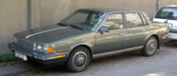
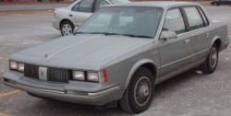
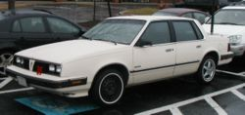
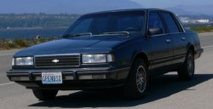
General Motors 1984 Models
Buick Century
Oldsmobile Cutlass Ciera
A-body cars
Pontiac 6000
Chevrolet Celebrity
Why is it bad that all four divisions produced the same car?
How is it possible that designers would produce the same car?
All photos from Wikipedia
See Fortune August 22, 1983 cover for photos new.
WSJ 2008 Version

Slide 10
Human Biases
Acquisition/Input
  Data availability
  Selective perception
  Frequency
  Concrete information
  Illusory correlation
Processing
  Inconsistency
  Conservatism
  Non-linear extrapolation
  Heuristics: Rules of thumb
  Anchoring and adjustment
  Representativeness
  Sample size
  Justifiability
  Regression bias
  Best guess strategies
  Complexity
  Emotional stress
  Social pressure
  Redundancy
Output
  Question format
  Scale effects
  Wishful thinking
  Illusion of control
Feedback
  Learning on irrelevancies
  Misperception of chance
  Success/failure attribution
  Logical fallacies in recall
  Hindsight bias
Barabba, Vincent and Gerald Zaltman, Hearing the Voice of the Market, Harvard Business Press: Cambridge, MA, 1991
Notes:
Humans make many mistakes when evaluating data and trying to make decisions.
This is a partial list from work done by Barabba and Zaltman—which was largely triggered by the GM design decisions.
These traits emphasize the importance of examining data using formal models and methodologies.

Slide 11
Model Building
Understand the Process
  Models force us to define objects and specify relationships. Modeling is a first step in improving the business process.
Optimization
  Models are used to search for the best solutions: Minimizing costs, improving efficiency, increasing profits, and so on.
Prediction
  Model parameters can be estimated from prior data. Sample data is used to forecast future changes based on the model.
Simulation
  Models are used to examine what might happen if we make changes to the process or to examine relationships in more detail.

Slide 12
Why Build Models?
File: C10Optimum.xls
Understanding the Process
Optimization
Prediction
Simulation or "What If" Scenarios
Optimization
Goal or output
Maximum
variables
25
20
Model: defined
15
by the data points
or equation
Output
10
5
5
0
3
1
2
3
4
5
1
6
7
8
9
Input Levels
10
Control variables

Slide 13
Prediction
File: C10Fig05.xls
25
20
Economic/
15
regression
Forecast
Output
10
5
Moving Average
0
Trend/Forecast
Q1
Q2
Q3
Q4
Q1
Q2
Q3
Q4
Q1
Q2
Time/quarters

Slide 14
Simulation
File: C08Fig10.xls
Goal or output
variables
25
20
15
Results from altering
Output
10
internal rules
5
0
1
2
3
4
5
6
7
8
9
10
Input Levels

Slide 15


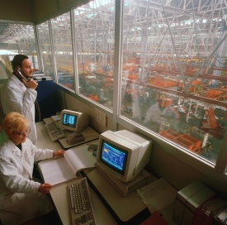
Object-Oriented Simulation Models
Custom Manufacturing
Purchase Order
Purchase Order
Routing & Scheduling
Customer
Order Entry
Invoice
Parts List
Shipping
Shipping Schedule
Production
Inventory & Purchasing
Notes:
Several OO simulation tools exist to help model operations.
Basic mathematical models are defined at each key step and the process is simulated to show potential outcomes. Parameters can be tweaked in the models to show the effect of changes. For example, hiring an additional order-entry clerk (or building a Web site) might process orders more efficiently, which might lead to a backlog in inventory and purchasing. The point is that managers can experiment with changes in the simulated model that are difficult or impossible to do in a real company.

Slide 16

Data Warehouse
Predefined
reports
Interactive
data analysis
Operations
data
Daily data
transfer
OLTP Database
3NF tables
Data warehouse
Star configuration
Flat files

Slide 17
Multidimensional OLAP Cube
Hybrid
Category
Full S
MTB
Road
Race
CA
1420
1258
1184
1098
1578
MI
437
579
683
873
745
Customer Location
NY
1011
1257
985
874
1256
TX
880
750
935
684
993
Jan
Feb
Mar
Apr
May
Time
Sale Month
Notes:
Think of a cube browser (or PivotTable in Microsoft terms) as a way to explore the data. It quickly computes and displays subtotals, filters data, and lets you drill down to see more detail. It often pulls data from a data warehouse using queries, but managers can explore the data interactively without having to write new queries.
Think of the tool as computing multiple levels of GROUP BY statements in SQL queries.

Slide 18
Microsoft Pivot Table

Slide 19
Microsoft Pivot Chart

Slide 20
DSS: Decision Support Systems
File: C10DSS.xls
Sales and Revenue 1994
Model
300
250
Legend
200
Sales
Revenue
150
Profit
sales
revenue
profit
prior
results
Prior
154
204.5
45.32
35.72
100
163
217.8
53.24
37.23
50
161
220.4
57.17
32.78
0
173
268.3
61.93
47.68
Jan
Feb
Mar
Apr
May
Jun
143
195.2
32.38
41.25
Output
data to analyze
181
294.7
83.19
67.52
Database

Slide 21
Sample DSS
The following slides illustrate some simple DSS models that managers should be able to create (with sufficient background in the discipline courses).
  Regression or time series forecast (marketing)
  Employee evaluation (HRM)
  Present value determination (finance)
  Basic accounting spreadsheets

Slide 22
Marketing Research Data
Internal | Purchase | Government
Sales Warranty cards Customer service lines Coupons Surveys Focus groups | Scanner data Competitive market analysis Mailing and phone lists Subscriber lists Rating services (e.g., Arbitron) Shipping, especially foreign Web site tracking, social networks Location | Census Income Demographics Regional data Legal registration Drivers license Marriage Housing/construction

Slide 23
Marketing Sales Forecast
File: C09 Marketing Forecast.xlsx
forecast
Note the fourth quarter sales jump.
The forecast should pick up this cycle.

Slide 24
Regression Forecasting
Data:
Quarterly sales and GDP for 16 years.
Model:
Sales = b0 + b1 Time + b2 GDP
Analysis:
Estimate model coefficients with regression.
Forecast GDP for each quarter.
 | Coefficients | Standard Error | T Stat
Intercept | -68.4499 | 13.4699 | -5.0817
Time | -1.28138 | 0.27724 | -4.6219
GDP | 0.081172 | 0.010345 | 7.8467
Output:
Compute Sales prediction.
Graph forecast.

Slide 25
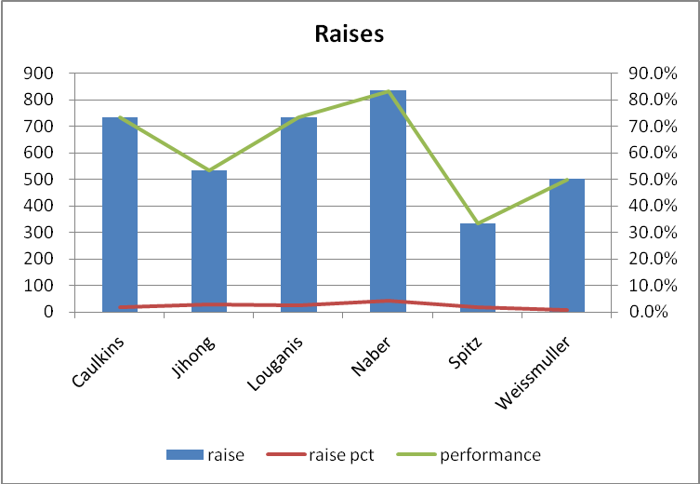
Interactive: HR Raises
File: C09 HRM Raises.xlsx
With appropriate data, the system could also statistically evaluate for non-discrimination

Slide 26
Finance Example: Project NPV
File: C09 Finance NPV.xlsx
Rate = 7%
Can you look at these cost and revenue flows and tell if the project should be accepted?

Slide 27
Accounting
File: C09 Accounting.xlsx
Balance Sheet for 2003
Cash 33,562 Accounts Payable 32,872
Receivables 87,341 Notes Payable 54,327
Inventories 15,983 Accruals 11,764
Total Current Assets 136,886 Total Current Liabilities 98,963
Bonds 14,982
Common Stock 57,864
Net Fixed Assets 45,673 Ret. Earnings 10,750
Total Assets 182,559 Liabs. + Equity 182,559

Slide 28
Accounting
Income Statement for 2003
Sales $97,655 tax rate 40%
Operating Costs 76,530 dividends 60%
Earnings before interest & tax 21,125 shares out. 9763
Interest 4,053
Earnings before tax 17,072
taxes 6,829
Net Income 10,243
Dividends 6,146
Add. to Retained Earnings 4,097
Earnings per share $0.42

Slide 29
Accounting Analysis
Balance Sheet projected 2004
Income Statement projected 2004
Cash $36,918
Acts Receivable 96,075
Inventories 17,581
Accts Payable $36,159
Notes Payabale 54,327
Accruals 12,940
Sales
$ 107,421
1
2
2
Operating Costs
84,183
Earn. before int. & tax
23,238
Total Cur. Assets 150,576
Total Cur. Liabs. 103,427
5
Interest
4,306
Bonds 14,982
Common Stock 57,864
Ret. Earnings 14,915
Earn. before tax
18,931
Net Fixed Assets 45,673
3
taxes
8,519
Net Income
10,412
Total Assets $196,248
Liabs + Equity 191,188
Dividends
6,274
Add. Funds Need 5,060
Add. to Ret. Earnings
$ 4,165
Bond int. rate 5%
4
Earnings per share
$0.43
Added interest 253
Tax rate 45%
Dividend rate 60%
Shares outstanding 9763
1
Forecast sales and costs.
Sales increase 10%
Operations cost increase 10%
2
Forecast cash, accts receivable, accts payable, accruals.
3
Add gain in retained earnings.
4
Compute funds needed and interest cost.
Add new interest to income statement.
Results in a CIRCular calculation.
5

Slide 30
Geographic Models
File: C09 GIS.xlsx
City | 2000 Pop | 2009 Pop | 2000 per- capita income | 2007 per- capita income | 2000 hard good sales (000) | 2000 soft good sales (000) | 2009 hard good sales (000) | 2009 soft good sales (000)
Clewiston | 8,549 | 7,107 | 15,466 | 15,487 | 452.0 | 562.5 | 367.6 | 525.4
Fort Myers | 59,491 | 64,674 | 20,256 | 30,077 | 535.2 | 652.9 | 928.2 | 1010.3
Gainesville | 101,724 | 116,616 | 19,428 | 24,270 | 365.2 | 281.7 | 550.5 | 459.4
Jacksonville | 734,961 | 813,518 | 19,275 | 24,828 | 990.2 | 849.1 | 1321.7 | 1109.3
Miami | 300,691 | 433,136 | 18,812 | 23,169 | 721.7 | 833.4 | 967.1 | 1280.6
Ocala | 55,878 | 55,568 | 15,130 | 20.748 | 359.0 | 321.7 | 486.2 | 407.3
Orlando | 217,889 | 235,860 | 20.729 | 23,936 | 425.7 | 509.2 | 691.5 | 803.5
Perry | 8,045 | 6,669 | 14,144 | 19,295 | 300.1 | 267.2 | 452.9 | 291.0
Tallahassee | 155,218 | 172,574 | 20,185 | 27,845 | 595.4 | 489.7 | 843.8 | 611.7
Tampa | 335,458 | 343,890 | 19,062 | 25,851 | 767.4 | 851.0 | 953.4 | 1009.1

Slide 31
Tallahassee
Jacksonville
Perry
Gainesville
2010
Hard
Goods
2010
Soft
Goods
Ocala
2000
Hard
Goods
2000
Soft
Goods
Orlando
Tampa
per capita income
20,700
30,100
19,400
27,200
Fort Myers
Clewiston
18,100
24,200
Miami
16,800
21,300
15,500-
21,300-
2000
2007

Slide 32
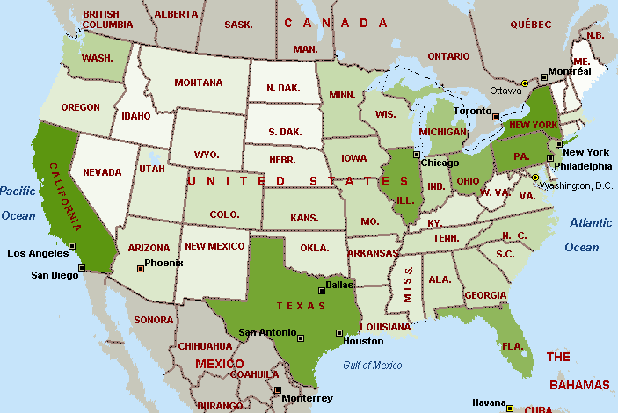
GIS: Shading (RT Sales in 2008)

Slide 33
Data Mining
Automatic analysis of data
Statistics
  Correlation
  Regression (multiple correlation)
  Clustering
  Classification
  Nonlinear relationships
More automated methods
  Market basket analysis
  Patterns: neural networks
Numerical data
  Commonly search for how independent variables (attributes or dimensions) influence the dependent (fact) variable.
Non-numerical data
  Event and sequence studies
  Language analysis
  Highly specialized—leave to discipline studies

Slide 34
Common Data Mining Goal
Independent Variables
Dimensions/Attributes
Location
Age
Dependent Variable
Fact
Income
Indirect effects
Sales
Time
Month
Category
Direct effects

Slide 35
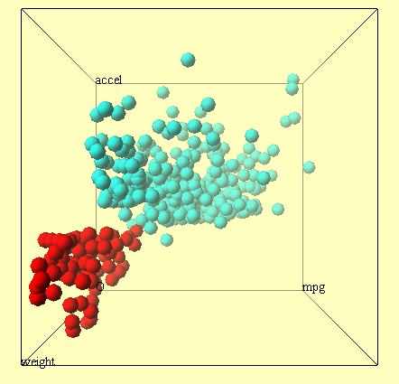
Data Mining: Clusters

Slide 36
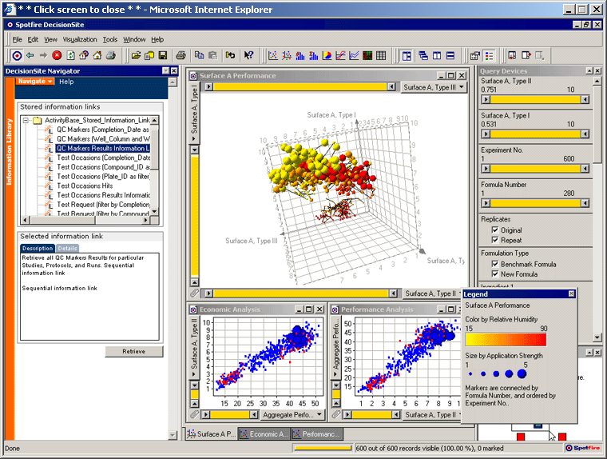
Data Mining Tools: Spotfire
http://www.spotfire.com

Slide 37

Market Basket Analysis
What items do customers buy together?

Slide 38
Data Mining: Market Basket Analysis
Goal: Measure association between two items
  What items do customers buy together?
  What Web pages or sites are visited in pairs?
Classic examples
  Convenience store found that on weekends, people often buy both beer and diapers.
  Amazon.com: shows related purchases
Interpretation and Use
  Decide if you want to put those items together to increase cross-selling
  Or, put items at opposite ends of the aisle and make people walk past the high-impulse items

Slide 39
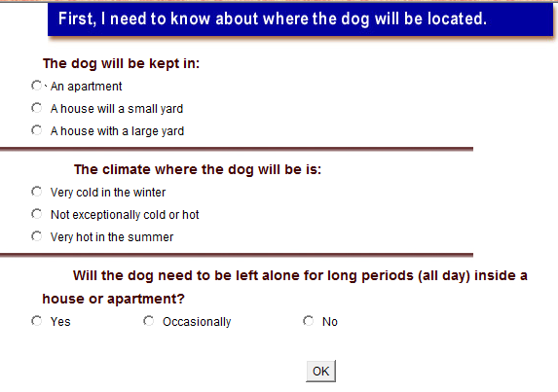
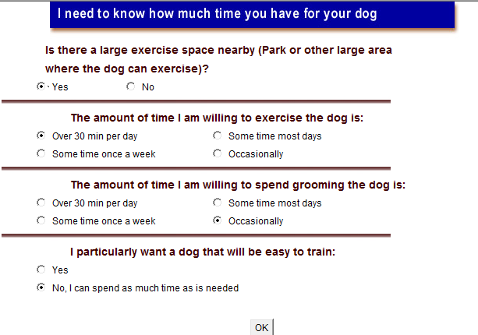
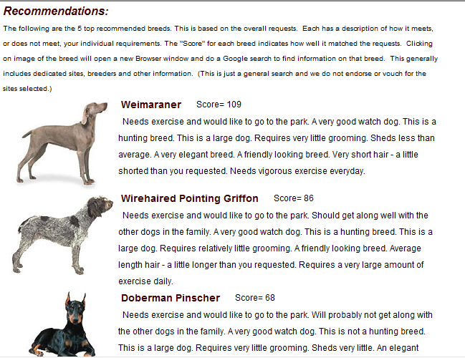
Expert System Example: Exsys: Dogs
http://www.exsys.com/demomain.html

Slide 40
Expert System
Expert
Knowledge Base
Symbolic &
Numeric Knowledge
Expert decisions
made by
non-experts
Rules
If income > 20,000
or expenses < 3000
and good credit history
or . . .
Then 10% chance of default

Slide 41
ES Example: bank loan
Welcome to the Loan Evaluation System.
What is the purpose of the loan? car
How much money will be loaned? 15,000
For how many years? 5
The current interest rate is 7%.
The payment will be $297.02 per month.
What is the annual income? 24,000
What is the total monthly payments of other loans? Why?
Because the payment is more than 10% of the monthly income.
What is the total monthly payments of other loans? 50.00
The loan should be approved, there is only a 2% chance of default.
Forward Chaining

Slide 42
Decision Tree (bank loan)
Payments
< 10%
monthly income?
No
Yes
Other loans
total < 30%
monthly income?
Yes
Credit
History
Good
Bad
No
So-so
Job
Stability
Approve
the loan
Deny
the loan
Good
Poor

Slide 43
Frame-Based ES
Job History
Employer, Salary, Date Hired
...
...
Customer Data
Name ____
Address ____
Years at address__
Co-applicant___
Rules
Job History
Employer, Salary, Date Hired
...
...
Recommendation
Lend $$$$
at ___ interest rate
for ___ months,
with ___ initial costs.
Loan Details
Purpose Boat
Loan Amount _____
Time _____
Data for Boat Loans
Length:
Engine:
Cost New:
Cost Used:

Slide 44
Early ES Examples
United Airlines GADS: Gate Assignment
American Express Authorizer's Assistant
Stanford Mycin: Medicine
DEC Order Analysis + more
Oil exploration Geological survey analysis
IRS Audit selection
Auto/Machine repair (GM:Charley) Diagnostic

Slide 45
ES Problem Suitability
Characteristics
  Narrow, well-defined domain
  Solutions require an expert
  Complex logical processing
  Handle missing, ill-structured data
  Need a cooperative expert
  Repeatable decision
Types of problems
  Diagnostic
  Speed
  Consistency
  Training

Slide 46
ES Development
ES Shells
  Guru
  Exsys
Custom Programming
  LISP
  PROLOG
Rules
and
decision
trees
entered
by designer
Forward
and
backward
chaining
by ES shell
Maintained by expert system shell
ES screens
seen by user
Expert
Knowledge
database
(for (k 0 (+ 1 k) )
exit when ( ?> k cluster-size) do
(for (j 0 (+ 1 j ))
exit when (= j k) do
(connect unit cluster k output o -A
to unit cluster j input i - A ))
. . . )
Knowledge
engineer
Programmer
Custom program in LISP

Slide 47
Some Expert System Shells
CLIPS
  Originally developed at NASA
  Written in C
  Available free or at low cost
  http://clipsrules.sourceforge.net/
Jess
  Written in Java
  Good for Web applications
  Available free or at low cost
  http://herzberg.ca.sandia.gov/jess/
ExSys
  Commercial system with many features
  www.exsys.com

Slide 48
Limitations of ES
Fragile systems
  Small environmental. changes can force revision. of all of the rules.
Mistakes
  Who is responsible?
    Expert?
    Multiple experts?
    Knowledge engineer?
    Company that uses it?
Vague rules
  Rules can be hard to define.
Conflicting experts
  With multiple opinions, who is right?
  Can diverse methods be combined?
Unforeseen events
  Events outside of domain can lead to nonsense decisions.
  Human experts adapt.
  Will human novice recognize a nonsense result?

Slide 49
AI Research Areas
Computer Science
  Parallel Processing
  Symbolic Processing
  Neural Networks
Robotics Applications
  Visual Perception
  Tactility
  Dexterity
  Locomotion & Navigation
Natural Language
  Speech Recognition
  Language Translation
  Language Comprehension
Cognitive Science
  Expert Systems
  Learning Systems
  Knowledge-Based Systems

Slide 50
Neural Network: Pattern recognition
Output Cells
Input weights
7
3
-2
4
Hidden Layer
Some of the connections
6
Incomplete
pattern/missing inputs.
Sensory Input Cells

Slide 51
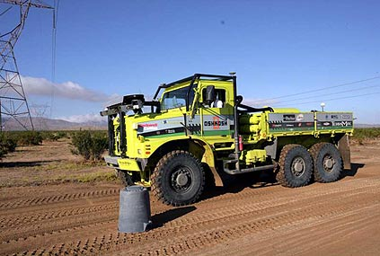
Machine Vision Example
http://www.terramax.com/
Several teams passed the second DARPA challenge to create autonomous vehicles. Although Stanford won the challenge, Team TerraMax had the most impressive entry.

Slide 52
Language Recognition
Look at the user’s voice command:
Copy the red, file the blue, delete the yellow mark.
Now, change the commas slightly.
Copy the red file, the blue delete, the yellow mark.
Emergency
Vehicles
No
Parking
Any Time
I saw the Grand Canyon flying to New York.
The panda enters a bar, eats, shoots, and leaves.

Slide 53
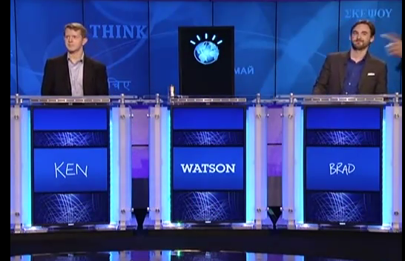
Natural Language: IBM Watson
http://www.youtube.com/watch?v=12rNbGf2Wwo Practice match 4 min.
February 14-16, 2011: Watson beat two top humans in Jeopardy.
Natural language parsing and statistical searching.
Multiple blade servers and 15 terabytes of RAM!

Slide 54
Subjective (fuzzy) Definitions
Subjective Definitions
reference point
cold
hot
temperature
e.g., average
temperature
Moving farther from the reference point
increases the chance that the temperature is
considered to be different (cold or hot).

Slide 55
DSS and ES

Slide 56
DSS, ES, and AI: Bank Example
Decision Support System
Expert System
Artificial Intelligence
Loan Officer
ES Rules
Determine Rules
Income
Existing loans
Credit report
What is the monthly income?
3,000
What are the total monthly payments on other loans? 450
How long have they had the current job? 5 years
. . .
Should grant the loan since there is only a 5% chance of default.
Data/Training Cases
Data
loan 1 data: paid
loan 2 data: 5 late
loan 3 data: lost
loan 4 data: 1 late
Model
Lend in all but worst cases
Monitor for late and missing payments.
Name Loan #Late Amount
Brown 25,000 5 1,250
Jones 62,000 1 135
Smith 83,000 3 2,435
...
Neural Network Weights
Output
Evaluate new data,
make recommendation.

Slide 57

Software Agents
Independent
Networks/
Communication
Uses
  Search
  Negotiate
  Monitor
Locate &
book trip.
Software agent
Vacation
Resorts
Resort
Databases

Slide 58
AI Questions
What is intelligence?
  Creativity?
  Learning?
  Memory?
  Ability to handle unexpected events?
  More?
Can machines ever think like humans?
How do humans think?
Do we really want them to think like us?

Slide 59
Cloud Computing
Many analytical problems are huge
  Requiring large amounts of data
  Massive amounts of processing time and multiple processors
Need to lease computing time
  Possibly supercomputer time (science)
  Otherwise, cloud computing such as Amazon EC2

Slide 60
Technology Toolbox: Forecasting a Trend
Rolling Thunder query for total sales by year and month
Use Format(OrderDate, “yyyy-mm”)
In Excel: Data/Import/New Database Query
Create a line chart, right-click and add trend line
In the worksheet, add a forecast for six months
C10TrendForecast.xls

Slide 61
Quick Quiz: Forecasting
1. Why is a linear forecast usually safer than nonlinear?
2. Why do you need to create a new column with month numbers for regression instead of using the formatted year-month column?
3. What happens to the trend line r-squared value on the chart when you add the new forecast rows to the chart?

Slide 62
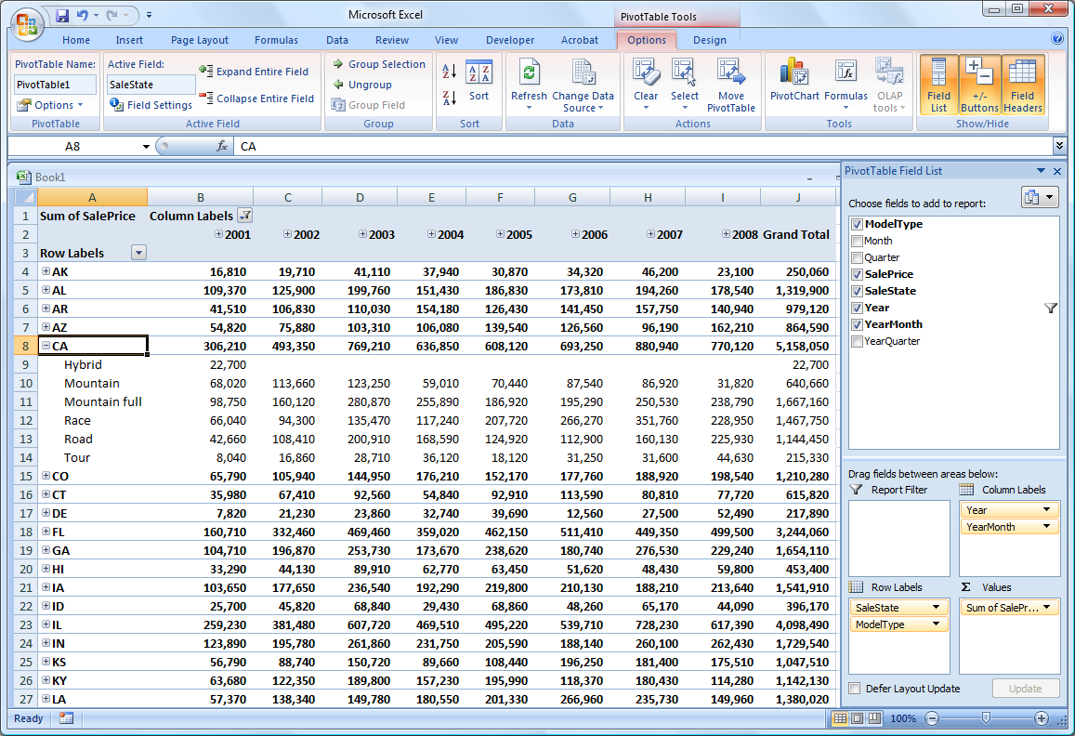
Technology Toolbox: PivotTable
C10PivotTable.xls
Excel: Data/PivotTable, External Data source
Find Rolling Thunder, choose qryPivotAll
Drag columns to match example. Play.

Slide 63
Quick Quiz: PivotTable
1. How is the cube browser better than writing queries?
2. How would you display quarterly instead of monthly data?
3. How many dimensions can you reasonably include in the cube? How would you handle additional dimensions?

Slide 64
Cases: Financial Services

